Slide 1
UNIT-IV
Components: Icons And Images, Multimedia, Color And Its Uses

Slide 2
The era of graphical user interfaces (GUIs) started with the Xerox Star in the 1970s and became widespread with Apple's Macintosh and Lisa in the 1980s, followed by Microsoft's Windows. GUIs replaced older text-based systems by using **icons** to represent objects and actions. This evolved further in the 1990s with the rise of the **World Wide Web**, which allowed the inclusion of multimedia (images, video, audio, etc.) on screens.
Graphics in screen design are powerful tools to engage users, enhance communication, and improve learning and recall. However, they must be used properly to avoid confusion and distractions. The guidelines cover icon usage, the icon design process, and the integration of other media like photos, animations, and diagrams. The goal is to ensure graphics serve a functional purpose and enhance the user experience.

Slide 3
ICONS
Icons are pictorial images on a screen that represent objects, actions, or commands users can interact with. They have been used throughout history, like in ancient pictographs, to communicate ideas. In modern user interfaces, icons come in different types: Rogers (1989)
1. Resemblance icons look like what they represent, such as a book icon for a dictionary.
2. Symbolic icons are abstract images, like a cracked glass symbol for "fragile."
3. Exemplar icons show examples, like a knife and fork icon for a restaurant.
4. Arbitrary icons are unrelated images whose meanings must be learned.
5. Analogy icons are associated with the object or action, like a wheelbarrow for the "move" command.
Icons help users quickly recognize and perform actions but must be carefully designed for clarity and effectiveness.

Slide 4
ICONS
To explain the characteristics of icons to students simply, focus on these key points:
Syntactics: This refers to how an icon looks. Is it square, round, big, or small? Icons that look similar should belong to the same group, making it easy to understand relationships between them.
Semantics: This is the meaning behind the icon. Does the icon clearly represent what it's supposed to (like a trash bin icon for deleting)?
Pragmatics: This deals with how the icon is displayed. Is the screen quality good enough to show the icon clearly?

Slide 5
ICON CHARACTERISTICS
For an icon to be effective, it needs to be:
Familiar: Easy to recognize without needing to learn.
Clear: Easy to see and understand.
Simple: No extra details that confuse the user.
Consistent: Look the same across all screens and sizes.
Direct: It should clearly represent what it does.
Efficient: It should save space and effort compared to words.
Discriminable: Easily distinguishable from other icons.
Also, consider the context in which the icon is used, the expectations users have, and how complex the task is—more complex tasks may need words in addition to icons.

Slide 6
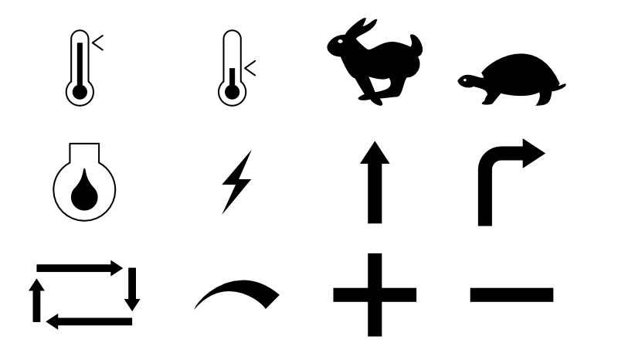
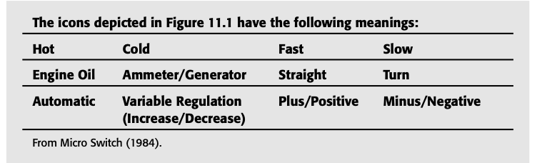
ICONS EXAMPLES

Slide 7
CHOOSING ICON
What Makes a Good Icon?
Looks Unique: The icon should stand out and not look like other icons to avoid confusion.
Clear Purpose: It should be obvious what the icon represents or does, so users know how to use it right away.
Recognizable at Small Sizes: Icons are often tiny (16 pixels), so they need to be clear and easy to recognize even when very small.
Good in Both Color and Black & White: The icon should look great in color but still be recognizable in black and white.

Slide 8
CHOOSING ICON
Size and Color Guidelines
Standard Sizes: Icons come in a few standard sizes:
  16x16 pixels
  32x32 pixels
  48x48 pixels
Why These Sizes? Smaller icons like 16x16 pixels are used in toolbars, while larger ones (32x32 or 48x48) are used for apps or on the desktop.
Use System Colors: Stick to colors from the system’s color palette, so the icons look good on all computers, even those with different color settings.

Slide 9
CHOOSING ICON
Practical Design Tips
Odd-Numbered Pixels: When designing, use an odd number of pixels (e.g., 15 or 21) so you have a center point, making the design easier to focus.
Selection Areas (Hot Zones): The entire icon should be clickable (this is called the "hot zone"), so users don’t struggle to click on it. The bigger the clickable area, the better.
Different Devices Need Different Icon Sizes:
  Stylus/Pen: Minimum icon size is 15 pixels.
  Mouse: Minimum size is 20 pixels.
  Finger (touchscreen): Minimum size is 40 pixels.

Slide 10
CHOOSING ICON IMAGES
1. Use Existing Icons:
If there are already icons for something, use them! This keeps things consistent across different systems. For example, the "trash bin" icon is widely recognized for deleting files—no need to change it.
2. Focus on Nouns (Objects):
It’s much easier to show an object (a noun) than an action (a verb). For example, a picture of a folder (noun) is clear, but showing "save" (an action) is harder to do with an image. So, use nouns when choosing icons.

Slide 11
CHOOSING ICON IMAGES
3. Stick with Traditional Images:
Old but Gold: Traditional images like a floppy disk for saving or an envelope for email work well because people are already familiar with them. Even if they’re old, users understand them better.
4. Respect Cultural Differences:
Think Globally: Different cultures see things differently. An icon that works in one country might be confusing or inappropriate in another. So, consider the culture of the users when designing or choosing icons.

Slide 12
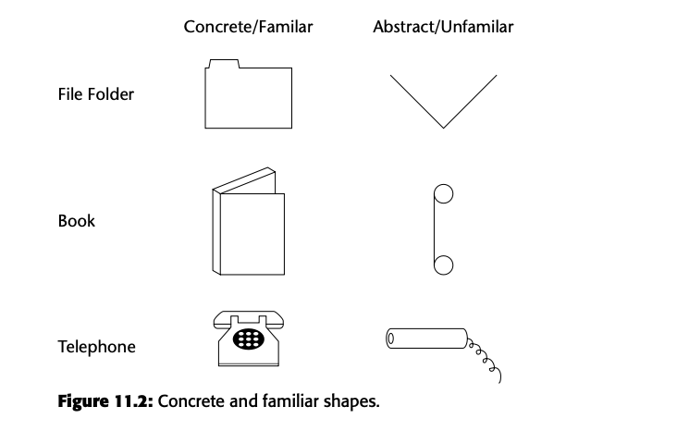
CREATING ICON IMAGES
1. Use Familiar and Concrete Shapes:
Make it look like the real thing: The icon should look like the object it represents. For example, a folder icon should look like an actual folder. When icons are familiar, people understand them faster.
Relate it to what people know: Think about what people already recognize, but remember that different cultures or groups may not be familiar with certain objects.

Slide 13
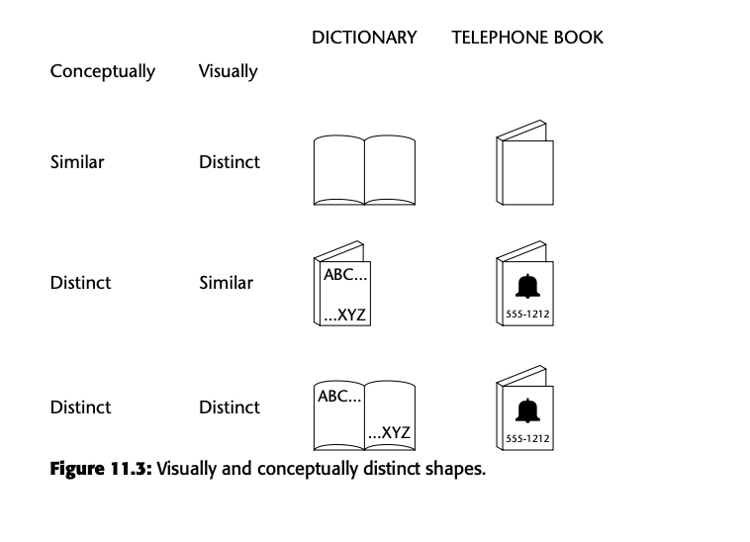
CREATING ICON IMAGES
2. Make Icons Visually and Conceptually Distinct:
Icons should be easy to tell apart: Every icon should look different enough so that people don’t get confused. For example, if you design icons for a dictionary and a phone book, show letters for the dictionary and numbers for the phone book.
Avoid using borders: Borders can hide the shape of the icon and make it harder to recognize.
3. Reflect the Object Clearly:
Keep it clear: The icon should be easy to see and not blurry. If it's unclear, users will struggle to recognize it.

Slide 14
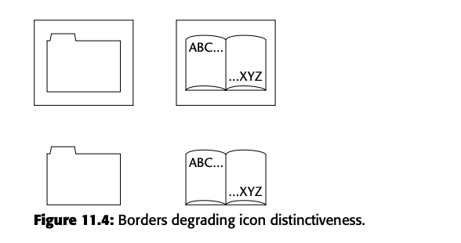
CREATING ICON IMAGES
4. Keep It Simple:
Use minimal details: Only include what's necessary for the icon to be understood. Avoid extra decorations or complex shapes that could confuse the user. Simple icons are easier to see and find on the screen.
5. Create Icons as a Set:
Make related icons look similar: If the icons represent a group of related objects (like tools), give them similar shapes or styles so users know they belong together.

Slide 15
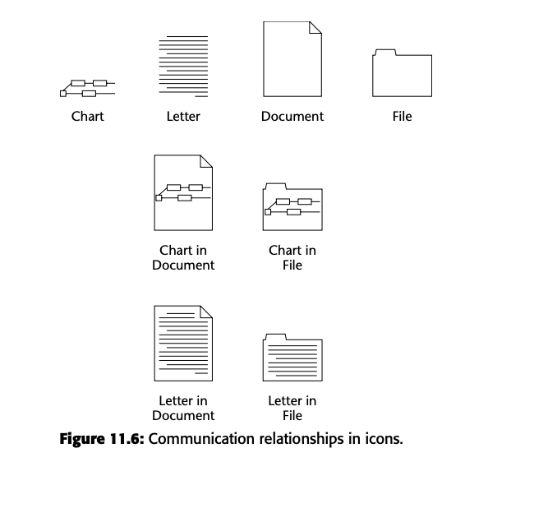
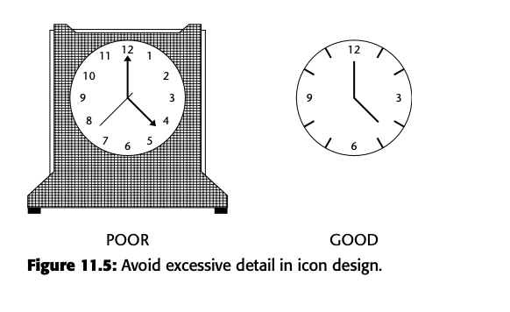
CREATING ICON IMAGES
6. Consistent Emotional Tone:
If an icon represents something serious, like a warning, the design should reflect that tone (for example, using strong colors like red or black).

Slide 16
How to draw icon images
1. Consistency in Shape:
Keep the same shape for icons even if they are shown in different sizes. This helps users recognize them quickly. For example, if a folder icon is resized, make sure it still looks like a folder at every size.
2. Avoid Triangular Arrows:
Don’t use triangular arrows because they are often used for other things in the system, like dropdown menus or scroll buttons. This can confuse users. Instead, use different symbols that won’t be mistaken for other features.

Slide 17
How to draw icon images
3. Express Attributes Meaningfully:
If an icon shows different statuses or attributes, make these clear. For example, if a document is "completed" or "in progress," use obvious visual cues like a filled bar rather than subtle shading, which can be confusing.
4. Proper Scale and Orientation:
Make sure the icon fits well on the screen and is consistent in size and direction with other similar icons. For instance, a small and large version of a book icon should both look like books and have the same orientation.

Slide 18
How to draw icon images
5. Use Perspective and Dimension:
Add depth and shadow to make the icon look more like a real object. Always place the light source from the top-left corner, as this is how other screen elements are usually shaded, helping it appear realistic.
6. Include a Label or Caption:
Always include a text label below the icon so users know exactly what it represents, especially for new or less frequent users. For example, under a printer icon, include the word "Print" so people don't have to guess.
ToolTips (pop-up labels) can also help, but they take time to appear, so having a label always visible underneath is faster and easier.

Slide 19
Icon Animation
Why use it?
  To give feedback (like showing something is loading).
  To make the interface visually interesting.
Tips for Animation:
  Don’t interrupt the user: The animation should not stop users from interacting with the system.
  Make it optional: Users should be able to turn off animations if they find them distracting.
  Not for decoration: Avoid using animation just to make things look "cool"—use it only when it helps the user.
  Smooth animation: For smooth movement, display at least 16 frames per second.

Slide 20
Auditory Icons
What are they?: Sounds that mimic real-world events, like the noise a printer makes when printing.
Why use sound?
  Feedback: Like hearing a sound when a file is deleted.
  Helping navigation: Sounds can indicate different actions or modes in a system.
Examples:
  A trash bin sound when you delete a file, or a sound that plays when dragging an object.

Slide 21
Icon Design Process
1. Define the Icon’s Purpose
Start with a clear idea: Understand what the icon is supposed to represent or do. Think of real-world metaphors (like a trash bin for delete).
2. Sketch Ideas on Paper
Sketch first: Draw rough ideas on paper before using a computer. It doesn't need to be perfect at this stage.
3. Draw in Black and White
Focus on shape: Start designing in black and white because many icons are displayed without color. Color is optional and just adds extra detail.

Slide 22
Icon Design Process
4. Test the Icon
Test for 3 things:
  Expectations: Does it match what users expect?
  Recognition: Is it easy to recognize what it represents?
  Learning: Can users quickly learn what it means?
5. Test for Legibility
Check clarity: Make sure the icon is clear and easy to see against different screen backgrounds (white, gray, etc.).
6. Register New Icons
System registration: After finalizing, make sure to register the icon in the system with a detailed description so it's ready for use.

Slide 23
Screen Presentation Tips
Limit the number of icons: Ideally, display only 8 to 12 icons at a time to avoid clutter.
Arrange icons logically: Group similar icons together, such as object icons separate from action icons.
Make selected icons obvious: Use a visual cue like a pressed or highlighted state when an icon is selected.
Allow user control: Let users rearrange icons or switch between icons and text for more flexibility.

