Slide 1
UNIT-IV

Slide 2
Choose the proper screen based controls
Screen controls, or widgets, are the parts of a screen you interact with. They can:
Let you enter or pick a value (like typing in a number or choosing from a list).
Allow you to change or edit a value (like updating your address).
Show you text, numbers, or images (like displaying your name or a picture).
Perform actions when you click or tap them (like saving a file or sending a message).
Provide extra options or information in a pop-up window (like showing more details when you hover over a button).

Slide 3
Screen based controls
To ensure a good user experience, remember these principles:
Appearance: Controls should look like what they do (e.g., buttons should look clickable).
Functionality: They should work as they appear (e.g., pressing a button should activate it).
Consistency: Use controls in a standard way to avoid confusing users.

Slide 4
Screen based controls
Buttons.
Text entry/read-only controls.
Selection controls.
Combination entry/selection controls.
Specialized operable controls.
Custom controls.
Presentation controls.
Web controls.

Slide 5
1.BUTTONS
Description:
— A square or rectangular-shaped control with a label inside that indicates action to be accomplished.
— The label may consist of text, graphics, or both.
Purpose:
— To start actions.
— To change properties.
— To display a pop-up menu.

Slide 6
1.BUTTONS
Advantages:
  — Always visible, reminding one of the choices available.
  — Convenient.
  — Can be logically organized in the work area.
  — Can provide meaningful descriptions of the actions that will be performed.
  — Larger size generally provides faster selection target.
  — Can possess 3-D appearance:
    Adds an aesthetically pleasing style to the screen.
    Provides visual feedback through button movement when activated.
  — May permit use of keyboard equivalents and accelerators.
  — Faster than using a two-step menu bar/pull-down sequence.
Disadvantages:
— Consumes screen space.
— Size limits the number that may be displayed.
— Requires looking away from main working area to activate. — Requires moving the pointer to select.

Slide 7
1.BUTTONS
Buttons come in three styles:
Pushbuttons (Command Buttons): Typically rectangular, with text indicating an action. When clicked, they execute the action immediately, commonly found in windows.
Icon or Toolbar Buttons: Square or rectangular with an icon or graphic. They may have a label or ToolTip and are often grouped in toolbars for quick access to commands.
Symbol Buttons: Square or rectangular with a symbol, specific to a platform. These buttons are found in window borders and are used for actions like resizing or accessing menus.

Slide 8
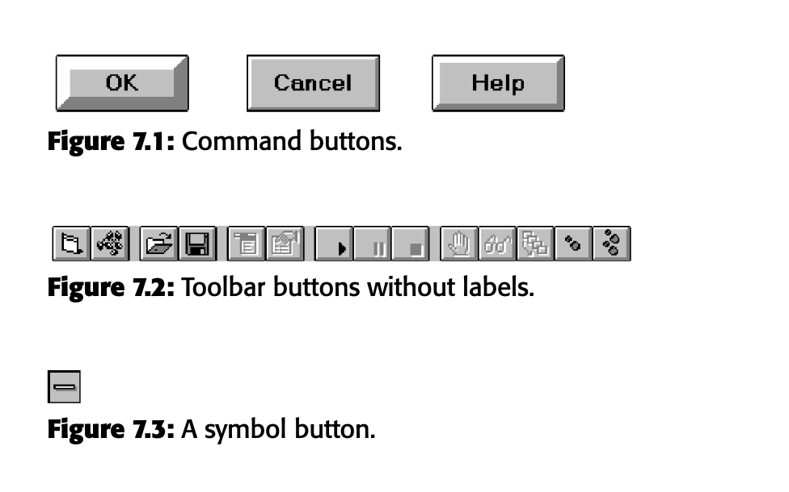
1.BUTTONS

Slide 9
1.1 COMMAND BUTTONS
Usage
With a menu bar: Use buttons for quick access to important commands.
Without a menu bar: Use buttons for all essential commands.
Structure
Shape: Rectangular, with a raised look.
Labels: Use meaningful, concise words (preferably one or two) with mixed-case letters. Keep labels consistent and clear.
Size: Buttons should be large enough for readability, with uniform height and width.

Slide 10
1.1 COMMAND BUTTONS
Layout
Keep button locations consistent across screens.
Exiting buttons (like "OK" or "Cancel") should be centered at the bottom.
Feature buttons (for extra actions) go on the right side or near related controls.
Organization
Group related buttons together, with the most frequent actions placed prominently (left-to-right or top-to-bottom).
Keep potentially harmful buttons separated from frequently used ones.

Slide 11
1.1 COMMAND BUTTONS
Visual Indicators
Buttons should visually change when hovered or pressed.
Disable (dim or gray out) buttons that are unavailable.
Keyboard Shortcuts
Provide keyboard mnemonics for each button, typically the first letter of its label. This helps users navigate without a mouse.

Slide 12
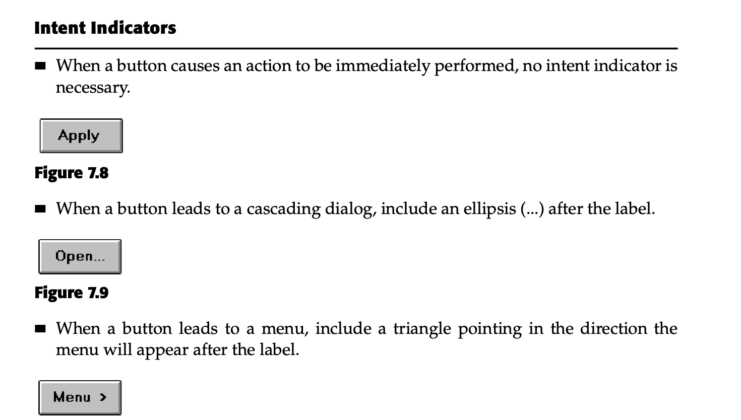

Slide 13
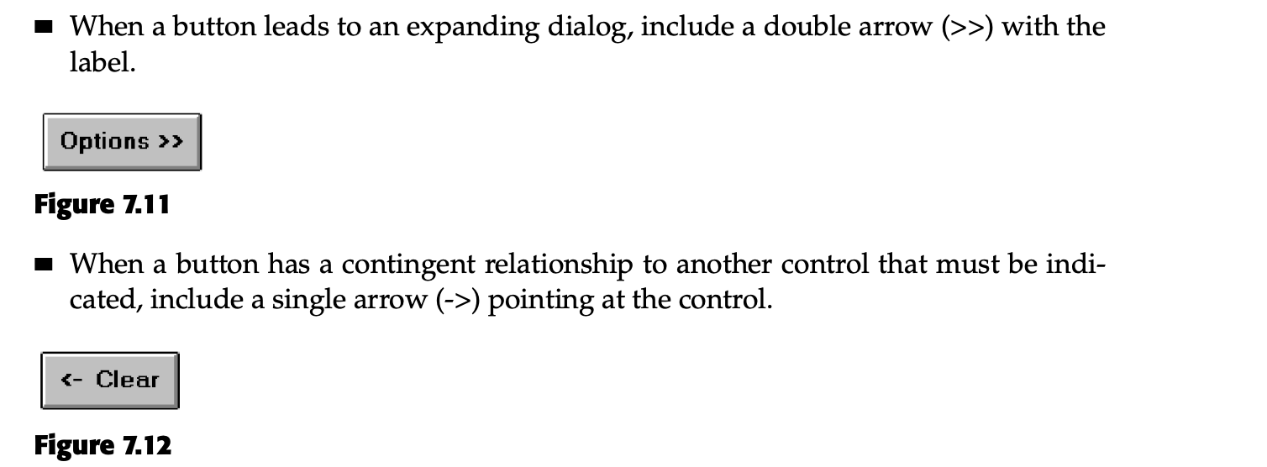

Slide 14
1.2 TOOLBAR BUTTONS
Toolbars are groups of commands or functions (mostly icons, sometimes text) that offer quick access to frequently used features. Here’s a simplified breakdown:
Usage
Toolbars provide easy access to common commands across multiple screens.
They can replace some menu items or launch sub-applications.

Slide 15
1.2 TOOLBAR BUTTONS
Structure
Icons: Buttons should be the same size, with clear, unique icons centered and raised in appearance.
Text: Labels should be clear and follow command button guidelines.
Consistency: Use the same icons throughout the app.
Size
Buttons: Typically 24x22 or 32x30 pixels. Larger buttons for high-resolution screens.
Icons: Common sizes are 16x16 or 14x24 pixels.
.

Slide 16
1.2 TOOLBAR BUTTONS
Organization
Group related buttons together.
Place frequently used buttons on the left (or top if vertical).
Separate destructive buttons from others.
Location
Place the main toolbar across the top of the window.
Allow users to move or turn the toolbar on/off and access toolbar functions through menus.
.

Slide 17
1.2 TOOLBAR BUTTONS
Customization
Let users customize or turn off the toolbar but provide a default setup.
Keyboard Shortcuts
Assign keyboard shortcuts (mnemonics) to toolbar buttons for quick access.
Activation
Highlight buttons visually when hovered or pressed. Grayed-out buttons indicate unavailable actions.
This ensures toolbars are user-friendly, organized, and customizable.
.

Slide 18
Multimedia
Multimedia refers to using more than one type of media (e.g., text, images, audio, video, animations) to communicate on a webpage.
Advantages
Captures attention: Using visuals, videos, or audio can keep visitors more engaged than just plain text.
Conveys complex information quickly: Some things are easier to explain with a picture, diagram, or video rather than words.
Accessibility for users with disabilities: Multimedia can make the web more accessible, like audio descriptions for visually impaired users or closed captions for people who are deaf.

Slide 19
Drawbacks of Overusing Multimedia
Slow loading times: Heavy images or videos can make websites load slower, which frustrates users, especially on slow internet connections.
Example: Imagine waiting for a website to load because it's filled with large images and videos—you might leave before it even finishes loading.
User confusion and frustration: When multimedia is overused or used in the wrong way, it can make it hard for users to find the information they’re looking for.
Accessibility issues: Some multimedia elements may not be accessible to people with disabilities if not properly designed.

Slide 20
1.Graphics
Purpose of Graphics
Graphics on a webpage are not just for decoration.
Each graphic should serve a purpose that improves the user experience.
The five main purposes of graphics are:
Navigational: Help users find their way around the site (e.g., icons for menus or links).
Representational: Show what’s being talked about in the text (e.g., an image of a product).
Organizational: Show relationships between items (e.g., flowcharts or diagrams).
Explanative: Demonstrate how something works (e.g., a step-by-step illustration).
Decorative: Add visual appeal, but this should always support the site's overall message.

Slide 21
Graphics
Graphics Should Supplement, Not Replace Text
Graphics should supplement the text, not substitute for it. Text is generally faster to load, easier to search, and more accessible to all users.
Use Graphics to Convey Information That Text Can’t
Images, videos, diagrams, and drawings can often explain something more efficiently or clearly than words alone.
Enhance Navigation with Graphics
Graphics can help users navigate a website more easily by providing visual cues (e.g., icons that represent different sections of the website).

Slide 22
Graphics
Limit Long-Loading Graphics
Large or richly colored images take longer to load, which can frustrate users, especially those with slow internet connections.
Coordinate Graphics with Page Elements
Graphics should fit in with the overall design of the webpage. This means coordinating the style of graphics with fonts, colors, and layout.
Avoid Gratuitous Decorations or Banner-Like Graphics
Important graphics should not look like ads or unnecessary decorations.
Users tend to ignore anything that looks like a banner ad even if it's an important graphic.

Slide 23
2. Images
Ensure all images convey their intended messages.
General:
  — Use standard images.
  — Emulate real-world objects.
  — Use images consistently.
  — Produce legible images.
  — Provide descriptive text or labels with all images.
  — Distinguish navigational images from decorative images.
  — Minimize
    The number of presented images.
    The size of presented images.
      Restrict single images to 5KB.
      Restrict page images to 20KB.
      Provide thumbnail size images.
    Image animation.
  — Avoid extraneous or gratuitous images.

Slide 24
2. Images
Color:
— Minimize the number of colors in an image.
Format:
— Produce images in the most appropriate format.
• GIF.
• JPEG.
Internationalization:
— Provide for image internationalization.
Design:
— Limit large images above the page fold. — Use simple background images.
–– Reuse images on multiple pages.

Slide 25
3. Image maps
Image Maps
Use:
  To provide navigation links to other content.
  (Example: A world map image where clicking on different countries takes the user to pages about those countries.)
Advantages:
  Can be arrayed in a meaningful and obvious structure.
  (Example: A floor plan image where different rooms are clickable, allowing users to navigate to specific room information.)
  Faster to load than separate images.
  (Example: A single image with clickable sections loads faster than loading multiple individual images for each clickable section, like different parts of a car diagram.)

Slide 26
3. Image maps
Disadvantages:
Consume a significant amount of screen space.
(Example: A large interactive map that takes up the majority of the webpage, pushing other content below the fold.)
Hot spots not always obvious.
(Example: A complex product image where it’s unclear which parts are clickable without hovering over them.)
One’s location within the image map is not always obvious.
(Example: On a clickable world map, users might not easily identify which country or region they are currently hovering over.)

Slide 27
4. photographs
Use:
When every aspect of the image is relevant.
(Example: A product photo where all parts of the product, like buttons or features, need to be visible to the user.)
Guidelines:
Use JPEG format.
(Example: Save and display the image in JPEG format, which is ideal for photos with rich color and detail.)
On the initial page, display a small version:
  Display a thumbnail size image.
  (Example: A small preview of a product photo, which loads quickly and can be clicked to view the full-size image.)
  Zoom in on the most relevant detail.
  (Example: A close-up of the camera lens on a smartphone to highlight its quality.)
  Link to larger photos showing as much detail as needed.
  (Example: Clicking the thumbnail of a car image leads to a high-resolution version showing the full exterior and interior details.)

Slide 28
4. photographs
Include fewer people and objects in less complicated settings than in photos for print.
(Example: A product image with a simple background and one person using the product, rather than a crowded, busy scene.)Emphasize close-up shots with clean backgrounds.
(Example: A clear, close-up shot of a wristwatch on a plain white background to highlight its design.)

Slide 29
5. video
Uses:
— To show things that move or change over time.
— To show the proper way to perform a task.
To show events that cannot be seen directly.
    To convey human behavior and emotions.
— To provide a personal message.
— To grab attention.
Disadvantages:
— Expensive to produce.
— Slow to download.
— Small and difficult to discern detail.
Guidelines:
  — Never automatically download a video into a page.
  — Create short segments.
  — Provide controls, including those for playing, pausing, and stopping.
  — Consider using
    Existing video.
    Audio only.
    A slide show with audio.

Slide 30
5. Diagrams
Uses:
— To show the structure of objects.
— To show the relationship of objects.
— To show the flow of a process or task.
— To reveal a temporal or spatial order.
Kinds:
— Flow charts.
— Cause and effect charts.
— Gantt charts.
— Entity relationship diagrams.
— Organization charts.
— Network diagrams.
Parts:
— Shapes.
— Lines.
— Labels.
Guidelines:
— Provide simple diagrams.
–– Provide cutaway diagrams or exploded views to illustrate key points.

Slide 31
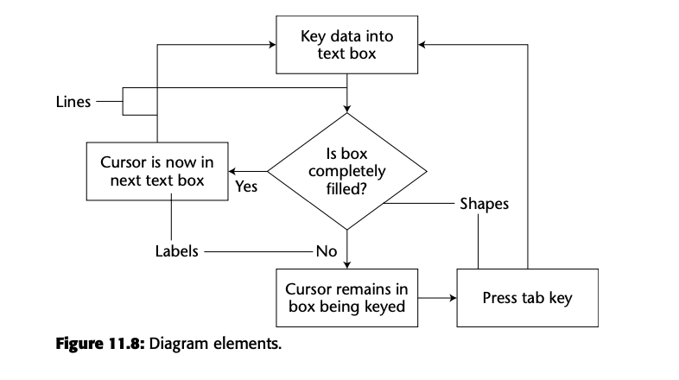

Slide 32
6. Drawings
Use:
— When selective parts need to be emphasized or represented.
Guidelines:
— Provide simple drawings showing minimal detail.
–– Provide a link to a complete drawing.

Slide 33
7. Animation
■ Uses:
  — To explain ideas involving a change in
  • Time.
  • Position.
  — To illustrate the location or state of a process.
  — To provide feedback.
  — To show continuity in transitions.
— To enrich graphical representations.
— To aid visualization of three-dimensional structures.
— To attract attention.
Disadvantages:
— Very distracting.
— Can potentially create problems for people with some disabilities.
— Slow loading.
Guidelines:
— Use only when an integral and meaningful part of the content.
— Introduce animation.
— Create short segments.
— Provide a freeze frame, stop, and replay mode.
–– Avoid distracting animation.

Slide 34
8. Audition
■ Uses:
— As a supplement to text and graphics.
— To establish atmosphere.
— To create a sense of place.
— To teach.
— To sample.
— For users
  With disabilities.
  In an eyes-busy and hands-busy situation.
  Who do not have access to keyboard and/or monitor.
Advantages:
— Does not obscure information on the screen. — Shorter downloading time than video.
Disadvantages:
  — Is annoying to many people, including users and nonusers in the vicinity.
  — Can easily be overused, increasing the possibility that it will be ignored.
  — Is not reliable because
    Some people are hard of hearing.
    If it is not heard, it may leave no permanent record of having occurred.
    The user can turn it off.
    Audio capability may not exist for the user.

Slide 35
8. Audition
Guidelines:
  — When words are spoken
    The content should be simple.
    The speed of narration should be about 160 words per minute.
  — When used to introduce new ideas or concepts, the narration should be slowed.
  — Off-screen narration should be used rather than on-screen narration.
• Unless the narrator is a recognized authority on the topic.
— Create short segments.
— Provide segments of high quality.
— Provide audio controls.
–– Play background audio softly.

Slide 36
9. Combining Mediums
Combinations:
— Use sensory combinations that work best together:
  Auditory text with visual graphics.
  Screen text with visual graphics.
Integration:
— Closely integrate screen text with graphics.
Relevance:
— Both the visual and auditory information should be totally relevant to the task being performed.
Presentation:
  — Visual and auditory textual narrative should be presented simultaneously, or the
  visuals should precede the narrative by no more than 7 seconds.
  — To control attention, reveal information systematically.
  • Limit elements revealed to one item at a time and use sequential revelations for related elements.
  — Animation must show action initiation as well as the action’s result.
  — Avoid animation that distracts from other more important information.
Downloading times:
— Consider downloading times when choosing a media.
Testing:
— Thoroughly test all graphics for • Legibility.
• Comprehensibility.
• Acceptance.

Slide 37
Choose the Proper Colors
Color enhances screen usability by grabbing attention and helping users understand information faster. However, it must be used thoughtfully to avoid distractions.
Color organizes information, makes screens more attractive, and helps distinguish between elements.
Misuse of color can cause distractions, visual fatigue, or confusion, making the screen harder to use.
Colors carry meanings. For instance, red often signals danger or urgency, while blue can be calming and trustworthy.

Slide 38
Choose the Proper Colors
Past studies have shown that too many colors or improper use of colors can confuse users and reduce screen effectiveness. Pastel colors and limiting the color palette can improve readability and focus.
Use color to highlight important information without overwhelming the user. Use contrast effectively to ensure readability.
Text and graphics need to have enough contrast for readability. Avoid too many bright, clashing colors that can distract or confuse users.

Slide 39
Choose the Proper Colors
In data visualizations, color can distinguish different data sets or highlight important trends. However, use a limited palette to avoid confusion.
On websites, colors should be used sparingly and thoughtfully. Avoid flashy designs that distract from the content. Choose colors that work well across all devices and screens.

Slide 40
Properties of colors
Three key properties of color: hue, chroma (saturation), and value (intensity).
Hue refers to the color itself, like red or blue.
Chroma measures how pure or vivid a color is, with higher saturation making a color more visible.
Value refers to how light or dark a color is.
The primary colors of light are red, green, and blue, which combine to form other colors and white light.
Warm colors are associated with longer wavelengths (like red), and cool colors with shorter wavelengths (like blue).

Slide 41
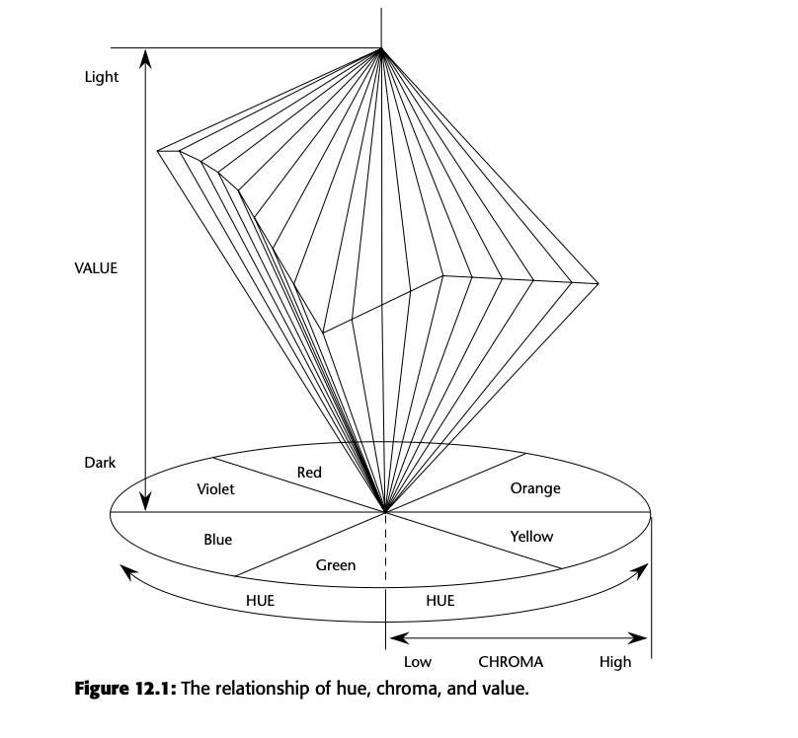
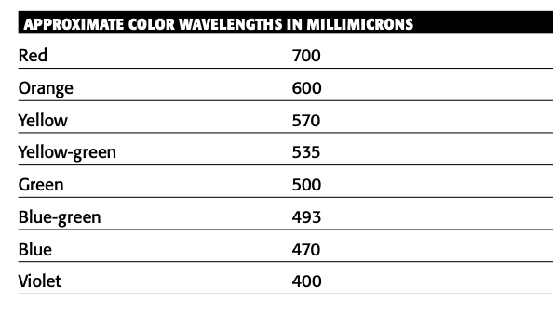
Relationship between colors

Slide 42
Color Uses
Use color to assist in formatting a screen:
  Relating or tying elements into groupings (e.g., using the same background color for similar sections on a form to indicate they belong together).
  Breaking apart separate groupings of information (e.g., using different background colors to separate headers from body text).
  Associating information that is widely separated on the screen (e.g., using the same color for labels and their corresponding data even if they are far apart).
  Highlighting or calling attention to important information (e.g., using red to highlight critical warnings or alerts).

Slide 43
Color Uses
Use color as a visual code to identify:
Screen components (e.g., different colors for buttons, text fields, and links to make navigation easier).
The logical structure of ideas, processes, or sequences (e.g., using color gradients to show progression through steps in a process).
Sources of information (e.g., blue for hyperlinks that direct users to external sources).
Status of information (e.g., green for active, yellow for warning, and red for error status).

Slide 44
Color Uses
Use color to:
Realistically portray natural objects (e.g., green for trees, blue for the sky).
Increase screen appeal (e.g., adding subtle, attractive colors to make a design look more engaging).

Slide 45
Possible Problems with Color
Color Misuse and Performance:
Simply adding color doesn't improve performance. Poor design will remain ineffective even if color is added. Misusing color can distract users and hinder information processing.
Cross-Disciplinary and Cross-Cultural Differences:
Color meanings differ across professions and cultures. For example, blue symbolizes reliability in finance but death in healthcare. Red represents danger in the U.S., death in Egypt, and life in India. Designers must consider these differences to avoid confusion.

Slide 46
Possible Problems with Color
Color Misuse and Performance:
Simply adding color doesn't improve performance. Poor design will remain ineffective even if color is added. Misusing color can distract users and hinder information processing.
Cross-Disciplinary and Cross-Cultural Differences:
Color meanings differ across professions and cultures. For example, blue symbolizes reliability in finance but death in healthcare. Red represents danger in the U.S., death in Egypt, and life in India. Designers must consider these differences to avoid confusion.

Slide 47
Possible Problems with Color
Varying Sensitivity of the Eye to Colors:
The human eye is more sensitive to mid-spectrum colors (yellow, green) than to extreme colors (red, blue). This affects how easily text or elements in these colors can be read. Some color combinations (like red and blue) can also strain the eyes and lead to visual fatigue.
Color-Viewing Deficiencies:
About 8% of men and 0.4% of women have some form of color blindness. Red-green deficiencies (protanopia and deuteranopia) and blue deficiencies (tritanopia) are common. Designers must ensure that color-deficient users can still effectively use a screen by avoiding reliance on color alone for conveying important information.

Slide 48
Possible Problems with Color
Color Connotations:
Colors carry learned meanings or associations. For instance, red is often associated with danger or stop, while green is linked to go or safety. Unexpected uses of color (e.g., using green for an error message) can confuse users.
Attention-Getting Capacity:
Color strongly draws attention and can cause users to mistakenly associate unrelated elements simply because they share the same color, leading to confusion. Overuse of color can result in the "Christmas tree" effect, where the screen becomes cluttered and distracting.

Slide 49
Color and Human Vision
The physiology of the human eye impacts color perception and screen design:
Lens:
  The lens focuses light on the retina, but different wavelengths (colors) focus at different distances. Red wavelengths focus farther back, and blue wavelengths focus in front, which can make blue appear blurry and lead to eye fatigue when switching between red and blue. This causes reds to seem closer and blues more distant, giving a 3D effect.
  Older lenses tend to yellow, making it harder to perceive blue. Large brightness contrasts also require frequent eye adjustments, causing visual fatigue.
Retina:
  The retina has rods (sensitive to low light) and cones (sensitive to color). Cones are divided into red (64%), green (32%), and blue (2%) sensitive types. The proportion of cone stimulation determines perceived color.
  Cones are concentrated in the center of the retina, while rods dominate the periphery. As a result, color sensitivity decreases toward the edges, and small blue objects in the center may not be seen due to "blue-blindness."
Color Perception:
  The eye is most sensitive to colors in the middle of the spectrum (yellow, green), and less to extreme colors (red, blue). To perceive blue or red, they must be more intense than yellow or green.
  Sharpness of images depends on brightness differences between objects, not just color. Differences in brightness create clearer edges, while color differences alone can result in blurry edges.

Slide 50
Guideline for choosing colors for categories of information:
Color-code different screen parts for selective attention
(Use different colors to highlight distinct areas of the screen so that users can focus on one part at a time, such as using blue for headers and green for footers.)
Color-code status types for decision-making
(Use colors to indicate the status of information, like red for errors, yellow for warnings, and green for success.)
Color-code for screen searching
(When users need to find specific information, use contrasting colors to make those items stand out, such as highlighting urgent messages in red while regular updates are in black.)

Slide 51
Guideline for choosing colors for categories of information:
Color-code for ordered sequences
(Use color to guide users through a process or workflow, such as numbering steps in a form with different colors like step 1 in blue, step 2 in green, etc.)
Color-code for visual groupings in crowded screens
(When a lot of information is on the screen, use colors to group related items together, such as using different shades of a single color to link connected items.)
Use color as a redundant code
(Besides color, also use other cues like shapes or labels, so that users who can’t perceive color differences still understand the information.)

Slide 52
Guidelines for using color to ensure clarity and aesthetic harmony:
Best Absolute Discrimination:
Use no more than four or five distinct colors that are widely spaced on the color spectrum for easy identification (e.g., using red, yellow, green, blue, and brown to label different sections of a chart).
Best Comparative Discrimination:
For comparing items, you can use six or seven distinct colors, also widely spaced (e.g., using orange, yellow-green, cyan, violet, and magenta to compare different data groups on a graph).

Slide 53
Guidelines for using color to ensure clarity and aesthetic harmony:
Choose Harmonious Colors:
Use combinations that work well together visually:
  One color plus two others near its complementary color (e.g., blue with yellow-orange and red-orange).
  Three colors spaced evenly around the color wheel (e.g., red, blue, and yellow for a balanced palette).
Extended Viewing or Older Viewers:
Use brighter colors for people who will be looking at the screen for long periods or for older viewers who may have decreased color sensitivity (e.g., bright yellow or bright green for clear labels on a medical monitoring device).

Slide 54
Emphasis
To draw attention or to emphasize elements, use bright or highlighted colors. To deemphasize elements, use less bright colors.
— The perceived brightness of colors from most to least is white, yellow, green,
red, blue.
To emphasize separation, use contrasting colors.
— Red and green, blue and yellow.
To convey similarity, use similar colors.
–– Orange and yellow, blue and violet.

Slide 55
Common Meanings
To indicate that actions are necessary, use warm colors. — Red, orange, yellow.
To provide status or background information, use cool colors.
— Green, blue, violet, purple.
Conform to human expectations.
— In the job.
–– In the world at large.

Slide 56
Location
In the center of the visual field, use red and green.
For peripheral viewing, use blue, yellow, black, and white.
Use adjacent colors that differ by hue and value or lightness.
Ordering
■ Order colors by their spectral position.
–– Red, orange, yellow, green, blue, indigo, violet.

Slide 57
Foregrounds & backgrounds
Foregrounds:
  — Use colors that highly contrast with the background color.
  — For text or data, use
    Black.
    Desaturated or spectrum center colors such as white, yellow, or green.
    Warmer more active colors.
  — Use colors that possess the same saturation and lightness.
  — To emphasize an element, highlight it in a light value of the foreground color,
  pure white, or yellow.
  — To deemphasize an element, lowlight it in a dark value of the foreground color.
Backgrounds:
  — Use a background color to organize a group of elements into a unified whole.
  — Use colors that do not compete with the foreground.
  — Use
    Light-colored backgrounds of low intensity: off-white or light gray.
    Desaturated colors.
    Cool, dark colors such as blue or black.
    Colors on the spectral extremes.
.

Slide 58
Three-Dimensional Look
■ Use at least five colors or color values to create a 3-D look on a screen.
— Background: the control itself and the window on which it appears
— Foreground: captions and lines for buttons, icons, and other objects.
• Usually black or white.
— Selected mode: the color used when the item is selected.
— Top shadow: the bezel on the top and left of the control.
–– Bottom shadow: the bezel on the bottom and right of the control.

Slide 59
Color Palette, Defaults, and Customization
Permit users to customize their colors.
Provide a default set of colors for all screen components.
Provide a palette of six or seven foreground colors.
— Provide two to five values or lightness shades for each foreground color.
Provide a palette of six or seven background colors.
Never refer to a screen element by its color.

Slide 60
Color Palette, Defaults, and Customization

