Slide 1
unit-iv
Windows: Characteristics, Components, Types, Selection Of Device Based And Screen Based Controls.
Components: Icons And Images, Multimedia, Color And Its Uses

Slide 2
4.1 Window
A window is an area of the screen, usually rectangular in shape, defined by a border that contains a particular view of some area of the computer or some portion of a person’s dialog with the computer.
It can be moved and rendered independently on the screen. A window may be small, containing a short message or a single field, or it may be large, consuming most or all of the available display space.
A display may contain one, two, or more windows within its boundaries.

Slide 3
4.1 Window Characteristics
Name or Title: Every window has a name or title at the top. This helps you know what the window is for.
Size: A window has a certain height and width, and you can change how big or small it is.
State (Active or Not Active): A window can be active (you’re working on it) or not active (you’re not working on it right now).
Visibility: Sometimes, only part of a window is visible because it might be behind another window or too big to fit on the screen.

Slide 4
4.1 Window Characteristics
Location: A window has a specific place on your screen
Presentation: Windows can be arranged in different ways: side by side (tiled), overlapping each other, or in a cascading pattern like falling dominos.
Management Capabilities: You can move, resize, minimize, maximize, or close a window.
Highlight: The highlight shows the part of the window you’re working on.
Function: Each window is dedicated to a specific task or application.

Slide 5
4.1 Advantages
Presentation of Different Levels of Information:
Windows enable users to explore information at different levels of detail. For example, a table of contents can be shown in one window, and selecting an item from this window can open more detailed content in another. This allows users to drill down into the information as needed.
Presentation of Multiple Kinds of Information:
Windows allow different types of information to be displayed simultaneously. For example, in an order-processing system, one window might show customer details, another the order details, and a third the availability and shipping dates. This helps users manage all relevant information in one view.

Slide 6
Advantages
Sequential Presentation of Information:
Windows can guide users through a process step by step. As users complete one step, new windows appear to gather further details. This approach is useful for tasks that have multiple steps, such as filling out an insurance application where different types of coverage require specific information.
Access to Different Sources of Information:
Windows allow users to access and view information from multiple sources at the same time. This is particularly useful for tasks that require comparing or referencing different pieces of information, such as a travel agent comparing destinations or a writer referencing multiple parts of a text.

Slide 7
Advantages
Combining Multiple Sources of Information:
Users can combine information from different windows into a single document. For instance, relevant text can be copied from several documents into one, making it easier to compile and synthesize information.
Performing More Than One Task:
Windows support multitasking, allowing users to work on more than one task at a time. For example, while waiting for a process to finish, another task can be performed. This flexibility increases productivity by enabling the user to shift focus between tasks as needed.

Slide 8
Advantages
Reminding:
Windows can serve as reminders by displaying information that might be useful in the near future, such as menus, a history of actions, or important upcoming events.
Monitoring:
Windows can be used to monitor changes, both internal and external. For example, users can observe how changes in one window affect another, or keep an eye on external data like stock prices while working on a different task.

Slide 9
Advantages
Multiple representations of the same task:
The same task or data can be viewed in different ways through multiple windows. This could involve comparing different drafts of a document, viewing different versions of a screen, or displaying various graphical representations of the same data.

Slide 10
Constraints in Window System Design
The problems with windowing systems can be attributed to three factors:
historical considerations,
hardware limitations,
and human limitations.

Slide 11
Constraints in Window System Design- historical considerations
Focus on Technical Problems Over User Considerations:
Historically, system developers have prioritized solving technical and hardware-related issues over considering user experience and usability. This has led to a lack of research and attention to design issues that directly impact how easy and intuitive window systems are for users.
Lack of Concrete Design Guidelines:
Due to the limited research and focus on usability, there are few established guidelines for designing window systems. This makes it challenging for designers to create consistent and user-friendly interfaces, as they have little concrete guidance to follow.

Slide 12
Constraints in Window System Design- historical considerations
Resistance to Standardization:
Standardization efforts are also hindered by several factors:
  Creativity and Originality Concerns: Some software developers resist standardization because they see it as a threat to their creativity and the potential financial rewards that come with creating unique interfaces.
  Corporate Competition: Companies may fear that standards promoted by others are biased towards those companies approaches, leading to reluctance in adopting them.
  Legal Concerns: Some companies have even resorted to legal action to protect their proprietary designs, further complicating efforts to standardize windowing interfaces.

Slide 13
Constraints in Window System Design- historical considerations
Resulting Fragmentation:
Due to these factors, each new system tends to introduce its own variation of windowing interfaces, leading to a fragmented experience where users must learn and adapt to a new interface with every new system they use.

Slide 14
Constraints in Window System Design- hardware limitations,
1.Screen Size:
Small Screens: Many of the screens we use today, like those on laptops or tablets, are not big enough to show multiple windows clearly.
Full-Screen Windows: Some people prefer to make one window big enough to cover the whole screen, just like using a big notebook so they can see the whole drawing at once.
2. Computer Power:
Processing Speed: Computers have a certain amount of power to do tasks.
Memory Size: Just like our brains can only remember so much at one time, a computer has a limited amount of memory.

Slide 15
Constraints in Window System Design- hardware limitations,
3. Screen Quality:
Resolution: The sharpness of what you see on the screen (called resolution) matters too. If the resolution isn’t good, the pictures, text, and shapes in the windows might look blurry or unclear, just like a fuzzy picture. This can make it hard to work with detailed content.

Slide 16
Constraints in Window System Design- human limitations,
1.Increased Complexity: Using a windowing system adds complexity because it requires learning and managing additional operations.
2.Impact on Task Focus: Managing windows can distract from the actual task, making it harder to concentrate on the work at hand.
3.Performance Trade-Offs: Studies show that while window systems can make it easier to organize information, they can also slow down task completion due to the time spent on window management.

Slide 17
Constraints in Window System Design- human limitations,
Error Rates: Non-window systems may lead to more user errors, even though tasks might be completed faster when window arrangement time is excluded.
Implicit vs. Explicit Management: Effective window management should ideally happen automatically (implicitly) based on user actions, rather than requiring the user to explicitly manage the windows.
Balance is Key: The benefits of using windows can be lost if the system requires too much manual window manipulation, so a balance is necessary for windows to be truly effective.

Slide 18
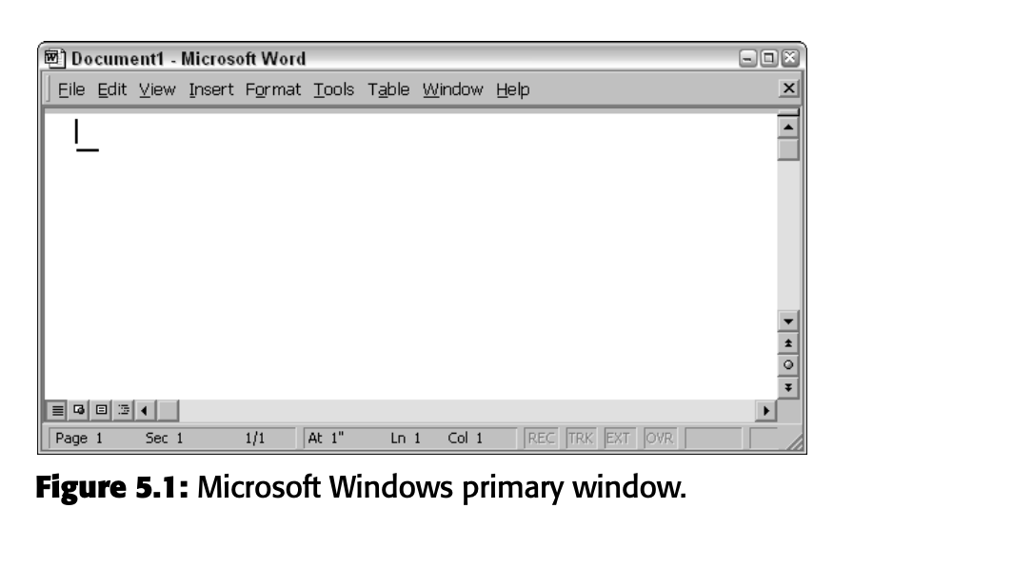
Components Of A Window
A window typically consists of numerous elements, some of which are universally present across all windows, while others appear only in specific types of windows or under certain conditions.

Slide 19
Components Of A Window
1.Frame or Border
A window typically has a frame or border, usually rectangular, that defines its boundaries and differentiates it from other windows.
The rectangular shape is preferred because it efficiently accommodates textual content, which is typically read from left to right.
The border can vary in thickness and color, helping to identify the type of window. For windows that fill the entire screen, the screen edge may serve as the border.
Resizable windows may include control points for adjusting their size, while non-resizable windows have borders that align with the window's edge.

Slide 20
Components Of A Window
2.Title Bar
The title bar, located at the top edge of a window within its border, spans the entire width of the window and contains a descriptive title that identifies the window's purpose or content.
Also known as the caption or title area on some platforms, the title bar in Microsoft Windows may include control buttons on the far left and right ends for accessing the system menu and resizing the window.
It also serves as a control point for moving the window and provides access to commands, such as displaying a shortcut menu when clicked with the secondary mouse button or using the Alt+Spacebar key combination.
Title bars are present on all primary and secondary windows. Microsoft advises against placing application commands or other controls in the title bar to avoid conflicts, especially in configurations supporting multiple languages.

Slide 21
Components Of A Window
3.Title Bar Icon
The Title Bar Icon is a small icon located at the left corner of the title bar in a window. It represents the application or file that is currently open in the window.
When you click this icon with the secondary mouse button (usually the right mouse button), a menu appears with commands that you can use, like "Minimize," "Maximize," or "Close.
Tools and Utilities: If you're using a tool or utility that doesn't create files (like a calculator), the icon in the title bar will usually be a small version of the application's icon.
Documents or Data Files: If you're working on a document (like a text file or spreadsheet), the icon will represent the type of file you’re working on, not just the application. For example, if you're editing a Word document, the icon might look like a small page with a "W" on it.
Saving Files: Even if you haven’t saved your file yet, the icon will still represent the type of file you're working on. After you save the file, the icon stays the same.

Slide 22
Components Of A Window
4.Window Sizing Buttons
Minimize button (looks like a small line):
Think of this as putting a piece of paper away in a drawer temporarily. It’s still there, but it’s hidden. When you click the minimize button, the window disappears from your screen and shrinks down to the taskbar (like putting the paper in the drawer).
Maximize button (looks like a big box):
This button makes your window take up the entire screen, like spreading out your paper so it covers your whole desk. When you click maximize, the window fills your screen, making it easier to see everything at once.
Restore button (looks like two overlapping boxes):
After you maximize a window, the restore button appears. This button shrinks the window back to the size it was before you made it full screen. It’s like taking the paper off the whole desk and putting it back to the corner.
Close button (looks like an x):
When you're done with your piece of paper, you can put it away completely. The close button removes the window from your screen entirely, like throwing the paper away or putting it back in a folder.

Slide 23
Components of A window
5.Window Sizing Buttons
Minimize button (looks like a small line):
Think of this as putting a piece of paper away in a drawer temporarily. It’s still there, but it’s hidden. When you click the minimize button, the window disappears from your screen and shrinks down to the taskbar (like putting the paper in the drawer).
Maximize button (looks like a big box):
This button makes your window take up the entire screen, like spreading out your paper so it covers your whole desk. When you click maximize, the window fills your screen, making it easier to see everything at once.
Restore button (looks like two overlapping boxes):
After you maximize a window, the restore button appears. This button shrinks the window back to the size it was before you made it full screen. It’s like taking the paper off the whole desk and putting it back to the corner.
Close button (looks like an x):
When you're done with your piece of paper, you can put it away completely. The close button removes the window from your screen entirely, like throwing the paper away or putting it back in a folder.

Slide 24
Components of A window
6. Menu bar
Purpose: A menu bar is used to organize and provide access to actions within a software application.
Location: It is located horizontally at the top of the window, just below the title bar.
Functionality: The menu bar contains a list of topics or items, which, when selected, display a pull-down menu with further options.
Default and Custom Actions: The system typically provides a default set of menu actions, which can be customized or augmented by the application.
Context-Sensitivity: The contents of the menu bar and its options are determined by the application's functionality and the specific context of the user interaction.
Alternative Name: In the past, some platforms referred to the menu bar as an "action bar."

Slide 25
Components of A window
7. Status bar
Purpose: A status bar is used to display information useful to the user, such as the current state of what is being viewed or descriptive messages about selected menu or toolbar buttons.
Location: It is typically located at the bottom of the screen, as recommended by Microsoft, but it may also be at the top on some platforms.
Alternative Names: Other platforms may refer to it as a status area, message area, or message bar.
Functionality: The status bar provides noninteractive information and can explain menu and control bar items as they are highlighted by the user.

Slide 26
Components of A window
8. Split Box
A split box allows you to divide a window into multiple sections, called panes, enabling you to view different parts of the same document simultaneously.
It is located above the vertical scroll bar or to the left of the horizontal scroll bar. By clicking and dragging the split box, you can create separate viewing areas, which is useful for comparing different sections of a document or examining two parts at once.
The split box is designed to be easily clickable, making it a convenient tool for multitasking within a single window.

Slide 27
Components of A window
9. Toolbar
A toolbar is a panel or a row of buttons that gives you quick access to the most commonly used commands or tools in a program, like saving a file, copying text, or undoing an action.
Alternate Names: Sometimes, toolbars are called command bars, and specialized versions may be known as ribbons, toolboxes, rulers, or palettes.
Easy Access: The toolbar is designed so you can quickly find and use the commands you need without having to search through menus.
Location and Movement: Toolbars can be fixed at the top or side of a window, moved around, or even appear in a pop-up window.
Example: In programs like Microsoft Word, the toolbar at the top (often called a ribbon) lets you quickly change the font, align text, or insert images with just a click.

Slide 28
Components of A window
10. Command Area
A command area is a specific space on your screen where you can type commands or instructions directly into the computer.
Purpose: It’s used when you need to manually enter a command instead of clicking a button or selecting an option from a menu.
Positioning: The command area is usually found at the bottom of the window. If there’s a horizontal scroll bar: The command area will be right below it. If there’s a message area: The command area will be just above the message area.

Slide 29
Components of A window
10. Size Grip
A size grip is a small area in the lower-right corner of a window on your computer screen that lets you resize the window.
Imagine it as a little handle that you can click and drag to make the window bigger or smaller. It usually looks like three small lines stacked diagonally.
We can find it at the bottom-right corner of the window, especially if there's a status bar or scroll bars in the window. Just click on it, drag it in any direction, and watch the window change size."

Slide 30
Components of A window
10. Work Area
The work area is the part of a window on your screen where you actually do your work.
It's like your workspace inside the window's borders. This area can include tools like menus, scroll bars, or message bars that help you with your tasks.
Depending on what you're doing, the work area might be where you type, fill out forms, or work on things like spreadsheets.
It's also known as the client area because it's the main space where you interact with the program."

Slide 31
Window’s presentation styles
There are three basic presentation styles
1.Tiled windows.
2. Overlapping Windows.
3. Cascading Windows

Slide 32
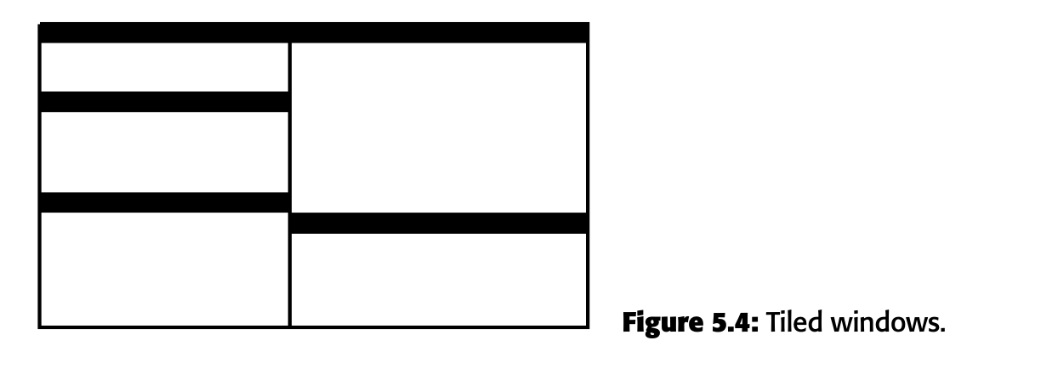
Window’s presentation styles
1.Tiled windows.
Tiled windows are like tiles on a floor or wall. Just like tiles fit together to cover a surface, tiled windows are arranged on your screen so that they fit together neatly without overlapping.
They adjust their size to fill up the available space on your screen. Usually, we can change both the height and width of these windows, but on some older or less powerful computers, we might only be able to change one dimension, like just making the window taller or shorter.

Slide 33
Window’s presentation styles
Tiled windows are the oldest type of window layout and offer several advantages:
Automatic Arrangement: The computer automatically places and sizes the windows for you, so you don't have to decide where to put them.
Always Visible: Since the windows don’t overlap, you can always see all the open windows, so you won’t accidentally lose or forget about any of them.
Complete Visibility: Every part of every window is always visible, so no information gets hidden behind other windows.
Simplicity: Tiled windows are simpler and easier to manage, especially for beginners, because there’s less to worry about compared to overlapping windows.
Easier Learning Curve: Studies show that new users find tiled windows easier to learn and use.
Efficiency for Simple Tasks: Tiled windows are better for tasks that don’t require moving or resizing windows a lot, as they keep everything organized.

Slide 34
Window’s presentation styles
Tiled windows also have some downsides:
Limited Space: You can only fit a few windows on the screen.
Constant Resizing: As you open or close windows, others change size, which can be annoying.
Unpredictable Changes: The windows might move or resize unexpectedly, which can be distracting.
Small Windows: With too many windows open, each one can become tiny and hard to use.
Less User Control: The system decides how windows are arranged, which might not suit your needs.
Crowded Screen: The windows fill the entire screen, making it look cluttered, especially with all the borders and controls visible.

Slide 35
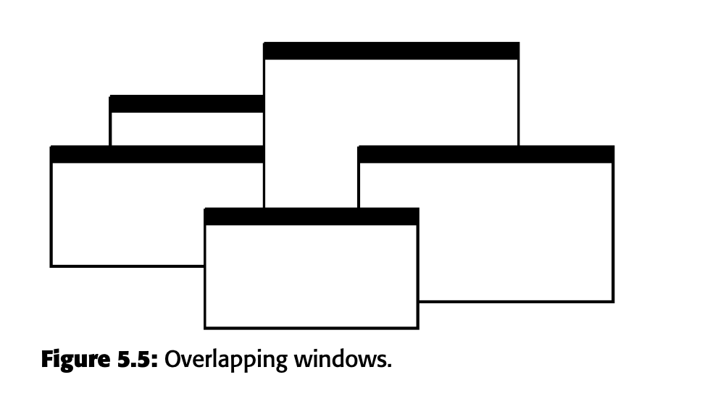
Window’s presentation styles
Overlapping windows
Overlapping windows are like papers stacked on a desk, where one window can be placed on top of another.
They look like they’re on different layers, giving them a 3D effect. We can control where these windows are placed and which one is on top. We can also resize many of them. This is the style of windows most computers use today.

Slide 36
Window’s presentation styles
Overlapping windows
Overlapping windows have several benefits:
Familiar Look: They have a 3D appearance, like papers on a desk, which feels natural.
More Control: You can arrange and organize the windows exactly how you want.
Consistent Size and Position: Windows can stay the same size and in the same place.
Space Flexibility: You can stack windows on top of each other, saving screen space.
Less Crowding: There's less visual clutter because windows can have clear borders and can even fill the whole screen.
Better for Complex Tasks: They work well when you need to move and resize windows a lot during a task."

Slide 37
Window’s presentation styles
Overlapping windows
Overlapping windows also have some downsides:
More Complex: They require more effort to manage, which can be distracting.
Hidden Information: Important information can get covered up by other windows.
Lost Windows: Windows can get buried and be hard to find, leading to confusion.
Visual Clutter: Too many overlapping windows can make the screen look messy and overwhelming.

Slide 38
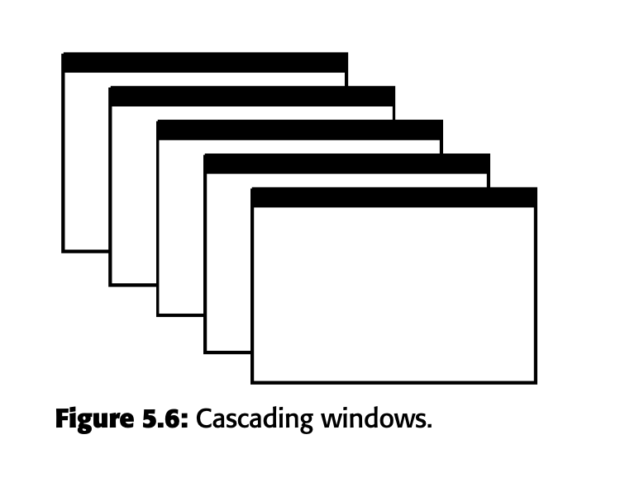
Window’s presentation styles
Cascading Windows
A special type of overlapping window has the windows automatically arranged in a regular progression. Each window is slightly offset from others, as illustrated in Figure 5.6.

Slide 39
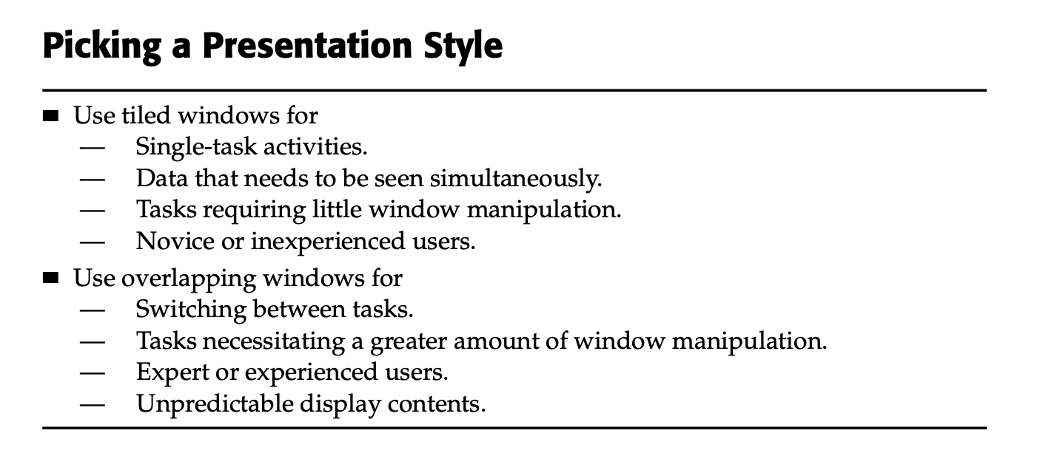
Window’s presentation styles

Slide 40
Types of Windows
Primary Window
Secondary Windows

Slide 41
Types of Windows
Primary Window
— Use to represent an independent function or application.
— Use to present constantly used window components and controls.
  Menu bar items that are
    Used frequently.
    Used by most, or all, primary or secondary windows.
  Controls used by dependent windows
— Use for presenting information that is continually updated, such as date and time.
— Use for providing context for dependent windows to be created.
— Do not
  Divide an independent function into two or more primary windows.
  Present unrelated functions in one primary window.

Slide 42
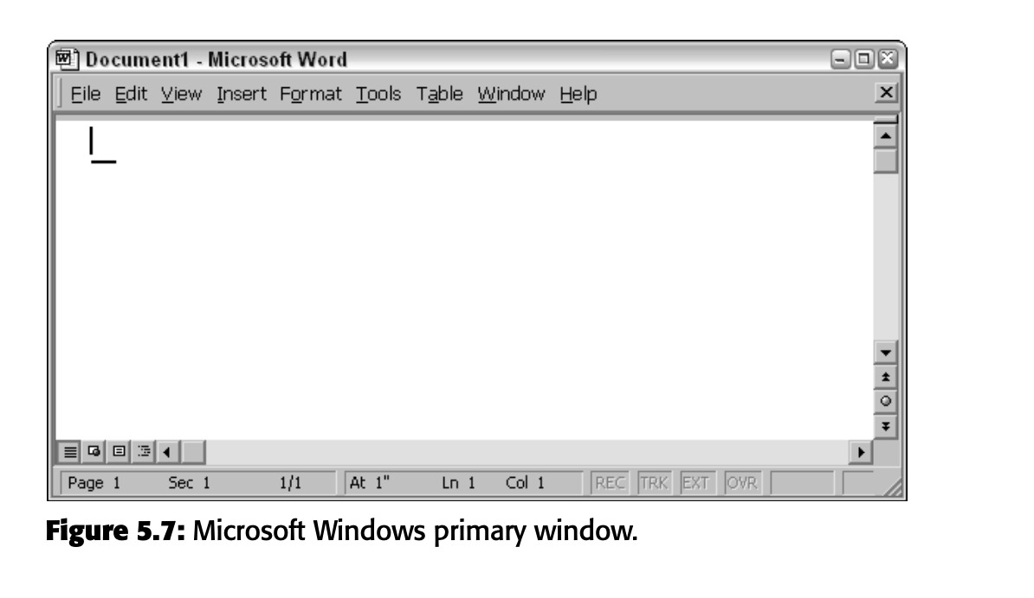
Types of Windows
Primary Window

Slide 43
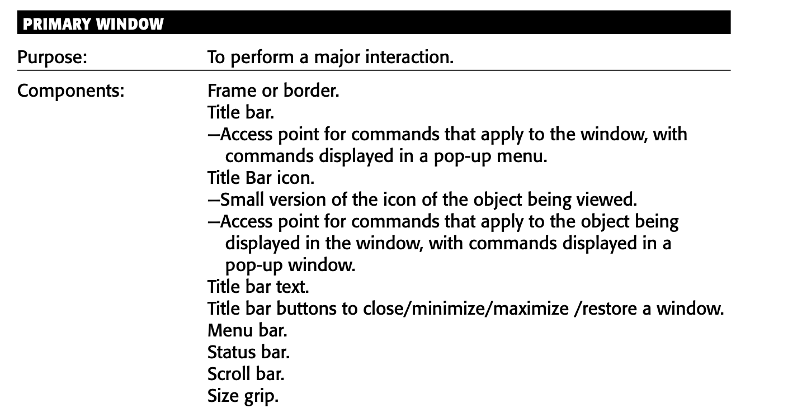
Types of Windows
Primary Window

Slide 44
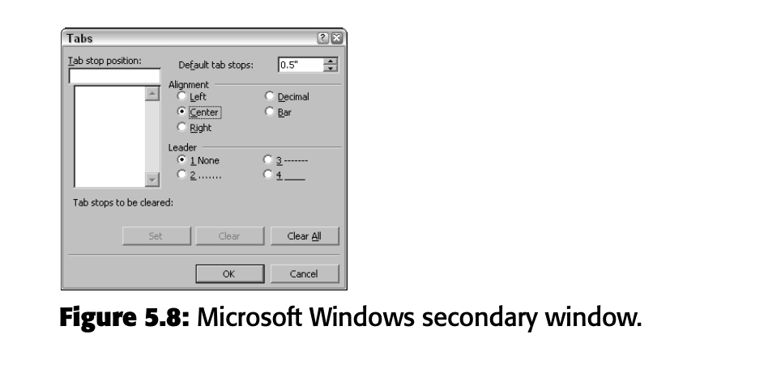
Types of Windows
Secondary Windows

Slide 45
Types of Windows
Secondary Windows
— For performing subordinate, supplemental, or ancillary actions that are
  Extended or more complex in nature.
  Related to objects in the primary window.
  — For presenting frequently or occasionally used window components.
Important guidelines:
— Should typically not appear as an entry on the taskbar.
–– A secondary window should not be larger than 263 dialog units x 263 dialog units.

Slide 46
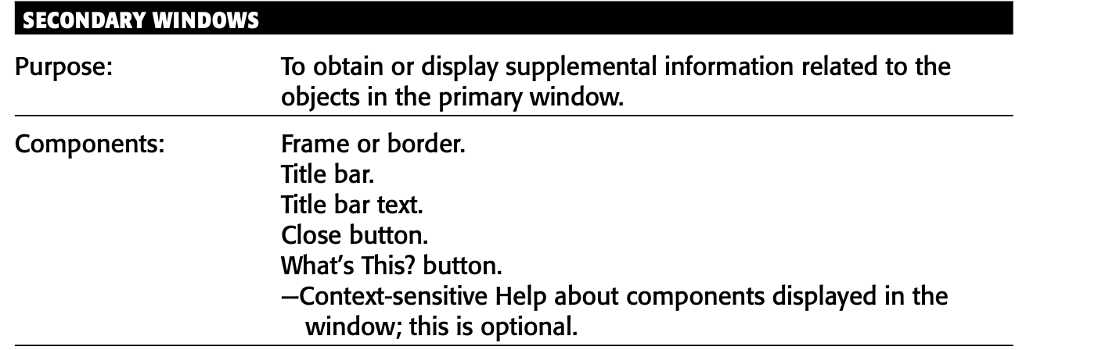
Types of Windows
Secondary Windows

Slide 47
Secondary Windows
Modal and Modeless
Modal:
  — Use when interaction with any other window must not be permitted.
  — Use for
    Presenting information; for example, messages (sometimes called a message box).
    Receiving user input; for example, data or information (sometimes called a prompt box).
    Asking questions; for example, data, information, or directions (sometimes called a question box).
  — Use carefully because it constrains what the user can do.
Modeless:
— Use when interaction with other windows must be permitted.
— Use when interaction with other windows must be repeated.

Slide 48
Secondary Windows
Cascading window
Purpose: Cascading is like opening a series of drawers in a filing cabinet. Each drawer might have more specific or advanced options.
How It Works: Imagine you click on a button in a software dialog box, and it opens another smaller box with more choices.
Guidelines:
  A button with three dots (...) indicates there are more choices available.
  The new box (or window) should appear slightly offset (cascaded) from the original one.
  Only two levels of these connected boxes should be used, to keep things simple.
  The original box should stay visible and not be covered by the new one.

Slide 49
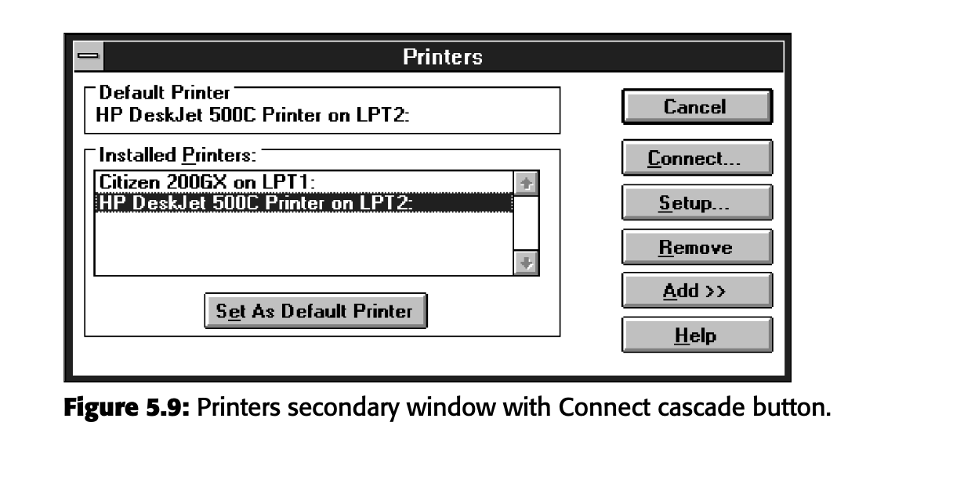
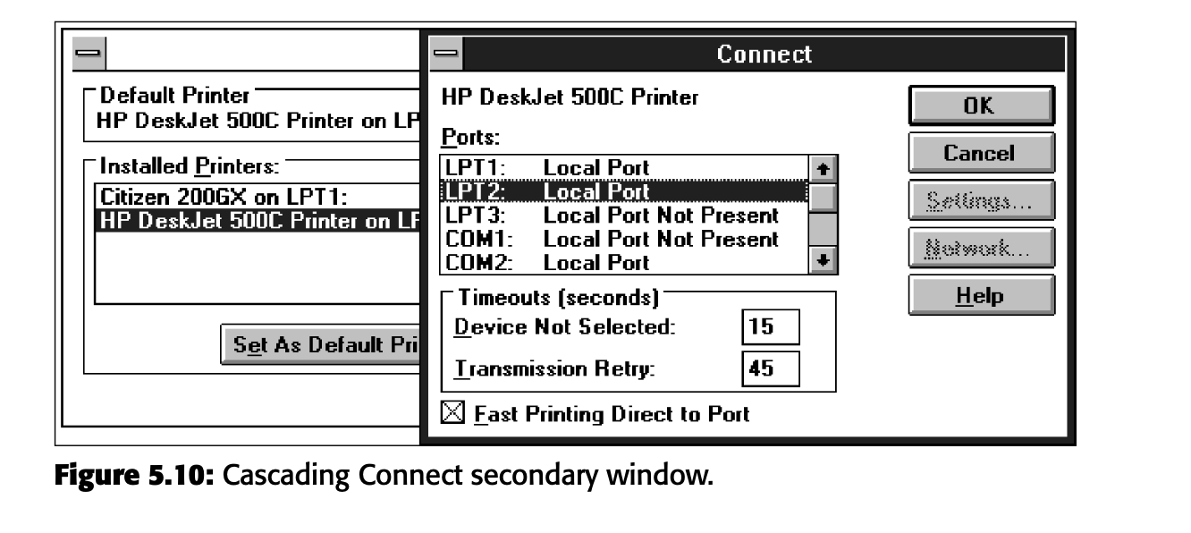

Slide 50
Secondary Windows
Unfolding window
Purpose: Unfolding is like pulling down a flap on a backpack to reveal more pockets. It happens on the same level, right where you are.
How It Works: If you click on a button with arrows (>>), more options appear, usually right beside or below the current options. It's like your dialog box suddenly has more room to show extra features.
Guidelines:
  The button with arrows (>>) is used to reveal more choices on the same screen.
  The box can expand to the right or down, depending on where there's space.

Slide 51
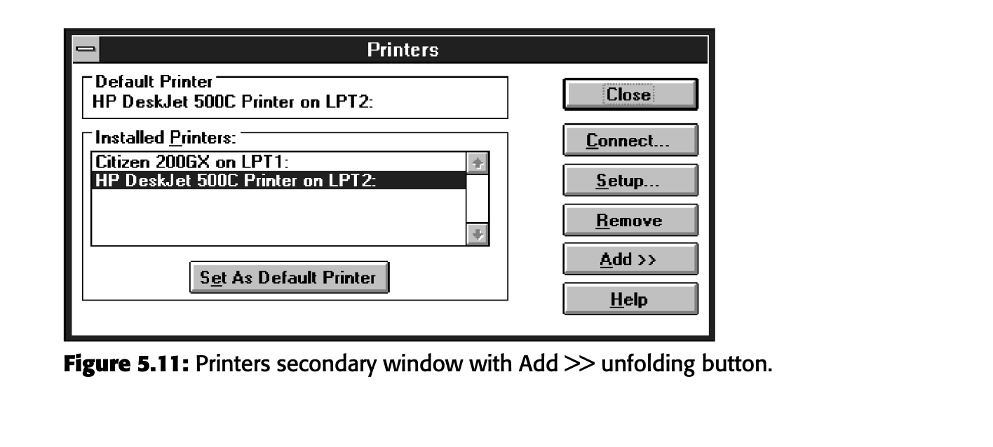
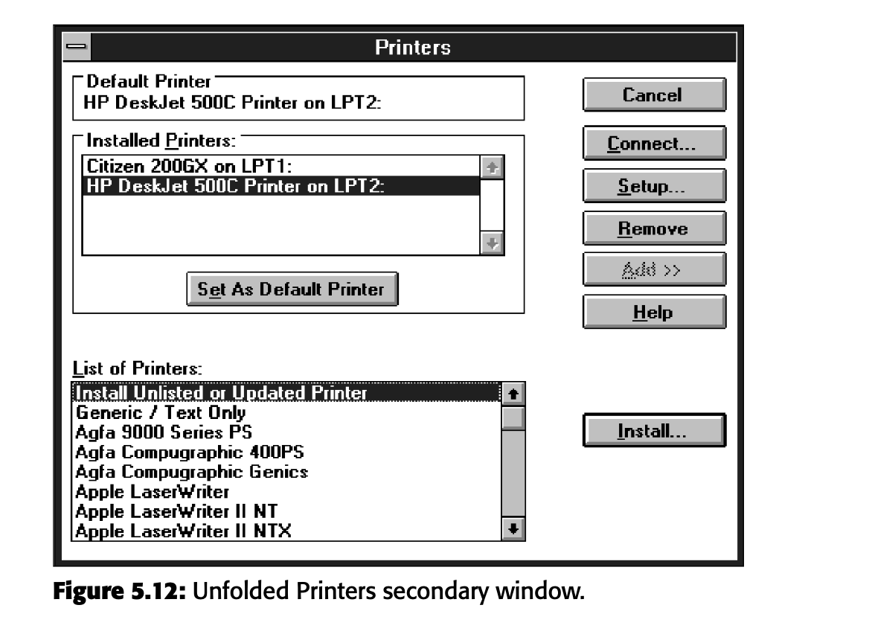

Slide 52
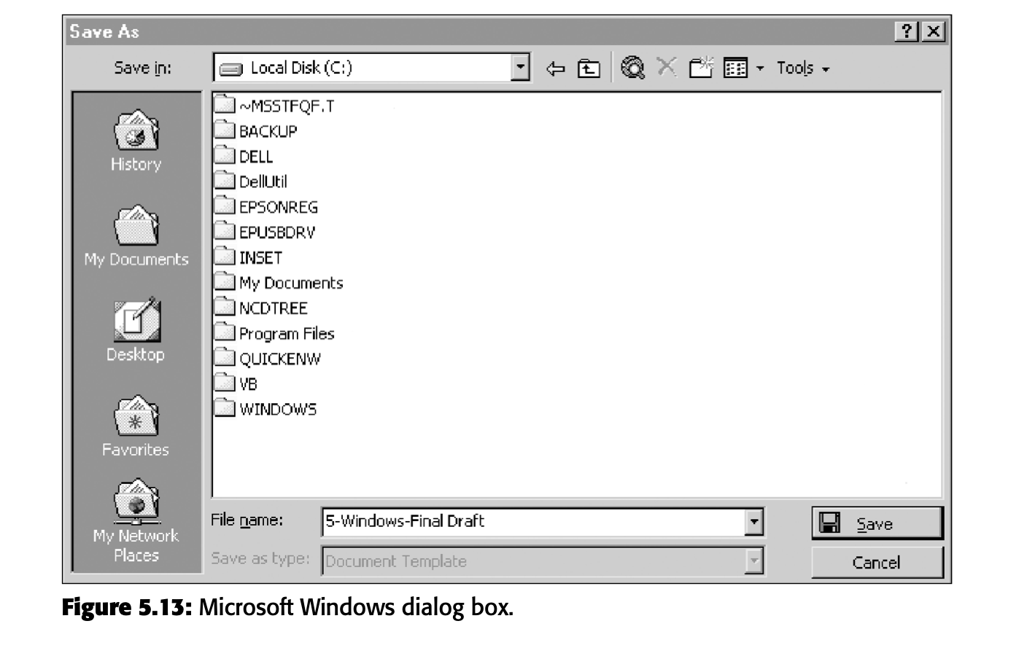
Secondary Windows
Dialog Boxes
Use for presenting brief messages.
Use for requesting specific, transient actions.
Use for performing actions that
— Take a short time to complete.
— Are not frequently changed.
Command buttons to include
— OK.
— Cancel.
— Others as necessary.

Slide 53
Secondary Windows
Property Sheets and Property Inspectors
A property sheet is like your one-stop control panel where you can see and adjust all the settings for an object.
Organize Settings with Tabs: If there are too many settings, they are organized into different sections using tabs. It's like having tabs for "Personal Info," "Privacy," and "Notifications" in your profile settings. Each tab groups related settings together.
Command buttons to include
  OK.
  Cancel.
  Apply.
  Reset.
  Others as necessary.

Slide 54
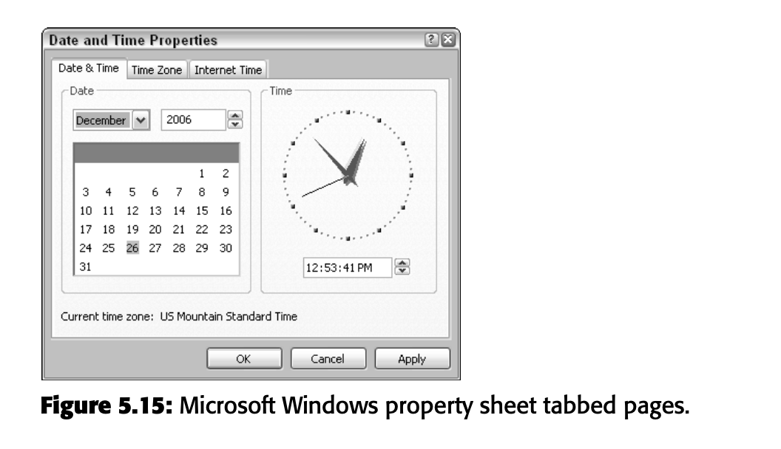
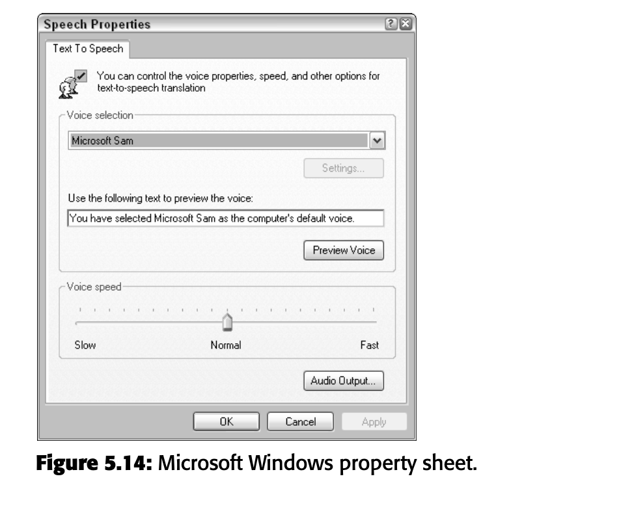
Secondary Windows
Single Property Sheet (No Tabs): If there are no tabs and everything is on one page, the command buttons like OK, Cancel, Apply, and Reset are placed right on that page.
Tabbed Property Pages: If the settings are divided into tabs, these command buttons are placed outside the tabs, because they apply to all the tabs, not just the one you’re looking at. It’s like having a "Save" button that works for all sections of your profile, not just one

Slide 55

Secondary Windows
A property inspector only shows you the most common or frequently used properties for an object. It’s like having just the essential tools you need, without digging through complicated menus.

Slide 56
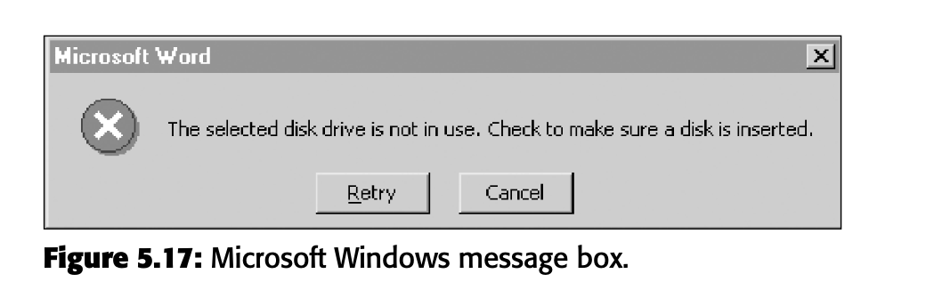
Secondary Windows
Message boxes
Use for displaying a message about a particular situation or condition.
Command buttons to include
— ok.
— Cancel.
— Help.
— Yes and no.
— Stop.
— Buttons to correct the action that caused the message box to be displayed.
Enable the title bar close box only if the message includes a cancel button.
Designate the most frequent or least destructive option as the default command Button.

Slide 57
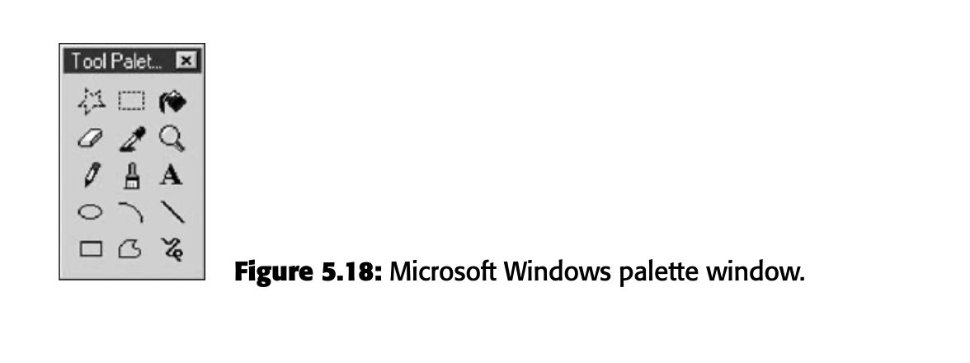
Secondary Windows
What is a palette window?
Imagine you’re doing an art project, and you have a small box with all your tools—like brushes, paints, and pencils—right next to you. A palette window in software is like that toolbox. It’s a small window that contains a set of controls or tools that you can use while working on something else.
Palette windows are distinguished by their visual appearance, a collection of images, colors or patterns. The title bar for a palette window is shorter and includes only a close button.
A palette window can be defined as fixed in size, or, more typically, resizable by the user.

Slide 58
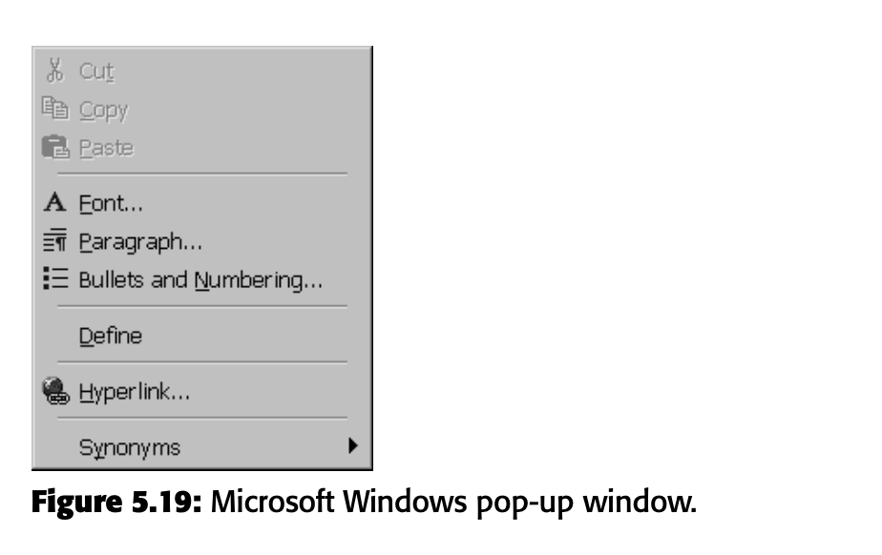
Secondary Windows
Pop-up windows
  Use pop-up windows to
    — display additional information when an abbreviated form of the information is
    The main presentation.
    — Collect secondary information.
    — Display textual labels for graphical controls.
    — Display context-sensitive help information.
  Present the pop-up at the front of the screen.
  Make the pop-up one-quarter to one-third of the window size.
  Provide ok or save and cancel buttons.
  Never display unsolicited pop-up windows.

Slide 59
Secondary Windows
What is a palette window?
Imagine you’re doing an art project, and you have a small box with all your tools—like brushes, paints, and pencils—right next to you. A palette window in software is like that toolbox. It’s a small window that contains a set of controls or tools that you can use while working on something else.
Palette windows are distinguished by their visual appearance, a collection of images, colors or patterns. The title bar for a palette window is shorter and includes only a close button.
A palette window can be defined as fixed in size, or, more typically, resizable by the user.

Slide 60
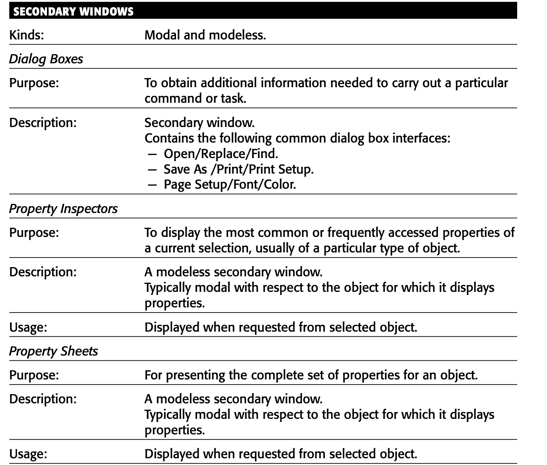

Slide 61
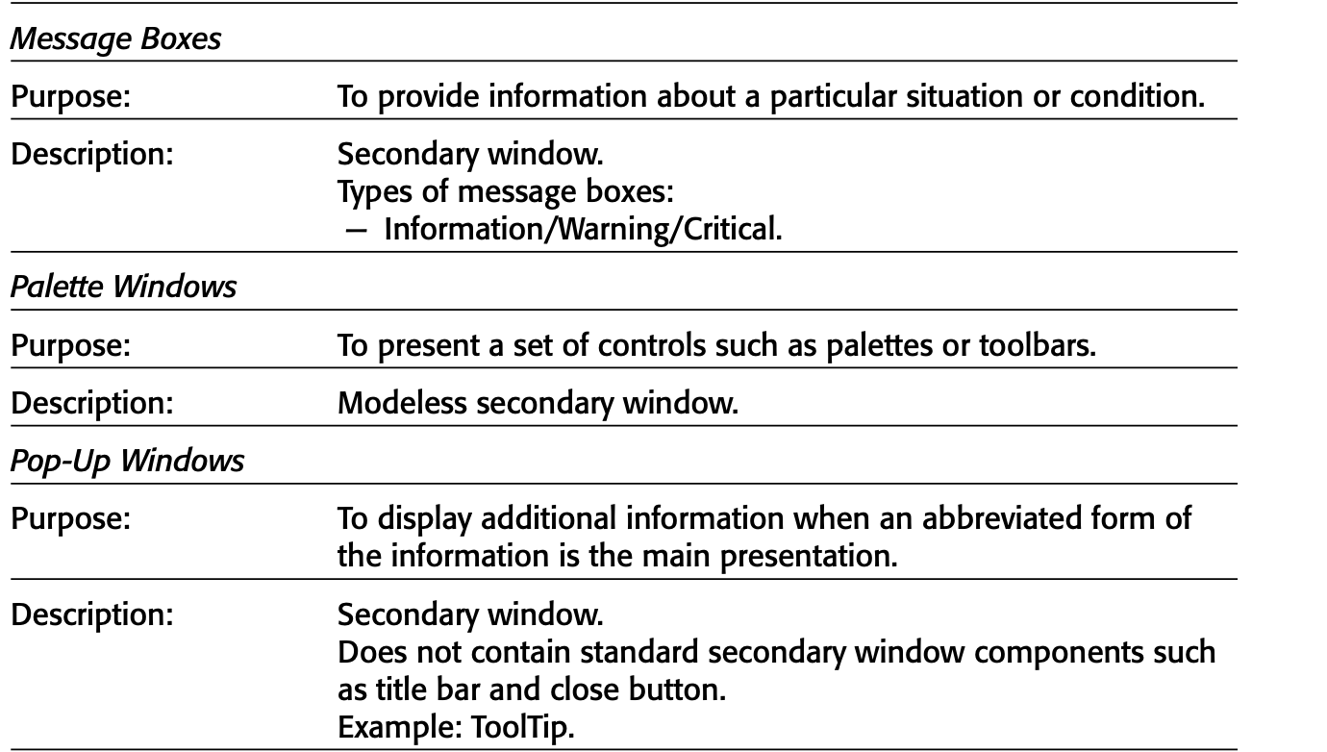

Slide 62
Selection Of Device Based Controls.
Characteristics of input devices
Several specific tasks are performed using today’s systems:
  ■■ to point at an object on the screen.
  ■■ To select the object or identify it as the focus of attention.
  ■■ To drag an object across the screen.
  ■■ To draw something free-form on the screen.
  ■■ To track or follow a moving object.
  ■■ To orient or position an object.
  ■■ To enter or manipulate data or information.

Slide 63
Selection Of Device Based Controls.
Input Devices
■■ Trackball
■■ Joystick
■■ Graphic tablet or trackpad
■■ Touch screen
■■ Light pen
■■ Voice
■■ Mouse
■■ Keyboard

Slide 64
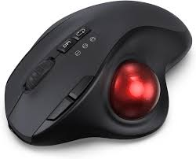
Trackball
–– A spherical object (ball) that rotates freely in all directions in its socket.
–– Direction and speed is tracked and translated into cursor movement.

Slide 65
Trackball
Advantages:
  –– direct relationship between hand and pointer movement in terms of direction And speed.
  –– Does not obscure vision of the screen.
  –– Does not require additional desk space (if mounted on keyboard).
Disadvantages:
  –– movement is indirect, in a plane different from the screen.
  –– No direct relationship exists between hand and pointer movement in terms of Distance.
  –– Requires a degree of eye-hand coordination.
  –– Requires hand to be removed from keyboard keys.
  –– Requires different hand movements.
  –– Requires hand to be removed from keyboard (if not mounted on keyboard).
  –– Requires additional desk space (if not mounted on keyboard).
  –– May be difficult to control.
  –– May be fatiguing to use over extended time.

Slide 66
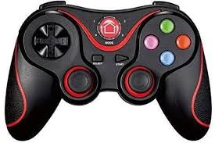
Joystick
  –– A stick or bat-shaped device anchored at the bottom.
  –– Variable in size, smaller ones being operated by fingers, larger ones requiring the Whole hand.
  –– Variable in cursor direction movement method, force joysticks respond to pressure; movable ones respond to movement.
  –– Variable in degree of movement allowed, from horizontal-vertical only to Continuous.

Slide 67
Joystick
Advantages:
–– direct relationship between hand and pointer movement in terms of direction.
–– Does not obscure the vision of the screen.
–– Does not require additional desk space (if mounted on keyboard).
Disadvantages:
–– movement indirect, in a plane different from screen.
–– Indirect relationship between hand and pointer in terms of speed and distance. –– Requires a degree of eye-hand coordination.
–– Requires hand to be removed from keyboard keys.
–– Requires different hand movements to use.
–– Requires hand to be removed from keyboard (if not mounted on keyboard).
–– Requires additional desk space (if not mounted on keyboard).
–– Maybe fatiguing to use over an extended time.
–– May be slow and inaccurate.

Slide 68
Graphic tablet or trackpad
A graphic tablet, also called a “trackpad,” “touch tablet,” “touchpad,” or simply “tablet,” is a device with a horizontal surface sensitive to pressure, heat, light, or the blockage of light. It may lie on the desk or may be incorporated on a keyboard, and it is operated with fingers, light pen, or objects like a pencil or stylus. The screen pointer imitates movement on the tablet.

Slide 69
Graphic tablet or trackpad
Advantages:
  –– direct relationship between touch movements and pointer movements in terms
  Of direction, distance, and speed.
  –– More comfortable horizontal operating plane.
  –– Does not obscure vision of screen.
Disadvantages:
–– movement is indirect, in a plane different from screen. –– Requires hand to be removed from keyboard.
–– Requires hand to be removed from keyboard keys.
–– Requires different hand movements to use.
–– Requires additional desk space.
–– Finger may be too large for accuracy with small objects

Slide 70
Touch Screen
A touch screen is a screen that consists of a special surface sensitive to finger or stylus touch. Objects on the screen are pointed to and touched to select them.
Design guidelines:
  –– screen objects should be at least 3⁄4 × 3⁄4 inches in size.
  –– Object separation should be at least 1⁄8 inch.
  –– Provide visual feedback in response to activation. Auditory feedback may also
  Be appropriate.
  –– When the consequences are destructive, require confirmation after selection to
  Eliminate inadvertent selection.
  –– Provide an instructional invitation to begin using.

Slide 71
Touch Screen
Advantages:
  –– direct relationship between hand and pointer location in terms of direction, distance, and speed.
  –– Movement is direct, in the same plane as screen.
  –– Requires no additional desk space.
  –– Stands up well in high-use environments.
Disadvantages:
–– finger may obscure part of screen.
–– Finger may be too large for accuracy with small objects.
–– Requires moving the hand far from the keyboard to use.
–– Very fatiguing to use for extended period of time.
–– May soil or damage the screen.

Slide 72
Light Pen
Description:
A light pen, or pen, also utilizes a touch screen, but one that is sensitive in a specific way to one kind of pen or stylus.

Slide 73
Light Pen
Advantages:
  –– direct relationship between hand and pointer movement in terms of direction, Distance, and speed.
  –– Movement is direct, in the same plane as screen.
  –– Requires minimal additional desk space.
  –– Stands up well in high-use environments.
  –– More accurate than finger touching.
Disadvantages:
–– hand may obscure part of screen.
–– Requires picking it up to use.
–– Requires moving the hand far from the keyboard to use.
–– Very fatiguing to use for extended period of time.

Slide 74
Voice
Description:
–– automatic speech recognition by the computer.
Advantages:
–– simple and direct.
–– Useful for people who cannot use a keyboard. –– Useful when the user’s hands are occupied.
Disadvantages:
  –– high error rates because of difficulties in
    Recognizing boundaries between spoken words.
    Blurred word boundaries because of normal speech patterns.
  –– Slower throughput than with typing.
  –– Difficult to use in noisy environments.
  –– Impractical to use in quiet environments.

Slide 75
Mouse
Description:
  –– A rectangular or dome-shaped, movable, desktop control containing from one to Three buttons used to manipulate objects and information on the screen.
  –– Movement of screen pointer mimics the mouse movement.
Advantages:
  –– direct relationship between hand and pointer movement in terms of direction, Distance, and speed.
  –– Permits a comfortable hand resting position.
  –– Selection mechanisms are included on mouse.
  –– Does not obscure vision of the screen.
Disadvantages:
–– movement is indirect, in a plane different from screen.
–– Requires hand to be removed from keyboard.
–– Requires additional desk space.
–– May require long movement distances.
–– Requires a degree of eye-hand coordination.

Slide 76
Keyboard
Description:
–– standard typewriter keyboard and cursor movement keys.
Advantages:
  –– familiar.
  –– Accurate.
  –– Does not take up additional desk space.
  –– Very useful for
    Entering text and alphanumeric data.
    Editing text and alphanumeric data.
    Keyed shortcuts — accelerators.
    Keyboard mnemonics — equivalents.
  –– Advantageous for
    Performing actions when less than three mouse buttons exist.
    Use with very large screens.
    Touch typists.
Disadvantages:
  –– slow for non-touch-typists.
  –– Can be over-elaborate.
  –– Slower than other devices in pointing.
  –– Requires discrete actions to operate.
  –– No direct relationship between finger or hand movement on the keys and cursor
  Movement on screen in terms of speed and distance.

Slide 77
Guidelines for Selecting the Proper Input Device
■ Consider the characteristics of the task.
— Provide keyboards for tasks involving
  Heavy text entry and manipulation.
  Movement through structured arrays consisting of a few discrete objects.
— Provide an alternative pointing device for graphical or drawing tasks. The following are some suggested best uses:
  Mouse — pointing, selecting, drawing, and dragging.
  Joystick — selecting and tracking.
  Trackball — pointing, selecting, and tracking.
  Touch screen — pointing and selecting.
  Graphic tablet — pointing, selecting, drawing, and dragging.
— Provide touch screens under the following conditions:
  The opportunity for training is minimal.
  Targets are large, discrete, and spread out.
  Frequency of use is low.
  Desk space is at a premium.
  Little or no text input requirement exists.

Slide 78
Guidelines for Selecting the Proper Input Device
Consider user characteristics and preferences.
— Provide keyboards for touch typists.
Consider the characteristics of the environment.
Consider the characteristics of the hardware.
Consider the characteristics of the device in relation to the application.
Provide flexibility.
Minimize eye and hand movements between devices.

Slide 79
Output Devices
The computer communicates to the user through output devices. The most common is the display screen.
Screens:
For many years, cathode ray tube (CRT) monitors were used. These monitors were bulky and heavy but provided good image quality. Over time, they improved to become flicker-free and provided sharp images, but their size and weight were a downside.
Now, liquid crystal display (lcd) screens are much more common. They are thinner, lighter, and take up less space than crts, making them more portable and easier to use in small spaces. Lcds also consume less power and are affordable.

Slide 80
Output Devices
When choosing a screen, consider:
Image quality: if you work with graphics or photos, a high-resolution screen is better. For simple text work, a lower resolution might be fine.
Colors: some applications need only basic colors, while others might need millions.
Size: screen size is measured diagonally. Larger screens show more information, while smaller screens are useful for portable devices.
Portability: lcds are easier to carry and use in different places compared to heavy crts.
Space: lcds take up less desk space, which is helpful in crowded work environments.

Slide 81
Output Devices
Speakers:
Computers now can play sounds ranging from simple beeps to full music tracks and sound effects. Good speakers are important for clear sound, especially when you're listening to music or using speech recognition programs. The quality of the speaker should match the type of sound being played—better speakers for higher quality sounds.

