Slide 1
Transaction Processing
1 Introduction to Transaction Processing
2 Transaction and System Concepts
3 Desirable Properties of Transactions
4 Characterizing Schedules based on Recoverability
5 Characterizing Schedules based on Serializability
6 Transaction Support in SQL

Slide 2
Transaction Concept
A transaction is a unit of program execution that accesses and possibly updates various data items.
E.g. transaction to transfer €50 from account A to account B:
  1. read_from_acoount(A)
  2. A := A – 50
  3. write_to_account(A)
  4. read_from_accont(B)
  5. B := B + 50
  6. write_to_account(B)
Two main issues to deal with:
  Failures of various kinds, such as hardware failures and system crashes
  Concurrent execution of multiple transactions

Slide 3
1 Introduction to Transaction Processing (1)
Single-User System:
  At most one user at a time can use the system.
Multiuser System:
  Many users can access the system concurrently.
Concurrency
  Interleaved processing:
    Concurrent execution of processes is interleaved in a single CPU
  Parallel processing:
    Processes are concurrently executed in multiple CPUs.

Slide 4
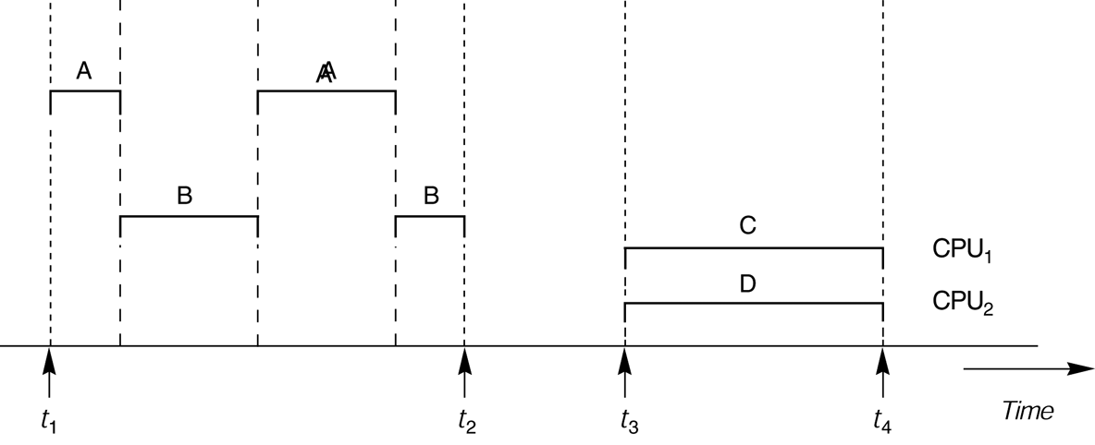
FIGURE 17.1
Interleaved processing versus parallel processing of concurrent transactions.

Slide 5
Introduction to Transaction Processing (2)
A Transaction:
  Logical unit of database processing that includes one or more access operations (read -retrieval, write - insert or update, delete).
A transaction (set of operations) may be stand-alone specified in a high level language like SQL submitted interactively, or may be embedded within a program.
Transaction boundaries:
  Begin and End transaction.
An application program may contain several transactions separated by the Begin and End transaction boundaries.

Slide 6
Introduction to Transaction Processing (3)
SIMPLE MODEL OF A DATABASE (for purposes of discussing transactions):
A database is a collection of named data items
Granularity of data - a field, a record , or a whole disk block (Concepts are independent of granularity)
Basic operations are read and write
  read_item(X): Reads a database item named X into a program variable. To simplify our notation, we assume that the program variable is also named X.
  write_item(X): Writes the value of program variable X into the database item named X.

Slide 7
Introduction to Transaction Processing (4)
READ AND WRITE OPERATIONS:
Basic unit of data transfer from the disk to the computer main memory is one block. In general, a data item (what is read or written) will be the field of some record in the database, although it may be a larger unit such as a record or even a whole block.
read_item(X) command includes the following steps:
  Find the address of the disk block that contains item X.
  Copy that disk block into a buffer in main memory (if that disk block is not already in some main memory buffer).
  Copy item X from the buffer to the program variable named X.

Slide 8
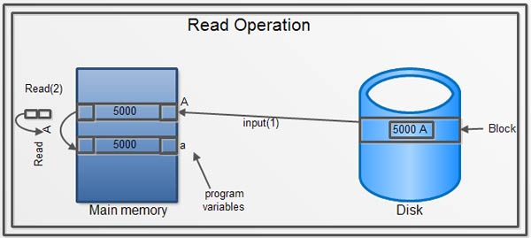

Slide 9
Introduction to Transaction Processing (5)
READ AND WRITE OPERATIONS (contd.):
write_item(X) command includes the following steps:
  Find the address of the disk block that contains item X.
  Copy that disk block into a buffer in main memory (if that disk block is not already in some main memory buffer).
  Copy item X from the program variable named X into its correct location in the buffer.
  Store the updated block from the buffer back to disk (either immediately or at some later point in time).

Slide 10
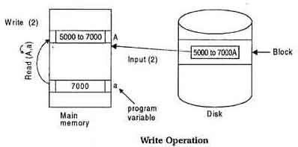

Slide 11
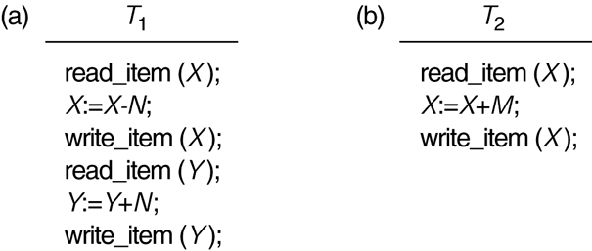
Two sample transactions
FIGURE 17.2 Two sample transactions:
  (a) Transaction T1
  (b) Transaction T2

Slide 12
Introduction to Transaction Processing (6)
Why Concurrency Control is needed:
The Lost Update Problem
  This occurs when two transactions that access the same database items have their operations interleaved in a way that makes the value of some database item incorrect.
The Temporary Update (or Dirty Read) Problem
  This occurs when one transaction updates a database item and then the transaction fails for some reason (see Section 17.1.4).
  The updated item is accessed by another transaction before it is changed back to its original value.
The Incorrect Summary Problem
  If one transaction is calculating an aggregate summary function on a number of records while other transactions are updating some of these records, the aggregate function may calculate some values before they are updated and others after they are updated.

Slide 13
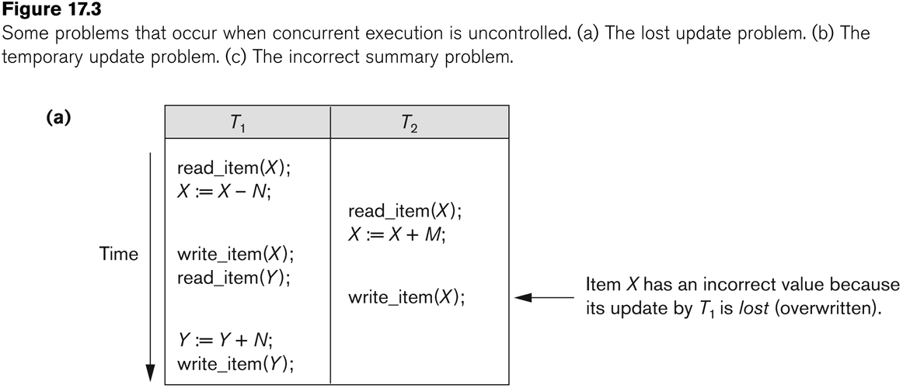
Concurrent execution is uncontrolled: (a) The lost update problem.

Slide 14
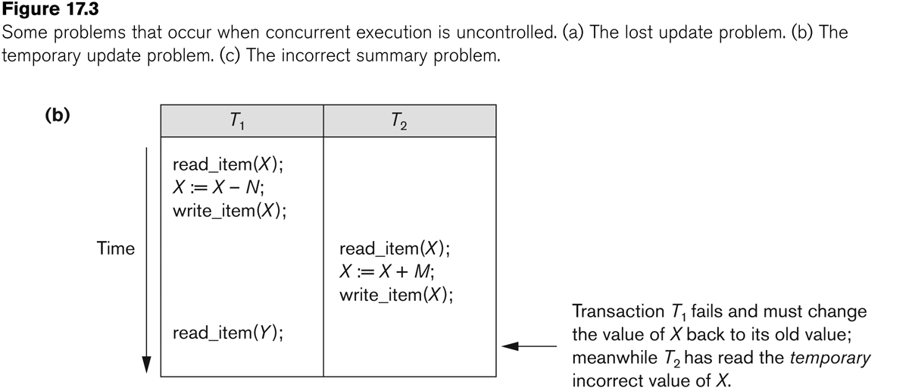
Concurrent execution is uncontrolled: (b) The temporary update problem.

Slide 15
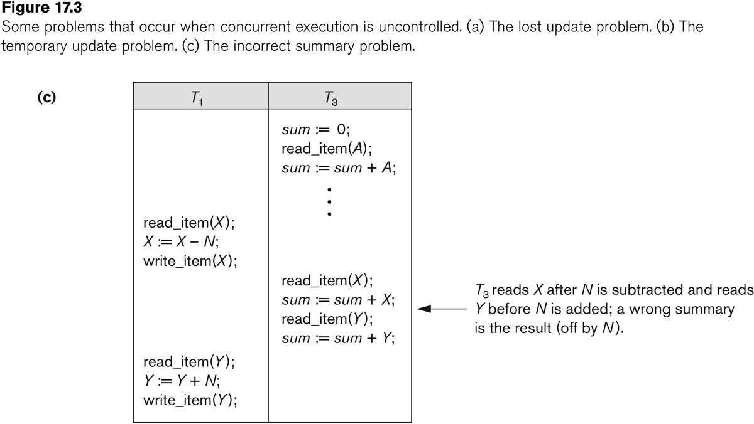
Concurrent execution is uncontrolled: (c) The incorrect summary problem.

Slide 16
Introduction to Transaction Processing (12)
Why recovery is needed:
(What causes a Transaction to fail)
  1. A computer failure (system crash):
    A hardware or software error occurs in the computer system during transaction execution. If the hardware crashes, the contents of the computer’s internal memory may be lost.
  2. A transaction or system error:
    Some operation in the transaction may cause it to fail, such as integer overflow or division by zero. Transaction failure may also occur because of erroneous parameter values or because of a logical programming error. In addition, the user may interrupt the transaction during its execution.

Slide 17
Introduction to Transaction Processing (13)
Why recovery is needed (Contd.):
(What causes a Transaction to fail)
  3. Local errors or exception conditions detected by the transaction:
    Certain conditions necessitate cancellation of the transaction. For example, data for the transaction may not be found. A condition, such as insufficient account balance in a banking database, may cause a transaction, such as a fund withdrawal from that account, to be canceled.
    A programmed abort in the transaction causes it to fail.
  4. Concurrency control enforcement:
    The concurrency control method may decide to abort the transaction, to be restarted later, because it violates serializability or because several transactions are in a state of deadlock (see Chapter 18).

Slide 18
Introduction to Transaction Processing (14)
Why recovery is needed (contd.):
(What causes a Transaction to fail)
  5. Disk failure:
    Some disk blocks may lose their data because of a read or write malfunction or because of a disk read/write head crash. This may happen during a read or a write operation of the transaction.
  6. Physical problems and catastrophes:
    This refers to an endless list of problems that includes power or air-conditioning failure, fire, theft, sabotage, overwriting disks or tapes by mistake, and mounting of a wrong tape by the operator.

Slide 19
2 Transaction and System Concepts (1)
A transaction is an atomic unit of work that is either completed in its entirety or not done at all.
  For recovery purposes, the system needs to keep track of when the transaction starts, terminates, and commits or aborts.
Transaction states:
  Active state
  Partially committed state
  Committed state
  Failed state
  Terminated State

Slide 20
Transaction and System Concepts (2)
Recovery manager keeps track of the following operations:
  begin_transaction: This marks the beginning of transaction execution.
  read or write: These specify read or write operations on the database items that are executed as part of a transaction.
  end_transaction: This specifies that read and write transaction operations have ended and marks the end limit of transaction execution.
    At this point it may be necessary to check whether the changes introduced by the transaction can be permanently applied to the database or whether the transaction has to be aborted because it violates concurrency control or for some other reason.

Slide 21
Transaction and System Concepts (3)
Recovery manager keeps track of the following operations (cont):
  commit_transaction: This signals a successful end of the transaction so that any changes (updates) executed by the transaction can be safely committed to the database and will not be undone.
  rollback (or abort): This signals that the transaction has ended unsuccessfully, so that any changes or effects that the transaction may have applied to the database must be undone.

Slide 22
Transaction and System Concepts (4)
Recovery techniques use the following operators:
  undo: Similar to rollback except that it applies to a single operation rather than to a whole transaction.
  redo: This specifies that certain transaction operations must be redone to ensure that all the operations of a committed transaction have been applied successfully to the database.

Slide 23
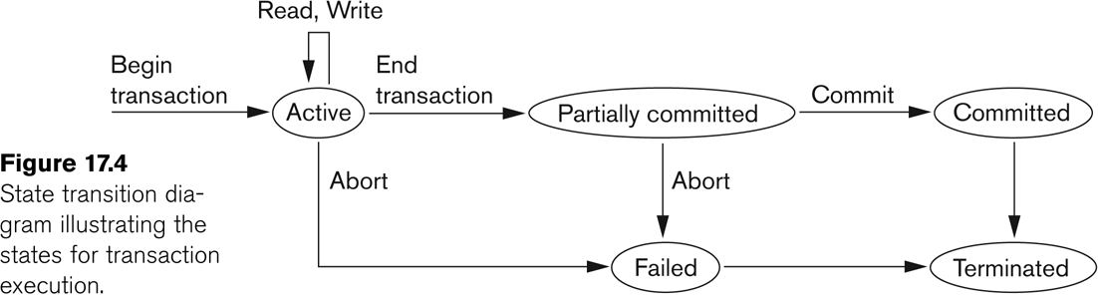
State transition diagram illustrating the states for transaction execution

Slide 24
Transaction and System Concepts (6)
The System Log
  Log or Journal: The log keeps track of all transaction operations that affect the values of database items.
    This information may be needed to permit recovery from transaction failures.
    The log is kept on disk, so it is not affected by any type of failure except for disk or catastrophic failure.
    In addition, the log is periodically backed up to archival storage (tape) to guard against such catastrophic failures.

Slide 25
Transaction and System Concepts (7)
The System Log (cont):
  T in the following discussion refers to a unique transaction-id that is generated automatically by the system and is used to identify each transaction:
  Types of log record:
    [start_transaction,T]: Records that transaction T has started execution.
    [write_item,T,X,old_value,new_value]: Records that transaction T has changed the value of database item X from old_value to new_value.
    [read_item,T,X]: Records that transaction T has read the value of database item X.
    [commit,T]: Records that transaction T has completed successfully, and affirms that its effect can be committed (recorded permanently) to the database.
    [abort,T]: Records that transaction T has been aborted.

Slide 26
Transaction and System Concepts (8)
The System Log (cont):
  Protocols for recovery that avoid cascading rollbacks do not require that read operations be written to the system log, whereas other protocols require these entries for recovery.
  Strict protocols require simpler write entries that do not include new_value (see Section 17.4).

Slide 27
Transaction and System Concepts (9)
Recovery using log records:
If the system crashes, we can recover to a consistent database state by examining the log and using one of the techniques described in Chapter 19.
  Because the log contains a record of every write operation that changes the value of some database item, it is possible to undo the effect of these write operations of a transaction T by tracing backward through the log and resetting all items changed by a write operation of T to their old_values.
  We can also redo the effect of the write operations of a transaction T by tracing forward through the log and setting all items changed by a write operation of T (that did not get done permanently) to their new_values.

Slide 28
Transaction and System Concepts (10)
Commit Point of a Transaction:
Definition a Commit Point:
  A transaction T reaches its commit point when all its operations that access the database have been executed successfully and the effect of all the transaction operations on the database has been recorded in the log.
  Beyond the commit point, the transaction is said to be committed, and its effect is assumed to be permanently recorded in the database.
  The transaction then writes an entry [commit,T] into the log.
Roll Back of transactions:
  Needed for transactions that have a [start_transaction,T] entry into the log but no commit entry [commit,T] into the log.

Slide 29
Transaction and System Concepts (11)
Commit Point of a Transaction (cont):
Redoing transactions:
  Transactions that have written their commit entry in the log must also have recorded all their write operations in the log; otherwise they would not be committed, so their effect on the database can be redone from the log entries. (Notice that the log file must be kept on disk.
  At the time of a system crash, only the log entries that have been written back to disk are considered in the recovery process because the contents of main memory may be lost.)
Force writing a log:
  Before a transaction reaches its commit point, any portion of the log that has not been written to the disk yet must now be written to the disk.
  This process is called force-writing the log file before committing a transaction.

Slide 30
3 Desirable Properties of Transactions
ACID properties:
Atomicity: A transaction is an atomic unit of processing; it is either performed in its entirety or not performed at all.
Consistency preservation: A correct execution of the transaction must take the database from one consistent state to another.
Isolation: A transaction should not make its updates visible to other transactions until it is committed; this property, when enforced strictly, solves the temporary update problem and makes cascading rollbacks of transactions unnecessary
Durability or permanency: Once a transaction changes the database and the changes are committed, these changes must never be lost because of subsequent failure.

Slide 31
E.g. transaction to transfer €50 from account A to account B:
  1. read_from_acoount(A)
  2. A := A – 50
  3. write_to_account(A)
  4. read_from_accont(B)
  5. B := B + 50
  6. write_to_account(B)
Atomicity requirement
  if the transaction fails after step 3 and before step 6, money will be “lost” leading to an inconsistent database state
    Failure could be due to software or hardware
  the system should ensure that updates of a partially executed transaction are not reflected in the database
  All or nothing, regarding the execution of the transaction
Durability requirement — once the user has been notified of transaction has completion, the updates must persist in the database even if there are software or hardware failures.

Slide 32
Transaction to transfer €50 from account A to account B:
  1. read_from_acoount(A)
  2. A := A – 50
  3. write_to_account(A)
  4. read_from_accont(B)
  5. B := B + 50
  6. write_to_account(B)
Consistency requirement in above example:
  the sum of A and B is unchanged by the execution of the transaction
In general, consistency requirements include
    Explicitly specified integrity constraints such as primary keys and foreign keys
    Implicit integrity constraints
      e.g. sum of balances of all accounts, minus sum of loan amounts must equal value of cash-in-hand
  A transaction must see a consistent database and must leave a consistent database
  During transaction execution the database may be temporarily inconsistent.
    Constraints to be verified only at the end of the transaction

Slide 33
Isolation requirement — if between steps 3 and 6, another transaction T2 is allowed to access the partially updated database, it will see an inconsistent database (the sum A + B will be less than it should be).
T1 T2
  1. read(A)
  2. A := A – 50
  3. write(A)
  read(A), read(B), print(A+B)
  4. read(B)
  5. B := B + 50
  6. write(B
Isolation can be ensured trivially by running transactions serially
  that is, one after the other.
However, executing multiple transactions concurrently has significant benefits, as we will see later.

Slide 34
ACID Properties - Summary
A transaction is a unit of program execution that accesses and possibly updates various data items.To preserve the integrity of data the database system must ensure:

Slide 35
Atomicity Either all operations of the transaction are properly reflected in the database or none are.
Consistency Execution of a (single) transaction preserves the consistency of the database.
Isolation Although multiple transactions may execute concurrently, each transaction must be unaware of other concurrently executing transactions. Intermediate transaction results must be hidden from other concurrently executed transactions.
  That is, for every pair of transactions T_{i} and T_{j}, it appears to T_{i} that either T_{j}, finished execution before T_{i} started, or T_{j} started execution after T_{i} finished.
Durability. After a transaction completes successfully, the changes it has made to the database persist, even if there are system failures.

Slide 36
Transaction Properties
There are four important properties of transaction that a DBMS must ensure to maintain data in the case of concurrent access and system failures. These are:
Atomicity: (all or nothing)
A transaction is said to be atomic if a transaction always executes all its actions in one step or not executes any actions at all It means either all or none of the transactions operations are performed.
Consistency: (No violation of integrity constraints)
A transaction must preserve the consistency of a database after the execution. The DBMS assumes that this property holds for each transaction. Ensuring this property of a transaction is the responsibility of the user.

Slide 37
Isolation: (concurrent changes invisibles)
The transactions must behave as if they are executed in isolation. It means that if several transactions are executed concurrently the results must be same as if they were executed serially in some order. The data used during the execution of a transaction cannot be used by a second transaction until the first one is completed.
Durability: (committed update persist)
The effect of completed or committed transactions should persist even after a crash. It means once a transaction commits, the system must guarantee that the result of its operations will never be lost, in spite of subsequent failures.
The acronym ACID is sometimes used to refer above four properties of transaction that we have presented here: Atomicity, Consistency, Isolation, and Durability.

