Slide 1
Computer Aided Software Engineering (CASE)

Slide 2
CASE tools help in software development effort and maintenance effort.
CASE is a much talked about topic in software industries.
In this scene, CASE tools promise effort and cost reduction in software development and maintenance.
Therefore, deployment and development of CASE tools have become pet subjects for most software project managers.

Slide 3
CASE and Its Scope
CASE tool is a generic term:
  denotes any form of automated support for software
  engineering.
In a more restrictive sense:
  a CASE tool automates some software development activity.

Slide 4
CASE and Its Scope
Some CASE tools assist in phase-related tasks:
  specification, structured analysis, design, coding, testing, etc.
Other tools help non-phase activities:
  project management and configuration management.

Slide 5
Objectives of CASE
To increase productivity
To help produce better quality software at lower cost.

Slide 6
CASE Environment
Although individual CASE tools are useful, the true power of a tool set can be realized only when these set of tools are integrated into a common framework or environment.
If the different CASE tools are not integrated, then the data generated by one tool would have to input to the other tools. This may also involve format conversions as the tools developed by different vendors are likely to use different formats. This results in additional effort of exporting data from one tool and importing to another. Also, many tools do not allow exporting data and maintain the data in proprietary formats.

Slide 7
CASE Environment
Tools covering different stages of life cycle share information (data):
  they should integrate through some central repository (store)
  consistent view of development information.

Slide 8
CASE Environment
The central repository is the data dictionary:
  contains definition of all composite and elementary data items.
  through this repository all CASE tools share information.

Slide 9
Programming Environment
A CASE environment helps:
  automate step-by-step methodologies.
In contrast to CASE environment:
  a programming environment denotes tools supporting coding phase alone.

Slide 10
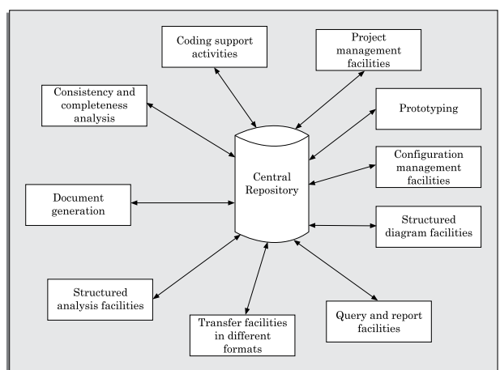
A CASE Environment

Slide 11
Benefits of CASE
A key benefit of using CASE environment:
  cost saving through all developmental phases.
Studies carried out to measure the impact of CASE usage:
  cost saving between 30% to 40%.
Use of CASE tools leads to improvements in quality:
  becomes easy to iterate through different software development phases.
  chances of human error is reduced.
  CASE tools help produce higher quality and consistent documents.

Slide 12
Benefits of CASE
Data relating to a software product are maintained in a central repository:
  redundancy in the stored data is reduced.
  chances of inconsistent documentation is reduced.
CASE tools take drudgery out from software engineers’ work:
  engineers need not manually check balancing of the DFDs
  easily draw diagrams and produce documentation, etc.

Slide 13
Benefits of CASE
CASE tools lead to cost saving in software maintenance effort:
  traceability and consistency checks,
  systematic information capture during various development phases.
Introduction of a CASE environment:
  impacts the style of working of engineers.
  makes them oriented towards structured and orderly approach.

Slide 14
CASE support in Software life cycle
CASE provides various types of supports during the different phases of a software life cycle.
CASE tools should support a development methodology, help enforce the same, and provide certain amount of consistency checking between different phases.
Some of the possible support that CASE tools usually provide in the software development life cycle are discussed below.

Slide 15
Prototyping Support
The prototyping CASE tool’s requirements are as follows:
Define user interaction.
Define the system control flow.
Store and retrieve data required by the system.
 incorporate some processing logic.
Prototyping CASE tool:
  often used in graphical user interface (GUI) development, supports creating a GUI using a graphics editor.

Slide 16
Prototyping Support
The user should be allowed to define:
  data entry forms, menus and controls.
It should integrate with the data dictionary of a CASE environment.
If possible, it should be able to integrate with external user defined modules written in C or some popular high level programming languages.
The user should be able to define the sequence of states through which a created prototype can run. The user should also be allowed to control the running of the prototype.
The run time system of prototype should support mock up run of the actual system and management of the input and output data.

Slide 17
Structured Analysis and Design
A CASE tool should:
  support some standard structured analysis and design technique.
  support easy creation of analysis and design diagrams.
  should provide easy navigation through different levels of design and analysis diagrams.

Slide 18
Structured Analysis and Design
The tool must support completeness and consistency checking.
The tool should disallow inconsistent operations:
  but it is difficult to implement such a feature.

Slide 19
Code Generation
As far as code generation is concerned:
  expectations from a CASE tool is low.
The CASE tool should support:
  generation of module skeletons in one or more popular languages.
  Another reasonable requirement is traceability from source code to design.

Slide 20
Code Generation
It should automatically generate header information:
  copyright messages,
  brief description of the module,
  author name and date of creation, etc.

Slide 21
Code Generation
The tool should generate data records or structures automatically:
  using data dictionary definitions.
  It should generate database tables for relational database management systems.

Slide 22
Code Generation
The tool should generate code for user interface from the prototype:
  for X window and MS window-based applications.

Slide 23
Test Case Generator
Static and dynamic program analysis of programs.
It should generate test reports in ASCII format:
  which can be directly imported into the test plan document.

Slide 24
Other Characteristics of Case Tools
Hardware and Environmental Requirements
The tool should work satisfactorily
  when many users work simultaneously.
The tool should support windowing interface:
  Enable the users to see more than one diagram at a time.
  Facilitate navigation and switching from one part to the other.

Slide 25
Documentation Support
The deliverable documents:
  should be able to incorporate text and diagrams from the central repository.
  help in producing up-to-date documentation.

Slide 26
Desirable Features
The CASE tool should integrate
  with commercially available desk-top publishing packages.
It should be possible to export text, graphics, tables, data dictionary reports:
  to DTP packages in standard formats such as PostScript.

Slide 27
Project Management
It should support collecting, storing, and analyzing information on the software project's progress:
  such as the estimated task duration,
  scheduled and actual task start, completion date, dates and results of the reviews, etc.

Slide 28
External Interface
The tool should allow exchange of information for reusability of design.
  The information exported by the tool should preferably be in ASCII format.
The data dictionary should provide
  a programming interface to access information.

Slide 29
Reverse Engineering Support
The tool should support:
  generating structure chart, DFD, and data dictionary from source code.
  should populate the data dictionary from source code.

Slide 30
Data Dictionary Interface
Data dictionary interface should provide
  viewing and updating the data definitions.
  print facility to obtain hard copy of the viewed screens.
  analysis reports like cross-referencing, impact analysis, etc.
  it should support a query language.

Slide 31
Tutorial and Help
Successful use of CASE tools:
  depends on the users’ capability to effectively use all supported features.
For the first time users:
  a computer animated tutorial is very important.

Slide 32
Tutorial and Help
The tutorial should not be limited to teaching the user interface part only:
  The tutorial should logically classify and cover all techniques and facilities.
  The tutorial should be supported by proper documentation and animation.

Slide 33
Towards Second Generation CASE Tool
An important feature of next generation CASE tools:
  be able to support any methodology.
Necessity of a CASE administrator for every organization:
  who would tailor the CASE environment to a particular methodology.

Slide 34
Intelligent Diagramming Support
Future CASE tools would
  aesthetically and automatically lay out the diagrams.

Slide 35
Data Dictionary Standards
The user should be allowed to:
  integrate many different tools into one environment.
  It is highly unlikely that any one vendor will be able to deliver a total solution.

Slide 36
A preferred tool would support tune up:
  user would act as a system integrator.
  This is possible only if some data dictionary standard emerges.

Slide 37
Customization Support
The user should be allowed to define new types of objects and connections.
This facility may be used to build some special methodologies.
Ideally it should be possible to specify the rules of a methodology to a rule engine:
  for carrying out the necessary consistency checks.

Slide 38
Architecture of a CASE Environment
The architecture of a typical modern CASE environment is shown diagrammatically in Figure 12.2.
The important components of a modern CASE environment are user interface, tool set, object management system (OMS), and a repository.

Slide 39
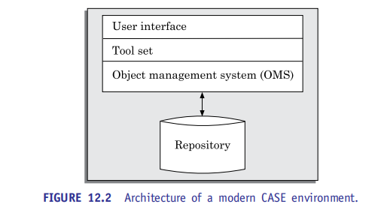
Architecture of a modern CASE Environment
Let us examine the other components of a CASE environment.

Slide 40
User interface
The user interface provides a consistent framework for accessing the different tools thus making it easier for the users to interact with the different tools and reducing the overhead of learning how the different tools are used.

Slide 41
Object management system and repository
Different case tools represent the software product as a set of entities such as specification, design, text data, project plan, etc.
The object management system maps these logical entities into the underlying storage management system (repository).
The commercial relational database management systems are geared towards supporting large volumes of information structured as simple relatively short records.
There are a few types of entities but large number of instances.
By contrast, CASE tools create a large number of entities and relation types with perhaps a few instances of each.
Thus, the object management system takes care of appropriately mapping these entities into the underlying storage management system.

Slide 42
Summary
We discussed important features of present-day CASE tools:
  and the emerging trends.
Use of CASE tools is indispensable for large software projects:
  where a team of software engineers work together.
The trend is now towards:
  distributed workstation-based CASE tools.
We discussed some desirable features of CASE tools.

