Slide 1

UNIT-IV
(Cluster Evaluation Measures)

Slide 2
Topics :
  Cluster Evaluation
    1. Cohesion and Separation
    2. Silhouette Coefficient

Slide 3
Cohesion and Separation are fundamental concepts used to evaluate the quality of clusters in clustering algorithms.

Slide 4
Cluster Evaluation
Clusters are evaluated based on some similarity or dissimilarity measure such as the distance between cluster points.
If the clustering algorithm separates dissimilar observations apart and similar observations together, then it has performed well.
Here we have to finding the group of objects in data such that the objects in a group will be similar(or related) to another and different from(or unrelated to) the objects in other.

Slide 5
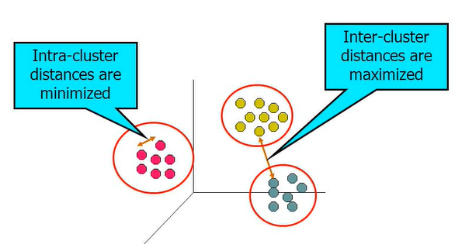
Contd..

Slide 6
Contd..
The two most popular internal evaluation metrics for clustering algorithms are
  1. Cohesion and Separation and
  2. Silhouette Coefficient.
Clustering analysis is broadly used in many applications such as market research, pattern recognition, data analysis, and image processing.

Slide 7
1. Cohesion and Separation
The two most popular evaluation metrics for clustering algorithms are the Cohesion and Separation and the Silhouette Coefficient.
Clustering analysis is broadly used in many applications such as market research, pattern recognition, data analysis, and image processing.

Slide 8
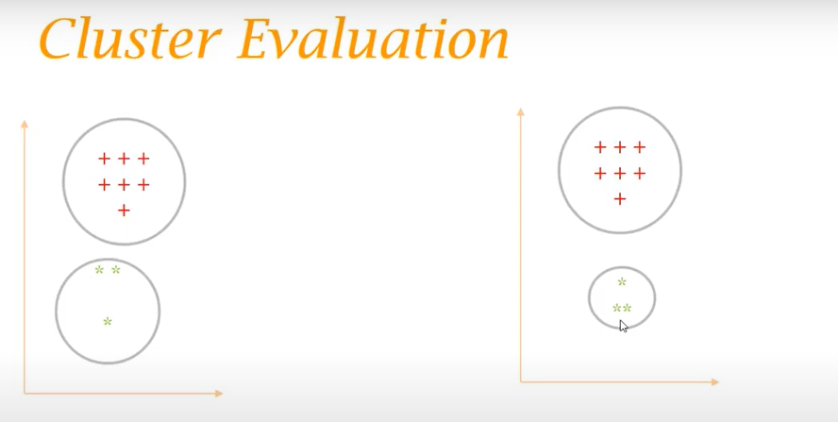
Cluster Evaluation
  In the above 2 cluster figures which cluster is better?

Slide 9
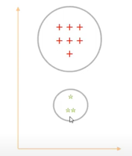
In the above figure , the points with in the cluster are more close to each other. This is called as “ Cohesion”.

Slide 10
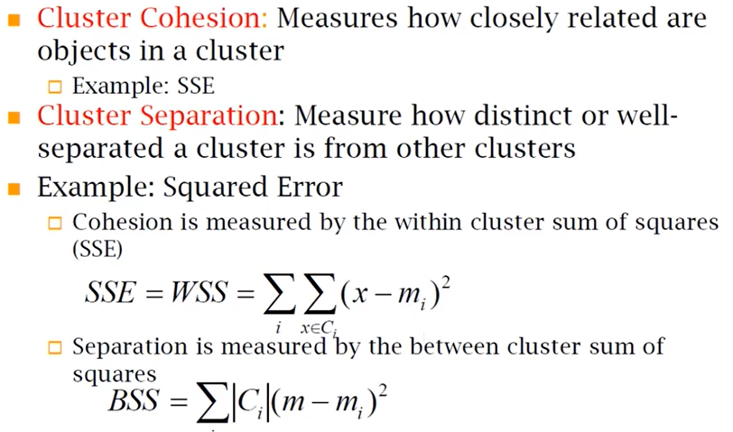
Formal Definitions of Cohesion and Separation

Slide 11



In the above formulas, Cohesion is measured by within cluster sum of squares.
Ie, Here Ci actually indicates the cluster number. And the
indicates the mean or centroid of the ith cluster.
By using ie, first of all for each cluster we are finding the distance of the points with in the cluster or from the mean of that clusters.
Suppose if have 10 clusters then we have to sum of all clusters.

Slide 12

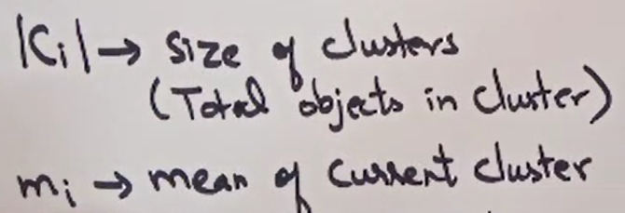
Q: How separation is measured?
Ans: here we have to take overall mean and then finding out that how the individual means are further from the overall mean.
            OR
Separation is measured between sum of squares.

Slide 13
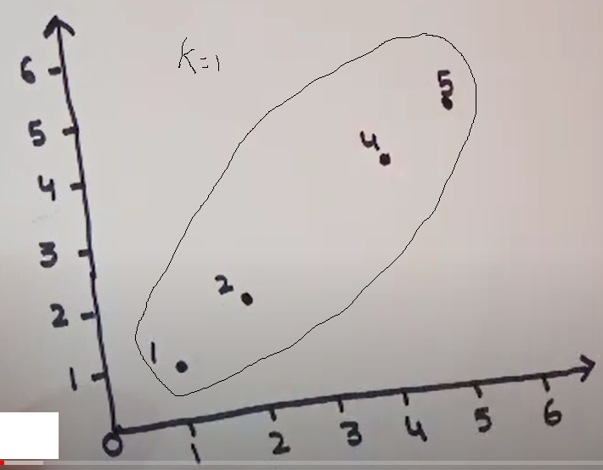
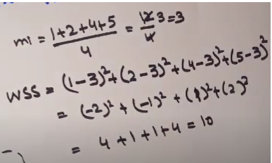
By calculating the Cohesion

Slide 14
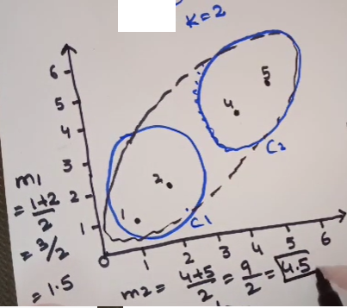
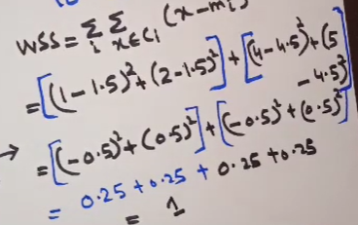
By calculating the Cohesion

Slide 15
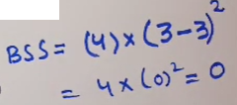
By calculating the Separation

Slide 16
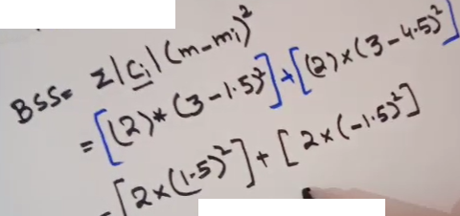
By calculating the Separation
Ans: 9

Slide 17
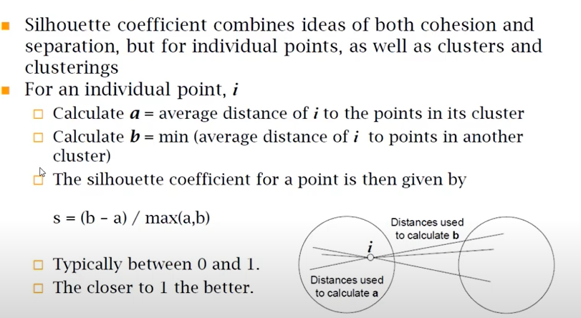
2. Silhouette Coefficient

Slide 18
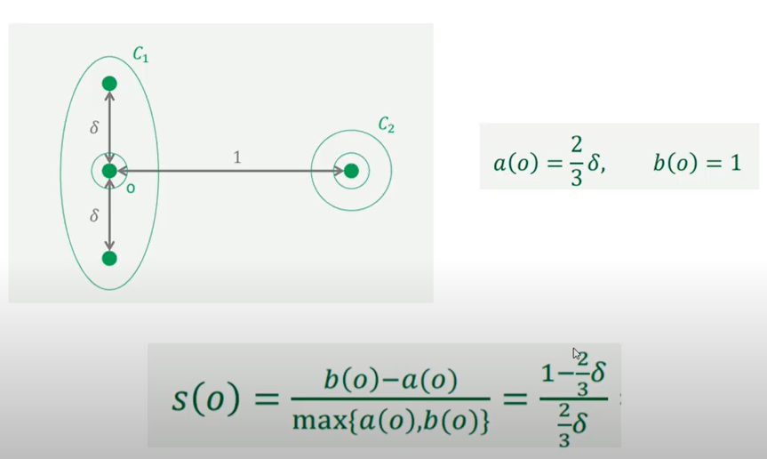
Example
Here Delta value is by taking more than 3/2

Slide 19

THANK YOU

