Slide 1

UNIT-IV
(Hierarchical Methods)

Slide 2
Topics :
  Hierarchical Clustering
    Types of Hierarchical Clustering
    Agglomerative Hierarchical Clustering Algorithm
    Example Problem

Slide 3
Hierarchical Methods
Q. What is Clustering?
Ans: let’s begin with an applicable example. Let’s say you want to travel to 20 places over a period of four days. How can you visit them all?
We can come to a solution using clustering, and grouping the places into four sets (or clusters).
To determine these clusters, places that are nearest to one another are grouped together. The result is four clusters based on proximity, allowing you to visit all 20 places within your allotted four-day period.

Slide 4
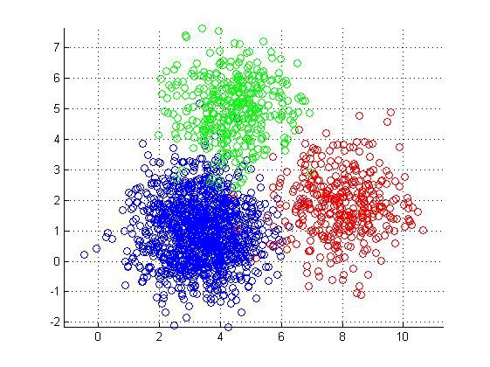
Contd..
Definition: Clustering is a technique that groups similar objects such that the objects in the same group are more similar to each other than the objects in the other groups. The group of similar objects is called a Cluster.

Slide 5
Contd..
There are many popular clustering algorithms that data scientists need to know:
  1. Partitioning Clustering (or) K-Means Clustering
  2. Hierarchical Clustering
  3. Density-Based Spatial Clustering of Applications
  with Noise (DBSCAN)
  4. Expectation-Maximization (EM) Clustering
  5. Fuzzy C- means Clustering etc.

Slide 6
Hierarchical Clustering
Hierarchical clustering is another unsupervised learning algorithm that is used to group together the unlabeled data sets into a cluster and also known as hierarchical cluster analysis or HCA.
In this algorithm, we develop the hierarchy of clusters in the form of a tree, and this tree-shaped structure is known as the dendrogram.
Sometimes the results of K-means clustering and hierarchical clustering may look similar, but they both differ depending on how they work.

Slide 7
Contd..
As there is no requirement to predetermine the number of clusters as we did in the K-Means algorithm.
Hierarchical clustering algorithms falls into following two categories.
  1. Agglomerative Hierarchical Clustering
  2. Divisive Hierarchical Clustering

Slide 8
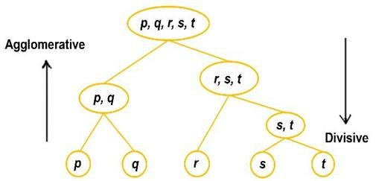
Contd..
1. In Agglomerative Hierarchical Algorithms, each data point is treated as a single cluster and then successively merge or agglomerate (bottom-up approach) the pairs of clusters.
The hierarchy of the clusters is represented as a dendrogram or tree structure.

Slide 9
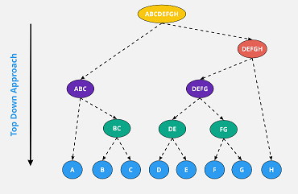
Contd..
2. Divisive Hierarchical clustering: Divisive algorithm is the reverse of the agglomerative algorithm as it is a top-down approach.
In divisive hierarchical algorithms, all the data points are treated as one big cluster and the process of clustering involves dividing (Top-down approach) the one big cluster into various small clusters.

Slide 10
1. Agglomerative Hierarchical Clustering
The Agglomerative Hierarchical Clustering Algorithm is a popular Clustering Algorithm.
To group the datasets into clusters, it follows the bottom-up approach. It means, this algorithm considers each dataset as a single cluster at the beginning, and then start combining the closest pair of clusters together.
It does this until all the clusters are merged into a single cluster that contains all the datasets.
The hierarchy of clusters is developed in the form of a tree in this technique, and this tree-shaped structure is known as the dendrogram.

Slide 11
Contd..
Dendrogram: A dendrogram is a visual representation of the hierarchical connection between items.
The dendrogram is a tree-like structure that is mainly used to store each step as a memory that the HC algorithm performs.
In the dendrogram plot, the Y-axis shows the Euclidean distances between the data points, and the x-axis shows all the data points of the given dataset.

Slide 12
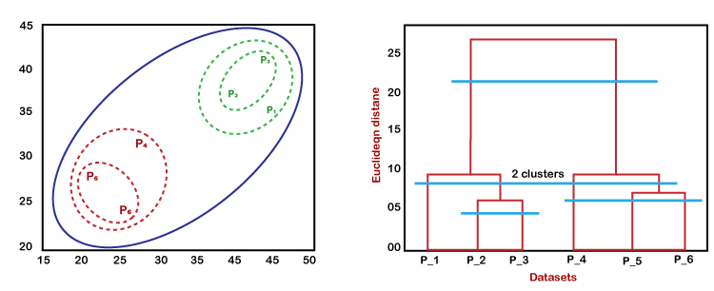
Contd..
In the above diagram, the left part is showing how clusters are created in agglomerative clustering, and the right part is showing the corresponding dendrogram.

Slide 13
Agglomerative Hierarchical
Clustering Algorithm
We are going to explain the most used and important Hierarchical clustering i.e. agglomerative.
The steps to perform the same is as follows −
Step 1 − Treat each data point as single cluster. Hence, we will be having, say K clusters at start. The number of data points will also be K at start.
Step 2 − Now, in this step we need to form a big cluster by joining two closet data points. This will result in total of K-1 clusters.

Slide 14
Contd..
Step 3 − Now, to form more clusters we need to join two closet clusters. This will result in total of K-2 clusters.
Step 4 − Now, to form one big cluster repeat the above three steps until K would become 0 i.e. no more data points left to join.
Step 5 − At last, after making one single big cluster, dendrogram will be used to divide into multiple clusters depending upon the problem.

Slide 15
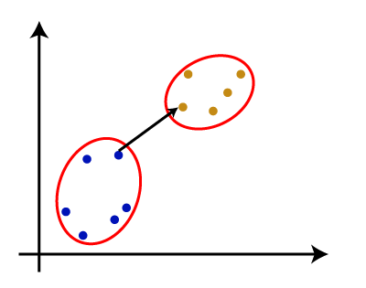
Measure for the Distance between Two Data points
The closest distance between the two clusters is crucial for the hierarchical clustering.
There are various ways to calculate the distance between two clusters, and these ways decide the rule for clustering.
These measures are called Linkage methods.
Some of the popular linkage methods are given below:
1. Single Linkage: It is the Shortest Distance between the closest points of the clusters. Consider the below image:

Slide 16
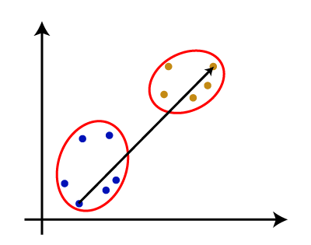
Contd..
2. Complete Linkage: It is the farthest distance between the two points of two different clusters. It is one of the popular linkage methods as it forms tighter clusters than single-linkage.

Slide 17
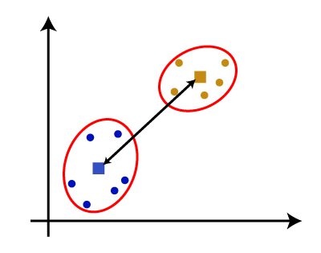
Contd..
3. Average Linkage: It is the linkage method in which the distance between each pair of datasets is added up and then divided by the total number of datasets to calculate the average distance between two clusters. It is also one of the most popular linkage methods.
4. Centroid Linkage: It is the linkage method in which the distance between the centroid of the clusters is calculated. Consider the below image:

Slide 18
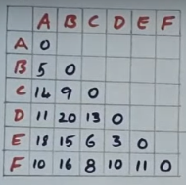
Agglomerative Clustering
(Single Link Approach)
First we consider one matrix. In that matrix we have some items : ie, A,B,C,D,E,F.
The values are represent in that matrix is Distance between the items.
In this Matrix all diagonals are
Zero.
In this matrix we can consider only
“ Lower Triangular Matrix “ or
“ Upper Triangular Matrix”

Slide 19
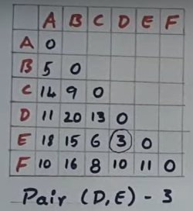
Contd..
Step-1: First we observe that in the matrix, we can apply the Agglomerative Clustering, we can find the least element in the entire Matrix.

Slide 20
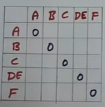
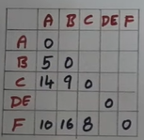
Contd..
Step-2: Next we can merge the (D,E)=(DE)=3. Next we can calculate the already available distances and New Distances in the Matrix.

Slide 21
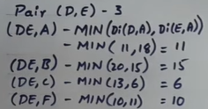
Contd..
Now we can calculate the Distance of (DE,A) , (DE,B) , (DE,C), (DE,F). So, we can take the original matrix and calculate the distance.

Slide 22
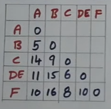
Contd..
So, we can substitute all these values into matrix.

Slide 23
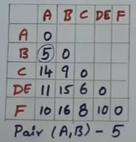
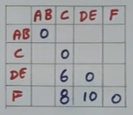
Contd..
Step-3: Again, we can find the least element in the updated Matrix. Here, Least Element is 5. ie the matrix pair is (B,A).
Next we can denote the Pair.
Ie, the new pair is : (A,B) to (AB)

Slide 24
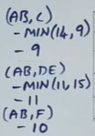
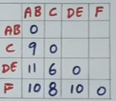
Contd..
Again we have to calculate the remaining distances.
SO, here the updated matrix is :

Slide 25
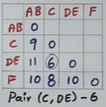
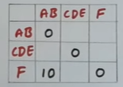

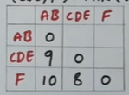
Contd..
Step-4: Again, we can find the least element in the updated Matrix. Here, Least Element is 6. ie the matrix pair is (C,DE).
Next we can denote the Pair.
Ie, the new pair is : (C,DE) to (CDE)

Slide 26
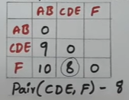



Contd..
Step-5: Again, we can find the least element in the updated Matrix. Here, Least Element is 8. ie the matrix pair is (CDE,F).
Next we can denote the Pair.
Ie, the new pair is : (CDE,F) to (CDEF)

Slide 27
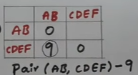
Contd..
Step-6: Again, we can find the least element in the updated Matrix. Here, Least Element is 9. ie the matrix pair is (AB,CDEF).
Next we can denote the Pair.
Ie, the new pair is : (AB,CDEF) to (ABCDEF)

Slide 28
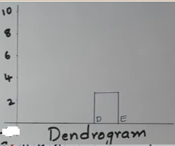
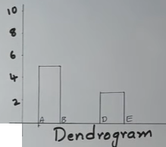
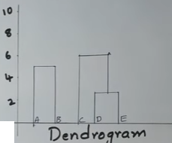
Contd..
Step-7: Next we can draw the Dendrogram. After that we can form the Clusters.
First we can draw the Dendrogram (D,E) =3 , (A,B)=5, (C,DE)=6

Slide 29
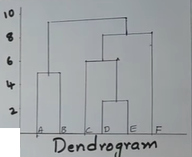
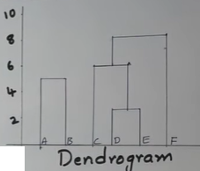
Contd..
Next we can draw the (CDE,F)=8 and
And Final Pair is(AB, CDEF) = 9

Slide 30
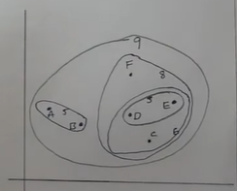
Contd..
Next, we can form these Dendrogram into Clusters

Slide 31
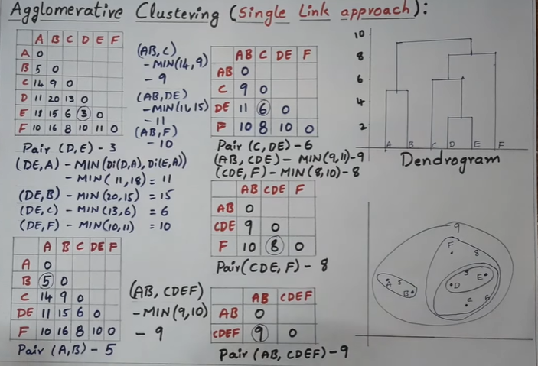
Contd..
Final Problem in single page

Slide 32
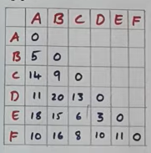
Agglomerative Clustering
(Complete Link Approach)
First we consider one matrix. In that matrix we have some items : ie, A,B,C,D,E,F.
The values are represent in that matrix is Distance between the items.
In this Matrix all diagonals are
Zero.
In this matrix we can consider only
“ Lower Triangular Matrix “ or
“ Upper Triangular Matrix”

Slide 33
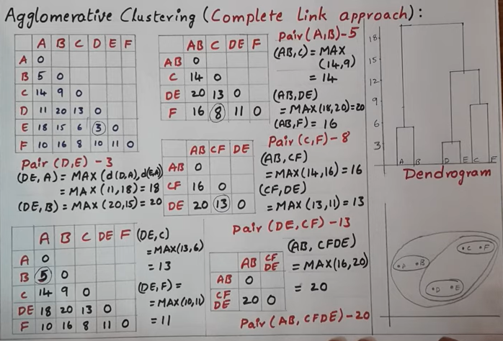

Slide 34

THANK YOU

