Slide 1

UNIT-IV
(Density Based Clustering)

Slide 2
Topics :
  DBSCAN Algorithm
  Example Problem

Slide 3
Density based Clustering
Density based clustering is also called as “DBSCAN Clustering”.
DBSCAN stands for “Density-Based Spatial Clustering of Applications with Noise”.
It is a popular unsupervised learning Algorithm and It was proposed by Martin Ester et al. in 1996.
DBSCAN is a clustering method that is used in machine learning to separate clusters of high density from clusters of low density.

Slide 4
Contd..
Here, DBSCAN identify the distinctive groups/clusters in the data, based on the idea that a cluster in data space is a contiguous region of high point density, separated from other such clusters by contiguous regions of low point density.

Slide 5
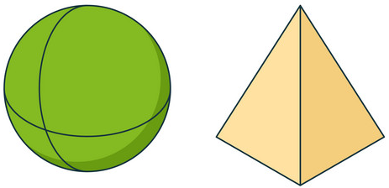
Why we need DBSCAN Algorithm?
  Partitioning methods (K-means) and hierarchical clustering work for finding spherical-shaped clusters or convex clusters.
  Partition-based and hierarchical clustering techniques are highly efficient with normal shaped clusters. However, when it comes to arbitrary shaped clusters or detecting outliers, density-based techniques are more efficient.

Slide 6
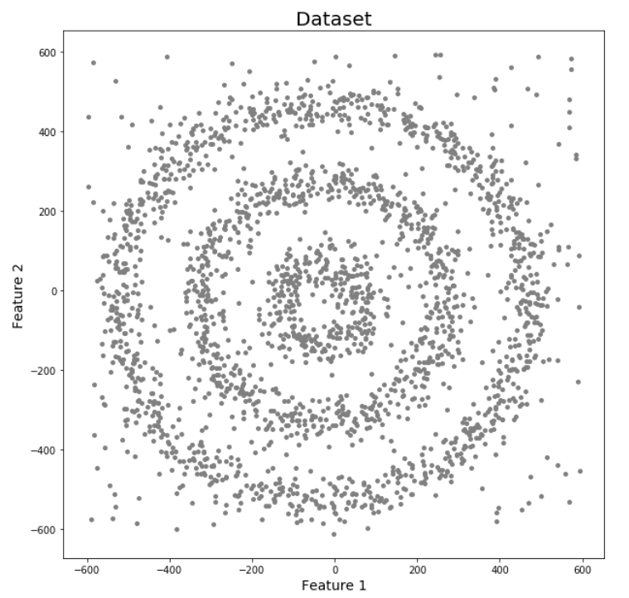
Contd..
  K-Means and Hierarchical Clustering both fail in creating clusters of arbitrary shapes. They are not able to form clusters based on varying densities. That’s why we need DBSCAN clustering.
  For Eg: Here we have data points densely present in the form of concentric circles:

Slide 7

Contd..
The DBSCAN algorithm uses two parameters:
1. minPts: The minimum number of points required within ε to form a dense region.
2. eps (ε): A distance measure that will be used to locate the points in the neighborhood of any point.
or The radius of the neighborhood around a point.
  Three Main points to form the clusters
  1. Core point: A point is a core point if there are at least minPts number of points (including the point itself) in its surrounding area with radius eps

Slide 8
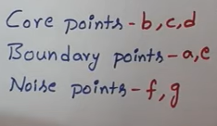
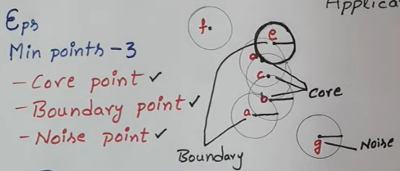
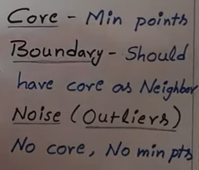
Contd..
2. Border point: A point is a border point if it is reachable from a core point and there are less than minPts number of points within its surrounding area.
3. Outlier or Noise Point: A point is an outlier if it is not a core point and not reachable from any core points.

Slide 9
Steps of DBSCAN:
Select an arbitrary point: Choose a point that has not been visited.
Check density conditions:
  If the point has at least MinPts within a distance of ε, it is a core point and a new cluster starts.
  If the point has fewer than MinPts within ε, it is marked as a border point or noise.
Expand the cluster:
  All points within ε of a core point are added to the cluster.
  If any of these new points are also core points, their neighbors are also added to the cluster.
  The process repeats recursively until no more points can be added.

Slide 10
  4.Repeat for unvisited points:If a point is not part of any cluster and is not a core point, it is marked as noise.Otherwise, it is assigned to an existing cluster.

Slide 11
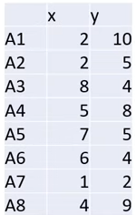
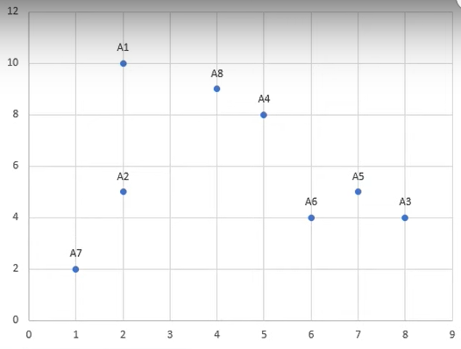
Example
Data Points:

Slide 12
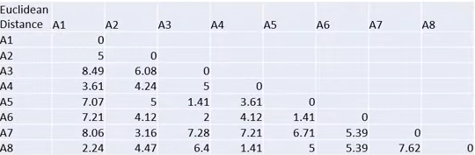
Contd..
Step-1: First we need to calculate the Euclidean Distance between the Points.

Slide 13

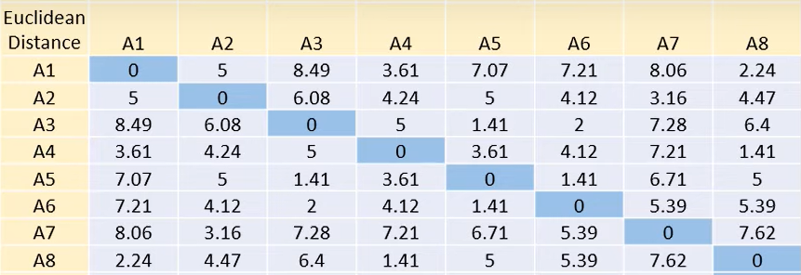
Contd..
In this table,

Slide 14
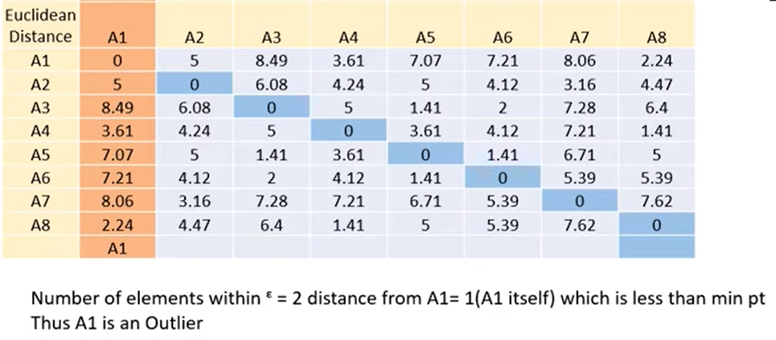
Contd..
Step-2: Now starts with Point A1. we will check how many points are with in this Epsilon. In A1 we again check either a Core or border or outlier.

Slide 15
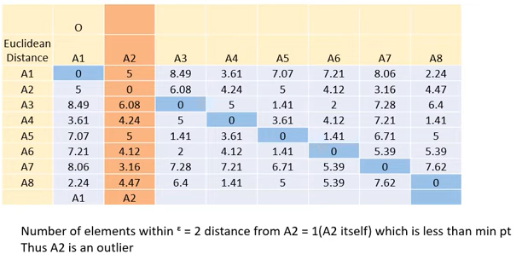
Contd..
Step-3: Now starts with Point A2. we will check how many points are with in this Epsilon. In A2 we again check either a Core or border or outlier.

Slide 16
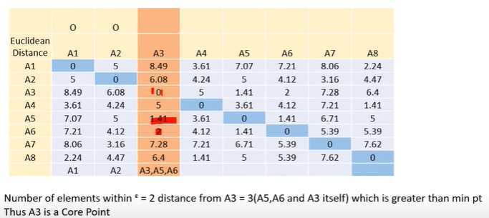
Contd..
Step-4: Now starts with Point A3. we will check how many points are with in this Epsilon. In A3 we again check either a Core or border or outlier.

Slide 17
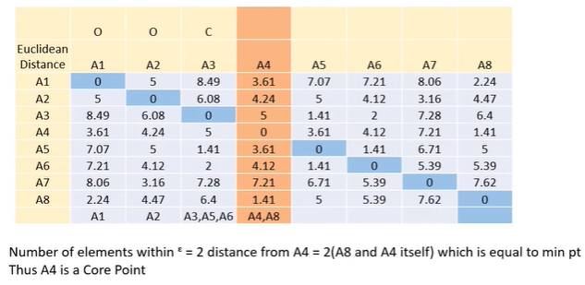
Contd..
Step-5: Now starts with Point A4. we will check how many points are with in this Epsilon. In A4 we again check either a Core or border or outlier.

Slide 18
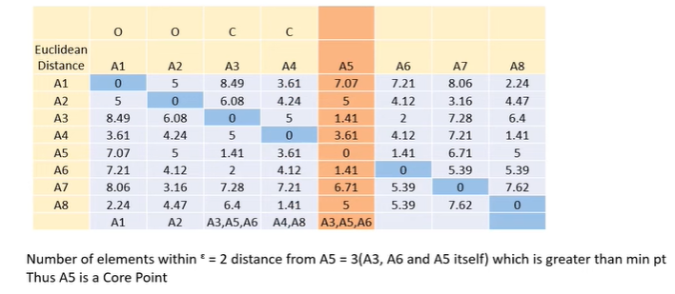
Contd..
Step-6: Now starts with Point A5. we will check how many points are with in this Epsilon. In A5 we again check either a Core or border or outlier.

Slide 19
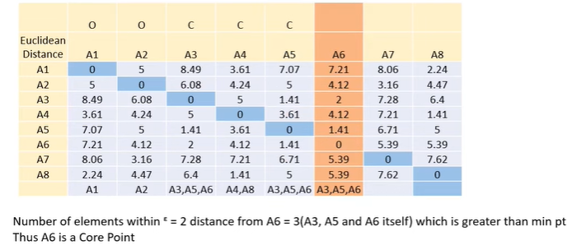
Contd..
Step-7: Now starts with Point A6. we will check how many points are with in this Epsilon. In A6 we again check either a Core or border or outlier.

Slide 20
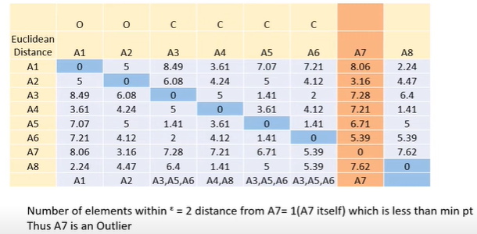
Contd..
Step-8: Now starts with Point A7. we will check how many points are with in this Epsilon. In A7 we again check either a Core or border or outlier.

Slide 21
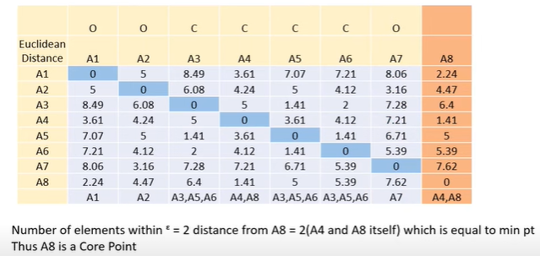
Contd..
Step-9: Now starts with Point A8. we will check how many points are with in this Epsilon. In A8 we again check either a Core or border or outlier.

Slide 22
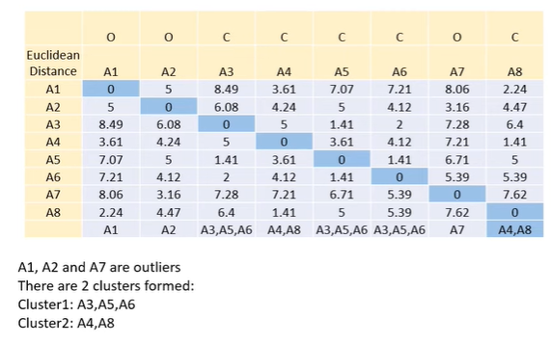
Contd..
Step-10: Finally we will check how many outliers and how many clusters are formed in this example.

Slide 23
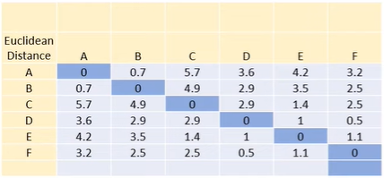

Example-2

Slide 24
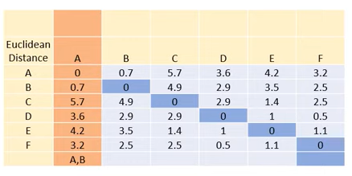

Contd..
Step-2: Now starts with Point A. we will check how many points are with in this Epsilon. In A we again check either a Core or border or outlier.

Slide 25
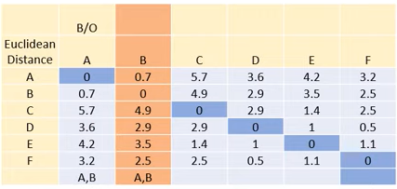

Contd..
Step-3: Now starts with Point B. we will check how many points are with in this Epsilon. In B we again check either a Core or border or outlier.

Slide 26
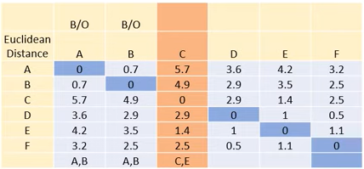

Contd..
Step-4: Now starts with Point c. we will check how many points are with in this Epsilon. In c we again check either a Core or border or outlier.

Slide 27
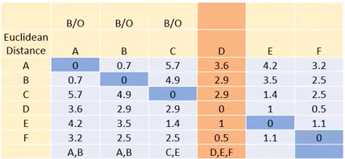

Contd..
Step-5: Now starts with Point D. we will check how many points are with in this Epsilon. In D we again check either a Core or border or outlier.

Slide 28
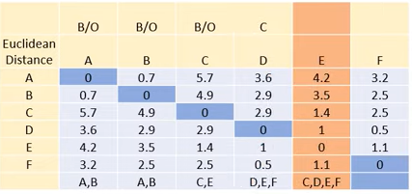

Contd..
Step-6: Now starts with Point E. we will check how many points are with in this Epsilon. In E we again check either a Core or border or outlier.

Slide 29
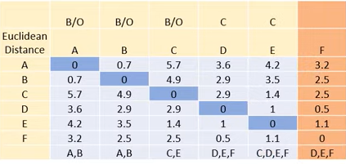

Contd..
Step-7: Now starts with Point F. we will check how many points are with in this Epsilon. In F we again check either a Core or border or outlier.

Slide 30
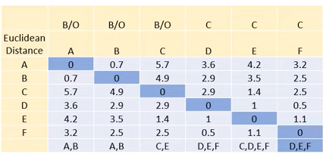
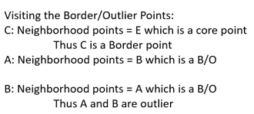
Contd..

Slide 31

THANK YOU

