Slide 1
SVM

Slide 2
Support Vector Machine Algorithm
Support Vector Machine or SVM is one of the most popular Supervised Learning algorithms, which is used for Classification as well as Regression problems. However, primarily, it is used for Classification problems in Machine Learning.
SVM is effective in handling complex datasets and is widely used in various applications, such as image recognition, text classification, and bioinformatics.

Slide 3
The goal of the SVM algorithm is to create the best line or decision boundary that can segregate n-dimensional space into classes so that we can easily put the new data point in the correct category in the future. This best decision boundary is called a hyperplane.

Slide 4
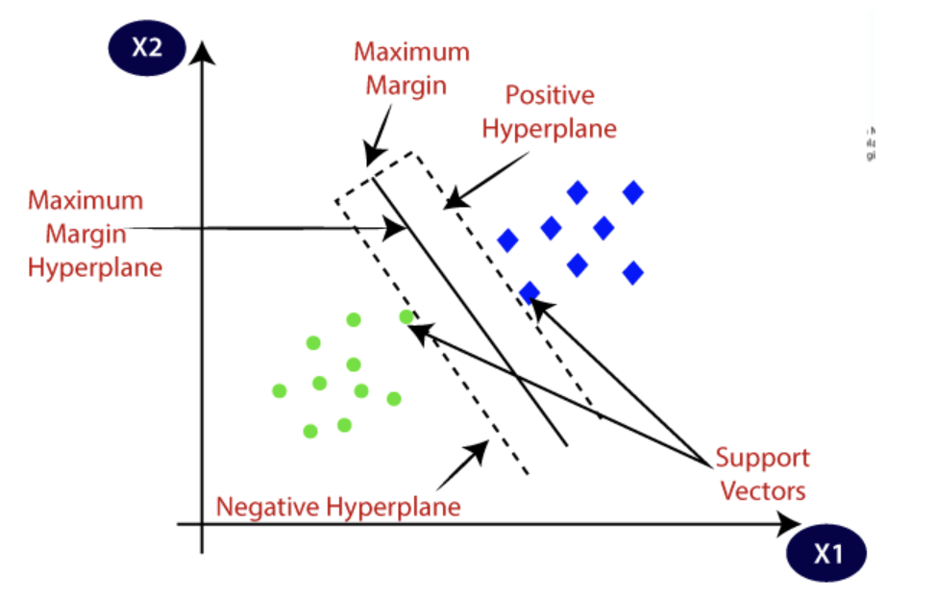

Slide 5

Maximum Margin:
The margin is the perpendicular distance between the decision boundary (hyperplane) and the nearest data points (support vectors).
SVM selects the decision boundary that maximizes this margin.
The perpendicular distance between the hyperplane and a point in space can be calculated using the formula for the distance from a point to a plane. For a hyperplane defined by the w⋅x+b=0, where w is the weight vector perpendicular to the hyperplane, x is the input feature vector, and b is the bias term, the distance d from a point X to the hyperplane is given by:

Slide 6
Here:
⋅⋅ denotes the dot product.
|w⋅X+b∣ is the absolute value of the dot product of w and X plus b.
∥w∥ is the Euclidean norm (magnitude) of the weight vector w.

Slide 7
Hyperplane Equation:
The decision boundary (hyperplane) in SVM can be represented by the equation w⋅x+b=0, where w is the weight vector perpendicular to the hyperplane, x is the input feature vector, and b is the bias term.

Slide 8
Support vectors
SVM chooses the extreme points/vectors that help in creating the hyperplane. These extreme cases are called as support vectors, and hence algorithm is termed as Support Vector Machine.

Slide 9
Positive Hyperplane:
The positive hyperplane is associated with the positive class or the class labeled as "1."
It is the hyperplane that is defined by the SVM algorithm to maximize the margin between the positive class and the decision boundary.
Support vectors from the positive class lie on the positive hyperplane or in its proximity.

Slide 10
Negative Hyperplane:
The negative hyperplane is associated with the negative class or the class labeled as "0."
It is the hyperplane that is defined by the SVM algorithm to maximize the margin between the negative class and the decision boundary.
Support vectors from the negative class lie on the negative hyperplane or in its proximity.

Slide 11
Types of SVM
Support Vector Machines (SVMs) can be categorized into different types based on their application and the nature of the data. The two main types of SVM are:
Linear SVM: Linear SVM is used for linearly separable data, which means if a dataset can be classified into two classes by using a single straight line, then such data is termed as linearly separable data, and classifier is used called as Linear SVM classifier.
Non-linear SVM: Non-Linear SVM is used for non-linearly separated data, which means if a dataset cannot be classified by using a straight line, then such data is termed as non-linear data and classifier used is called as Non-linear SVM classifier.

Slide 12
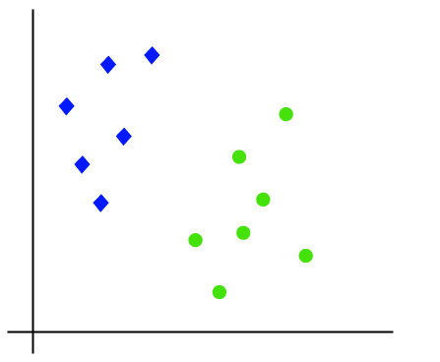
Linear SVM:
The working of the SVM algorithm can be understood by using an example. Suppose we have a dataset that has two tags (green and blue), and the dataset has two features x1 and x2. We want a classifier that can classify the pair(x1, x2) of coordinates in either green or blue. Consider the below image:

Slide 13
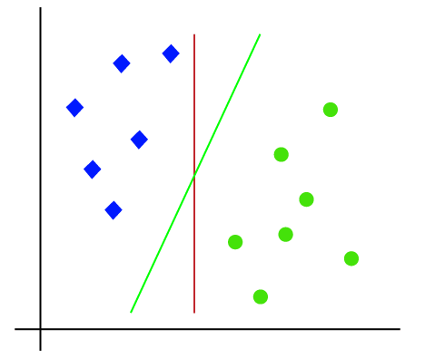
So as it is 2-d space so by just using a straight line, we can easily separate these two classes. But there can be multiple lines that can separate these classes. Consider the below image:

Slide 14
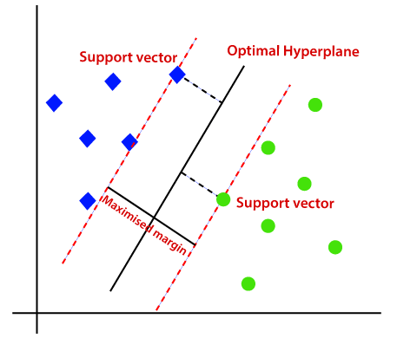
Hence, the SVM algorithm helps to find the best line or decision boundary; this best boundary or region is called as a hyperplane. SVM algorithm finds the closest point of the lines from both the classes. These points are called support vectors. The distance between the vectors and the hyperplane is called as margin. And the goal of SVM is to maximize this margin. The hyperplane with maximum margin is called the optimal hyperplane.

Slide 15
Nonlinear SVM:
Nonlinear SVM is used when the data is not linearly separable, i.e., the classes cannot be separated by a straight line or hyperplane.
In nonlinear SVM, the input features are mapped to a higher-dimensional space using a kernel function. This mapping allows for the creation of nonlinear decision boundaries.
Common kernel functions include Polynomial Kernel, Radial Basis Function (RBF) Kernel, and Sigmoid Kernel.
Nonlinear SVM is effective for handling complex patterns and relationships in the data.

Slide 16
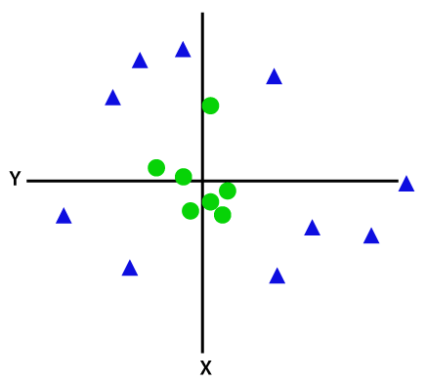
Non-Linear SVM:
If data is linearly arranged, then we can separate it by using a straight line, but for non-linear data, we cannot draw a single straight line. Consider the below image:

Slide 17
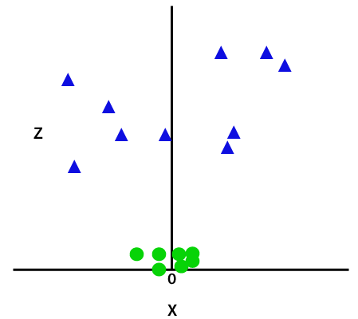
So to separate these data points, we need to add one more dimension. For linear data, we have used two dimensions x and y, so for non-linear data, we will add a third dimension z. It can be calculated as:z=x² +y²
By adding the third dimension, the sample space will become as below image:

Slide 18
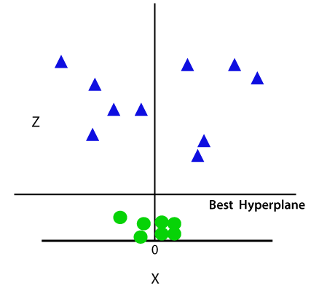
So now, SVM will divide the datasets into classes in the following way. Consider the below image:

Slide 19
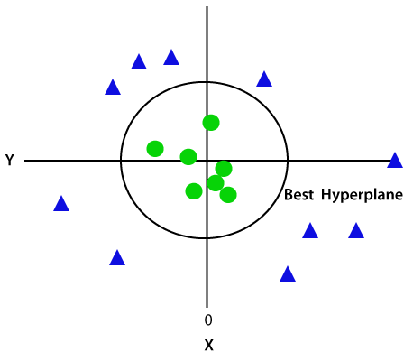
Since we are in 3-d Space, hence it is looking like a plane parallel to the x-axis. If we convert it in 2d space with z=1, then it will become as:
Hence we get a circumference of radius 1 in case of non-linear data.

