Slide 1
UNIT-IV
(CASE BASED REASONING)

Slide 2
Topics :
    Case Based Reasoning
      CBR Workflow
      CBR Example
      Real Time Scenario

Slide 3
Case Based Reasoning
All instance based learners have 3 properties.
  1. They are Lazy Learners
  2. Classification is different for each instance
  3. Instances are represented with n-dimensional Euclidean Space.
CBR is any kind of problem-solving approach that uses past solutions(experiences) to solve similar problems.
Ie, In CBR, everything is considered as case and based on previous cases , then we can find the solution.
Case-based reasoning is all around us.

Slide 4
Contd..
For example, Google Maps uses case-based reasoning to tell you how long your journey will take by examining the patterns of past users to see how long it took them to get from point A to point B.
Even if your path is from two slightly different points, it makes inferences on how long your journey will take.
Generally, In every Machine Learning Algorithm we have instances.
Here in case of CBR instances are represented as Symbols not values.

Slide 5
Contd..
In CBR, we are having 3 components. Those are:
  1. Similarity Functions or Distance Measures
  2. Approximation / Adjustment of instances
  3. Symbolic representation of the instances
  For modeling CBR , we can use CADET System
  CADET stands for Case based Design Tool.
  Here in CADET , we are having 75 predefined libraries. Based on this predefined libraries, then we will generate any new situation.

Slide 6
Contd..
Case-Based Reasoning classifiers (CBR) use a database of problem solutions to solve new problems.
CBR methods can be coupled with other methods
  1. Artificial Neural Networks
  2. Classification
  3. Optimization Algorithm
  4. Genetic Algorithm
  5. Fuzzy Logic etc.

Slide 7
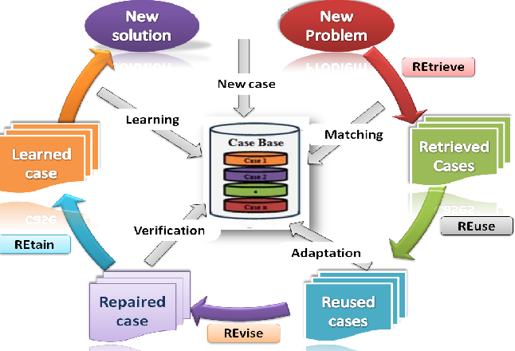
CBR Workflow

Slide 8
Contd..
Four step process for CBR:
In general, the case-based reasoning process entails:
1. Retrieve- Gathering from memory an experience closest to the current problem.
2. Reuse- Suggesting a solution based on the experience and adapting it to meet the demands of the new situation.
3. Revise- Evaluating the use of the solution in the new context.
4. Retain- Storing this new problem-solving method in the memory system

Slide 9
Prototypical Example of Case Based Reasoning
A CADET System Employs Case Based Reasoning to assist in the Conceptual Design of simple mechanical devices such as Water Faucets.
Here It uses a Library Containing Approximately 75 Previous Designs to suggest conceptual Designs to meet specifications of new Design Problems
Each Instance stored a Memory (Eg: Water Pipe) is represented by describing both its structure and Qualitative Function

Slide 10
Contd..
In our homes, now a days modern based taps are worked.
Here we have to take T- Junction Tap.
Ie, if we lift the tap ,we will be getting the water. And based on the direction of the tap , ie. if it is completely towards left side , we will get hot water. Etc.
In our example, we can represented with the help of symbols not values.

Slide 11
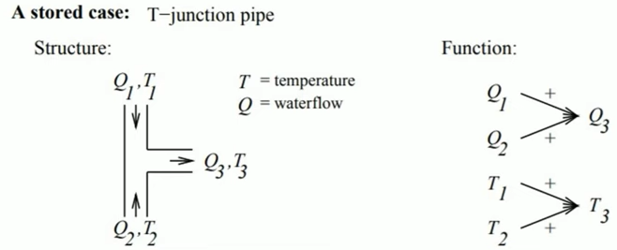
Contd..

Slide 12
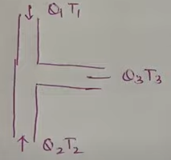
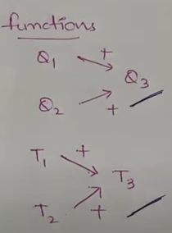
In this figure,
Q- Means Water flow and
T- Means Temperature.
so here in this figure, Q1T1 & Q2T2
and Q3T3 is the combo of both.
here we used the functions Q1
and Q2 will give you Q3
And T1 and T2 will give you T3.
So this is the basic system we have
in our house.
These type of examples are defined in
CADET System.

Slide 13
Contd..
Suppose we need to construct and manufacture of another tap. Which will control the temperature and water flow.
So here we have only the option to choose the Hot Water and Cold Water. But we don’t have the option to choose the Flow of water without ground water/water in the tank or we don’t have an option to choose the Temperature without geyser.
but here in our system , we can control the Temperature.
SO, here what we can do?

Slide 14
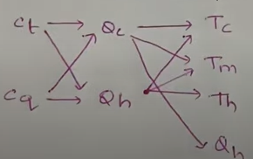
Contd..
So, here we have to take the help of the system based on existing system and we will do some modifications in the existing system in order to get the system that we have desired.
Here, Ct stands for Control of Temperature and Cq stands for Control of Water Flow
Qc and Qh - is the cold water and Hot water and Temperatures are various parameters etc.

Slide 15
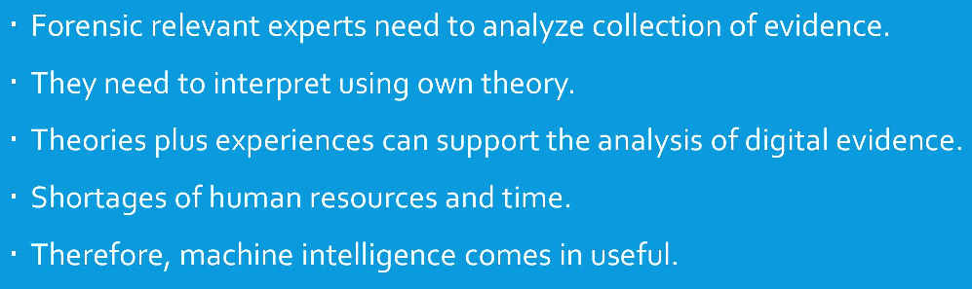
Contd..
Real time Example: An application of CBR with ML for forensic Autopsy

Slide 16
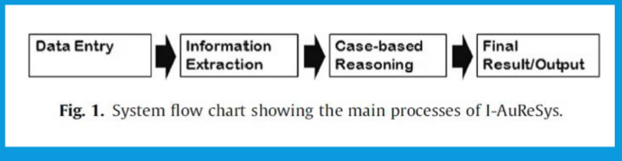
Contd..
System Flow graph
Step-1:

Slide 17
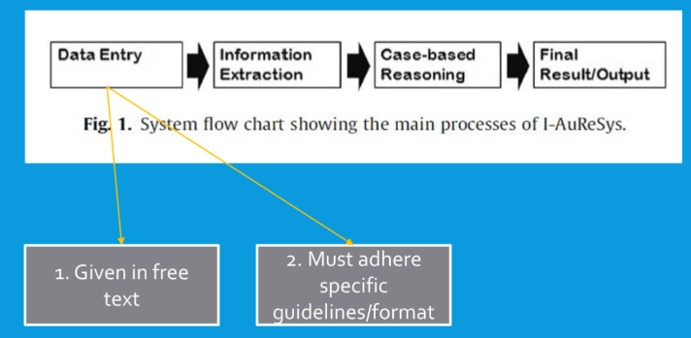
Contd..
Step-2:

Slide 18
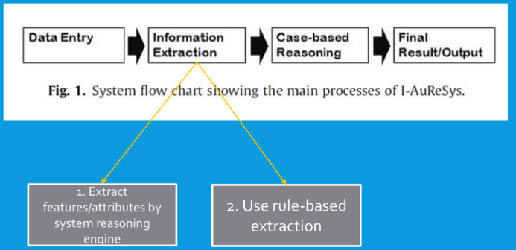
Contd..
Step-3:

Slide 19
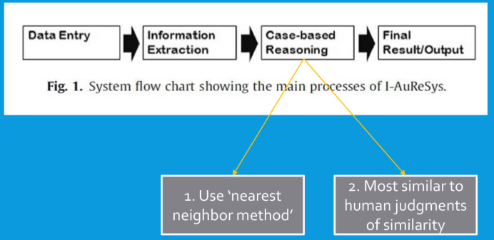
Contd..
Step-4:

Slide 20
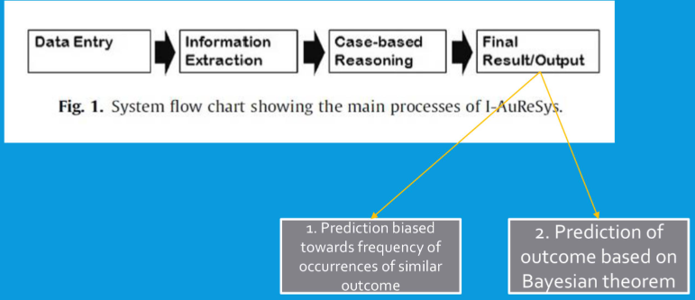
Contd..
Step-5:

Slide 21
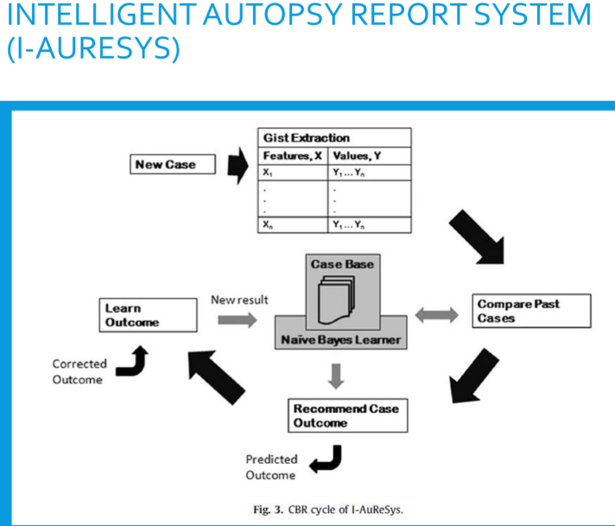

Slide 22
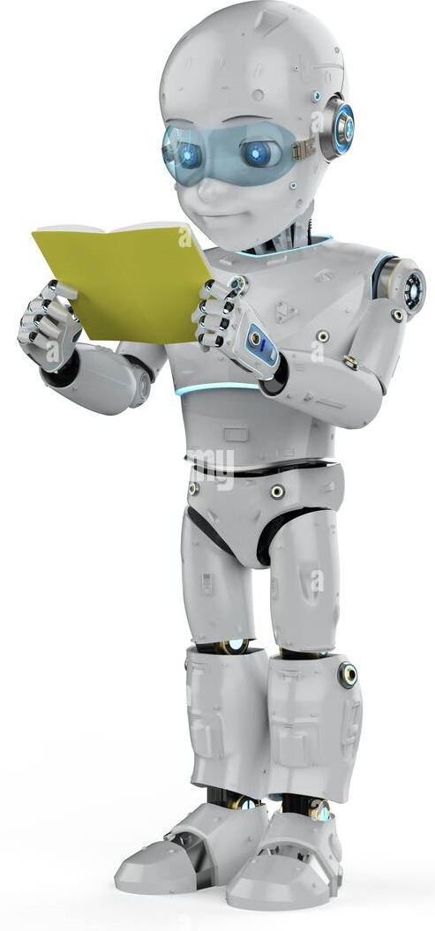
THANK YOU

