Slide 1

UNIT-III
(Bayesian Learning)

Slide 2
Supervised Learning
Topics :
  Bayes Theorem
  Naive Bayes Classifier
    Examples

Slide 3
Bayes Theorem
In order to explain Naive Bayes we need to first explain Bayes theorem.
Bayes' Theorem, named after 18th-century British mathematician Thomas Bayes, is a mathematical formula for determining conditional probability.
Here, Conditional probability is the likelihood of an outcome occurring, based on a previous outcome having occurred in similar circumstances.
Eg: Coin a Toss, Roll a Dice, Playing Cards etc.

Slide 4
Contd..
When you flip a fair coin, there is an equal chance of getting either heads or tails. So you can say the probability of getting heads is 50%.
Similarly what would be the probability of getting a 1 when you roll a dice with 6 faces? Assuming the dice is fair, the probability of 1/6 = 0.166.
There fore these are the classical examples of Conditional Probability.
So, when you say the conditional probability of A given B, it denotes the probability of A occurring given that B has already occurred.

Slide 5
Contd..
Mathematically, Conditional probability of A given B can be computed as:
P(A|B) = P(A AND B) / P(B)
Eg: School Example Consider a school with a total population of 100 persons. These 100 persons can be seen either as ‘Students’ and ‘Teachers’ or as a population of ‘Males’ and ‘Females’.
With below tabulation of the 100 people, what is the conditional probability that a certain member of the school is a ‘Teacher’ given that he is a ‘Man’?

Slide 6
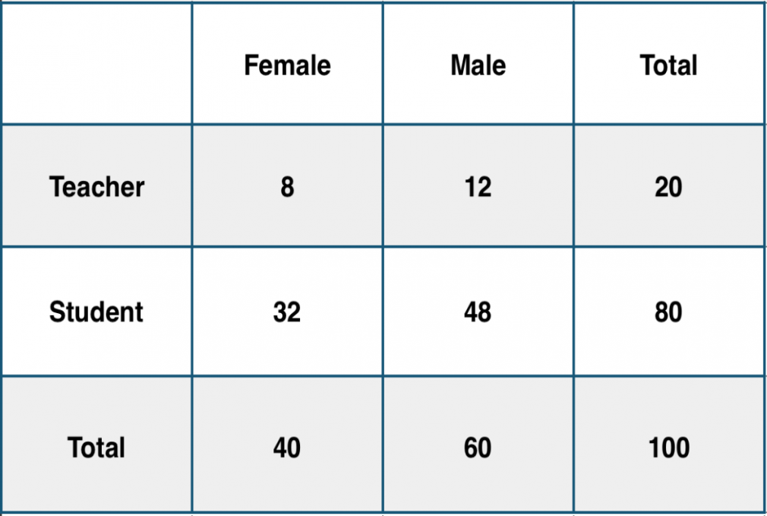
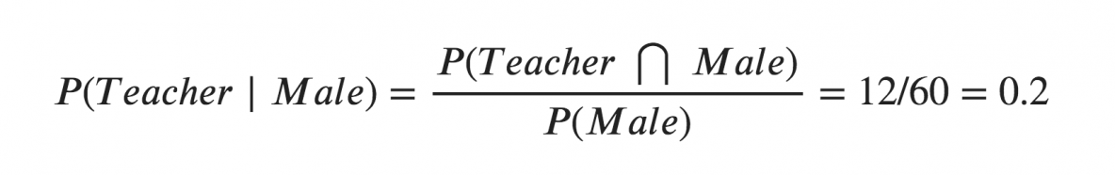
Contd..
To calculate this, you may filter the sub-population of 60 males and focus on the 12 (male) teachers. So the required conditional probability
P(Teacher | Male) = 12 / 60 = 0.2.

Slide 7
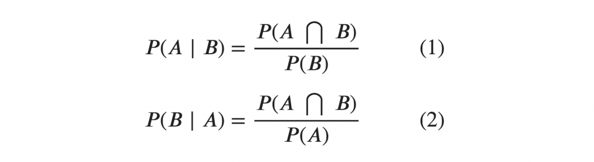
Contd..
This can be represented as the intersection of Teacher (A) and Male (B) divided by Male (B).
Likewise, the conditional probability of B given A can be computed.
The Bayes Rule that we use for Naive Bayes, can be derived from these two notations.

Slide 8
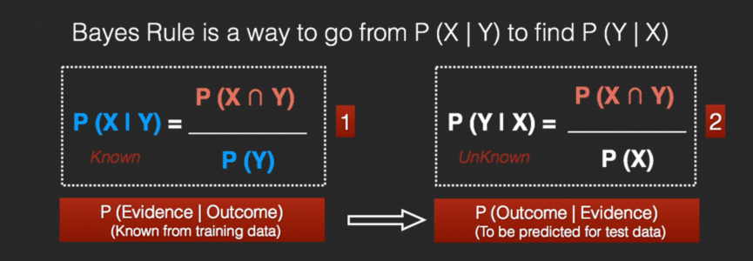
Contd..

Slide 9
Contd..
Bayes Theorem is also used widely in machine learning, where it is a simple, effective way to predict classes with precision and accuracy.
The Bayesian method of calculating conditional probabilities is used in machine learning applications that involve classification tasks.
A simplified version of the Bayes Theorem, known as the Naive Bayes Classification, is used to reduce computation time and costs.

Slide 10
Naive Bayes Classifier
Naïve Bayes algorithm is a supervised learning algorithm, which is based on Bayes theorem and used for solving classification problems and also solving Regression Problems.
It is mainly used in text classification that includes a high-dimensional training dataset.
Naïve Bayes Classifier is one of the simple and most effective Classification algorithms which helps in building the fast machine learning models that can make quick predictions.

Slide 11
Contd..
The Naïve Bayes algorithm is comprised of two words Naïve and Bayes, Which can be described as:
Naïve: It is called Naïve because it assumes that the occurrence of a certain feature is independent of the occurrence of other features.
Such as if the fruit is identified on the bases of color, shape, and taste, then red, spherical, and sweet fruit is recognized as an apple.
Hence each feature individually contributes to identify that it is an apple without depending on each other.

Slide 12
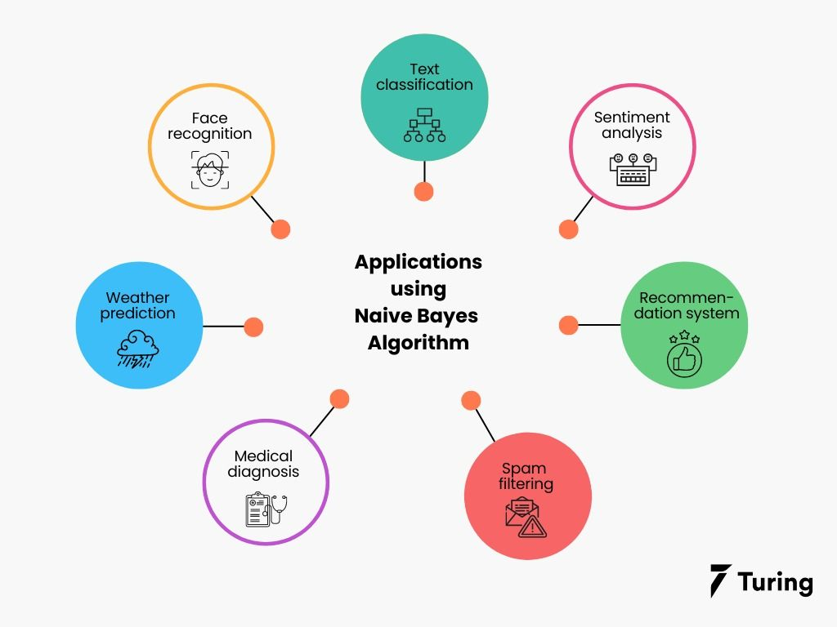
Contd..

Slide 13
Advantages of Naive bayes
The following are some of the benefits of the Naive Bayes classifier:
It is simple and easy to implement
It doesn’t require as much training data
It handles both continuous and discrete data
It is fast and can be used to make real-time predictions

Slide 14
USE CASE
Text classification is one of the most popular applications of a Naive Bayes classifier.
Problem statement: To perform text classification of news headlines and classify news into different topics for a news website.

Slide 15
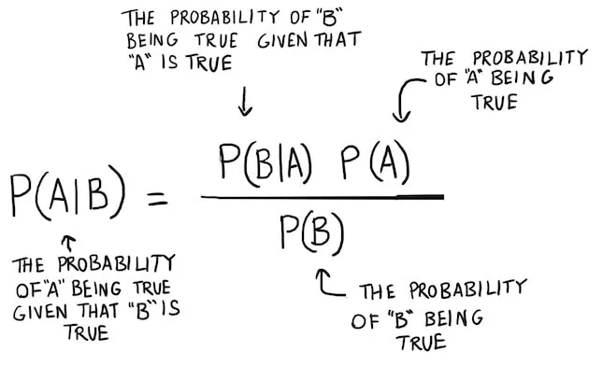
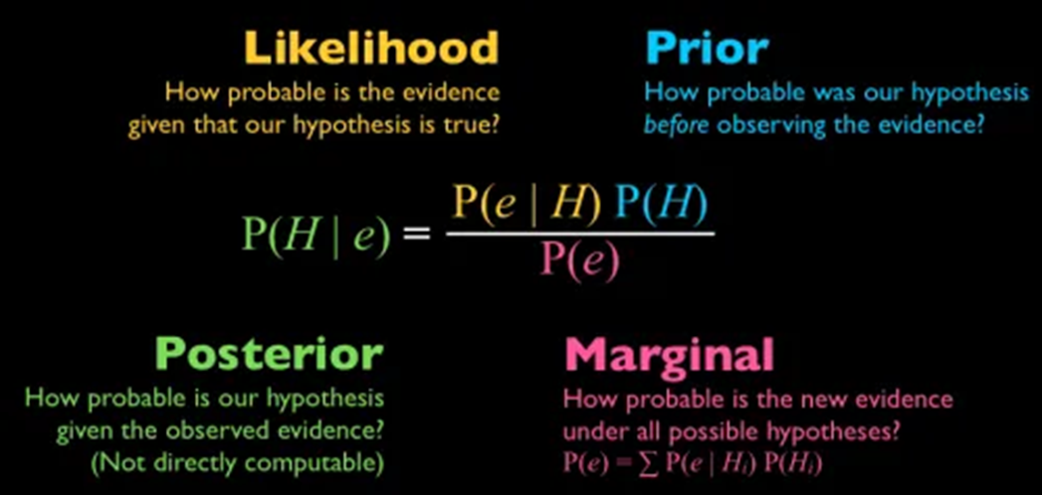
Algorithm
The Naive Bayes Classifier is inspired by Bayes Theorem which states the following equation:

Slide 16


This equation can be rewritten using X (input variables) and y (output variable) to make it easier to understand.
This equation is solving for the probability of y given input features X.
Re write as

Slide 17


Here x1, x2…, xn represents the Features (or) Attributes . i.e, color, shape, size etc. and
‘y’ is the Class Labels. i.e, Yes or No etc.
Because of the naive assumption (hence the name) that variables are independent given the class, we can rewrite P(X|y) as follows:

Slide 18
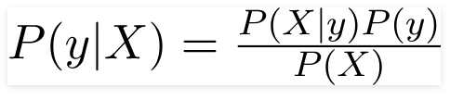
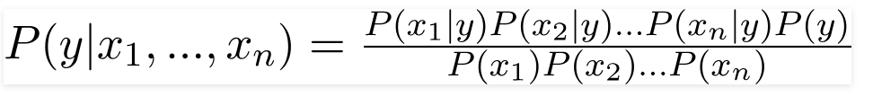
By this equation,
By substituting for X and expanding using the chain rule we get,
Now, you can obtain the values for each by looking at the dataset and substitute them into the equation.

Slide 19


For all entries in the dataset, the denominator does not change, it remains static.
Therefore, the denominator can be removed and proportionality can be injected.
Finally, we have to find the class variable (y) with maximum probability.

Slide 20
Here, Argmax is simply an operation that finds the argument that gives the maximum value from a target function.

Slide 21
Naïve Bayes Algorithm Steps
Step-1: Convert the data set into a frequency table
Step-2: Next calculate the Likely hood table from the Frequency Table
Step-3: Now, use Naive Bayesian equation to calculate the posterior probability for each class.
Finally, The class with the highest posterior probability is the outcome of the prediction.

Slide 22
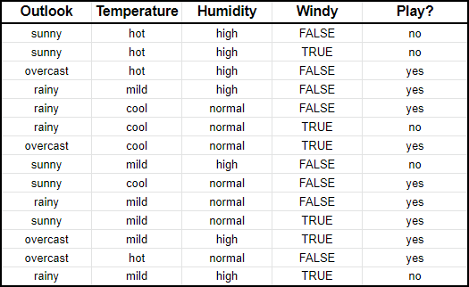
Example-1
Suppose you tracked the weather conditions for 14 days and based on the weather conditions, you decided whether to play golf or not play golf.

Slide 23
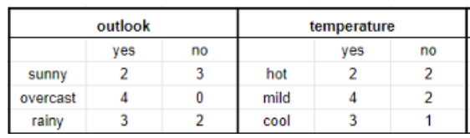
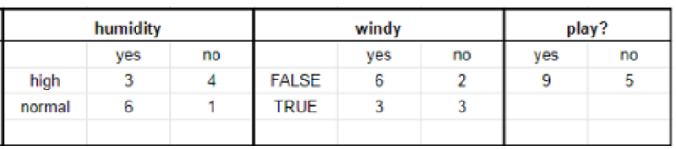
Contd..
Step-1: First, we need to convert this into a Frequency Table

Slide 24
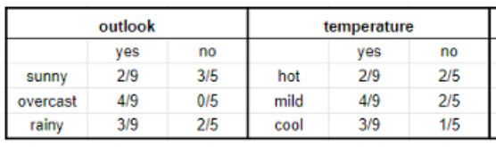
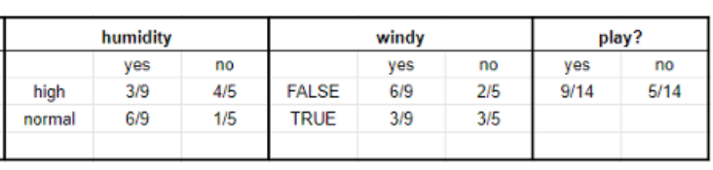
Contd..
Step-2: Next, convert this into a Likelihood Table. i.e, we want to convert the frequencies into ratios or conditional probabilities:

Slide 25
Contd..
Step-3: Finally, we can use the proportionality equation to predict y, given X.
Imagine that X = {outlook: sunny, temperature: mild, humidity: normal, windy: false}.
First, we’ll calculate the probability that you will play golf given X, P(yes|X) followed by the probability that you won’t play golf given X, P(no|X).

Slide 26
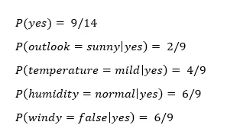
Contd..
Using the chart above, we can get the following information:

Slide 27
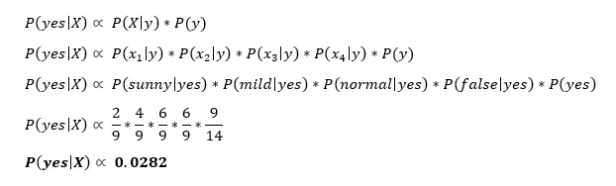
Contd..
Now we can simply input this information into the following formula:

Slide 28
Similarly, you would complete the same sequence of steps for P(no|X).
Since P(yes|X) > P(no|X), then you can predict that this person would play golf given that the outlook is sunny, the temperature is mild, the humidity is normal and it’s not windy.

Slide 29
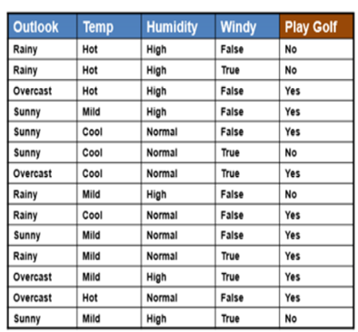
Example-2

Slide 30
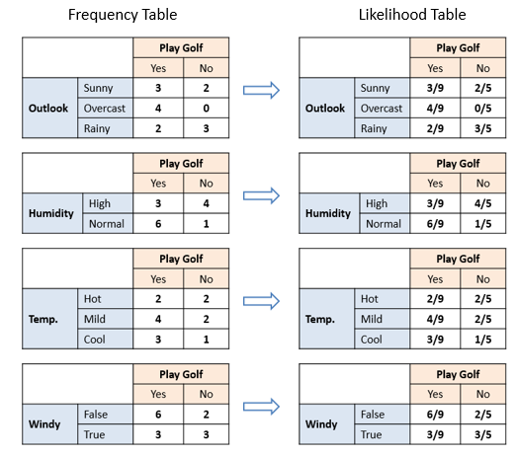

Slide 31
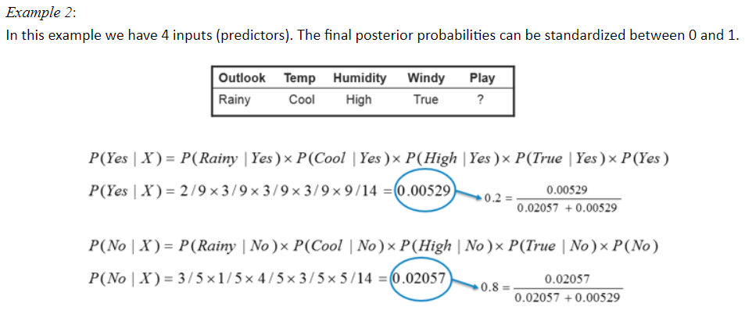
The class with the highest posterior probability is the outcome of prediction. Ie, Not to play Golf

Slide 32

Contd..
Step-1: First we can calculate the Prior Probabilities and then Current Probabilities.
In this Example, Prior Probability is :
P(Yes) / P(No)

Slide 33
Contd..
Next, we can Calculate the Current Probability, that is also called as “ Conditional Probability” of Individual Attributes.
Here we have 4 Attributes: Outlook, Temperature, Humidity, Wind.
We need to calculate conditional Probabilities of all these.

Slide 34
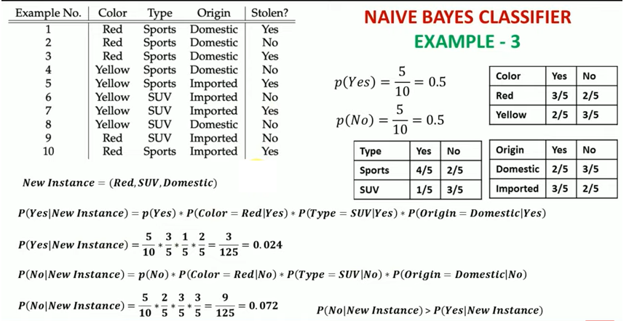
Ans : NO

Slide 35
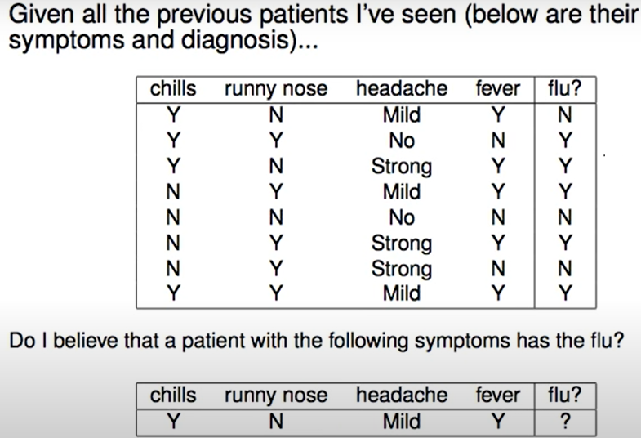
Example-4

Slide 36
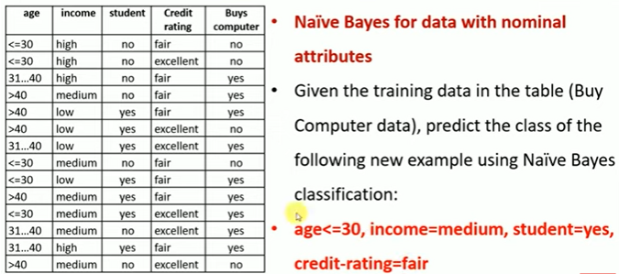
Example-5

Slide 37

THANK YOU

