Slide 1

UNIT-III
(Measuring Classifier Accuracy)

Slide 2
Topics :
  Measuring Classifier Accuracy
    Confusion Matrix
    Accuracy
    Precision
    Recall or Sensitivity
    F-Score

Slide 3
Confusion Matrix
The confusion matrix is one of the most popular and widely used performance measurement techniques for classification models.
Confusion Matrix as the name suggests gives us a matrix as output and describes the complete performance of the model.
And it also used to determine the performance of the classification models for a given set of test data.

Slide 4
Contd..
Since it shows the errors in the model performance in the form of a matrix, hence also known as an Error Matrix. Some features of Confusion matrix are given below:
1. For the 2 prediction classes of classifiers, the matrix is of 2*2 table, for 3 classes, it is 3*3 table, and so on.
2. The matrix is divided into two dimensions, that are predicted values and actual values along with the total number of predictions.

Slide 5
Contd..
3. Predicted values are those values, which are predicted by the model, and actual values are the true values for the given observations.
It looks like the below table:
For a binary classification problem, we would have a 2 x 2 matrix as shown below with 4 values:
The target variable has two values: Positive or Negative
The columns represent the actual values of the target variable
The rows represent the predicted values of the target variable

Slide 6
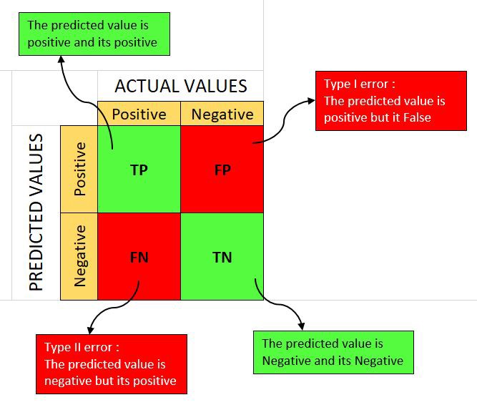
Contd..

Slide 7
Real Time Example (Scenario)
In this scenario, a machine learning model predicts whether a person has diabetes (Positive) or does not have diabetes (Negative) based on medical test results.

Slide 8
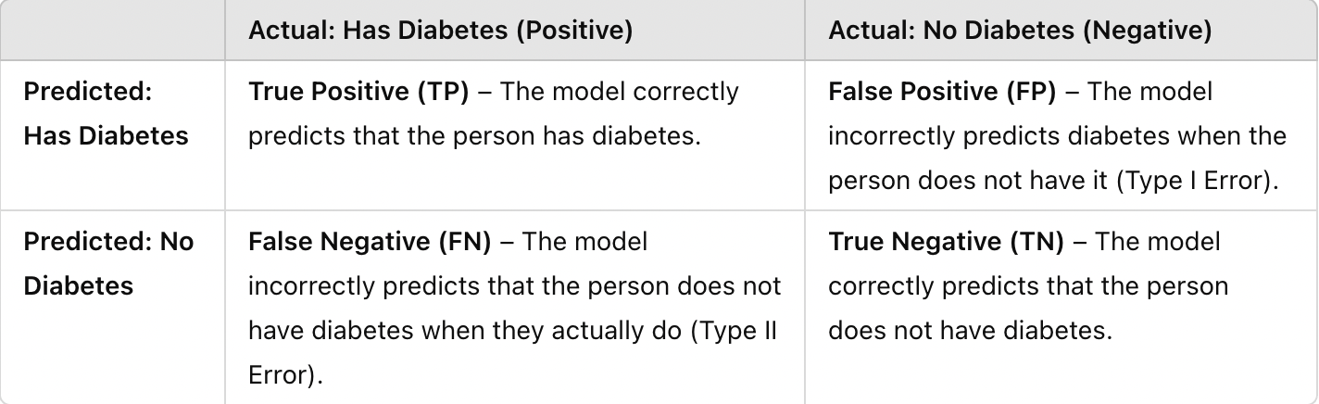

Slide 9
Contd..
The following 4 are the basic terminology which will help us in determining the metrics. Those are:
1. True Positives (TP): when the actual value is Positive and predicted is also Positive.
2. True negatives (TN): when the actual value is Negative and prediction is also Negative.
3. False positives (FP): When the actual is negative but prediction is Positive. Also known as the Type 1 error
4. False negatives (FN): When the actual is Positive but the prediction is Negative. Also known as the Type 2 error.

Slide 10
Example-2
Based on the Confusion Matrix, We have to calculate the Measures.
In this Example, We have a total of 20 cats and dogs and our model predicts whether it is a cat or not.
Actual values = [‘dog’, ‘cat’, ‘dog’, ‘cat’, ‘dog’, ‘dog’, ‘cat’, ‘dog’, ‘cat’, ‘dog’, ‘dog’, ‘dog’, ‘dog’, ‘cat’, ‘dog’, ‘dog’, ‘cat’, ‘dog’, ‘dog’, ‘cat’]
Predicted values = [‘dog’, ‘dog’, ‘dog’, ‘cat’, ‘dog’, ‘dog’, ‘cat’, ‘cat’, ‘cat’, ‘cat’, ‘dog’, ‘dog’, ‘dog’, ‘cat’, ‘dog’, ‘dog’, ‘cat’, ‘dog’, ‘dog’, ‘cat’].

Slide 11
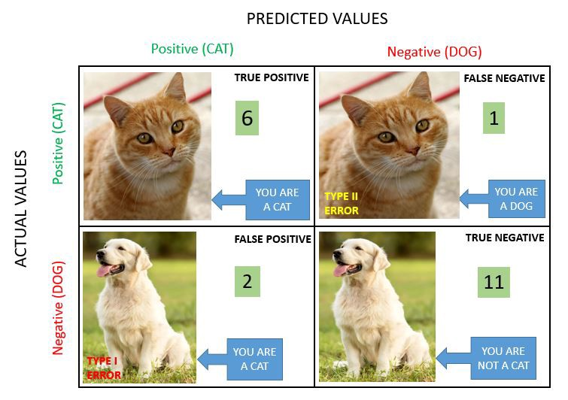
Contd..

Slide 12
Contd..
1. True Positive (TP) = 6
You predicted positive and it’s true. You predicted that an animal is a cat and it actually is.
2. True Negative (TN) = 11
You predicted negative and it’s true. You predicted that animal is not a cat and it actually is not (it’s a dog).
3. False Positive (Type 1 Error) (FP) = 2
You predicted positive and it’s false. You predicted that animal is a cat but it actually is not (it’s a dog).
4. False Negative (Type 2 Error) (FN) = 1
You predicted negative and it’s false. You predicted that animal is not a cat but it actually is.

Slide 13
Classification Measures
Basically, it is an extended version of the confusion matrix. There are measures other than the confusion matrix which can help achieve better understanding and analysis of our model and its performance.
Those are:
    Accuracy
    Precision
    Recall or Sensitivity
    F-Score

Slide 14

1. Accuracy
It is one of the important parameters to determine the accuracy of the classification problems.
It defines how often the model predicts the correct output.
It can be calculated as the It’s the ratio between the number of correct predictions and the total number of predictions.

Slide 15
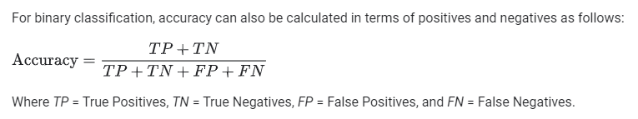
Contd..

Slide 16
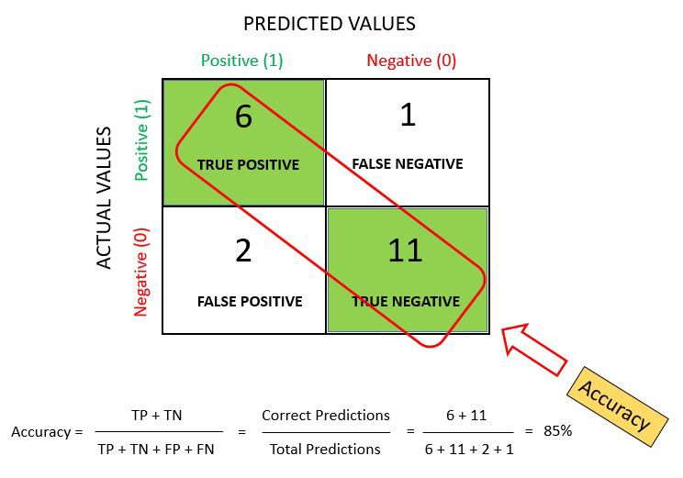
Contd..

Slide 17
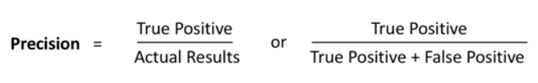
2. Precision
Precision is defined as the ratio of correctly classified positive samples (True Positive) to a total number of classified positive samples (either correctly or incorrectly).
It can be calculated using the below formula:

Slide 18
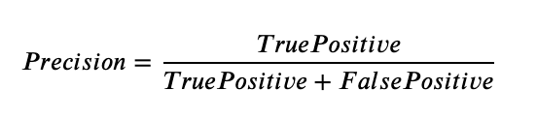
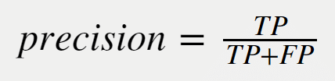
Contd..

Slide 19
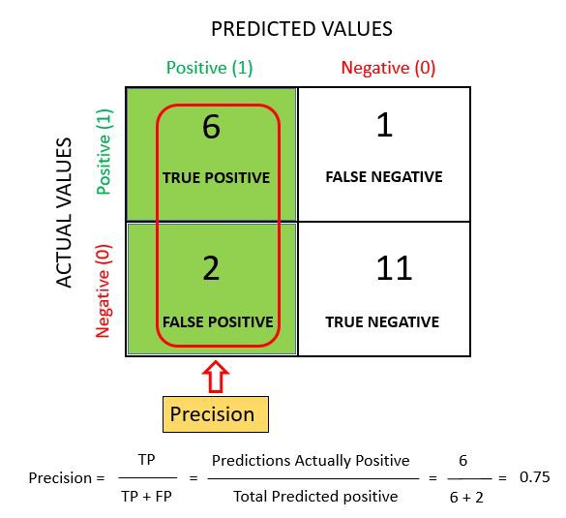
Contd..

Slide 20

3. Recall or Sensitivity
Recall is defined as the ratio of the total number of correctly classified positive classes divide by the total number of positive classes.
It can be calculated using the below formula:

Slide 21
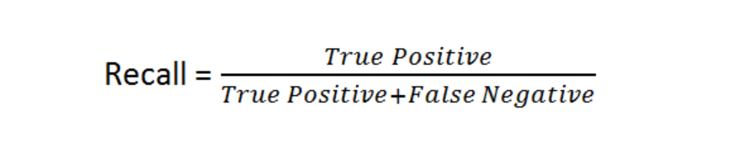
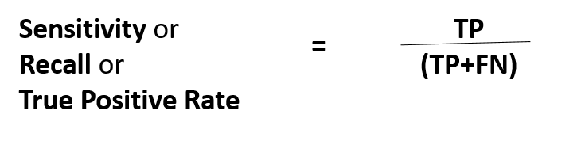
Contd..

Slide 22
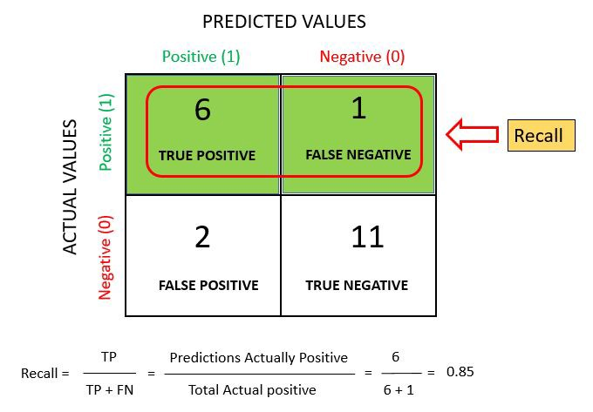
Contd..

Slide 23
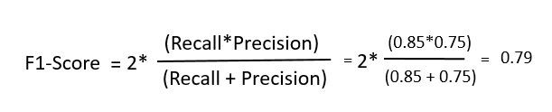
4. F- Score / F- Measure
An F-Score is a way to measure a model’s accuracy based on recall and precision.
The F1 score is a number between 0 and 1 and is the harmonic mean of precision and recall.

Slide 24

THANK YOU

