Slide 1

UNIT-III
(Evaluating Hypothesis)

Slide 2
Topics :
    Evaluating Hypothesis
    Estimating Hypothesis Accuracy
      Sample Error and
      True Error

Slide 3
Evaluating Hypothesis
Example: Suppose you want to predict whether it will rain tomorrow.
Hypothesis: "If the sky is cloudy today, it will rain tomorrow."
Testing: You check past weather data and see if this rule holds true.
Evaluation: If it correctly predicts rain most of the time, the hypothesis is strong. If not, we modify or reject it.

Slide 4
Evaluating Hypothesis
In ML, a hypothesis is the model's assumption about the relationship between input (features) and output (labels).
A good hypothesis (model) makes accurate predictions.
A bad hypothesis (model) makes many errors and needs improvement.

Slide 5
Evaluating Hypothesis
We test the hypothesis (model) by checking how well it predicts unseen data using:
Training Data: Used to learn patterns.
Testing Data: Used to evaluate accuracy

Slide 6
Evaluating Hypothesis
To evaluate the hypothesis, we use:
Accuracy (correct predictions / total predictions)
Precision & Recall (for classification problems)
Mean Squared Error (MSE) (for regression problems)

Slide 7
Estimating Hypothesis Accuracy
Let us make some assumptions:
We have a space of possible instances (X=x1,x2,..xn).
It emphasizes the presence of a probability distribution (D) that determines the likelihood of encountering different instances in X.
A trainer (supervisor) provides training examples to the model based on a target function f(x).

Slide 8
Contd..
Here, the target function is f(x)=f(x)= x2 which means the output is computed as x2.
The classification output is in the set F(x) = (0,1) meaning it’s a binary classification task.
Now, after classification, what is the Probable error in this estimation made.

Slide 9
Example
Suppose we want to create a machine learning model to predict whether a person is likely to purchase a new smartphone based on certain attributes. The space of possible instances (X) includes various individuals, each characterized by attributes such as age, income, occupation, and previous smartphone usage.

Slide 10
Now, there is an underlying probability distribution (D) that represents the likelihood of encountering different individuals in the population. For instance, the distribution might assign a higher probability to encountering younger individuals with higher incomes who frequently upgrade their smartphones.
The trainer collects training data by independently drawing instances from the distribution (D) and provides the correct target values to teach the target function (f). In this case, the target function (f) classifies individuals into two categories: those likely to purchase a new smartphone (1) and those not likely to purchase (0).

Slide 11
For example, the trainer surveys people at a shopping mall, collecting data on age, income, and previous smartphone usage. The collected instances, along with their corresponding target values (whether they purchased a smartphone or not), form the training examples. The learner's goal is to learn from these examples and generalize the target function to make predictions about individuals not present in the training set.

Slide 12
Contd..
In evaluating a hypothesis, three key questions are addressed:
1. Generalization to Additional Data: If a hypothesis is accurate over a limited sample of data, how well will it perform on additional, unseen data?
2. Comparison of Hypotheses: When comparing two hypotheses, determining which one is superior when applied to a sample of data.
Optimal Use of Limited Data: When dealing with limited data, finding the best approach to utilize this data for both learning and estimating the hypothesis.

Slide 13
To answer these questions, the concept of "Probable Error" is introduced. Probable Error is a measure used to compute the accuracy of the hypothesis, providing insights into the error bars associated with the estimate. The Probable Error quantifies the difference between the Sample Error and True Error by providing a confidence interval for how much the Sample Error might deviate from the True Error.

Slide 14
Errors are 2 types :
1. Sample Error
2. True Error

Slide 15
Sample error
The sample error refers to the error rate of a hypothesis over a specific sample of data that is available for training.
The sample error is computed by comparing the predictions made by the model to the actual target values in the training dataset. If the model misclassifies some instances in the training data, those instances contribute to the sample error.

Slide 16
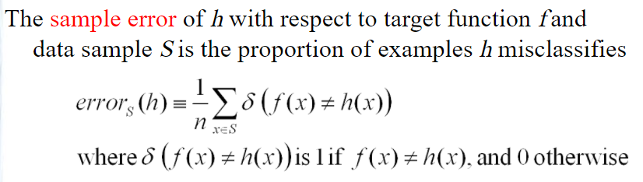
Contd..

Slide 17
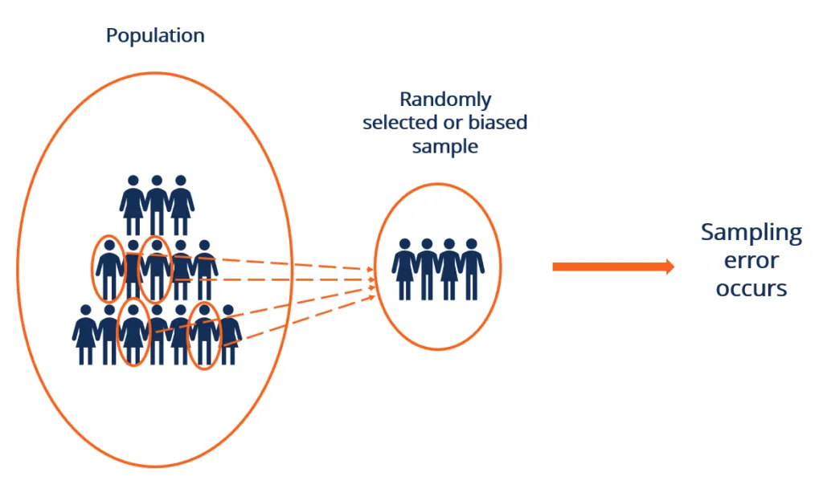
Contd..
Here, f(x) = Learned Target Function
h(x) = Predicted Function by the Hypothesis
Sample Error is the error Calculated w.r.t Data Sample Set S.

Slide 18
True error
The true error, on the other hand, represents the error rate of the hypothesis over the entire, but unknown, distribution (D) of examples.
The true error is computed by comparing the predictions made by the model to the actual target values in the test dataset.(unknown data)

Slide 19
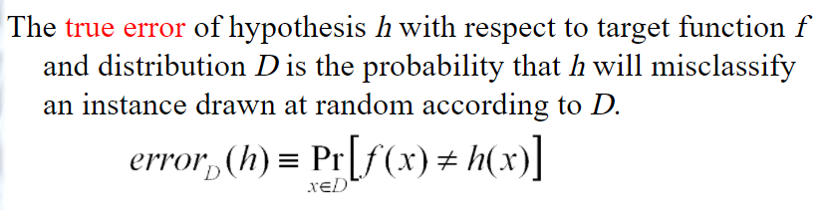
Contd..
2. True Error:

Slide 20
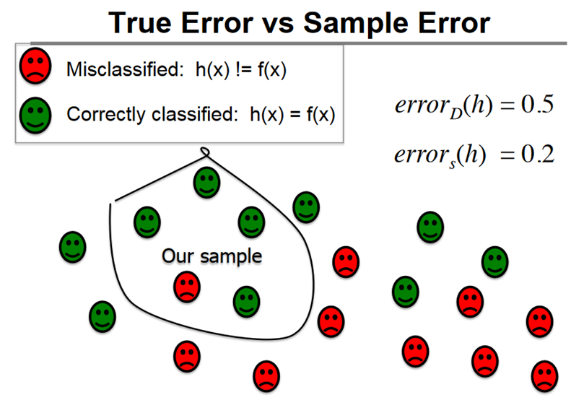
Contd..

Slide 21
For Eg: True Error is the error Calculated with respect to Data Distribution D. Here we can see that Sample Error is 0.2 (i.e 1 out of 5) from the OUR SAMPLE circle & True Error is 0.5 (i.e 10 out of 20) from all the DATA DISTRIBUTION

Slide 22

THANK YOU

