Slide 1
Backpropagation
Backpropagation, short for "backward propagation of errors," is a supervised learning algorithm used to train artificial neural networks (ANNs). It is a crucial component of the training process, allowing the network to learn and adjust its weights and biases to minimize the difference between predicted and actual outputs.

Slide 2
Here is an overview of the backpropagation algorithm:
1. Forward Pass:
Input: Provide the neural network with input data.
Forward Pass: Compute the output of the network by propagating the input through each layer using the current weights and biases.
Compute Loss: Compare the predicted output with the actual output to calculate the loss, which is a measure of the difference between the predicted and true values.

Slide 3
2. Backward Pass (Backpropagation):
Compute Gradient:
  Starting from the output layer, calculate the gradient of the loss with respect to the weights and biases using the chain rule of calculus.
  Propagate these gradients backward through the network.
Update Weights and Biases:
  Adjust the weights and biases in the opposite direction of the gradient to minimize the loss.
  The update rule typically involves multiplying the gradient by a learning rate and subtracting it from the current weights and biases.
Repeat:
  Repeat the process for a specified number of iterations (epochs) or until convergence.

Slide 4
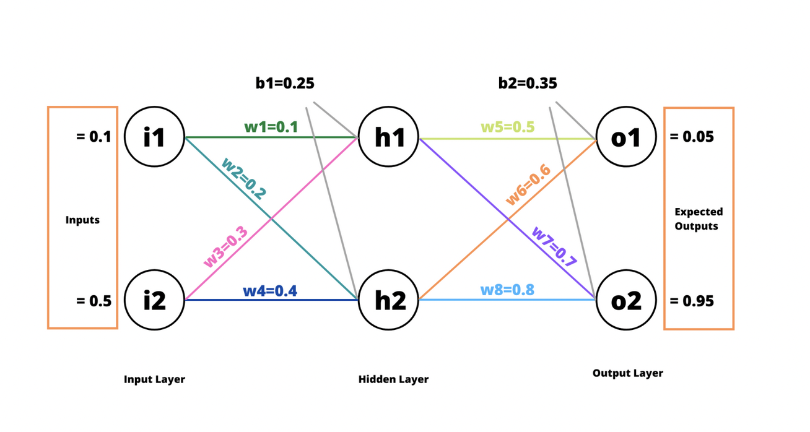
Example-1
There are two units in the Input Layer, two units in the Hidden Layer and two units in the Output Layer. The w1,w2,w2,…,w8 represent the respective weights. b1 and b2 are the biases for Hidden Layer and Output Layer, respectively.

Slide 5
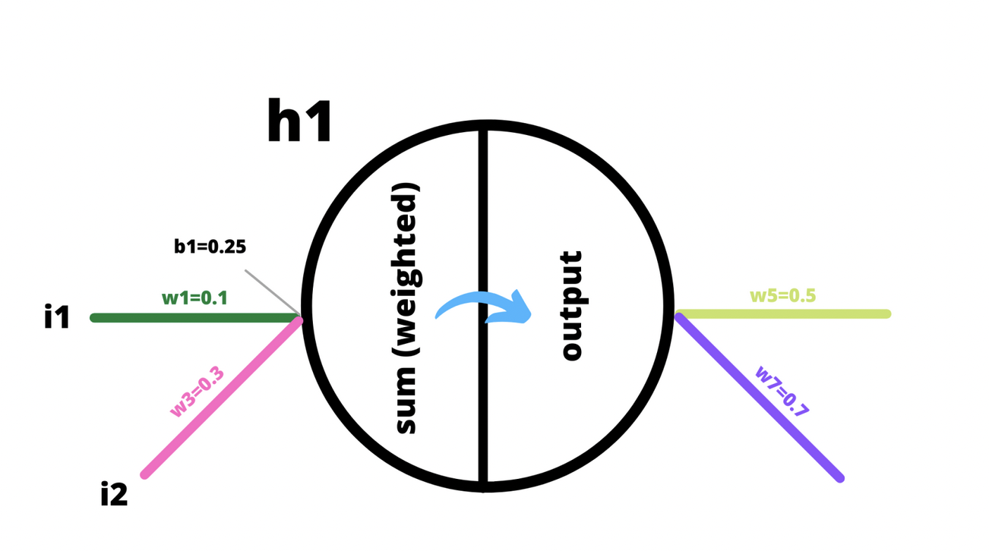
we’ll be passing two inputs i1 and i2, and perform a forward pass to compute total error and then a backward pass to distribute the error inside the network and update weights accordingly.
Inside a unit, two operations happen (i) computation of weighted sum and (ii) squashing of the weighted sum using an activation function. The result from the activation function becomes an input to the next layer (until the next layer is an Output Layer). In this example, we’ll be using the Sigmoid function (Logistic function) as the activation function. The Sigmoid function basically takes an input and squashes the value between 0 and +1.

Slide 6
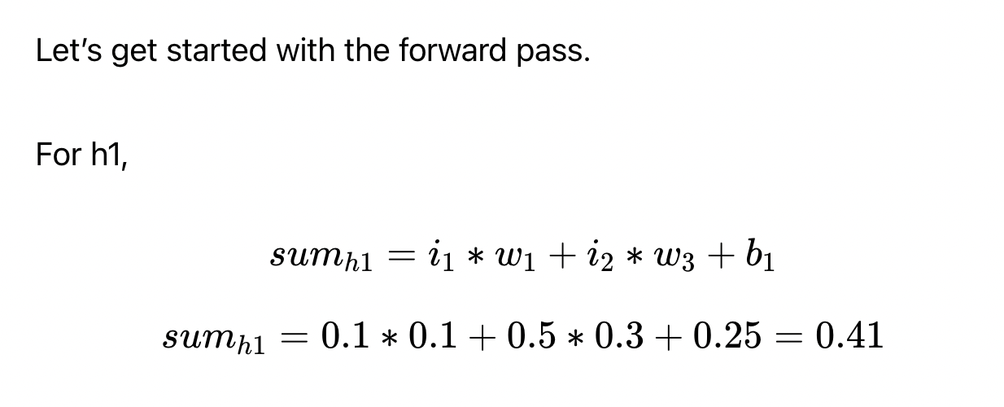
The Forward Pass
Compute weighted sum and process the sum through an activation function. The outcome of the activation function determines if that particular unit should activate or become insignificant.

Slide 7
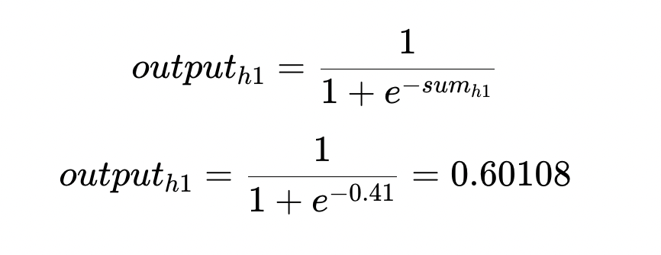
Now we pass this weighted sum through the logistic function (sigmoid function) so as to squash the weighted sum into the range (0 and +1). The logistic function is an activation function for our neural network.

Slide 8
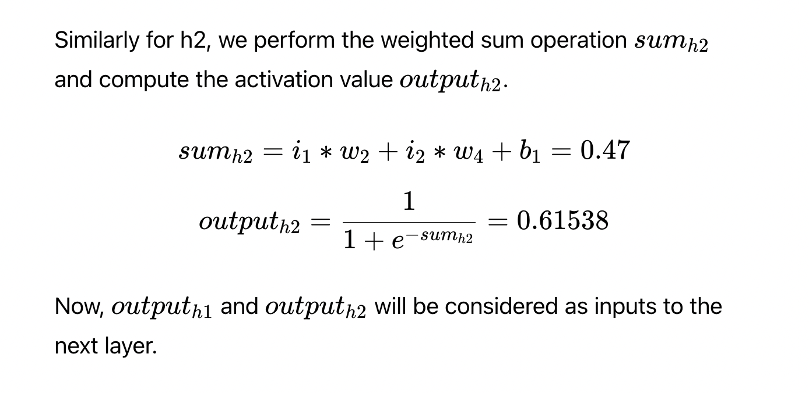

Slide 9
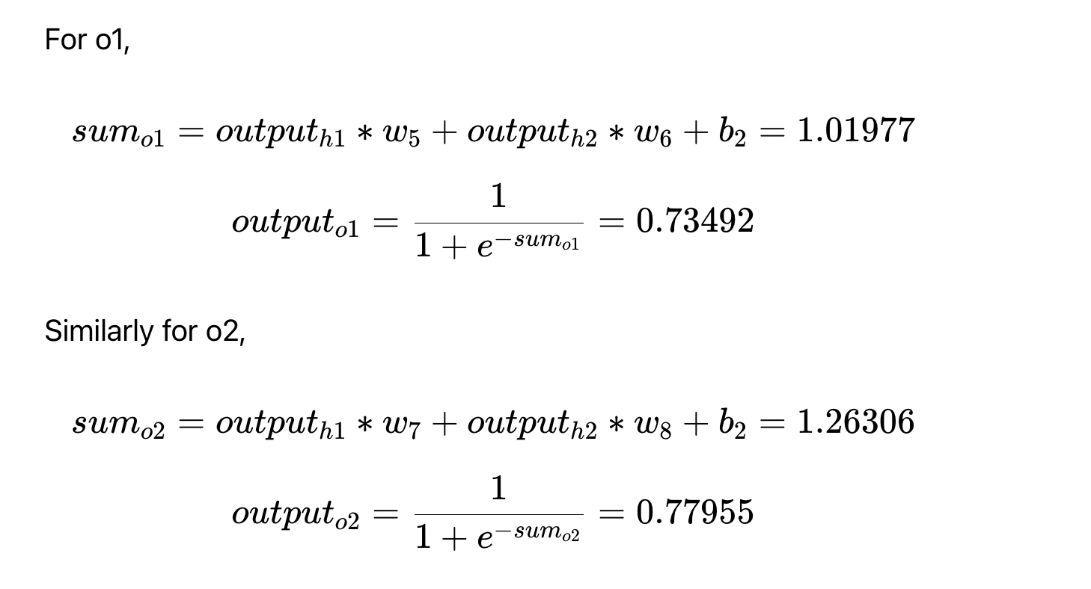

Slide 10
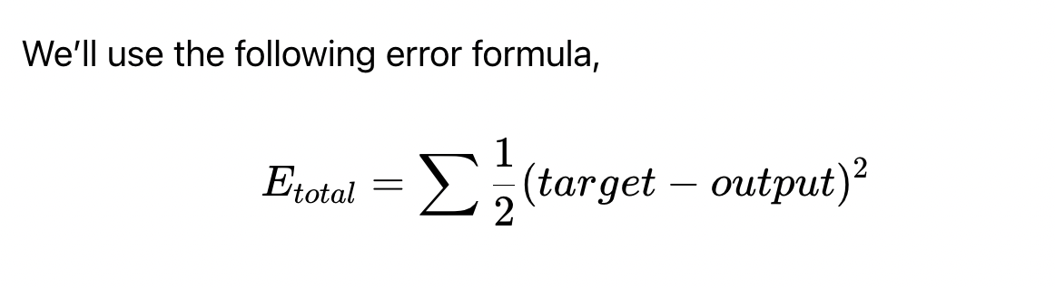
Computing the total error
We started off supposing the expected outputs to be 0.05 and 0.95 respectively for outputo1outputo1​ and outputo2outputo2​. Now we will compute the errors based on the outputs received until now and the expected outputs.

Slide 11
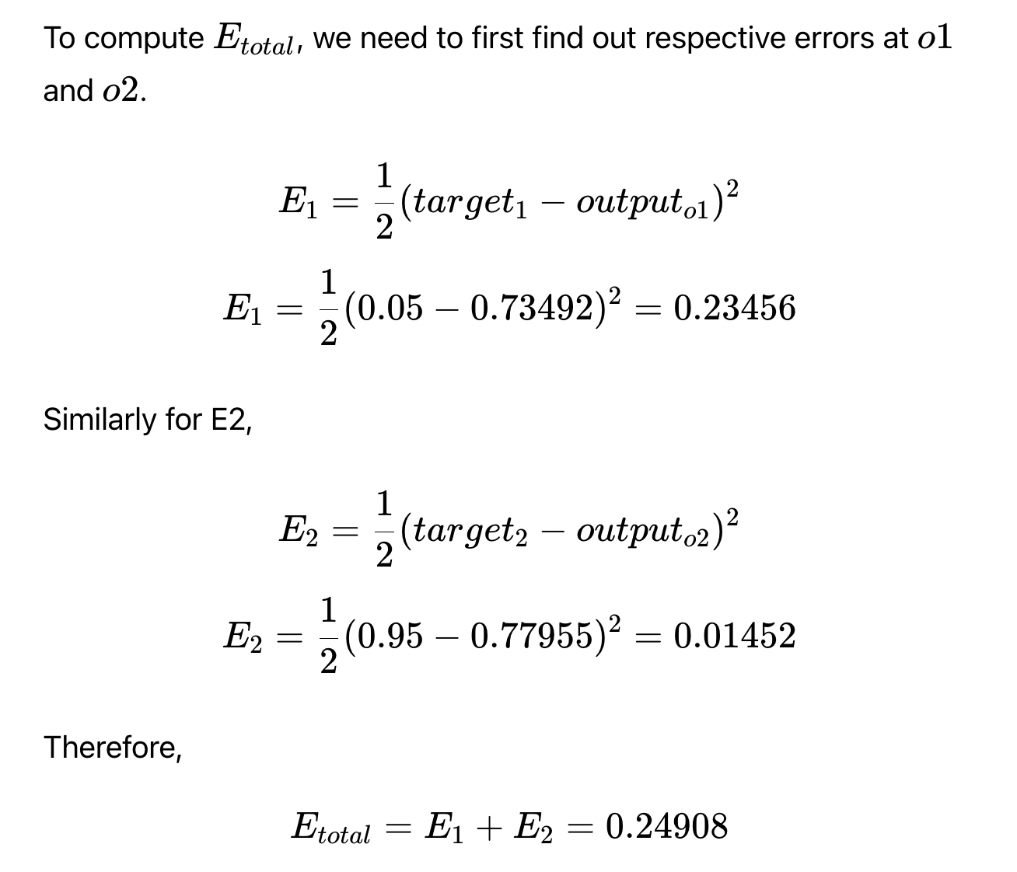

Slide 12
The Backpropagation
The aim of backpropagation (backward pass) is to distribute the total error back to the network so as to update the weights in order to minimize the cost function (loss). The weights are updated in such as way that when the next forward pass utilizes the updated weights, the total error will be reduced by a certain margin (until the minima is reached).

Slide 13
The primary goal of training a neural network is to minimize the difference between the predicted output and the actual target error or loss.
Training is an iterative process, and each iteration involves a forward pass to make predictions, a backward pass to calculate gradients, and weight updates to minimize error.
The gradient (partial derivative) of the error with respect to each weight indicates the direction in which the weight should be adjusted to minimize the error.
The term "convergence" in this context means that the model's parameters (weights and biases) are adjusting in a way that brings the model closer to an optimal configuration.

Slide 14
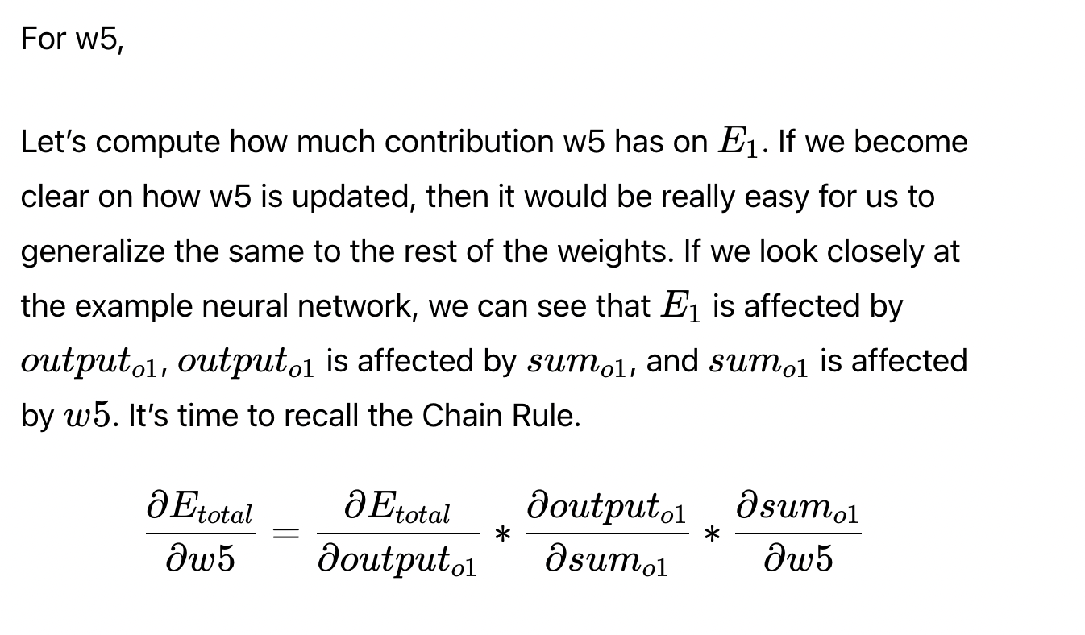
For weights in the output layer (w5, w6, w7, w8)

Slide 15
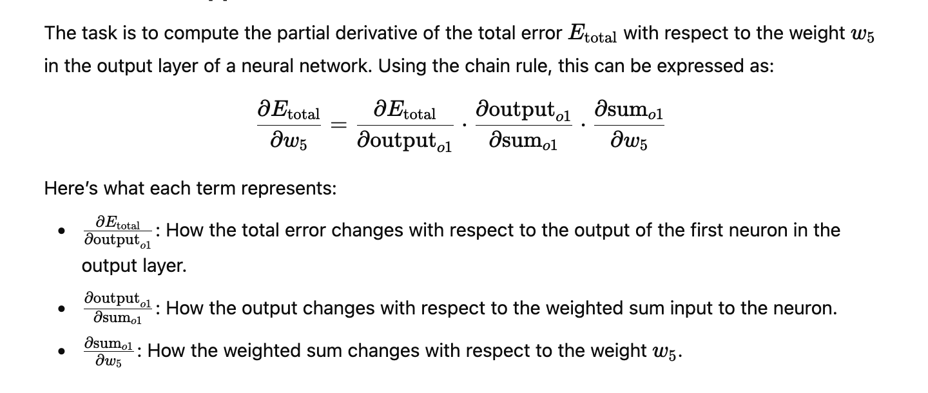

Slide 16
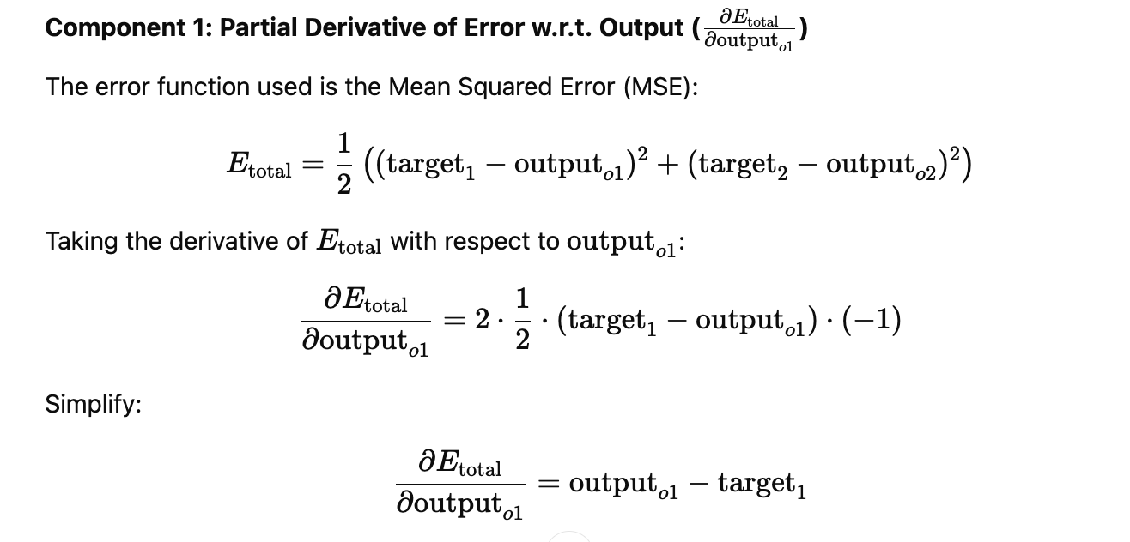

Slide 17
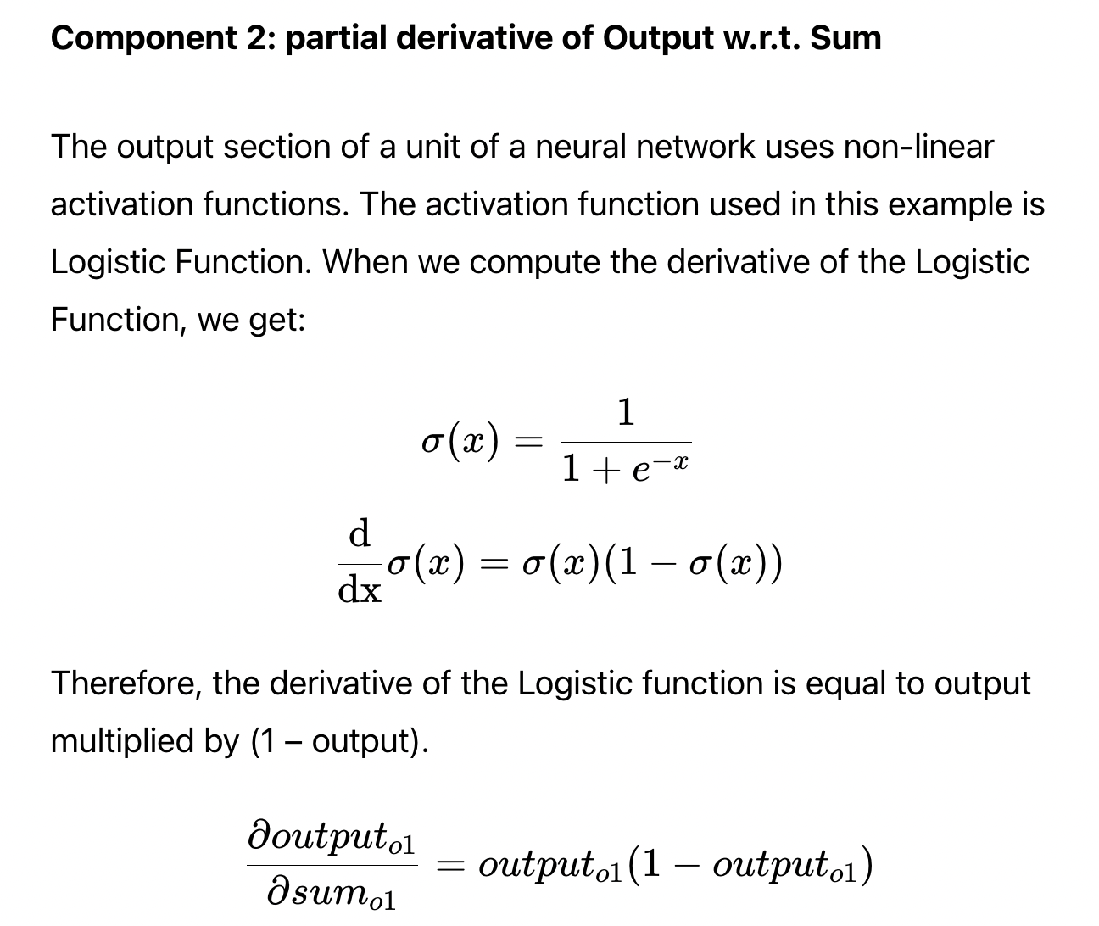

Slide 18
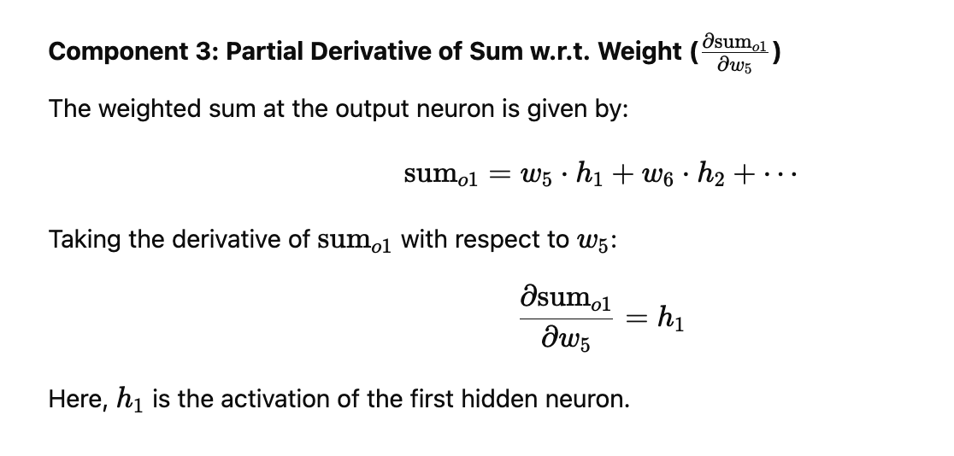

Slide 19
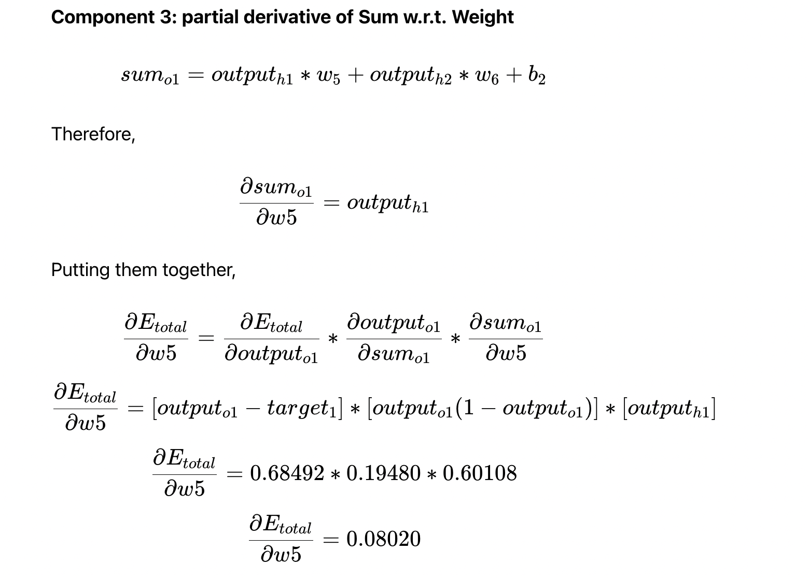

Slide 20
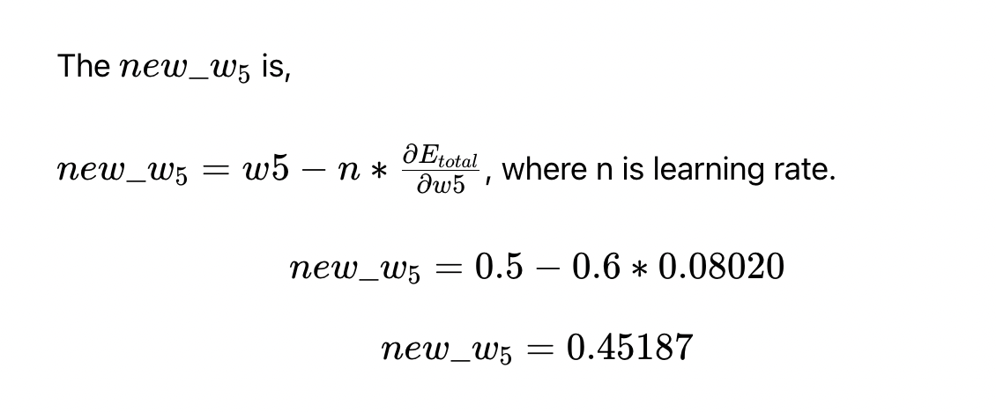

Slide 21
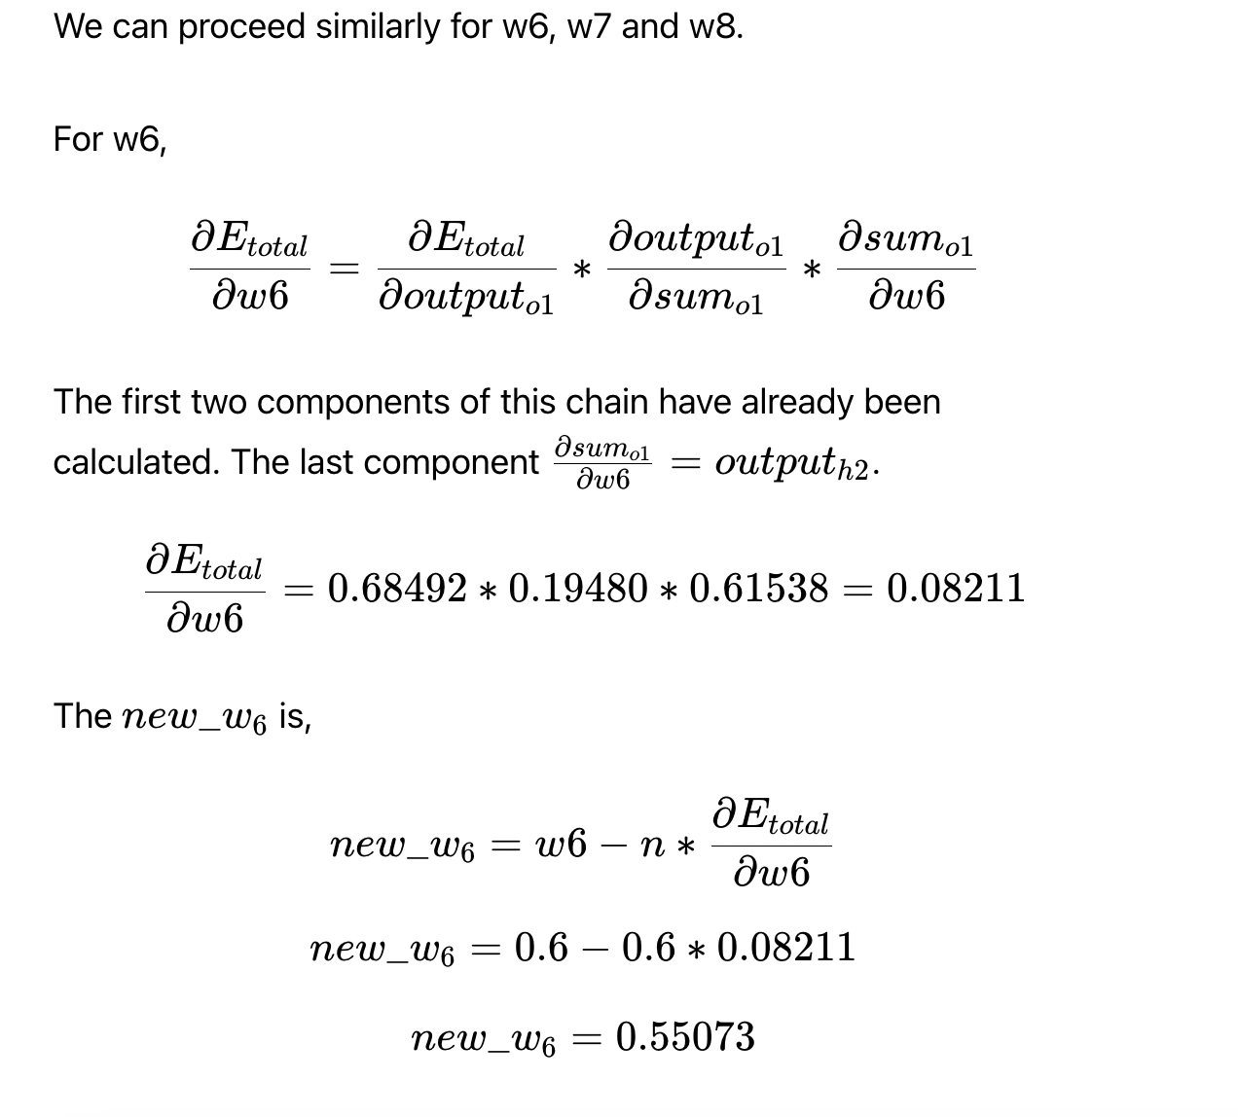

Slide 22
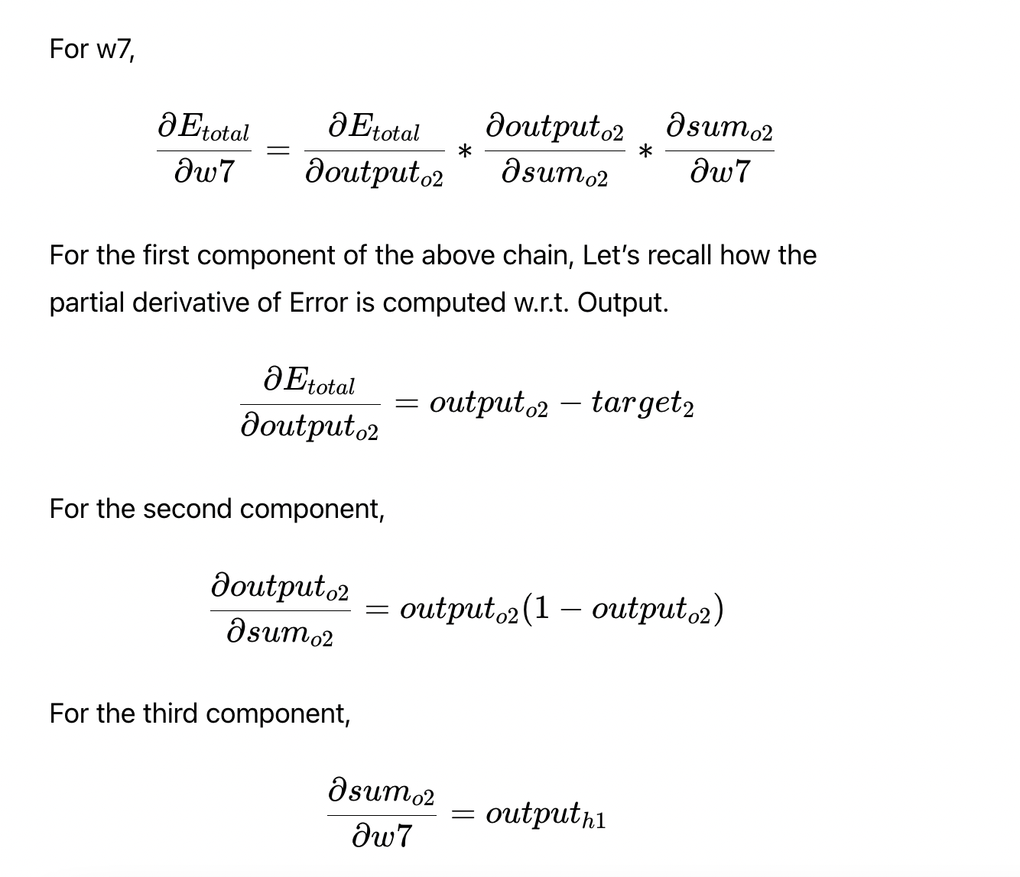

Slide 23
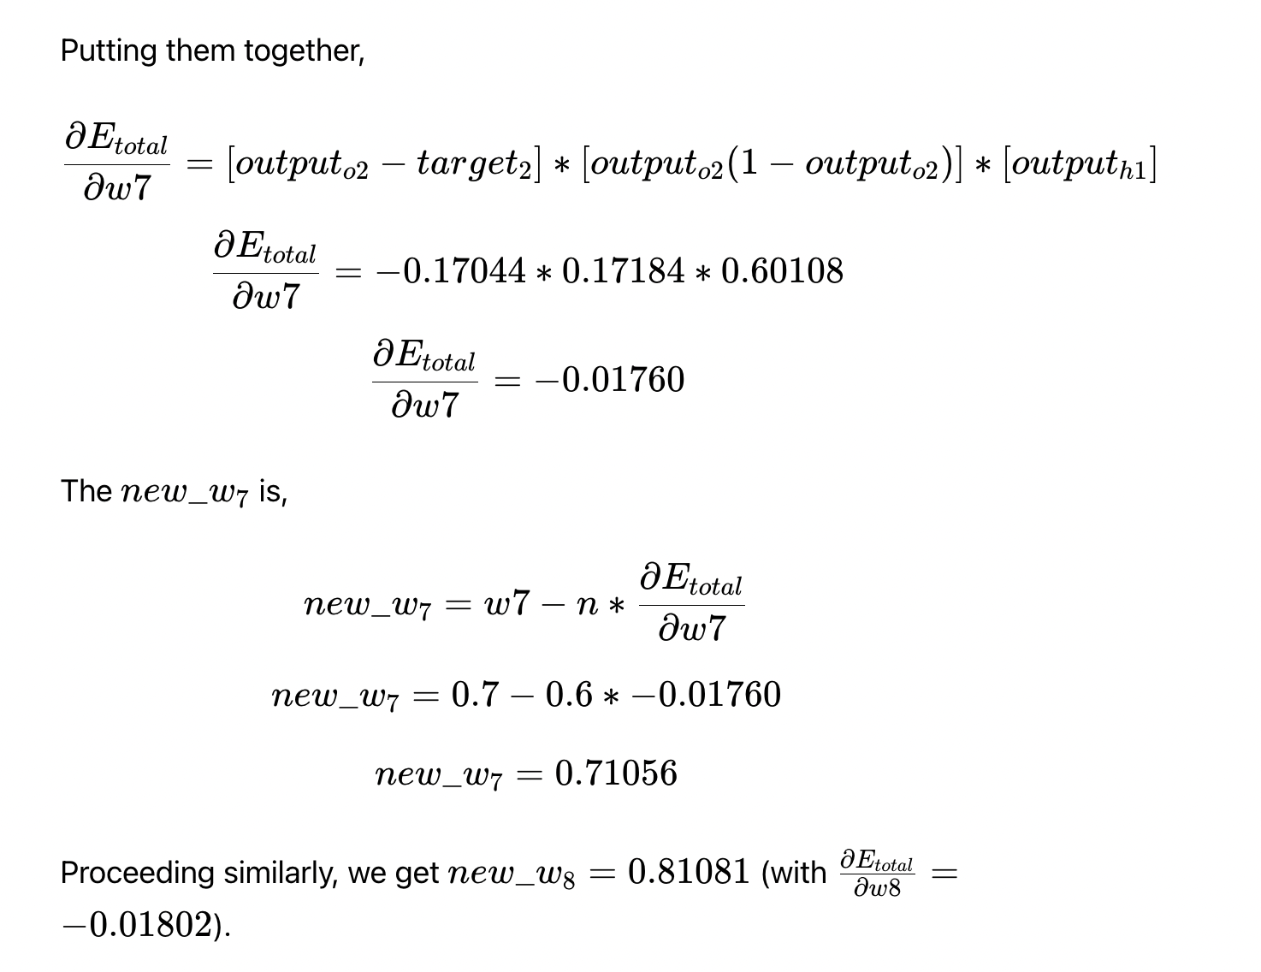

Slide 24
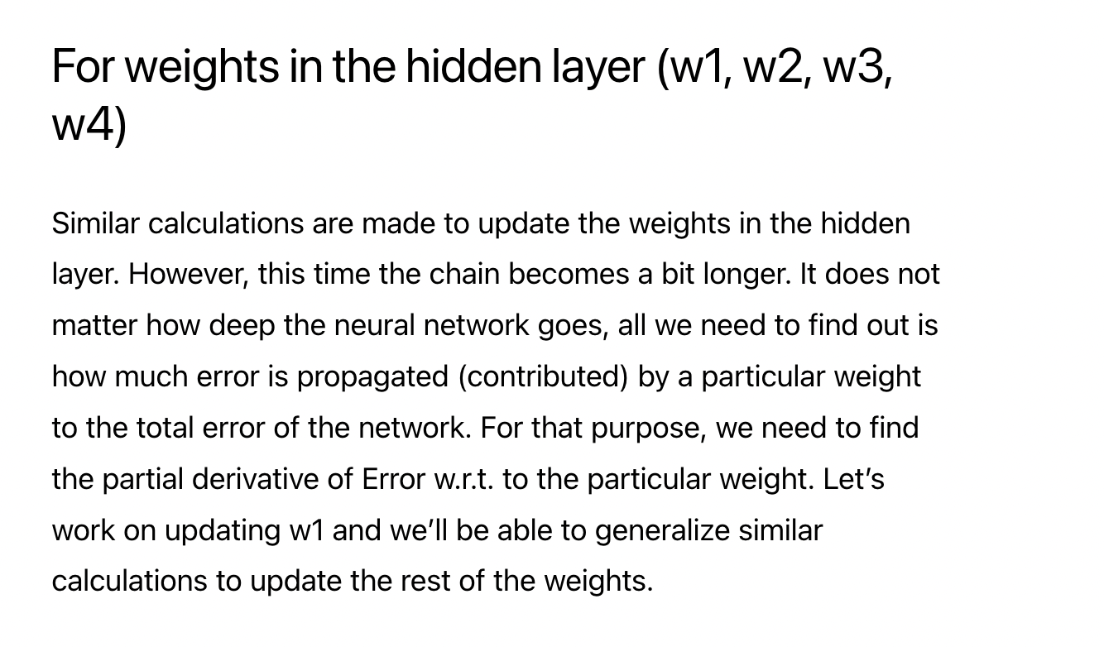

Slide 25
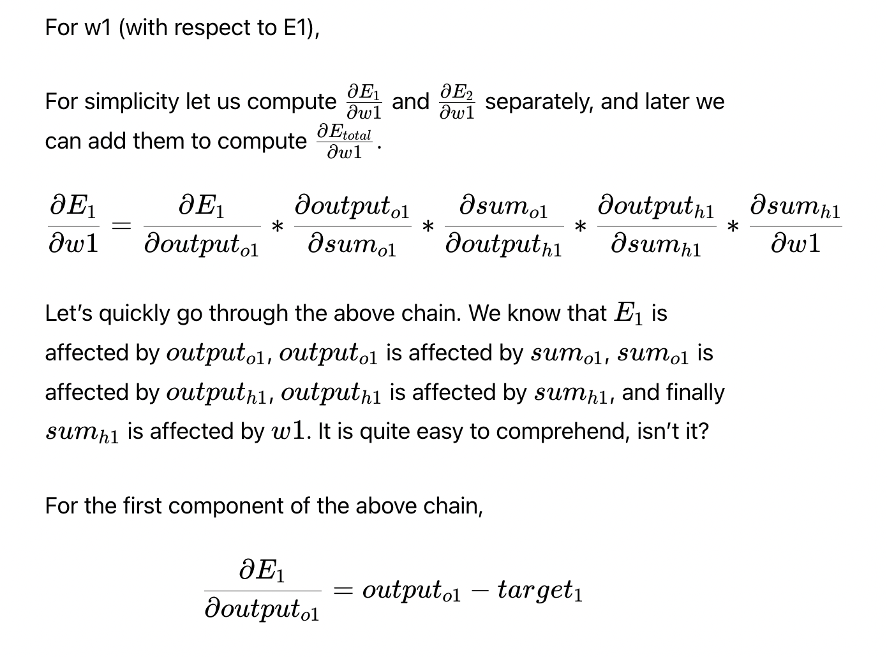

Slide 26
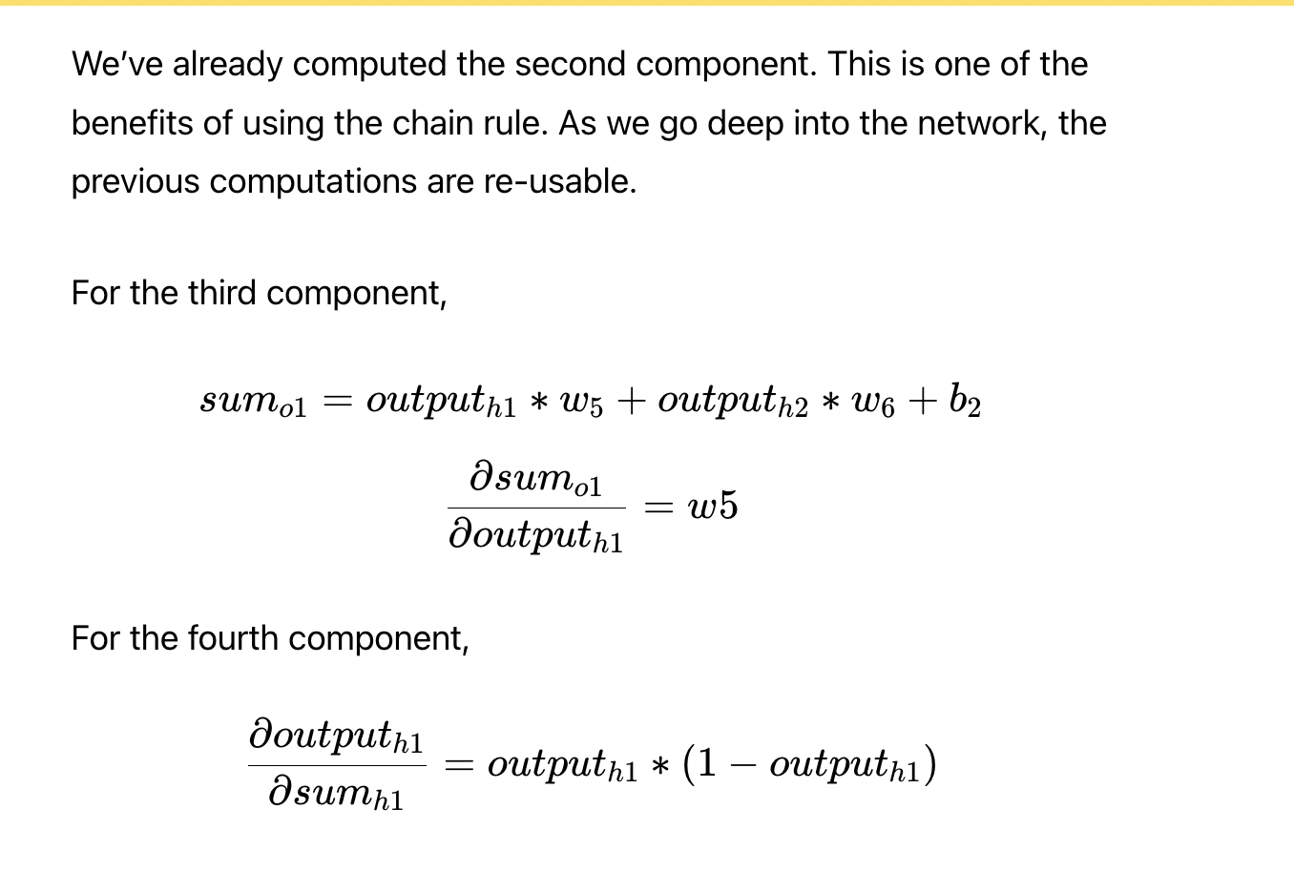

Slide 27
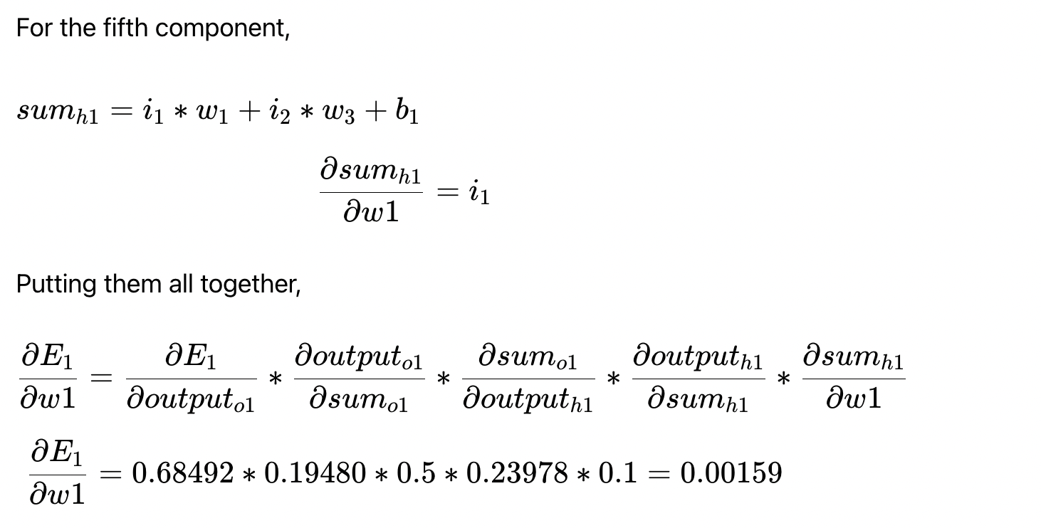

Slide 28
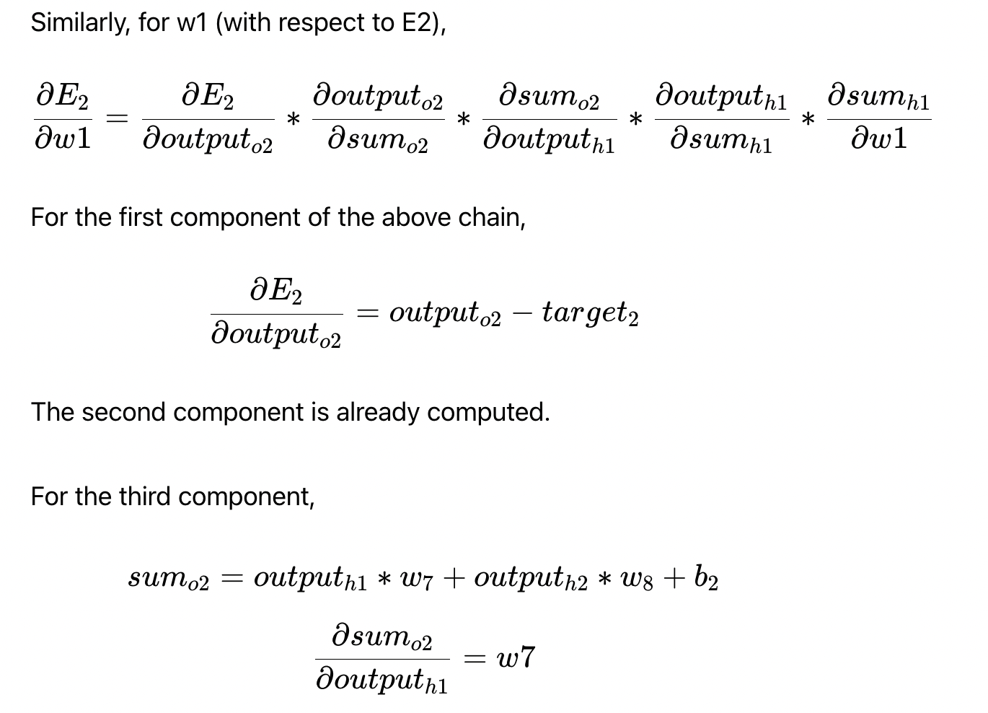

Slide 29
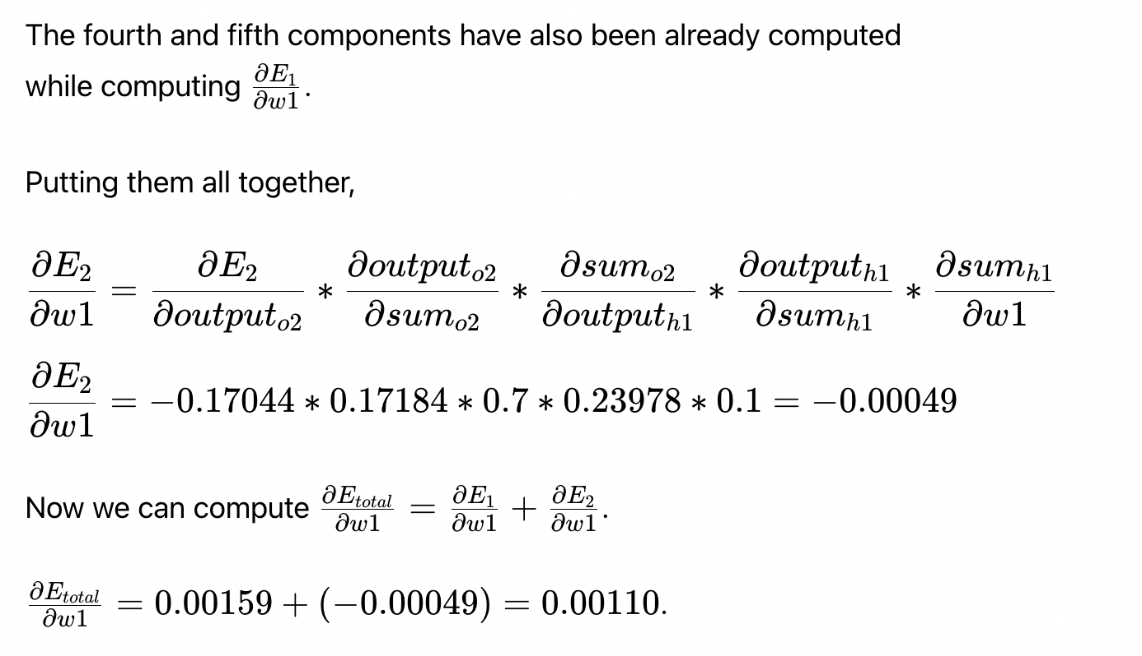

Slide 30
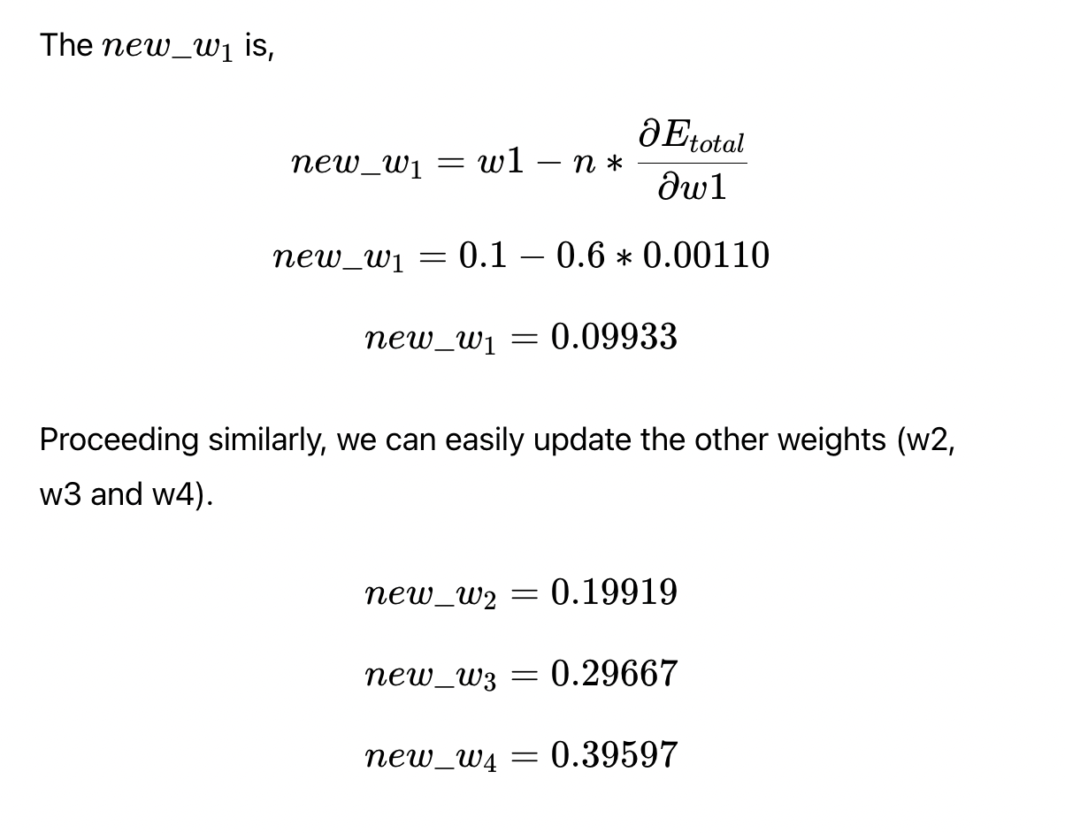

Slide 31
Once we’ve computed all the new weights, we need to update all the old weights with these new weights. Once the weights are updated, one backpropagation cycle is finished. Now the forward pass is done and the total new error is computed. And based on this newly computed total error the weights are again updated. This goes on until the loss value converges to minima. This way a neural network starts with random values for its weights and finally converges to optimum values.

