Slide 1
Example -2

Slide 2
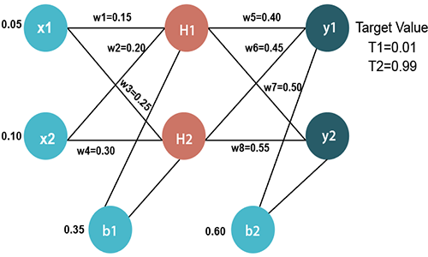
The goal of backpropagation is to optimize the weights so that the neural network can learn how to correctly map arbitrary inputs to outputs.

Slide 3
Input values
X1=0.05
X2=0.10
Initial weight
W1=0.15 w5=0.40
W2=0.20 w6=0.45
W3=0.25 w7=0.50
W4=0.30 w8=0.55
Bias Values
b1=0.35 b2=0.60
Target Values
T1=0.01
T2=0.99

Slide 4
The Forward Pass
For h1,
Sum_{h1}=x1×w₁+x2×w₂+b1
Sum_{h1} =0.05×0.15+0.10×0.20+0.35
Sum_{h1}=0.3775
To calculate the final result of h1, we performed the sigmoid function as Output_{h1=}1/1+e^{-Sumh1}
Output_{h1=} 0.5932

Slide 5
We will calculate the value of H2 in the same way as H1
Sum_{h2} =x1×w₃+x2×w₄+b1
Sum_{h2}=0.05×0.25+0.10×0.30+0.35
Sum_{h2} =0.3925
To calculate the final result of h1, we performed the sigmoid function as Output_{h2=}1/1+e^{-Sumh1}
Output_{h2=} 0.5968

Slide 6
Now, we calculate the values of y1 and y2 in the same way as we calculate the Output_{h1} and Output_{h2}.
To find the value of y1, we first multiply the input value i.e., the outcome of Output_{h1} and Output_{h2} from the weights as
Sum_{O1}= Output_{h1} ×w₅+ Output_{h2} ×w₆+b2
Sum_{O1}=0.593269992×0.40+0.596884378×0.45+0.60
Sum_{O1}1=1.10590597
Output_{O1=}0.7513
Sum_{O2}=Output_{h1}×w₇+Output_{h2}×w₈+b2
Sum_{O2}=0.593269992×0.50+0.596884378×0.55+0.60
Sum_{O2}=1.2249214
Output_{O1=}0.77292

Slide 7
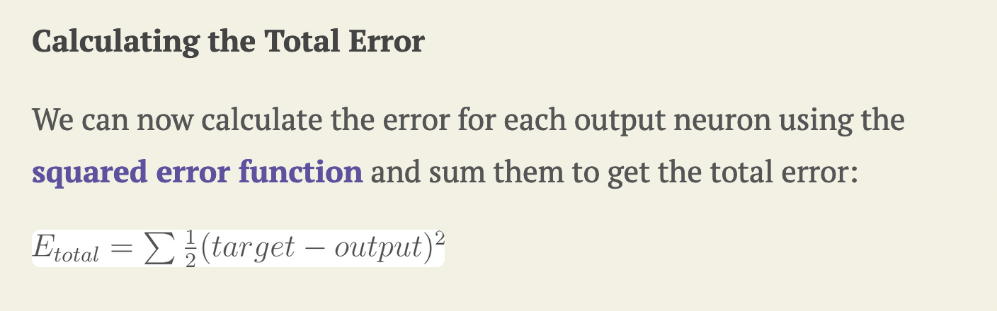

Slide 8
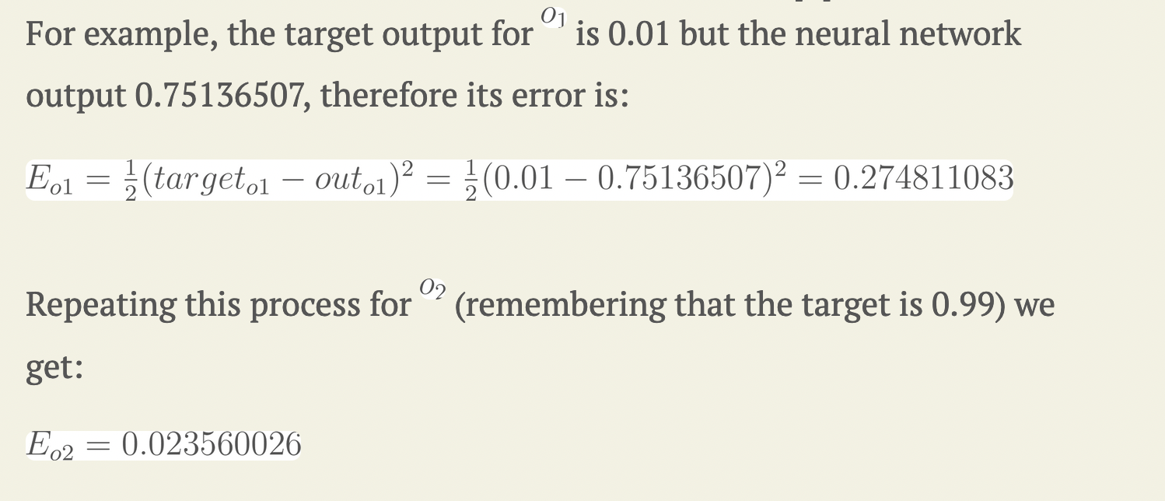

Slide 9
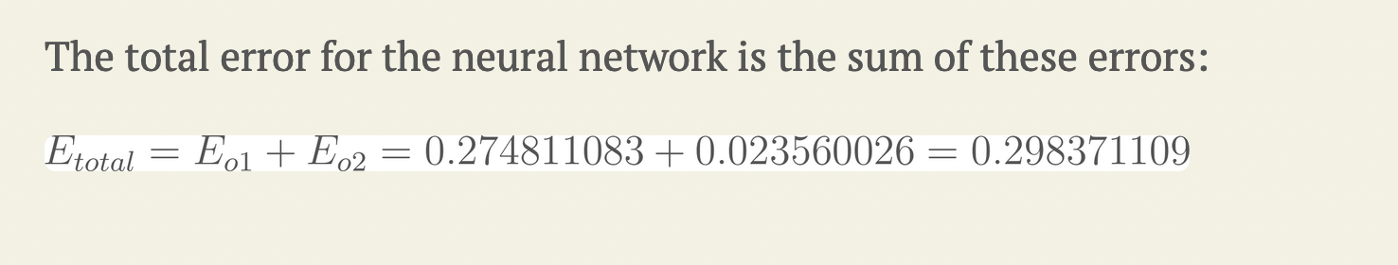

Slide 10
The Backwards Pass
Our goal with backpropagation is to update each of the weights in the network so that they cause the actual output to be closer the target output, thereby minimizing the error for each output neuron and the network as a whole.

Slide 11
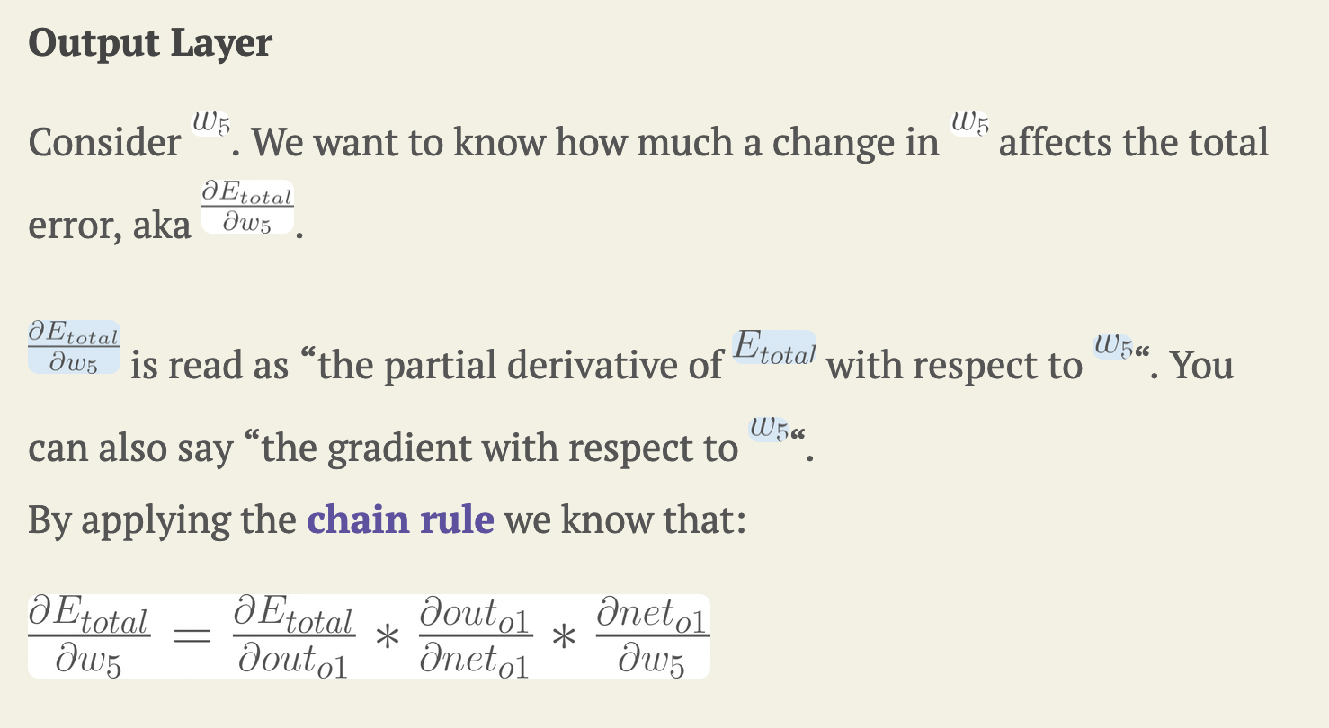

Slide 12
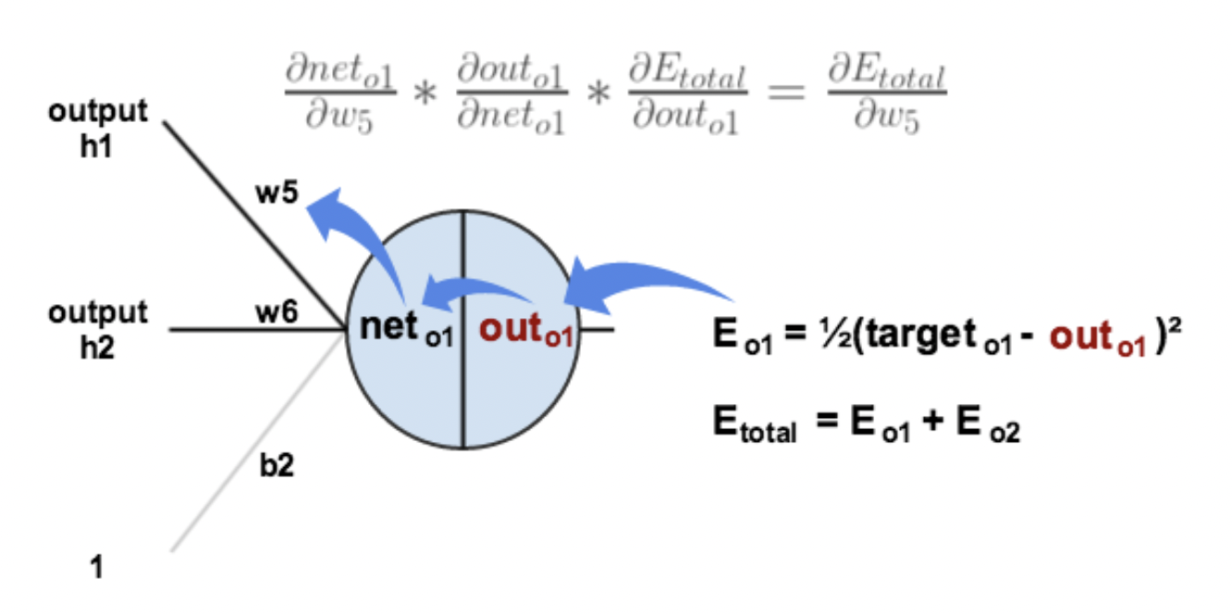
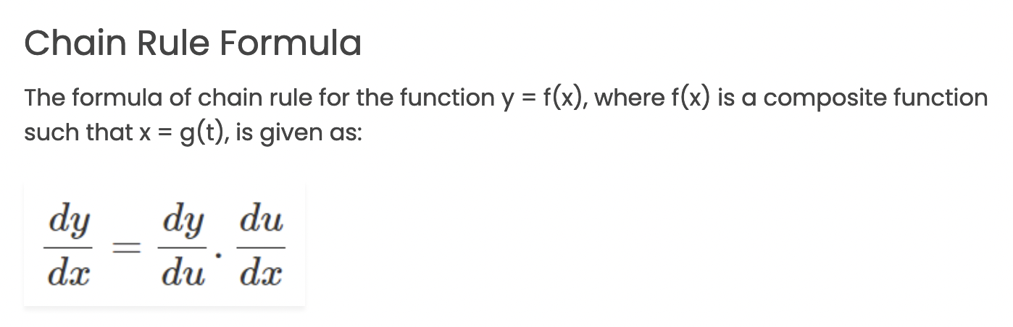

Slide 13
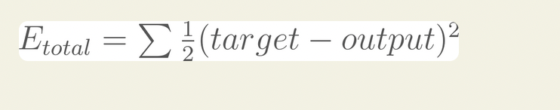
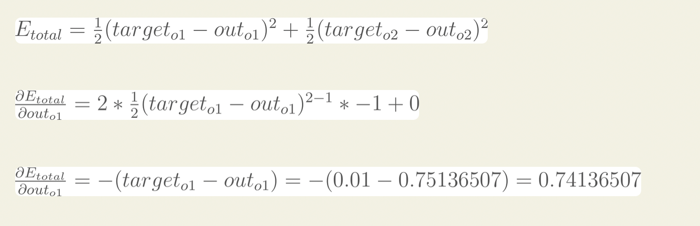
Let’s deal with each component of the above chain separately.
Component 1: partial derivative of Error w.r.t. Out
Treat target1, outo2, and target2 as constants.

Slide 14
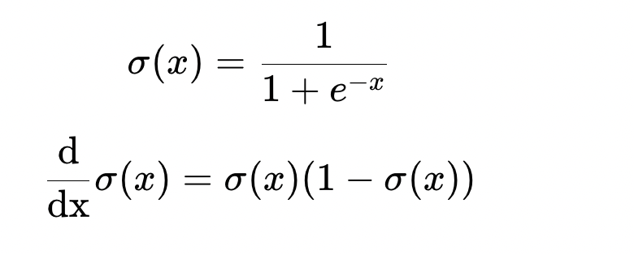
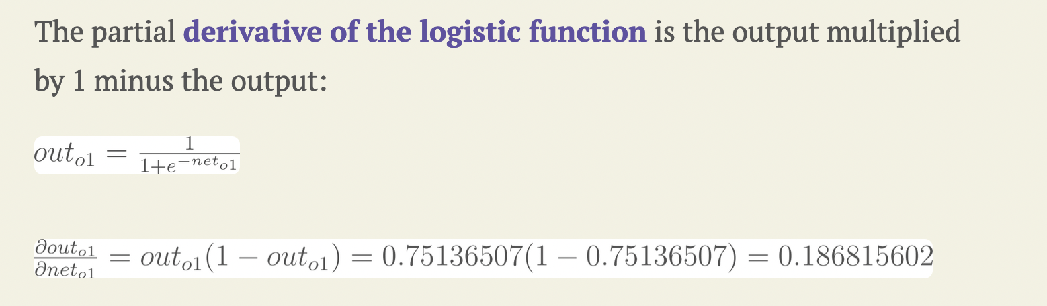
Component 2: partial derivative of Out w.r.t. net
When we compute the derivative of the Logistic Function, we get:

Slide 15
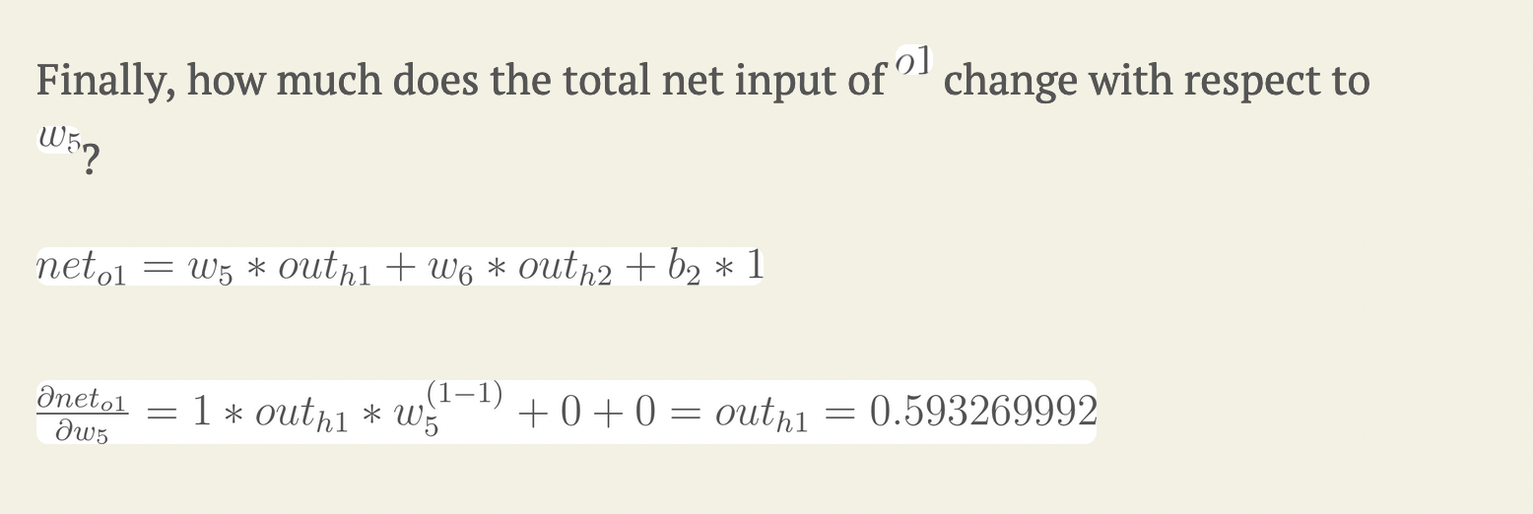
Component 3: partial derivative of net w.r.t. Weight w5
Treat outh1, w6, and b2 as constants. The derivative of outh1 * w5 is outh1

Slide 16
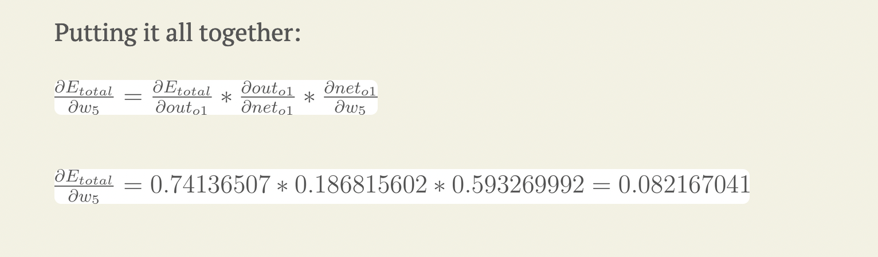
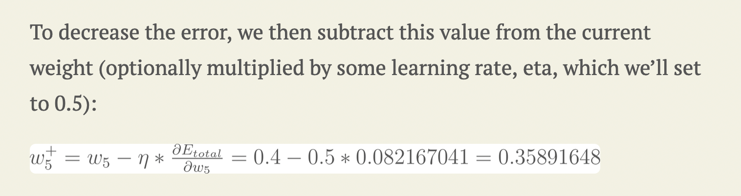

Slide 17
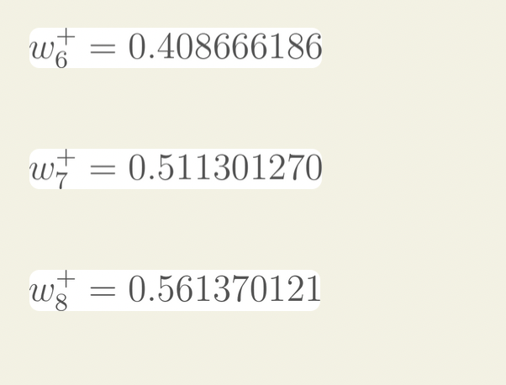

Slide 18
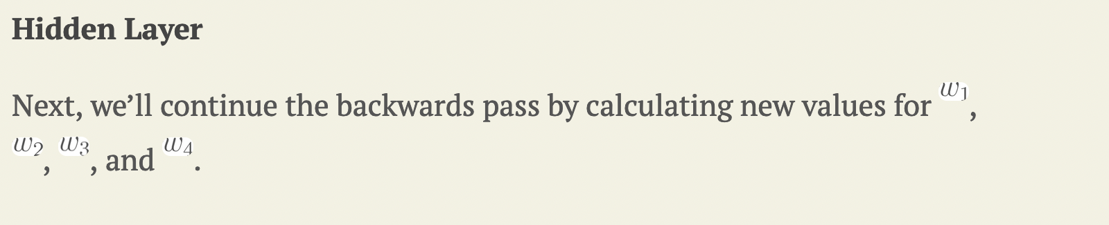
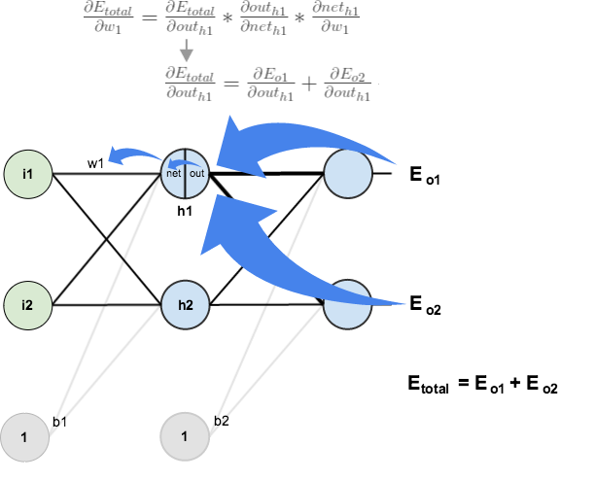

Slide 19
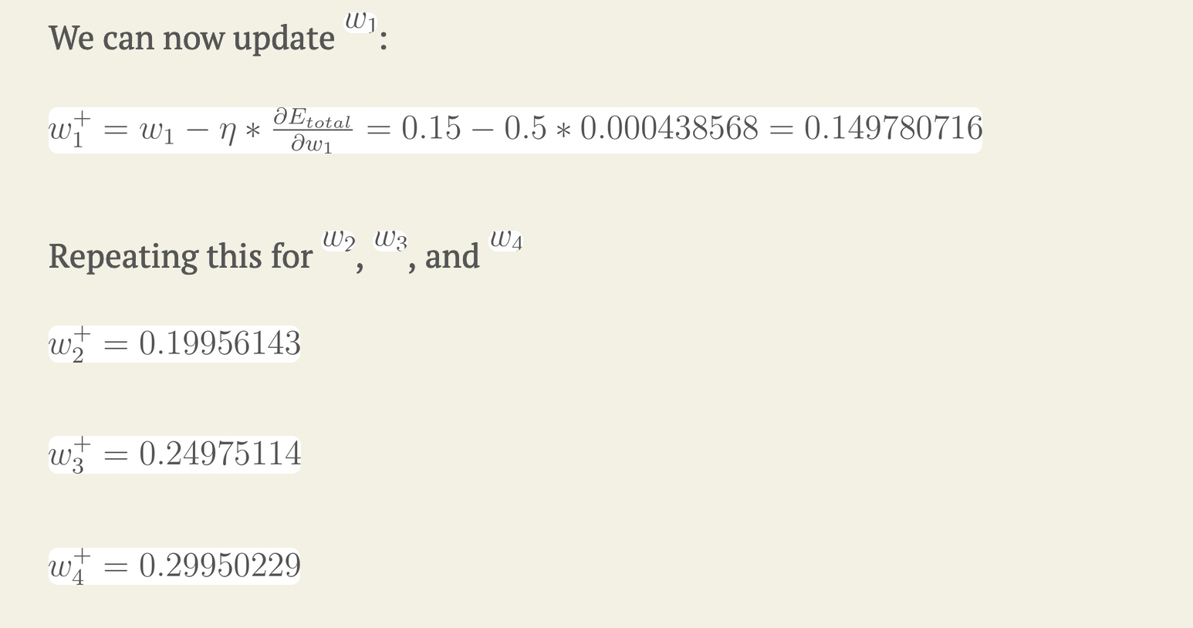

Slide 20
Finally, we’ve updated all of our weights! When we fed forward the 0.05 and 0.1 inputs originally, the error on the network was 0.298371109. After this first round of backpropagation, the total error is now down to 0.291027924. It might not seem like much, but after repeating this process 10,000 times, for example, the error plummets to 0.0000351085. At this point, when we feed forward 0.05 and 0.1, the two outputs neurons generate 0.015912196 (vs 0.01 target) and 0.984065734 (vs 0.99 target).

