Slide 1
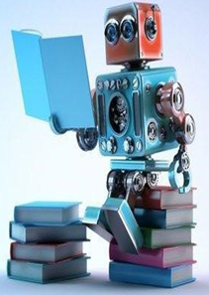
UNIT-I
(Well posed Learning Problems)

Slide 2
Machine Learning
Topics :
  Well-posed Learning Problems

Slide 3
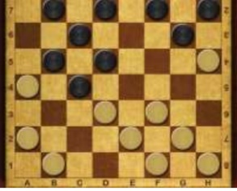
  Well-Posed Learning Problems
For any learning system, we must be knowing the three elements — T (Task), P (Performance Measure), and
E (Training Experience).
Examples:
Checkers Learning Problem:
  Task T: playing checkers
  Performance measure P: percent of games won against opponents
  Training experience E: playing practice games against itself

Slide 4

2. A Hand Written Recognition Learning Problem:
  Task T: Recognizing and classifying
  handwritten words with images
  Performance measure P: Percentage of words correctly classifies
  Training experience E: A database of hand written words with given classifications.

Slide 5
3. To better filter the e-mails as spam or not:
  Task T: Classifying emails as spam or not
  Performance measure P: The fraction of emails accurately classified as spam or not spam
  Training experience E: observing you label email as spam or not
4. Face Recognition Problem:
  Task T: Predicting different types of Faces
  Performance measure P: able to predict maximum types of faces.
  Training experience E: Training Machine will maximum amount of dataset of different face images.

Slide 6
5. Fruit Prediction Problem:
  Task T: Identify different fruits for recognition
  Performance measure P: able to predict maximum variety of Fruits.
  Training experience E: Training Machine with largest datasets of Fruit Images

Slide 7
6. Automatic Translation of Documents:
  Task T: Translating one type of language used in a document to other language
  Performance measure P: able to convert one language to other language efficiently
  Training experience E: Training Machine with largest dataset with different types of languages.

Slide 8
(Designing a
Learning System)

Slide 9
Designing a learning system
Topics :
  Designing a Learning System in ML
    Choosing Training Experience
    Choosing Target Function
    Choosing representation of Target Function
    Choosing Function Approximation
    Final Design

Slide 10
Introduction
For any learning system, we must be knowing the three elements — T (Task), P (Performance Measure), and
E (Training Experience).
Computers learning from data is known as machine learning.
There are lots of different ways (Algorithms) by which machines can learn.
The algorithms can be grouped into supervised, unsupervised, and reinforcement algorithms.
The data that you feed to a machine learning algorithm can be input-output pairs or just inputs.

Slide 11
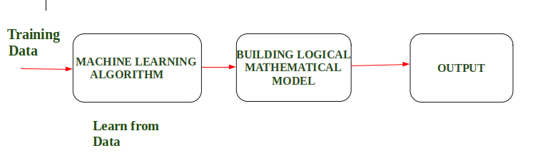
Contd..
Example : In Driverless Car, the training data is fed to Algorithm like how to Drive Car in Highway, Busy and Narrow Street with factors like speed limit, parking, stop at signal etc.
After that, a Logical and Mathematical model is created and after that, the car will work according to the logical model. Also, the more data is fed the more efficient output is produced.

Slide 12
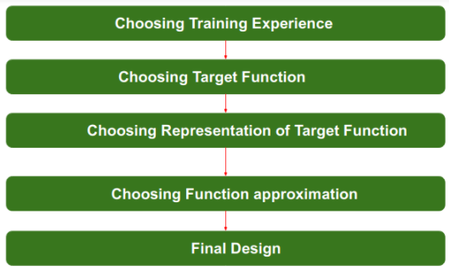
Steps for Designing a Learning System

Slide 13
1. Choosing the Training Experience
Before Train the data, first where we can get the data
After gathering the Data, we must have to Preprocess the Data
The very important and first task is to choose the training data or training experience which will be given to the Machine Learning Algorithm.
The use of Training is that the algorithm must have a significant impact on the Success or Failure of the Model.
It consists of 2 attributes

Slide 14
Contd..
Below are the attributes which will impact on Success and Failure of Data:
1. Direct or Indirect Training Experience: In the case of direct training experience, an individual board states and correct move for each board state are given.
In case of indirect training experience, the move sequences for a game and the final result (win, loss or draw) are given for a number of games.
2. Teacher or Not:
Supervised — The training experience will be labeled, which means, all the board states will be labeled with the correct move. So the learning takes place in the presence of a supervisor or a teacher.

Slide 15
Contd..
Un Supervised — The training experience will be unlabeled, which means, all the board states will not have the moves. So the learner generates random games and plays against itself with no supervision or teacher involvement.
For example: when training data is fed to the machine then at that time accuracy is very less but when it gains experience while playing again and again with itself or opponent the machine algorithm will get feedback and control the chess game accordingly.

Slide 16
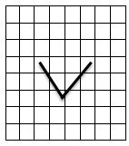
2. Choosing the Target Function
The next important step is choosing the target function.
It means according to the knowledge fed to the algorithm the machine learning will choose NextMove function which will describe what type of legal moves should be taken.
i.e, what type of Knowledge is learnt and how it is used by the performance system.
Example: Checkers Game
While moving diagonally set of all possible moves is called “Legal Moves”.
In that all moves select “One Move” ie, called “Target Move”.

Slide 17
Contd..
Mathematically,
Target Function = v(b)
Board States= b
Legal moves set = B.
Based on that we have assigned 4 possibilities.
‘b’ is final board state, that is won , then v(b) =100
‘b’ is final board state, that is lost , then v(b) =-100
‘b’ is final board state, that is draw , then v(b) = 0
If ‘b’ is not final state then v(b)= v(b’)
ie , finally b’ is the final state.

Slide 18
3. Choosing Representation of Target Function
Now its time to choose a representation that the learning program will use to describe the function
For any board state , we can calculate function “C” as linear combination of following board features. i.e, C(b).
Features:
X1 = No. of Black Pieces on Board
X2 = No. of Red Pieces on Board
X3 = No. of Black Kings on Board
X4 = No. of Red Kings on Board
X5 = No. of Black Pieces threatened by red( Blacks which can be beaten by Red)
X6 = No. of Red Pieces threatened by Black.

Slide 19
Contd..
V = w0 + w1 · x1(b) + w2 · x2(b) + w3 · x3(b) + w4 · x4(b) +w5 · x5(b) + w6 · x6(b)
i.e, When the machine learning algorithm will know all the possible legal moves, then the next step is to choose the optimized move using any representation.
So that we can use Linear Equations, Hierarchical Graph Representation, Tabular form etc.
For Example: while playing chess machine have 4 possible moves, so the machine will choose that optimized move which will provide success to it.

Slide 20
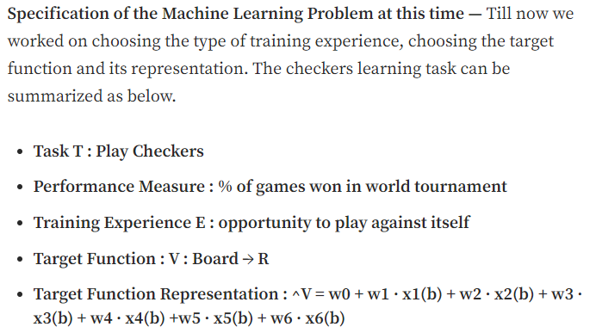
Contd..

Slide 21
4. Choosing Function Approximation Algorithm
To learnt a Target Function (f) we need a set of training examples.
Example: Black won the game (ie, X2=0, which means no red)
In this function approximation, we need to follow 2 steps:
1. Estimating Training values: In every step, we consider successor (depending on next step of opponent)
V_{train(b)}= V(successor(b)).

Slide 22
Contd..
2. Adjusting the Weights: There are some algorithms to find the weights of linear functions.
Ie, here we are using LMS( Least Mean Square) used to minimize the Error.
ie, if Error=0, no need to change
If Error is “Positive” , each weight is increased.
If Error is “Negative” , each weight is decreased.

Slide 23
5. Final Design
The Final Design is created at last when system goes from number of examples , failures and success , correct and incorrect decision and what will be the next step etc.
Example: DeepBlue is an intelligent computer which is ML-based won chess game against the chess expert Garry Kasparov, and it became the first computer which had beaten a human chess expert.

Slide 24
(Perspectives & Issues in ML)

Slide 25
Perspectives in ML
Perspectives of Machine Learning involves searching very large space of possible hypothesis , to determine one that best fits the observed data and any prior knowledge held be learner by using various learning Algorithms.
Machine Learning is used in various applications such as email filtering, speech recognition, computer vision, self-driven cars, Amazon product recommendation, etc.
It can be seen in every industry, such as healthcare, education, finance, automobile, marketing, shipping, infrastructure, automation, etc.

Slide 26
Contd..
Almost all big companies like Amazon, Facebook, Google, Adobe, etc., are using various machine learning techniques to grow their businesses.
Machine Learning is the study of learning algorithms using past experience and making future decisions. Although, Machine Learning has a variety of models.
Here is a list of the most commonly used machine learning algorithms by all data scientists and professionals in today's world.

Slide 27
Contd..
The List of Various Algorithms are:
1. Regression
2. Decision Tree
3. Bayes Theorem and Naïve Bayes Classification
4. Support Vector Machine (SVM) Algorithm
5.K-Nearest Neighbor (KNN) Algorithm
6. K-Means etc.

Slide 28
Issues in ML
Similarly, Machine Learning offers great opportunities, but some issues need to be solved.
A career in the Machine learning domain offers job satisfaction, excellent growth, high salary, but it is a complex and challenging process.
There are a lot of challenges that machine learning professionals face to inculcate ML skills and create an application from various tools.
The major challenges faced by machine learning professionals are:

Slide 29
Contd..
1. What Algorithms should be used ?
2. Which Algorithm perform best for which types of problems?
3. How much Training Data is Sufficient ?
4. What kind of methods should be used?
5. For which type of data , which methods should be used? And also the remaining issues are:

Slide 30
Contd..
1. Poor Quality Data: Data plays a significant role in the machine learning process. One of the significant issues that machine learning professionals face is the absence of good quality data.
Noisy data, incomplete data, inaccurate data, and unclean data lead to less accuracy in classification and low-quality results.
Hence, data quality can also be considered as a major common problem while processing machine learning algorithms.

Slide 31
Contd..
Hence the quality of data is essential to enhance the output.
Therefore, we need to ensure that the process of data preprocessing which includes removing outliers, filtering missing values, and removing unwanted features, is done with the utmost level of perfection.

Slide 32
Contd..
2. Inadequate Training Data: The most important task you need to do in the machine learning process is to train the data to achieve an accurate output. Less amount training data will produce inaccurate or too biased predictions.
Example: Consider a machine learning algorithm similar to training a child. One day you decided to explain to a child how to distinguish between an apple and a watermelon. You will take an apple and a watermelon and show him the difference between both based on their color, shape, and taste. In this way, soon, he will attain perfection in differentiating between the two.

Slide 33
Contd..
But on the other hand, a machine-learning algorithm needs a lot of data to distinguish.
For complex problems, it may even require millions of data to be trained. Therefore we need to ensure that Machine learning algorithms are trained with sufficient amounts of data.

Slide 34
Contd..
3. Under fitting of Training Data: Whenever a machine learning model is trained with fewer amounts of data, and as a result, it provides incomplete and inaccurate data and destroys the accuracy of the machine learning model.
Example: It simply means trying to fit in undersized jeans.

Slide 35
Contd..
To overcome this Issue:
1. Maximize the training time
2. Enhance the complexity of the model
3. Add more features to the data
4. Reduce the constraints
5. Increasing the training time of model

Slide 36
Contd..
3. Overfitting of Training Data: Overfitting is one of the most common issues faced by Machine Learning engineers and data scientists. Whenever a machine learning model is trained with a huge amount of data, it starts capturing noise and inaccurate data into the training data set.
It negatively affects the performance of the model.
Example: It is like trying to fit in Oversized jeans.

Slide 37
Contd..
Let’s consider a model trained to differentiate between a cat, a rabbit, a dog, and a tiger. The training data contains 1000 cats, 1000 dogs, 1000 tigers, and 4000 Rabbits.
Then there is a considerable probability that it will identify the cat as a rabbit.
hence the prediction was negatively affected.

Slide 38
Contd..
To overcome this Issue:
1. Increase training data in a dataset.
2. Reduce the noise
3. Reduce the number of attributes in training data.
4. Remove outliers in the training data

Slide 39
Contd..
4. Machine Learning is a Complex process: The machine learning industry is young and it is continuously changing. Rapid hit and trial experiments are being carried on.
It includes analyzing the data, training data, applying complex mathematical calculations, and a lot more. Hence it is a really complicated process which is another big challenge for Machine learning professionals.

Slide 40
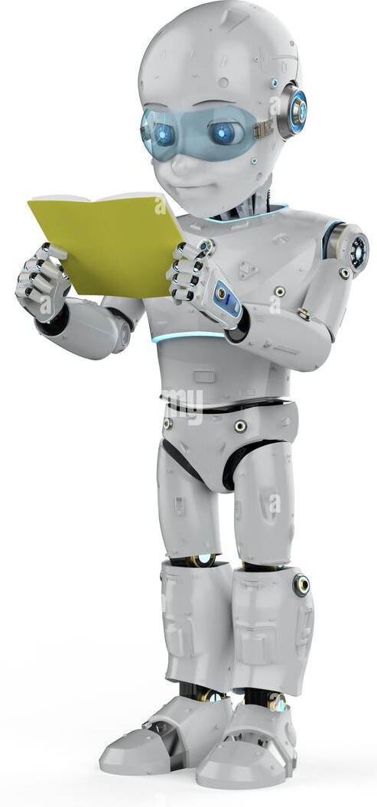
THANK YOU

