Slide 1
Database Management Systems
Overview
P.Dedeepya
Assistant professor
Dept. of CSE, PVPSIT

Slide 2
  OVERVIEW/OUTLINE OF THE COURSE:
  1.NEED/WHY THIS COURSE SHOULD BE STUDIED /IMPORTANCE OF THIS COURSE:
  What is a data?
  Raw, unprocessed facts and figures that can be represented as numbers, symbols, or characters.
  Ex: 25, Deepak, Hyderabad.
  What is Information?
Data that has been processed, organized, and given context, making it meaningful and useful.
  Ex: The age of Deepak is 25 who is residing in Hyderabad.

Slide 3
  OVERVIEW/OUTLINE OF THE COURSE:
  1.NEED/WHY THIS COURSE SHOULD BE STUDIED /IMPORTANCE OF THIS COURSE:
  What is a database?
  A database is a collection of related data.
  What is a DBMS?
Database Management System (DBMS) is a collection of programs designed to
store, manage, and maintain database in a secure, safe, and consistent state.
  It is fair to say that databases play a critical role in almost all areas where computers are used, including business, electronic commerce, engineering, medicine, genetics, law, education etc.,

Slide 4
Database applications
Banking: transactions
Airlines: reservations, schedules
Universities: registration, grades
Sales: customers, products, purchases
Online retailers: order tracking, customized recommendations
Manufacturing: production, inventory, orders, supply chain
Human resources: employee records, salaries, tax deductions

Slide 5
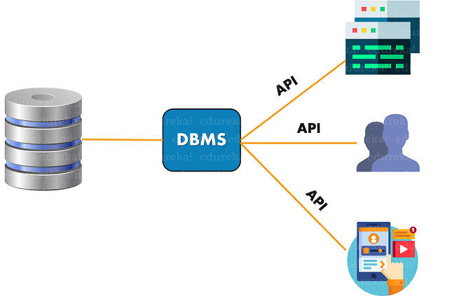

Slide 6
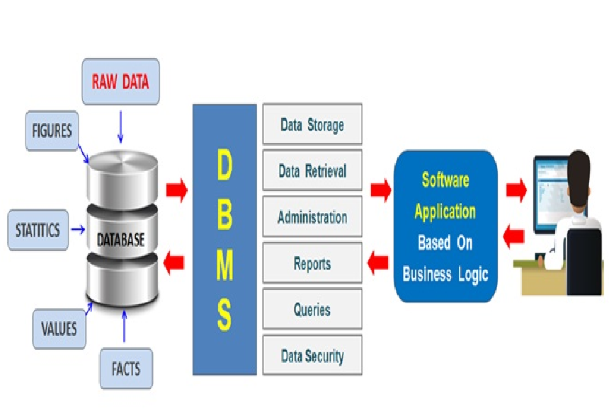

Slide 7
IMPORTANCE
Databases provide vital support for the daily operations and decision making in organizations.
Daily operations such as taking orders, making reservations and paying an employee.
Decision making tasks such as resolving customer complaints , choosing suppliers and deciding on the location of a new store.
Database management systems is today an integral part of functioning of companies and organizations around the world.
DBMSs are the enabling tools to create and utilize database in organizations . Use of this system increases efficiency of business operations and reduces overall costs.
Some of the data that are easily managed with DBMS include: employee records, student information, payroll, accounting, project management, inventory and library books.
These systems are built to be extremely versatile.

Slide 8
EXAMPLEs:
You make transactions using bank account in ATM’s, Malls or for online purchases, that data has to be stored somewhere in order to do the debit/credit operations or to keep track for future references.
Same as above suppose you make purchases from an eCommerce site, so for keeping track of the transactions and delivery of your desired product that data has to be stored

Slide 9
EXAMPLEs:
For example, You work in an organization , There are 100s & 1000s of employees who’s data needs to be stored, organized for later use. A certain amount of employees may work on a networking project, some might belong to a finance/sales department.
In order to organize all the employees in a collective format DBMS comes to the rescue. Now we can easily fetch data of employee who work for finance , with some more filters such as based on age, years of experience, Position & fetch the necessary data. This is a simple example of what a DBMS does.

Slide 10
  a) ROLE OF THIS COURSE IN PLACEMENTS:
DBMS is important subject from placement point of view.
Understanding of DBMS is very basic requirement as it complements the programming skills.
The companies expect that the students are comfortable to store and retrieve data to complete any project.

Slide 11
b) % of weightage in GATE exam:
The following topics are covered in our syllabus for GATE exam:
  ER model
  Relational model
  Relational algebra
  SQL. Integrity constrains
  Normal forms
  Transactions
  Concurrency control
Marks :7-8 marks
Weightage :7-8%

Slide 12
c)Role of this course in Project implementation:
A Database Management System (DBMS) is a software system designed to efficiently store, retrieve, manipulate, and query large amounts of data.
Practical implementation is key to understand the DBMS concepts.
Because the focus of the course is on the design as well as the implementation of DBMSs an emphasis will be placed on simple DBMS implementation project.

Slide 13
Course Outcomes
CO1) Understand the basic concepts of database management systems.
CO2) Apply ER model, Relational Algebra and SQL operations to find solutions for a given application.
CO3) Apply normalization techniques to improve database design.
CO4) Analyse a real time scenario to use Conceptual and Relational data models for designing the database.

Slide 14
2. Outline/ Overview of the course Unit wise
UNIT 1: Introduction.
UNIT 2: Conceptual Data Modeling.
UNIT 3: Relational Model & Basic SQL
UNIT 4: Database Design Theory & Normalization
UNIT 5: Transaction Processing, Introduction to Concurrency Control, Introduction to
Recovery Protocols

Slide 15
UNIT 1: Introduction
a) Need/ Importance :
  Databases and database systems are an essential component of life in modern society: most of us encounter several activities every day that involve some interaction with a database.
  For example, if we go to the bank to deposit or withdraw funds, if we make a hotel or airline reservation, if we access a computerized library catalog to search for a bibliographic item, or if we purchase something online—such as a book, toy, or computer—chances are that our activities will involve someone or some computer program accessing a database.

Slide 16
Unit 1: Introduction to Databases, Overview of Database Languages and architectures
b) Main theme of the Unit
  This unit covers the main fundamental concepts like: Characteristics of the Database Approach, Database Users, Advantages of Database Systems, Database applications.
  Brief Introduction of different Data Models, Concepts of Schema, Instance and data Independence, Three-Schema Architecture for Data Independence, Database System environment, Centralized and Client-Server Architecture for databases.

Slide 17
UNIT 2: Conceptual Data Modeling
Need/ Importance :
  Conceptual modelling is a very important phase in designing a successful database application.
  It is used as a way to describe physical or social aspects of the world in an abstract way.
  The conceptual data model represents the overall structure of data required to support the business requirements independent of any software or data storage structure.
  A commonly-used conceptual model is called an entity-relationship model.

Slide 18
UNIT 2: Conceptual Data Modeling
Main theme of the Unit :
  This unit mainly covers the role of
    Entities - Strong and Week
    Attributes - Composite , Multivalued and Derived.
    Relationships – Binary and Ternary
    in the conceptual design of the database

Slide 19
UNIT 3: Relational Model, SQL, Relational Algebra
a) Need/ Importance :
A data model is a collection of concepts that can be used to describe the conceptual/logical structure of
a database. By structure is meant the data types, relationships, and constraints that should hold for
the data.
  The most popular data model in DBMS is the Relational Model. It is a more scientific model than others.
  The SQL language may be considered one of the major reasons for the commercial success of relational databases.
  The relational algebra is very important for several reasons:
    First, it provides a formal foundation for relational model operations.
    Second, and perhaps more important, it is used as a basis for implementing and optimizing queries in the query processing and optimization modules that are integral parts of RDBMSs.

Slide 20
UNIT 3: Relational Model, SQL, Relational Algebra
b) Main theme of the Unit:
  This unit concentrate on describing the basic principles of the relational model of data and constraints
  This unit also describes:
    The SQL DDL commands for creating schemas and tables, and gives an overview
    of the basic data types in SQL.
    How basic constraints such as key and referential integrity are specified.
    The basic SQL constructs for specifying retrieval queries,
    The SQL DML commands for insertion, deletion, and data updates
    More complex SQL retrieval queries
    the SQL facility for defining views on the database
  This unit also covers the relational algebra operations like:
    Select , Project, Rename, Union, Intersect, Cartesian product, Join and Division

Slide 21
UNIT 4: Database Design Theory & Normalization
Need/ Importance:
  The goal of this unit is evaluating relational schemas for design quality.
  A good database design ensures that users can change rows of a database without unexpected side effects.
  Normalization is the process of removing unwanted redundancy in a table design.

Slide 22
UNIT 4: Database Design Theory & normalization
Main theme of the Unit :
  This unit mainly covers the most important part of the normalization process , that is to identify or assert functional dependencies.
  Based on the FDs the goodness of the relations can be measured through various normal forms : 1NF, 2NF, 3NF, BCNF, 4NF, 5NF

Slide 23
UNIT 5: Transaction Processing, Introduction to Concurrency Control, INTRODUCTION TO RECOVERY PROTOCOLS
Need/ Importance :
  Transaction processing is designed to maintain database integrity (the consistency of related data items)
  Concurrency control is a most important element for the proper functioning of a system where two or multiple database transactions that require access to the same data, are executed simultaneously.
  A database recovery will involve bringing the data back to its state at the time of the problem. Often a recovery involves restoring databases and then reapplying the correct changes that occurred to that database , in the correct sequences

Slide 24
UNIT 5: Transaction Processing, Introduction to Concurrency Control, INTRODUCTION TO RECOVERY PROTOCOLS
Main theme of the Unit:
  This unit mainly covers:
    ACID properties of the transactions
    Two phase locking protocols for concurrency control
    Recovery techniques

Slide 25
3. Scope for implementation of comprehensive Case Study/ Mini Project
Car rental system
Online Delivery distribution system
Service center management system
Insurance management system
Inventory Control Management
Hospital management system

Slide 26
4. Scope for Certification through NPTEL/Coursera:
An NPTEL course "DATABASE MANAGEMENT SYSTEMS" is offered by IIT Kharagpur.
The course topics covers most of our course contents. So , student can enroll for the course to get more exposure to the topics and assess themselves.

Slide 27
Coursera courses:
DATABASE MANAGEMENT ESSENTIALS - University of Colorado(7 weeks)
RELATIONAL DATABASE SYSTEMS - University of Mexico(6 weeks)
INTRODUCTION TO STRUCTURED QUERY LANGUAGE - University of MIchigan(4 Weeks)
CREATING DATABASE TABLES WITH SQL - Guided Project(50 minutes)
RETRIEVE DATA USING SINGLE-TABLE SQL QUERIES - Guided project (50min)
MANIPULATING DATA WITH SQL - Guided project (50min)
INTRODUCTION TO RELATIONAL DATABASE AND SQL - Guided project(50min)

