Slide 1
UNIT-V
Interaction devices:
Keyboards and Keypads, pointing devices, speech and Auditory
Interfaces

Slide 2
Interaction devices
Advancements in processing speed, storage capabilities, and input/output technologies, and provides an overview of key innovations that have transformed how users interact with computers.

Slide 3
Advancements in input devices:
Traditional text input via the QWERTY keyboard remains dominant, but novel strategies for mobile devices have emerged.
Pointing devices, like the mouse and touchscreen, have expanded functionality and freed users from relying solely on keyboards.
New input methods, such as gestural input, voice input/output, and wearable devices, are becoming more prominent.

Slide 4
Specialized input/output technologies:
Devices like eye-trackers, DataGloves, and haptic feedback systems have niche applications, especially in fields like telemedicine and accessibility for users with disabilities.
Innovations such as brain-controlled devices are pushing the boundaries of human-computer interaction.

Slide 5
Multimodal interfaces:
These combine different modes of input/output, like voice and touch, allowing users to switch between them based on context, such as while driving.
These interfaces are crucial for users with disabilities and contribute to the goal of universal usability.

Slide 6
Context-aware computing:
The rise of mobile devices and GPS enables context-aware applications, such as location-based services, that can enhance user experiences by adapting to their surroundings.

Slide 7
5.1Keyboards and Keypads
Keyboard Efficiency and Usage:
The keyboard, despite being criticized, remains highly effective and widely used.
Typing speeds range from 1 keystroke per second for beginners to 15 keystrokes per second (about 150 words per minute) for highly skilled users.
It highlights that current keyboards mostly permit one keypress at a time, with dual keypresses (e.g., SHIFT + a letter) for specific functions.

Slide 8
Potential for Higher Data Entry Rates:
There is a suggestion that higher data entry speeds could be achieved with new designs inspired by devices like the piano, which allows multiple simultaneous keypresses.
Chord keyboards are introduced as an example, used by courtroom recorders, allowing faster typing speeds (up to 300 words per minute), though they require specialized training.

Slide 9
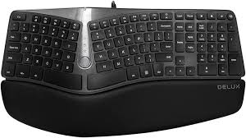
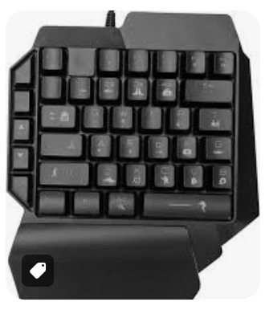
Variations in Keyboard Design:
Size and packaging of keyboards affect user satisfaction. Larger keyboards are perceived as professional but may intimidate novice users, while smaller keyboards are seen as compact and useful for mobile devices.
Special one-handed keyboards are highlighted for tasks requiring simultaneous data entry and object manipulation, which can be helpful for certain professional roles.
Ergonomic keyboards, which are adjustable or split to reduce physical strain, are shown to benefit users by reducing stress on hands and arms.

Slide 10
Innovation in Mobile Keyboards:
Tiny keyboards on mobile devices, such as those on Blackberries or phones, are evolving, with designs ranging from static and dynamically labeled keys to virtual keyboards and foldable designs, to improve user experience and portability.

Slide 11
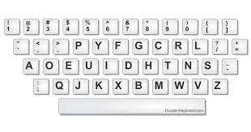
KEYBOARD LAYOUT
QWERTY Layout
Developed by Christopher Latham Sholes in the 1870s to prevent typewriter jams by spacing frequently used letter pairs far apart.
This layout became the standard, even after the mechanical problems it addressed were eliminated by electronic keyboards.
Dvorak Layout
Created in the 1920s to reduce finger travel and increase typing speed (potentially more than 200 words per minute).
Despite its documented efficiency, it has seen limited acceptance due to the effort required to learn and switch from QWERTY.

Slide 12
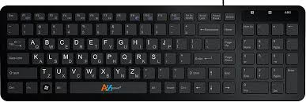
ABCDE Layout:
An alphabetical keyboard arrangement, designed for easier use by non-typists.
Despite its intuitive layout, it shows no advantage over QWERTY, and users generally prefer to learn QWERTY instead.
Placement of Non-Alphabetic Keys:
The debate over the placement of keys like HOME or INSERT has lessened due to the rise of smaller keyboards on laptops and pocket devices.
There’s also a minor controversy over the number pad layout, where telephones use the 1-2-3 order on the top row, but most computer keyboards follow the 7-8-9 calculator layout.

Slide 13
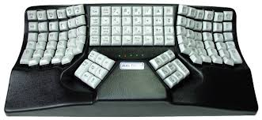
Ergonomic Keyboards:
  Redesigned split keyboards aim to reduce strain by separating keys for each hand and supporting better posture.
  Although these designs have shown preference for comfort, there’s limited empirical evidence of improvements in typing speed, accuracy, or reduced strain.
Specialized Keyboards for Users with Disabilities:
  Innovative designs, like KeyBowl’s orbiTouch (which replaces keys with bowls), help users with conditions like carpal tunnel syndrome or arthritis by reducing wrist and finger movements.
  Other devices, like Dasher, allow users to input text through continuous 2D streams of predicted characters, using pointing devices such as mice, touchpads, or eye-trackers.

Slide 14
KEYS
Key Design:
Modern keyboards have refined 12-millimeter-square keys with concave surfaces and a matte finish for better finger contact and reduced glare.
A keypress requires 40-125 grams of force and a 3-5 millimeter displacement, optimized for rapid typing, low error rates, and suitable feedback.
The tactile and audible feedback from a light click is crucial for touch typing, which is why membrane keyboards (with nonmoving surfaces) are unsuitable for extensive typing but acceptable for harsh environments like fast food restaurants or factories.

Slide 15
Special Key Design:
Larger keys, such as the space bar, ENTER, SHIFT, and CTRL, are designed for easier and more reliable access.
Keys like CAPS LOCK and NUM LOCK provide visual feedback (e.g., physical locking or an embedded light) to show their state.
"Home" keys (F and J) often have a deeper concavity or raised dots to help touch typists position their fingers correctly.
Key labels should be readable, permanent, and meaningful; large-print keyboards are available for visually impaired users.

Slide 16
Function Keys and Key Combinations:
Function keys (e.g., F1-F10) are less commonly used today, with key combinations (e.g., CTRL-C for Copy) becoming more popular due to mnemonic value and keeping hands on the home keys.
Function keys may still be used for special or programmed functions.

Slide 17
Cursor Movement Keys:
Cursor-movement keys (up, down, left, right) have become more important with form-filling and direct-manipulation interfaces.
The popular inverted-T arrangement minimizes hand and finger movement for quick, error-free navigation.
Additional keys like TAB, HOME, END, and key combinations (e.g., CTRL with arrow keys) allow for faster, larger movements.
In some applications, letter keys may be reassigned as cursor-movement keys to minimize finger motion (e.g., in games).

Slide 18
Auto-Repeat Feature:
Most keys have an auto-repeat function, where holding down the key automatically repeats the character or action.

Slide 19
SMALL SIZED KEYBOARDS FOR OTHER DEVICES
Reduced-Size Keyboards:
Mini Keyboards: Smaller devices like laptops use full-sized keyboards, but some portable devices have greatly reduced sizes. Wireless or foldable keyboards allow greater flexibility.
Virtual Keyboards: These project an image of a keyboard on a flat surface, with sensors tracking finger movements. They accommodate various sizes and international layouts but lack tactile feedback for touch typing.
Cloth Keyboards: A new innovation by ElekSen that can be folded into any shape, but like virtual keyboards, they also lack tactile feedback.

Slide 20
Mobile Phone Keypads:
Multi-function Devices: Phones now handle messaging, photography, and web access, leading to innovations in text entry.
Softkeys: Dynamically labeled keys located below the display that change based on the device's status and context.
Number Keypad Layout: Phones typically use a standard number layout, with some rare exceptions, like circular layouts.

Slide 21
Text Entry Methods for Phones:
MultiTap: Users press a number key multiple times to specify a letter and pause between letters on the same key.
Predictive Text (T9): Dictionary-based predictive text entry is preferred for faster messaging.
LetterWise: A method that uses probabilities of prefixes for easier text input of non-dictionary words, resulting in faster typing speeds (20 words per minute) compared to MultiTap (15 words per minute).

Slide 22
Pointing and Drawing Devices:
Many handheld devices have dropped physical keyboards, relying on touchscreens and styluses for text entry.
Virtual Keyboards: On larger screens, users can tap virtual keyboards to type. Studies show typing speeds of 20-30 words per minute with practice.
Handwriting Recognition: Writing on touch-sensitive surfaces with a stylus is another option, but accuracy is often problematic. Improved recognition can be achieved using context, stroke speed, and direction.

Slide 23
Gestural Data Entry:
Simplified Character Sets (Graffiti): Graffiti, used by Palm devices, simplifies the character set for easier recognition but requires user training.
EdgeWrite: Developed for users with disabilities, this method uses a physical border to frame the drawing area, recognizing characters based on hitting corners. EdgeWrite improves accuracy and accessibility for users with motor impairments who struggle with traditional keyboards.

Slide 24
Pointing Devices
Pointing devices enable users to avoid learning keyboard commands, reducing errors and improving efficiency in tasks like computer-aided design or air-traffic control.
They are particularly useful for smaller devices and large displays where keyboards are impractical, allowing direct interaction with the interface.

Slide 25
Pointing Devices
Categories of Pointing Tasks:
Select: Users pick an item from a set, such as choosing a file from a directory or a part in a design.
Position: Users place a point in one, two, or three-dimensional space, such as positioning windows or moving text blocks.
Orient: Users choose a direction in space, such as rotating symbols, controlling a robot, or indicating motion.
Path: Involves rapid movements for creating paths, like drawing curves or issuing machine instructions.
Quantify: Users specify numeric values, like setting sound amplitude or page numbers.
Text: Involves editing and manipulating text, including centering, setting margins, and page layout.

Slide 26
Categories of Pointing Devices:
Direct Control: Devices like touchscreens and styluses allow interaction directly on the screen surface.
Indirect Control: Devices such as mice, trackballs, joysticks, graphics tablets, and touchpads offer indirect control, with frequent novel designs emerging in both categories.

Slide 27
Direct-Control Pointing Devices
Direct-control pointing devices allow users to interact directly with the screen or surface. These devices create a sense of immediate control, as users touch or manipulate items directly on the display surface where the action occurs. Some of the most common direct-control devices include:

Slide 28
Touchscreens
Stylus Pens
Lightpens
Multi-touch Surfaces

Slide 29
Indirect-Control Pointing Devices
Indirect-control pointing devices function away from the display screen, requiring users to control an on-screen cursor or pointer through the device. These devices typically offer more precision for detailed tasks but can demand greater hand-eye coordination. Examples of indirect-control devices include:

Slide 30
Mouse
Trackball
Joystick
Trackpoint
Touchpad
Graphics Tablet

Slide 31
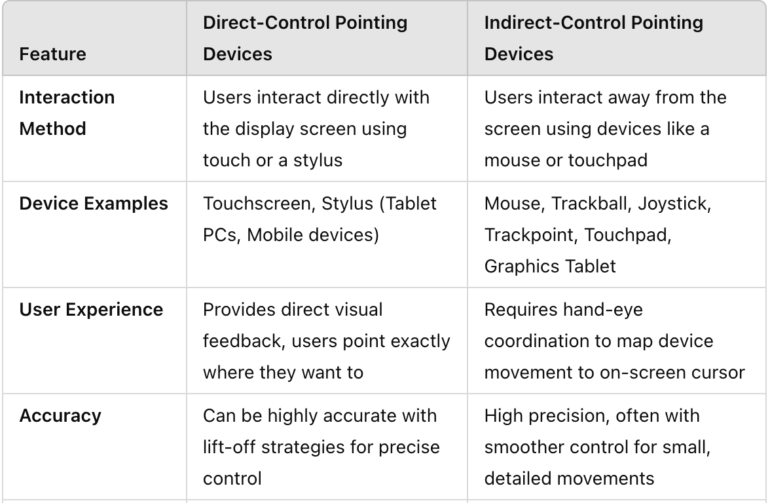

Slide 32
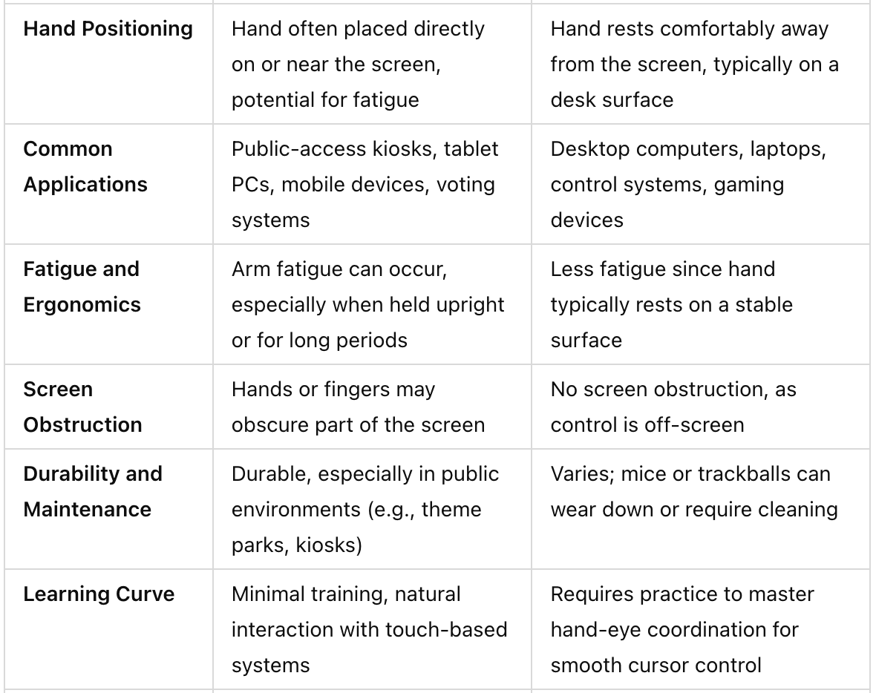

Slide 33
