Slide 1
UNIT-V
(Counters)

Slide 2
Contents
Topics :
  Counters
    Ripple Counter
      Binary Ripple Counter
      BCD Ripple Counter
      Synchronous Counter
        2-Bit, 3-Bit, 4-Bit Synchronous Counter
        Up-Down Counter
        BCD Synchronous Counter
        Binary Counter with Parallel Load

Slide 3
INTRODUCTION
A counter is a device which can count any particular event on the basis of how many times the particular event(s) is occurred.
In a digital logic system or computers, this counter can count and store the number of time any particular event or process have occurred, depending on a clock signal.
Most common type of counter is sequential digital logic circuit with a single clock input and multiple outputs.
In our Daily Life Digital Clock is the Best Example of Counters.

Slide 4
Contd..
The counter is one of the widest applications of the flip flop.
Counters are used not only for counting but also for measuring Frequency and Time.
Counters are designed by grouping of Flip-flops and applying a Single Clock signal to them.
The sequence of states may follow the binary number sequence or any other sequence of states.
A counter that follows the binary number sequence is called a binary counter .

Slide 5
Contd..
An n ‐bit binary counter consists of n flip‐flops and can count in binary from 0 through 2^{n} -1.
There are 2 types of Counters.
  1. Asynchronous Counter or Ripple Counter
  2. Synchronous Counter

Slide 6
Asynchronous Counter
The Asynchronous counter is also known as the ripple counter.
Here we can use Two Flip Flops , ie, J-K Flip Flop and T- Flip Flop.
These two flip flops are in Toggle State.
The external clock pulse is applied to only one flip flop. The output of this flip flop is treated as a clock pulse for the next flip flop.

Slide 7
Contd..
The number of flip flops used in a ripple counter is depends up on the number of states of counter
(ex: Mod 4, Mod 2 etc.).
The number of output states of counter is called “Modulus” or “MOD” of the counter.
The maximum number of states that a counter can have is 2n where n represents the number of flip flops used in counter.
For example, if we have 2 flip flops, the maximum number of outputs of the counter is 4 i.e. ₂². So it is called as “MOD-4 counter” or “Modulus 4 counter”.

Slide 8
Contd..
These counters can count in different ways based on their circuitry.
1. UP COUNTER: Counts the values in ascending order.
2. DOWN COUNTER: Counts the values in descending order.
3. UP-DOWN COUNTER: A counter which can count values either in the forward direction or reverse direction is called an up-down counter or reversible counter.

Slide 9
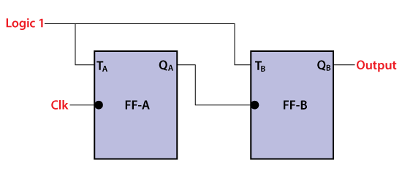
Contd..
Below is a diagram of the 2-bit Asynchronous counter in which we used two T flip-flops. Apart from the T flip flop, we can also use the JK flip flop by setting both of the inputs to 1 permanently.
The external clock pass to the clock input of the first flip flop, i.e., FF-A and its output, i.e., is passed to clock input of the next flip flop, i.e., FF-B.

Slide 10
BCD Ripple Counter
A decimal counter follows a sequence of 10 states and returns to 0 after the count of 9.
Such a counter must have at least four flip‐flops to represent each decimal digit.
since, a decimal digit is represented by a binary code with at least four bits.
If BCD is used, the sequence of states is as shown in the state diagram.

Slide 11
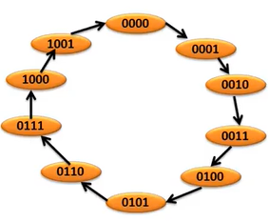
Contd..
A decimal counter is similar to a binary counter, except that the state after 1001 (the code for decimal digit 9) is 0000 (the code for decimal digit 0).
State Diagram:

Slide 12
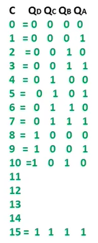

Contd..
But in BCD Counter total No. of States are: 0 to 9.
BCD Counter is also called Modulo-10 Counter.
For Designing of BCD Counter, we need 4 bits. So that we consider 4- Flip Flops.
Here we considered 4- T Flip Flops and provide Logic-1.

Slide 13
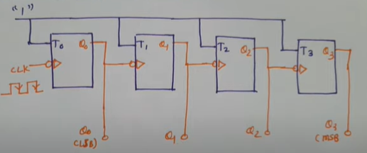
Contd..
In T- Flip Flop , if T=1 , then output will be Toggle after every clock signal Triggering.

Slide 14
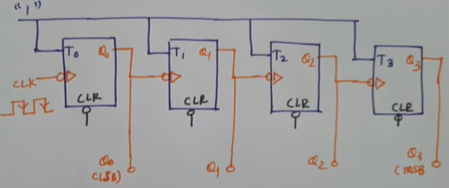
Contd..
In this Flip Flop it will be counting 0 to 15. but it will be stopping 1010.
So that here we can apply the clear terminal.
Here Clear Terminal is active low signal, if Clr=0, then output will be Q=0.

Slide 15
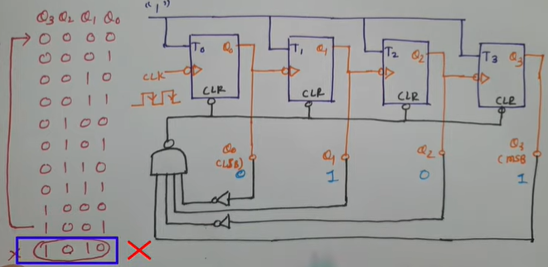
Contd..
This Clear Terminal, we want to connect with NAND Gate . And this NAND Gate output will connect to all Clear Terminals.

Slide 16
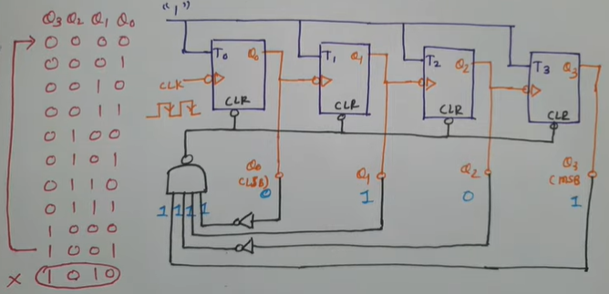
Contd..
After Inverting, the output is 1111. so, here all 1’s the output if the NAND Gate is ‘0’.
As this ‘0’ , then all Flip Flops will get Clear.
Finally this state jump to 0000.

Slide 17
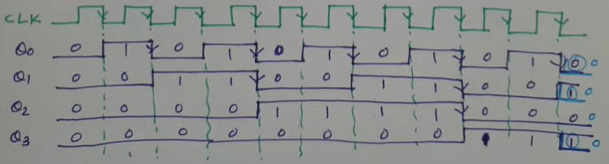
Contd..
Timing Diagram:

Slide 18
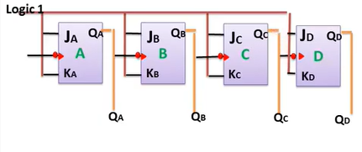
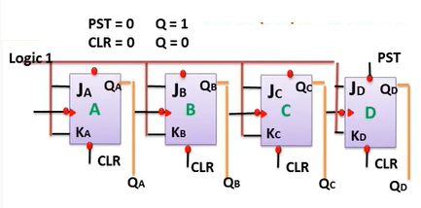
BCD Ripple Counter using J-K Flip Flop
Circuit Diagram:
Step-2: here we can use Clear and Preset to change the output.

Slide 19
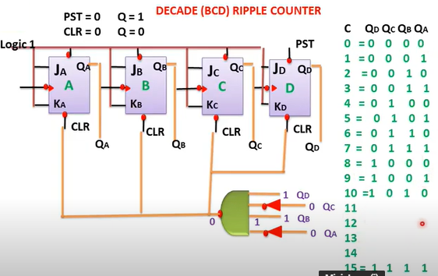
Contd..
Step-3:

Slide 20
Contd..
Step-4:

