Slide 1
UNIT-V
(Counters)

Slide 2
Synchronous Counter
Synchronous counters are different from ripple counters in that clock pulses are applied to the inputs of all flip‐flops.
A common clock triggers all flip‐flops simultaneously, rather than one at a time in succession as in a ripple counter.
If T = 0 or J = K = 0, the flip‐flop does not change state. If T = 1 or J = K = 1, the flip‐flop complements.
The disadvantage of Asynchronous Counter is each Flip flop is triggered by the Previous Flip Flop. So that the speed of operation was slow.

Slide 3
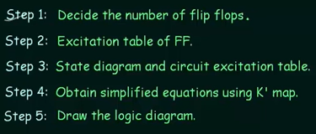
Contd..
To overcome this difficulty the parallel Flip-flops or Synchronous Flip-flops was designed.
Below is a diagram of the 2-bit Synchronous counter in which we used two J-K flip-flops.
How to Design Synchronous Counter :

Slide 4
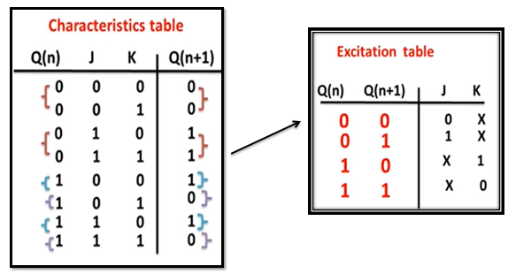
Contd..
Excitation Table for J-K Flip Flop

Slide 5
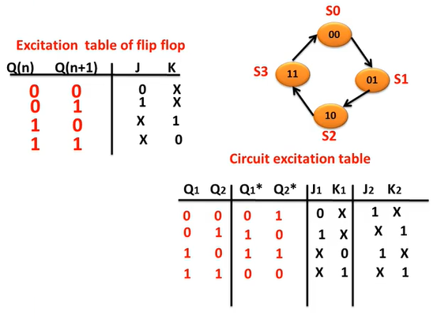
Contd..
Based on the Excitation Table, we can write State Diagram and Circuit Excitation Table.

Slide 6
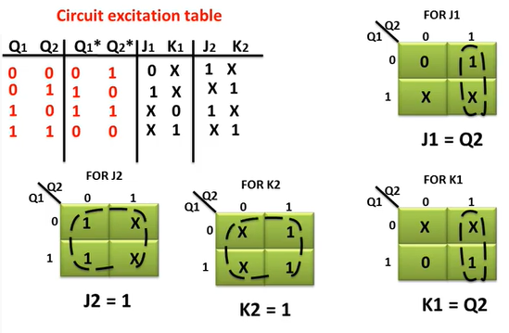
Contd..
Based on the Circuit Excitation Table write the K-Map.

Slide 7
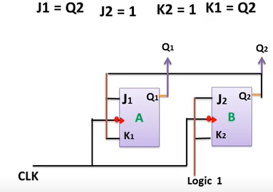
Contd..
Finally implement the 2 Bit Synchronous UP Counter using J-K Flip Flop.

Slide 8
3- Bit Synchronous UP Counter
Excitation Table for J-K Flip Flop

Slide 9
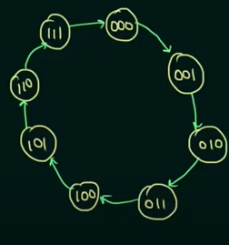
Contd..
Based on the Excitation Table, we can write State Diagram and Circuit Excitation Table.

Slide 10
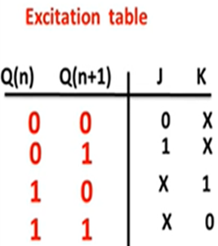
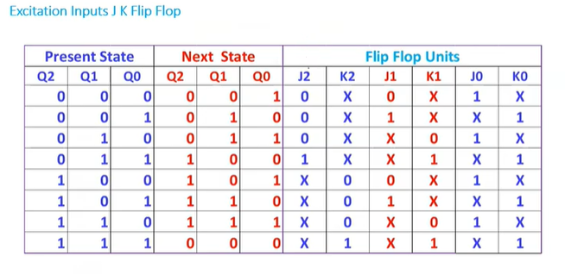
Contd..
Based on the Excitation Table, we can write Circuit Excitation Table.

Slide 11
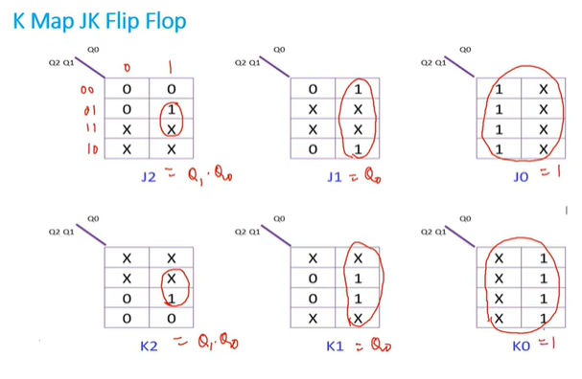
Contd..

Slide 12
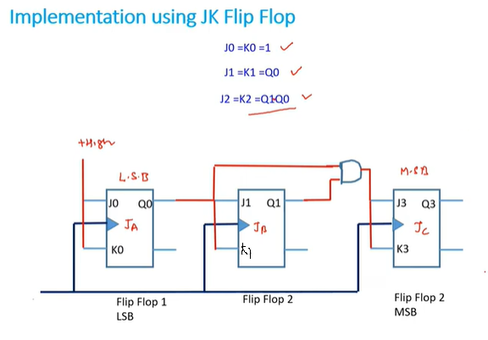
Contd..

Slide 13
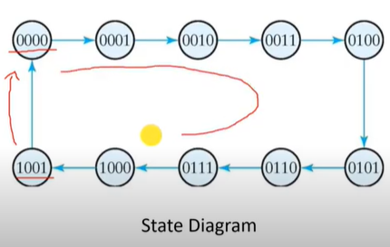
4- Bit Synchronous UP Counter
State Diagram:

Slide 14
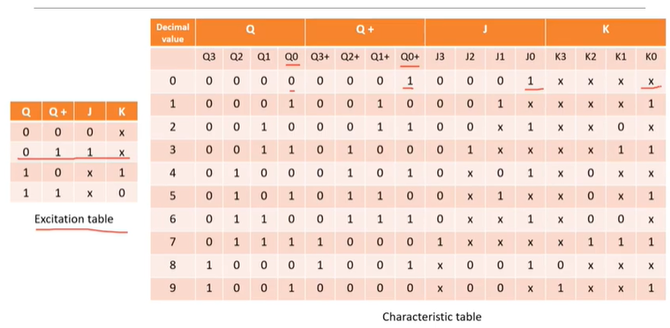
Contd..

Slide 15
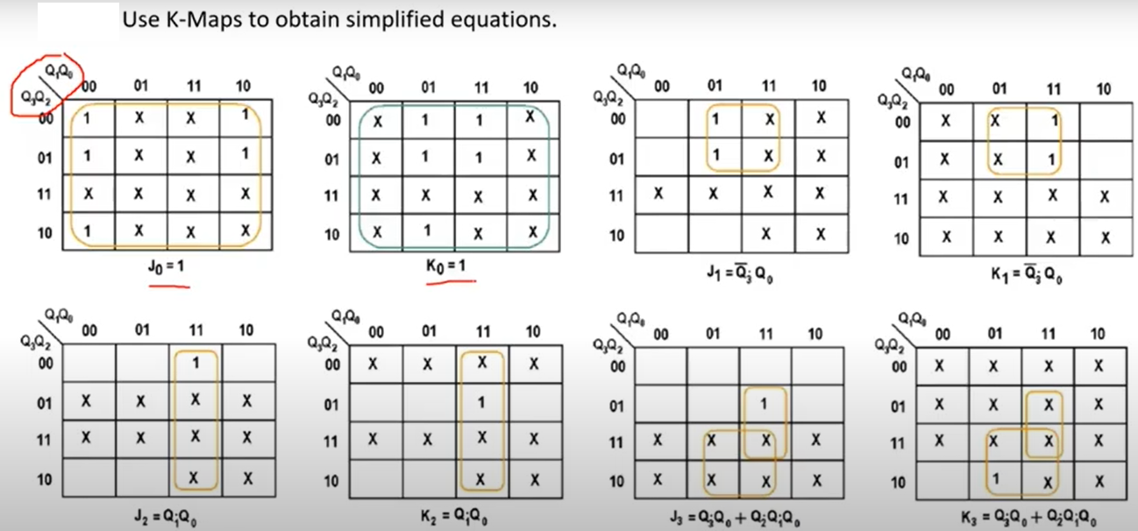
Contd..

Slide 16
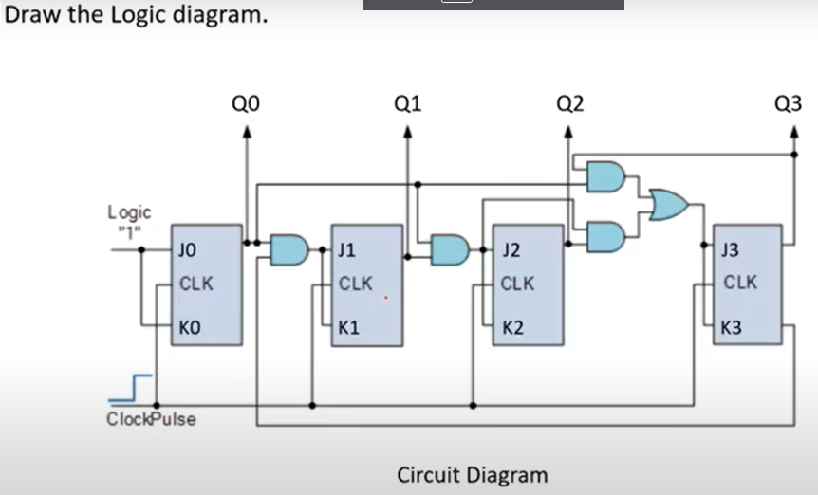
Contd..

Slide 17
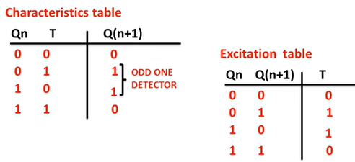
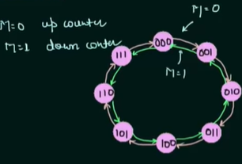
3- Bit UP-Down Binary Counter
First we can take Excitation table for T- Flip Flop and find State Table

Slide 18
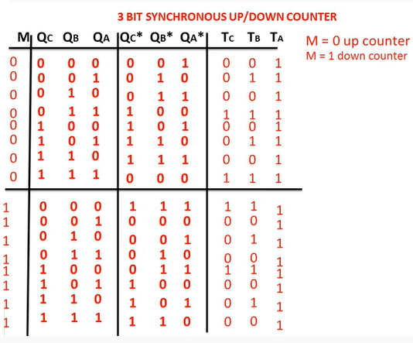
Contd..
Characteristic Table

Slide 19
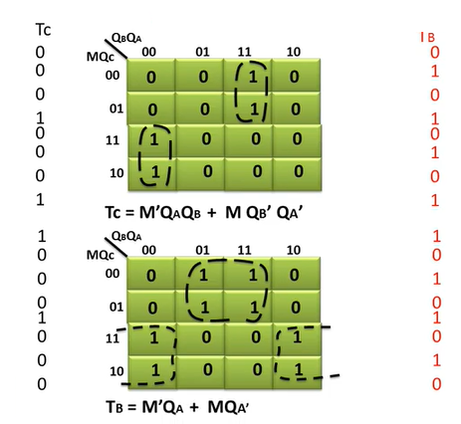
Contd..
K-Map

Slide 20
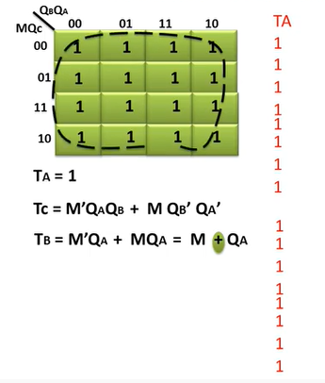
Contd..
K-Map

Slide 21
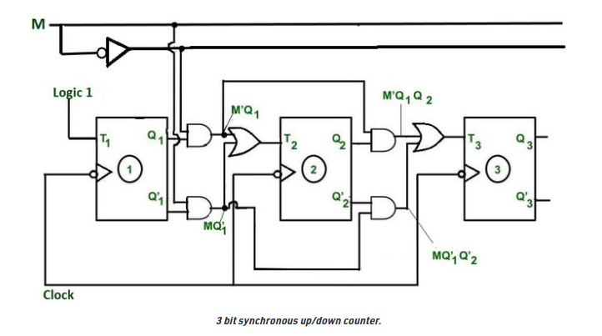
Contd..
Logic Diagram

Slide 22
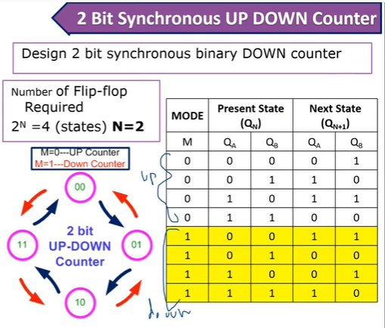
2- Bit UP-Down Binary Counter

Slide 23
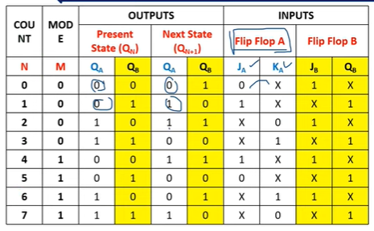
Contd..
Write the Characteristic Table for J-K Flip Flop

Slide 24
BCD Synchronous Counter
A BCD counter counts in binary‐coded decimal from 0000 to 1001 and back to 0000.
Because of the return to 0 after a count of 9, a BCD counter does not have a regular pattern, unlike a straight binary count.
To derive the circuit of a BCD synchronous counter, it is necessary to go through a sequential circuit design procedure.

Slide 25
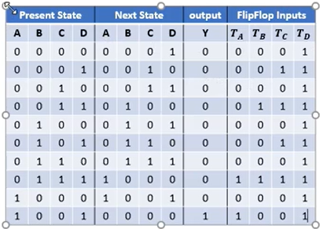
Contd..
Characteristic Table:

Slide 26
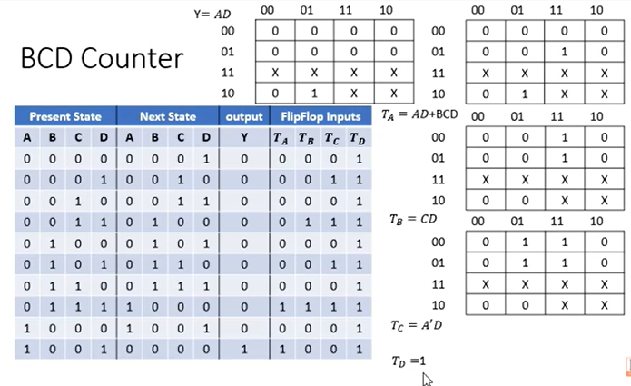
Contd..
K-Map:

Slide 27
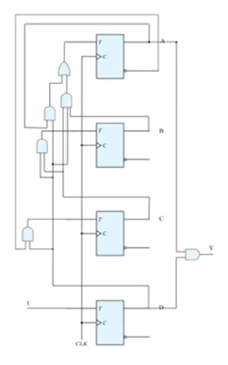
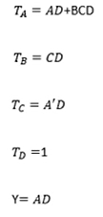
Contd..
Circuit Diagram:

Slide 28
Binary Counter with Parallel Load
A counter with a parallel load can be used to generate any desired count sequence.
Counters employed in digital systems quite often require a parallel‐load capability for transferring an initial binary number into the counter prior to the count operation.
The given figure shows the top‐level block diagram symbol and the logic diagram of a four‐bit register that has a parallel load capability and can operate as a counter.

Slide 29
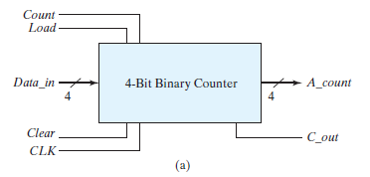
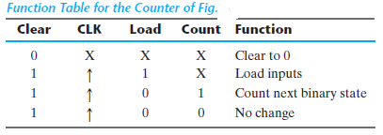
Contd..
When equal to 1, the input load control disables the count operation and causes a transfer of data from the four data inputs into the four flip‐flops.
If both control inputs are 0, clock pulses do not change the state of the register.

Slide 30
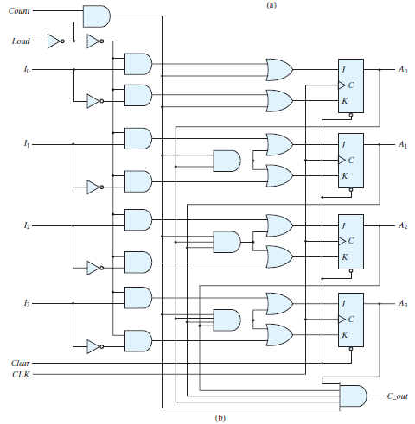
Circuit Diagram

Slide 31
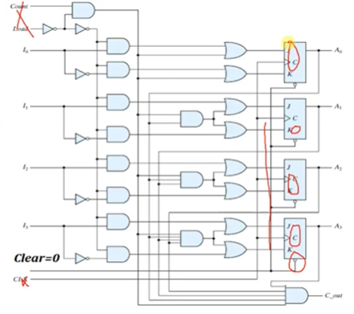
When Clear=0, The Clear input is asynchronous and, when equal to 0, causes the counter to be cleared regardless of the presence of clock pulses or other inputs.

Slide 32
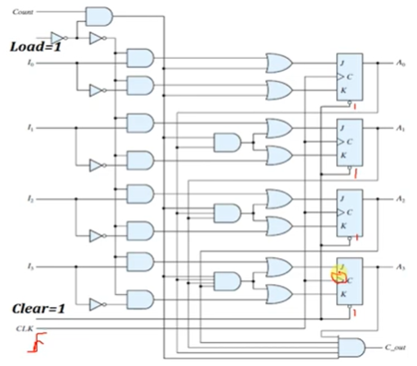
When Clear=1, all flip flops is given as 1, and flip flops inputs are dependent on the clock.

Slide 33
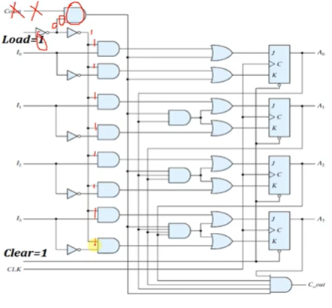
When Load=1

Slide 34
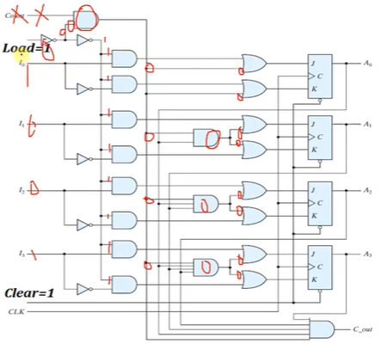
When Load=1,

Slide 35
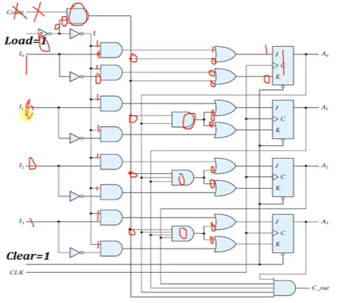
When Load=1, for eg: input : 1001, when first input I0, then out put is “SET”

Slide 36
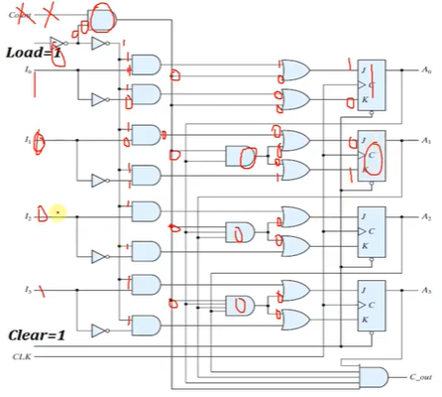
When Load=1, for eg: input : 1001, when first input I1, then out put is “RESET”

Slide 37
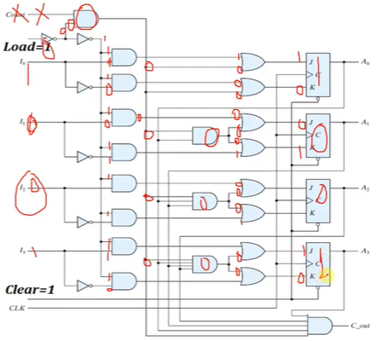
When Load=1, for eg: input : 1001, when first input I2,I3, then out put is “SET” and “RESET”

Slide 38
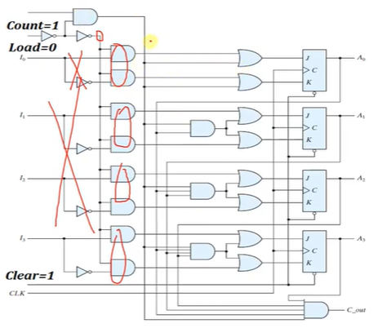
When Load=0,

Slide 39
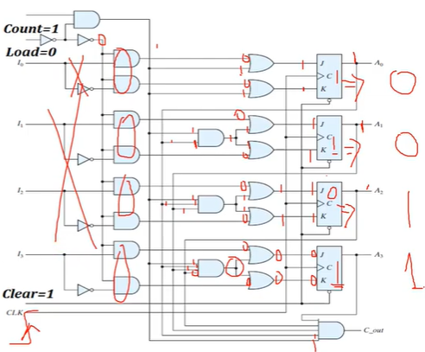
When Count = 1, Load=0,

Slide 40
When Count = 1, Load=0,

Slide 41
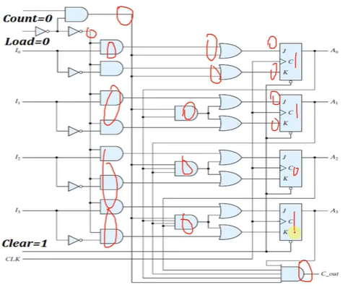
When Count = 0, Load=0,

Slide 42
Other Counters
Counters can be designed to generate any desired sequence of states. A divide‐by‐ N counter (also known as a modulo‐ N counter) is a counter that goes through a repeated sequence of N states.
Counters are used to generate timing signals to control the sequence of operations in a digital system.
Counters can also be constructed by means of shift registers.

Slide 43
Contd..
Here, we present a few examples of non binary counters. Those are:
  Ring Counter
  Johnson Counter

Slide 44
RING COUNTER
It is the Application of Shift Register.
A ring counter is a special type of application of the Serial IN Serial OUT Shift register.
The only difference between the shift register and the ring counter is that the last flip flop outcome is taken as the output in the shift register.
But in the ring counter, this outcome is passed to the first flip flop as an input. All of the remaining things in the ring counter are the same as the shift register.

Slide 45

Contd..
A ring counter is a circular shift register with only one flip‐flop being set at any particular time; all others are cleared.
Here the output of the last Flip flop is connected to the input of First Flip Flop.
Now we can show the Ring Counter by using D- Flip Flop.
A ring counter of n-bits has only n valid states instead of 2^{n} states.

Slide 46
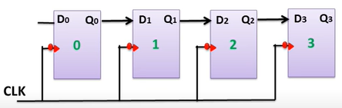
Contd..
Here , first we can take 4 D- Flip Flops , all have the same Clock Signal. Because Here we can follow the Synchronous Counter.

Slide 47
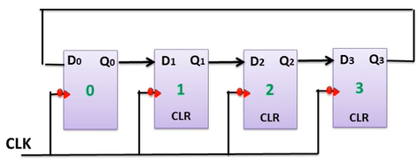
Contd..
The output of last Flip Flop is connected to input of First Flip Flop.

Slide 48
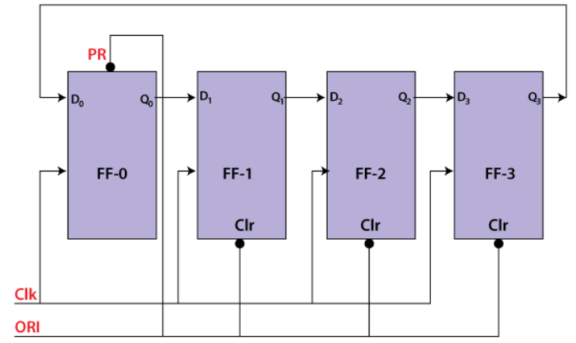
Contd..
Here, in Ring Counter we can use The Overriding input(ORI) is used to design this circuit.
The Overriding input is used as clear and pre-set.

Slide 49
Contd..
Here the preset (P) pin is meant to initialize the counter by loading a certain bit-pattern into it,
while the clear (C) pin is meant to clear all the flip-flops in the chain.
Usually, ring counters are loaded with a pattern where in all are zeros while a single bit will be one, for which, the ring counters are also called one-hot counters.
For example, a 4-bit ring counter will be loaded with a bit pattern of 0001.

Slide 50

Contd..
The output is 1 when the pre-set set to 0.
The output is 0 when the clear set to 0.
Both PR and CLR always work in value 0 because they are active low signals.

Slide 51
Contd..
Working Procedure: The ORI input is passed to the PR input of the first flip flop, i.e., FF-0, and it is also passed to the clear input of the remaining three flip flops, i.e., FF-1, FF-2, and FF-3.
The pre-set input set to 0 for the first flip flop. So, the output of the first flip flop is one, and the outputs of the remaining flip flops are 0. The output of the first flip flop is used to form the ring in the ring counter and referred to as Pre-set 1.

Slide 52
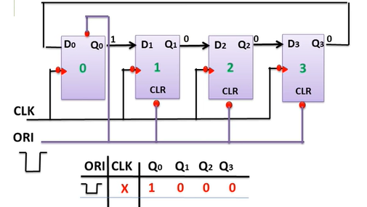
Contd..

Slide 53
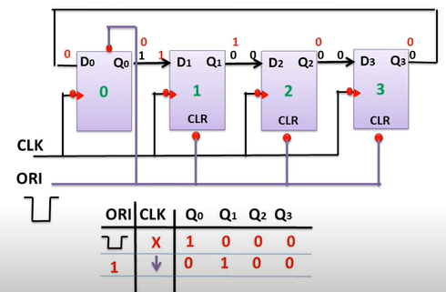
Contd..
Next, last Flip Flop output is moved to the First Flip Flop input in the Ring Counter.

Slide 54
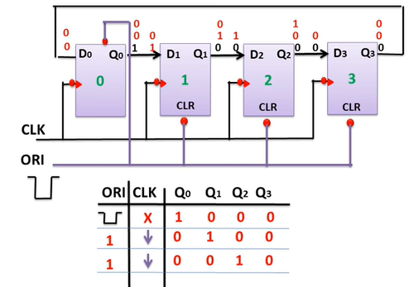
Contd..
Next, iteration

Slide 55
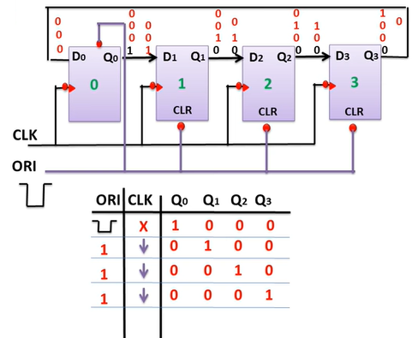
Contd..
Next, iteration

Slide 56
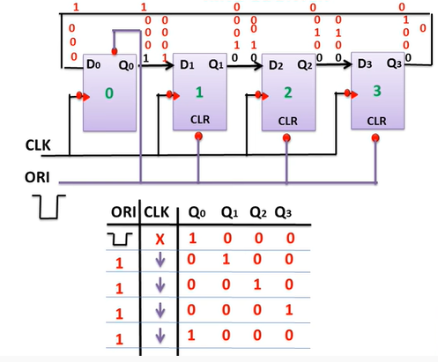
Contd..
Next, iteration

Slide 57
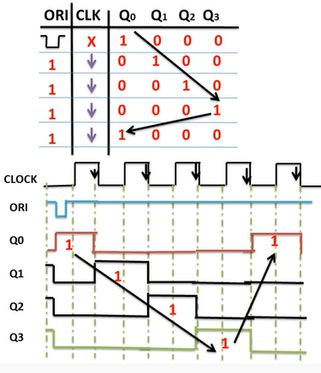
Contd..
Finally, if we observe that

Slide 58
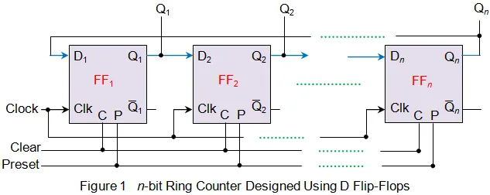
Contd..
N-bit Ring Counter

Slide 59
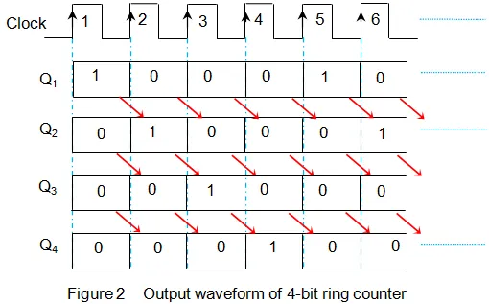
Contd..
Timing Diagram:

Slide 60

Contd..

Slide 61
JOHNSON COUNTER
The Johnson counter is similar to the Ring counter.
The only difference between the Johnson counter and the ring counter is that the outcome of the last flip flop is passed to the first flip flop as an input.
But in Johnson counter, the inverted outcome Q' of the last flip flop is passed as an input.
The remaining work of the Johnson counter is the same as a ring counter.
The Johnson counter is also referred to as the Creeping counter.

Slide 62

Contd..
Here, we can take 4 D- Flip Flops.

Slide 63

Contd..
The counter produces the output 0000 when there is no clock input passed(0).

Slide 64

Contd..
The counter produces the output 1000 when the 1st clock pulse is passed to the flip flops
The counter produces the output 1100 when the 2nd clock pulse is passed to the flip flops.

Slide 65
Contd..
The counter produces the output 1000 when the 1st clock pulse is passed to the flip flops
The counter produces the output 1100 when the 2nd clock pulse is passed to the flip flops.

Slide 66

Contd..
The counter produces the output 1110 when the 3rd clock pulse is passed to the flip flops

Slide 67

Contd..
The counter produces the output 1111 when the 4th clock pulse is passed to the flip flops.

Slide 68
Contd..
The counter produces the output 0111 when the 5th clock pulse is passed to the flip flops.
The counter produces the output 0011 when the 6th clock pulse is passed to the flip flops.
The counter produces the output 0001 when the 7th clock pulse is passed to the flip flops.

Slide 69

Contd..
Truth Table

Slide 70

Contd..
N-Bit Johnson Counter:

Slide 71

Contd..
N- bit Truth Table

Slide 72

Contd..
Timing Diagram

Slide 73
Difference b/w Ring and Johnson Counter
Ring Counter | Johnson Counter
The output of the last flip flop is given as input to starting flip flop. | The output of the last flip-flop is complemented and given as input to starting flip flop.
Number of states = Number of flip flops used | If ‘n’ number of flip flops are used then ‘2n’ number of states is required.
Input frequency = n | Input frequency = f
Output frequency = f/n | Output frequency = f/2n
Total unused states = ( 2^{n} – n) | Total unused states = ( 2^{n} – 2n)

