Slide 1
Outline of today’s session
Conversion of flip-flop
Procedure
Conversions
SR→ JK,T,D
JK→ SR,T,D
T→ SR,JK,D
D→ SR,JK,T

Slide 2
Necessity of conversion
JK flip – flops and D flip – flops are the most widely used flip – flops. And so their availability in the form of integrated circuits (IC’s) is abundant. Numerous varieties of JK flip – flop and D flip – flop are available in the semiconductor market.
The less popular SR flip – flop and T flip – flop are not available in the market as integrated circuits (IC’s) (even though a very few number of SR flip – flops are available as IC’s, they are not frequently used). There might be a situation where the less popular flip – flops are required in order to implement a logic circuit.
In order use the less popular flip – flops, we will convert one type of flip – flop into another.

Slide 3
Procedure to convert one flip flop into other
Step 1: Identify available and required Flip flop.
Step 2: Make the characteristic table for required Flip flop.
Step 3: Make the excitation table for available Flip flop.
Step 4: Make the conversion table
Step 5: Write the Boolean expression for inputs of available Flip flop.
Step 6: Draw the circuit.

Slide 4
SR Flip – flop to JK Flip – flop
Write the characteristic table for the two inputs J and K. For two inputs along with the Q_{t}, we get 8 possible combinations in characteristic table.
For every combination of J, K ,Q_{t} , we find the corresponding Q_{t+1} state.
Using these Q_{t} and Q_{t+1 ,} we write the values of S and R, using Excitation table
This table is called Conversion table.

Slide 5
Conversion table : SR→ JK

Slide 6
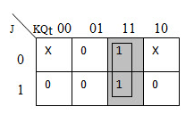
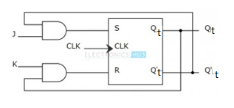
K-Maps: SR→ JK
The K – map for S is shown below:
The K – map for R is shown below:
S=JQ¹_{t}
R=KQ_{t}

Slide 7
SR→ JK, D, T
SR FF to JK FF(Flipflop) conversion equation
S = J*Q_{t}' R = K*Q_{t}
SR FF to D FF(Flipflop) conversion equation
S = D R =D'
SR FF to T FF(Flipflop) conversion equation
S = T*Q_{t}' R = T*Q_{t}

Slide 8
JK→ SR, D, T
JK FF to SR FF(Flipflop) conversion equation
J = S K = R
JK FF to D FF(Flipflop) conversion equation
J = D K = D'
JK FF to T FF(Flipflop) conversion equation
J = K = T

Slide 9
D→ SR, JK, T
D FF to SR FF(Flipflop) conversion equation
D = S + R'*Q_{t}
D FF to JK FF(Flipflop) conversion equation
D = J*Q‘_{t} + K'*Q_{t}
D FF to T FF(Flipflop) conversion equation
D = T (ex-or) Q_{t}

Slide 10
T→ SR, JK, D
T FF to JK FF(Flipflop) conversion equation
T = J*Q'_{t} + K*Q_{t}
T FF to SR FF(Flipflop) conversion equation
T = S*Q'_{t} + R*Q_{t}
T FF to D FF(Flipflop) conversion equation
T = D (ex-or) Q_{t}

Slide 11
Flip-Flop With Asynchronous Inputs (Preset And Clear)
Asynchronous inputs on a flip-flop have control over the outputs (Q and Q¹) regardless of clock input status.
These inputs are called the preset (PRE) and clear (CLR).
The preset input drives the flip-flop to a set state while the clear input drives it to a reset state.
PRESET→ Set state
CLEAR→ Reset state

Slide 12
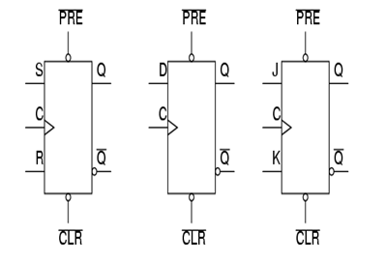
Asynchronous Inputs (Preset And Clear)
Asynchronous inputs, just like synchronous inputs, can be engineered to be active-high or active-low.
If they’re active-low, there will be an inverting bubble at that input lead on the block symbol, just like the negative edge-trigger clock inputs.
Active HIGH
Active LOW

Slide 13
Asynchronous Inputs (Preset And Clear)
When the preset input is activated, the flip-flop will be set (Q=1, not-Q=0) regardless of any of the synchronous inputs or the clock.
When the clear input is activated, the flip-flop will be reset (Q=0, not-Q=1), regardless of any of the synchronous inputs or the clock.
If both preset and clear inputs are activated we get an invalid state on the output.

Slide 14
THANK YOU

