Slide 1
Outline of today’s session
Flipflops
SR
D
JK
T
Operation of SR flip flop
Symbol
Logic circuit
Charateristic Table
Characteristic Equation
Excitation table

Slide 2
SR latch using NOR gates

Slide 3
SR latch using NAND gates

Slide 4
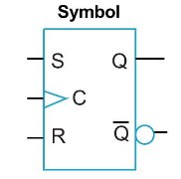
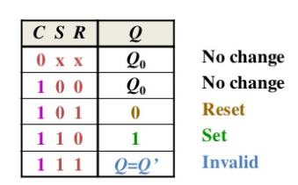
SR flip-flop using NAND gates

Slide 5
SR flip-flop using NAND gates
Operation of SR latch can be modified by providing an additional input signal that may be treated as control input or enable input or clock input.
The enable or clock input determines when the state of the latch can be changed by determining whether S and R can affect the circuit.
It consists of basic SR latch and two additional NAND gates.
S and R inputs are allowed to affect the latch when the clock input is HIGH.
When the CLK input is high (during a clock pulse) the input NAND gates act as inverters.
While the CLK input is low, the two extra NAND gates are disabled. The outputs are completely isolated from the inputs and so retain any previous state.

Slide 6
SR flip-flop characteristic table
S | R | Q_{t} | Q_{t+1}
0 | 0 | 0 | 0
0 | 0 | 1 | 1
0 | 1 | 0 | 0
0 | 1 | 1 | 0
1 | 0 | 0 | 1
1 | 0 | 1 | 1
1 | 1 | 0 | Invalid
1 | 1 | 1 | Invalid
S | R | Q_{t+1}
0 | 0 | Qt
0 | 1 | 0
1 | 0 | 1
1 | 1 | Invalid

Slide 7
SR flip-flop characteristic Equation

Slide 8
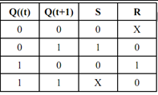
SR flip-flop Excitation table
For a given combination of present state Q_{t} and next state Q_{t+1}, excitation table tell the inputs required.

Slide 9
D flip-flop
D flip flop is a better alternative that is very popular with digital electronics. They are commonly used for counters and shift-registers and input synchronization.
In a D flip flop, the output can be only changed at the clock edge, and if the input changes at other times, the output will be unaffected.

Slide 10
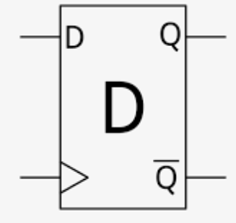
D flip-flop

Slide 11
D flip-flop characteristic table
D | Q_{t} | Q_{t+1}
0 | 0 | 0
0 | 1 | 0
1 | 0 | 1
1 | 1 | 1
D | Q_{t+1}
0 | 0
1 | 1

Slide 12
D flip-flop characteristic Equation
Q_{(t+1)}=D

Slide 13
D flip-flop Excitation table

Slide 14
JK flip-flop
The JK flip flop is an improvement on the SR flip flop where S=R=1 is not a problem.
The input condition of J=K=1, gives an output inverting the output state.

Slide 15
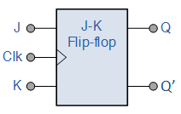
JK flip-flop

Slide 16
JK flip-flop characteristic table
J | K | Q_{t} | Q_{t+1}
0 | 0 | 0 | 0
0 | 0 | 1 | 1
0 | 1 | 0 | 0
0 | 1 | 1 | 0
1 | 0 | 0 | 1
1 | 0 | 1 | 1
1 | 1 | 0 | 1
1 | 1 | 1 | 0
J | K | Q_{t+1}
0 | 0 | Q_{t}
0 | 1 | 0
1 | 0 | 1
1 | 1 | Q¹_{t}

Slide 17
JK flip-flop characteristic Equation
Q_{(t+1)}=J.Q’_{t}+K’.Q_{t}

Slide 18
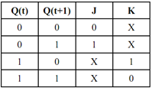
JK flip-flop Excitation table

Slide 19
T flip-flop
A T flip flop is like JK flip-flop. These are basically a single input version of JK flip flop.
This modified form of JK flip-flop is obtained by connecting both inputs J and K together.
This flip-flop has only one input along with the clock input.
These flip-flops are called T flip-flops because of their ability to complement its state (i.e.) Toggle, hence the name Toggle flip-flop.

Slide 20
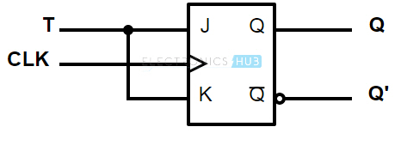
T flip-flop

Slide 21
T flip-flop characteristic table
T | Q_{t} | Q_{t+1}
0 | 0 | 0
0 | 1 | 1
1 | 0 | 1
1 | 1 | 0
T | Q_{t+1}
0 | Q_{t}
1 | Q¹_{t}

Slide 22
T flip-flop characteristic Equation
Q_{(t+1)}=T.Q’_{t}+T’.Q_{t}

Slide 23
T flip-flop Excitation table

Slide 24
Summary of the Types of Flip-flop Behavior

Slide 25
THANK YOU

