Slide 1
Outline of today’s session
RS latch
Operation
Using NAND
Using NOR
Circuit

Slide 2
SR LATCH
A latch is an electronic logic circuit that has two inputs and one output.
One of the inputs is called the SET input; the other is called the RESET input.
Latch is an electronic logic circuit with two stable states i.e. it is a bistable multivibrator.
Latch has a feedback path to retain the information. Hence a latch can be a memory device.
Latch can store one bit of information as long as the device is powered on.

Slide 3
SR latch
SR latch is known as SET-RESET latch.
An SR latch (Set/Reset) is an asynchronous device.
It can be designed with the help of two NOR gates or with two NAND gates that have a cross-feedback loop.
The inputs of an SR latch are labeled S (set) and R (reset) the outputs are labeled as Q and Q’.

Slide 4
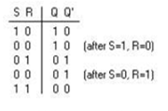
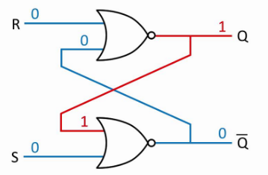
SR latch with NOR gates

Slide 5
Operation of SR latch(NOR)
When S=1, R=0 →Q=1, Q’=0, This state is also called the SET state.
When S=0, R=1→Q=0, Q’=1 This state is known as the RESET state.
In both the states you can see that the outputs are just compliments of each other and that the value of Q follows the value of S.
When S=0, R=0 →Q & Q’ = Previous value of the Q and Q’
(No Change).
If both the values of S and R are switched to 0, then the circuit remembers the value of S and R in their previous state. The value of Q and Q’ are same as their previous values.
When S=1, R=1 → Q=0, Q’=0 [Invalid]
This is an invalid state because the values of both Q and Q’ are 0. They are supposed to be compliments of each other. Normally, this state must be avoided.
This circuit is also known as S’R’ latch.

Slide 6
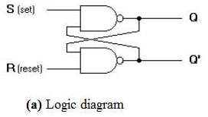
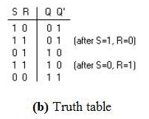
SR latch with NAND gates

Slide 7
Operation of SR latch(NAND)
When S=1, R=0→Q=0, Q’=1 This state is also called the RESET state.
When S=0, R=1→Q=1, Q’=0 This state is known as the SET state.
In both the states the outputs are just compliments of each other and that the value of Q follows the compliment value of S.
When S=0, R=0→Q=1, & Q’ =1 [Invalid]
If both the values of S and R are switched to 0 it is an invalid state because the values of both Q and Q’ are 1. They are supposed to be compliments of each other. Normally, this state must be avoided.
When S=1, R=1→Q & Q’= Previous value of the Q and Q’(No Change).
If both the values of S and R are switched to 1, then the circuit remembers the value of S and R in their previous state.

Slide 8
THANK YOU

