Slide 1
UNIT-III BCD to 7 Segment Display

Slide 2
Contents
Topics :
BCD to 7 Segment Display

Slide 3
BCD to 7 Segment Display
A Digital Decoder IC, is a device which converts one digital format into another and one of the most commonly used devices for doing this is called the Binary Coded Decimal (BCD) to 7-Segment Display Decoder.
BCD (Binary Coded Decimal) is an encoding scheme which represents each of the decimal numbers by its equivalent 4-bit binary pattern.
Seven segment displays comprise of seven individual segments formed by either Light Emitting Diodes (LEDs) or Liquid Crystal Displays (LCDs) arranged in a definite pattern

Slide 4
Contd..
Step-1:

Slide 5
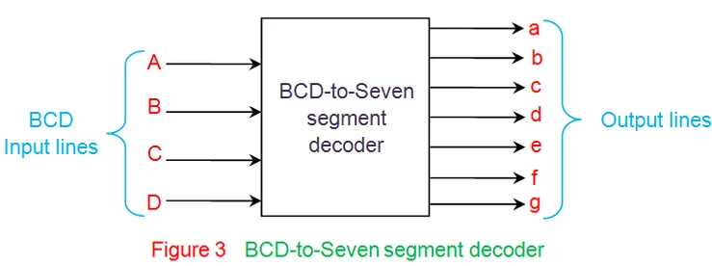
Contd..
BCD to seven segment decoder is a circuit used to convert the input BCD into a form suitable for the display.
It has four input lines (A, B, C and D) and 7 output lines (a, b, c, d, e, f and g) as shown in given figure.

Slide 6
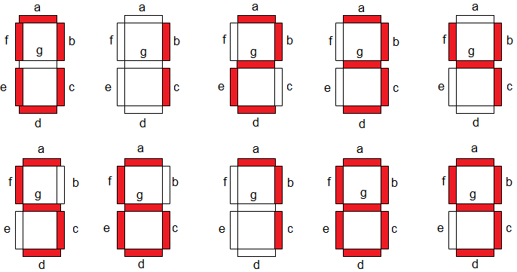
Contd..

Slide 7
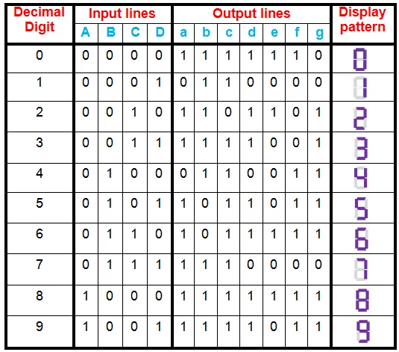
Contd..
Step-2:
Considering common cathode type of arrangement, the truth table for the decoder can be given as in Table I.

Slide 8
Contd..
Step-3:
From the above truth table, the Boolean expressions of each output functions can be written as
a = F1 (A, B, C, D) = ∑m (0, 2, 3, 5,6, 7, 8, 9)
b = F2 (A, B, C, D) = ∑m (0, 1, 2, 3, 4, 7, 8, 9)
c = F3 (A, B, C, D) = ∑m (0, 1, 3, 4, 5, 6, 7, 8, 9)
d = F4 (A, B, C, D) = ∑m (0, 2, 3, 5, 6, 8)
e = F5 (A, B, C, D) = ∑m (0, 2, 6, 8)
f = F6 (A, B, C, D) = ∑m (0, 4, 5, 6, 8, 9)
g = F7 (A, B, C, D) = ∑m (2, 3, 4, 5, 6, 8, 9)

Slide 9
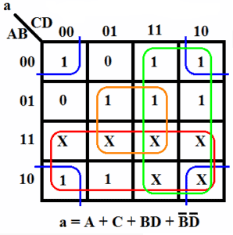
Contd..
Step-4:
Now, we can design the whole circuit by creating Boolean Expression and Circuit Diagram one by one for each segment.
So here we can use the K-Map to find out the Boolean Expression.
For output ‘a’:

Slide 10
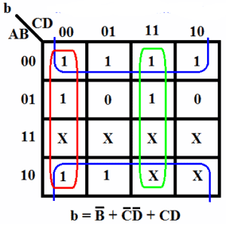
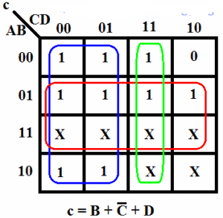
Contd..
For output ‘b’:
For Output ‘C’:

Slide 11
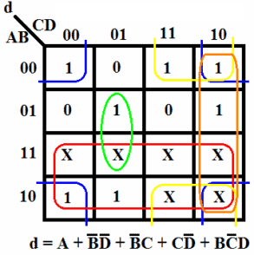
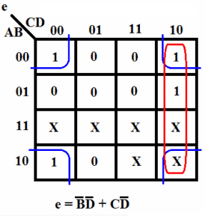
Contd..
For output ‘d’:
For Output ‘e’:

Slide 12
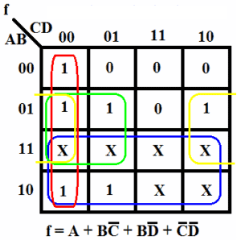
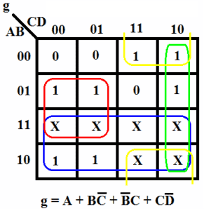
Contd..
For output ‘f’:
For Output ‘g’:

Slide 13
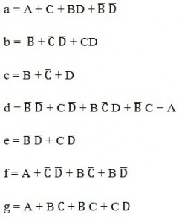
Contd..
From the above simplification, we get the output values as:

Slide 14
Contd..
Step-5:
The final step involves drawing a combinational logic circuit for each output signal.
Once the task was accomplished, a combinational logic circuit can be drawn using 4 inputs (A,B,C,D)and a 7- segment display (a,b,c,d,e,f,g) as output.

Slide 15
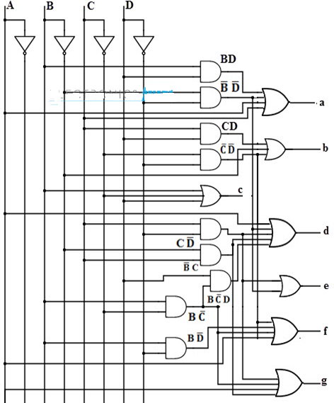

Slide 16
Contd..
Applications:
This circuit can be modified using timers and counters to display the number of clock pulses.
It can be used as a timer circuit.
It can be mainly used in Calculators, Digital Display units etc.
Disadvantages:
This circuit involves lot of logic gates and is quite complex.
Timing delay by each logic gate is a matter of concern and this circuit might not produce accurate results when used to display count of pulses.

