Slide 1
UNIT-III (Decoders, Encoders)

Slide 2
Contents
Topics :
Decoders
Encoders

Slide 3
DECODER
Discrete quantities of information are represented in digital systems by binary codes.
A decoder is a combinational circuit that has ‘n’ input lines and maximum of 2^{n} output lines.
While decoding, the decoder generally places a logic 1 at one of its outputs to create the exact code.
The general structure of a decoder is shown below. It also has an enable input. When it is set to logic HIGH, the coded output will be seen depending on the binary data input.

Slide 4
Contd..
Applications
Code converters
Used in the memory system of computers to access a particular memory location based on the address produced by a computing device.
To carry out the operations in the Arithmetic Logic Unit of CPU, decoders are used to decode the program instructions to activate the control lines.

Slide 5
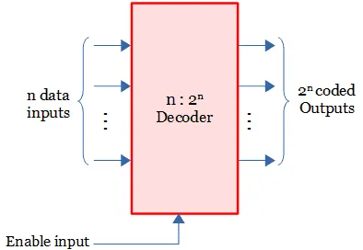
Contd..
There are different type of decoders based on the number of inputs and its coded output.

Slide 6
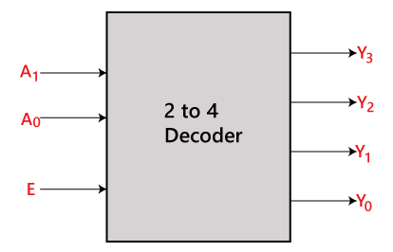
2 to 4 Line Decoder
In the 2 to 4 line decoder, there is a total of three inputs, i.e., A₀, and A₁ and E and four outputs, i.e., Y₀, Y₁, Y₂, and Y₃.
For each combination of inputs, when the enable 'E' is set to 1, one of these four outputs will be 1.
The block diagram and the truth table of the 2 to 4 line decoder are given below.

Slide 7
Contd..
Some binary decoders have an additional input pin labelled “Enable” that controls the outputs from the device.
This extra input allows the decoders outputs to be turned “ON” or “OFF” as required.
These types of binary decoders are commonly used as “memory address decoders” in microprocessor memory applications.
Each output represents one of the minterms of the 2 input variables, (each output = a minterm).

Slide 8
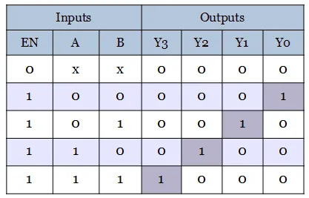
Contd..
By the use of Data Lines it represents the address of memory locations.
Truth Table:
The output values will be: Qo=A’B’ Q1=A’B Q2=AB’ Q3=AB

Slide 9
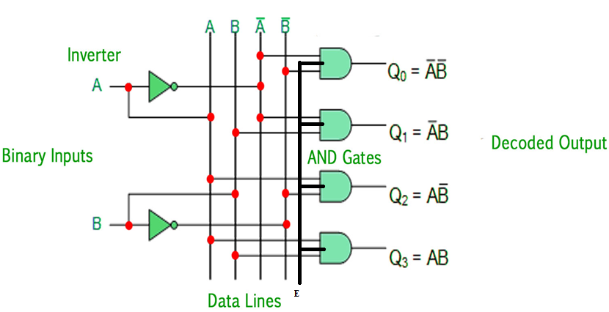
Contd..

Slide 10
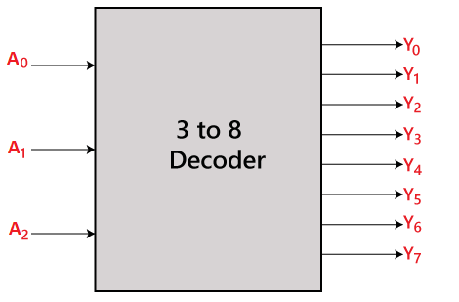
3 to 8 Line Decoder
Block Diagram:
A Decoder with 3 inputs and it gives 8 outputs.

Slide 11
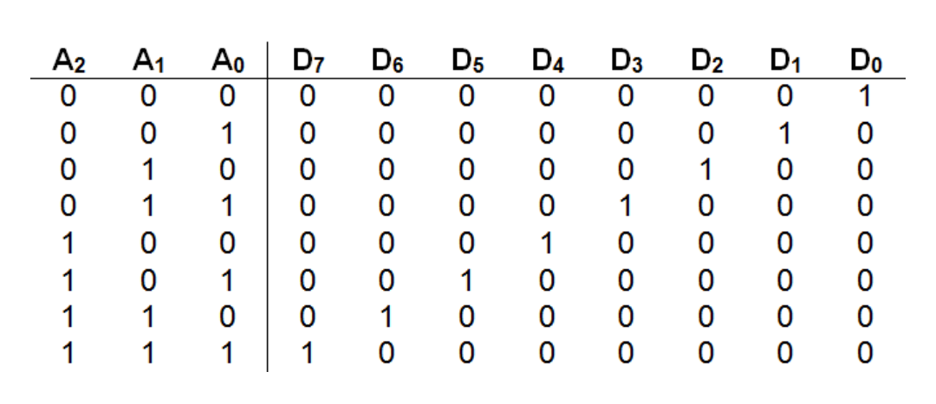
Contd..
Truth Table:

Slide 12
Contd..
The logicial expresión of the term Y₀, Y₁, Y₂, Y₃, Y₄, Y₅, Y₆, and Y₇ is as follows:
Y₀=A₀'.A₁'.A₂' Y₁=A₀.A₁'.A₂' Y₂=A₀'.A₁.A₂' Y₃=A₀.A₁.A₂' Y₄=A₀'.A₁'.A₂ Y₅=A₀.A₁'.A₂ Y₆=A₀'.A₁.A₂ Y₇=A₀.A₁.A₂

Slide 13
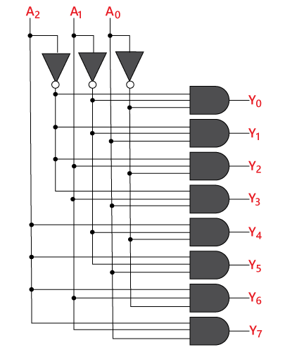
Contd..
Circuit Diagram:

Slide 14
Implementing High Order Decoder to Low Order Decoder
Now, let us implement the following two higher-order decoders using lower-order decoders.
1. 3 to 8 decoder
2. 4 to 16 decoder
1. 3 to 8 Decoder: let us implement 3 to 8 decoder using 2 to 4 decoders. We know that 2 to 4 Decoder has two inputs, A₁ & A₀ and four outputs, Y₃ to Y₀. Whereas, 3 to 8 Decoder has three inputs A₂, A₁ & A₀ and eight outputs, Y₇ to Y₀.

Slide 15
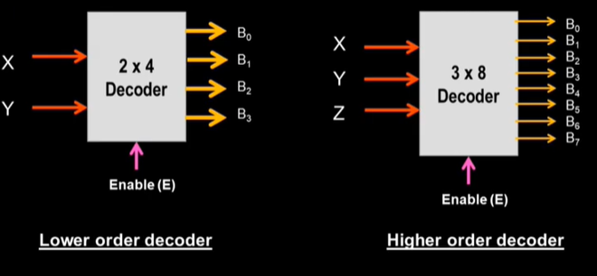
Contd..

Slide 16
Contd..
We can find the number of lower order decoders required for implementing higher order decoder using the following formula.

Slide 17
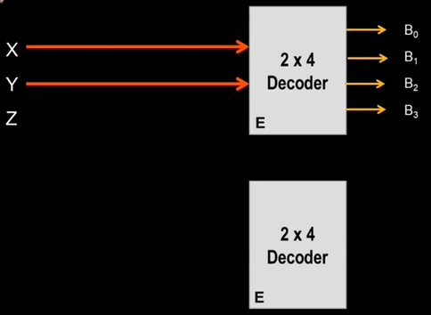
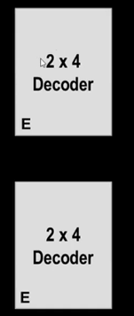
Contd..
Block Diagram:
Step-1:
Step-2:

Slide 18
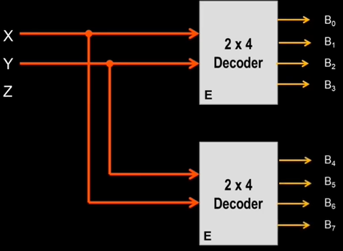
Contd..
Step-3:

Slide 19
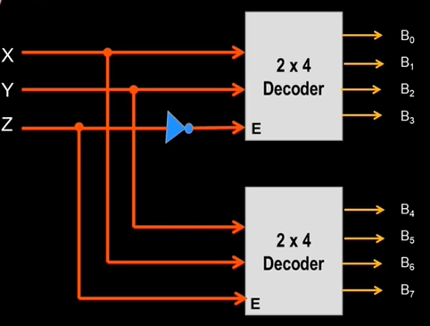
Contd..
Step-4: Both the decoders have the enable line for the 3rd input Z.

Slide 20
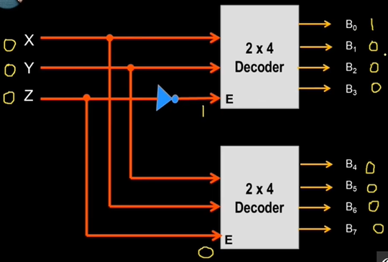
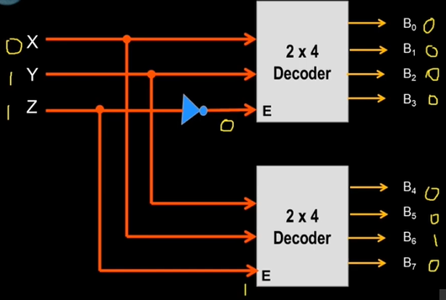
Contd..
For Example

Slide 21
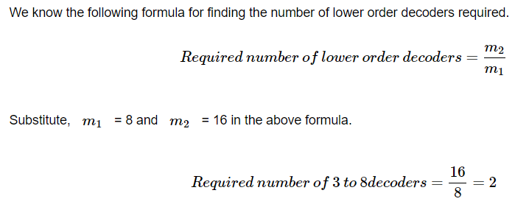
4 to 16 Decoder
Here, 4 to 16 decoder using 3 to 8 decoders.
We know that 3 to 8 Decoder has three inputs A2, A1 & A0 and eight outputs, Y7 to Y0.
Whereas, 4 to 16 Decoder has four inputs A3, A2, A1 & A0 and sixteen outputs, Y15 to Y0:

Slide 22
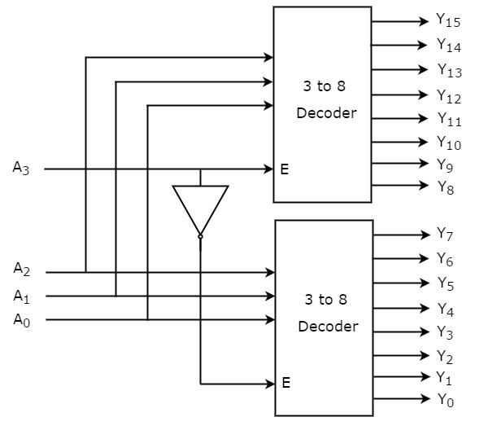
Contd..
Therefore, we require two 3 to 8 decoders for implementing one 4 to 16 decoder. The block diagram of 4 to 16 decoder using 3 to 8 decoders is shown in the following figure.

Slide 23
Contd..
The parallel inputs A₂, A₁ & A₀ are applied to each 3 to 8 decoder.
The complement of input, A3 is connected to Enable, E of lower 3 to 8 decoder in order to get the outputs, Y₇ to Y₀. These are the lower eight min terms.
The input, A₃ is directly connected to Enable, E of upper 3 to 8 decoder in order to get the outputs, Y₁₅ to Y₈. These are the higher eight min terms.

Slide 24
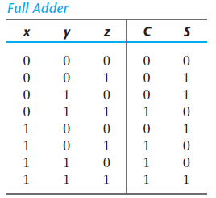
Combinational Logic Implementation
Example-1: we obtain the functions for the combinational circuit in sum-of-minterms form:
S(x, y, z) = (1, 2, 4, 7)
C(x, y, z) = (3, 5, 6, 7)

Slide 25
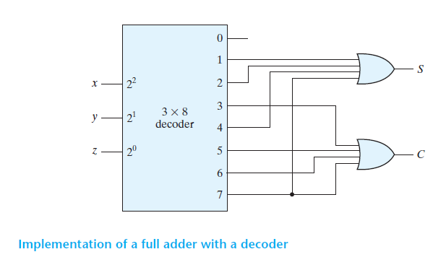
Contd..

Slide 26
ENCODER
An Encoder is a Digital Circuit that performs the reverse operation of the Decoder.
It has maximum of 2^{n} input lines and ‘n’ output lines.
At a time, only one input line is activated for simplicity.
It is optional to represent the enable signal in encoders.
There are various types of Encoders .
4- 2 Encoder
8- 3 Encoder
10- 4 Encoder and many more

Slide 27
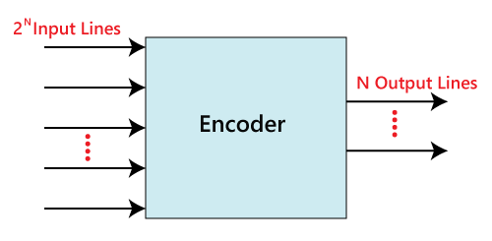
Contd..
Block Diagram:

Slide 28
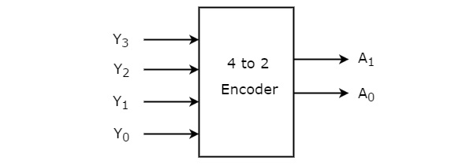
4 – 2 Encoder
In 4 to 2 line encoder, there are total of four inputs, i.e., Y0, Y1, Y2, and Y3, and
In 4-input lines, one input-line is set to true at a time to get the respective binary code in the output side.
Below are the block diagram and the truth table of the 4 to 2 line encoder.

Slide 29
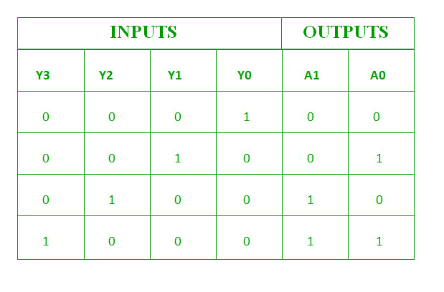
Contd..
Truth Table:
From Truth table, we can write the Boolean functions for each output as: A1=Y3+Y2
A0=Y3+Y1

Slide 30
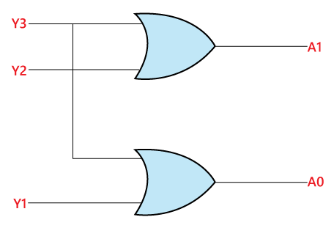
Contd..
Circuit Diagram:
The above Circuit Diagram contains Two OR Gates.

Slide 31
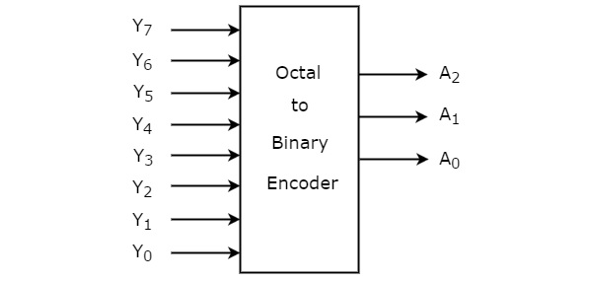
8-3 Encoder or (Octal to Binary)
The 8 to 3 Encoder or octal to Binary encoder consists of 8 inputs : Y7 to Y0 and 3 outputs : A2, A1 & A0. Each input line corresponds to each octal digit and three outputs generate corresponding binary code.
In 8-input lines, one input-line is set to true at a time to get the respective binary code in the output side.

Slide 32
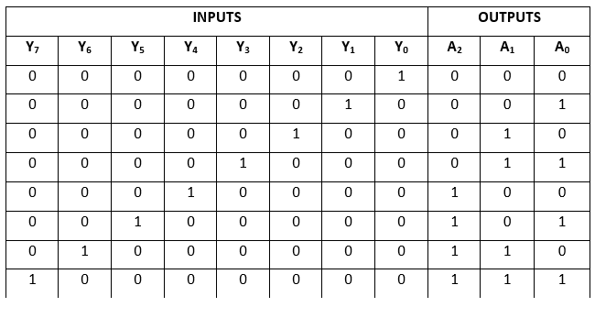
Contd..
Truth Table:
From Truth table, we can write the Boolean functions for each output as
A2=Y7+Y6+Y5+Y4
A1=Y7+Y6+Y3+Y2
A0=Y7+Y5+Y3+Y1

Slide 33
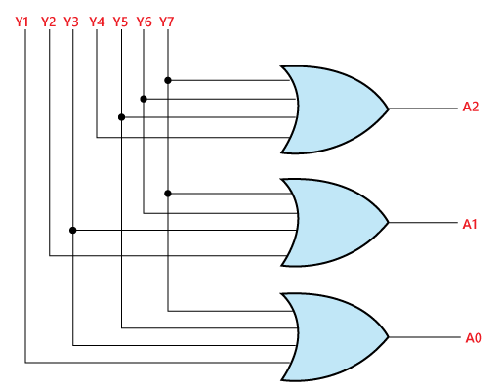
Contd..
Circuit Diagram:

Slide 34
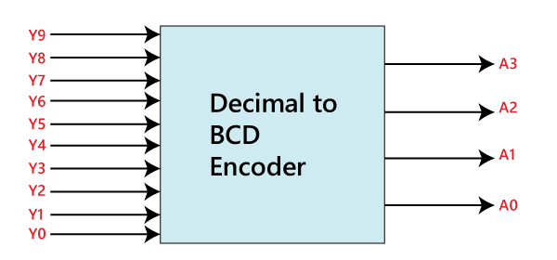
Decimal to BCD Encoder
The Octal to Binary Encoder is also known as 10 to 4 line Encoder. In 10 to 4 line encoder, there are total of ten inputs, i.e., Y0, Y1, Y2, Y3, Y4, Y5, Y6, Y7, Y8, and Y9 and four outputs, i.e., A0, A1, A2, and A3.
In 10-input lines, one input-line is set to true at a time to get the respective BCD code in the output side

Slide 35
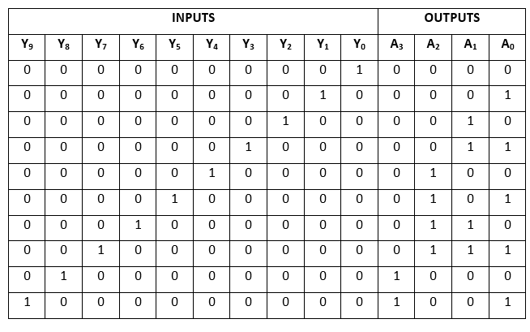
Contd..
Truth Table:

Slide 36
Contd..
From Truth table, we can write the Boolean functions for each output as
A3 = Y9 + Y8 A2 = Y7 + Y6 + Y5 +Y4 A1 = Y7 + Y6 + Y3 +Y2 A0 = Y9 + Y7 +Y5 +Y3 + Y1

Slide 37
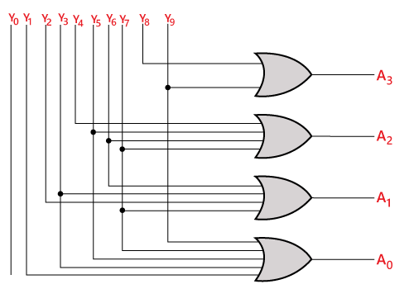
Contd..
Circuit Diagram:

