Slide 1
Carry Look-Ahead Adder

Slide 2
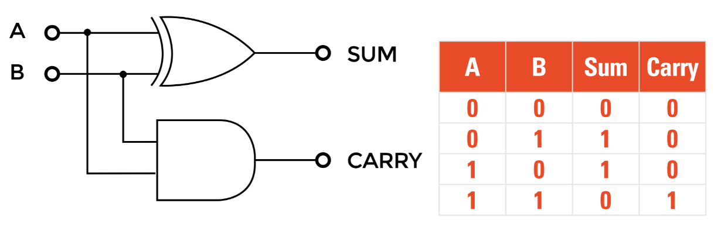
Half Adder
What is half adder?
Half adder:
A half adder is used to add two single-digit binary numbers and results into a two-digit output.

Slide 3
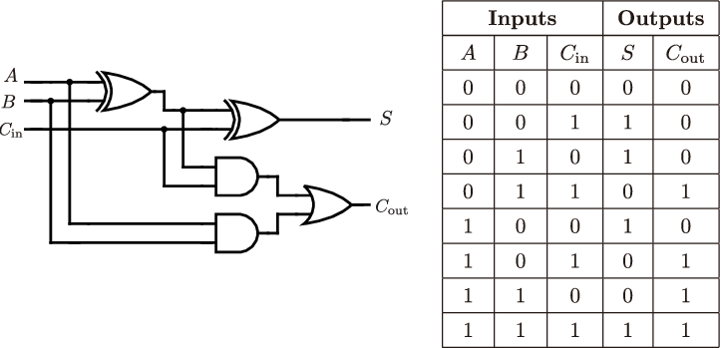
What is Full adder?
A full adder circuit is central to most digital circuits that perform addition or subtraction. It is so called because it adds together two binary digits, plus a carry-in digit to produce a sum and carry-out digit.

Slide 4
Predict carry(Before it is actually calculated.)
The value of c3 depends on s3

Slide 5
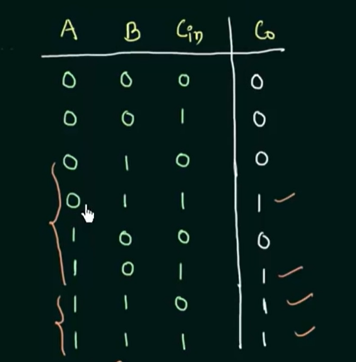

Slide 7
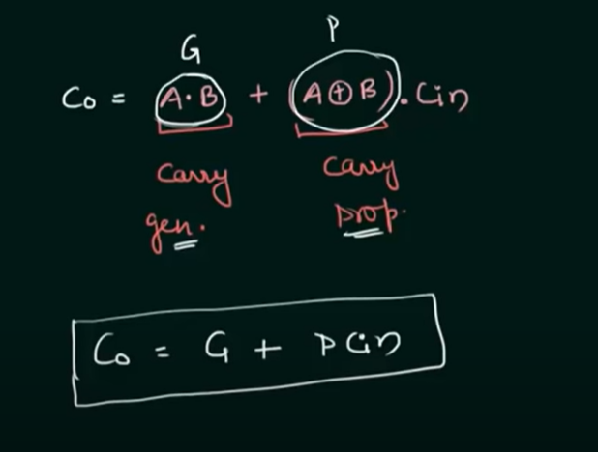
Carry generator
Carry Propagator

Slide 9
Prediction

Slide 13
LOGIC DIAGRAM

