Slide 1
UNIT-II Canonical & Standard Form

Slide 2
Canonical and Standard Form
Topics :
Max and Min Terms
Sum of Product
Product of Sum

Slide 3
Minterms and Maxterms
In a Boolean function, the variables may appear either in complemented or in normal form. i.e, A binary variable may appear either in its normal form (x) or in its complement form (x’) is called “Literal”.
For example, in the Boolean expression
f = (A . D) + (B’ . C),
the variables A, C and D are in normal form but the variable B is in complemented form.
In this expression, A, B’, C and D are called the literals.

Slide 4
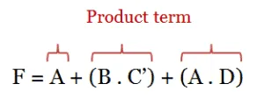
Contd..
Q. How these literals appear in the expression decides the term. Here, the literals appear in product term.
A product term is defined as either a literal or a product(conjunction) of literals.
Ex:

Slide 5
Contd..
Similarly, a sum term is defined as either a literal or a sum(disjunction) of literals.
Ex:
In Boolean Algebra, The Function, F can be expressed in Two Ways
1. Sum of Product Form ( SOP Form)
2. Product of Sum Form ( POS Form)

Slide 6
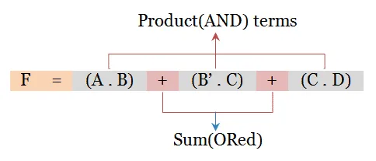
Sum of Product (SOP) Form
Sum of Product form is a group of product(AND) terms that are summed(ORed) together.
Here, the product and sum are not mathematical operations but are binary operations.
i.e, The SOP expression may consists of two or more product(AND) terms, all of which are ORed together.

Slide 7
Contd..
Now consider two binary variables x and y combined with an AND operation.
Since each variable may appear in either form, there are four possible combinations: x’y’, x’y, xy’, and xy.
Each of these four AND terms is called a minterm or a Standard Product.
In a similar manner, n variables can be combined to form 2^{n} Minterms.

Slide 8
Minterm Representation
Minterms are the short hand notations used to express the product terms in SOP form.
That is, each individual term in SOP form is called minterm.
For a Boolean function having n variables, there will be 2^{n} Minterms.
For example, a Boolean function with 3 variables will have 2³ = 8 Minterms and a Boolean Function with
4 variables will have 2⁴ = 16 Minterms.

Slide 9
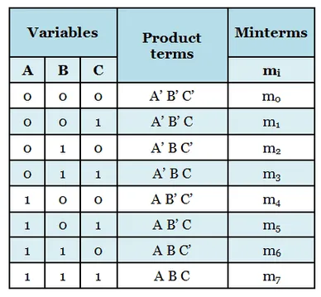
Contd..
The following table shows the Minterms for 3 variable Boolean function.

Slide 10
Contd..
Shorthand Notation for Minterm:
We know that, when Boolean variables are in the form of minterm, the variables will appear in the product.
There are the following steps for getting the shorthand notation for minterm.
1. we will write the term consisting of all the variables
2. Next, we will write 0 in place of all the complement variables such as ~A or A'.
3. Next, We will write 1 in place of all the non-complement variables such as A or b.

Slide 11
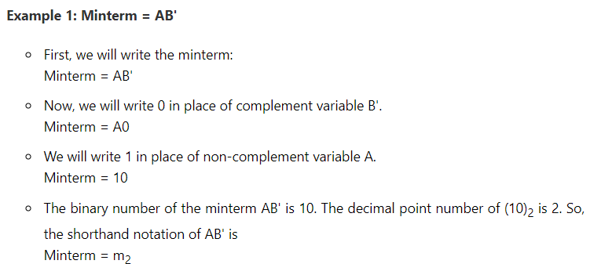
Contd..
4. Now, we will find the decimal number of the binary formed from the above steps.
In the end, we will write the decimal number as a subscript of letter m(minterm).
Ex:

Slide 12
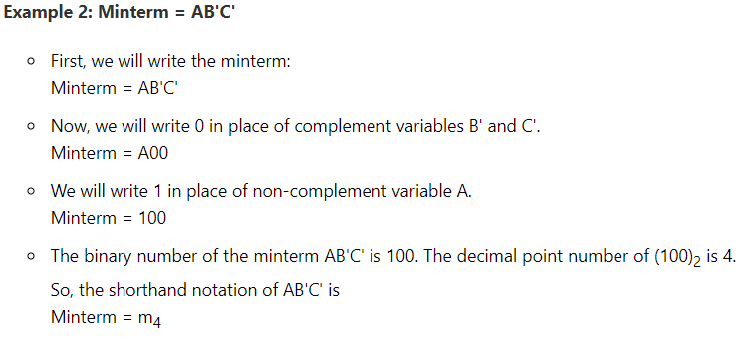
Contd..

Slide 13
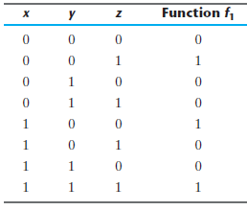
Contd..
Here, the Sum of Product form will be written only when the Function is High.

Slide 14
Contd..
For example, the function f1 in the above Table is
determined by expressing the combinations
001, 100, and 111 as
x’y’z, xy’z’, and xyz, respectively.
Since each one of these Minterms results in f1 = 1, we have
f1 = x’y’z + xy’z’ + xyz
= m1 + m4 + m7.
=
The SOP form can be written directly from the Truth Table.
M(1,4,7)

Slide 15
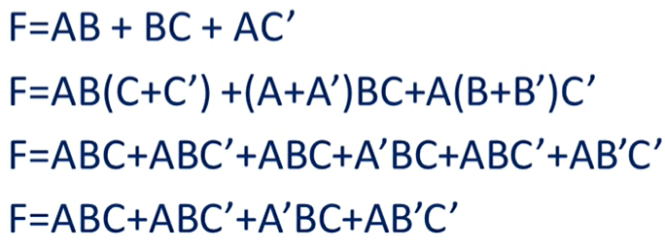
Contd..
Canonical / Standard SOP Form: Each Minterm is having all the variables in normal or Complemented form.
Q. How to Convert Expression into Canonical Form:

Slide 16
Contd..
If each term in the SOP form contains all the literals in either complemented or complemented form, then the SOP is referred to as Canonical or standard SOP form, where each individual term is called minterm.
In the above example, ABC, A’B’C, ABC’, A’BC and A’BC’ are the five minterms, where each term has all the literals in the Boolean function either in complemented or uncomplemented form. So, it is said to be a standard or canonical form.

Slide 17
Contd..
Non Canonical SOP Form or Minimal SOP Form: Each Minterm does not have all the variables in normal or complemented form.
i.e, The non-canonical or normal SOP form is a simplified version of standard or canonical SOP form. The normal form is obtained by doing simplification to the standard form.
Consider the given equation and see how it is simplified to get the non-canonical SOP form.

Slide 18
Contd..
The obtained expression F = AB + A’B + A’B’C is in SOP form but literal C is missing in 1st and 2nd terms. Hence, it is a non-canonical SOP form.

Slide 19
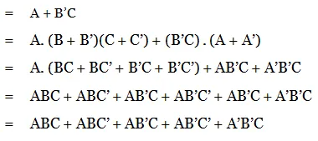
Contd..
Example: Express the Boolean function F = A + B’C as a sum of minterms
The function has three variables: A, B, and C. The first term A is missing two variables; therefore

Slide 20
Contd..
Finally, the Function is
F = ABC + ABC’ + AB’C + AB’C’ + A’B’C
= m7 + m6 + m5 + m4 + m1
Rearrange the order,
F = A’B’C + AB’C’ + AB’C + ABC’ + ABC
= m1 + m4 + m5 + m6 + m7
When a Boolean function is in its sum‐of‐minterms form, it is sometimes convenient to express the function in the following brief notation:

Slide 21
Product of Sum (POS) Form
The short form of the product of the sum is POS, and it is one kind of Boolean algebra expression.
POS is used when the output is LOW or “0”.
But when in SOP form the output is HIGH or 1. But in POS form , the Output is LOW or 0.
Product of Sum form is a group of Sum(OR) terms that are Multiplied(ANDed) together.
Here also, the product and sum are not mathematical operations but are binary operations.

Slide 22
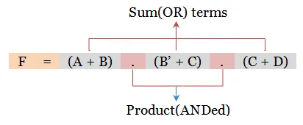
Contd..
The POS expression may consists of two or more sum(OR) terms, all of which are ANDed together. It is also called as “Maxterm”

Slide 23
Maxterm Representation
Maxterm representation is similar to the minterm representation but here it is used to express the sum terms in POS form.
That is, each individual term in POS form is called maxterm.
For a Boolean function having n variables, there will be 2^{n} maxterms.
For example, a Boolean function with 3 variables will have 2³ = 8 maxterms and a Boolean unction with 4 variables will have 2⁴ = 16 maxterms.

Slide 24
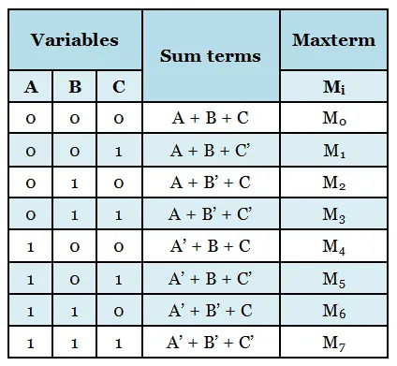
Contd..
The following table shows the Maxterm for 3 variable Boolean function.

Slide 25
Contd..
For example, The canonical POS expression
F = (A+B+C) . (A’+B’+C) . (A+B+C’) . (A’+B+C) . (A’+B+C’)
can be written as follows in terms of Maxterm notation.
F = M₀ +M₆ + M₁ + M₄ + M₅
F = Π(M₀, M₆, M₁, M₄, M₅),
where Π denotes product of sum.

Slide 26
Contd..
Here, the Product of Sum form will be written only when the Function is Low.

Slide 27
Contd..
For example, the function f1 in the above Table is
determined by expressing the combinations
000, 010, 011, 101, 110 as
x’y’z, x’yz’, x’yz, xy’z and xyz’ respectively.
This is the complement of f1’.
If we take the complement of f1’, we obtain the function f1:

Slide 28
Contd..
Canonical / Standard POS Form: If each term in the POS form contains all the literals in either complemented or uncomplemented form, then the POS is referred to as Canonical or standard POS form, where each individual term is called Maxterm.
In the above example, (A+B+C), (A’+B’+C), (A+B+C’), (A’+B+C) and (A’+B+C’) are the five maxterms, where each term has all the literals in the Boolean function either in complemented or uncomplemented form. So, it is said to be a standard or canonical POS form.

Slide 29
Contd..
Non Canonical SOP Form or Minimal SOP Form: Each Minterm does not have all the variables in normal or complemented form.
i.e, The non-canonical or normal SOP form is a simplified version of standard or canonical SOP form. The normal form is obtained by doing simplification to the standard form.
Consider the given equation and see how it is simplified to get the non-canonical SOP form.

Slide 30
Contd..
Non Canonical POS Form : The non-canonical or normal POS form is a simplified version of standard or canonical POS form.
The obtained expression is in POS form but literal C is missing in 1st and 2nd terms. Hence, it is a non-canonical POS form.

Slide 31
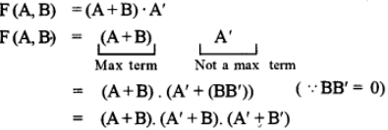
Contd..
Conversion of non-canonical POS to canonical POS form :
Convert the given expression F(A, B) = (A+B).A’ into canonical POS form.

Slide 32
Contd..
Example: Express the Boolean function F = xy + x’z as a product of MaxTerms.
First, convert the function into OR terms by using the distributive law:

Slide 33
Contd..
i.e,

Slide 34
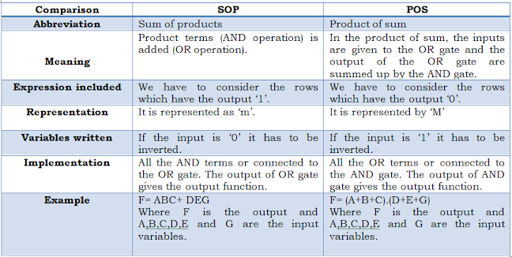
Difference b/w Sum of Products and Product of Sums

Slide 35
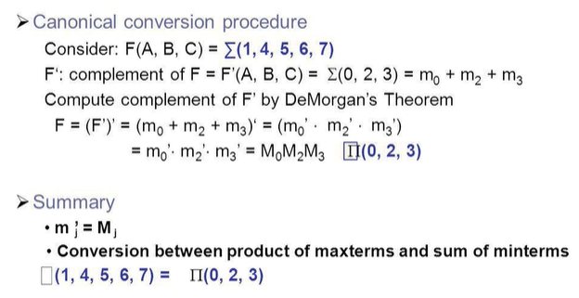
Conversion between canonical forms
Canonical SOP can be converted into canonical POS form and the vice versa can be done in a simple way.

Slide 36
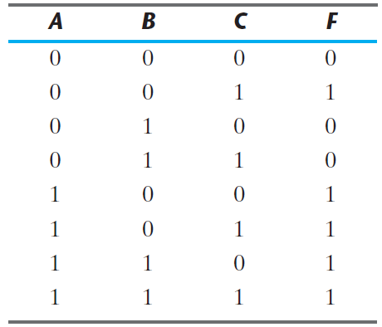
Truth Table

Slide 37
Contd..
Example:
consider the SOP expression
F = ABC + A’B’C + ABC’ + A’BC +A’BC’.
Now to convert it into canonical POS expression, follow the steps below.

Slide 38
Contd..
The above expression in terms of minterm is given by,
F = m₇ +m₁ + m₆ + m₃ + m₂.
The minterms and MaxTerms have a complementary relationship for a given Boolean expression.
So, write the expression in terms of Maxterm for the remaining terms in the above minterm expression.
We get, F = M₀ + M₄ + M₅
Thus, the canonical POS expression is,
F = (A+B+C) . (A’+B+C) . (A’+B+C’)

Slide 39
Contd..
Example: (GATE Question)
Consider the POS expression in terms of Maxterm
F = Π M(1, 3, 5, 7, 9, 11, 12, 13).
The SOP expression is given by,
F = ∑ m(0, 2, 4, 6, 8, 10, 14, 15)

Slide 40
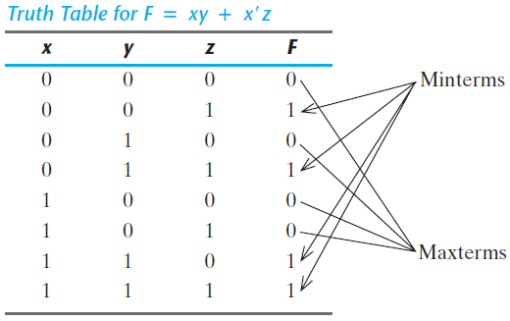
Contd..
Example:
Consider the Boolean Expression, F = xy + x’z
First, we derive the truth table of the function

Slide 41
Contd..
The minterms of the function are read from the truth table to be 1, 3, 6, and 7. The function expressed as a sum of minterms is:
Since there is a total of eight minterms or MaxTerms in a function of three variables.
We determine the missing terms to be 0, 2, 4, and 5. The function expressed as a product of MaxTerms is:

Slide 42
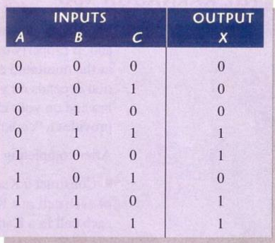
Contd..
Example:
Determine the Standard SOP expression and the equivalent Standard POS Expression:

Slide 43
Example

Slide 44
Standard Forms
Another method of representing Boolean outputs is by using standard form.
In this configuration,the terms that form the function may contain one, two, or any number of literals.
There are two types of standard forms:
1.The sum of products and
2. The Product of Sums.
Boolean Functions can generally be expressed in the form of Sum of Products(SOP) and Product of Sums(POS)
.

Slide 45
Contd..
The sum of products is a Boolean expression containing AND terms, called product terms, with one or more literals each. The sum denotes the ORing of these terms.
An example of a function expressed as a sum of products is : F1 = y’ + xy + x’yz’
The expression has three product terms, with one, two, and three literals. Their sum is, in effect, an OR operation.

Slide 47
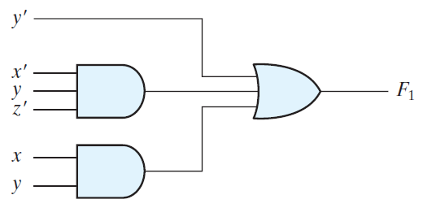
F1 = y’ + xy + x’yz’
Figure: Sum of Products

Slide 49
Contd..
A product of sums is a Boolean expression containing OR terms, called sum terms.
Each term may have any number of literals. The product denotes the ANDing of these terms.
An example of a function expressed as a product of sums : F2 = x(y’+ z)(x’ + y + z’)
This expression has three sum terms, with one, two, and three literals. The product is an AND operation

Slide 50
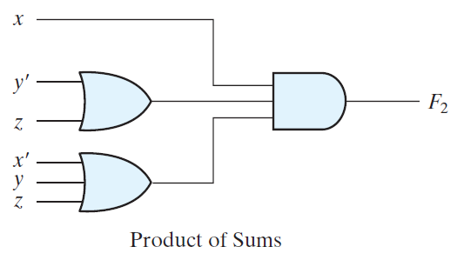
F2 = x(y’+ z)(x’ + y + z’)

