Slide 1
UNIT-II (Boolean Algebra)

Slide 2
Introduction to Boolean Algebra
Topics :
Boolean Algebra
Laws in Boolean Algebra

Slide 3
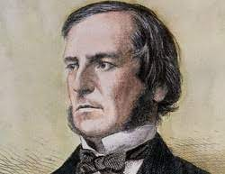
Boolean Algebra
The Boolean algebra is mainly used for simplifying and analyzing the complex Boolean expression. It is also known as Binary Algebra.
In Boolean Algebra , there are no fractions, decimals, -ve no’s, square roots, etc.
Because it deals with Binary variables(i.e, 0 and 1) and logical operations. Here the three basic Logic operators are AND, OR, NOT(complement).
George Boole developed the binary algebra in 1854.

Slide 4
Laws in Boolean Algebra
Boolean Algebra is the mathematics we use to analyze digital gates and circuits.
The “Laws of Boolean” is mainly used to simplify a complex Boolean expression ie, we can reduce the number of logic gates.
So, In Boolean Algebra , we have own set of rules or laws which are used to define and reduce Boolean expressions.

Slide 5
Rules in Boolean Algebra

Slide 6
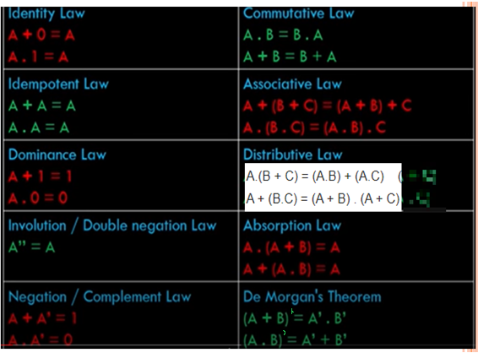
Contd..

Slide 7
Contd..

Slide 8
Contd..

Slide 9
Contd..

Slide 10
Contd..

Slide 11
Contd..

Slide 12
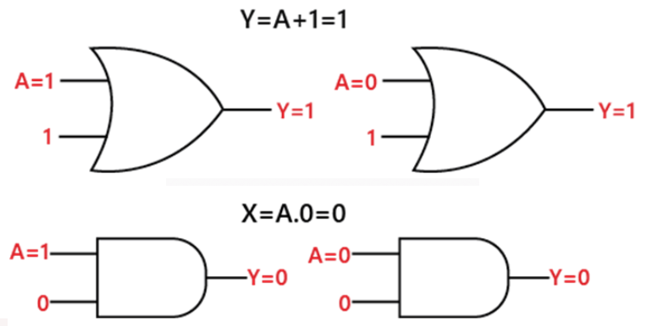
Contd..

Slide 13
Contd..

Slide 14
Contd..

Slide 15
Contd..

Slide 16
Contd..

Slide 17
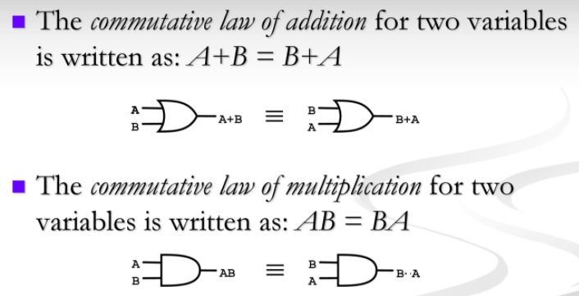
Contd..

Slide 18
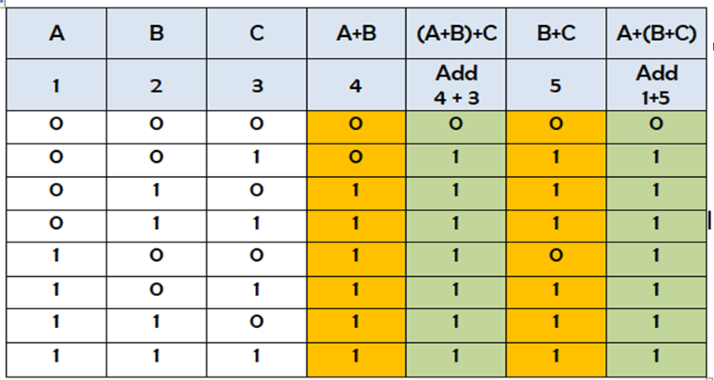
Associative Law

Slide 19
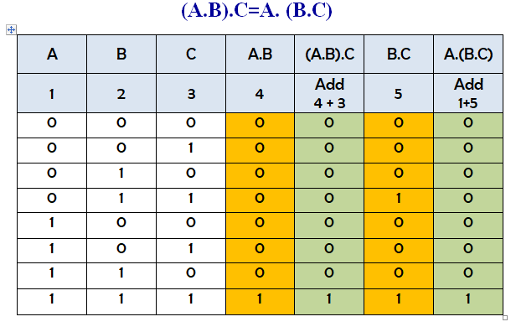
Contd..

Slide 20
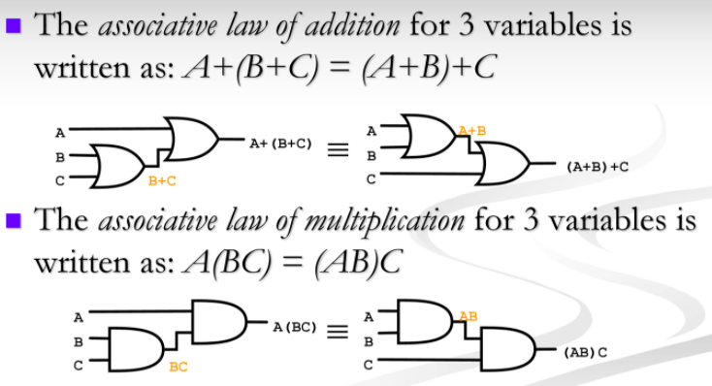
Contd..

Slide 21
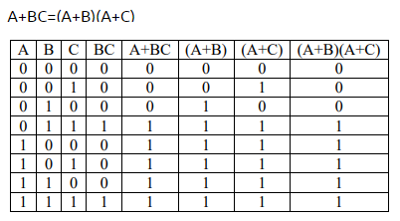
Distributive Law

Slide 22
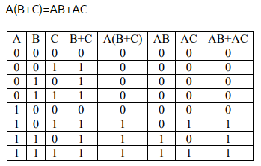
Contd..

Slide 23
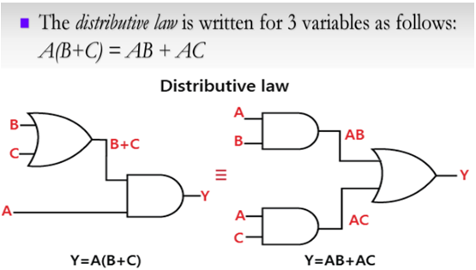
Contd..

Slide 24
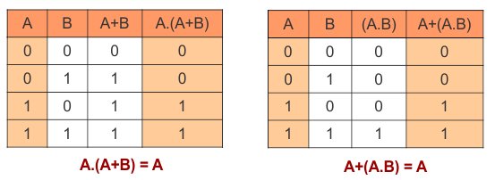
Absorption Law

Slide 25
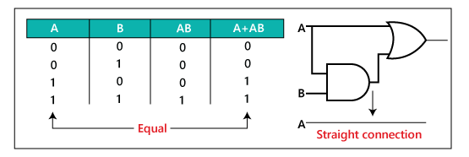
Contd..

Slide 26
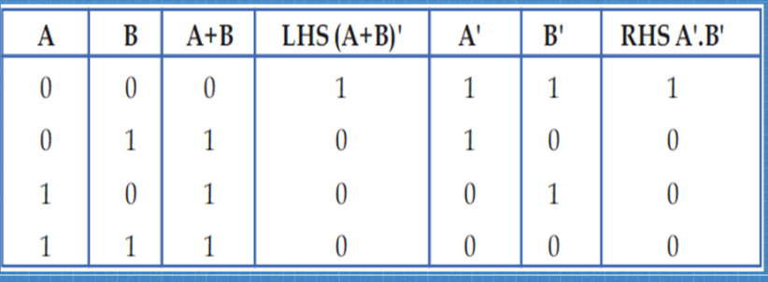
De Morgan’s Law

Slide 27
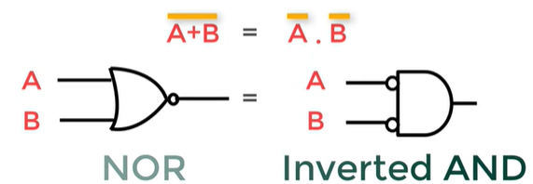
De Morgan’s Law

Slide 28
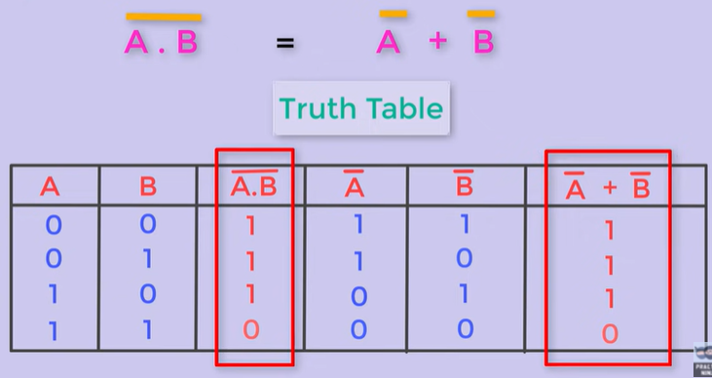
Contd..

Slide 29
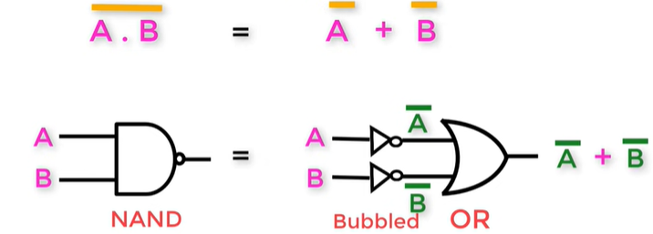
Contd..

Slide 30
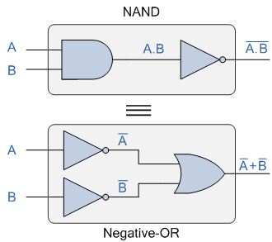
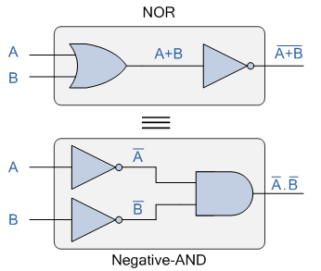
Contd..
A NAND Gate is equivalent to inversion version followed by OR Gate
A NOR Gate is equivalent to inversion version followed by AND Gate

Slide 31
Contd..

