Slide 1
Fundamentals of Digital Logic Design-
FDLD
II/IV B.Tech, Semester-I

Slide 2
Fundamentals of Digital Logic Design-FDLD
Course Outcomes
Upon successful completion of the course, the student will be able to
CO1 | Understand the basic concepts of digital circuits.
CO2 | Apply minimization techniques to simplify Boolean expressions.
CO3 | Apply the principles of digital electronics to design combinational and sequential circuits.
CO4 | Analyze the functionality of combinational circuits and sequential circuits.

Slide 3
SYLLABUS
UNIT-I
CO1 | Digital Systems and Binary Numbers: Digital Systems, Binary Numbers, Number Base Conversions, Octal and Hexadecimal Numbers, Complements of Numbers, Signed Binary Numbers, Binary codes and Binary Logic.

Slide 4
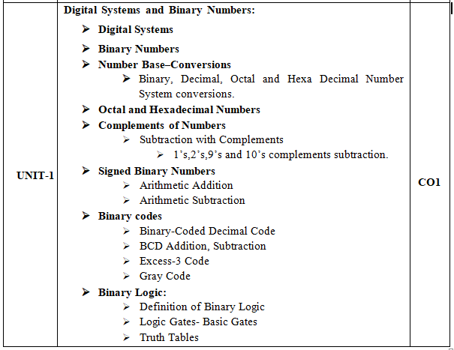
Course Content

Slide 5
SYLLABUS
UNIT-II
CO1, CO2 | Boolean Algebra and Logic Gates: Introduction, Basic Definitions, Axiomatic definition of Boolean Algebra, Basic theorems and properties of Boolean Algebra, Boolean functions, Canonical and Standard Forms. Gate–Level Minimization: Introduction, Map Method-Two variable, Three variable K-map’s, Four Variable K-Map, Product of Sums Simplification, Don’t Care Conditions, NAND and NOR implementation.

Slide 6
Course Content

Slide 7
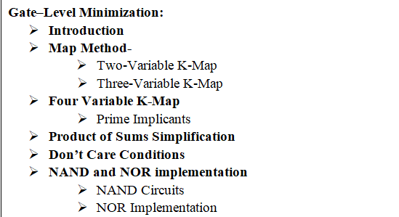
Contd..

Slide 8
SYLLABUS
UNIT-III
CO1, CO3, CO4 | Combinational Logic: Introduction, Combinational Circuit, Analysis Procedure, Design Procedure, Binary adder - subtractor, Decimal Adder, BCD to Seven Segment Display, Encoders, Decoder, Multiplexers, Demultiplexers.

Slide 9
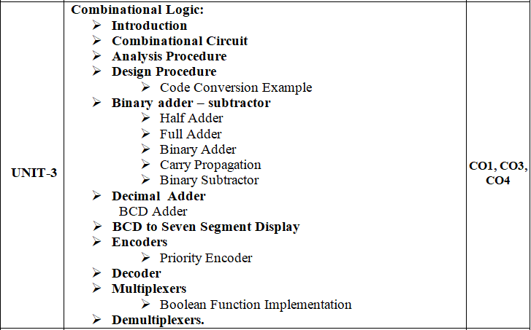
Course Content

Slide 10
SYLLABUS
UNIT-IV
CO1, CO3, CO4 | Sequential Logic: Introduction, Storage Elements: Latches –SR, D Latches Storage Elements: Flip Flops–SR, JK, D and T Flip Flops, Characteristic tables, Characteristic equation, Excitation tables.

Slide 11
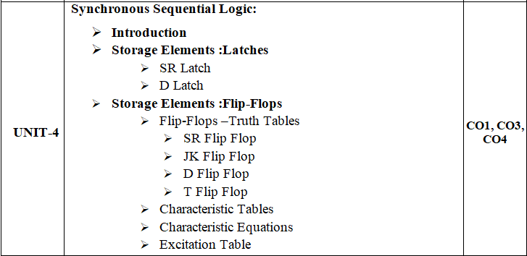
Course Content

Slide 12
SYLLABUS
UNIT-V
CO1, CO3, CO4 | Registers and Counters: Registers, Shift Registers- Serial Transfer, Serial Addition, Universal Shift Register, Ripple Counters-Binary Ripple Counter, BCD Ripple Counter, Synchronous Counters-Binary Counter, Up–Down Binary Counter, BCD Counter, Binary Counter with Parallel Load, Other Counters- Ring counter, Johnson counter.

Slide 13
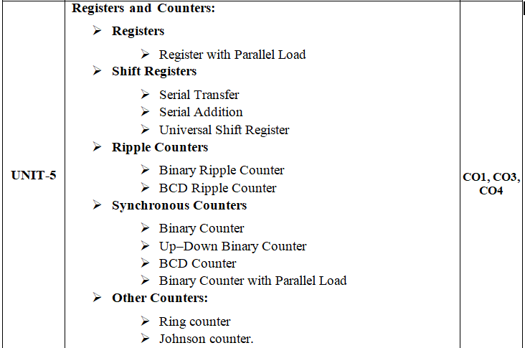
Course Content

Slide 14
Learning Resources :
Text Books:
Digital Design, M. Morris Mano, Michael D.Ciletti, Fifth Edition, 2013, Pearson.
Reference Books:
Switching Theory and Finite Automata, Zvi. Kohavi, Niraj K. Jha, Third Edition, 2010, Cambridge, University Press.
Fundamentals of Digital circuits, A. Anand Kumar, Third Edition, 2013, PHI

Slide 15
e-Resources:
https://nptel.ac.in/courses/106/108/106108099/
http://nptel.ac.in/courses/117106086/1
https://nptel.ac.in/courses/117/105/117105080/
https://www.udemy.com/course/digital-electronics-logic-design/
https://learnabout-electronics.org/Digital/dig20.php
https://www.tutorialspoint.com/digital_circuits/digital_circuits_logic_gates.htm
https://www.geeksforgeeks.org/digital-electronics-logic-design-tutorials/

Slide 16
UNIT-I (Digital Systems)

Slide 17
Introduction to Digital System
Topics :
Introduction
Analog and Digital Representations
Analog and Digital Conversions
Differences b/w Analog and Digital
Digital Computer System
Digital Logic System

Slide 18
Introduction
Digital systems have such a prominent role in everyday life that we refer to the present technological period as the digital age.
Digital systems are used in communication, business transactions, traffic control, spacecraft guidance, medical treatment, weather monitoring, the Internet, and many other commercial, industrial, and scientific enterprises.
In previous days , Most naturally occurring physical quantities in our world are “Analog” in nature.

Slide 19
Contd..
Digital systems are designed to store, process, and communicate information in digital form. They are found in a wide range of applications, including process control, communication systems, digital instruments, and consumer products.
Generally, Quantitates are measured, monitored, recorded, manipulated arithmetically, observed in most physical systems.
There are 2 ways to represent their values. Those are:
Analog Representation
Digital Representation

Slide 20
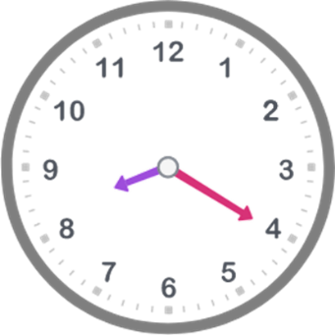
Contd..
1. Analog Representation: The physical Quantities or Signals are works on a continuous range of values. Analog means “Continuous”. It generally deals with physical variables such as voltage, pressure, temperature, speed, etc.
Examples:
1. Analog Clock : An analogue clock shows the time with a smoothly moving seconds hand. The change is continuous.

Slide 21
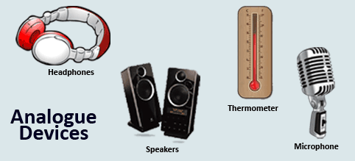
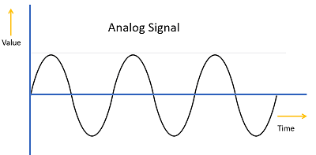
Contd..
2. Sound: Sound is also a good example of analogue data. Sound waves change in a very smooth way.
Ex: Micro Phones, Headphones etc.
3. Temperature
Generally Analog signals are represented in the Sine Form.

Slide 22
Contd..
2. Digital Representation: Represent a quantity by a symbol or digit.
Digital parameters have fixed set of discrete values.
Example: Age, Month
Digital Devices are used the “ Digital data”.
Examples:
Computers
Mobile Phones
Digital Clock

Slide 23
Contd..
1. Q. Are Computers Analog or Digital Systems?
Ans: Computers are Digital Systems.
2. Q. Which is easier to Design?
Digital Systems are easier to design, because they deal with a limited set of values rather than infinitely large range of values.

Slide 24
ANALOG to DIGITAL CONVERSION
Analog values can only be used by analog devices.
Digital values can only be used by digital devices.
If we want to use analog values with a digital device or digital values with an analog device we need to use data conversion.
There are two types of data converters: 1. Analog to Digital Converter (ADC) 2. Digital to Analog Converter (DAC)

Slide 25
Contd..
1. Analog to Digital Converter (ADC): If we try to attach an analog device (like a microphone) to a computer we will need to convert the analog data to digital before the computer can use it.
The microphone is used to pass the analog sound waves through the ADC which will convert the sound from analog to digital.
The ADC then passes the converted digital data into the computer where the sound can be stored and edited.

Slide 26
Contd..
Figure: Analog to Digital Conversion

Slide 27
Contd..
2. Digital to Analog Converter (DAC): If we want to listen to digital music (like mp3's) we would need to attach an analog device such as loud speakers or headphones to our computer.
The computer will pass the digital sound values through a DAC (located on a sound card) which will convert the digital data to analog.
The DAC then passes the converted analog data onto the analog loud speaker which we would then hear as sound waves.

Slide 28
Contd..
Figure: Digital to Analog Conversion

Slide 29
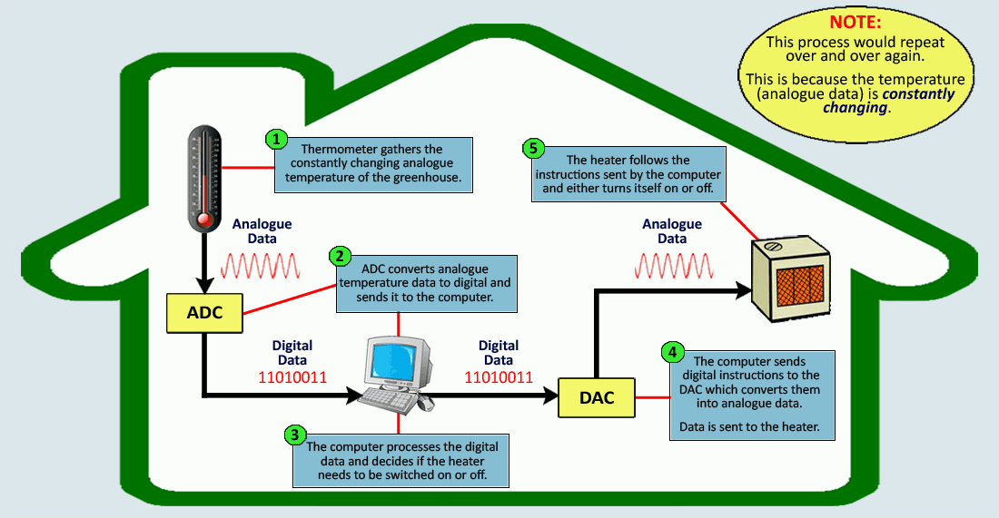
Example-2: Temperature

Slide 30
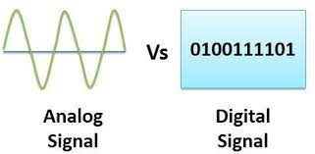
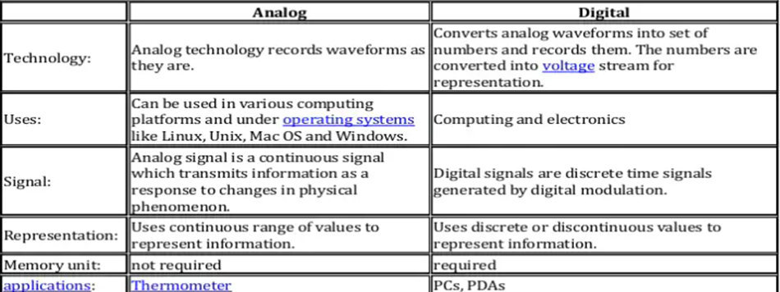
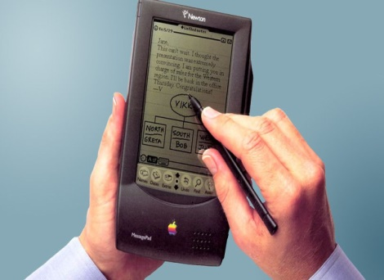
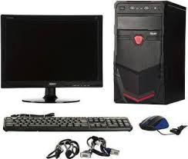
Difference between Analog and Digital Representation

Slide 31
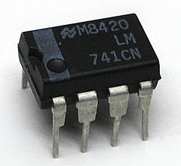
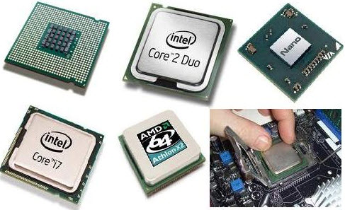
Operational Amplifier
Microprocessor

Slide 32
Digital Computer System
The general‐purpose digital computer is the best‐known example of a digital system.
A Digital computer can be considered as a digital system that performs various computational tasks.
The first electronic digital computer was developed in the late 1940s and was used primarily for numerical computations.
By convention, the digital computers use the binary number system, which has two digits: 0 and 1. A binary digit is called a bit.
A computer system is subdivided into two functional entities:
Hardware and
Software.

Slide 33
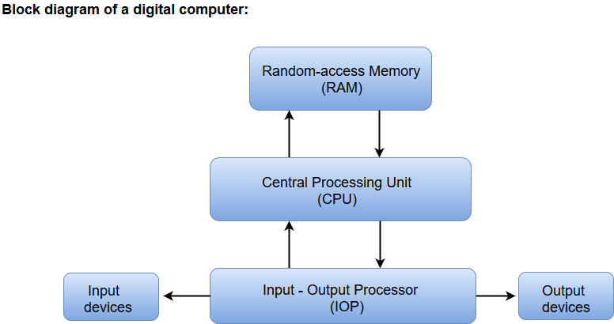

Slide 34
Contd..
The Central Processing Unit (CPU) performs arithmetic and other data‐processing operations as specified by the program.
The memory unit stores programs as well as input, output, and intermediate data.
The Random Access Memory (RAM) for real-time processing of the data. Computer memory or random access memory (RAM) is your system's short-term data storage; it stores the information your computer is actively using so that it can be accessed quickly

Slide 35
Contd..
The Input-Output devices for generating inputs from the user and displaying the final results to the user.
The program and data prepared by a user are transferred into memory by means of an input device such as a keyboard.
An output device, such as a printer, receives the results of the computations, and the printed results are presented to the user
A digital computer is a powerful instrument that can perform not only arithmetic computations, but also logical operations. In addition, it can be programmed to make decisions based on internal and external conditions.

Slide 36
Digital Logic System
Digital Logic is the basis of electronic systems, such as computers and cell phones.
The Digital Logic is rooted in binary code, a series of zeroes and ones each having an opposite value.
This system facilitates the design of electronic circuits that convey information, including logic gates.
Digital Logic gate functions include and, or and not. The value system translates input signals into a specific output. Ex: Digital Logic facilitates computing, robotics and other electronic applications.

Slide 37
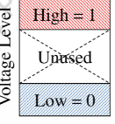
How do computers represent digits?
Binary Digits ( 0 and 1) are used instead of Decimal Numbers.
Using Electronic Voltage
High Voltage-1, Low Voltage-0
Using Electric Charge
Used in Memory Cells
Charged Memory Cell=1, Discharged memory Cell=0
Using Magnetic Field
Magnetic polarity indicates 1 or 0

