Slide 1
UNIT-I
(Signed Binary Numbers)

Slide 2
Signed Binary Numbers
Topics :
Arithmetic Addition.
Arithmetic Subtraction.

Slide 3
Signed Binary Numbers
In ordinary arithmetic, a negative number is indicated by a minus sign and a positive number by a plus sign.
Because of hardware limitations, computers must represent everything with binary digits.
The convention is to make the sign bit 0 for positive and 1 for negative.
This bit is placed in Left Most of the Number

Slide 4
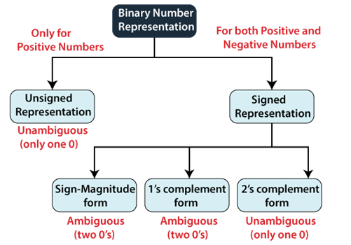
Contd..

Slide 5
Contd..
The signed numbers have a sign bit so that it can differentiate positive and negative integer numbers.
The signed binary number technique has both the sign bit and the magnitude of the number.
For representing the negative decimal number, the corresponding symbol in front of the binary number will be added.

Slide 6
Contd..
There are 3 ways to represent signed binary numbers.
1. Sign- Magnitude Form
2. 1’s Complement
3. 2’s Complement
1. Sign- Magnitude Form: In this form, a binary number has a bit for a sign symbol. If this bit is set to 1, the number will be negative else the number will be positive if it is set to 0. Apart from this sign-bit, the n-1 bits represent the magnitude of the number.

Slide 7
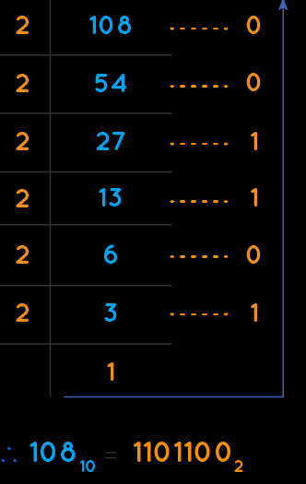
Contd..
Ex: Consider the negative decimal number -108.
The magnitude of this number is 108.
We know the unsigned binary representation of 108 is 1101100.
It is having 7 bits. All these bits represent the magnitude.

Slide 8
Contd..
Since the given number is negative, consider the sign bit as one, which is placed on left most side of magnitude.

Slide 9
Contd..
2. 1’s Complement:
Eg: Consider the negative decimal number -108.
The magnitude of this number is 108.
We know the signed binary representation of 108 is 01101100.
It is having 8 bits. The MSB of this number is zero, which indicates positive number.
Then Calculate 1’s Complement. i.e of zero is one and vice-versa. So, replace zeros by ones and ones by zeros in order to get the negative number.

Slide 10
Contd..
Replace 0 to 1 and 1 to 0
01101100
10010011

Slide 11
Contd..
2. 2’s Complement:
The 2’s complement of a binary number is obtained by adding one to the 1’s complement of signed binary number.
So, 2’s complement of positive number gives a negative number.
Similarly 2’s complement of negative number gives a positive number.

Slide 12
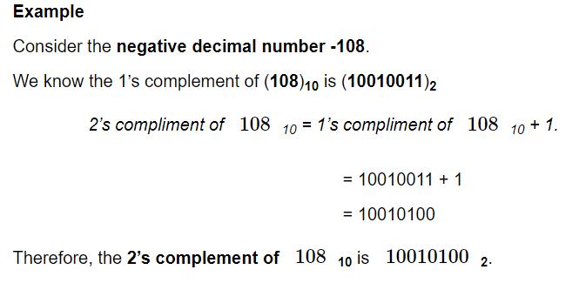
Contd..

Slide 13
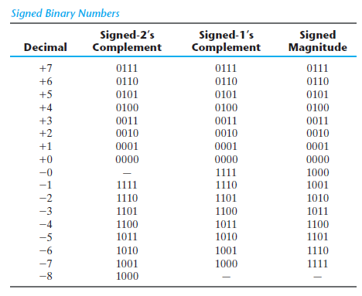
Contd..

Slide 14
Arithmetic Addition
The addition of two numbers in the signed-magnitude system follows the rules of ordinary arithmetic.
If the signs are the same, we add the two magnitudes and give the sum the common sign.
If the signs are different, we subtract the smaller magnitude from the larger and give the difference the sign of the larger magnitude.

Slide 15
Contd..
The addition of two signed binary numbers with negative numbers represented in signed-2's-complement form is obtained from the addition of the two numbers, including their sign bits.
A carry out of the sign-bit position is discarded.

Slide 16
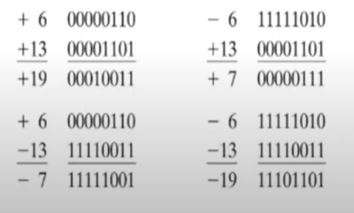
Contd..
Ex:

Slide 17
Contd..
1. Calculate +6 and +13:

Slide 18
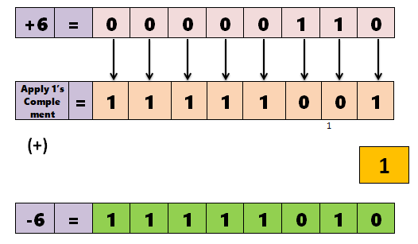
Contd..
2. Calculate -6 and +13:
To get -6 value , first we convert -6 in 2’s Complement.

Slide 19
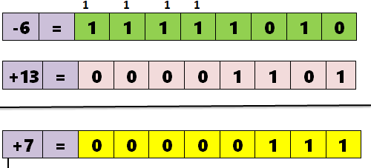
Contd..
Next , we add -6 and +13.

Slide 20
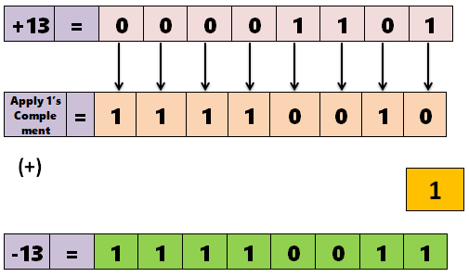
Contd..
3. Calculate +6 and -13:
To get -13 value , first we convert -13 in 2’s Complement.

Slide 21
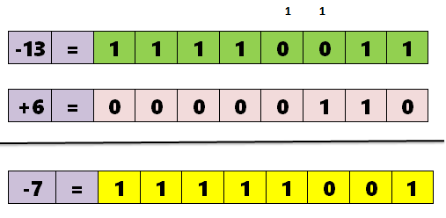
Contd..
Next , we add -13 and +6.

Slide 22
Contd..
3. Calculate -6 and -13:
To get -6 & -13 value , first we convert -6 & -13 in 2’s Complement. So, 1st convert -6 using 2’s complement

Slide 23
Contd..
To get -13 value , first we convert -13 in 2’s Complement.

Slide 24
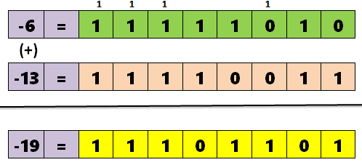
Contd..
Next ,we can add -6 and -13.

Slide 25
Contd..

Slide 26
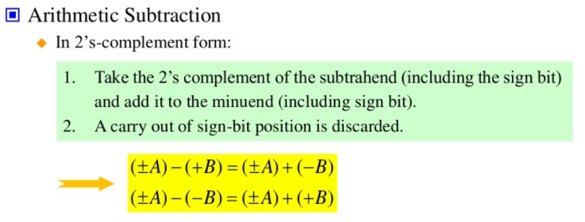
Arithmetic Subtraction

Slide 27
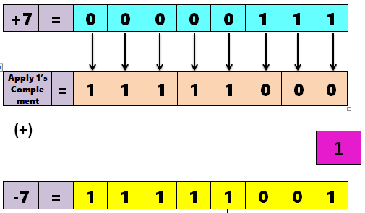
Contd..
1. Calculate 14 - 7:
Here , we can follow this Rule:
This 14- 7 , we can write it as : (+14) + ( -7)

Slide 28
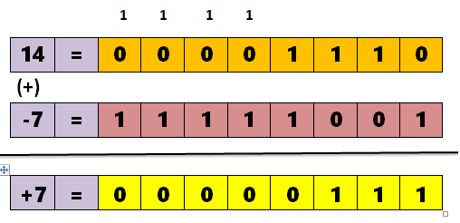
Contd..
Next ,we can add 14 and -7.

Slide 29
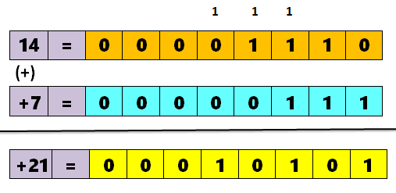
2. Calculate 14 – (-7):
This 14- (-7) , we can write it as : (+14) + ( +7).
We can add +14 and +7.

Slide 30
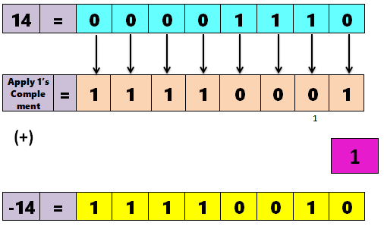
3. Calculate (-14) – (7):
This (-14) - (7) , we can write it as : (-14) + (-7).
First , we can solve (-14). i.e, we can find 2’s Complement of 14.

Slide 31
Contd..
Second , we can solve (-7).

Slide 32
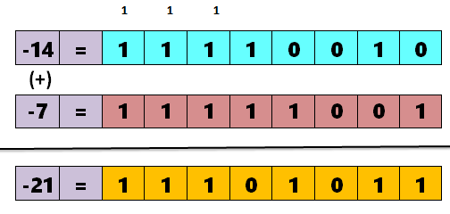
Contd..
Now, we can add (-14) + (-7)

Slide 33
4. Calculate (-14) – (-7):
This (-14) - (-7) , we can write it as : (-14) + (+7).
First , we can solve (-14).

Slide 34
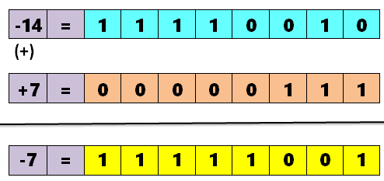
Contd..
Now, we can add (-14) + (+7)

Slide 35
PRACTICE PROBLEMS
1. Add the following signed numbers
28 + (-15)
-25 + 6
2. Subtract the following signed numbers
22 – 46
(- 7) – (-3)

