Slide 1
UNIT-I (Digital Systems)

Slide 2
Introduction to Digital System
Topics :
Number System
Types of Number System
Binary Arithmetic

Slide 3
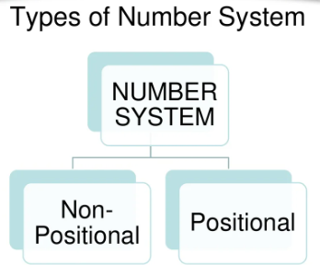
Number System
Numbers are highly significant and play an essential role in Mathematics and also very important to understand the Design and organization of the Computer.
Number System is the way to represent Numbers.
Every Computer stores numbers, letters and other special characters in Coded Form.
There are 2 types in Number System
Non Positional Number System
Positional Number System

Slide 4
1. Non Positional Number System
The Non-Positional number system is also known as the Non-Weighted Number System.
In the olden days, people used this type of number system for simple calculations like additions and subtractions.
In this system, the digit value is independent of its position.
The non-positional number system consists of different symbols that are used to represent numbers

Slide 5
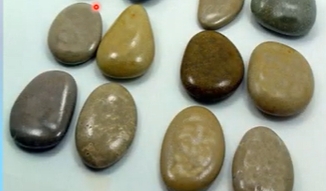
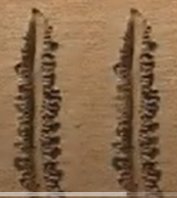
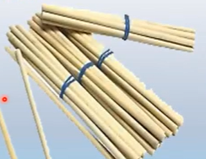
Contd..
In this System we can count with the
Fingers
Pebbles
Cut spots on the ground or walls
Stick

Slide 6
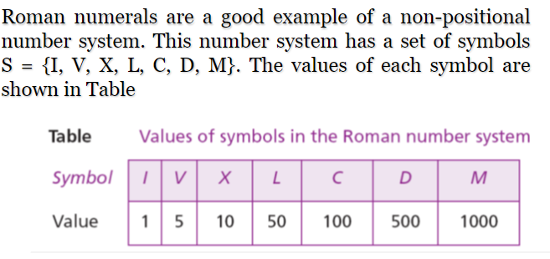
Contd..
Here Symbols represent the value regardless of its position
Drawback: Difficult to perform Arithmetic Calculations.

Slide 7
2. Positional Number System
The Positional Number System is also known as the Weighted Number System.

Slide 8
Contd..
A Positional Number System is simply way of representing Numerical Values. It uses symbols called Numerals to represent numeric quantities.
In Day to Day Life we deal with Decimal Number Systems. i.e, Base 10 Environment.
But Computers only understand 2 Digits. Ie, 0 & 1. i.e, Base 2 Environment
But Computers exist in Base 2 Environment

Slide 9
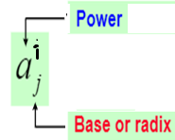
Contd..
The base or radix of the number system is the total number of the digit used in the number system.
Suppose if the number system representing the digit from 0 – 9 then the base of the system is the 10.

Slide 10
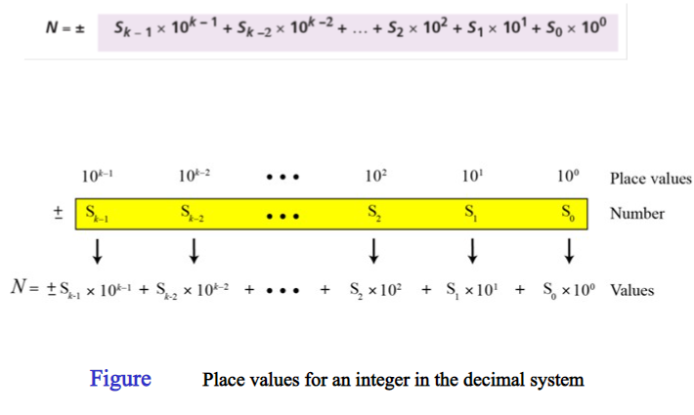
Contd..

Slide 11
Contd..

Slide 12
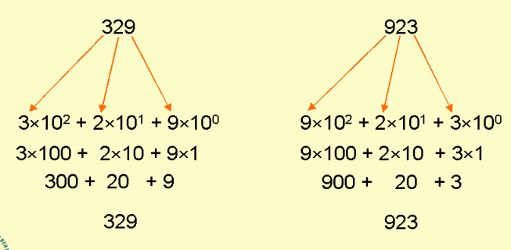
Contd..
Example:

Slide 13
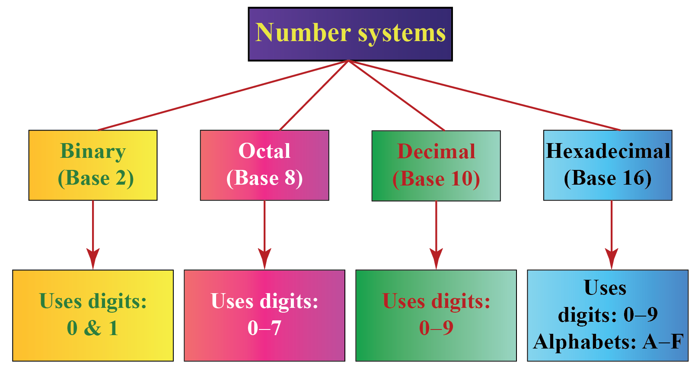

Slide 14
Contd..

Slide 15
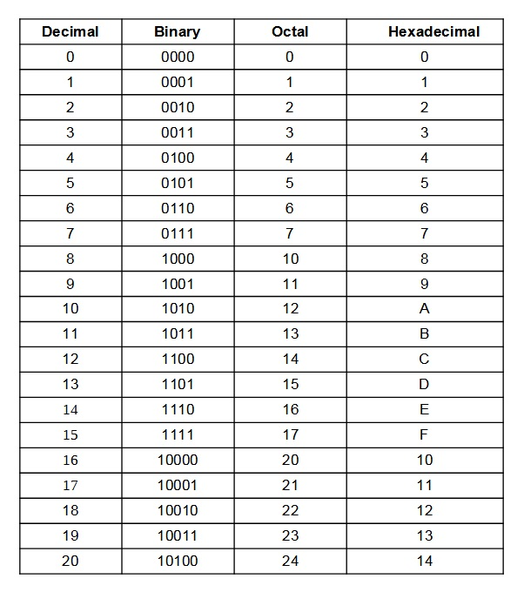
Contd..

Slide 16
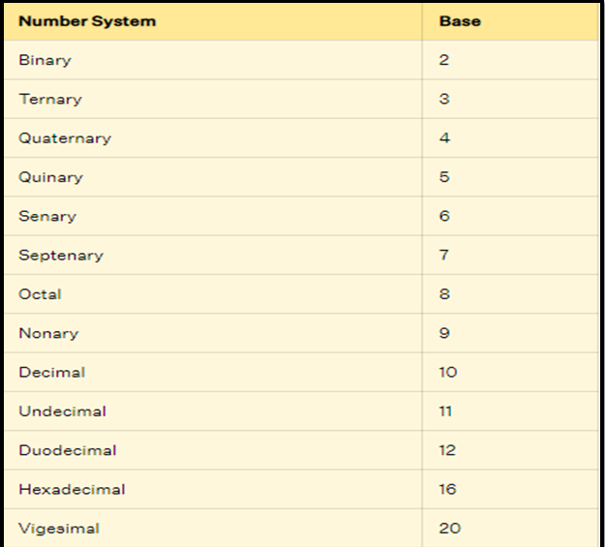
Overall Number System in Mathematics

Slide 17
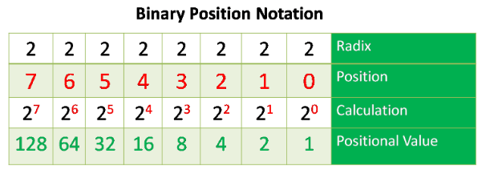
Contd..
1. Binary Number System: Binary Number System comprises of two digits 0 & 1, thus, the base of the binary number system is 2. Thus, it is called as a base-2 system. It is much easier and simpler than decimal number system because it is comprised of only two digits.

Slide 18
Contd..

Slide 19
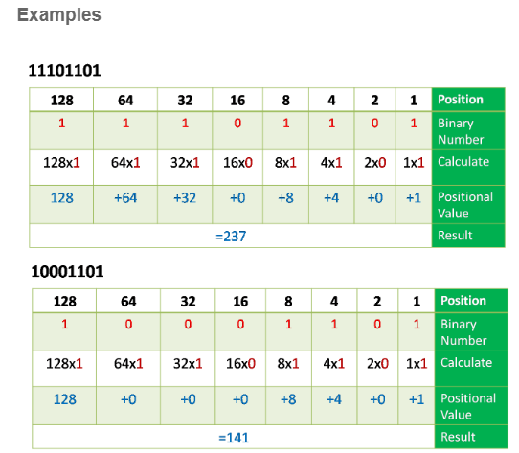
Contd..

Slide 20
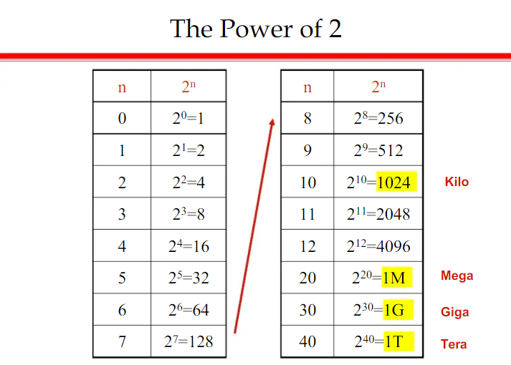
Contd..

Slide 21
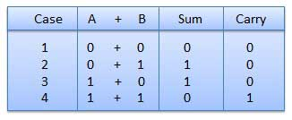
Binary Addition
Adding two or more binary numbers is one of the Arithmetic operations on binary numbers or base-2 number systems.
The addition of binary numbers is done by adding the digits starting from the right side of the numbers.
Rules of Binary Addition:

Slide 22
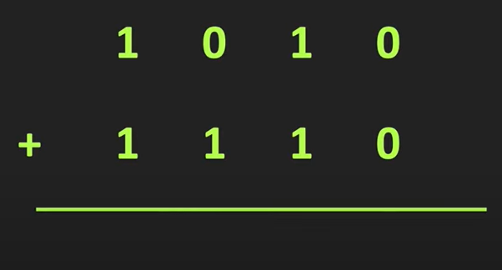
Contd..
In fourth case, a binary addition is creating a sum of (1 + 1 = 10) i.e. 0 is written in the given column and a carry of 1 over to the next column.
Eg-1:

Slide 23
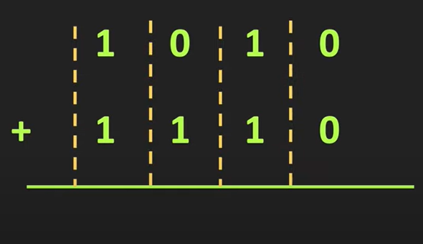
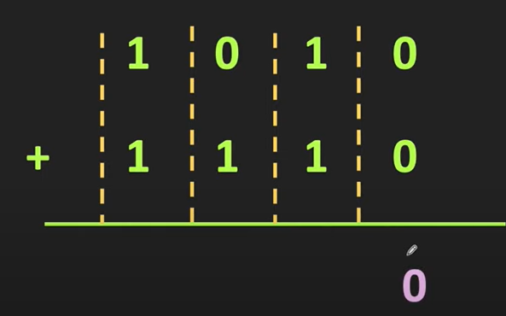
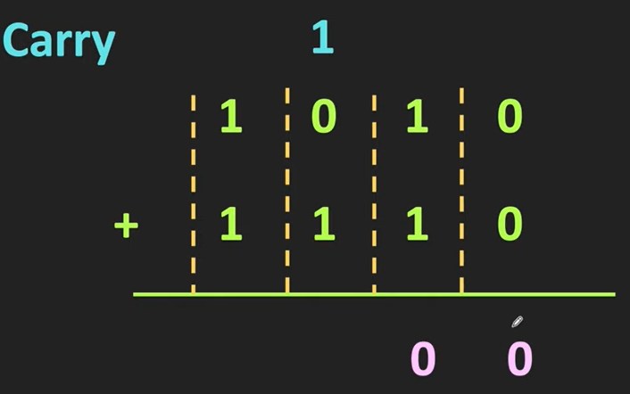
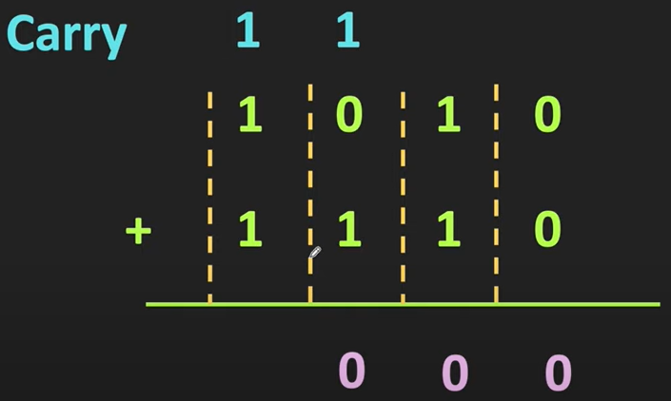
Contd..
Step-1:
Step-2:
Step-3:
Step-4:

Slide 24
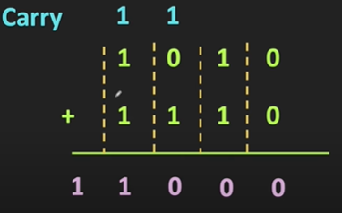
Contd..
Step-5: Final Answer is :
Q. Problem is correct or Not, What we can do?
Ans: we can convert this numbers into the Decimal Equivalent.
So, First we can assign the weights of each Digit.

Slide 25
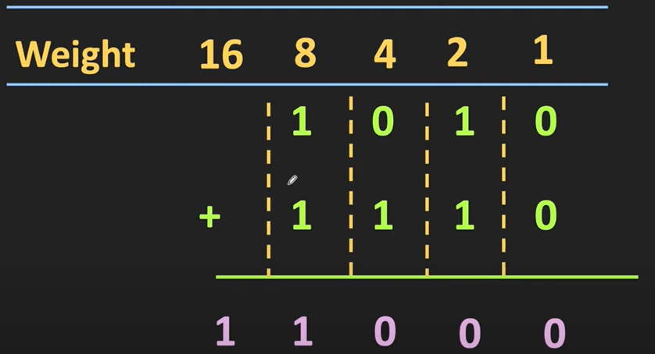
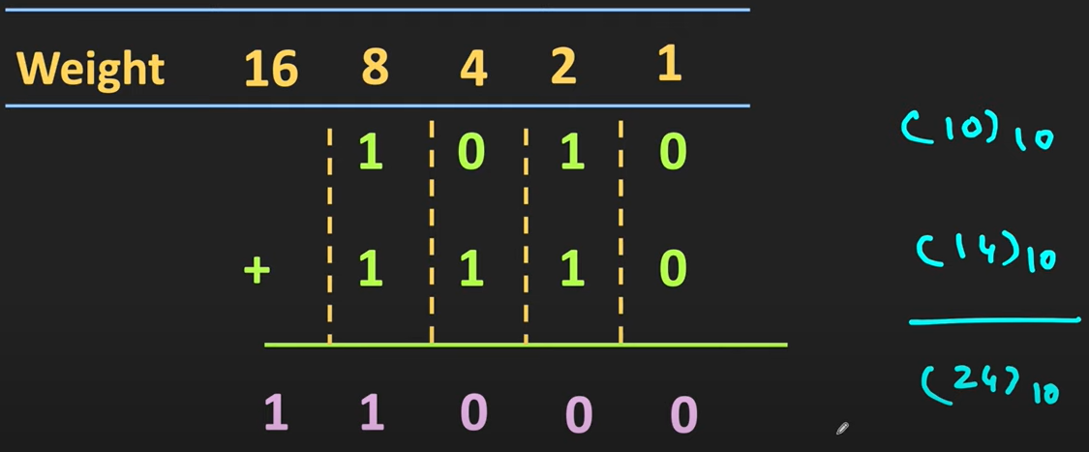
Contd..
Our Final Answer is :
Assign the Weights :
Add Weights of each Digit:

Slide 26
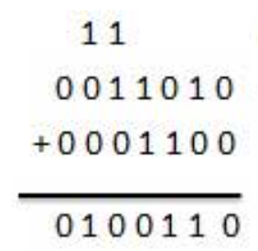
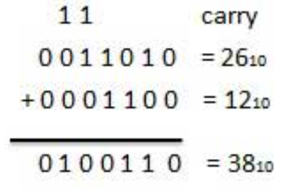
Contd..
Example-2:
Ans:
Check with Decimal

Slide 27
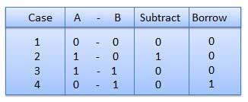
Binary Subtraction
Binary subtraction is the process of subtracting binary numbers.
we may sometimes need to subtract 0 from 1. In such cases, we use the concept of borrowing where we needed.
Rules of Binary Subtraction:

Slide 28
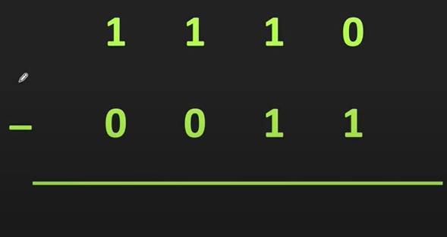
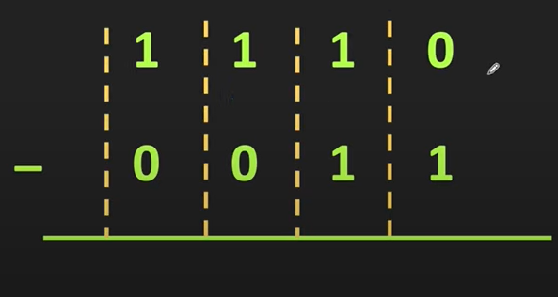
Contd..
Eg-1:
Step-1 ( Here Right most Column , then 0 <1)

Slide 29
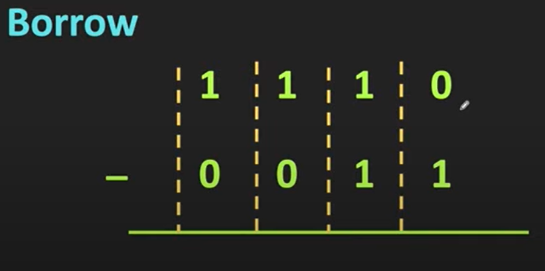
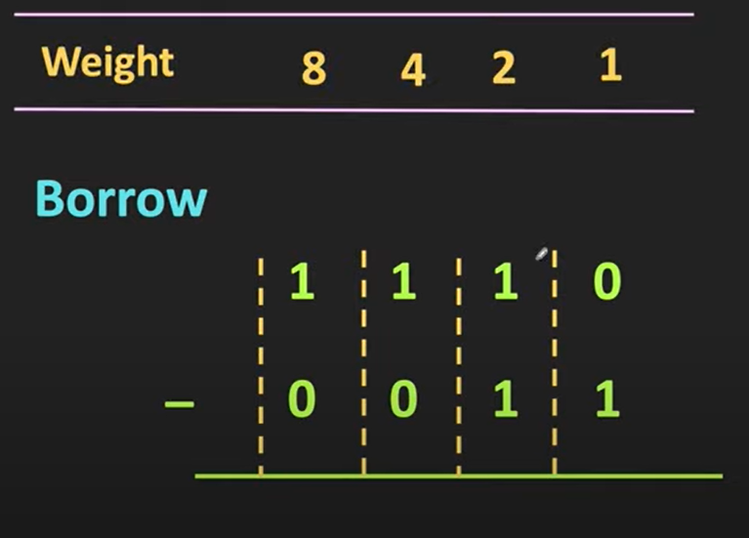
Contd..
Step-2: ( Take Borrow from the Next Column)
Here, first we will show the weights of each Digit.

Slide 30
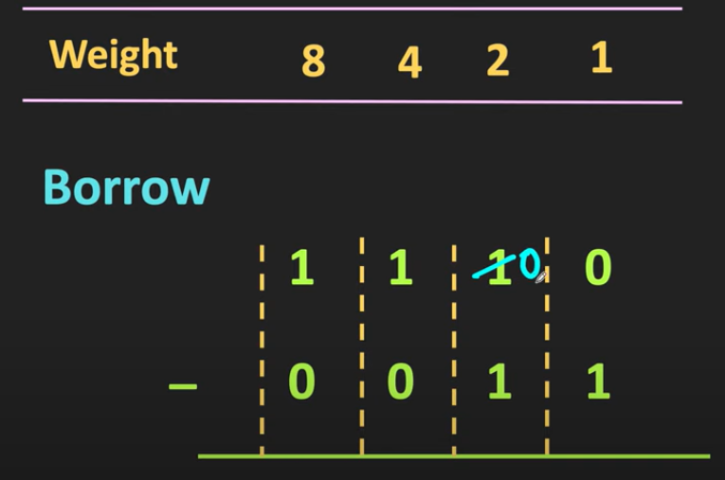
Contd..
Next, we take the Borrow if we go to the 2nd Column and indeed one this 2nd column.
Now , we can Borrow this one from the 2nd Column.
Next , we can replace this One from the Zero

Slide 31
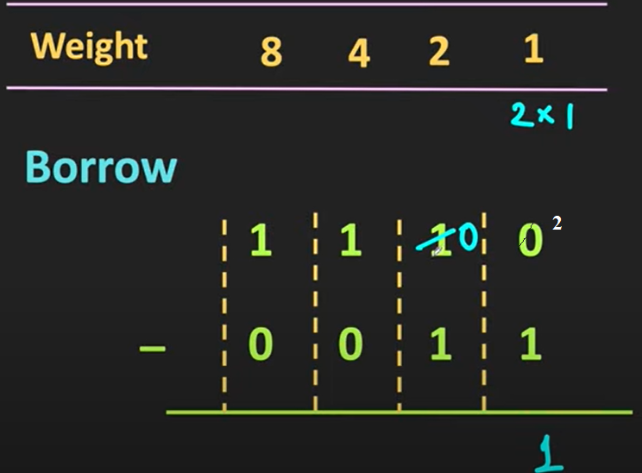
Contd..
Now , this 2nd Column One is moved to the 1st Column.

Slide 32
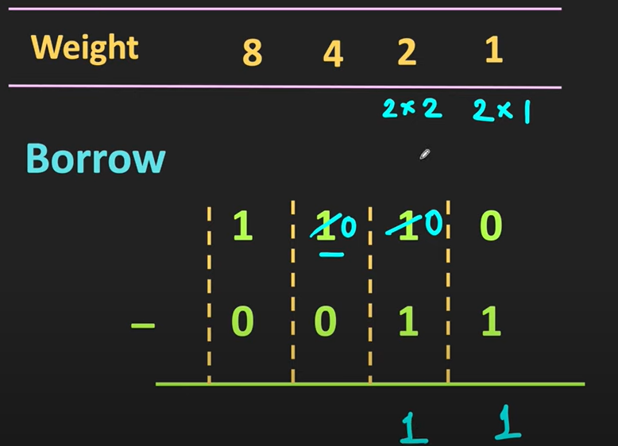
Contd..
Next , move to the next column.

Slide 33
Contd..
Finally the subtracted value is

Slide 34
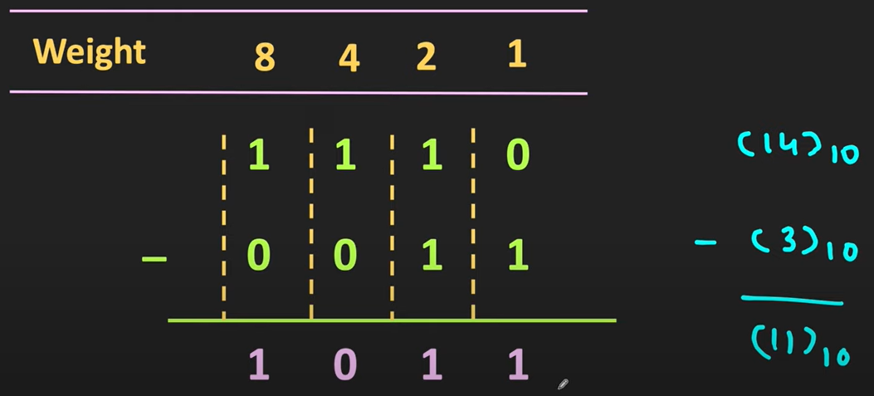
Contd..
Now next check with Decimal.

Slide 35
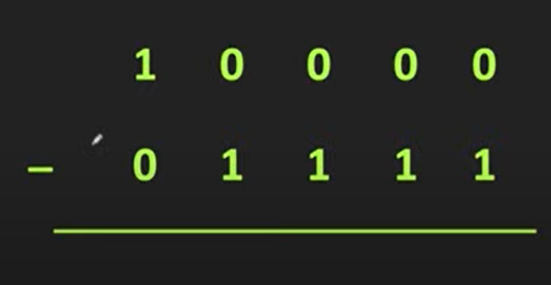
Contd..
Example-2:

Slide 36
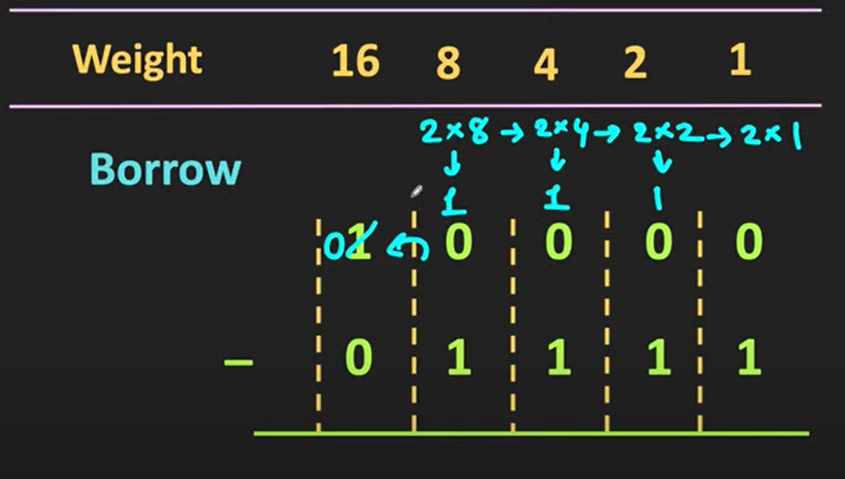
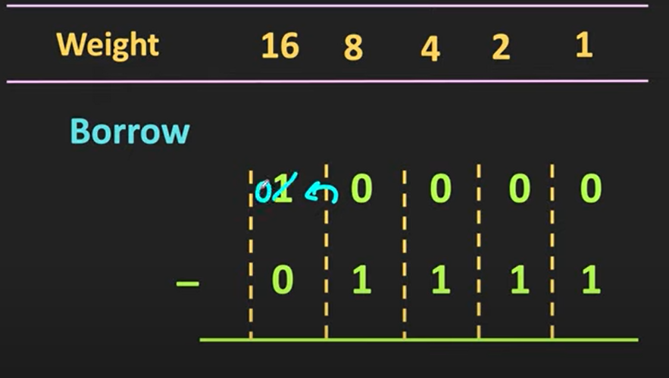
Contd..
Step-2: ( Take Borrow from the Next Column)

Slide 37
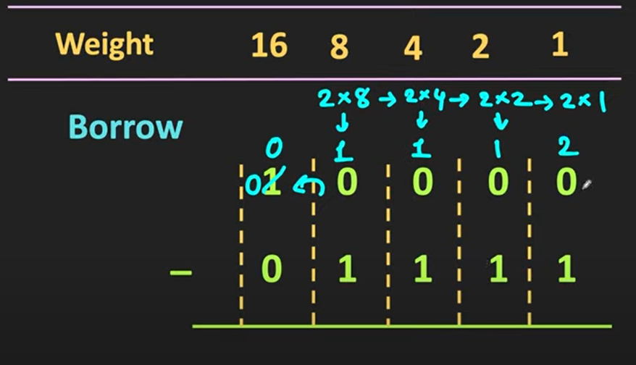
Contd..
Step-3: ( Take Borrow from the Last Column)

Slide 38
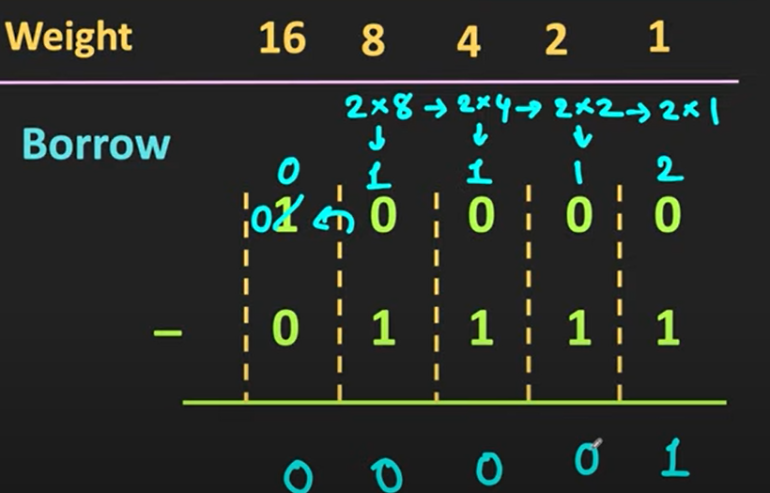
Contd..
Step-4: Final Answer is

Slide 39
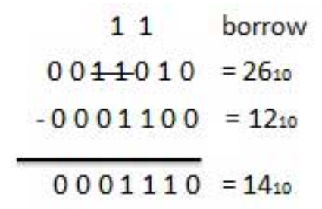
Contd..
Example-3:
Ans:

Slide 40
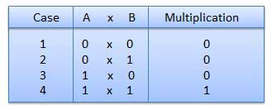
Binary Multiplication
Binary multiplication is the process of multiplying binary numbers. The process of multiplying binary numbers is the same as that of arithmetic multiplication with decimal numbers.
Rules of Binary Multiplication:

Slide 41
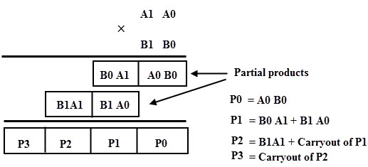
Contd..
Example:

Slide 42
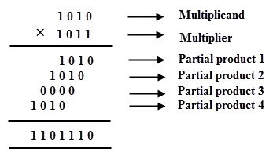
Contd..
Example-1:

Slide 43
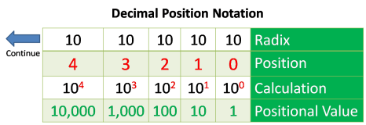
Contd..
2. Decimal Number System: The decimal number system comprises of digits from 0-9 i.e. 0, 1, 2, 3, 4, 5, 6, 7, 8 & 9. The base or radix of the decimal number system is 10 because total number of digits available in decimal number system is 10.
For example, the decimal number 2541 consist of the digit 1 in the unit position, 4 in the tens position, 5 in the hundreds position, and 2 in the thousand positions and the value will be written as:

Slide 46
Contd..
3. Octal Number System: The octal number system has base 8(means it has only eight digits from 0 to 7). There are only eight possible digit values to represent a number. With the help of only three bits, an octal number is represented. Each set of bits has a distinct value between 0 and 7.
While solving an octal number, each place is a power of eight.
For example: (347)8
(347)8 = 3 x 8² + 4 x 8¹ + 7 x 8⁰

Slide 47
Contd..
3. Octal Number System: The octal number system has base 8(means it has only eight digits from 0 to 7). There are only eight possible digit values to represent a number. With the help of only three bits, an octal number is represented. Each set of bits has a distinct value between 0 and 7.
While solving an octal number, each place is a power of eight.
For example: (347)8(347)8 = 3 x 8² + 4 x 8¹ + 7 x 8⁰

Slide 48
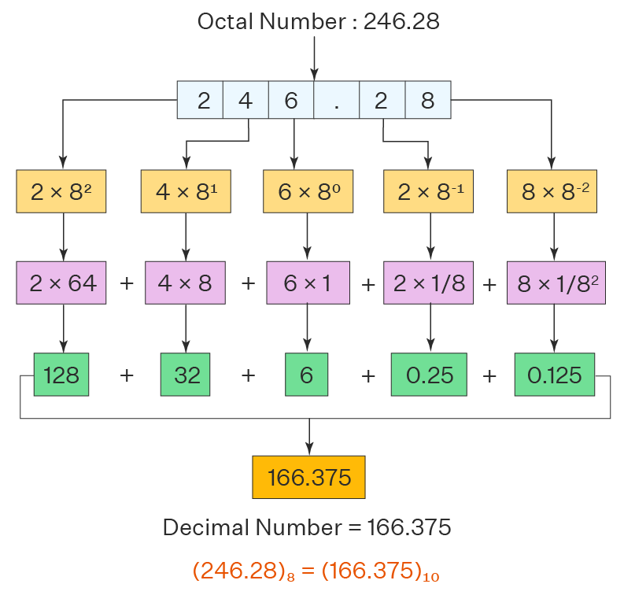
Contd..
Example-2:

Slide 49
Contd..
4. Hexa Decimal Number System: It is another technique to represent the number in the digital system called the hexadecimal number system. The number system has a base of 16 means there are total 16 symbols(0, 1, 2, 3, 4, 5, 6, 7, 8, 9, A, B, C, D, E, F) used for representing a number. The single-bit representation of decimal values10, 11, 12, 13, 14, and 15 are represented by A, B, C, D, E, and F. Only 4 bits are required for representing a number in a hexadecimal number. Each set of bits has a distinct value between 0 and 15.

Slide 50
Contd..

Slide 51
Contd..

Slide 52
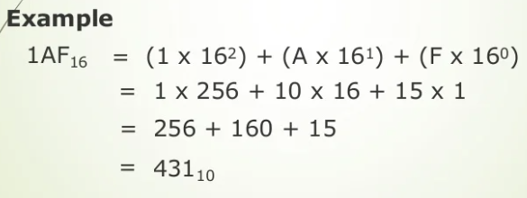
Contd..
Example :
5B52 = 16³ 5+ 16² 11+ 16¹5 + 16⁰2
= 54096 + 11256 + 80 + 2
= 23378

Slide 53
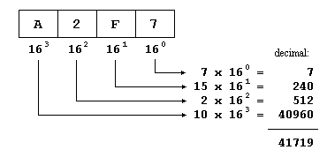
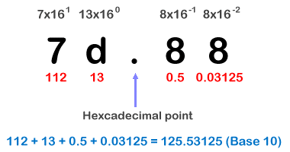
Contd..
Example-3:
Example-4:

Slide 54
Contd..
Example-1 :
5B52 = 16³ 5+ 16² 11+ 16¹5 + 16⁰2
= 54096 + 11256 + 80 + 2
= 23378

