Slide 1
UNIT-I (Logic Gates)

Slide 2
Logic Gates
Topics :
Logic Gates
Basic Logic Gates
Universal Logic Gates
Other Logic Gates

Slide 3
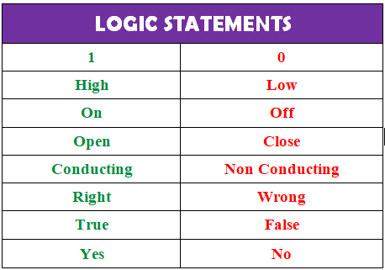
Logic Gates
Gate: A Gate is defined as a Digital Circuit which follows some logical relationship between the input and output voltages.

Slide 4
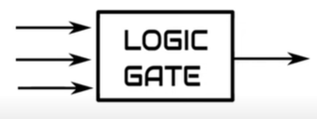
Logic Gates
A Logic Gates is an electronic circuit which performs the particular logic operation or Decision.
It is a Physical Device which performs logic operation on one or more inputs and finally it produces the single output.
The inputs and outputs of logic gates can be represented by HIGH and LOW, 0 and 1, True and False.
Here the output is depends on type of logic gate and nature of input variable.

Slide 5
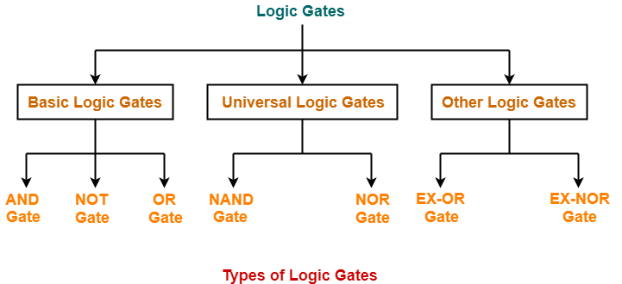
Contd..
All digital systems can be constructed by only three basic logic gates. These basic gates are called the AND gate, the OR gate, and the NOT gate.

Slide 6
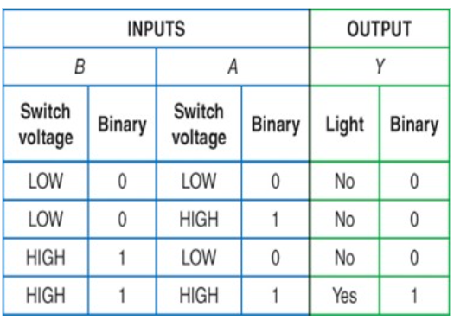
Contd..

Slide 7
Basic Logic Gates
1. AND Gate: Here A, B are the inputs and Y is the output of two input AND gate. If both inputs are ‘1’, then only the output, Y is ‘1’. For remaining combinations of inputs, the output, Y is ‘0’.
This is symbol for AND operation.
The Boolean Symbol (.) dot operator is used to perform the operation between two inputs.

Slide 8
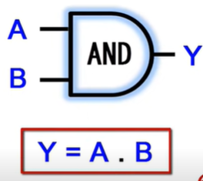
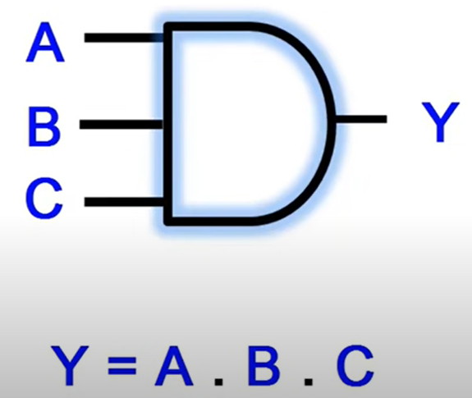
Contd..
2- input AND Gate
3- input AND Gate
Truth Table: The relationship between the input and output logic levels on a gate can be best illustrated using “truth table”.
A truth table is a table or chart that lists all of the possible input combinations and the resulting output logic level.

Slide 9
Contd..

Slide 10
Contd..

Slide 11
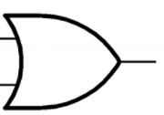
Contd..
2. OR Gate: The output of OR Gate is ‘High’ if both the inputs are ‘High’ or one of the inputs is ‘High’. The output is ‘Low’ if both the inputs are ‘Low’.
This is symbol for AND operation.
The Boolean Symbol (+) is used to perform the operation between two inputs.

Slide 12
Contd..

Slide 13
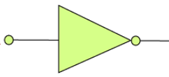
Contd..
3. NOT Gate: The NOT gate is a single input single output gate. This gate is also known as Inverter because it performs the inversion of the applied binary signal, i.e., it converts 0 into 1 or 1 into 0.
This is symbol for NOT operation.

Slide 14
Contd..

Slide 15
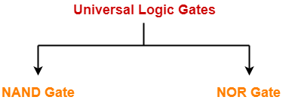
Universal Logic Gates
A universal gate is a logic gate which can implement any Boolean function without the need to use any other type of logic gate.
There are following two Universal Gates.

Slide 16
Contd..
1. NAND Gate: The NAND gate is the combination of AND gate and NOT gate. This gate gives the same result as a NOT-AND operation. This gate can have two or more than two input values and only one output value.
The small circle (bubble) at the output of the graphic symbol of a NOT gate is formally called a negation indicator and designates the logical complement.

Slide 17
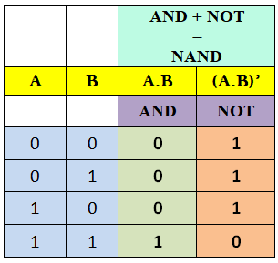
Contd..

Slide 18
Contd..
2. NOR Gate: The NOR gate is the combination of an OR gate and NOT gate. This gate gives the same result as the NOT-OR operation. This gate can have two or more than two input values and only one output value.

Slide 19
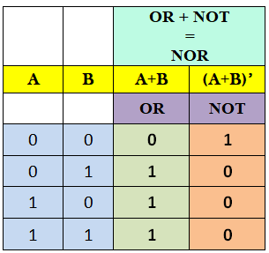
Contd..

Slide 20
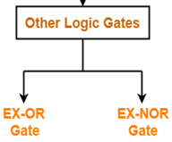
Other Logic Gates
A other Logic gates are special type of Logic Gates. It can be used in the half adder, full adder and subtractor.
There are following two other Logic Gates.

Slide 21
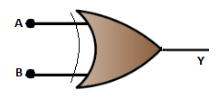
Contd..
1. X-OR Gate: The XOR gate is also known as the Ex-OR gate. The exclusive-OR gate is sometimes called as EX-OR and X-OR gate.
The output of XOR Gate is ‘High’ if either of the input is ‘High’.
The output is ‘Low’ if both the inputs are ‘High’ or if both the inputs are ‘Low’.

Slide 22
Contd..

Slide 23
Contd..
2. EX-NOR Gate: The XNOR gate is also known as the Ex-NOR gate.
The exclusive-NOR gate is sometimes called as EX-NOR and X-NOR gate.
The output of XNOR Gate is ‘High’ if both the inputs are ‘High’ or if both the inputs are ‘Low’. The output is ‘Low’ if either of the input is ‘Low’

Slide 24
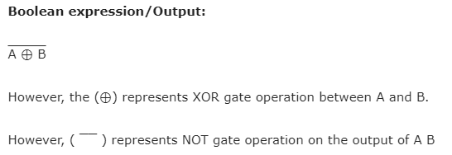
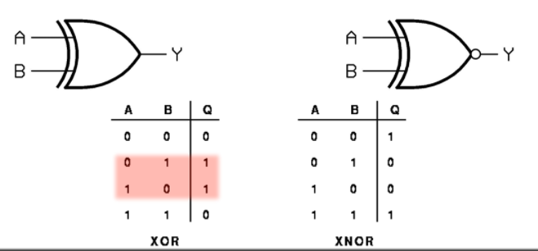
Contd..

Slide 25
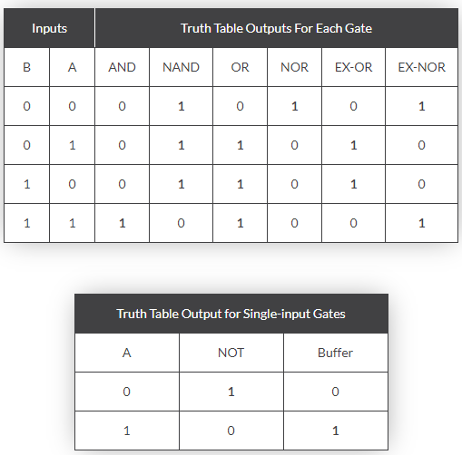
Digital Gates Truth Table Summary

