Slide 1
UNIT-I (Complements)

Slide 2
Complements
Topics :
Complement of Numbers
Subtraction of 1’s , 2’s and 9’s ,10’s Complements

Slide 3
Complements of Numbers
Complements are used in digital computers to simplify the subtraction operation and for logical manipulation
There are two types of complements for each base‐r system:
1. The radix complement (r’s complement) and
2. Diminished radix complement (r - 1)’s complement
If Radix=10, ( Decimal)
10’s Complement
9’s Complement
If Radix =2, ( Binary)
2’s Complement
1’s Complement

Slide 4
Binary System Complements
In number representation techniques, the binary number system is the most used representation technique in digital electronics.
The complement is used for representing the negative decimal number in binary form.
As the binary system has base r = 2. So the two types of complements for the binary system are 2's complement and 1's complement.

Slide 5
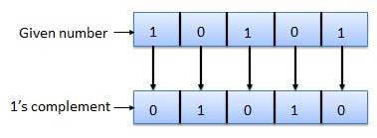
1’s Complement
The 1's complement of a number is found by changing all 1's to 0's and all 0's to 1's.
This is called as taking complement or 1's complement. Example :

Slide 6
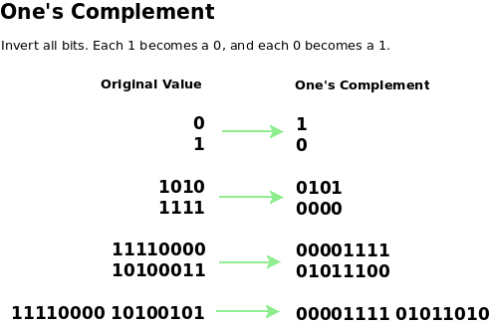
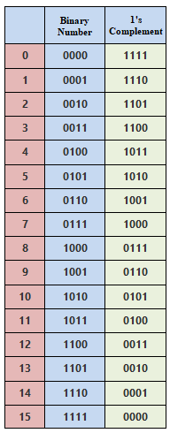
Contd..

Slide 7
1’s Complement Subtraction
1’s complement subtraction is a method to subtract two binary numbers.
Steps for 1’s Complement Subtraction of smallest number from Largest Number:
Step-1: Determine the 1’s complement of the smaller number.
Step-2: Add this to the larger number.
Step-3: Remove the carry and add it to the result. This carry is called end-around-carry.

Slide 8
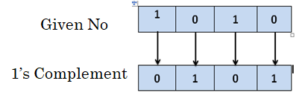
Contd..
Example: Subtract (1010)₂ from (1111)₂ using 1’s complement method.
Ans: Step-1: Take the Smallest Number : 1010
Apply 1’s Complement . ie, replacing 1’s to 0’s and 0’s to 1’s.

Slide 9
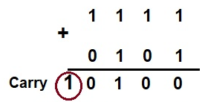
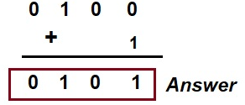
Contd..
Step-2: In this step, we need to add the value calculated in step-1 to 1111. This is shown below.
Step-3: Remove the carry and add it to the result.

Slide 10
Contd..
Steps for 1’s Complement Subtraction of Largest number from Smallest Number:
Step-1: Determine the 1’s complement of the Largest number.
Step-2: Add this to the Smallest number.
Step-3: The answer is the 1’s complement of the true result and opposite in sign. There is no carry.

Slide 11
Contd..
Example: Subtract (1010)₂ from (1000)₂ using 1’s complement method.
Ans: Step-1: Take the Largest Number : 1010
Apply 1’s Complement . Ie, replacing 1’s to 0’s and 0’s to 1’s.

Slide 12
Contd..
Step-2: In this step, we need to add the value calculated in step-1 to 1000. This is shown below.

Slide 13
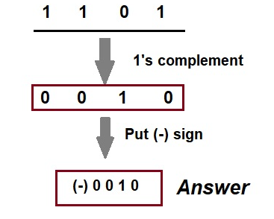
Contd..
Step-3: Finally take 1’s complement of the result to get the answer
Mind that No carry has been obtained while subtracting a larger number from a smaller number. Further, a minus sign has been put.

Slide 14
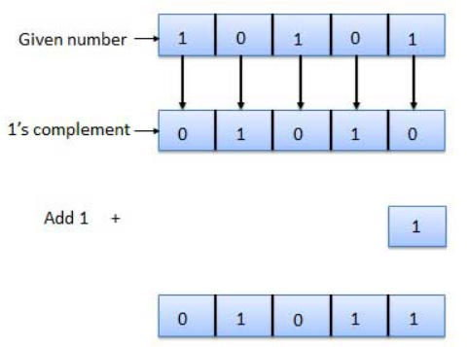
2’s Complement
The 2's complement of binary number is obtained by adding 1 to the Least Significant Bit (LSB) of 1's complement of the number.
2's complement = 1's complement + 1
Example :

Slide 15
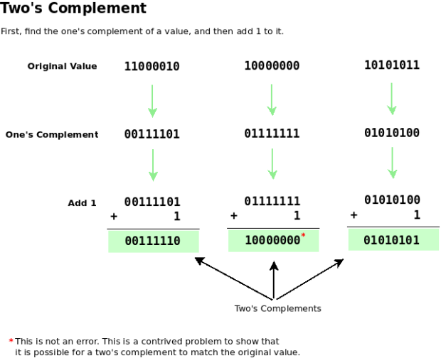
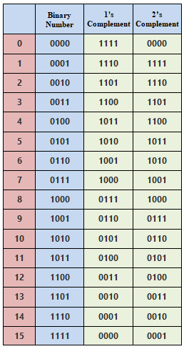
Contd..

Slide 16
2’s Complement Subtraction
2’s complement subtraction is a method to subtract two binary numbers.
Steps for 2’s Complement Subtraction of smallest number from Largest Number:
Step-1: Determine the 2’s complement of the smaller number.
Step-2: Add this to the larger number.
Step-3: Omit the Carry.
Note: there is always a carry in this case.

Slide 17
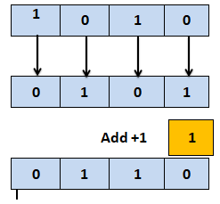
Contd..
Example: Subtract (1010)₂ from (1111)₂ using 2’s complement method.
Answer: Step-1: Take the Smallest Number : 1010
Apply 2’s Complement .

Slide 18
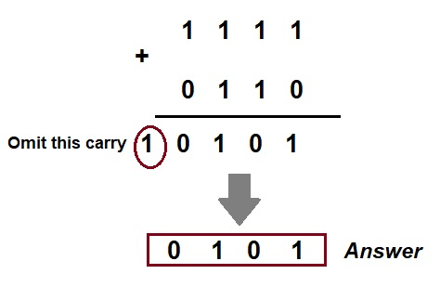
Contd..
Step-2: Add this step-1 number to Largest Number
Step-3: omit the carry.

Slide 19
Contd..
Steps for 2’s Complement Subtraction of Largest number from Smallest Number:
Step-1: Determine the 2’s complement of the Largest number.
Step-2: Add this to the smallest number.
Step-3: There is no carry in this case. The result is in 2’s complement form and is negative.

Slide 20
Contd..
Example: Subtract (1010)₂ from (1000)₂ using 2’s complement method. ( 1010= 10 and 1000= 8)
Ans: Step-1: Find the 2’s complement of Largest Number 1010
Apply 2’s Complement .

Slide 21
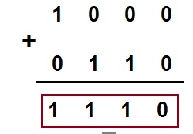
Contd..
Step-2: In this step, we need to add the value calculated in step-1 (0110) to 1000. This is shown below.

Slide 22
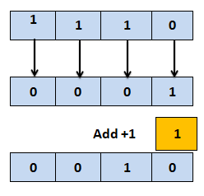
Contd..
Step-3: There is no carry in this case. The result is in 2’s complement form and it is negative.
i.e, again we have to calculate 2’s Complement from the final result.

Slide 23
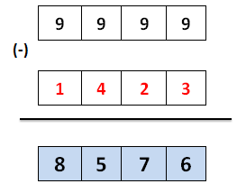
9’s Complement
The 9's complement is used to find the subtraction of the decimal numbers. The 9's complement of a number is calculated by subtracting each digit of the number by 9.
Example : suppose we have a number 1423, and we want to find the 9's complement of the number.

Slide 24
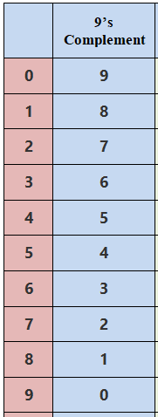
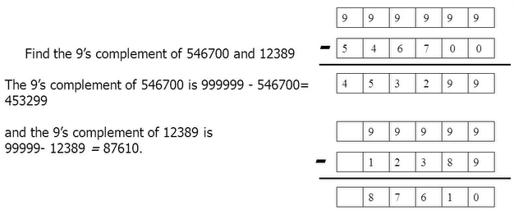
Contd..

Slide 25
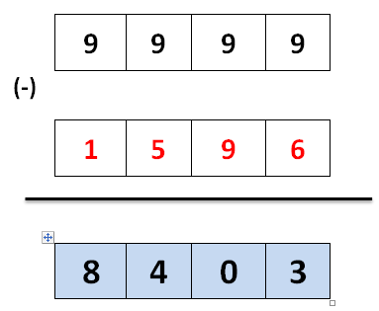
9’s Complement Subtraction
9’s complement subtraction is a method to subtract two Decimal Numbers.
Steps for 9’s Complement Subtraction of smallest number from Largest Number: ( Carry is produced)
Ex: (1823) – (1596) = ?
Step-1: First we will find the 9’s Complement of given smallest number.
9’s complement

Slide 26
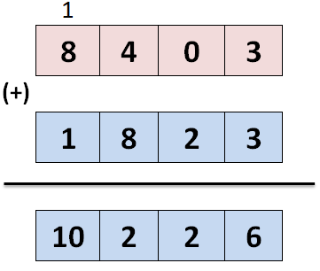
Cond..
Step-2: In this step, we need to add the value calculated in step-1 (8403) to 1823. This is shown below.

Slide 27
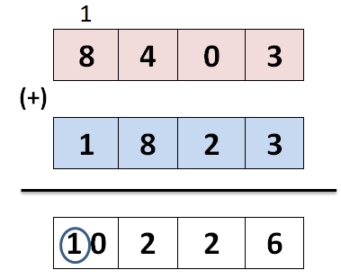
Cond..
Step-3: Here, we discard the ‘1’ and this ‘1’ is add to the final answer.
Discard-1

Slide 28
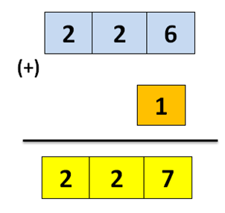
Cond..
Step-4: The Final Answer is

Slide 29
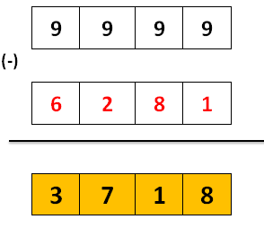
Contd..
Steps for 9’s Complement Subtraction from Largest number from Smallest Number: ( No Carry)
Ex: (5027) – (6281) = ?
Step-1: First we will find the 9’s Complement of given Largest number.
9’s complement

Slide 30
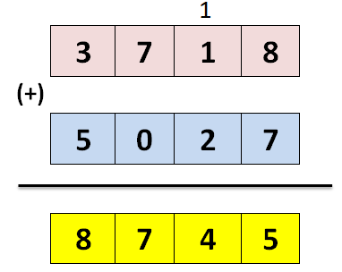
Cond..
Step-2: In this step, we need to add the value calculated in step-1 (3718) to 5027. This is shown below.

Slide 31
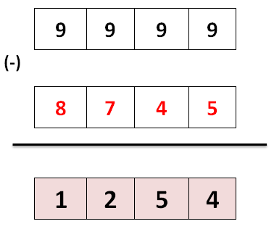
Cond..
Step-3: Here, again we can find the 9’s complement of the resultant number.

Slide 32
Cond..
Example:

Slide 33
10’s Complement
The 10's complement is also used to find the subtraction of the decimal numbers.
The 10's complement of a number is calculated by subtracting each digit by 9 and then adding 1 to the result.
i.e, Simply, by adding 1 to its 9's complement we can get its 10's complement value.
(10’s Complement = 9’s Complement + 1)

Slide 34
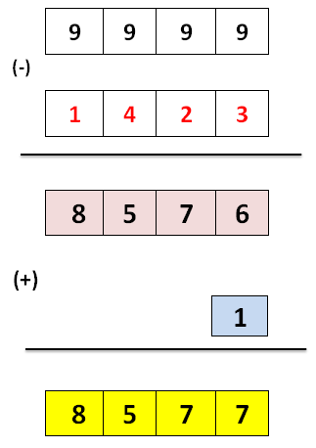
Contd..
Example: suppose we have a number 1423, and we want to find the 10's complement of the number.

Slide 35
10’s Complement Subtraction
10’s complement subtraction is a method to subtract two Decimal Numbers.
Steps for 10’s Complement Subtraction from smallest number from Largest Number: ( Carry is produced)

Slide 36
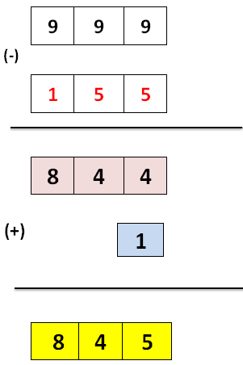
Cond..
Ex: A= (215) – B=(155) = ?
Step-1: First we will find the 10’s Complement of given smallest number.(i.e, 155)
10’s complement

Slide 37
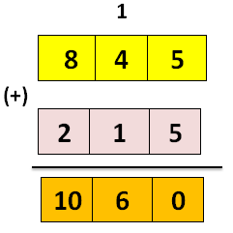
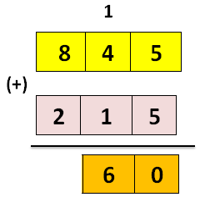
Cond..
Step-2: Adding 10’s Complement of B to A
Step-3: In this Case Carry is omitted. So the Final Answer is 60.
Discard-10

Slide 38
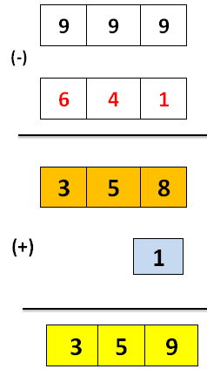
Contd..
Steps for 10’s Complement Subtraction from Largest number from Smallest Number: (No Carry)
Ex: (325) – (641) = ?
Step-1: First we will find the 10’s Complement of given Largest number.
10’s complement

Slide 39
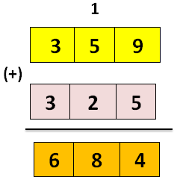
Cond..
Step-2: Adding 10’s Complement of B to A

Slide 40
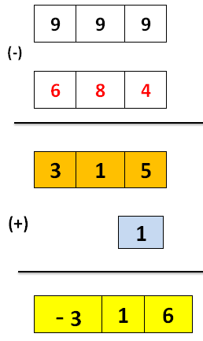
Cond..
Step-3: Again we calculate the 10’s Complement. The final Result is :

Slide 41
Complements Examples
1. Using 10’s Complement , Subtract 72532 – 3250.
2. Using 2’s Complement , Subtract 1010100 - 1000100
3. Using 9’s Complement , Subtract 841 – 329.
4. Using 1’s Complement, Subtract 1010 from 1111 .
5. Find the 10’s Complement of 12398.
6. Find the 2’s Complement of 1101100
7. Find the 9's and the 10's complement of the following decimal number: 52,784,630 (MAR-2021)

Slide 42
Cond..
8. Using 10’s Complement, Subtract (APR-2019)
i) (72532) 10 – (3250)10
ii) (3250) 10 – (72532)10
9. Perform Subtraction with the following unsigned decimal numbers by taking 10’s complement of the subtrahend (MAY-2017)
i) 20-100
ii) 1200-250
iii) 1753-8640
iv) 5250-1321

Slide 43
Cond..
10. The 2’s Complement of the Number 1101110 is (APR-2016)
11. Perform the subtraction with the following binary numbers
using 2’s complement. 11010 – 11011(FEB-2022)
12. Using 2’s Complement method, perform 15610 – 9910
(APR-2015)

