Slide 1
A
Nothing is impossible to a willing heart.

Slide 2
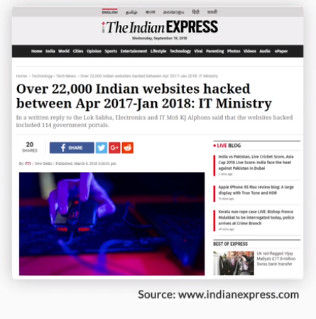

Slide 3
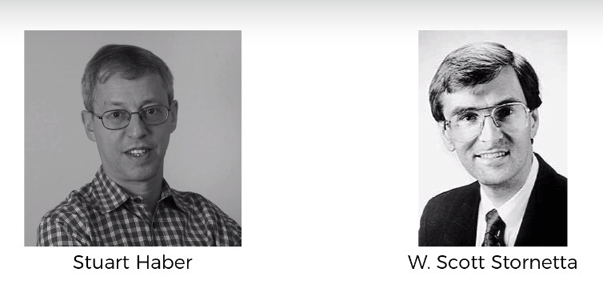
What is a Blockchain
https://www.anf.es/pdf/Haber_Stornetta.pdf

Slide 4
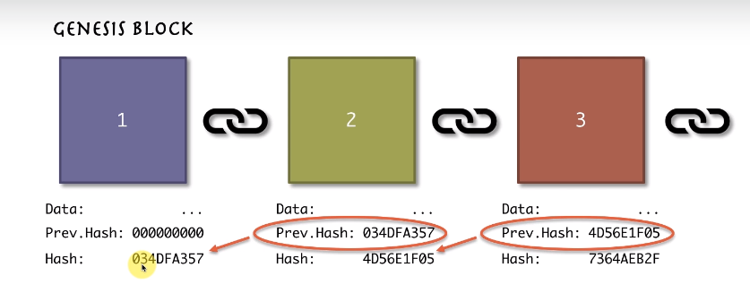
Blockchain

Slide 5
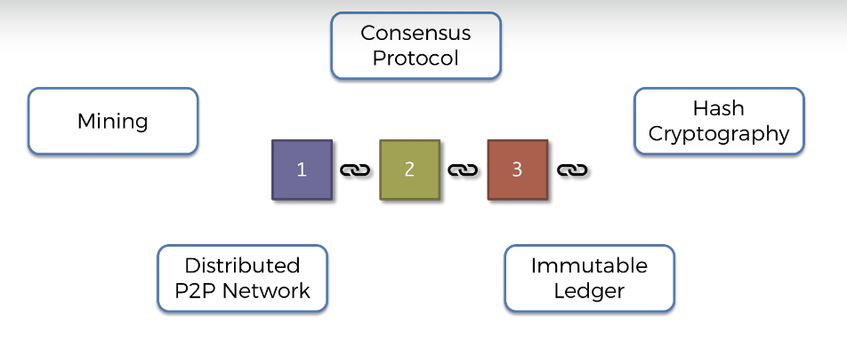
Blockchain

Slide 6
SHA256 Hash

Slide 7
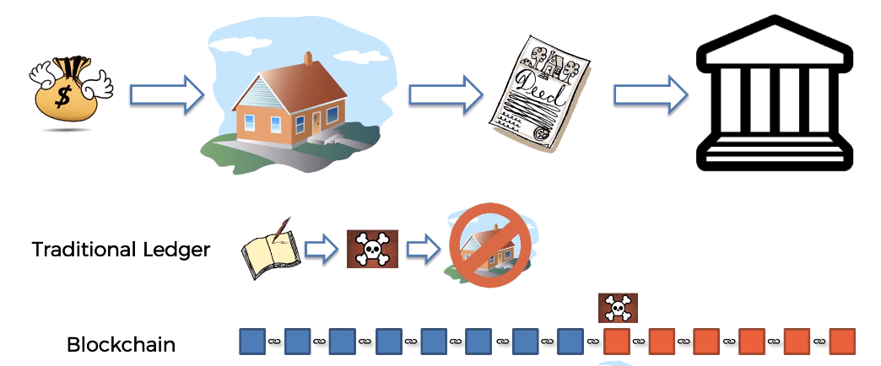
Immutable Ledger

Slide 8
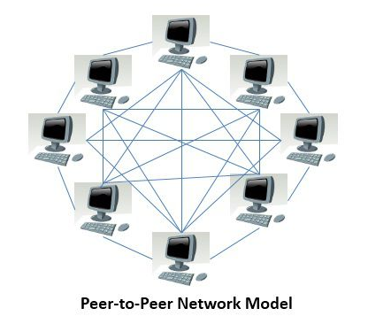
Distributed P2P Network

Slide 9
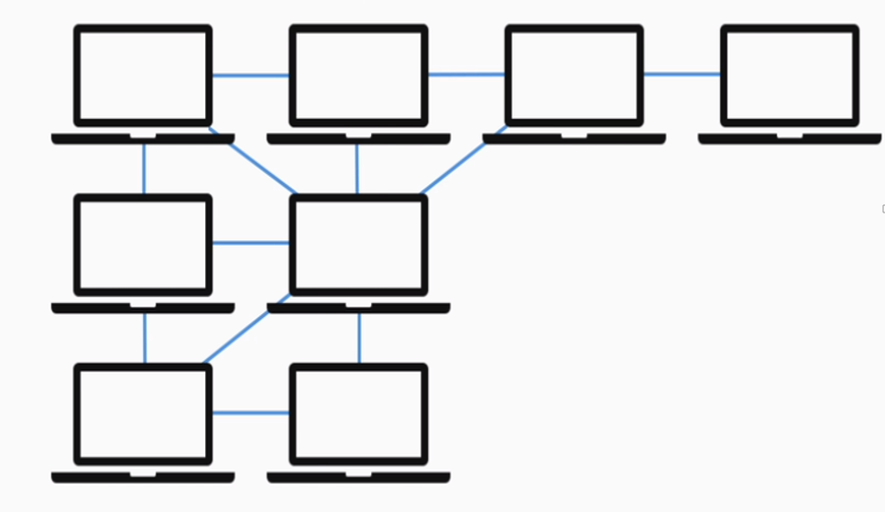
Distributed P2P Network

Slide 10
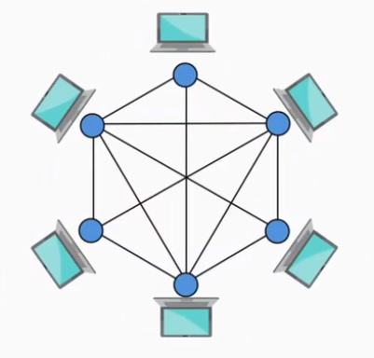
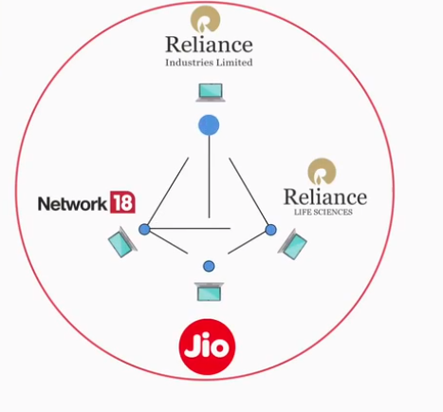
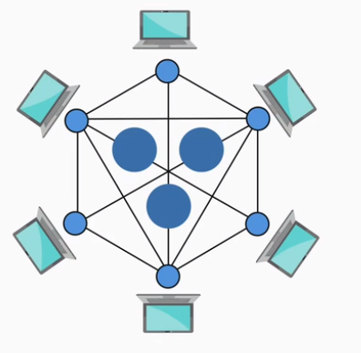
All blockchain structures fall into three categories:
Public blockchain architecture
Private blockchain architecture
Consortium blockchain architecture

Slide 11
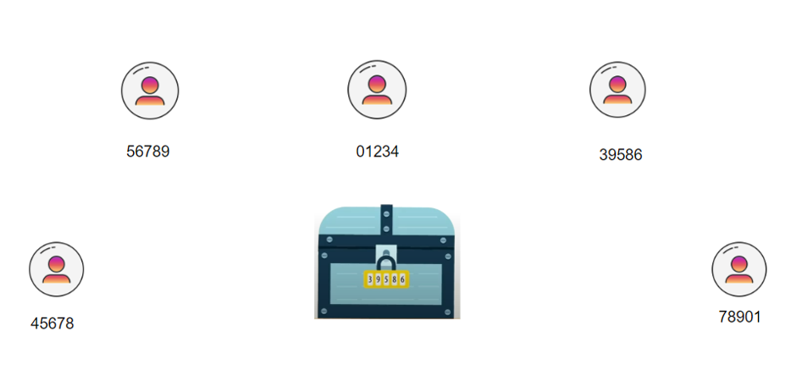
How Mining Works?

Slide 12
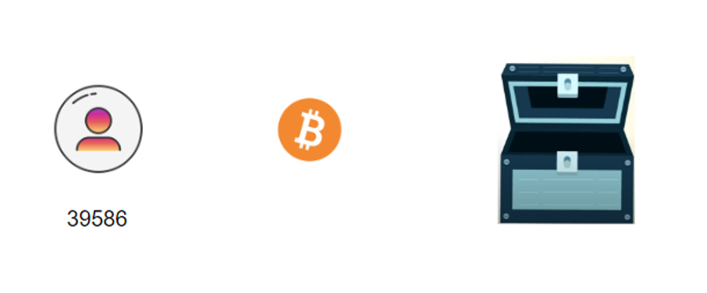
How Mining Works?

Slide 13
Consensus

Slide 14
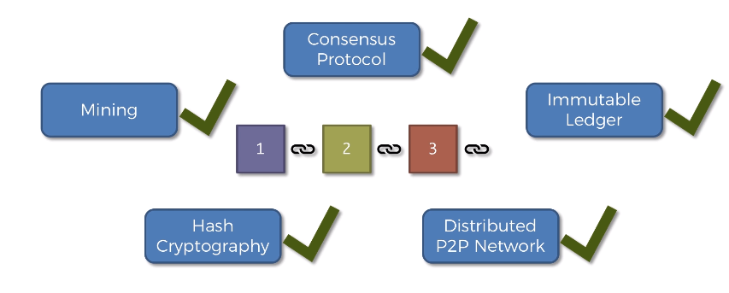
Properties

Slide 15
Three key areas

