Slide 1
Cryptocurrency

Slide 2
What is Bitcoin?

Slide 3
Bitcoin

Slide 4
Bitcoin’s Monetary Policy

Slide 5
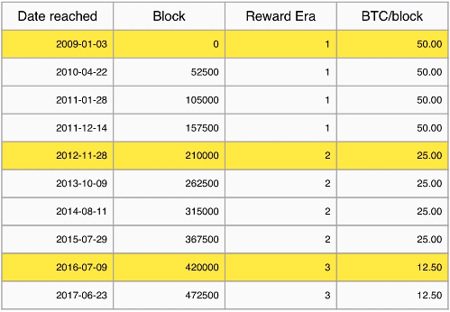
Bitcoin’s Monetary Policy

Slide 6
Bitcoin’s Monetary Policy

Slide 7
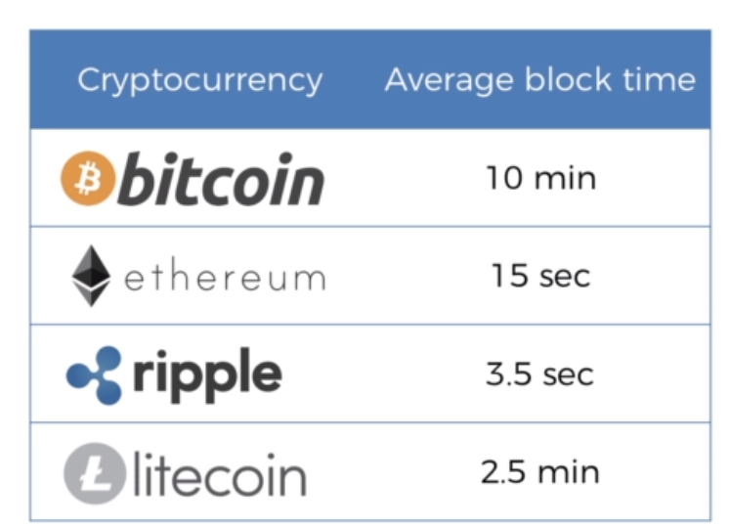
Block Frequency

Slide 8
Understanding Mining Difficulty
What is the Current Target?
How is “Mining Difficulty” calculated?

Slide 9
Current Target

Slide 10
Mining Difficulty
Difficulty = current target / max target
Difficulty is adjusted every 2016 blocks (2 weeks)

Slide 11
Virtual Tour of a Bitcoin Mine
https://qz.com/1055126/photos-china-has-one-of-worlds-largest-bitcoin-mines/

Slide 12
Mining Pools

Slide 13
CPUs vs GPUs vs ASICs
CPU = Central Processing Unit (General) < 10 MH/s
GPU = Graphics Processing Unit (Specialized) < 1 GH/s
ASIC = Application Specific Integrated Circuit (Totally Specialized) >1000 GH/s

Slide 14
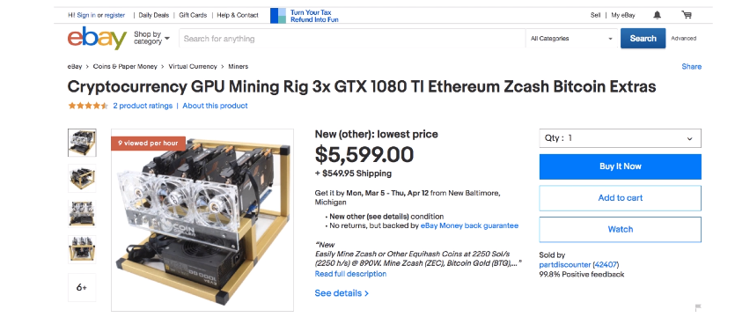
GPU

Slide 15
How do Mempools Work?

Slide 16
Signatures: Private & Public Keys

Slide 17
An inspired individual who is continuously looking forward to make a difference in this world by collaborating and working along with like minded high spirited individuals.
PRASANTH SAHOO
THANK YOU
Mail id: prasanthsahoo45@gmail.com

