Slide 1
Nature view of a tree
Concept of TREES
Computer scientist's view
leaves
root
leaves
branches
branches
nodes
root

Slide 2
Definition of a Tree
A tree is a finite set of one or more nodes such that ,there is a specially designated node called the root.
The remaining nodes are partitioned into n>=0 disjoint sets T1, ..., Tn, where each of these sets is a tree.
We call T1, ..., Tn the subtrees of the root.

Slide 3
Tree Terminology
Root: node without parent (A)
Siblings: nodes share the same parent
Internal node: node with at least one child (A, B, C, F)
External node (leaf ): node without children (E, I, J, K, G, H, D)
Ancestors of a node: parent, grandparent, grand-grandparent, etc.
Descendant of a node: child, grandchild, grand-grandchild, etc.
Depth of a node: number of ancestors
(or) the number of edges from the root to the node
Height of a tree: maximum depth of any node (or) The height of a tree is a height of the root.
Degree of a node: the number of its children
Degree of a tree: the maximum number of its node.
Subtree: tree consisting of a node and its descendants
A
subtree
B
C
D
E
F
G
H
I
J
K

Slide 4
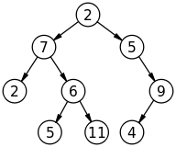
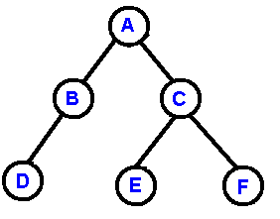
Binary tree
A Binary tree is a finite set of elements(known as nodes) that is either
empty or is partitioned into three disjoint subsets.
The first subset contains a single element called the root of the tree
The other two subsets called the left and right subtrees are themselves binary trees

Slide 5
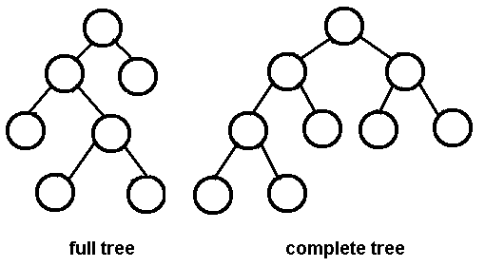
Types of Binary tree
A binary tree is called strictly / Full binary tree if each node has exactly zero or two children.
A binary tree is called perfect binary tree if each node has exactly two children and all leaf nodes are at the same level. The height of a perfect binary tree is log2n, where n is the number of nodes in the tree. This type of tree is often used in computer algorithms, as it allows for efficient representation and processing of data.
A binary tree is called complete binary tree in which all levels are completely filled, with the possible exception of the bottom level, which is filled from left to right. This type of tree is often used in algorithms that require data to be stored in a heap structure, such as a priority queue or heap sort. The advantage of using a complete binary tree over other types of trees is that the tree can be efficiently stored in an array.
Full/Strictly binary tree
perfect binary tree
Complete binary tree

Slide 6
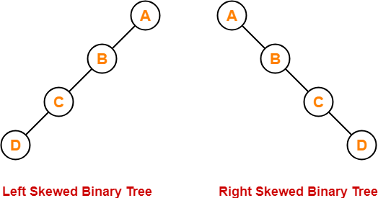
Degenerate Binary Tree: A degenerate binary tree is a tree in which every internal node has only one child. This results in a tree that is similar to a linked list. Degenerate trees are not commonly used in computer algorithms, as they do not provide efficient access to data. In many cases, a degenerate tree can be replaced with a more efficient data structure, such as an array or linked list.
A binary tree is called skewed binary tree, if all the elements are inserted either completely left or completely right of each node.

Slide 7
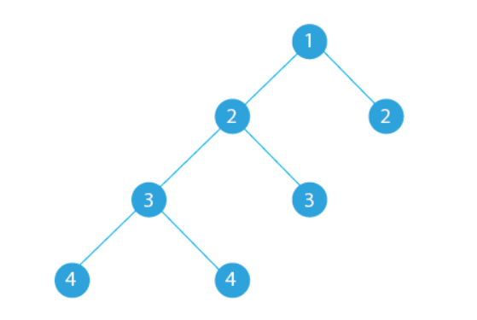
Balanced Binary Tree: A balanced binary tree is a binary tree where the height difference between the left and right subtrees of any node is no greater than some constant value. This helps ensure fast search times and prevent the tree from becoming too unbalanced. Examples of balanced binary trees include red-black trees and AVL trees. These trees are commonly used in computer algorithms and data structures that require fast access to data, such as search trees and heaps. The advantage of using a balanced binary tree is that search times are guaranteed to be logarithmic, ensuring efficient access to data.

Slide 9
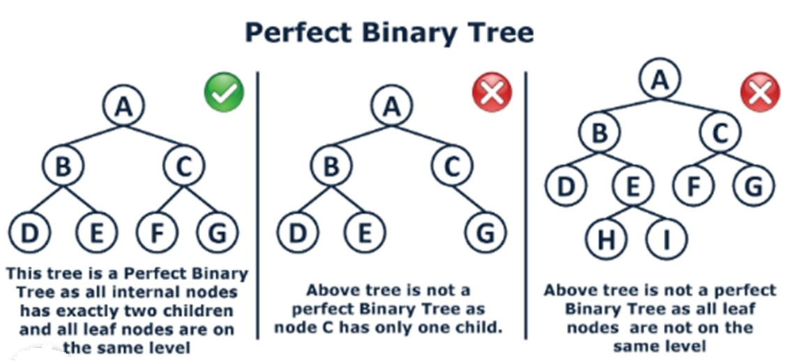

Slide 11
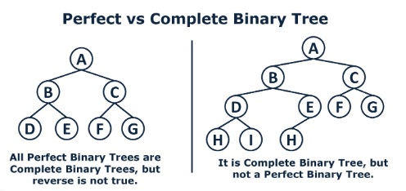

Slide 12
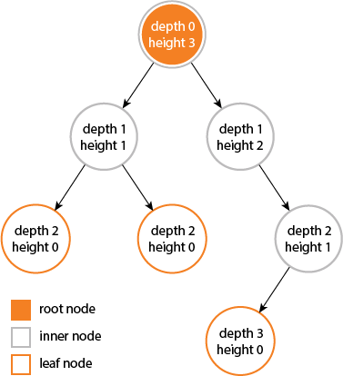
Depth , Height and level of a binary tree
The depth of a node is the number of edges from the node to the tree's root node. A root node will have a depth of 0.
The height of a node is the number of edges on the longest path from the node to a leaf. A leaf node will have a height of 0.
The level of a node in a binary tree is defined as follows:
the root of the tree has level 0,
and the level of any other node in the tree is one more than the level of its parent.
height and depth of a tree is equal but, height and depth of a node is not equal because, the height is calculated by traversing from the given node to the deepest possible leaf. The depth is calculated from traversal from root to the given node.

Slide 13
What is the height of the tree ?
A
B
C
D
E
F
G
I
H
J

Slide 14
Properties of Binary trees
If a binary tree contains m nodes at level l, it contains at most 2m nodes at level l+1
The maximum number of nodes at level ‘l’ of a binary tree is 2^{l}. ( level starts from 0 onwards)
The Maximum number of nodes in a binary tree of height ‘h’ is 2^{(h+1)} – 1. (consider height of the leaf as 0)
A strictly/full binary tree with n leaves always contains (2*n - 1) nodes.
A complete binary tree of depth d is the strictly binary tree all of whose leaves are at level d.
The number of nodes n in a complete binary tree is between 2^{h} (minimum) and 2^{h+1} – 1 (maximum).

Slide 15
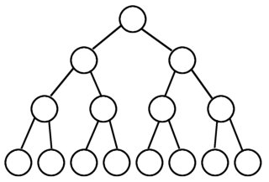
Relation between Number of nodes of a tree and height of the binary tree
Property 1 : The Maximum number of nodes in a binary tree of height ‘h’ is
2^{(h+1)} – 1. (consider height of the leaf as 0).
Property 2 : For n node, the maximum and minimum height of a tree is n-1
and Log₂(n+1) - 1
level 0
Nodes = 2⁰ =1
A
B
C
level 1
Nodes = 2¹ =2
h=3
D
E
F
G
level 2
Nodes = 2² =4
H
I
J
K
L
M
N
O
level 3
Nodes = 2³ =8
The number of nodes = 2⁰ + 2¹ + 2² + 2³ = 15 (2⁴ - 1)
Therefore, the maximum number of nodes of height h = 2^{(h+1)} -1

Slide 16
Contd..
Property 2 : For n node, the maximum and minimum height of a tree is
(n-1) and Log₂(n+1) -1

Slide 17
Contd..
Property 3: The maximum number of nodes at level ‘l’ of a binary tree is 2^{l}. ( level l starts from 0 onwards)
level 0
Nodes = 2⁰ =1
A
B
C
level 1
Nodes = 2¹ =2
D
E
F
G
level 2
Nodes = 2² =4
I
M
level 3
Nodes = 2³ =8
H
J
K
L
N
O

Slide 18
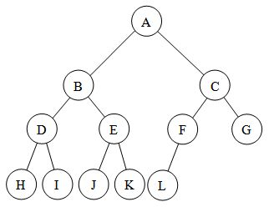
Contd..
Property 4: If a binary tree contains m nodes at level l, it contains at most 2*m nodes at level l+1
Property 5 : The number of nodes n in a complete binary tree is between 2^{h} (minimum) and 2^{h+1} – 1 (maximum).
Height of a complete binary tree is 3
The number of nodes of a tree are between
2³ (8 ) to 2⁴ -1 (15)
level 0
level 1
At most = 2* m= 2*1<=2 nodes
level 2
At most = 2 * m = 2 *2 <=4 nodes
level 3
At most = 2 * m = 2 *4 <=8 nodes

Slide 19
property 6 : A strictly binary tree with n leaves always contains (2*n - 1) nodes.
Number of the leaf nodes = 4 ( node 2, 6, 7,and 5)
The total number of nodes in a tree = 2*4 – 1 = 7

Slide 20
Representation of Binary trees
Using an array
Using linked list

Slide 21
Binary tree representation using array
If the parent is stored at i , then
left child is stored at 2*i +1, and
right child is stored at 2*i + 2
A
B
C
D
E
F
G
H
A | B | C | D | - | E | F | - | - | - | - | - | G | - | - | - | - | - | - | - | - | - | - | - | H
0 | 1 | 2 | 3 | 4 | 5 | 6 | 7 | 8 | 9 | 10 | 11 | 12 | 13 | 14 | 15 | 16 | 17 | 18 | 19 | 20 | 21 | 22 | 23 | 24
How to reduce the memory wastage?
Represent the elements using perfect binary tree or complete binary tree

Slide 22
A
A | B | C | D | E | F | G | H
0 | 1 | 2 | 3 | 4 | 5 | 6 | 7
B
C
D
E
F
G
H
All the elements are stored in an array without any wastage of memory

Slide 23
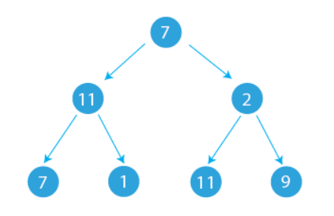
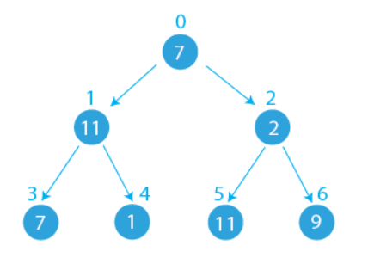
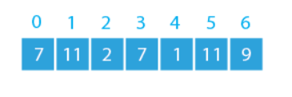

Slide 24
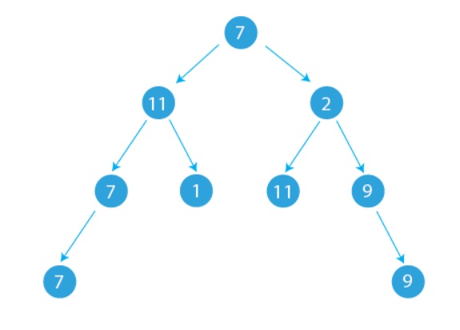
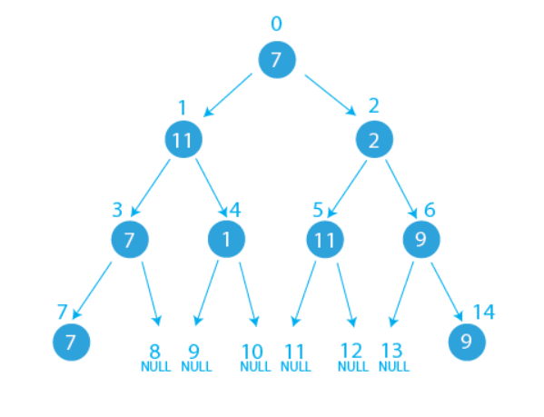

Slide 25
Applications of Binary Tree
Data representation and storage: Binary trees are commonly used to store data in an organized, hierarchical manner, where each node has at most two child nodes.
Searching: Binary search trees allow for efficient searching of data as it is structured in a manner that enables a binary search approach.
Sorting algorithms: Binary trees can be used to implement sorting algorithms, such as Heap sort.
Expression trees: Binary trees can be used to store expression trees, which are used to evaluate expressions in the mathematically correct order.
Path finding: Binary trees can be used to find the shortest path in a graph or network, as in Dijkstra’s algorithm.
Decision-making algorithms: Binary trees can be used to implement decision-making algorithms, such as ID3 (for decision tree learning).

Slide 26
Advantages of Array Representation of Binary Tree
Easy to implement: Array representation of binary trees is simple to implement and understand.
Memory efficient: Array representation takes less memory compared to linked representation, as there are no pointers to be stored.
Easy to access children: Children of a node can be easily accessed in an array representation as the indices for left and right children are easily computable.
Traversals are efficient: Array representation allows for efficient traversals, such as pre-order, in-order, and post-order.
Space utilization: Array representation can utilize space efficiently, as all the memory is contiguous and not spread out.

Slide 27
Disadvantages of Array Representation of Binary Tree:
Difficult to insert and delete nodes: Inserting and deleting nodes in an array representation is complex, as the structure needs to be re-arranged.
Limited to complete trees: Array representation is limited to complete trees and cannot handle cases where there are missing nodes in a tree.
Limited flexibility: Array representation has limited flexibility and cannot handle trees with an unpredictable number of nodes.
Fixed size: The size of an array must be pre-determined, so if the tree grows beyond the size of the array, it cannot be resized dynamically.
No explicit pointers: Array representation does not have explicit pointers to parent or child nodes, making it harder to navigate the tree in certain cases.

Slide 28
Draw the Memory representations using an array for the following trees
A
A
B
B
D
D
H
H
Binary tree 1
Binary tree 2

Slide 29
Binary tree representation using linked list
struct node {
int data;
struct node *leftchild,*rightchild;
};
A
root = 0x1000
B
C
left child | data | right child
 | A
D
E
F
0x1000
G
 | B
 | C
H
 | D
 | E
 | F
 | G
 | H

Slide 30
Binary tree representation using linked list
A
left child | data | right child
0x2000 | A | 0x3000
root = 0x1000
B
C
0x1000
D
E
F
0x8000 | B | NULL
0x2000
0x4000 | C | 0x5000
0x3000
G
H
NULL | D | NULL
0x8000
NULL | E | 0x6000
0x4000
NULL | F | NULL
0x5000
0x7000 | G | NULL
0x6000
NULL | H | NULL
0x7000

Slide 31
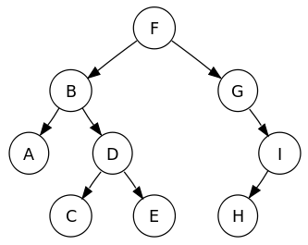
Example
The depth of a node is the number of edges from the root to the node.
The height of a node is the number of edges from the node to the deepest leaf.
The height of a tree is a height of the root.

Slide 32
Binary Tree traversals
root
In order traversal
visit left subtree in inorder recursively
visit the root node
visit right subtree in inorder recursively
Pre order traversal
visit the root node
visit left subtree in preorder recursively
visit right subtree in preorder recursively
Post order traversal
visit left subtree in postorder recursively
visit right subtree in postorder recursively
visit the root node
Left subtree
Left subtree

Slide 33
Inorder traversal
preorder traversal
postorder traversal
While(tree is not empty) {
visit left subtree in inorder recursively
visit the root node
visit right subtree in inorder recursively
}
While(tree is not empty) {
visit the root node
visit left subtree in preorder recursively
visit right subtree in preorder recursively
}
While(tree is not empty) {
visit left subtree in postorder recursively
visit right subtree in postorder recursively
visit the root node
}
A
A
A
B
C
B
C
B
C
Visiting sequence : B A C
Visiting sequence : A B C
Visiting sequence : B C A

Slide 34
A
B
C
D
H
E
F
Dummy nodes

Slide 35
Inorder traversal ( L root R)
While (tree is not empty) {
visit left subtree in inorder recursively
visit the root node
visit right subtree in inorder recursively
}
A
B
C
D
H
E
F
Sequence :
D
B
H
A
E
C
F

Slide 36
preorder traversal ( root L R)
While(tree is not empty) {
visit the root node
visit left subtree in preorder recursively
visit right subtree in preorder recursively
}
A
B
C
D
H
E
F
Sequence :
A
B
D
H
C
E
F

Slide 37
postorder traversal (L R root)
While(tree is not empty) {
visit left subtree in postorder recursively
visit right subtree in postorder recursively
visit the root node
}
A
B
C
D
H
E
F
Sequence :
D
H
B
E
F
C
A

Slide 38
Find inorder, preorder, and postorder traversal of the tree.
Inorder : A B C D E F G H I
Preorder : F B A D C E G I H
Postorder : A C E D B H I G F

Slide 39
Inorder
F
A
B
C
D
E
F
G
H
I
B
G
A
D
I
C
E
H

Slide 40
Problems
Find an equivalent binary tree using the following
Inorder : A B C D E F G H I
Preorder : F B A D C E G I H

Slide 41
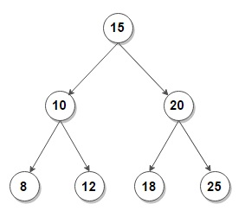
Binary Search Tree
A binary tree is said to be binary search tree , if every node satisfies the following properties
All the left subtree key values are less than the parent node key values, and
All the right subtree key values are greater than or equal to the parent node key values.
Both the left and right subtrees must also be binary search trees.

Slide 42
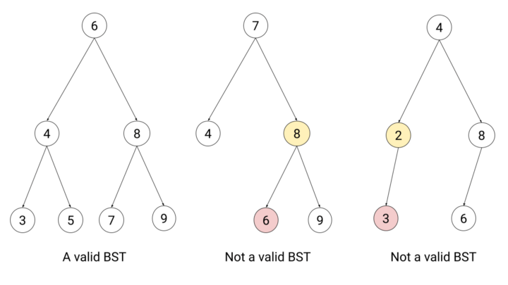
Example : BST

Slide 43
Creation of BST
25 11 8 42 26 51 39 10 31
25
11
42
8
26
51
10
39
31

Slide 44
Creation of BST
25 11 8 42 26 51 39
25
25
25
25
25
25
25
11
11
11
42
11
42
11
42
11
42
8
8
8
26
8
26
51
8
51
26
39

Slide 45
Creation of BST
25 11 8 42 26 51 39 10 31
25
p,
11
42
8
26
51
10
39
31

Slide 46
Insert operation of BST
p,
q
25
q
9 < 25
p,
11
42
9 < 11
p,
q
8
p,
q
26
51
9 > 8
10
9 < 10
39
So, 9 is inserted to left of 10
9
31

Slide 47
Insert Operation of BST
p,
q
25
q
9 < 25
p,
11
42
9 < 11
p,
q
8
p,
q
26
51
9 > 8
10
9 < 10
39
So, 9 is inserted to left of 10
9
31

Slide 48
Delete Operation of BST
Case 1: Node to be deleted is a leaf node (no children)
i.e., Nodes contains 9, 31, 40,51
25
11
42
Case 2: Node to be deleted has only child (right or left)
i.e., nodes 8,10,11,26
8
26
51
10
Case 3: Node to be deleted has both children (right or left).
i.e., nodes contains 25, 42,39
39
9
31
40

Slide 49
Delete Operation of BST
Node to be deleted is 9
Case 1: Node to be deleted is a leaf node (no children)
25
Let us say p points to parent of node to be deleted and q points to node to be deleted.
11
42
Detach the node 9 from the tree by
If p->lchild=q then
p->lchild=NULL
else
p->rchild=NULL
8
26
51
p
10
39
X
q
9
31
40

Slide 50
Contd..
Case 2: Node to be deleted has only one child (either left or right)
25
Let us say p points to parent of node to be deleted and q points to the node to be deleted.
p
11
42
If q is left child of parent p , then {
if q contains leftchild only then
p->lchild =q->lchild;
else
p->lchild= q->rchild;
}
else {// q is right child of parent p
if q contains leftchild only then
p->rchild = q->lchild;
else
p->rchild = q->rchild;
}
X
8
q
26
51
10
39
31
40

Slide 51
Contd..
Node to be deleted is 10
Case 2: Node to be deleted has only one child (either left or right)
25
Let us say p points to parent of node to be deleted and q points to the node to be deleted.
p
11
42
If q is left child of parent p , then {
if q contains leftchild then
p->lchild =q->lchild;
else
p->lchild= q->rchild;
}
else {// q is right child of parent p
if q contains leftchild then
p->rchild = q->lchild;
else
p->rchild = q->rchild;
}
8
q
26
51
X
10
39
9
31
40

Slide 52
Contd…
Node to be deleted is 39
Case 3: Node to be deleted has both children (right or left).
i.e., nodes contains 25, 42,39
25
Let us say p points to parent of node to be deleted and q points to the node to be deleted.
11
42
Step 1: Find the inorder successor/predecessor of the node to be deleted ‘q’ of the tree.
p
8
26
51
Node 39’s inorder predecessor is 31 and successor is 40
q
Step 2: store the selected inorder successor/ predecessor node value
10
39
40
val = 40
9
Step 3: Call the delete function with key as predecessor/ successor data value.
31
40
call delete(q, val)
predecessor
successor
It will be either case 1 or case 2
Step 4: update the node q’s value with val

Slide 53
Contd…
Node to be deleted is 39
Case 3: Node to be deleted has both children (right or left).
i.e., nodes contains 25, 42,39
25
Let us say p points to parent of node to be deleted and q points to the node to be deleted.
11
42
Step 1: Find the inorder successor/predecessor of the node to be deleted ‘q’ of the tree.
p
8
26
51
Node 39’s inorder predecessor is 31 and successor is 40
q
Step 2: store the selected inorder successor/ predecessor node value
10
39
31
val = 31
9
Step 3: Call the delete function with key as predecessor/ successor data value.
31
40
call delete(q, val)
predecessor
successor
It will be either case 1 or case 2
Step 4: update the node q’s value with val

Slide 54
Contd…
Node to be deleted is 42
p
Case 3: Node to be deleted has both children (right or left).
i.e., nodes contains 25, 42,39
25
Let us say p points to parent of node to be deleted and q points to the node to be deleted.
q
11
42
40
Step 1: Find the inorder successor/predecessor of the node to be deleted ‘q’ of the tree.
8
26
51
Node 39’s inorder predecessor is 40 and successor is 51
Step 2: store the selected inorder predecessor/ successor node value
10
39
successor
val = 40
9
Step 3: Call the delete function with key as predecessor/ successor data value.
31
40
call delete(q, val)
predecessor
It will be either case 1 or case 2
Step 4: update the node q’s value with val

Slide 55
Contd…
Case 3: Node to be deleted has both children (right or left).
i.e., nodes contains 25, 42,39
Let us say p points to parent of node to be deleted and q points to the node to be deleted.
25
Step 1: Find the inorder successor/predecessor of the node to be deleted ‘q’ of the tree.
11
42
p
Node 39’s inorder predecessor is 31 and successor is 40
8
26
51
Step 2: Swap node q’s data with inorder successor/ predecessor node’s data.
q
10
40
39
swap node 39 and node 40
9
Step 3: Call the delete function with the new swapped node recursively, until the node is deleted.
31
39
40
call delete(inorder successor)
predecessor
successor

Slide 56
Search- recursive
p
q
Algorithm BST_Search(struct node *t , int key)
{
if(key==t->data)
return 1;
else if(key < t->data)
BST_search(t->lchild,key)
else if(key > t->data)
BST_search(t->rchild,key)
else
return -1;
}
25
11
42
6
26
51
10
39
9
31
40

Slide 57
Search – (non recursive)
p
q
Algorithm BST_Search(struct node *t , int key)
{
p=q=t;
while(q->data!=NULL && q!=NULL){
p=q;
if(key < p->data)
q=p->lchild;
else
q=p->rchild;
}
if(q!=NULL)
return 1;
else
return 0;
}
25
11
42
6
26
51
10
39
9
31
40

Slide 58
Minimum and Maximum
p
q
Algorithm find_min(struct node *t )
{
while(t->lchlid!=NULL)
t = t->lchild;
return t->data;
}
25
11
42
6
26
51
Algorithm find_max(struct node *t )
{
while(t->rchlid!=NULL)
t = t->rchild;
return t->data;
}
10
39
9
31
40

