Slide 1
Unit-3

Slide 2
Unit-3 syllabus
Stack
Definition and its ADT
Implementation of stack ADT using array
Implementation of stack ADT using Linked List
Applications of stack
Queue
Definition and its ADT
Implementation of Queue ADT using array
Implementation of Queue ADT using Linked List
Different types of Queue
Implementation of Circular Queue
Applications of Queue

Slide 3
Stack
Stack is a linear data structure that inserts and deletes the elements at only one end (known as top)
or
LIFO (“Last-In –First-Out”)
Stack ADT
Operations on stack
push(S , ele) – insert an element ele into the stack S.
pop(S) – deletes an element from the stack S and returns the deleted element.
Peek(S) – returns the top element of the stack S, it doesn’t delete the element.
isEmpty(S) – checks whether the stack is Empty or not.
isFull(S) – checks whether the stack is Full or not.
Error conditions of Stack
Overflow – If an attempt is made to insert an element into stack that is full is known as Overflow
Underflow – If an attempt is made to delete an element from the empty stack is known as Underflow

Slide 4
Types of Stacks:
Fixed Size Stack: As the name suggests, a fixed size stack has a fixed size and cannot grow or shrink dynamically. If the stack is full and an attempt is made to add an element to it, an overflow error occurs. If the stack is empty and an attempt is made to remove an element from it, an underflow error occurs.
Dynamic Size Stack: A dynamic size stack can grow or shrink dynamically. When the stack is full, it automatically increases its size to accommodate the new element, and when the stack is empty, it decreases its size. This type of stack is implemented using a linked list, as it allows for easy resizing of the stack.

Slide 5
Variations of Stacks
Infix to Postfix Stack: This type of stack is used to convert infix expressions to postfix expressions.
Expression Evaluation Stack: This type of stack is used to evaluate postfix expressions.
Recursion Stack: This type of stack is used to keep track of function calls in a computer program and to return control to the correct function when a function returns.
Memory Management Stack: This type of stack is used to store the values of the program counter and the values of the registers in a computer program, allowing the program to return to the previous state when a function returns.
Balanced Parenthesis Stack: This type of stack is used to check the balance of parentheses in an expression.
Undo-Redo Stack: This type of stack is used in computer programs to allow users to undo and redo actions.

Slide 6
Applications of the stack:
Infix to Postfix /Prefix conversion
Redo-undo features at many places like editors, photoshop.
Forward and backward features in web browsers
Used in many algorithms like Tower of Hanoi, tree traversals, stock span problems, and histogram problems.
Backtracking is one of the algorithm designing techniques. Some examples of backtracking are the Knight-Tour problem, N-Queen problem, find your way through a maze, and game-like chess or checkers in all these problems we dive into someway if that way is not efficient we come back to the previous state and go into some another path. To get back from a current state we need to store the previous state for that purpose we need a stack.

Slide 7
Applications of the stack:
In Graph Algorithms like Topological Sorting and Strongly Connected Components
In Memory management, any modern computer uses a stack as the primary management for a running purpose. Each program that is running in a computer system has its own memory allocations
String reversal is also another application of stack. Here one by one each character gets inserted into the stack. So the first character of the string is on the bottom of the stack and the last element of a string is on the top of the stack. After Performing the pop operations on the stack we get a string in reverse order.
Stack also helps in implementing function call in computers. The last called function is always completed first.
Stacks are also used to implement the undo/redo operation in text editor.

Slide 8
Stack -working
5
4
3
2
1
0
5
4
3
2
1
0
5
4
3
2
1
0
5
4
3
2
1
0
5
4
3
2
1
0
push(20)
push(30)
push(40)
push(50)
top =
50
top =
40
40
top =
30
30
30
top =
20
20
20
20
top=-1
void push(S,ele){
if(isFull(S)) {
printf(“stack is overflow”);
exit(0);
}
S.top=S.top+1;
S.data[S.top]=ele;
}
int isFull(S) {
if (S.top==MaxSize-1)
return 1;
return 0;
}

Slide 9
Stack -working
5
4
3
2
1
0
5
4
3
2
1
0
5
4
3
2
1
0
5
4
3
2
1
0
5
4
3
2
1
0
pop()
pop()
pop()
pop()
top =
50
40
top =
40
30
30
top =
30
20
20
20
top =
20
top = -1
return 50
return 40
return 30
return 20
int pop(S){
if(isEmpty(S)) {
printf(“stack is underflow”);
exit(0);
}
x=S.data[S.top];
S.top=S.top-1;
return x;
}
int isEmpty(S) {
if (S.top==-1)
return 1;
return 0;
}

Slide 10
Advantages of array implementation:
Easy to implement.
Memory is saved as pointers are not involved.
Disadvantages of array implementation:
It is not dynamic i.e., it doesn’t grow and shrink depending on needs at runtime. [But in case of dynamic sized arrays like vector in C++, list in Python, ArrayList in Java, stacks can grow and shrink with array implementation as well].
The total size of the stack must be defined beforehand.

Slide 11
Stack – implementation using Linked List
push(50)
push(20)
push(30)
push(40)
newnode
newnode
50
3000
top=
4000
NULL
newnode
40
NULL
top=
3000
2000
3000
40
2000
newnode
30
NULL
30
1000
30
1000
top=
2000
1000
2000
2000
top=
1000
20
NULL
1000
20
NULL
1000
20
NULL
1000
20
NULL
top= NULL
void push(ele){
newnode=(struct node*) malloc(sizeof(struct node));
newnode->data=ele;
newnode->next=NULL;
if(top==NULL)
top=newnode;
else{
newnode->next=top;
top=newnode;
}
}

Slide 12
Stack -working
pop()
pop()
pop()
pop()
50
3000
top=
4000
NULL
40
2000
40
NULL
3000
top=
3000
2000
30
1000
30
NULL
2000
2000
30
1000
top=
2000
1000
1000
20
NULL
1000
20
NULL
1000
20
NULL
top=
1000
20
NULL
return 40
return 30
top= NULL
return 50
return 20
int pop(){
if(top==NULL)
return -1;
else{
x=top->data;
d_node=top;
top=top->next;
free(d_node);
return x; }

Slide 13
Stack Applications
Conversion of Infix expression to postfix expression
Evaluating postfix expression
Balancing parenthesis(symbols)

Slide 14
Precedence | Operator | Description | Associativity
17 | () | Parentheses (function call) | Left-to-Right
 | [] | Array Subscript (Square Brackets)
 | . | Dot Operator
 | -> | Structure Pointer Operator
16 | ++ , - - | Postfix increment, decrement | Left-to-Right
15 | $ | Exponent | Right-to-Left
14 | ++ / - - | Prefix increment, decrement | Right-to-Left
 | + / – | Unary plus, minus
 | ! , ~ | Logical NOT, Bitwise complement
 | (type) | Cast Operator
 | * | Dereference Operator
 | & | Addressof Operator
 | sizeof | Determine size in bytes
13 | *,/,% | Multiplication, division, modulus | Left-to-Right
12 | +/- | Addition, subtraction | Left-to-Right
11 | << , >> | Bitwise shift left, Bitwise shift right | Left-to-Right

Slide 15
Precedence | Operator | Description | Associativity
10 | < , <= | Relational less than, less than or equal to | Left-to-Right
 | > , >= | Relational greater than, greater than or equal to
9 | == , != | Relational is equal to, is not equal to | Left-to-Right
8 | & | Bitwise AND | Left-to-Right
7 | ^ | Bitwise exclusive OR | Left-to-Right
6 | | | Bitwise inclusive OR | Left-to-Right
5 | && | Logical AND | Left-to-Right
4 | || | Logical OR | Left-to-Right
3 | ?: | Ternary conditional | Right-to-Left
2 | = | Assignment | Right-to-Left
 | += , -= | Addition, subtraction assignment
 | *= , /= | Multiplication, division assignment
 | %= , &= | Modulus, bitwise AND assignment
 | ^= , |= | Bitwise exclusive, inclusive OR assignment
 | <<=, >>= | Bitwise shift left, right assignment
1 | , | comma (expression separator) | Left-to-Right

Slide 16
Algorithm converts infix to postfix.
A+B*(C$D-E)$(F+G*H)-L
ABCD$E-FGH*+$*+L-
K+L-M*N+(O$P)*W/U/V*T+Q
KL+MN*-OP$W*U/V/T*+Q+
Infix to Postfix/Prefix converter - how to convert step by step using stack (web4college.com)
Process:
Scan input string from left to right character by character.
If the character is an operand, put it into output stack.
If the character is an operator and operator's stack is empty, push operator into operators' stack.

Slide 17
-continued
If the operator's stack is not empty, there may be following possibilities.
If the precedence of scanned operator is greater than the top most operator of operator's stack, push this operator into operand's stack.
If the precedence of scanned operator is less than or equal to the top most operator of operator's stack, pop the operators from operand's stack until we find a low precedence operator than the scanned character. Never pop out ( '(' ) or ( ')' ) whatever may be the precedence level of scanned character.
If the character is opening round bracket ( '(' ), push it into operator's stack.
If the character is closing round bracket ( ')' ), pop out operators from operator's stack until we find an opening bracket ('(' ).
Now pop out all the remaining operators from the operator's stack and push into output stack.

Slide 19
Evaluate a Postfix Expression Using Stack
Create a stack that holds integer type data to store the operands of the given postfix expression. Let it be st.
Iterate over the string from left to right and do the following -
If the current element is an operand, push it into the stack.
Otherwise, if the current element is an operator do the following -
Pop an element from st, let it be op1.
Pop another element from st, let it be op2.
Computer the result of op2 OPERATOR op1, and push it into the stack. Note the order i.e. op2 OPERATOR op1 should not be changed otherwise it will affect the final result in some cases.

Slide 20
Check for Balanced Brackets in an expression
Input: exp = “[()]{}{[()()]()}” Output: Balanced Explanation: all the brackets are well-formed
Input: exp = “[(])” Output: Not Balanced Explanation: 1 and 4 brackets are not balanced because there is a closing ‘]’ before the closing ‘(‘

Slide 21
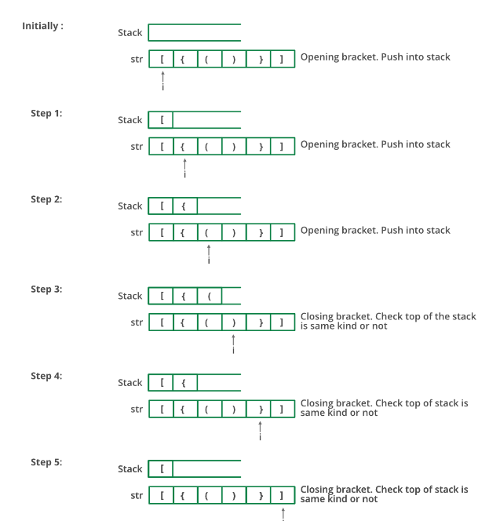

Slide 22
Follow the steps mentioned below to implement the idea:
Create a stack
while (end of input is not reached)
{
1) If the character read is not a symbol to be balanced, ignore it.
2) If the character is an opening symbol like (, [, {, push it onto the stack
3) If it is a closing symbol like ),],}, then if the stack is empty report an error. Otherwise pop the stack.
4) If the symbol popped is not the corresponding opening symbol, report an error.
}
c) At end of input, if the stack is not empty report an error

Slide 23
Conversion of Infix to postfix expression
Infix expression : a + b * c
Symbol scanned | Stack | Postfix string | Action performed
a
a
Append the symbol scanned to postfix string
+
+
a
Push the ‘+’ into the stack
b
+
a b
Append the symbol scanned to postfix string
*
+
*
a b
Check the precedence of the top of the stack and symbol scanned i.e., + < *, therefore push the operator * into the stack
c
+
*
a b c
Append the symbol scanned to postfix string
+
a b c *
Since the input is empty ,pop the top of the stack symbols and append to the postfix string until the
Stack is empty
a b c * +

Slide 24
Conversion of Infix to postfix expression
Infix expression : (a + b) * (c-d)
Symbol scanned | Stack | Postfix string | Action performed
(
(
Push the ‘(’ into the stack
a
(
a
Append the symbol ‘a’ to postfix string
+
(
+
a
Push ‘+’ in to the stack
b
(
+
a b
Append the symbol ‘b’ to postfix string
)
a b +
Pop the symbols from the stack and append to the postfix string until the symbol ‘(‘ is encountered
*
*
a b +
Push ‘*’ in to the stack
(
*
(
a b +
Push ‘(’ in to the stack

Slide 25
Infix expression : (a + b) * (c-d)
Symbol scanned | Stack | Postfix string | Action performed
c
*
(
a b + c
Append ‘c’ to the postfix string
-
*
(
-
a b + c
Push ‘-’ in to the stack
d
*
(
-
a b + c d
Append ‘d’ to the postfix string
)
*
a b + c d -
Pop the symbols from the stack and append to the postfix string until the symbol ‘(‘ is encountered
a b + c d - *
Pop the symbols from the stack and append
to the postfix string

Slide 26
Postfix Evaluation
2 3 4 * + 8 2 / -
5
4
3
2
1
0
5
4
3
2
1
0 | 2
5
4
3
2
1 | 3
0 | 2
5
4
3
2
1
0 | 2
5
4
3
2
1
0
5
4
3
2
1
0
5
4
3
2
1
0
5
4
3
2
1
0
5
4
3
2
1
0
top=
4
top=
2
top=
3
top=
12
top=
8
8
top=
4
top=
2
top=
14
14
14
14
top=
10
Op2 = 4
Op2 = 12
Op2 = 2
Op2 = 4
Op1 = 3
Op1 = 2
Op1 = 8
Op1 = 14
Perform
3*4=12
Perform
12+2=14
Perform
8/2=4
Perform
14-4=10
Push 12 in
to stack
Push 14 in
to stack
Push 4 in
to stack
Push 10 in
to stack

Slide 28
Queue
Queue is a linear data structure that inserts the elements at one end(known as rear) and deletes the elements at another end (known as front)
or
FIFO (“First-In –First-Out”)
Queue ADT
Operations on Queue
Enqueue(Q , ele) – insert an element ele into the queue Q.
Dequeue(Q) – deletes an element from the queue Q and returns the deleted element.
Front(Q) – returns the front element of the queue Q, it doesn’t delete the element.
Rear(Q): This operation returns the element at the rear end without removing it.
isEmpty(Q) – checks whether the queue Q is Empty or not.
isFull(Q) – checks whether the queue Q is Full or not.
Size(): This operation returns the size of the queue i.e. the total number of elements it contains.
Error conditions of Queue
Overflow – If an attempt is made to insert an element into queue that is full is known as queue Overflow
Underflow – If an attempt is made to delete an element from the empty queue is known as Queue Underflow

Slide 29
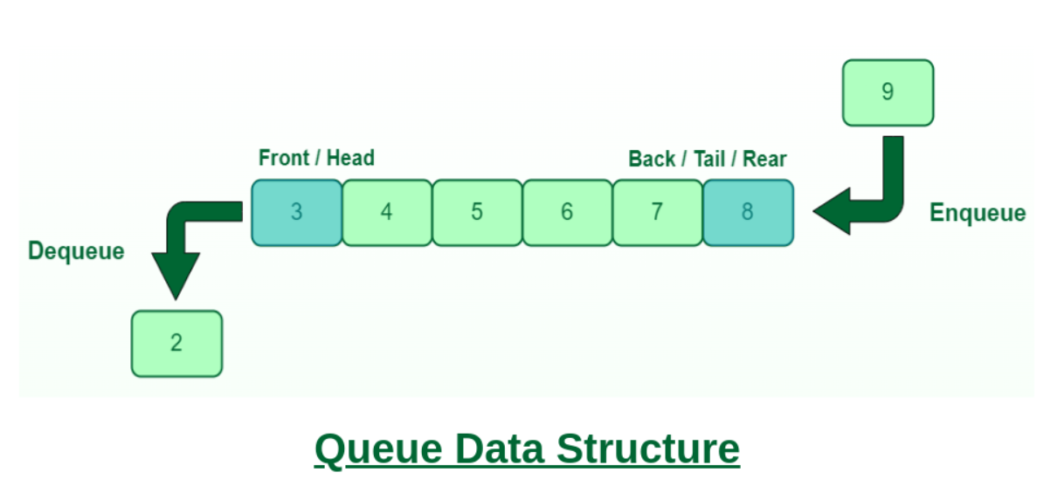

Slide 30
Different types of Queue
Simple Queue
Circular Queue
Priority Queue
DeQue (Double-ended Queue)

Slide 31
Simple Queue: Simple queue also known as a linear queue is the most basic version of a queue. Here, insertion of an element i.e. the Enqueue operation takes place at the rear end and removal of an element i.e. the Dequeue operation takes place at the front end. Here problem is that if we pop some item from front and then rear reach to the capacity of the queue and although there are empty spaces before front means the queue is not full but as per condition in isFull() function, it will show that the queue is full then. To solve this problem we use circular queue.
Circular Queue: In a circular queue, the element of the queue act as a circular ring. The working of a circular queue is similar to the linear queue except for the fact that the last element is connected to the first element. Its advantage is that the memory is utilized in a better way. This is because if there is an empty space i.e. if no element is present at a certain position in the queue, then an element can be easily added at that position using modulo capacity(%n).

Slide 32
Priority Queue: This queue is a special type of queue. Its specialty is that it arranges the elements in a queue based on some priority. The priority can be something where the element with the highest value has the priority so it creates a queue with decreasing order of values. The priority can also be such that the element with the lowest value gets the highest priority so in turn it creates a queue with increasing order of values. In pre-define priority queue, C++ gives priority to highest value whereas Java gives priority to lowest value.
Dequeue: Dequeue is also known as Double Ended Queue. As the name suggests double ended, it means that an element can be inserted or removed from both ends of the queue, unlike the other queues in which it can be done only from one end. Because of this property, it may not obey the First In First Out property.

Slide 33
Applications of Queue:
Queue is used when things don’t have to be processed immediately, but have to be processed in First In First Out order like Breadth First Search. This property of Queue makes it also useful in following kind of scenarios.
When a resource is shared among multiple consumers. Examples include CPU scheduling, Disk Scheduling.
When data is transferred asynchronously (data not necessarily received at same rate as sent) between two processes. Examples include IO Buffers, pipes, file IO, etc.
Queue can be used as an essential component in various other data structures.

Slide 34
Complexity Analysis:
Time Complexity
Operations Complexity
Enqueue(insertion) O(1)
Deque(deletion) O(1)
Front(Get front) O(1)
Rear(Get Rear)O(1)
IsFull(Check queue is full or not)O(1)
IsEmpty(Check queue is empty or not)O(1)
Auxiliary Space: O(N) where N is the size of the array for storing elements.

Slide 35
Advantages of Array Implementation:
Easy to implement.
A large amount of data can be managed efficiently with ease.
Operations such as insertion and deletion can be performed with ease as it follows the first in first out rule.
Disadvantages of Array Implementation:
Static Data Structure, fixed size.
If the queue has a large number of enqueue and dequeue operations, at some point (in case of linear increment of front and rear indexes) we may not be able to insert elements in the queue even if the queue is empty (this problem is avoided by using circular queue).
Maximum size of a queue must be defined prior.

Slide 36
Characteristics of Queue:
Queue can handle multiple data.
We can access both ends.
They are fast and flexible.
Queue Representation:
Like stacks, Queues can also be represented in an array: In this representation, the Queue is implemented using the array.
Variables used in this case are
Queue: the name of the array storing queue elements.
Front: the index where the first element is stored in the array representing the queue.
Rear: the index where the last element is stored in an array representing the queue.

Slide 37
Steps for enqueue:
Check the queue is full or not
If full, print overflow and exit
If queue is not full, increment tail and add the element
Step 1: IF REAR = MAX - 1 Write OVERFLOW Go to step [END OF IF]
Step 2: IF FRONT = -1 and REAR = -1 SET FRONT = REAR = 0 ELSE SET REAR = REAR + 1 [END OF IF]
Step 3: Set QUEUE[REAR] = NUM
Step 4: EXIT

Slide 38
void insert (int queue[], int max, int front, int rear, int item) {
if (rear + 1 == max) {
printf("overflow");
}
else {
if(front == -1 && rear == -1) {
front = 0;
rear = 0;
}
else {
rear = rear + 1;
}
queue[rear]=item;
}
}

Slide 39
Steps for dequeue:
Check queue is empty or not
if empty, print underflow and exit
if not empty, print element at the head and increment head
If, the value of front is -1 or value of front is greater than rear , write an underflow message and exit.
Otherwise, keep increasing the value of front and return the item stored at the front end of the queue at each time.
ALGORITHM
Step 1: IF FRONT = -1 or FRONT > REAR Write UNDERFLOW ELSE SET VAL = QUEUE[FRONT] SET FRONT = FRONT + 1 [END OF IF]
Step 2: EXIT

Slide 40
int delete (int queue[], int max, int front, int rear) {
int y;
if (front == -1 || front > rear) {
printf("underflow");
}
else {
y = queue[front];
if(front == rear) {
front = rear = -1;
else
front = front + 1;
}
return y;
}
}

Slide 41
Linked List implementation of Queue
The array implementation can not be used for the large scale applications where the queues are implemented. One of the alternative of array implementation is linked list implementation of queue.
The storage requirement of linked representation of a queue with n elements is o(n) while the time requirement for operations is o(1).
In a linked queue, each node of the queue consists of two parts i.e. data part and the link part. Each element of the queue points to its immediate next element in the memory.
In the linked queue, there are two pointers maintained in the memory i.e. front pointer and rear pointer. The front pointer contains the address of the starting element of the queue while the rear pointer contains the address of the last element of the queue.

Slide 42
Insertion and deletions are performed at rear and front end respectively. If front and rear both are NULL, it indicates that the queue is empty

Slide 43
Insert operation
The insert operation append the queue by adding an element to the end of the queue. The new element will be the last element of the queue.
Firstly, allocate the memory for the new node ptr by using the following statement.
Ptr = (struct node *) malloc (sizeof(struct node));
There can be the two scenario of inserting this new node ptr into the linked queue.
In the first scenario, we insert element into an empty queue. In this case, the condition front = NULL becomes true. Now, the new element will be added as the only element of the queue and the next pointer of front and rear pointer both, will point to NULL.

Slide 44
Step 1: Allocate the space for the new node PTR
Step 2: SET PTR -> DATA = VAL
Step 3: IF FRONT = NULL SET FRONT = REAR = PTR SET FRONT -> NEXT = REAR -> NEXT = NULL ELSE SET REAR -> NEXT = PTR SET REAR = PTR SET REAR -> NEXT = NULL [END OF IF]
Step 4: END

Slide 45
void insert(struct node *ptr, int item; ) {
ptr = (struct node *) malloc (sizeof(struct node));
if(ptr == NULL) {
printf("\nOVERFLOW\n");
return; }
else {
ptr -> data = item;
if(front == NULL) {
front = ptr;
rear = ptr;
front -> next = NULL;
rear -> next = NULL; }
else {
rear -> next = ptr;
rear = ptr;
rear->next = NULL; }
}
}

Slide 46
Deletion
Deletion operation removes the element that is first inserted among all the queue elements. Firstly, we need to check either the list is empty or not. The condition front == NULL becomes true if the list is empty, in this case , we simply write underflow on the console and make exit.
Otherwise, we will delete the element that is pointed by the pointer front. For this purpose, copy the node pointed by the front pointer into the pointer ptr. Now, shift the front pointer, point to its next node and free the node pointed by the node ptr. This is done by using the following statements.

Slide 47
Step 1: IF FRONT = NULL Write " Underflow " Go to Step 5 [END OF IF]
Step 2: SET PTR = FRONT
Step 3: SET FRONT = FRONT -> NEXT
Step 4: FREE PTR
Step 5: END

Slide 48
void delete (struct node *ptr)
{
if(front == NULL)
{
printf("\nUNDERFLOW\n");
return;
}
else
{
ptr = front;
front = front -> next;
free(ptr);
}
}

Slide 49
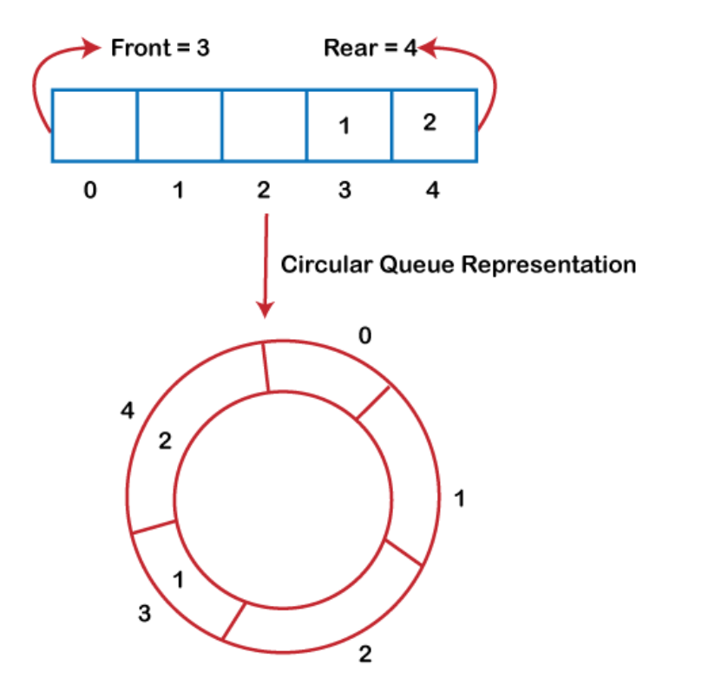
Circular Queue
There was one limitation in the array implementation of Queue. If the rear reaches to the end position of the Queue then there might be possibility that some vacant spaces are left in the beginning which cannot be utilized. So, to overcome such limitations, the concept of the circular queue was introduced.
A circular queue is similar to a linear queue as it is also based on the FIFO (First In First Out) principle except that the last position is connected to the first position in a circular queue that forms a circle. It is also known as a Ring Buffer.

Slide 50
Operations on Circular Queue
The following are the operations that can be performed on a circular queue:
Front: It is used to get the front element from the Queue.
Rear: It is used to get the rear element from the Queue.
enQueue(value): This function is used to insert the new value in the Queue. The new element is always inserted from the rear end.
deQueue(): This function deletes an element from the Queue. The deletion in a Queue always takes place from the front end.

Slide 51
Applications of Circular Queue
Memory management: The circular queue provides memory management. As we have already seen that in linear queue, the memory is not managed very efficiently. But in case of a circular queue, the memory is managed efficiently by placing the elements in a location which is unused.
CPU Scheduling: The operating system also uses the circular queue to insert the processes and then execute them.
Traffic system: In a computer-control traffic system, traffic light is one of the best examples of the circular queue. Each light of traffic light gets ON one by one after every jinterval of time. Like red light gets ON for one minute then yellow light for one minute and then green light. After green light, the red light gets ON.

Slide 52
Enqueue operation
The steps of enqueue operation are given below:
First, we will check whether the Queue is full or not.
Initially the front and rear are set to -1. When we insert the first element in a Queue, front and rear both are set to 0.
When we insert a new element, the rear gets incremented, i.e., rear=rear+1.
Scenarios for inserting an element
There are two scenarios in which queue is not full:
If rear != max - 1, then rear will be incremented to mod(maxsize) and the new value will be inserted at the rear end of the queue.
If front != 0 and rear = max - 1, it means that queue is not full, then set the value of rear to 0 and insert the new element there.
There are two cases in which the element cannot be inserted:
When front ==0 && rear = max-1, which means that front is at the first position of the Queue and rear is at the last position of the Queue.
front== rear + 1;

Slide 53
Algorithm to insert an element in a circular queue
Step 1: IF (REAR+1)%MAX = FRONT Write " OVERFLOW " Goto step 4 [End OF IF]
Step 2: IF FRONT = -1 and REAR = -1 SET FRONT = REAR = 0 ELSE IF REAR = MAX - 1 and FRONT ! = 0 SET REAR = 0 ELSE SET REAR = (REAR + 1) % MAX [END OF IF]
Step 3: SET QUEUE[REAR] = VAL
Step 4: EXIT

Slide 54
Dequeue Operation
The steps of dequeue operation are given below:
First, we check whether the Queue is empty or not. If the queue is empty, we cannot perform the dequeue operation.
When the element is deleted, the value of front gets decremented by 1.
If there is only one element left which is to be deleted, then the front and rear are reset to -1.

Slide 55
Algorithm to delete an element from the circular queue
Step 1: IF FRONT = -1 Write " UNDERFLOW " Goto Step 4 [END of IF]
Step 2: SET VAL = QUEUE[FRONT]
Step 3: IF FRONT = REAR SET FRONT = REAR = -1 ELSE IF FRONT = MAX -1 SET FRONT = 0 ELSE SET FRONT = FRONT + 1 [END of IF] [END OF IF]
Step 4: EXIT

