Slide 1
Artificial Intelligence
Dr. PARVATHANENI NAGA SRINIVASU [B.Tech, M.Tech, Ph.D.]
Associate Professor,
Department of Computer Science and Engineering,
Prasad V. Potluri Siddhartha Institute of Technology,
Vijayawada-520007, Andhra Pradesh
Honorary Member- London Journal Press
Life Member-Computer Society of India
Life Member-IAENG
Life Member-International Association of Engineers
Life Member-Engineering Research and Publications
Member-Indian Academicians and Research Associates
Mobile:+91-9000595535

Slide 2
Topics
Defining Artificial Intelligence.
Foundations of AI,
Applications of AI.
Intelligent agents: Agents and Environments.
Structure of agents.

Slide 3
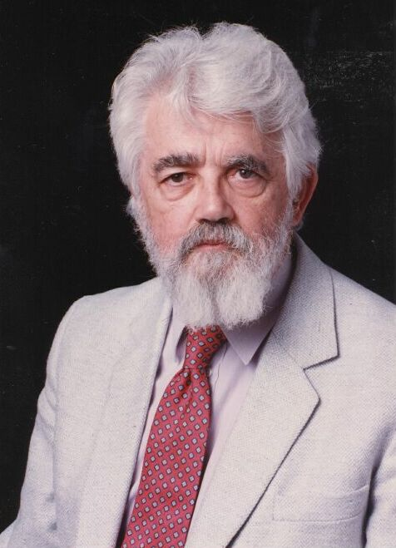
Introduction to AI
A branch of Computer Science named Artificial Intelligence (AI) pursues creating the computers / machines as intelligent as human beings.
John McCarthy the father of Artificial Intelligence described AI as, “The science and engineering of making intelligent machines, especially intelligent computer programs”.
Artificial Intelligence (AI) is a branch of Science which deals with helping machines find solutions to complex problems in a more human-like fashion.
This generally involves borrowing characteristics from human intelligence, and applying them as algorithms in a computer friendly way.
A more or less flexible or efficient approach can be taken depending on the requirements established, which influences how artificial the intelligent behaviour appears.

Slide 4

Defining AI techniques.
THOUGHT
Systems that think
like humans
Systems that think
rationally
Systems that act
like humans
Systems that act
rationally
BEHAVIOUR
HUMAN
RATIONAL

Slide 5
Thinking Humanly
Humans as observed from ‘inside’
How do we know how humans think?
Cognitive science: modeling the processes of human thought.
Through a set of experiments and computational models, trying to build good explanations of what we do when we solve a particular task.
Relevance to AI: to solve a problem that humans (or other living being) are capable of, it's good to know how we go about solving it.

Slide 6
Acting Humanly
How do you distinguish intelligent behavior from intelligence?
Turing test, by A. Turing, 1950: determining if a program qualifies as artificially intelligent by subjecting it to an interrogation along with a human counterpart.
The program passes the test if a human judge cannot distinguish between the answers of the program and the answers of the human subject.

Slide 7
Thinking Rationally
Humans are not always ‘rational’
Rational thinking- defined in terms of logic?
Systems capable of reasoning, capable of making logical deductions from a knowledge base.
This requires some capacity to make logical inferences, like "All humans are mortal; Socrates is a human; thus Socrates is mortal".

Slide 8
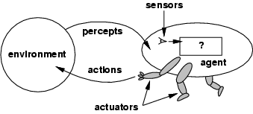
Acting Rationally
Rational behavior: doing the right thing.
Many AI applications adopt the intelligent agent approach.
An agent is an entity capable of generating action.
In AI a rational agent must be autonomous, capable of perceiving its environment, adaptable, with a given goal.
Most often the agents are small pieces of code with a specific proficiency. The problem is solved by combining the skills of several agents.

Slide 9
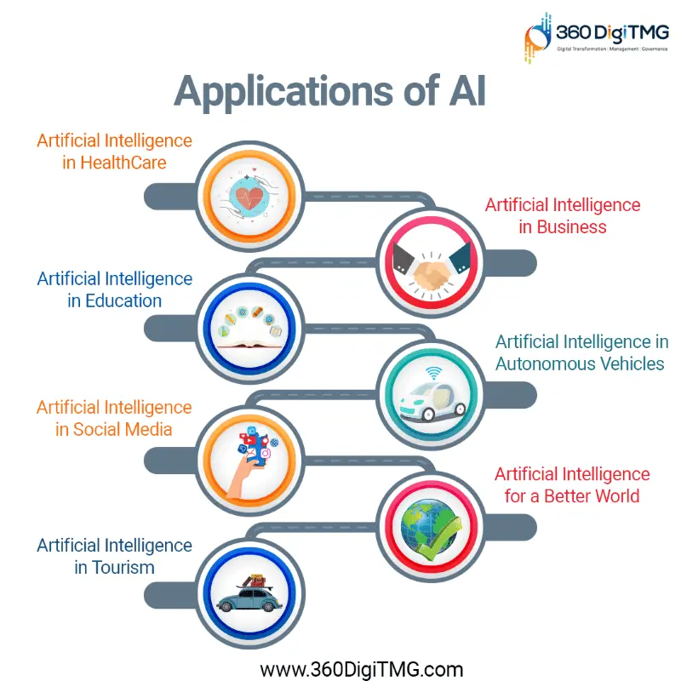

Slide 10
Agents
An agent is anything that can be viewed as perceiving its environment through sensors and acting upon that environment through actuators
Human agent:
  eyes, ears, and other organs for sensors;
  hands, legs, mouth, and other body parts for actuators
Robotic agent:
  cameras and infrared range finders for sensors
  various motors for actuators

Slide 11
Continued…
The agent function maps from percept histories to actions:
[f: P* → A]
The agent program runs on the physical architecture to produce f
agent = architecture + program

Slide 12
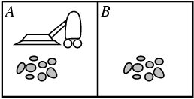
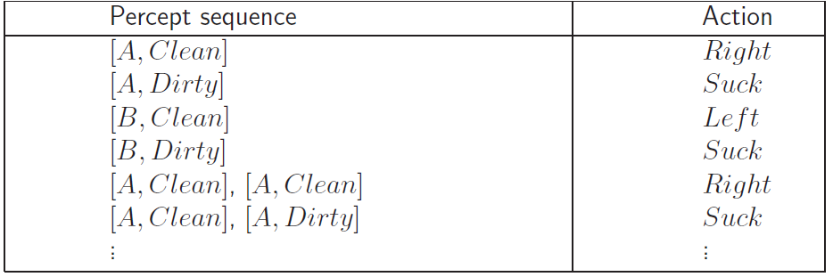
Vacuum-cleaner world
Percepts: location and contents, e.g., [A,Dirty]
Actions: Left, Right, Suck, NoOp
Agent’s function → look-up table
  For many agents this is a very large table

Slide 13
PEAS
PEAS: Performance measure, Environment, Actuators, Sensors
Must first specify the setting for intelligent agent design
Consider, e.g., the task of designing an automated taxi driver:
  Performance measure: Safe, fast, legal, comfortable trip, maximize profits
  Environment: Roads, other traffic, pedestrians, customers
  Actuators: Steering wheel, accelerator, brake, signal, horn
  Sensors: Cameras, sonar, speedometer, GPS, odometer, engine sensors, keyboard

Slide 14
Continued…
Agent: Interactive English tutor
Performance measure: Maximize student's score on test
Environment: Set of students
Actuators: Screen display (exercises, suggestions, corrections)
Sensors: Keyboard

Slide 15
Environment types
Fully observable (vs. partially observable)
Deterministic (vs. stochastic)
Episodic (vs. sequential)
Static (vs. dynamic)
Discrete (vs. continuous)
Single agent (vs. multiagent):

Slide 16

Continued…
1) Fully observable / Partially observable
  If an agent’s sensors give it access to the complete state of the environment needed to choose an action, the environment is fully observable.
  (e.g. chess)

Slide 17
Continued…
Deterministic / Stochastic
  An environment is deterministic if the next state of the environment is completely determined by the current state of the environment and the action of the agent;
  In a stochastic environment, there are multiple, unpredictable outcomes. (If the environment is deterministic except for the actions of other agents, then the environment is strategic).
  In a fully observable, deterministic environment, the agent need not deal with uncertainty.

Slide 18
Continued…
Episodic / Sequential
  In an episodic environment, the agent’s experience is divided into atomic
  episodes. Each episode consists of the agent perceiving and then performing a single action.
  Subsequent episodes do not depend on what actions occurred in previous episodes. Choice of action in each episode depends only on the episode itself.
  (E.g., classifying images.)
  In a sequential environment, the agent engages in a series of connected
  episodes. Current decision can affect future decisions. (E.g., chess and driving)

Slide 19
Continued…
Static / Dynamic
  A static environment does not change while the agent is thinking.
  The passage of time as an agent deliberates is irrelevant.
  The environment is semidynamic if the environment itself does not change
  with the passage of time but the agent's performance score does.

Slide 20
Continued…
Discrete / Continuous
  If the number of distinct percepts and actions is limited, the environment is discrete, otherwise it is continuous.
Single agent / Multi-agent
  If the environment contains other intelligent agents, the agent needs to be concerned about strategic, game-theoretic aspects of the environment (for either cooperative or competitive agents).
  Most engineering environments don’t have multi-agent properties, whereas most social and economic systems get their complexity from the interactions of (more or less) rational agents.

Slide 21
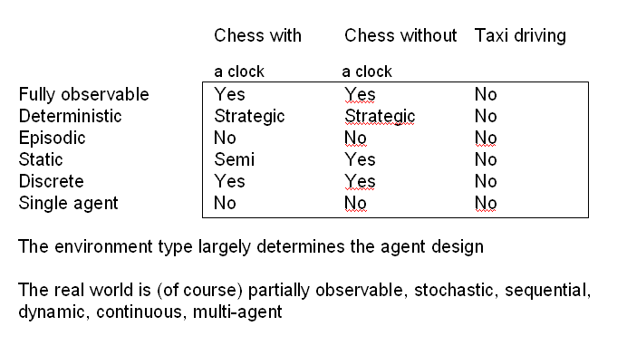
Continued…

Slide 22
Types of Agents
  Simple reflex agents
  Reflex agents with state/model
  Goal-based agents
  Utility-based agents

Slide 23
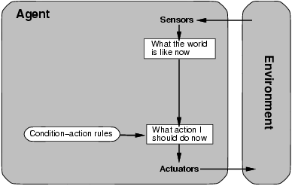
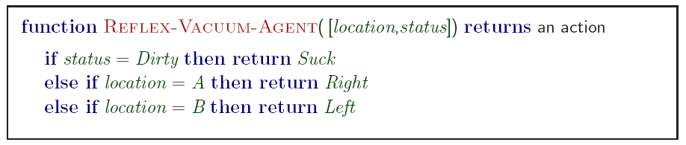
Simple reflex agents
Simple but very limited intelligence.
Action does not depend on percept history, only on current percept.
Therefore no memory requirements.

Slide 24
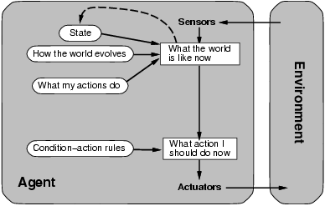
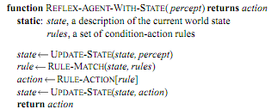
Model-based reflex agents
Know how world evolves
  Overtaking car gets closer from behind
How agents actions affect the world
  Wheel turned clockwise takes you right
Model base agents update their state

Slide 25
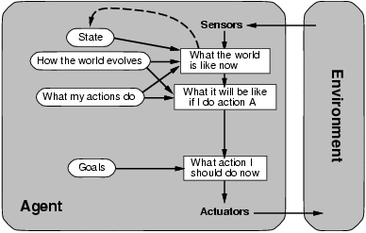
Goal-based agents
knowing state and environment? Enough?
  Taxi can go left, right, straight
Have a goal
  A destination to get to
Uses knowledge about a goal to guide its actions
  E.g., Search, planning

Slide 26
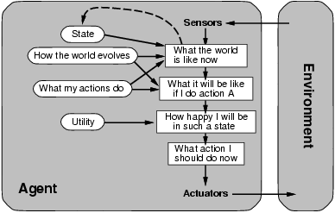
Utility-based agents
Goals are not always enough
  Many action sequences get taxi to destination
  Consider other things. How fast, how safe…..
A utility function maps a state onto a real number which describes the associated degree of “happiness”, “goodness”, “success”.

