Slide 1
UNIT-II :
Understanding Harmony in the Human Being - Harmony in Myself!

Slide 2
Understanding human being as a co-existence of the sentient ‘I’ and the material ‘Body’
Human being is more than just a Body. He is a co-existence of both the Self(I/ Jivana) and the Body.
There is an exchange of information between the two. Our body acts according to the suggestions given by our “Jivana”.

Slide 3
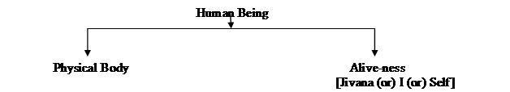

Slide 4
All the human feelings of happiness, sorrow, pain, excitement etc. are all experienced by “I” and not the “Body”.
Having Physical Facilities ensures the fulfillment of the needs of the body, but it does not fulfill the needs of the “I”.
Hence, for every human being, we need to fulfill the needs of both:
· Of “I” = Happiness (Sukha)
· Of “Body” = Physical Facilities (Suvidha)
One of these cannot replace the other.

Slide 5
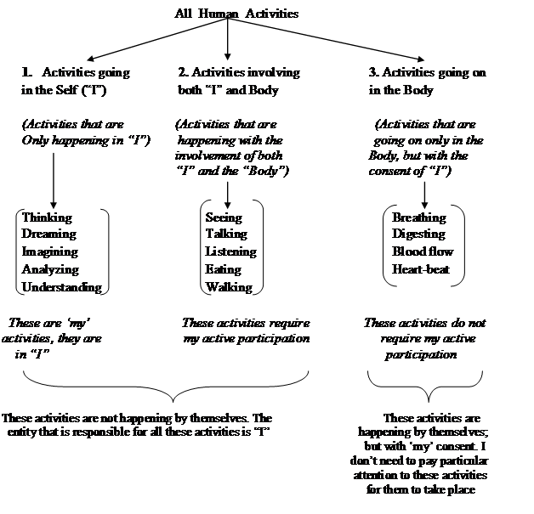

Slide 6
All human activities can be put under three categories –
Activities that are going on in the Self (Sentient Activities)
Activities that are going on in the Body (Material Activities)
Activities involving both the Self and the Body

Slide 7
Bodily functions / Activities in the Body:
The body is a set of “Self-organized activities” that occur with my (I) consent but without my(I) participation.
e.g.: the functions like breathing, digestion, organ functions
However some of these activities can be stopped by me (I) if I want.
e.g.: breathing
The activities in the body can also be understood as the mutual interaction between two material entities for “recognition” and “fulfillment” of their relationship.
e.g.: “Body” recognizes its relation with “Water” and fulfills it (by absorbing the water we drink, to the extent needed and uses it for the nourishment of various organs)

Slide 8
Understanding the Human Being
(As Co-existence of Self and Body)
We are human beings and we need to first understand ourselves.
So, what is a human being? The proposal is that human being is co-existence of the Self and the Body.
Self is what we term as ‘I’ and Body is what we see with our eyes.
To understand the two realities, we can start by looking at the needs, activities and response of the Self
and the Body.

Slide 9
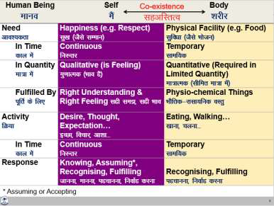
To understand the two realities, we can start by looking at the needs, activities and response of the Self and the Body

Slide 10
The Needs of the Self and the Body
The need of the Self is happiness (e.g. feeling of respect leading to happiness) while the need of the body is physical facility (e.g. food).
All the needs related to the Self are continuous in time while all the needs related to the Body are required for a limited time.
This is one way we can differentiate between the need of the Self and the need of the Body.

Slide 11
Quantity and Quality.
The other way to see the difference between the two is in terms of quantity and quality. The need for food is quantitative in nature. We can identify the quantity of the food needed to nurture our body.
Same is the case with the need of clothes, shelter, etc. On the other hand, the feeling of respect, trust, etc.
Is not quantitative. We don’t say, ‘today I got half kg of respect’ or ‘two metres of trust’. These feelings are qualitative in nature.

Slide 13
Activities in the Self / Jivana:
Since “Jivana” is a conscious entity, in addition to “recognizing” and “fulfilling”, it also carries out activities of “assuming” and “knowing”.
In “I”, the activities take place in the following order:

Slide 14


Slide 15
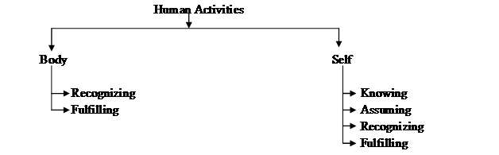

Slide 16
“Knowing” means we have the “Right Understanding”. As a result of “knowing”, we understand the reality. When we lack “Right Understanding”, the faculty of “knowing” is dormant; and we only operate on the basis of assumptions. Wrong assumptions lead to wrong Recognition and wrong Fulfillment.

Slide 17
I am the Seer, I am the Doer and I am the Enjoyer.
I am the Seer
Behind all our activities of our Seeing, Understanding, Doing and Enjoying is a feeling of “I-ness” with which we identify ourselves. Every human being actually participates in a number of such activities everyday. In all these activities, the body acts only as an instrument. It is the “I” that sees or understands something.
For e.g.: Our eyes and ears act as instruments which help us to see or listen anything. They do not convey any any information. It is the “I” that understands what it has seen or listened to.
“Seer” also means the one who understands.
Hence I am the Seer (Drasta).
·

Slide 18
I am the Doer
Once I have seen and understood something, I decide what I should/ should not do. I take the help of my body parts to accomplish the task I want to do.
For e.g.: I use my hands to write, my legs to walk etc. My body works as per the instructions given by me. Hence I am the Doer and I express my actions via my body.
Doer means “one who does” or “the one who takes decisions to do something”.
Hence I am the Doer (Karta).
I am the Enjoyer
I use my body as an instrument to perform various activities. It is I who enjoy the pleasure derived out of those activities.
For e.g.: mouth helps to chew and the tongue to taste, but I enjoy the taste and flavour. I am the one feeling excited, angry, sad, happy etc. my body is only one instrument.
Enjoyer means “one who enjoys”.
Hence I am the Enjoyer (Bhokta).

