Slide 1
UNIT-1
Register Transfer and Micro-Operations

Slide 2
Register Transfer Language
Register Transfer
memory Transfers
Bus construction with Multiplexers, Arithmetic Micro-operations
Logic Micro-operations
Shift Micro-operations
Arithmetic Logic Shift Unit.

Slide 3
Register
A processor register (CPU register) is one of a small set of data holding places that are part of the computer processor.
A register may hold an instruction, a storage address, or any kind of data (such as a bit sequence or individual characters).

Slide 4
Register Transfer Language
Combinational and sequential circuits can be used to create simple digital systems
Logic gates are the low-level building blocks of a digital computer
Simple digital systems are frequently characterized in terms of
1) The registers they contain,
2) The operations that are performed on data stored in them
The operations executed on the data in registers are called micro-operations ex: shift,count,clear,load

Slide 5
Register Transfer language
Rather than specifying a digital system in words, a specific notation is used , Register Transfer Language
The symbolic notation used to describe the micro-operation transfer among register is called register transfer language
Register Transfer language
A symbolic language
A convenient tool for describing the internal organization of digital computer
Can also be used to facilitate the design process of digital systems

Slide 6
Registers are designated by capital letters sometimes followed by numbers(ex: A,R13)
Often the names indicate function
MAR: memory address register
PC: Program Counter
IR: Instruction Register
Registers and their contents can be viewed and represented in different ways
A register can be viewed as a single entity
MAR

Slide 7
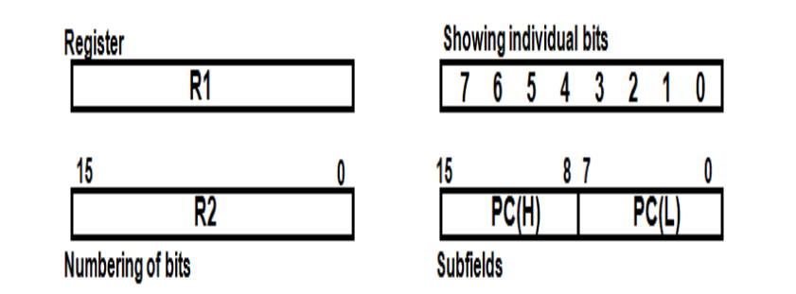
RTL
Designation of a Register
a register
Portion of a register
A bit of a register

Slide 8
Register Transfer
Copying the contents of one register to another is a register transfer
A register transfer is indicated as
R2←R1
In this case contents of R1 are copied into R2
A simultaneous transfer of all bits from source R1 to the destination register R2 during one clock pulse
Note that this is a non-destructive i.e., the contents of R1 are not altered by loading them to R2

Slide 9
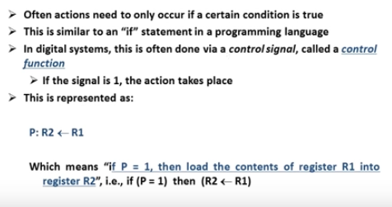
Control Functions

Slide 10
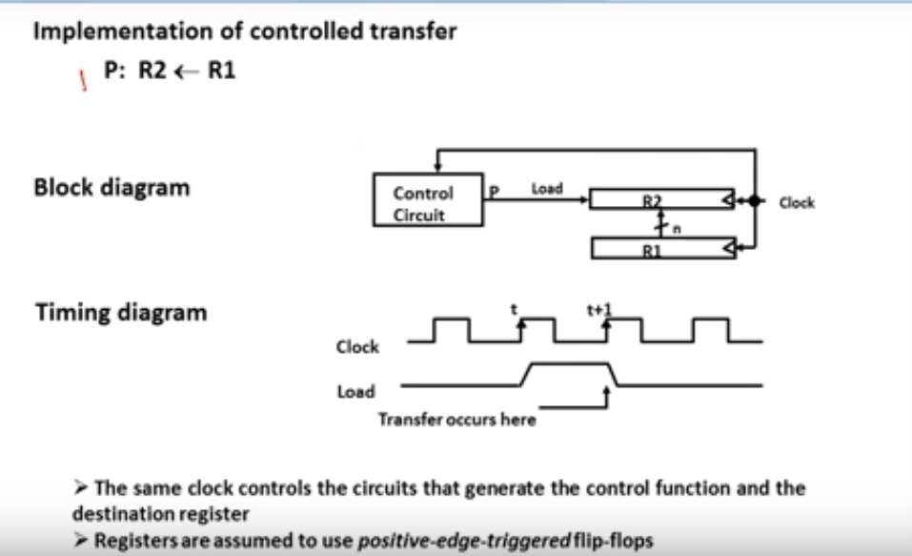
Hardware Implementation of Controlled Transfers

Slide 11
Hardware implementation
R1 transfer to R2. Output of register R1is connected to n input of register R2.
Register R2 has a load control activated by P control function and the whole operation is synchronized with the central clock.
The rising edge of the CLK input triggers activates P at t time and at t+1 time the transfer takes place.

Slide 12
Simultaneous Operations:
In cases where two or more operations are to occur simultaneously, they are separated with commas as shown next:
P: R3 <-R5, MAR<-IR
If the control function P = 1, load the contents of R5 into R3, and at the same time (clock), load the contents of register IR into register MAR .

Slide 13
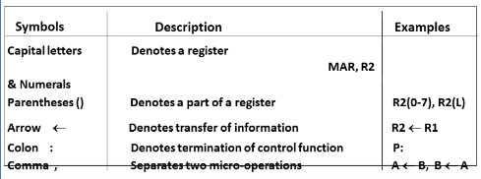
Basic symbols in Register Transfer

Slide 14
Bus Transfers
If we need to move data from and to multiple registers , problem arises. The number of wires will be so large if separate lines are used to connect all registers with each other.
Instead have one centralised circuits for data transfer the bus
Bus structure consists of set of common lines, one for each bit of a register through which binary information is transferred.
use control circuits to select which register is the source, and which is the destination

Slide 15
Constructing Common bus system
There are two ways to construct a common bus system
Multiplexers- Multiple inputs single output
Tri-state Buffers

Slide 16
Constructing bus system using multiplexers
For a bus system to multiplex k registers of n bits each,
No of multiplexers =n
Size of each multiplexer=kx1
EX: For a bus system to multiplex 4 registers of 8 bits each,
Size of multiplexers= No. Of Registers=4
Number of multiplexers= Size of each registers
No of multiplexers =8
Size of each multiplexer=kx1=4x1

Slide 17
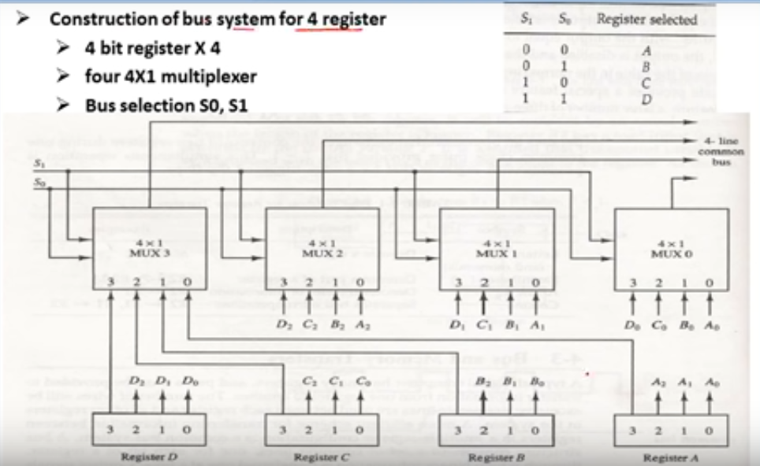

Slide 18
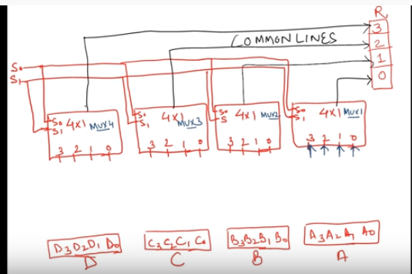

Slide 19
Assignment
Construction of bus system for 8 registers with 16 bits each
No of multiplexers=??
Size of each multiplexer=???
Bus selection ????????

Slide 20
Number of Multiplexers-16
Size of each multiplexer-8x1
BUS selection-3

Slide 21
Memory Transfer
Memory Read: A transfer of information into DR(Data Register) from memory word M selected by address in AR
DR<-M[AR]
Memory Write: A transfer information from DR into memory word M selected by address in AR
M[AR]<-DR

Slide 22
Microoperations
Computer System microoperations are of four types:
Register Transfer microoperations
Arithmetic microoperations
Logic microoperations
Shift microoperations

Slide 23
Arithmetic microoperations
The basic arithmetic microoperations are
1) Addition
2) Subtraction
3) Increment
4) Decrement
The additional arithmetic microoperations are:
Add with carry
Subtract with borrow etc..

Slide 24
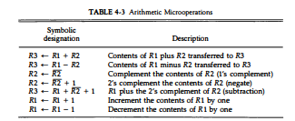
Arithmetic Microoperations

Slide 25
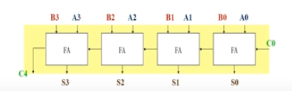
Binary Adder
4-bit binary adder:
Binary adder=the arithmetic sum of two binary numbers of any length
C0(input carry) C4(output carry)

Slide 26
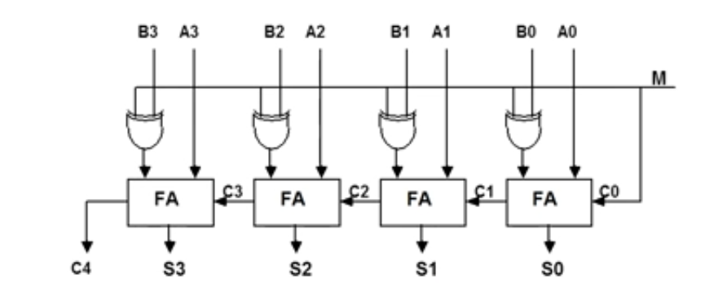
Binary Adder- Subtractor
Mode input M controls the Entire operation
M=0 Then the circuit acts as adder
M=1 Then the circuit acts as Subtractor

Slide 27
When the mode input (M) is at a low logic, i.e. '0', the circuit act as an adder and when the mode input is at a high logic, i.e. '1', the circuit act as a subtractor.
The exclusive-OR gate connected in series receives input M and one of the inputs B.
When M is at a low logic, we have B⊕ 0 = B.
The full-adders receive the value of B, the input carry is 0, and the circuit performs A plus B.
When M is at a high logic, we have B⊕ 1 = B' and C0 = 1.
The B inputs are complemented, and a 1 is added through the input carry. The circuit performs the operation A plus the 2's complement of B.

Slide 28

Assignment
The adder-subtractor circuit of Fig. 4-7 has the following values for input mode M and data inputs A and B. In each case, determine the values of the outputs: S3, S2, S1, S0, and C4•

Slide 29
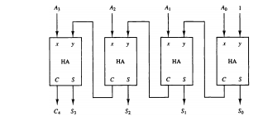
4-bit Binary Incrementer

Slide 30
The half adders are connected one after the other , as it has 2 inputs and 2 outputs , so for the LSB ( least significant bit) half adder or the right most half adder is given 1 as direct input( first input) and A0 which is the first bit of the register (second input) , so we get the two output : sum (S0) and carry (C).
The carry(C) from previous half adder is propagated to the next half adder, so the carry output of the previous half adder becomes the input of the next higher order half adder.
So considering the case for 4 half adders the circuit gets in total 4 bits (A0, A1, A2, A3), 1 is added and we get an incremented output.

Slide 31
ASSIGNMENT
Design a 4-bit combinational circuit decrementer using four full-adder circuits

Slide 32
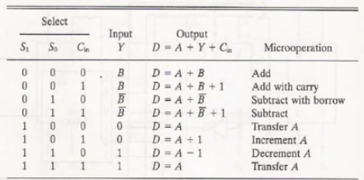
Arithmetic circuit Function table

Slide 33
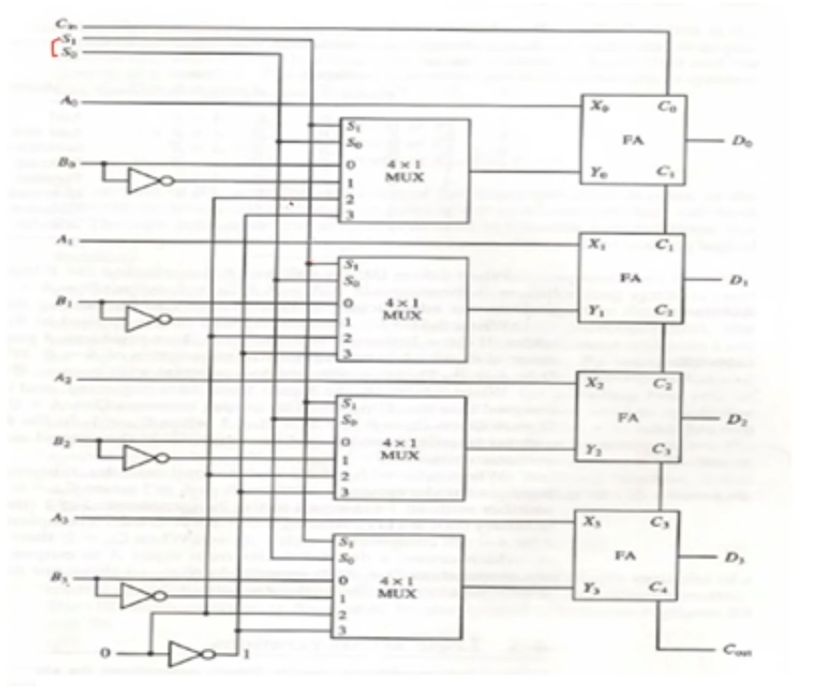

Slide 34
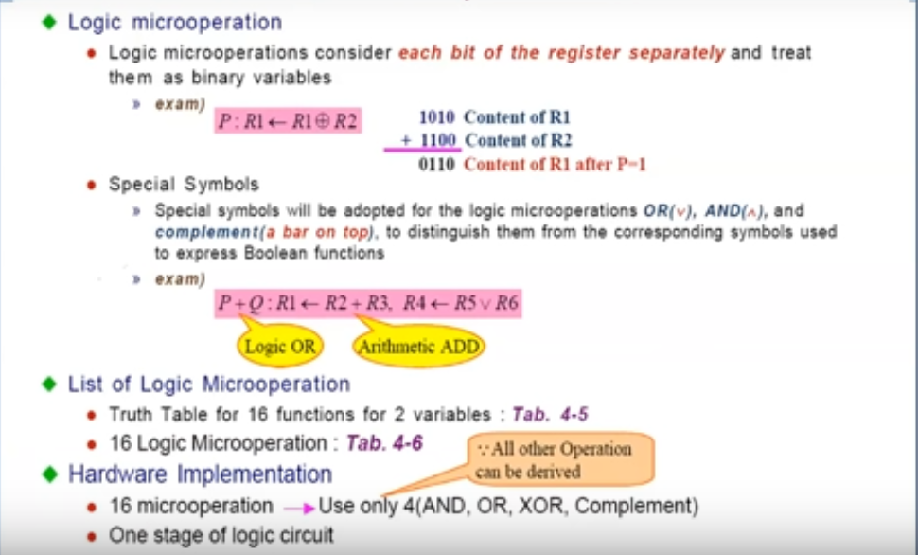
Logic Microoperations

Slide 35
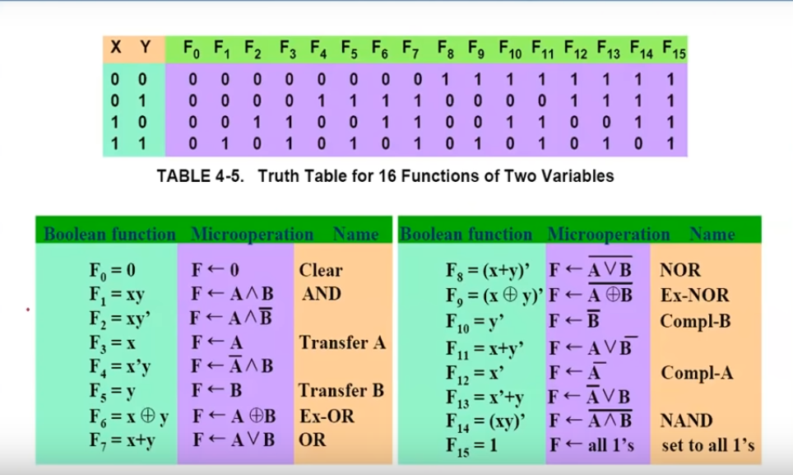

Slide 36
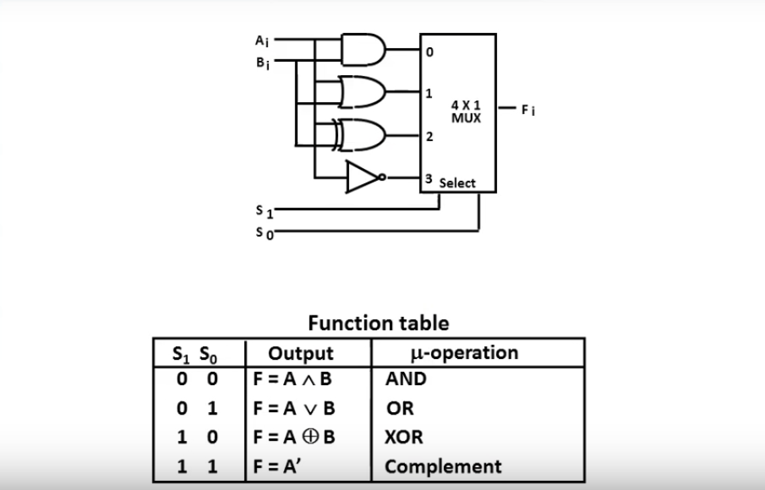
Hardware Implementation

Slide 37
Assignment
Design a digital circuit that performs the four logic operations of exclusiveOR, exclusive-NOR, NOR, and NAND. Use two selection variables. Show the logic diagram of one typical stage

Slide 38
Starting from an initial value of R =11011101, determine the sequence of binary values in R after a logical shift-left, followed by a circular shift-right, followed by a logical shift-right and a circular shift-left.

Slide 39
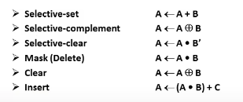
Applications of Logic Microoperations
Logic microoperations can be used to manipulate individual bits or a portion of a word in a register
Consider data in register A.In another register B,is bit data that will be used to modify contents of A

Slide 40
Selective Set
In Selective set operation, the bit pattern in B is used to set certain bits in A
1 1 0 0 A
1 0 1 0 B
1 1 1 0 A (A<-A+B)
If a bit in B is set to 1,the same position in A gets set to 1,otherwise it is unchanged

Slide 41
Selective Complement
In a Selective Complement operation, the bit pattern in B is used to complement certain bits in A
1 1 0 0 A
1 0 1 0 B
0 1 1 0 A (A ← A ⊕ B )
If a bit in B is set to 1,the same position in A gets complimented from its original value ,otherwise it is unchanged

Slide 42
Selective Clear
In a Selective Clear operation, the bit pattern in B is used to clear certain bits in A
1 1 0 0 A
1 0 1 0 B
0 1 0 0 A
If a bit in B is set to 1,the same position in A gets set to 0,otherwise it is unchanged

Slide 43
mask
In mask operation, the bit pattern in B is used to clear certain bits in A
1 1 0 0 A
1 0 1 0 B
1 0 0 0 A (A<-A.B)
If a bit in B is set to 0,the same position in A gets set to 0,otherwise it is unchanged

Slide 44
clear
In a clear microoperation , if the bits in same position in A and B are same , they are cleared in A otherwise set in A
1 1 0 0 A
1 0 1 0 B
0 1 1 0 A A ← A ⊕ B

Slide 45
INSERT
An insert operation is used to introduce a specific bit pattern into A register, leaving the other bit positions unchanged
This is done as
A mask operation to clear desired bit positions followed by
An or operation to introduce new bits into desired positions
Example:
Suppose you want to introduce 1010 into lower order four bits of A
1101 1000 1011 0001 A(original)
1101 1000 1011 1010 A(desired)
1101 1000 1011 0001 A(original)
1111 1111 1111 0000 Mask
1101 1000 1011 0000 A(Intermediate)
0000 0000 0000 1010 Added Bits
1101 1000 1011 1010 A(Desired)

Slide 46

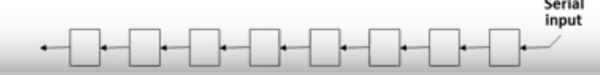
SHIFT MICRO OPERATIONS
There are three types of shifts
Logical Shift
Circular Shift
Arithmetic shift
What differentiates them is the information that goes into the serial input
A right shift operation
A left shift operation

Slide 47


LOGICAL SHIFT
In a logical shift the serial input to the shift is a 0
A right logical shift operation
A Left Logical Shift operation
In a register transfer language, the following notation is used:
-shl for a logical shift left
-shr for a logical shift right
Examples:
R2<-shl R2

Slide 48
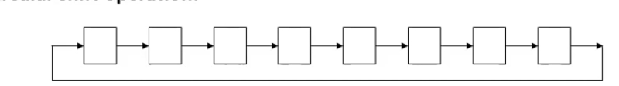
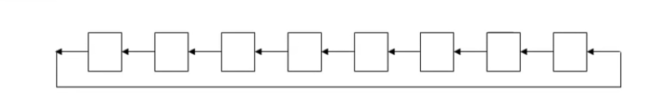
CIRCULAR SHIFT
In a circular shift the serial input is the bit that is shifted out of the other end of register
A right circular shift
A left circular shift
In RTL the following notation is used
cil - circular shift left
cir – circular shift right

Slide 49
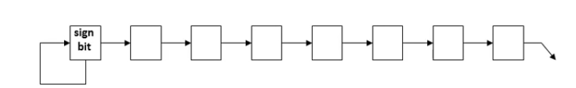
ARITHMETIC SHIFT
An arithmetic shift is meant for signed binary numbers
An arithmetic left shift multiplies a signed number by 2
An arithmetic right shift divides a signed by number by 2
Sign bit : 0 for positive and 1 for negative
The main distinction of an arithmetic shift is that it must keep the sign of the number the same as it performs the multiplication or division
Right Arithmetic shift

Slide 50
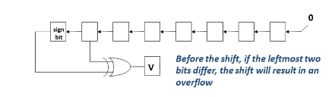
ARITHMETIC SHIFT
Left Arithmetic shift:
An left arithmetic shift left must be checked for the overflow

Slide 51
Assignment
An 8-bit register contains the binary value 10011100. What is the register value after an arithmetic shift right? Starting from the initial number 10011100, determine the register value after an arithmetic shift left, and state whether there is an overflow

Slide 52
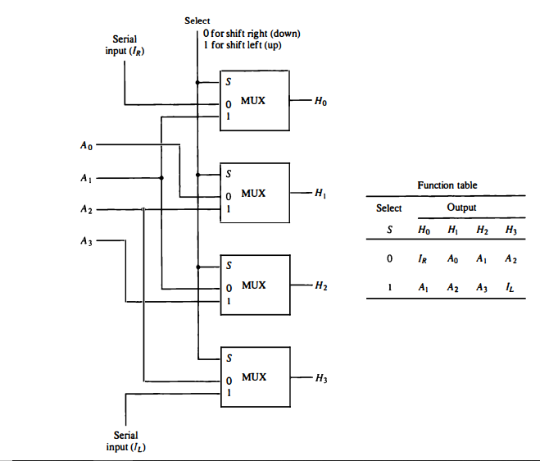

Slide 53
Arithmetic Logic Shift Unit
Instead of individual registers performing the micro operations directly , computer systems employ a number of storage registers connected to a common operational unit called an arithmetic logic unit , abbreviated ALU
To perform a specific operation , the contents of specified registers are placed in the inputs of the common ALU
The ALU performs an operation and the result of the operation is transferred to a destination register
The Arithmetic , Logic and Shift units introduced in previous sections can be combined into one ALU with common selection variables

Slide 54
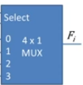


S3
S2
S1
One Stage of Arithmetic Circuit
S0
One stage of Logic Circuit

Slide 55
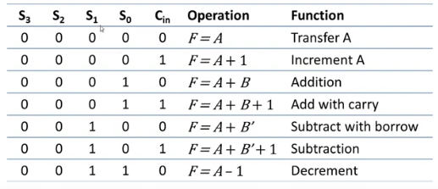
ALU Function
Arithmetic

Slide 56
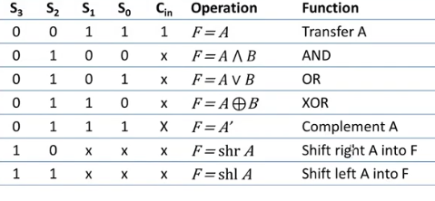

Slide 57


Exercise

Slide 58
digital computer has a common bus system for 16 registers of 32 bits each. The bus Is constructed with multiplexers.
a. How many selection inputs are there in each multiplexer?
b. What size of multiplexers are needed?
c. How many multiplexers are there in bus

Slide 59
Starting from an initial value of R 11011101, determine the sequence of binary values in R after a logical shift-left, followed by a circular shift-right, followed by a logical shift-right and a circular shift-left.

