Slide 1

Outline
  Parallel Processing
  Pipelining
  Arithmetic Pipeline
  Instruction Pipeline
Looping

Slide 2
Parallel Processing

Slide 3
Parallel Processing
Parallel processing is a term used to denote a large class of techniques that are used to provide simultaneous data-processing tasks for the purpose of increasing the computational speed of a computer system.
The system may have two or more ALUs to be able to execute two or more instruction at the same time. 
The system may have two or more processors operating concurrently. 
It can be achieved by having multiple functional units that perform same or different operation simultaneously.
Purpose of parallel processing is to speed up the computer processing capability and increase its throughput.
Throughput:
The amount of processing that can be accomplished during a given interval of time.
. 

Slide 4
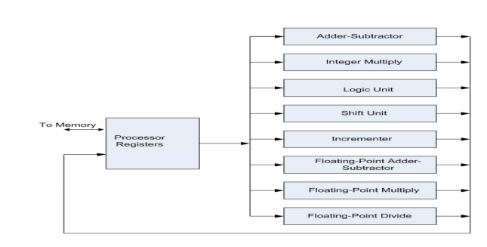

Slide 5
Classification
There are variety of ways in which the parallel processing can be classified
○ Internal Organization of Processor ○
Interconnection structure between processors
○ Flow of information through system
. One classification introduced by M. J. Flynn considers the organization of a computer system by the number of instructions and data items that are manipulated simultaneously.
The sequence of instructions read from memory constitutes an instruction stream .
The operations performed on the data in the processor constitutes a data stream .

Slide 6
Flynn's taxonomy
Data Stream
Single
Multiple
Instruction Stream
Single
SISD
SIMD
Multiple
MISD
MIMD

Slide 7
Single Instruction Single Data & Single Instruction Multiple Data
Single Instruction Single Data (SISD)
SISD represents the organization of a single computer containing a control unit, a processor unit, and a memory unit.
Instructions are executed sequentially and the system may or may not have internal parallel processing capabilities.
Single Instruction Multiple Data (SIMD)
SIMD represents an organization that includes many processing units under the supervision of a common control unit.
All processors receive the same instruction from the control unit but operate on different items of data.

Slide 8
Multiple Instruction Single Data & Multiple Instruction Multiple Data
Multiple Instruction Single Data (MISD)
There is no computer at present that can be classified as MISD.
MISD structure is only of theoretical interest since no practical system has been constructed using this organization.
Multiple Instruction Multiple Data (MIMD)
MIMD organization refers to a computer system capable of processing several programs at the same time.
Most multiprocessor and multicomputer systems can be classified in this category.
Contains multiple processing units.
Execution of multiple instructions on multiple data.

Slide 9
Pipelining

Slide 10
Pipelining
Pipeline is a technique of decomposing a sequential process into sub operations, with each sub process being executed in a special dedicated segment that operates concurrently with all other segments.
The result obtained from the computation in each segment is transferred to the next segment in the pipeline.
The registers provide isolation between each segment.
The technique is efficient for those applications that need to repeat the same task many times with different sets of data.

Slide 11

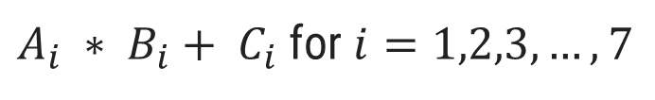
Pipelining example
$A_{i} ∗ B_{i}+ C_{i}$ for $i=1,2,3,…,7$
R1
R2
Multiplier
R3
R4
Adder
R5

Slide 12
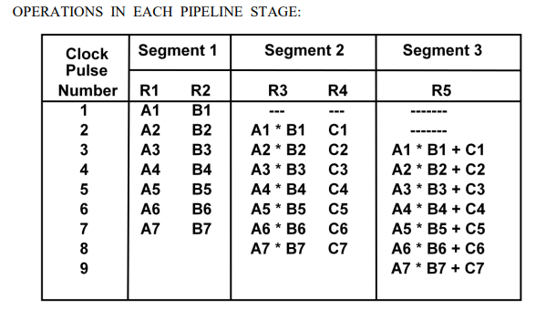

Slide 13
Pipelining
General structure of four segment pipeline
Clock
S₁
R₁
S₂
R₂
S₃
R₃
S₄
R₄
Input

Slide 14
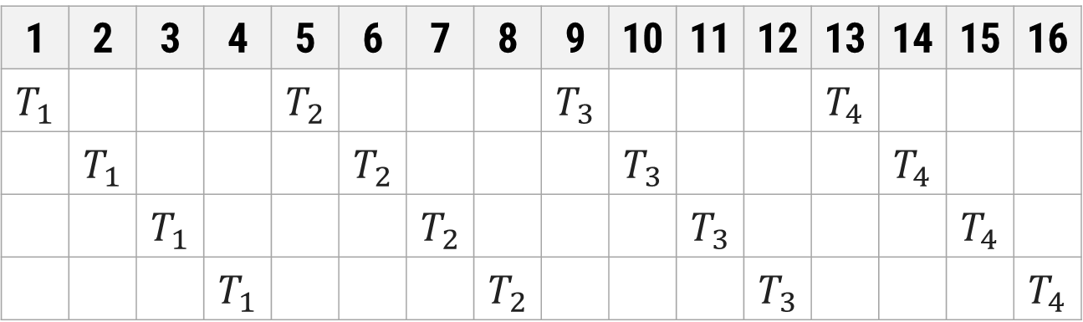
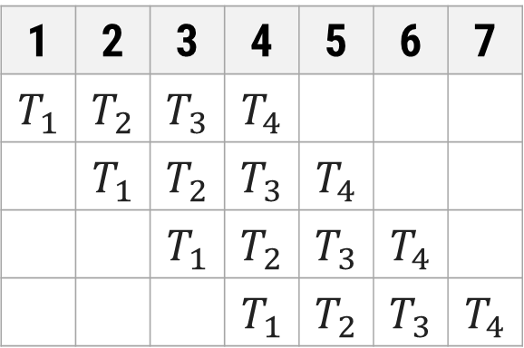
Space-time Diagram
Segment
1 | 2 | 3 | 4 | 5 | 6 | 7 | 8 | 9 | 10 | 11 | 12 | 13 | 14 | 15 | 16
$$T_{1}$$ |  |  |  | $$T_{2}$$ |  |  |  | $$T_{3}$$ |  |  |  | $$T_{4}$$
 | $$T_{1}$$ |  |  |  | $$T_{2}$$ |  |  |  | $$T_{3}$$ |  |  |  | $$T_{4}$$
 |  | $$T_{1}$$ |  |  |  | $$T_{2}$$ |  |  |  | $$T_{3}$$ |  |  |  | $$T_{4}$$
 |  |  | $$T_{1}$$ |  |  |  | $$T_{2}$$ |  |  |  | $$T_{3}$$ |  |  |  | $$T_{4}$$
1
2
Non Pipelined Architecture
3
4
Segment
1 | 2 | 3 | 4 | 5 | 6 | 7
$$T_{1}$$ | $$T_{2}$$ | $$T_{3}$$ | $$T_{4}$$
 | $$T_{1}$$ | $$T_{2}$$ | $$T_{3}$$ | $$T_{4}$$
 |  | $$T_{1}$$ | $$T_{2}$$ | $$T_{3}$$ | $$T_{4}$$
 |  |  | $$T_{1}$$ | $$T_{2}$$ | $$T_{3}$$ | $$T_{4}$$
Clock cycles
1
2
Pipelined Architecture
3
4

Slide 15
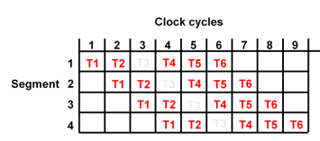
Pipeline Speedup

Slide 16
Consider the case where a k-segment pipeline used to execute n tasks.
N=6 k=4
Pipelined Machine (k stages, n tasks)
➢ The first task t1 requires k clock cycles to complete its operation since there are k segments ➢ The remaining n-1 tasks require n-1 clock cycles
➢ The n tasks clock cycles = k+(n-1) (9 in previous example)
Conventional Machine (Non-Pipelined)
➢ Cycles to complete each task in nonpipeline = k ➢
For n tasks, n cycles required =n*k
Speedup ratio = nk/(k+n-1)

Slide 17
Determine the number of clock cycles that it takes to process 200 tasks in a six-segment pipeline

Slide 18
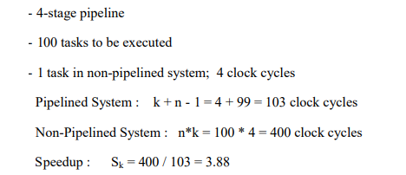

Slide 19
Arithmetic Pipeline

Slide 20
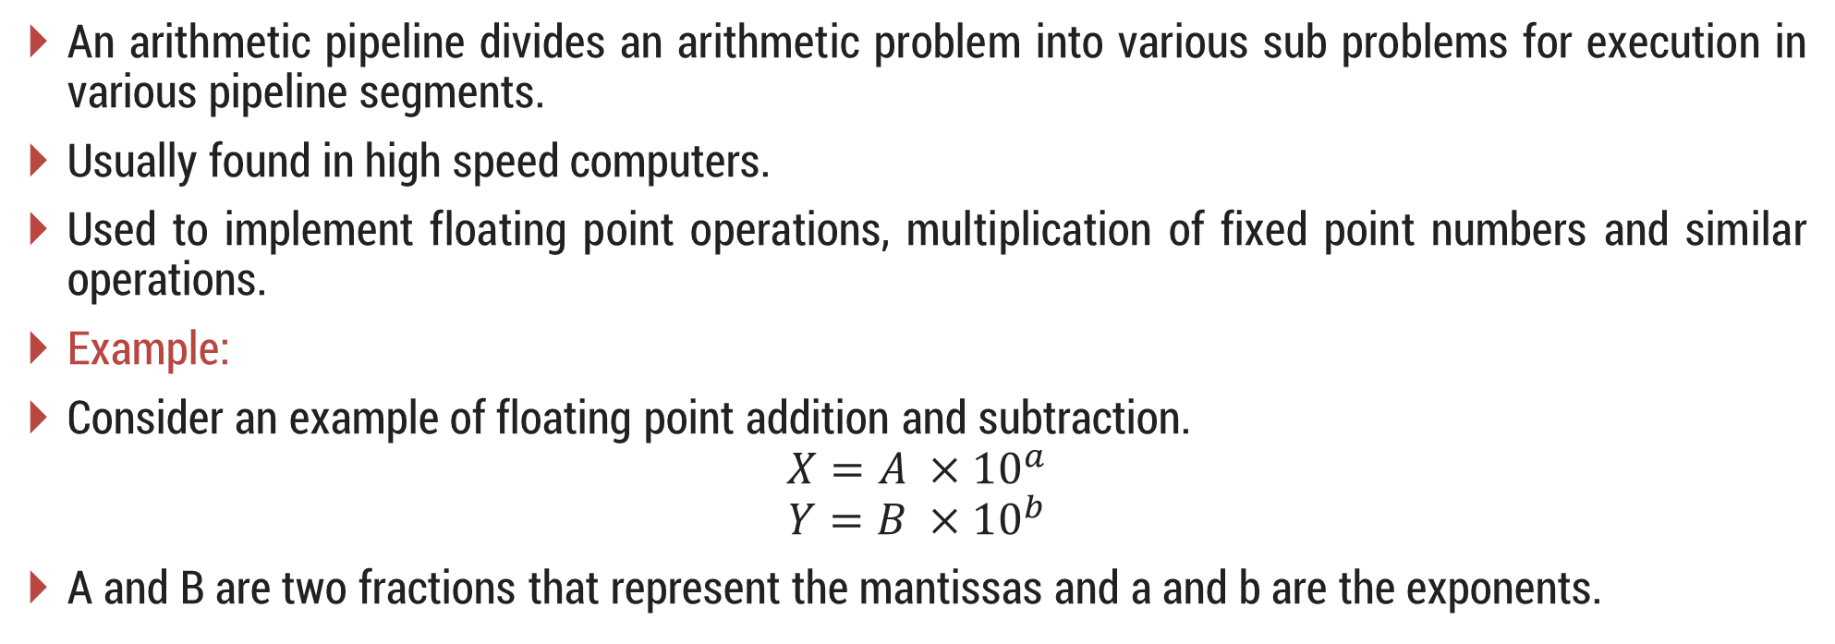
Arithmetic Pipeline
An arithmetic pipeline divides an arithmetic problem into various sub problems for execution in various pipeline segments.
Usually found in high speed computers.
Used to implement floating point operations, multiplication of fixed point numbers and similar operations.
Example:
Consider an example of floating point addition and subtraction.
$$X=A ×{10}^{a}$$
$$Y=B ×{10}^{b}$$
A and B are two fractions that represent the mantissas and a and b are the exponents.

Slide 21
Example of Arithmetic Pipeline
Consider the two normalized floating-point numbers:
X = 0.9504 x 10³ Y = 0.8200 x 10²
Segment-1: The larger exponent is chosen as the exponent of result.
Segment-2: Aligning the mantissa numbers
X = 0.9504 x 10³ Y = 0.0820 x 10³
Segment-3: Addition of the two mantissas produces the sum
Z = 1.0324 x 10³
Segment-4: Normalize the result
Z = 0.10324 x 10⁴
The sub-operations that are performed in the four segments are:
  Compare the exponents
  Align the mantissas
  Add or subtract the mantissas
  Normalize the result

Slide 22
A
Mantissas
a
Exponents
B
b
R
R
Segment 1:
Compare exponents by subtraction
Difference
R
Segment 2:
Choose exponent
Align mantissas
R
Segment 3:
Add or subtract mantissas
R
R
Segment 4:
Adjust exponent
Normalize result
R
R

Slide 23
Instruction Pipeline
Section - 5

Slide 24
Instruction Pipeline
An instruction pipeline reads instruction from the memory while previous instructions are being executed in other segments of the pipeline. Thus we can execute multiple instructions simultaneously.
In the most general case, the computer needs to process each instruction with the following sequence of steps
  Fetch the instruction from memory.
  Decode the instruction.
  Calculate the effective address.
  Fetch the operands from memory.
  Execute the instruction.
  Store the result in the proper place.
Different segments may take different times to operate on the incoming information.
The design of an instruction pipeline will be most efficient if the instruction cycle is divided into segments of equal duration.

Slide 25
Instruction Pipeline
Assume that the decoding of the instruction can be combined with the calculation of the effective address into one segment.
Assume further that most of the instructions place the result into a processor registers so that the instruction execution and storing of the result can be combined into one segment.
This reduces the instruction pipeline into four segments.
  FI: Fetch an instruction from memory
  DA: Decode the instruction and calculate the effective address of the operand
  FO: Fetch the operand
  EX: Execute the operation

Slide 26
Four segment CPU pipeline
Fetch instruction from memory
Segment1:
Segment2:
Decode instruction & calculate effective address
yes
Branch?
no
Segment3:
Fetch operand from memory
Segment4:
Execute instruction
Interrupt handling
yes
Interrupt?
no
Update PC
Empty pipe

Slide 27
Space-time Diagram
Step:
1 | 2 | 3 | 4 | 5 | 6 | 7 | 8 | 9 | 10 | 11 | 12 | 13
FI | DA | FO | EX
 | FI | DA | FO | EX
 |  | FI | DA | FO | EX
 |  |  | FI | DA | FO | EX
 |  |  |  | FI | DA | FO | EX
 |  |  |  |  | FI | DA | FO | EX
 |  |  |  |  |  | FI | DA | FO | EX
Instruction 1
2
3
4
5
6
7

Slide 28
Space-time Diagram
Step:
1 | 2 | 3 | 4 | 5 | 6 | 7 | 8 | 9 | 10 | 11 | 12 | 13
FI | DA | FO | EX
 | FI | DA | FO | EX
 |  | FI | DA | FO | EX
 |  |  | FI | - | - | FI | DA | FO | EX
 |  |  |  | - | - | - | FI | DA | FO | EX
 |  |  |  |  |  |  |  | FI | DA | FO | EX
 |  |  |  |  |  |  |  |  | FI | DA | FO | EX
Instruction 1
2
(Branch)
3
4
5
6
7

Slide 29
Pipeline Conflict
Pipeline Conflict
There are three major difficulties that cause the instruction pipeline conflicts.
  Resource conflicts caused by access to memory by two segments at the same time. Most of these conflicts can be resolved by using separate instruction and data memories.
  Data dependency conflicts arise when an instruction depends on the result of a previous instruction, but this result is not yet available.
  Branch difficulties arise from branch and other instructions that change the value of PC.

Slide 30
Handling Branch Instructions
The branch instruction breaks the normal sequence of the instruction stream, causing difficulties in the operation of the instruction pipeline.

Slide 31
RISC Pipeline
Section - 6

Slide 32
RISC Pipeline (Three segment instruction pipeline)
Because of the fixed-length instruction format, the decoding of the operation can occur at the same time as the register selection.
Since all the operands are in registers, there is no need for calculating an effective address or fetching of operands from memory.
RISC has main two facilities:
  Single-cycle instruction execution
  Compiler support
Mainly three types of instructions in RISC:
  Data manipulation instructions
  Data transfer instructions
  Program control instructions
The instruction cycle can be divided into three sub-operations and implemented in three segments:
  I : Instruction fetch
  A : ALU operation
  E : Execute instruction

Slide 33
Delayed Load
Clock cycles:
1 | 2 | 3 | 4 | 5 | 6
I | A | E
 | I | A | E
 |  | I | A | E
 |  |  | I | A | E
Load R1
Pipeline timing with data conflict
Load R2
Add R1+R2
Store R3
Clock cycles:
1 | 2 | 3 | 4 | 5 | 6 | 7
I | A | E
 | I | A | E
 |  | I | A | E
 |  |  | I | A | E
 |  |  |  | I | A | E
Load R1
Load R2
No-operation
Pipeline timing with delayed load
Add R1+R2
Store R3

Slide 34
Delayed Branch
Clock cycle:
1 | 2 | 3 | 4 | 5 | 6 | 7 | 8 | 9 | 10
I | A | E
 | I | A | E
 |  | I | A | E
 |  |  | I | A | E
 |  |  |  | I | A | E
 |  |  |  |  | I | A | E
 |  |  |  |  |  | I | A | E
 |  |  |  |  |  |  | I | A | E
Load R1
Increment R2
Add R3+R4
Subtract R6-R5
Branch to X
No operation
No operation
Instruction in X
Using no-operation instructions

Slide 35
Delayed Branch
Clock cycle:
1 | 2 | 3 | 4 | 5 | 6 | 7 | 8
I | A | E
 | I | A | E
 |  | I | A | E
 |  |  | I | A | E
 |  |  |  | I | A | E
 |  |  |  |  | I | A | E
Load R1
Increment R2
Branch to X
Add R3+R4
Subtract R6-R5
Instruction in X
Rearranging the instructions

Slide 36
Vector Processing
Section - 7

Slide 37
Vector Processing
In many science and engineering applications, the problems can be formulated in terms of vectors and matrices that lend themselves to vector processing.
Applications of Vector processing
  Long-range weather forecasting
  Petroleum explorations
  Seismic data analysis
  Medical diagnosis
  Aerodynamics and space flight simulations
  Artificial intelligence and expert systems
  Mapping the human genome
  Image processing
Matrix Multiplication
Matrix multiplication is one of the most computational intensive operations performed in computers with vector processors.

Slide 38
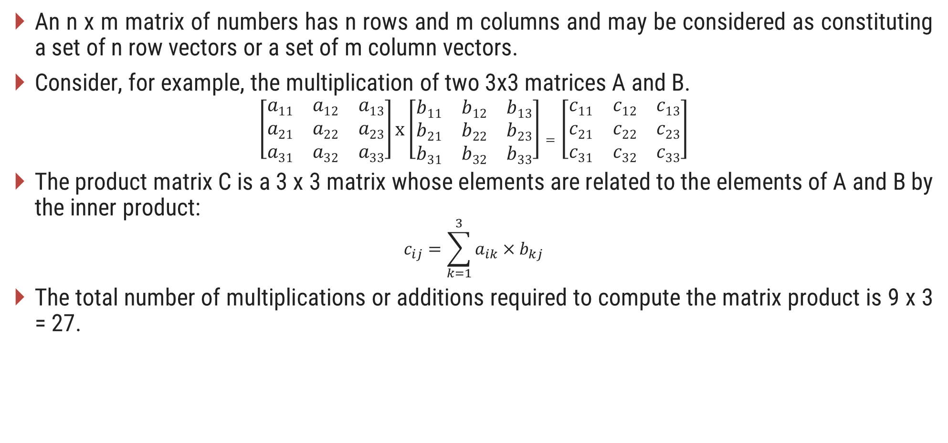
Vector Processing
An n x m matrix of numbers has n rows and m columns and may be considered as constituting a set of n row vectors or a set of m column vectors.
Consider, for example, the multiplication of two 3x3 matrices A and B.
$$\left[\begin{matrix}a11 & a12 & a13 \\ a21 & a22 & a23 \\ a31 & a32 & a33\end{matrix}\right]x\left[\begin{matrix}b11 & b12 & b13 \\ b21 & b22 & b23 \\ b31 & b32 & b33\end{matrix}\right]=\left[\begin{matrix}c11 & c12 & c13 \\ c21 & c22 & c23 \\ c31 & c32 & c33\end{matrix}\right]$$
The product matrix C is a 3 x 3 matrix whose elements are related to the elements of A and B by the inner product:
$$c_{ij}=\sum_{k=1}^{3}{a_{ik}×b_{kj}}$$
The total number of multiplications or additions required to compute the matrix product is 9 x 3 = 27.
Source A
Source B
Multiplier Pipeline
Adder Pipeline

Slide 39
Memory Interleaving
Address bus
AR
AR
AR
AR
Memory array
Memory array
Memory array
Memory array
DR
DR
DR
DR
Data bus

Slide 40
Array Processors
Section - 8

Slide 41
Array Processors
An array processor is a processor that performs computations on large arrays of data.
Two different types of processors
  Attached array processor: It is an auxiliary processor attached to a general-purpose computer.
  SIMD array processor: It is a processor that has a single-instruction multiple-data organization.
Attached array processor:
General-purpose computer
Input-output interface
Attached array processor
Main memory
High-speed memory to memory bus
Local memory

Slide 42
SIMD Array Processor
PE₁
M₁
Master control unit
PE₂
M₂
PE₃
M₃
Main memory
PE_{n}
M_{n}

Slide 43
Questions asked in GTU exam
Section - 9

Slide 44
Questions asked in GTU exam
Discuss four-segment instruction pipeline with diagram(s).
Explain Flynn's taxonomy for classifying parallel processors. Explain each class.
Draw space-time diagram for 4-segment pipeline with 8 tasks.
What is speedup? Derive the equation of speedup for k-segment pipeline processing for task.
Write note on memory interleaving
Compare SIMD and MIMD.
Explain pipeline processing conflict.
Explain vector operation.
Explain parallel processing.

Slide 45
Questions
Explain pipelining. How does it enhance the CPU performance?
Explain Vector Processing.
Describe SIMD array processor.
Explain Delay load.
Explain term: Pipeline Conflict.
State any two solutions for handling branch difficulties.
What do you mean by speed-up in context of pipelining?
Data dependency

