Slide 1
Input/output Organisation

Slide 2

Outline
Peripheral devices
Input/output Interface
Asynchronous Data Transfer
Modes Of Transfer
Priority Interrupt
DMA
Input-Output Processor (IOP)
Questions
Looping

Slide 3
Peripheral Devices

Slide 4
Peripheral Devices
Input or output devices that are connected to computer are called peripheral devices.
For example: Keyboards, display units and printers are common peripheral devices.
There are three types of peripherals:
Input peripherals : Allows user input, from the outside world to the computer. Example: Keyboard, Mouse ,scanner etc.
Output peripherals: Allows information output, from the computer to the outside world. Example: Printers, Monitors etc
Input-Output peripherals: Allows both input (from outisde world to computer) as well as, output(from computer to the outside world). Example: Touch screen , Headset ( speaker+ Microphone) etc.

Slide 5
Keyboard
ASCII code 7 bits
94 printable and 34 non-printable characters
34 non printable characters are also called control characters
1) Format Selectors –HT,VT, Carriage return
2) Communication Control Characters-STX-Start of text, ETX-End of text
3) Information Seperators –RS-Record separator, FS-File separator

Slide 6
Input-Output Interface

Slide 7
Input-Output Interface
Provides a method for transferring information between internal storage (such as memory and CPU registers) and external I/O devices
Resolves the differences between the computer and peripheral devices
To communicate with a particular device, the processor places a device address on address lines.

Slide 8
I/O Bus and Interface

Slide 9
Commands

Slide 10
I/O BUS AND MEMORY BUS

Slide 11
Memory Mapped I/O and Isolated I/O
As a CPU needs to communicate with the various memory and input-output devices (I/O) as we know data between the processor and these devices flow with the help of the system bus.
There are three ways in which system bus can be allotted to them :
Separate set of address, control and data bus to I/O and memory.
Have common bus (data and address) for I/O and memory but separate control lines.
Have common bus (data, address, and control) for I/O and memory.

Slide 12
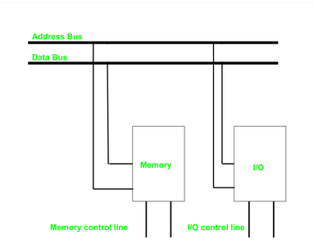
Isolated I/O –
In Isolated I/O,the CPU has distinct input and output instructions and each of these instruction is associated with address of an interface register.
Have common bus(data and address) for I/O and memory but separate read and write control lines for I/O.
when CPU decode instruction then if data is for I/O then it places the address on the address line and set I/O read or write control line on due to which data transfer occurs between CPU and I/O.

Slide 13
Memory Mapped I/O

Slide 14
Asynchronous Data Transfer

Slide 15
Generally the data can be transfer between the source machine and the destination machine in two ways.
1) Synchronous Mechanism
2)A Synchronous Mechanism
Synchronous Mechanism: In Synchronous Mechanism stores the source and the destination mechanism shares the same clock pulse.
2)A Synchronous Mechanism: STROBE & HANDSHAKING

Slide 16
Asynchronous Data Transfer

Slide 17
Strobe Method
1.1 Source initiated Strobe
When source initiates the process of data transfer. Strobe is just a signal.
(i) First, source puts data on the data bus and ON the strobe signal. (ii) Destination on seeing the ON signal of strobe, read data from the data bus. (iii) After reading data from the data bus by destination, strobe gets OFF.
Source unit
Data Bus
Destination unit
Strobe
Data
Valid Data
Strobe
It shows that first data is put on the data bus and then strobe signal gets active.

Slide 18
( i)First, the destination ON the strobe signal to ensure the source to put the fresh data on the data bus. (ii) Source on seeing the ON signal puts fresh data on the data bus. (iii) Destination reads the data from the data bus and strobe gets OFF signal.
It shows that first strobe signal gets active then data is put on the data bus.

Slide 19
Disadvantage
In Source initiated Strobe, it is assumed that destination has read the data from the data bus but their is no surety.
In Destination initiated Strobe, it is assumed that source has put the data on the data bus but their is no surety.

Slide 20
2.1 Source initiated Handshake
Source unit
Destination unit
Data bus
Source unit
Destination unit
Data valid
Place data on bus.
Enable data valid.
Data accepted
Accept data from bus.
Enable data accepted.
Valid Data
Data bus
Disable data valid.
Invalidate data on bus.
Data valid
Disable data accepted.
Ready to accept data (initial state).
Data accepted
It shows that first data is put on the data bus then data valid signal gets active and then data accepted signal gets active. After accepting the data, first data valid signal gets off then data accepted signal gets off.

Slide 21
2.2 Destination initiated Handshake
Data bus
Source unit
Destination unit
Data valid
Source unit
Destination unit
Ready for data
Ready to accept data.
Enable Ready for data.
Place data on bus.
Enable data valid.
Ready for data
Accept data from bus.
Disable Ready for data.
Data valid
Disable data valid.
Invalid data on bus
(initial state).
Valid Data
Data bus
It shows that first Request for Data signal gets active then data is put on data bus then Data valid signal gets active. After reading data, first Request for Data signal gets off then Data valid signal.

Slide 22
Modes Of Transfer

Slide 23
Modes of Transfer
Data transfer between the central computer and I/O devices may be handled in a variety of modes.
Some modes use the CPU as an intermediate path; others transfer the data directly to and from the memory unit.
Data transfer to and from peripherals may be handled in one of three possible modes:
Programmed I/O
Interrupt-initiated I/O
Direct memory access (DMA)

Slide 24
Programmed I/O
Read status register
Check flag bit
= 0
Flag
CPU
Data bus
Interface
I/O
device
I/O bus
= 1
Address bus
Data register
Data valid
Read data register
I/O read
I/O write
Status register
F
Data accepted
Transfer data to memory
Operation complete?
no
yes
Continue with program

Slide 25
Programmed I/O
It is due to the result of the I/O instructions that are written in the computer program.
Each data item transfer is initiated by an instruction in the program.
In this case it requires constant monitoring by the CPU of the peripheral devices.
Example
In this case, the I/O device does not have direct access to the memory unit.
A transfer from I/O device to memory requires the execution of several instructions by the CPU, including an input instruction to transfer the data from device to the CPU and store instruction to transfer the data from CPU to memory.
In programmed I/O, the CPU stays in the program loop until the I/O unit indicates that it is ready for data transfer.
This is a time consuming process since it needlessly keeps the CPU busy. This situation can be avoided by using an interrupt facility.

Slide 26
Interrupt-initiated I/O
An alternative to the CPU constantly monitoring the flag is to let the interface inform the computer when it is ready to transfer data.
While the CPU is running a program, it does not check the flag.
However, when the flag is set, the computer is momentarily interrupted from proceeding with current program and is informed of the fact that the flag has been set.
The CPU deviates from what it is doing to take care of the input or output transfer.
After the transfer is completed, the computer returns to the previous program to continue what it was doing before the interrupt.

Slide 27
Priority Interrupt

Slide 28
polling
what if multiple devices generate interrupts simultaneously. In that case, we have to have a way to decide which interrupt is to be serviced first. In other words, we have to set a priority among all the devices for systemic interrupt servicing.
Polling is the software method of establishing priority of simultaneous interrupt.
Establishes priority over the various sources to determine which condition is to be serviced first
when two or more requests arrive simultaneously.
•Highest priority source is tested first and if its interrupt signal is on, control branches to a
service routine for this source

Slide 29
Priority Interrupt (Daisy-Chaining Technique)
Determines which interrupt is to be served first when two or more requests are made simultaneously
Also determines which interrupts are permitted to interrupt the computer while another is being serviced.
Higher priority interrupts can make requests while servicing a lower priority interrupt.
VAD-Vector address NVAD-Non Vector PI=Priority input po=priority output
Processor data bus
VAD 1
VAD 2
VAD 3
Device 1
Device 2
Device 3
PI
PO
PI
PO
PI
PO
To next
device
Interrupt request
INT
CPU
Interrupt acknowledge
INTACK

Slide 30
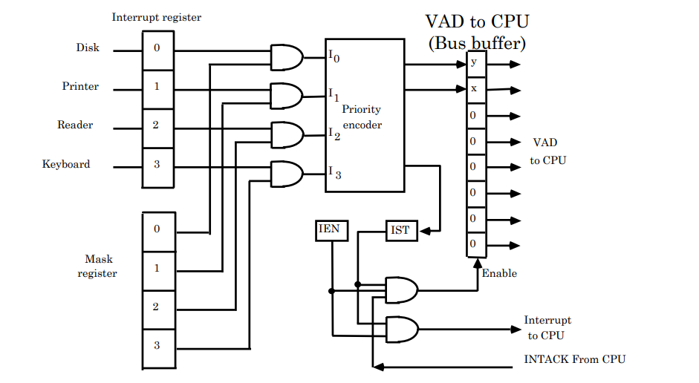
Parallel priority

Slide 31
Priority encoder

Slide 32
The output of the priority encoder is used to form part of vector address for each interrupt source.

Slide 33
Interrupt cycle
The Interrupt enable flip-flop (IEN) can be set or cleared by program instructions.
A programmer can therefore allow interrupts (clear IEN) or disallow interrupts (set IEN)
At the end of each instruction cycle the CPU checks IEN and IST. If either is equal to zero, control continues with the next instruction. If both = 1, the interrupt is handled.
Interrupt micro-operations:
SP←SP – 1 (Decrement stack pointer)
M[SP] ← PCc Push PC onto stack
INTACK ← 1 Enable interrupt acknowledge
PC ←VAD Transfer vector address to PC
IEN ←0 Disable further interrupts
Go to fetch next instruction

Slide 34
DMA (Direct Memory Access)
Section - 4

Slide 35
DMA (Direct Memory Access)
The transfer of data between a fast storage device such as magnetic disk and memory is often limited by the speed of the CPU.
Removing the CPU from the path and letting the peripheral device manage the memory buses directly would improve the speed of transfer.
This transfer technique is called direct memory access (DMA).
During DMA, CPU is idle and has no control of the memory buses.
A DMA controller takes over the buses to manage the transfer directly between the I/O device and memory.
ABUS
Address bus
High-impedance (disabled) when BG is enabled
Bus request
BR
DBUS
Data bus
CPU
RD
Read
Bus granted
BG
WR
Write

Slide 36
DMA Controller
DMA Controller
DMA controller - Interface which allows I/O transfer directly between Memory and Device, freeing CPU for other tasks
CPU initializes DMA Controller by sending memory address and the block size (number of words).
Address bus
Data bus
Data bus buffers
Address bus buffers
Address register
DMA Select
DS
Internal Bus
Register select
RS
Word count register
Read
RD
Control logic
Control register
Write
WR
Bus request
BR
Bus grant
BG
DMA Request
Interrupt
Interrupt
DMA Acknowledge
to I/O device

Slide 38
Input-Output Processor (IOP)
Section - 5

Slide 39
IOP
An input-output processor (IOP) is a processor with direct memory access capability
The IOP is similar to CPU except that it is designed to handle only I/O processing
The IOP fetches and executes I/O instructions to facilitate I/O transfer
Both CPU and IOP exists in the system however CPU is master,while IOP is slave
The CPU only initiates the I/O program after that IOP operates independent of CPU
The I/O processor is capable of performing actions without interruption or intervention from the CPU. The CPU only needs to initiate the I/O processor by telling it what activity to perform. Once the necessary actions are performed, the I/O processor then provides the results to the CPU.

Slide 40
Memory occupies the central position and can communicate with each processor. 
CPU is responsible for processing data. 
IOP provides the path for transfer of data between various peripheral devices and memory. 
Data formats of peripherals differ from CPU and memory. IOP maintain such problems. 
Data are transfer from IOP to memory by stealing one memory cycle. 
Instructions that are read from memory by IOP are called commands to distinguish them from instructions that are read by the CPU

Slide 41
CPU operations
IOP operations
CPU – IOP Communication
Send instruction to test IOP path
Transfer status word to memory location
If status OK, send start I/O instruction to IOP
Access memory for IOP program
CPU continues with another program
Conduct I/O transfers using DMA; prepare status report
I/O transfer completed; interrupt CPU
Request IOP status
Transfer status word to memory location
Check status word for correct transfer
Continue

Slide 42
Questions
Section - 6

Slide 43
Questions
Explain daisy chain priority interrupt.
Explain the DMA operation.
What is the use of IOP? Explain its communication with CPU.
Explain asynchronous data transfer using timing diagrams.
Differentiate isolated I/O and memory mapped I/O.
Differentiate Programmed I/O and Interrupt initiated I/O.
What are the advantages of Serial Data Transmission of data?
Briefly explain source initiated transfer using handshaking.
Enlist possible modes of data transfer to and from peripherals.

