Slide 1
Basic Computer Organization
UNIT-II

Slide 2

Outline
Instruction codes,
Computer Registers-Types,
Computer Instructions – Instruction set completeness,
Timing and Control,
Instruction Cycle- Fetch and Decode,
Register Reference Instructions,
Memory-Reference Instructions,
Input- Output and Interrupt – Input-Output Configuration,
Input- Output Instructions,
Program Interrupt,
Interrupt Cycle.
Looping

Slide 3
Instruction Codes
Section - 1

Slide 4
Introduction
Every different processsor type has its own design(different registers, buses, microoperations,machine instructions etc)
Modern Processor is a very complex device
It contains
Many registers
Multiple arithmetic units,for both integer and floating point calculations
The ability to pipleline several instructions to speed execution
However to understand how processor works,we will start with a simplified processor model

Slide 5
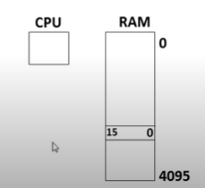
Basic Computer
The Basic computer has two components, a processor and memory
The memory has 4096 words in it
4096=2¹² so it takes 12 bits to select a word in memory
Each word is 16 bits long

Slide 6
Instruction
Program
  A sequence of (machine) instructions
(Machine) instruction
  A group of bits that tell the computer to perform a specific operation(a sequence of microoperation)
The instructions of a program along with needed data are stored in memory
The CPU reads next instruction from memory
It is placed in an Instruction Register(IR)
Control circuitry in control unit then translates the instruction into the sequence of microoperations necessary to implement it

Slide 7
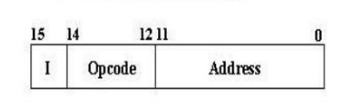
Instruction Format
A computer instruction is often divided into two parts
  An opcode (Operation Code) that specifies the operation for that instruction
  An address that specifies the registers and/or locations in memory to use for that operation
In the basic computer, since the memory contains 4096=(2¹²) words, we needs 12 bits to specify which memory address this instruction will use
In the basic computer bit 15 of the instruction specifies the addressing mode(0:direct addressing,1:Indirect addressing)
Since the memory words and hence the instructions, are 16 bits long ,that leaves 3 bits for instructions opcode

Slide 8
Instruction format of basic computer
Instruction Format
15
14
12
11
0
I
Opcode
Address
0 | 0 | 0 | 1 | 0 | 1 | 0 | 0 | 0 | 1 | 0 | 1 | 0 | 1 | 1 | 1
Add Instruction – ADD 457

Slide 9
Stored Program Organization
Memory
4096 x 16
15
12
11
0
Opcode
Address
Instructions
(program)
Instruction Format
Operand
(data)
15
0
Binary Operand
Processor Register (accumulator or AC)

Slide 10
Stored Program Organization
The simplest way to organize a computer is to have one processor register(AC) and an instruction code format with two parts.
  The first part specifies the operation (opcode) to be performed and the second specifies an address (operand).
The memory address tells the control where to find an operand in memory.
This operand is read from memory and used as the data to be operated on together with the data stored in the processor register.
Instructions are stored in one section of memory and data in another.
For a memory unit with 4096 words, we need 12 bits to specify an address since 2¹² = 4096.
If we store each instruction code in one 16-bit memory word, we have available four bits for operation code (opcode) to specify one out of 16 possible operations, and 12 bits to specify the address of an operand.
The control reads a 16-bit instruction from the program portion of memory.
It then executes the operation specified by the operation code.

Slide 11
Direct & Indirect Addressing of Memory
If the second part of an instruction format specifies the address of an operand, the instruction is said to have a direct address.
In Indirect address, the bits in the second part of the instruction designate an address of a memory word in which the address of the operand is found.
Accumulator is one type of cpu register it is also a temporary
register
Memory
Memory
22
0
ADD
457
35
1
ADD
300
300
1350
457
Operand
1350
Operand
+
+
AC
AC

Slide 12
Direct & Indirect Addressing of Memory
15
14
12
11
0
15
14
12
11
0
22
0
ADD
457
35
1
ADD
300
A direct address instruction is placed at address 22 in memory.
The I bit is 0, so the instruction is recognized as a direct address instruction.
The opcode specifies an ADD instruction, and the address part is the binary equivalent of 457.
The control finds the operand in memory at address 457 and adds it to the content of AC.
The instruction in address 35 has a mode bit I = 1, recognized as an indirect address instruction.
The address part is the binary equivalent of 300.
The control goes to address 300 to find the address of the operand.
The address of the operand in this case is 1350.
The operand found in address 1350 is then added to the content of AC.

Slide 13
Computer Registers
Section - 2

Slide 14
Computer Registers
11
0
15
0
PC
Program Counter(12)
AC
Accumulator(16)
Holds address of instruction
Processor register
11
0
7
0
AR
Address Register(12)
OUTR
Output Register(8)
Holds address for memory
Holds output character
15
0
7
0
IR
Instruction Register(16)
INPR
Input Register(8)
Holds instruction code
Holds input character
15
0
Memory
4096 words
16 bits per word
TR
Temporary Register(16)
Holds temporary data
15
0
DR
Data Register(16)
Holds memory operand

Slide 15
1
0
0
S₂
Common Bus System of Basic Computer
Memory
4096 x 16
S₁
Bus
S₀
7
Address
Write
Read
AR
1
LD
INR
CLR
PC
2
LD
INR
CLR
AC
DR
3
1
LD
INR
CLR
Adder & Logic
E
4
AC
LD
INR
CLR
DR AC
INPR
IR
5
AC DR
LD
TR
6
LD
INR
CLR
OUTR
LD
Clock
AC

Slide 16
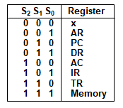
Common Bus System
Three control lines, S₂, S₁, and S₀ control which register the bus selects as its input
Either one of the registers will have its load signal activated, or the memory will have its read signal activated
  Will determine where the data from the bus gets loaded
The 12-bit registers, AR and PC, have 0’s loaded onto the bus in the high order 4 bit positions
When the 8-bit register OUTR is loaded from the bus, the data comes from the low order 8 bits on the bus

Slide 17
The basic computer has eight registers, a memory unit and control unit
Connections:
The outputs of all the registers except the OUTR (output register) are connected to the common bus. The output selected depends upon the binary value of variables S2, S1 and S0. The lines from common bus are connected to the inputs of the registers and memory. A register receives the information from the bus when its LD (load) input is activated while in case of memory the Write input must be enabled to receive the information. The contents of memory are placed onto the bus when its Read input is activated
Various Registers:
4 registers DR, AC, IR and TR have 16 bits and 2 registers AR and PC have 12 bits. The INPR and OUTR have 8 bits each. The INPR receives character from input device and delivers it to the AC while the OUTR receives character from AC and transfers it to the output device. 5 registers have 3 control inputs LD (load), INR (increment) and CLR (clear). These types of registers are similar to a binary counter.

Slide 18
Adder and logic circuit:
The adder and logic circuit provides the 16 inputs of AC. This circuit has 3 sets of inputs. One set comes from the outputs of AC which implements register micro operations. The other set comes from the DR (data register) which are used to perform arithmetic and logic micro operations. The result of these operations is sent to AC while the end around carry is stored in E as shown in diagram. The third set of inputs is from INPR.

Slide 19

Q&A
A computer uses a memory unit with 256K words of 32 bits each. A binary instruction code is stored in one word of memory. The instruction has four parts: an indirect bit. an operation code, a register code part to specify one of 64 registers, and an address part.
a. How many bits are there in the operation code, the register code part, and the address part?
b. Draw the instruction word format and indicate the numberof bits in each part.
c. How many bits are there in the data and address inputs oi the memory?

Slide 20
Sol:
a) 256k= 2⁸ * 2¹⁰⁼ 2¹⁸
64 registers = 2⁶ => 6 bits
Address = 18 bits
Register code=6 bits
Indirect bit =1
Total=18+6=1=25
32-25=7 bits for opcode
c) Data=32 bits, Address=18 bits

Slide 21
Q&A
For each case, specify the register transfer that-will be executed during the next dock transition.
S2 | S1 | S0 | LD OF Register | Memory | Adder
1 | 1 | 1 | IR | Read | -----
1 | 1 | 0 | PC
1 | 0 | 0 | DR | Write
0 | 0 | 0 | AC |  | Add

Slide 22
Answers
Memory read to bus and load to IR: IR ← M[AR]
TR to bus and load to PC: PC ← TR
DR ← AC, M[AR]← AC
Add DR (or INPR) to AC: AC ← AC + DR

Slide 23
Computer Instructions
Section - 3

Slide 24



Basic Computer Instructions
There are three types of computer instructions
Memory-Reference Instructions (OP-code = 000 ~ 110)
Register-Reference Instructions (OP-code = 111, I = 0)
Input-Output Instructions (OP-code =111, I = 1)

Slide 25
Set of Memory Reference Instructions
15
14
12
11
0
I
Opcode
Address
0 | 0 | 0 | 0 | Address
1
1
1
1
0xxx
8xxx
AND
AND the content of memory to AC
1xxx
9xxx
ADD
Add the content of memory to AC
2xxx
Axxx
LDA
Load memory word to AC
3xxx
Bxxx
STA
Store content of AC in memory
4xxx
Cxxx
BUN
Branch unconditionally
5xxx
Dxxx
BSA
Branch and save return address
6xxx
Exxx
ISZ
Increment and skip if zero

Slide 26
Set of Register Reference Instructions
Register Reference Instruction
15
14
13
12
11
0
0
1
1
1
Register Operation
0 | 1 | 1 | 1 | 0 | 0 | 0 | 0 | 0 | 0 | 0 | 0 | 0 | 0 | 0 | 0
1
1
1
1
1
1
1
7800
CLA
Clear AC
7400
CLE
Clear E
7200
CMA
Complement AC
7100
CME
Complement E
7080
CIR
Circulate right AC and E
7040
CIL
Circulate left AC and E
7020
INC
Increment AC

Slide 27
Set of Register Reference Instructions
Register Reference Instruction
15
14
13
12
11
0
0
1
1
1
Register Operation
0 | 1 | 1 | 1 | 0 | 0 | 0 | 0 | 0 | 0 | 0 | 0 | 0 | 0 | 0 | 0
1
1
1
1
1
7010
SPA
Skip next instruction if AC is positive
7008
SNA
Skip next instruction if AC is negative
7004
SZA
Skip next instruction if AC is zero
7002
SZE
Skip next instruction if E is zero
7001
HLT
Halt computer

Slide 28
Set of Input-Output Instruction
Input – Output Instruction
15
14
13
12
11
0
1
1
1
1
I/O Operation
1 | 1 | 1 | 1 | 0 | 0 | 0 | 0 | 0 | 0 | 0 | 0 | 0 | 0 | 0 | 0
1
1
1
1
1
1
F800
INP
Input character to AC
F400
OUT
Output character from AC
F200
SKI
Skip on input flag
F100
SKO
Skip on output flag
F080
ION
Interrupt on
F040
IOF
Interrupt off

Slide 29
Instruction Set Completeness
Instruction set is said to be complete if it includes enough instructions in each of the following categories:
  Arithmetic, logical and shift instructions
  Instructions for moving information to and from memory and processor registers
  Program control instructions together with instructions that check status conditions
  Input and output instructions

Slide 30
Timing and Control
Section - 4

Slide 31
Control Unit
Control unit (CU) of a processor translates from machine instructions to the control signals (for the microoperations) that implement them
Control units are implemented in one of two ways
Hardwired Control
  CU is made up of sequential and combinational circuits to generate the control signals
Microprogrammed Control
  A control memory on the processor contains microprograms that activate the necessary control signals
We will consider a hardwired implementation of the control unit for the Basic Computer.
How to design the Hardwired Control

Slide 32
Control Unit of Basic Computer
0 | 0 | 0 | 1 | 0 | 1 | 0 | 0 | 0 | 1 | 0 | 1 | 0 | 1 | 1 | 1
Instruction Register
Other inputs
15 | 14 | 13 | 12 | 11 - 0
0
0
0
1
Control Logic Gates
3 x 8
Decoder
7 6 5 4 3 2 1 0
D₀
Control O/p
I
D₁
D₇
T₁₅
T₀
15 14 . . . 2 1 0
4 x 16
Decoder
4-bit sequence counter (SC)
Increment (INR)
Clear (CLR)
Clock

Slide 33
Control Unit
Components of Control unit are
  Two decoders
  A sequence counter
  Control logic gates
An instruction read from memory is placed in the instruction register (IR).
In control unit the IR is divided into three parts: I bit, the operation code (12-14)bit, and bits 0 through 11.
The operation code in bits 12 through 14 are decoded with a 3 x 8 decoder.
Bit-15 of the instruction is transferred to a flip-flop designated by the symbol I.
The eight outputs of the decoder are designated by the symbols D₀ through D₇.
Bits 0 through 11 are applied to the control logic gates.
The 4‐bit sequence counter can count in binary from 0 through 15. The outputs of counter are decoded into 16 timing signals T₀ through T₁₅.
The sequence counter SC can be incremented or cleared synchronously.

Slide 34
Control Unit
Most of the time, the counter is incremented to provide the sequence of timing signals out of 4 X 16 decoder.
Once in awhile, the counter is cleared to 0, causing the next timing signal to be T₀.
As an example, consider the case where SC is incremented to provide timing signals T₀, T₁, T₂, T₃ and T₄ in sequence. At time T₄, SC is cleared to 0 if decoder output D₃ is active. This is expressed symbolically by the statement
D₃T₄: SC ← 0
Initially, the CLR input of SC is active. SC Means Sequence counter.
The first positive transition of the clock clears SC to 0, which in turn activates the timing T₀ out of the decoder.
T₀ is active during one clock cycle.
The positive clock transition labeled T₀ in the diagram will trigger only those registers whose control inputs are connected to timing signal T₀.

Slide 35












Timing Cycle for D₃T₄: SC ← 0
$$T_{0}$$
$$T_{1}$$
$$T_{2}$$
$$T_{3}$$
$$T_{4}$$
$$T_{5}$$
Clock
$$T_{0}$$
$$T_{1}$$
$$T_{2}$$
$$T_{3}$$
$$T_{4}$$
$$D_{3}$$
CLR SC

Slide 36
Control Unit
SC is incremented with every positive clock transition, unless its CLR input is active.
This procedures the sequence of timing signals T₀, T₁, T₂, T₃ and T₄, and so on. If SC is not cleared, the timing signals will continue with T₅, T₆, up to T₁₅ and back to T₀.
The last three waveforms shows how SC is cleared when D₃T₄ = 1.
Output D₃ from the operation decoder becomes active at the end of timing signal T₂.
When timing signal T₄ becomes active, the output of the AND gate that implements the control function D₃T₄ becomes active.
This signal is applied to the CLR input of SC.
On the next positive clock transition the counter is cleared to 0.
This causes the timing signal T₀ to become active instead of T₅ that would have been active if SC were incremented instead of cleared.

Slide 37
Control Organization
Hardwired Control
  The control logic is implemented with gates, flips-flops, decoders and other digital circuits.
  It can be optimized to produce a fast mode of operation.
  It requires changes in the wiring among the various components if the design has to be modified or changed.
Microprogrammed Control
  The control information is stored in a control memory.
  The control memory is programmed to initiate the required sequence of micro-operations.
  Any required changes or modifications can be done by updating the microprogram in control memory.

Slide 38
Instruction Cycle
Section - 5

Slide 39
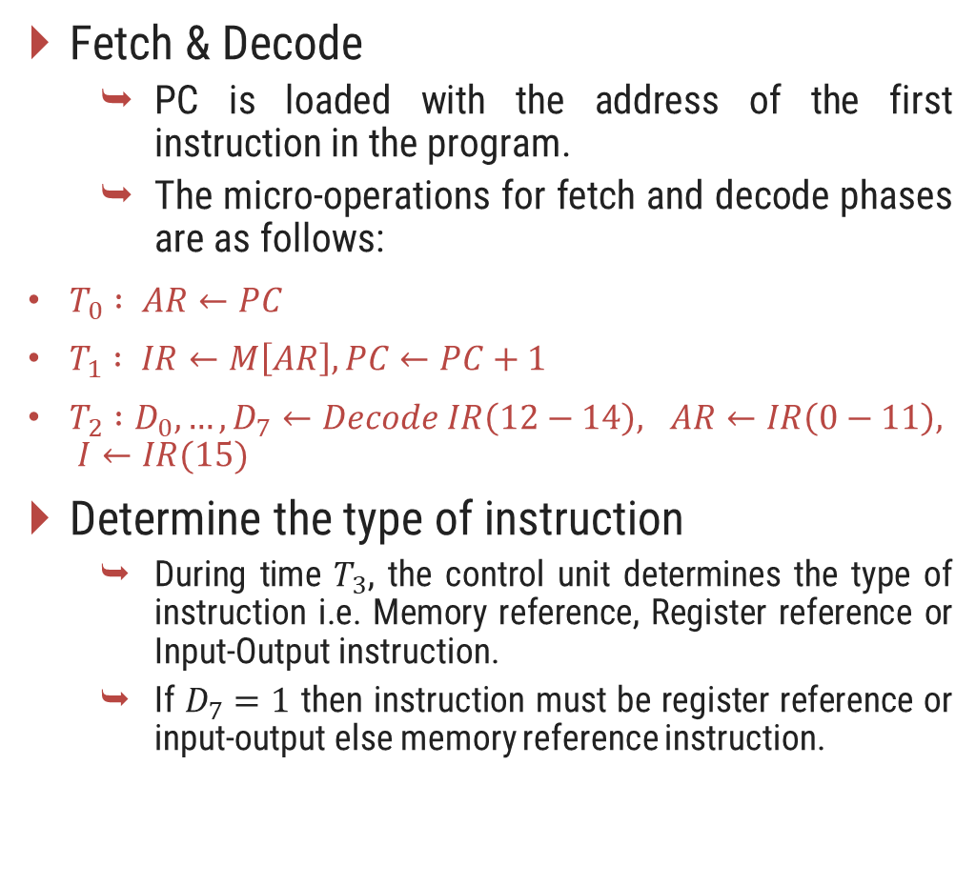
Instruction Cycle
A program residing in the memory unit of the computer consists of a sequence of instructions. In the basic computer each instruction cycle consists of the following phases:
  Fetch an instruction from memory.
  Decode the instruction.
  Read the effective address from memory if the instruction has an indirect address.
  Execute the instruction.
After step 4, the control goes back to step 1 to fetch, decode and execute the next instruction.
This process continues unless a HALT instruction is encountered.
Fetch & Decode
  PC is loaded with the address of the first instruction in the program.
  The micro-operations for fetch and decode phases are as follows:
$T_{0} : AR←PC$
$T_{1} : IR←M\left[AR\right], PC←PC+1$
$T_{2} :D_{0},…,D_{7}←Decode IR\left(12−14\right), AR←IR\left(0−11\right), I←IR(15)$
Determine the type of instruction
  During time $T_{3}$, the control unit determines the type of instruction i.e. Memory reference, Register reference or Input-Output instruction.
  If $D_{7}=1$ then instruction must be register reference or input-output else memory reference instruction.

Slide 40





Start
SC ← 0
$$T_{0}$$
AR ← PC
$$T_{1}$$
IR ← M[AR], PC ← PC + 1
$$T_{2}$$
Decode operation code in IR(12-14)
AR ← IR(0-11), I ← IR(15)
(Register or I/O) = 1
D₇
= 0 (Memory-reference)
(I/O) = 1
I
= 0 (register)
(indirect) = 1
I
= 0 (direct)
$$T_{3}$$
$$T_{3}$$
$$T_{3}$$
$$T_{3}$$
Execute input-output instruction
SC ← 0
Execute
register-reference instruction
SC ← 0
AR ← M[AR]
Nothing
Execute
memory-reference instruction
SC ← 0

Slide 41
Memory-Reference Instructions
Section - 6

Slide 42
Memory Reference Instructions
AND: AND to AC
This is an instruction that performs the AND logic operation on pairs of bits in AC and the memory word specified by the effective address. The result of the operation is transferred to AC.
ADD: ADD to AC
This instruction adds the content of the memory word specified by the effective address to the value of AC. The sum is transferred into AC and the output carry C_{out} is transferred to the E (extended accumulator) flip-flop.
D₀T₄: DR ← M[AR]
D₀T₅: AC ← AC ∧ DR, SC ← 0
D₁T₄: DR ← M[AR]
D₁T₅: AC ← AC + DR, E ← C_{out}, SC ← 0

Slide 43
Memory Reference Instructions
LDA: Load to AC
This instruction transfers the memory word specified by the effective address to AC.
STA: Store AC
This instruction stores the content of AC into the memory word specified by the effective address.
D₂T₄: DR ← M[AR]
D₂T₅: AC ← DR, SC ← 0
D₃T₄: M[AR] ← AC, SC ← 0

Slide 44
Memory Reference Instructions
BUN: Branch Unconditionally
This instruction transfers the program to instruction specified by the effective address. The BUN instruction allows the programmer to specify an instruction out of sequence and the program branches (or jumps) unconditionally.
BSA: Branch and Save Return Address
This instruction is useful for branching to a portion of the program called a subroutine or procedure. When executed, the BSA instruction stores the address of the next instruction in sequence (which is available in PC) into a memory location specified by the effective address.
D₄T₄: PC ← AR, SC ← 0
D₅T₄: M[AR] ← PC, AR ← AR + 1
D₅T₅: PC ← AR, SC ← 0

Slide 45
Memory Reference Instructions (BSA)
20
0 BSA 135
20
0 BSA 135
PC = 21
Next Instruction
21
Next Instruction
AR = 135
135
21
136
Subroutine
PC = 136
Subroutine
1 BUN 135
1 BUN 135
Memory, PC and AR at Time T₄
Memory and PC after execution

Slide 46
Memory Reference Instructions
ISZ: Increment and Skip if Zero
These instruction increments the word specified by the effective address, and if the incremented value is equal to 0, PC is incremented by 1. Since it is not possible to increment a word inside the memory, it is necessary to read the word into DR, increment DR, and store the word back into memory.
D₆T₄: DR ← M[AR]
D₆T₅: DR ← DR + 1
D₆T₆: M[AR] ← DR, if (DR = 0) then (PC ← PC + 1), SC ← 0

Slide 47
Register Reference Instruction
D₇I’T₃ = r (common to all register reference instructions)
IR(i) = B_{i} [bit in IR(0-11) that specifies the operation]
CLA
rB₁₁
AC ← 0
Clear AC
CLE
rB₁₀
E ← 0
Clear E
CMA
rB₉
AC ← AC’
Complement AC
CME
rB₈
E ← E’
Complement E
CIR
rB₇
AC ← shr AC, AC(15) ← E, E ← AC(0)
Circulate right
CIL
rB₆
AC ← shl AC, AC(0) ← E, E ← AC(15)
Circulate left
INC
rB₅
AC ← AC + 1
Increment AC
SPA
rB₄
If (AC(15) = 0) then (PC ← PC + 1)
Skip if AC is positive
SNA
rB₃
If (AC(15) = 1) then (PC ← PC + 1)
Skip if AC is negative
SZA
rB₂
If (AC = 0) then (PC ← PC + 1)
Skip if AC is zero
SZE
rB₁
If (E = 0) then (PC ← PC + 1)
Skip if E is zero
HLT
rB₀
S ← 0 (S is a start-stop flip-flop)
Halt Computer

Slide 48
Input-output and Interrupt
Section - 7

Slide 49
Input-Output of basic computer
Input-Output terminal
Serial communication interface
Computer registers and flip-flop
FGO
=1
=0
Printer
Receiver Interface
OUTR
AC
Keyboard
Transmitter Interface
INPR
FGI
=0
=1

Slide 50
Input-Output of basic computer
A computer can serve no useful purpose unless it communicates with the external environment.
To exhibit the most basic requirements for input and output communication, we will use a terminal unit with a keyboard and printer.
The terminal sends and receives serial information and each quantity of information has eight bits of an alphanumeric code.
The serial information from the keyboard is shifted into the input register INPR.
The serial information for the printer is stored in the output register OUTR.
These two registers communicate with a communication interface serially and with the AC in parallel.

Slide 51
Process of input & output information transfer
Input Transfer
Output Transfer
Initially, the input flag FGI is cleared to 0. When a key is struck in the keyboard, an 8-bit alphanumeric code is shifted into INPR and the input flag FGI is set to 1.
As long as the flag is set, the information in INPR cannot be changed by striking another key. The computer checks the flag bit; if it is 1, the information from INPR is transferred in parallel into AC and FGI is cleared to 0.
Once the flag is cleared, new information can be shifted into INPR by striking another key.
The output register OUTR works similarly but the direction of information flow is reversed.
Initially, the output flag FGO is set to 1. The computer checks the flag bit; if it is 1, the information from AC is transferred in parallel to OUTR and FGO is cleared to 0. The output device accepts the coded information, prints the corresponding character, and when the operation is completed, it sets FGO to 1.
The computer does not load a new character into OUTR when FGO is 0 because this condition indicates that the output device is in the process of printing the character.

Slide 52
Input-Output Instruction
D₇IT₃ = p (common to all input-output instructions)
IR(i) = B_{i} [bit in IR(6-11) that specifies the operation]
INP
pB₁₁
AC(0-7) ← INPR, FGI ← 0
Input Character
OUT
pB₁₀
OUTR ← AC(0-7), FGO ← 0
Output Character
SKI
pB₉
If (FGI = 1) then (PC ← PC + 1)
Skip on input flag
SKO
pB₈
If (FGO = 1) then (PC ← PC + 1)
Skip on output flag
ION
pB₇
IEN ← 1
Interrupt enable on
IOF
pB₆
IEN ← 0
Interrupt enable off

Slide 53
Interrupt Cycle
Instruction cycle
= 0
R
= 1
Interrupt cycle
Fetch & Decode instruction
Store return address in location 0
M[0] ← PC
Execute instruction
IEN
= 0
= 1
Branch to location 1
PC ← 1
= 1
FGI
= 0
= 1
IEN ← 0
R ← 0
FGO
= 0
R ← 1

Slide 54
Interrupt Cycle
The interrupt cycle is a hardware implementation of a branch and save return address operation.
An interrupt flip-flop R is included in the computer.
When R = 0, the computer goes through an instruction cycle.
During the execute phase of the instruction cycle IEN is checked by the control.
If it is 0, it indicates that the programmer does not want to use the interrupt, so control continues with the next instruction cycle.
If IEN is 1, control checks the flag bits.
If both flags are 0, it indicates that neither the input nor the output registers are ready for transfer of information.
In this case, control continues with the next instruction cycle. If either flag is set to 1 while IEN = 1, flip-flop R is set to 1.
At the end of the execute phase, control checks the value of R, and if it is equal to 1, it goes to an interrupt cycle instead of an instruction cycle.

Slide 55
Register transfer statements for Interrupt cycle
The flip-flop is set to 1 if IEN = 1 and either FGI or FGO are equal to 1. This can happen with any clock transition except when timing signals T₀, T₁ or T₂ are active.
The condition for setting flip-flop R = 1 can be expressed with the following register transfer statement:
T₀′ T₁′ T₂′ (IEN) (FGI + FGO): R ← 1
The symbol + between FGI and FGO in the control function designates a logic OR operation. This is AND with IEN and T₀′ T₁′ T₂′.
The fetch and decode phases of the instruction cycle must be modified and Replace T₀, T₁, T₂ with R'T₀, R'T₁, R'T₂
Therefore the interrupt cycle statements are :
RT₀ : AR ← 0, TR ← PC
RT₁ : M[AR] ← TR, PC ← 0
RT₂ : PC ← PC + 1, IEN ← 0, R ← 0, SC ← 0

Slide 56
Register transfer statements for Interrupt cycle
During the first timing signal AR is cleared to 0, and the content of PC is transferred to the temporary register TR.
With the second timing signal, the return address is stored in memory at location 0 and PC is cleared to 0.
The third timing signal increments PC to 1, clears IEN and R, and control goes back to T₀ by clearing SC to 0.
The beginning of the next instruction cycle has the condition RT₀ and the content of PC is equal to 1. The control then goes through an instruction cycle that fetches and executes the BUN instruction in location 1.

Slide 57
Demonstration of Interrupt Cycle
0
0
256
1
0 BUN 1120
PC = 1
0 BUN 1120
Main Program
Main Program
255
255
PC = 256
256
1120
I/O program
1120
I/O program
1 BUN 0
1 BUN 0
Before Interrupt
After Interrupt

Slide 58
IMPORTANT QUESTIONS
Write a detailed note on instruction cycle with neat diagrams.
Explain control unit of basic computer and its working with diagram.
For the basic computer explain following instructions
  LDA
  ADD
  AND
  CLA
Draw and explain flowchart for interrupt cycle.
For the basic computer explain following instructions
  BUN
  BSA
  CIL
  SZE
Explain how Input/Output can be performed using interrupts.
State the differences between hardwired control and microprogrammed control.

Slide 59
A computer uses a memory unit with 256K words of 32 bits each. A binary instruction code is stored in one word of memory. The instruction has four parts: an indirect bit, an operation code, a register code part to specify one of 64 registers, and an address part. 1) How many bits are there in operation code, the register code part, and the address part? 2) Draw the instruction word format and indicate the number of bits in each part. 3) How many bits are there in the data and address inputs of the memory?
Draw and explain basic computer instruction formats.
Differentiate MRI and non-MRI.
Explain Direct and Indirect Addressing.
Give an example of register transfer of data through accumulator.
What is Interrupt? How it is useful for a system?
Explain CLA, ISZ, INP instruction.
Explain seven register common bus system.

Slide 60
Explain with clear diagram, how data can be input to the computer using INP instruction.
What is a Program Counter?
What is an Accumulator?
What is an Instruction Register?
What do you understand by Memory Address?
What is a Carry Flag?
Explain Instruction Fetch.
Explain Instruction Decode.
Enlist major components of CPU.
Effective address.

Slide 61
Exercises
Explain why each of the following miaooperations cannot be executed
. IR <-M[PC]
AC <- AC + TR

Slide 62
For each of the following 16-bit iitstructions, give the equivalent four-digit hexadecimal code and explain in your own words what it is that the instruction is going to perform.
a. 0001 0000 0010 0100
b. 1011 0001 0010 0100

Slide 63
A computer uses a memory unit with 512K words of 32 bits each. A binary instruction code is stored in one word of memory. The instruction has four parts: an indirect bit, an operation code, a register code part to specify one of 64 registers, and an address part.
1) How many bits are there in operation code, the register code part, and the address part?
2) How many bits are there in the data and address inputs of the memory?
Solution
Memory unit =512k words
1 WORD=32 Bits =4B
Binary instruction code stored in 1 word of memory Instruction divided as follows,
Addressing mode = 1 bit for direct or indirect
Register code = 64 Registers = 6 bits
Since, registers are already addressed, only memory needs to be addressed
Address part = (512 K) = 19 bits
Operation mode = 32 – 1 – 6 – 19 = 6bits
Therefore, bits for addressing mode part, opcode part, register code part and the address part = (1, 4, 6, 19)
Addressing mode | Operation code | Register code | Address part

