Slide 1
UNIT-V
VALUE ENGINEERING LEVEL OF EFFORT

Slide 2
VALUE ENGINEERING TEAM
Value Engineering/ Value Analysis (VE/VA) is essentially a team effort.
A small committee comprising representatives from the Design, Production, Purchase and Accounts Departments identifies and decides the product(s) / service(s) to be taken up for value analysis.
Any other departmental representative can be co-opted as and when necessary.
One of the members of the VE team is appointed as VE Team leader or simply the Value Engineer.
The success of the VE program largely depends on the leader of the VE team.

Slide 3
VE COORDINATOR/FACILITATOR
Each VE job plan have a VE Coordinator.
The coordinator's function is to ensure the proper application of VE policies and procedures according to the requirement of the organization.
The VE coordinator serves as the focal point for All communications between the VE team, the project owner/user and other stake holders.
The VE coordinator has to initiate action, convene meetings at regular intervals and see that substantial results are obtained.
As the facilitator of the VE effort, the coordinator is required to remain objective, and to sufficiently direct the VE team to ensure that its efforts are productive and remain focused on the project.
The VE coordinator in consultation with VE team leader identifies the improvement opportunities, scope, schedule, ideal team member candidates and study logistics including meeting locations, study field trips, data collection and preservation of data.
The coordinator also monitors and periodically reports management/ project manager about the progress of VE studies.

Slide 4
The duties of VE coordinator are as follow:
Coordinate with VE team leader, VK team members and management/ project manager on all VE activities.
Coordinate the identification process of Project, Product and Process Studies
Obtain the approval from the management for financial resources and set time target for implementation of VE program.
Review the progress of the VE program periodically in a year as needed
To identify, manage and check the availability of qualified team leaders and experienced team members to participate in the studies.
To arrange for formal training of the team members, if required.
Ensure VE studies are conducted in accordance with policies of the organization and approved procedures.
For consultant-led studies, the coordinator is responsible for preparing task order to request consultant services under executed VE service contract. Task orders must be prepared in consultation with the VE team leader, key team members and key stakeholders.
Assist management to manage and allocate require financial assistance for VE project.
Schedule study dates including due dates for key deliverables and secure meeting room location(s) for the study meeting dates.

Slide 5
Notify the team members about the training program, study dates, agenda and location.
Ensure that the VE team leader and team have adequate background data to generate sound assumptions and analysis.
Monitor study activities to assure adherence to the standards as defined 11 Initiate the follow up action to ensure the consistent progress of the VE in the VE standards.
Initiate the follow-up action to ensure the consistent progress of the VE Program
Ensure that basic activities required for VE study are completed, including follow-up on implementation results.
Maintain hard copies and electronic files of all completed VE study reports.
Providing electronic and/or hard copies to all interested parties.
Advocate the merits of VE by reporting/marketing study results and participant contributions.
Assist management in assessing the cost and return on investment (ROI)of the VE studies.

Slide 6
VALUE ENGINEERING DESIGNER OR TEAM LEADER
In most of the cases the Design (or R&D) Manager is appointed as team leader However, certain organizations appoint a VE specialist / consultant as the team leader.
A large part of whatever Value Analysis work done is initiated by the team leader.
The team leader with the help of VE coordinator is primarily responsible for gathering the relevant documentation and information and compiling it systematically into a report.
The VE coordinator is responsible for guiding the technical resources assigned to the VE team through the VE methodology.
A large share of the initial phase of the Value Analysis work will be done by the team leader, or by other departments according to his instructions.
It is responsibility to seek the maximum value when a product requirement comes up to the design stage.
It is his duty to challenge wasteful and avoidable costs inherent in the design.

Slide 7
VE team leader help to ensure a successful study and is responsible for
Identifying the need for a VE study.
Identifying projects to be value analyzed.
Meeting with project stakeholders, decision makers and team members during the selection of VE alternatives for making decision (accept, accept with modification(s), conditionally accept or reject).
Ensuring VE studies are conducted on promising projects.
Arranging for adequate resources for the required and/or desired VE study within the project work plan budget and schedule.
Leading the VE team through the VE methodology.
Developing the VE study plan to outline the studies.
Identifying the most qualified VE team members; this may include sab consultant experts, who can work directly with other multi-disciplined members on various project issues.

Slide 8
Formally appointing the members of team in the project development stage, prior to incurring any costs and/or commitment of personnel resources.
Documenting the VE/VA alternatives to ensure clear, thorough communication of the VE team members.
Preparing the VE/VA report, following the requirements outlined in the VE/VA Report Guide, in a timely fashion and to submit to the management.
Providing electronic and/or hard copies to all interested parties.
Ensuring the VE/VA study is in compliance with organizational policy.
Performing a follow-up on the implementation plan.
The VE team leader should have attended an appropriate VE Workshop training seminar, preferably with additional experience as a team member on one mare VE projects.
The VE team leader typically has credentials as a Certified Value Specialist, as defined and recognized by SAVE International.

Slide 9
VE LEVEL OF EFFORT
Deciding minimum level of effort required for value engineering is not easy because overall effort required for VE studies is a function of several variables including the magnitude and complexity of the project as well as the degree of repetition within a project.
The status of budget, schedule and technology issues may also have impact on the efforts required for VE studies.
Different analysts have proposed different methods to estimate Level of VE efforts required as follows:
(1) At least one full-time value engineer per one hundred (100) design or production personnel involved in the production of product is required. The length of period for which such value engineer is required depends upon the complicacy of problem.
(2) 0.1% to 0.5% of total annual sales production volume expressed in rupees as an initial operating budget for VE. For procuring activities, one full-time value engineer for every 50 employees is reasonable. This ratio may vary considerably depending upon the degree of in-house specification analysis undertaken.

Slide 10
(3) The projects can be grouped as Level-A and Level-B. Level-A study is the most comprehensive and should be considered for complex projects, new construction, capacity improvements and major reconstruction. This level will typically involve task-based consulting engineers with particular expertise relating to the type of project under study.
The Level-B study should be considered for "maintenance" type work(paving, guide rail, drainage improvements) and replaced-in-kind work where no additional capacity is gained. Level-B studies may be completed by task-based consultant or in-house staff. Once a project is selected for study, the design team will determine the level of study and composition of study team.
(4) The projects under study can be categorized into three different levels .viz low level, average and High level. The level of project is differentiated based on the complexity of the project.
Low level: lower complexity projects which do not require very large extra design and manufacturing infrastructure or projects with a very high degree of repetition e.g. small motors, fans, pumps, toys.

Slide 11
ii) Average: projects of average complexity requiring relatively higher degree of design and manufacturing infrastructure and many components can be used from existing production line e.g. large motors, refrigerator, air conditioner.
(iii) High level: projects of high complexity such as automobile, machine tools, special purpose
Recommended VE level of effort is shown in fig.
It shows the estimated man-hour required for different projects depending upon the degree of complexity the project. machines etc.

Slide 12
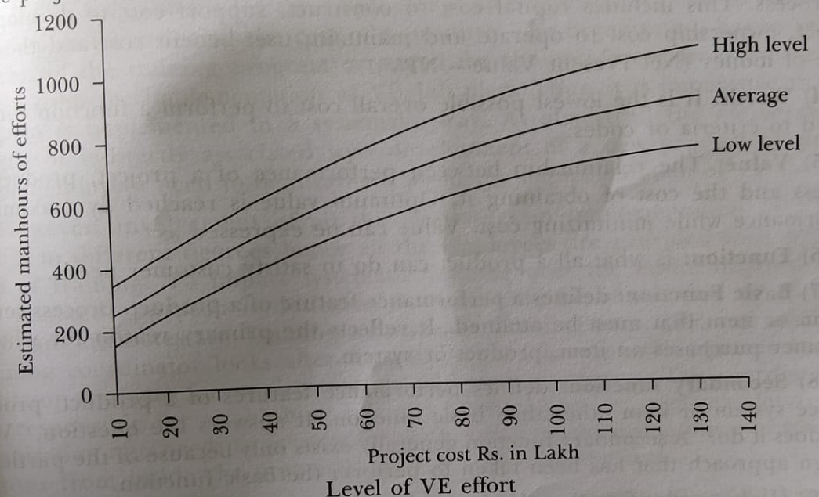

Slide 13
To find the approximate requirement of man-hours for a given VE project., locate the estimated project cost on the horizontal axis and move vertically to a point representing the approximate degree of project complexity (high, average,low).
Total recommended effort hours can be located on the vertical axis. This figure represents the total recommended level of effort for two studies - one at concept Design and one at Tentative Design.
Dividing the hours identified by the no. of hours appropriate to "average" complexity will produce a "complexity will produce a ‘complexity’ factor can be calculated.
The level of effort to be applied also varies with the nature of the VE organization, and the type of operation at the activity, i.e.. the percent of design development, and production; the type of product or services, etc.
These indices are guidelines and should not be considered inflexible requirements. Also the need for dedicated people may be reduced if there are trained people in the organization who perform VE as an integral part of their job and can be made available for special intensive reviews.

Slide 14
DEFINITIONS
Value Engineering (VE):
An organized effort directed at analyzing the function of a component, product, system, equipment, installation, operation, maintenance, repair, replacement, facilities and procedures for the purpose of achieving required function at lowest possible cost of effective ownership consistent with performance, reliability, quality and maintainability. The primary goal of a VA/VE study is to improve value.
(2) Value Analysis (VA):
VA and VE are used interchangeably, however, Value analysis is used in connection with the study of items or products or services already in existence, where as, Value engineering is the study of design and systems prior to the issue of finalizing the concept or design.

Slide 15
(3) Project Cost:
The sum of all costs involved in delivering a project, product or process. This includes capital cost to construct, support cost to develop the project, ownership cost to operate and maintain, user-benefit cost and the time-value of money (Net Present Value- NPV).
(4) Worth:
It is the lowest possible overall cost to perform a function without regard to criteria or codes.
(5) Value:
The relationship between the performance of a project, product, or process and the cost of obtaining it. The optimum value is reached by maximizing performance while minimizing cost.
(6) Function:
is what all a product can do to satisfy customer needs.
(7) Basic Function:
defines a performance feature of a product, process service system or item that must be attained. It reflects the primary reason for which a customer purchases an item, product or system.

Slide 16
(8) Secondary function: defines performance features of a product, process, service system or item other than basic function. It answers the question, "What else does it do?" A secondary function generally exists only because of the particular design approach that has been taken to perform the basic function.
(9) Higher order function:
Higher order function is the function or the reason for which the customer purchases a product.
(10) Required secondary function:
Required secondary function is defined as the function required for achieving the basic function while designing a product. It may not be mistaken with secondary function which is the function performed by a product due to the method/ approach selected for designing a product.
(11) Assumed functions:
Assumed functions are the functions indicating the provision of some components, assembly or hardware which are ultimately responsible for achieving the basic function.
(12) Supporting functions:
Supporting functions are those desirable functions which the product is expected to perform beyond the basic function.

Slide 17
(13) Function Analysis:
The process of judiciously identifying the elemental function(s) of a project, product, or service.
(14) Function Analysis System Technique (FAST) diagram:
A method of analyzing the relationship between function(s) of a product and the methodology to achieve the function(s). Functions are analyzed by aligning them in a "how" and "why" logic diagram.
(15) VE Job Plan:
A well-planned VE procedure to be adopted by an organization for the implementation of VE studies. The VE job plan passes through six phases.
(16) VE Project:
Selection of a product, process, service or any other such thing for VE studies and step-wise procedure of conducting the VE study.
(17) Life cycle cost:
The total cost of a system, building, program, project, or other product, computed over its useful life. It includes all relevant costs involved in acquiring, owning, operating, maintaining, and disposing of the system, project or product over a specified period of time, including environmental and energy costs.

Slide 18
VE IN SOFTWARE
It has been underlined that VE procedures can be applied to both hardware and software projects.
The application will be made sense of by calling attention to the distinctions in the methodology.
To rehearse Value engineering the functional equipment approach has become a standard technique. A somewhat unique methodology is required to apply VE to software cost issues.
Since Value engineering is fruitful in decreasing equipment cost since it is work arranged and not equipment situated, then, at that point, the utilization of VE to software should be work-situated and not nonhardware situated.
At the end of the day, the group should not focus on lessening the expenses of the software as such yet should recognize and once again move the pointless expense coming about because of the functions made and expected as a result of the software things.

Slide 19
How can software be drawn nearer from a Value engineering point of view?
Gather the real factors to Engineer Job Plan specific methods.
Determine the expenses.
Put a dollar sign on the particular prerequisites,
Challenge the particulars and prerequisites.
To take care of the software issue we should consolidate the best innovative reasoning and experience of architects, examiners and the executive's workforce. This can be achieved by
Defining the essential software capacities required.
Arranging and joining these capacities.
Identifying the auxiliary and superfluous capacities.
Removing these, in this manner staying away from the equivalent pointless expenses.

Slide 20
VALUE ENGINEERING IN CONSTRUCTION PROJECTS
Value Engineering is used in construction projects to provide a clear and detailed analysis of how best to meet the goals of the construction project.
Value Engineering, when used with cost estimating, allows for an independent review of the entire construction project. This review process, typically completed within a Value Engineering workshop, is focused on one common goal: to provide the highest value at the lowest cost.
Value Engineering gives all parties involved the confidence that the maximum performance and highest value construction project can and will happen.
The ultimate goal of every construction project is to remain on scope, within budget, and on-time. This requires a concerted and professional independent review of every aspect of the construction project.
In case of materials purchase, architectural design, project management, or environmental assessment – Value Engineering can and will help to do the job better.
Working with an independent review team, gives the confidence that bias and influence are not part of the Value Engineering and cost estimating process.

Slide 21
Value Engineering can be used at any phase of the construction project to ensure the best possible value with the lowest cost to resources, budgets, scheduling, and success.
Value Engineering can help to avoid problems that plague every type of construction project, regardless of size and scope:
Last minute design and scope changes to save money and time.
Architectural redesign mid-project, forcing delays, cost overruns, and a change in vision.
Stress on general contractors to build within the agreed upon budget.
All people working on the project are maxed out – time, abilities, skills, resource, logistically, and financially.
Value Engineering process is used:
1. Planning
The more planning and analysis done at the early stage of the construction project – the better for everyone.
Value Engineering is valuable in identifying early-on where the barriers in the project are and areas for improvement.
This first planning phase can help everyone save time, spend less money, raise ideas and changes, and open the discussion on how best to achieve the goals of the project.
All with no interruption to the schedule.

Slide 22
2. Design At this second phase of the Value Engineering process, the design is typically at the schematic stage
During this stage, the design team and the client come together to review the suggested design, the estimated budget, schedule, and overall approach to the project. The goal is to ensure that the design is aligned with achieving the best possible outcome for the project.
3. Methodology and Approach It is in this third phase, that the Value Engineering workshop can and should be used. SAVE International has outlined 6 key steps that should be followed during the workshop:
Information Phase: collect all information to fully understand the project.
Function Analysis Phase: clearly identify the functions and goals of the project.
Creative Phase: idea generation/brainstorming to best achieve the project.
Evaluation Phase: evaluate all ideas to determine which offer the best value and outcome success for the project.
Development Phase: review and determine the best alternatives, with a focus on how to improve the construction project value.
Presentation Phase: the value decision is presented to all stakeholders and invested parties.

