Slide 1
Operating systems
UNIT-II

Slide 2
INTRODUCTION
Early computer systems allowed only one program to be executed at a time.
current-day computer systems allow multiple programs to be loaded into memory and executed concurrently.
This evolution requires compartmentalization of the various programs; and these needs resulted in the notion of a process
It is a program in execution.
A process is the unit of work in a modern time-sharing system.

Slide 3
A system therefore consists of a collection of processes
Operating system processes executing system code and user processes executing user code.

Slide 4
  Process
A program in execution is called a process.
A process will need certain resources such as CPU time, memory, files and I/O devices to accomplish its task.
These resources are allocated to the process either when it is created or while it is executing.
Generally the terms job and process are almost the same.
Process execution must progress in sequential fashion

Slide 5
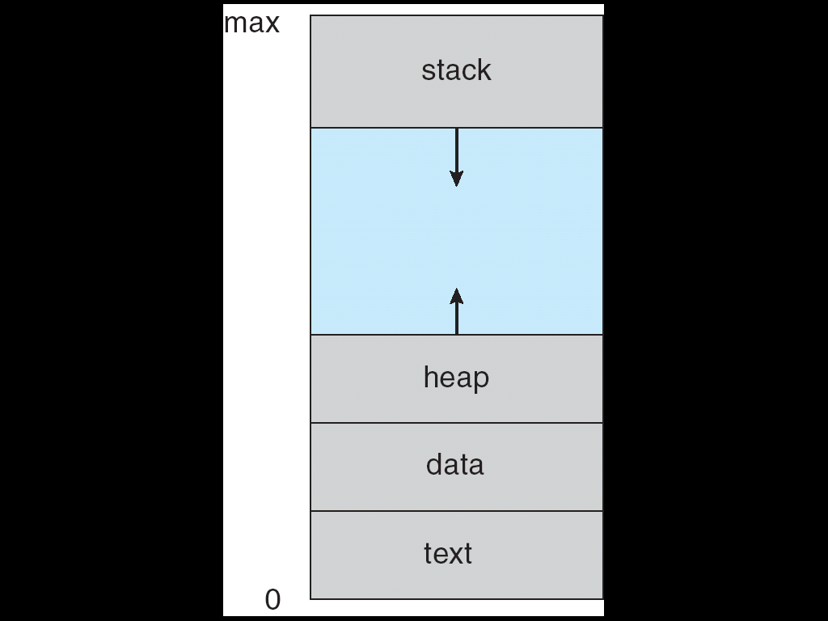
Process representation in memory
  A process includes:
    program counter
    stack
    data section
    heap

Slide 6
A process is a program under execution.
Text section includes the current activity , as represented by the value of the program counter and contents of processor’s registers.
It generally includes process stack, containing temporary data
and data section containing global variables.
It also includes heap which is memory that is dynamically allocated during process run time.

Slide 7
A program is a passive entity, such as a file containing a list of instructions stored on disk (often called an executable file).
Whereas a process is an active entity, with a program counter
  specifying the next instruction to execute and a set of associated resources. A
Program becomes a process when an executable file is loaded into memory.
Two common techniques for loading executable files
double-clicking an icon representing the executable file.
entering the name of the executable file on the command line

Slide 8
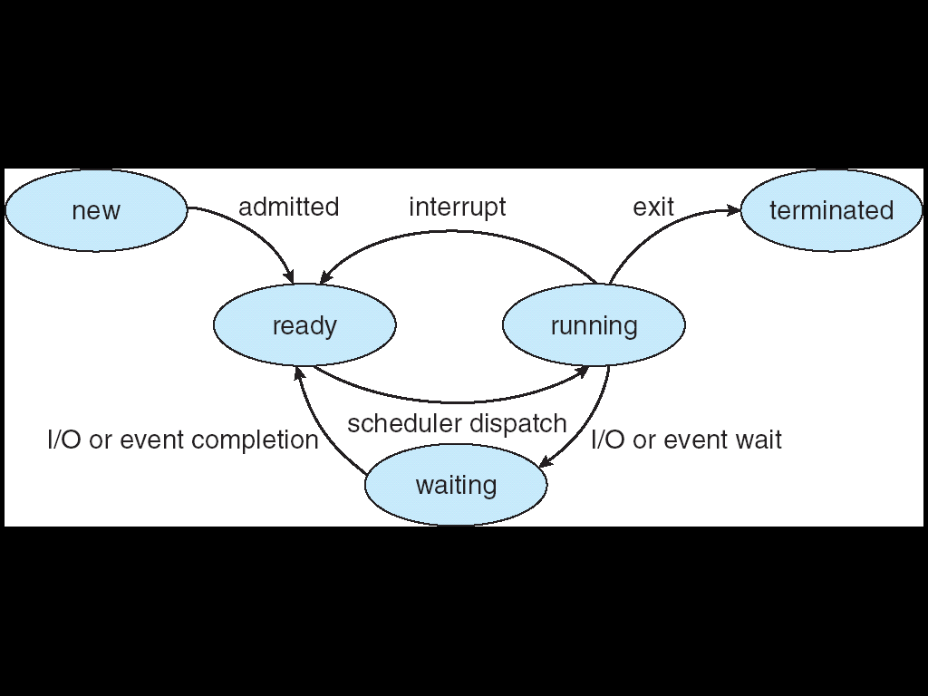
  Process State

Slide 9
As a process executes, it changes state.
The state of process is defined in part by the current activity of that process.
Each process may be in one of the following states.
  New: The process is being created.
  Running: Instructions are being executed.
  Waiting: The process is waiting for some event to occur (such as I/O completion or reception of a signal).
  Ready: The process is waiting to be assigned to the processor.
  Terminated: The process has finished execution.
At any point of time only one process can be running. Many processes may be ready and waiting.

Slide 10
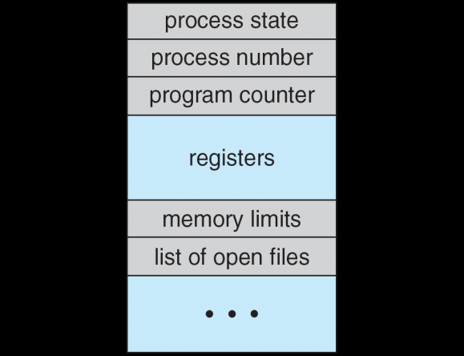
Process Control Block
Each process is represented in the operating system by a process control block also called task control block.
Information associated with each process
  Process state
  Program counter
  CPU registers
  CPU scheduling information
  Memory-management information
  Accounting information
  I/O status information

Slide 11
It contains many pieces of information associated with a specific process, including these:
    Process State: The state may be new, ready, running, and waiting, halted and so on…
    Program Counter: The counter indicates the address of next instruction to be executed for this process.
    CPU Registers: The registers vary in number and type, depending on computer architecture. They include accumulators, index registers, stack pointers and general purpose register plus any condition code information.

Slide 12
    CPU Scheduling Information: The information includes a process priority, pointers to scheduling queues and any other scheduling parameters
    Memory Management Information : This include information such as the values of the base and limit registers, the page tables or segment tables depending on the memory system used by operating system
    Accounting Information: This includes the amount of CPU and real time used, time limits, account numbers, job or process numbers and so on…
    I/O Status Information: This includes the list of I/O devices such as tape drivers allocated to this process, list of open files and so on….

Slide 13
Process Scheduling
The objective of multiprogramming is to have some process running at all times.
The objective of time sharing is to switch the CPU among processes so frequently that users can interact with each program while it is running.
To meet these objectives, the process scheduler selects an available process (possibly from a set of several available processes) for program execution on the CPU.
For a single-processor system, there will never be more than one running process.
If there are more processes, the rest will have to wait until the CPU is free and can be rescheduled.

Slide 14
    Scheduling Queues
      Job Queue: As processes enter the system they are put into a job queue this queue consists of all process in the system
      Ready queue: The processes that are residing in main memory and are ready and waiting to execute are kept a list called the ready queue.
      This queue is generally stored as a linked list.
      A ready queue header will contain pointers to the first and last PCB’s in the list.
      Each PCB has a pointer field that points to the next process in the ready queue.
      Device Queue: A list of process waiting for a particular I/O device is called a device queue.

Slide 15
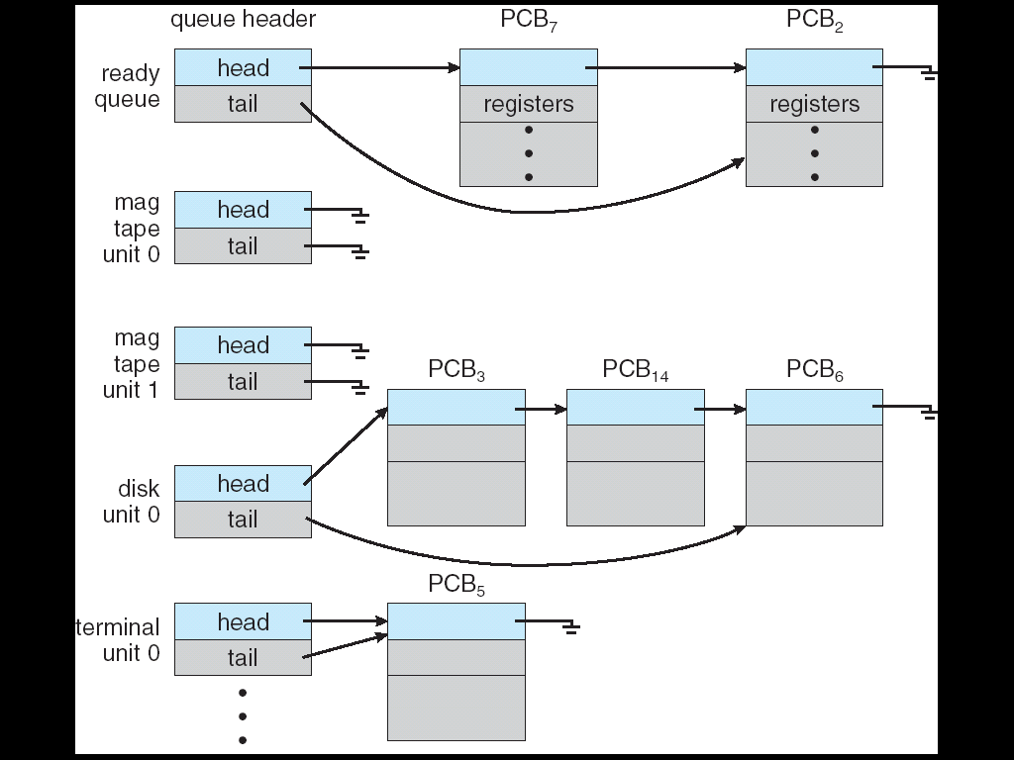

Slide 16
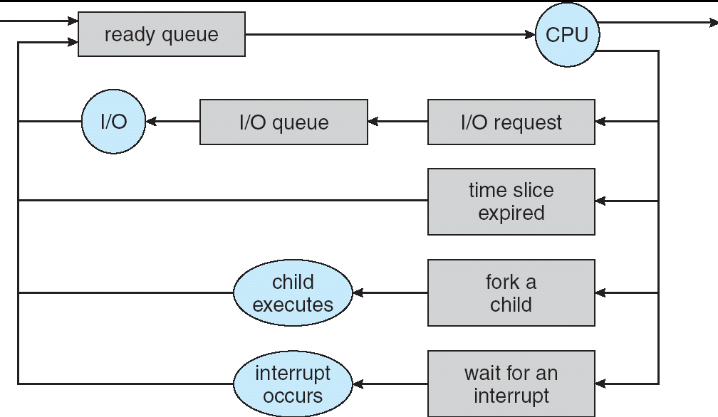
In queuing diagram each rectangular box represents a queue.
The circles represent the resources that serve the queues
The arrows indicate the flow of processes in the system.

Slide 17
Schedulers
A process migrates among the various scheduling queues throughout its lifetime.
The selection process is carried out by the appropriate scheduler.

Slide 18
Short term Vs Long Term
SYSTEM
CPU
Short term
Ready Queue
Long term

Slide 19
Schedulers
      Long-term Scheduler:
It is also known as job scheduler.
It selects processes from this pool and loads them into memory for execution.
It executes much less frequently; minutes may separate the creation of one new process and the next.
It controls the degree of multiprogramming.

Slide 20
If the degree of multiprogramming is stable, then the average rate of process creation must be equal to the average departure rate of processes leaving the system.
Thus, the long-term scheduler may need to be invoked only when a process leaves the system.
Because of the longer interval between executions, the long-term scheduler can afford to take more time to decide which process should be selected for execution.

Slide 21
Processes can be described as either:
I/O-bound process – spends more time doing I/O than computations, many short CPU bursts
CPU-bound process – spends more time doing computations; few very long CPU bursts
It is important that the long-term scheduler select a good process mix of I/O-bound and CPU-bound processes.
If all processes are I/0 bound, the ready queue will almost always be empty, and the short-term scheduler will have little to do.
If all processes are CPU bound, the I/0 waiting queue will almost always be empty, devices will go unused, and again the system will be unbalanced.
The system with the best performance will thus have a combination of CPU-bound and I/O-bound processes.

Slide 22
      Short-term Scheduler
It is also known as CPU scheduler.
It selects from among the processes that are ready to execute and allocates the CPU to one of them.
It must select a new process for the CPU frequently.

Slide 23
The primary distinction between these two schedulers lies in frequency of execution.
The short-term scheduler must select a new process for the CPU frequently.
A process may execute for only a few milliseconds before waiting for an I/O request.
Often, the short-term scheduler executes at least once every 100 milliseconds.
Because of the short time between executions, the short-term scheduler must be fast.

Slide 24
      Medium-term Scheduler:
The medium-term scheduler temporarily removes processes from main memory and places them in secondary memory and vice versa.
This is referred as "swapping out" or "swapping in" / "paging out" or "paging in".
The medium-term scheduler may decide to swap out a process which has not been active for some time, or a process which has a low priority, or a process which is page faulting frequently, or a process which is taking up a large amount of memory in order to free up main memory for other processes, swapping the process back in later when more memory is available, or when the process has been unblocked and is no longer waiting for a resource.

Slide 25
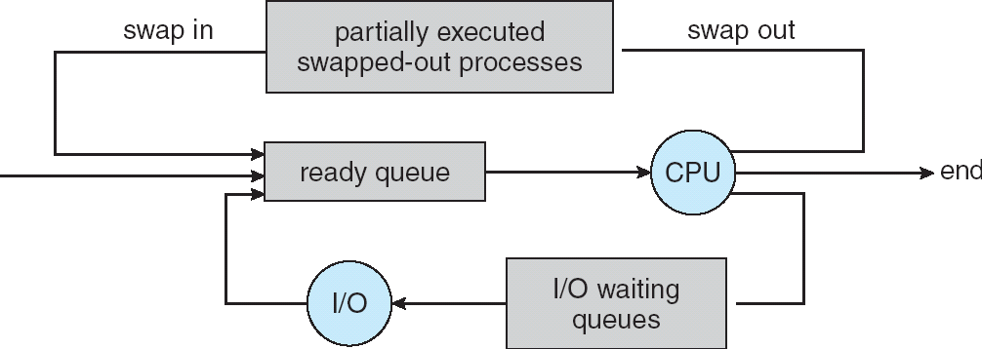

Slide 26
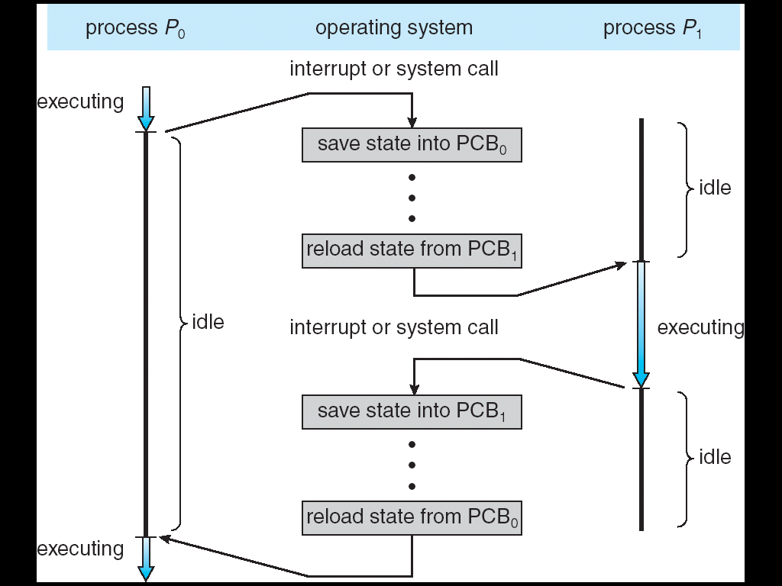
Context switch: Switching the CPU to another process requires performing a state save of the current process and a state restore of a different process.

Slide 27
Context switch
When CPU switches to another process, the system must save the state of the old process and load the saved state for the new process.
This is called Context Switch.
Context-switch time is overhead; the system does no useful work while switching Time dependent on hardware support.
When a context switch occur kernel saves the context of old process in its PCB and loads the context of new process that is scheduled to run.

Slide 28
      CPU Scheduler
Whenever the CPU becomes idle, the operating system must select one of the processes in the ready queue to be executed.
The selection process is carried out by the short-term scheduler (or CPU scheduler).
The scheduler selects a process from the processes in memory that are ready to execute and allocates the CPU to that process.
CPU scheduling decisions may take place when a process:
  Switches from running to waiting state
  Switches from running to ready state
  Switches from waiting to ready
  Terminates
Scheduling under 1 and 4 is no preemptive
  Once CPU has been allocated to a process, the process keeps the CPU until it is terminated or switched to waiting state.
All other scheduling is preemptive

Slide 29
  Scheduling Criteria
Different CPU Scheduling algorithms have different properties.
In choosing which algorithm to use in a particular situation, we must consider the properties of the various algorithms.
Many criteria have been suggested for comparing CPU-scheduling algorithms.
Which characteristics are used for comparison can make a substantial difference in which algorithm is judged to be best.

Slide 30
The criteria include the following
CPU utilization:
  To keep the CPU as busy as possible.
  It range from 0 to 100 percent.
  In a real system it should range from 40%(for lightly loaded system) to 90% (for heavily loaded system)
Throughput:
  One measure of work is the number of processes that are completed per time unit, called throughput.
  For long processes, this rate may be one process per hour; for short transactions, it may be ten processes per second.
Turnaround time:
  The interval from the time of submission of process to the time of completion is the turnaround time.
  This time is the sum of the periods spent waiting to get into memory, waiting in the ready queue, executing in the CPU and doing I/O.

Slide 31
Waiting time:
  The amount of time that a process has been waiting in the ready queue.
  It is the sum of the periods spent waiting in the ready queue.
Response time :
  The amount of time it takes from when a request was submitted until the first response is produced, not output (for time-sharing environment)
It is desirable to maximize CPU utilization and throughput and to minimize turnaround time, waiting time and response time.

Slide 32
Scheduling Algorithms
CPU scheduling deals with the problem of deciding which of the processes in the ready queue is to be allocated the CPU.
There are many different CPU scheduling algorithms are there:
  FCFS(First –Come, First-Served)
  SJF(Shortest-Job-First)
  Priority Scheduling
  Round-Robin(RR)

Slide 33
Scheduling algorithms
FCFS-First come First serve- Purely non-preemptive
SJF-Shortest Job First Preemptive &
Priority Non Preemptive
Round Robin- Purely preemptive

Slide 34
  FCFS(First –Come, First-Served): Non preemptive.
The simplest CPU-scheduling algorithm is the first-come, first-served (FCFS) scheduling algorithm.
With this scheme, the process that requests the CPU first is allocated the CPU first.
The implementation of the FCFS policy is easily managed with a FIFO queue.
When a process enters the ready queue, its PCB is linked onto the tail of the queue.
When the CPU is free, it is allocated to the process at the head of the queue.
The running process is then removed from the queue.
The code for FCFS scheduling is simple to write and understand.

Slide 35
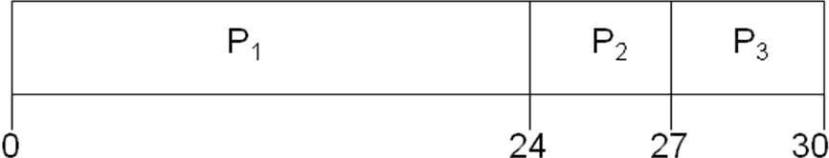
Example 1:
Consider the following set of processes that arrive at time 0, with the length of the CPU burst given in milliseconds:
Process Burst Time
P₁ 24
P₂ 3
P₃ 3
Suppose that the processes arrive in the order: P₁ , P₂ , P₃
The Gantt Chart for the schedule is:

Slide 36
Waiting time for P₁ = 0; P₂ = 24; P₃ = 27
Average waiting time: (0 + 24 + 27)/3 = 17
Disadvantage: The average waiting time under the FCFS
policy is often quite long.
Convoy Effect:
All other processes wait for the one big process to get off the CPU. This effect results in lower CPU utilization and device utilization.
Convoy effect means short process behind long process

Slide 37
CASE 2:
Suppose that the processes arrive in the order: P₂ , P₃ , P₁
Waiting time for P₁ = 6; P₂ = 0; P₃ = 3
Average waiting time: (6 + 0 + 3)/3 = 3
Much better than previous case
P₂
P₃
P₁
0
3
6
30

Slide 38


Slide 39
SJF (Shortest-Job-First)
Associate with each process the length of its next CPU burst. Use these lengths to schedule the process with the shortest time
If the next CPU bursts of two processes are the same, FCFS scheduling is used to break the tie.
Two schemes:
Non preemptive (shortest next CPU burst) – once CPU given to the process it cannot be preempted until completes its CPU burst
Preemptive – if a new process arrives with CPU burst length less than remaining time of current executing process, preempt. This scheme is known as the Shortest-Remaining-Time-First (SRTF)

Slide 40
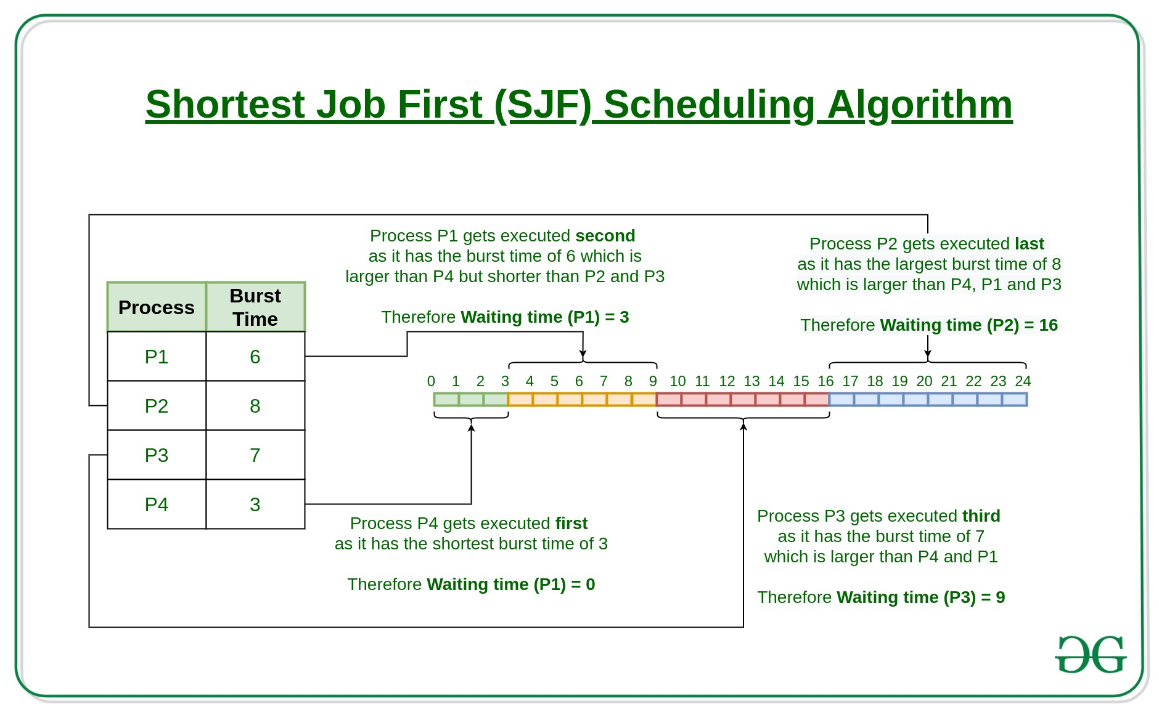
Example 1:

Slide 41

Gantt chart

Slide 42
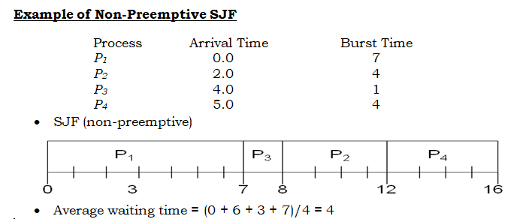

Slide 43
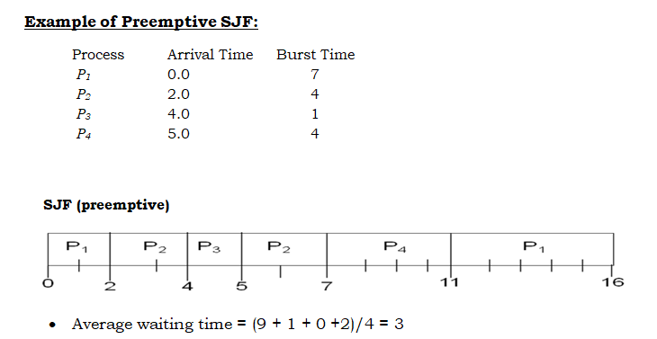

Slide 44
Advantages
SJF is optimal – gives minimum average waiting time for a given set of processes
Moving a short process before a long one decreases the waiting time of the short process.
SJF is frequently used for long term scheduling.
It reduces the average waiting time over FIFO (First in First Out) algorithm.
It is appropriate for the jobs running in batch, where run times are known in advance.

Slide 45
Disadvantages
The real difficulty with the SJF algorithm is knowing the length of the next CPU request
Job completion time must be known earlier, but it is hard to predict.
Elapsed time should be recorded, that results in more overhead on the processor.

Slide 46
Calculation of length of next CPU burst
We may not know the length of the next CPU burst, but we may be able to predict its value.
By computing an approximation of the length of the next CPU burst, we can pick the process with the shortest predicted CPU burst.
The next CPU burst is generally predicted as an exponential average of the measured lengths of previous CPU bursts.

Slide 47
Let, Tn be the actual burst time of n^{th} process.
τ(n) be the predicted burst time for n^{th} process then the CPU burst time for the next process (n+1) will be calculated as,
τ(n+1) = α. Tn + (1-α) . τ(n)
Where, α is the smoothing. Its value lies between 0 and 1.

Slide 48
Smoothening factor (α) – It controls the relative weight of recent and past history in our prediction.
If α = 0, Τ_{n+1} = Τ_{n} i.e. recent history has no effect .
If α = 1, Τ_{n+1} = t_{n} i.e. only the most recent CPU burst matters
If α = 1/2, recent and past history are equally weighted.
The value of t_{n} contains our most recent information; T_{n} stores the past history.

Slide 49
Priority Scheduling
SJF algorithm is a special case of the general priority scheduling algorithm.
A priority is associated with each process, and the CPU is allocated to the process with highest priority.
Equal-priority processes are scheduled in FCFS order.
An SJF algorithm is simply a priority algorithm where the priority(p) is the inverse of the (predicted) next CPU burst.
The large CPU burst, the lower the priority, and vice versa.
  Priorities are generally indicated by some fixed range of numbers, such as 0 to 7, or 0 to 4095. Here we assume low numbers represent high priority.

Slide 50
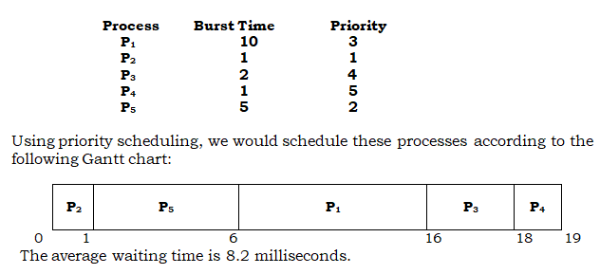
Example
  Consider the following set of processes, assumed to have arrived at time 0, in the order p1, p2,…., p5, with the length of the CPU burst given in milliseconds.

Slide 51
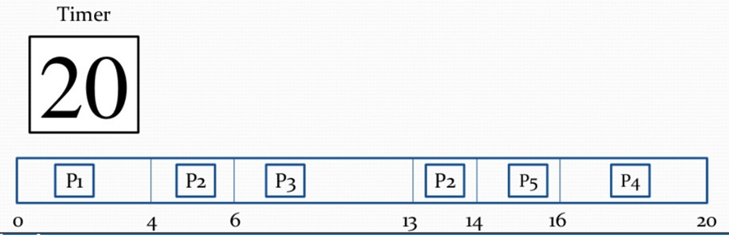
Preemptive priority
Process | Priority | Burst time | Arrival time
P1 | 1 | 4 | 0
P2 | 2 | 3 | 0
P3 | 1 | 7 | 6
P4 | 3 | 4 | 11
P5 | 2 | 2 | 12

Slide 52
Priority scheduling can be either preemptive or non preemptive.
When a process arrives at the ready queue, its priority compared with the priority of currently running process.
A preemptive priority scheduling algorithm will preempt the CPU if the priority of newly arrived process is higher, than the currently running process.
A non preemptive scheduling algorithm will simply put the new process at the head of the ready queue.

Slide 53
Drawback
Starvation
Starvation or indefinite blocking is the major problem in priority scheduling algorithms.
A process that is ready to run but waiting for the CPU can be considered blocked.
A priority scheduling algorithm can leave some low priority processes indefinitely.
High priority processes can prevent low- priority processes from ever getting the CPU.

Slide 54
Aging
Aging is a solution to the problem of indefinite blocking of low – priority processes.
Aging is a technique of gradually increasing the priority of a process that wait in the system for a long time.
For ex: Priorities range from low to high that is 127 to 0, we could increase the priority of a waiting process by 1 every 15 minutes.

Slide 55
Round Robin Scheduling
This algorithm is designed especially for time sharing systems.
It is similar to FCFS scheduling, but pre-emption is added to switch between processes.
A small unit of time called time quantum or time slice is defined.
Time quantum is generally from 10 to 100 ms. the ready queue is treated as a circular queue.
The CPU scheduler goes around the ready queue, allocating the CPU to each process for a time interval of upto 1 time quantum.
The ready queue acts as FIFO queue of processes, new processes are added to tail of ready queue.

Slide 56
The CPU scheduler picks the first process from the ready queue, sets a timer to interrupt after 1 time quantum, and dispatches the process.
In RR scheduling we are having two possibilities first one is the process may have CPU burst of less than 1 time quantum.
In this case the process itself releases the CPU voluntarily. Scheduler will then proceed to the next process in ready queue.
Second possibility is CPU burst of currently running process is longer than 1 time quantum, the timer will go off and cause interrupt to the operating system.
A context switch will be executed, and the process will be executed, and the process will be put any the tail of ready queue.
The CPU scheduler will then select the next process in the ready queue.
The average waiting time in RR policy is long.

Slide 57
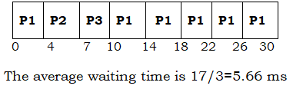
Example
Consider the following set of processes that arrive at 0, with the length of the CPU burst given in milliseconds.
Process Burst Time
P₁ 24
P₂ 3
P₃ 3

Slide 58
Explanation
If we use time quantum of 4 milliseconds, then process p1 gets the first 4 milliseconds. Since it requires another 20 milliseconds, it is pre-empted after the first time quantum, and CPU is given to the next process in the queue, process p2.
Since p2 does not need 4 milliseconds, it quits before its time quantum expires. The CPU is given to process p3.
Once each process received 1 time quantum the CPU is returned to process p1 for an additional time quantum

Slide 59
RR example
Process A.T B.T
P1 0 5
P2 1 7
P3 3 4

Slide 60
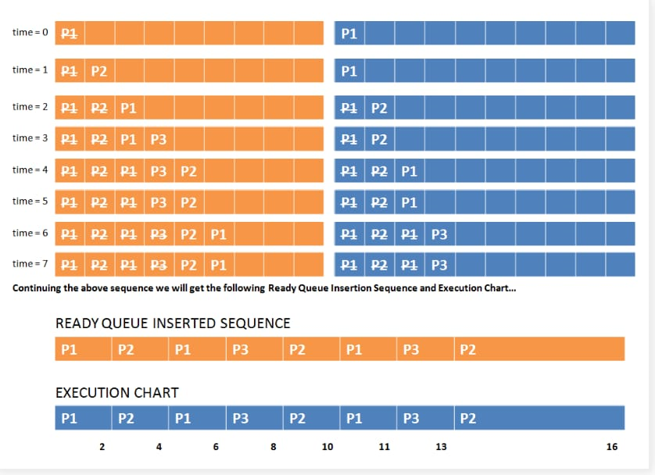

Slide 61
Multilevel Queue Scheduling
Processes are easily classified into different groups.
For example common division is made between foreground (interactive) processes and background (batch) processes.
These two types of processes have different response time requirements.
A multi level queue scheduling algorithm partitions ready queue into several separate queues.
The processes are permanently assigned to one queue, generally based on some property of process, such as memory size, process priority, or process type.
For example, separate queues might be used for foreground and background processes.
The foreground queue might be scheduled by an RR- algorithm.

Slide 62
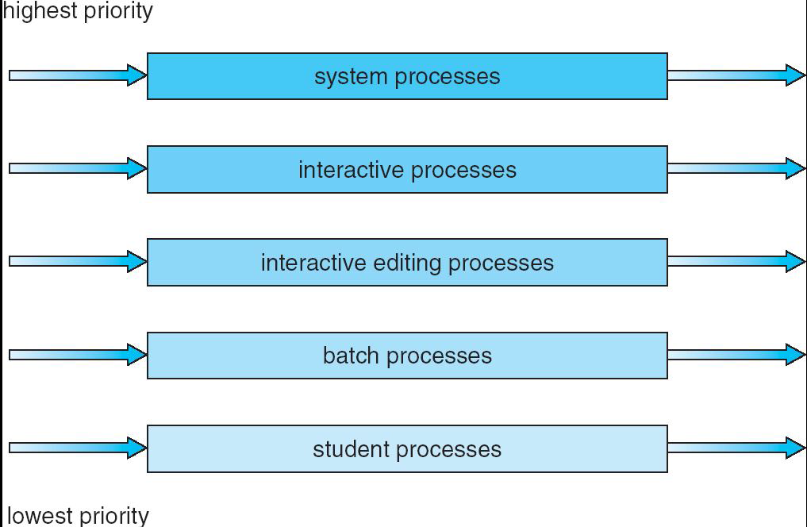
Example of a multilevel queue scheduling algorithm with five queues, listed below in order of priority.
If interactive editing processes entered the ready queue while a batch processes was running, the batch process would be pre-empted.
The foreground queue can be given can be given 80 percent of CPU time for RR scheduling among its processes, where as the background queue receives 20 percent of CPU time for its processes in FCFS basis.

Slide 63
Multilevel Feedback Queue Scheduling
When the multilevel queue scheduling algorithm is used, processes are permanently assigned to a queue when they enter the system.
This algorithm allows a process to move between queues. The idea is to separate processes according to the CPU bursts.
If a process uses too much CPU time, it will be moved to lower-priority queue.
This scheme leaves I/O bound and interactive processes in the higher-priority queues.
A process that waits too long in a lower priority queue may be moved to a higher priority queue.
This form of aging prevents starvation.

Slide 64
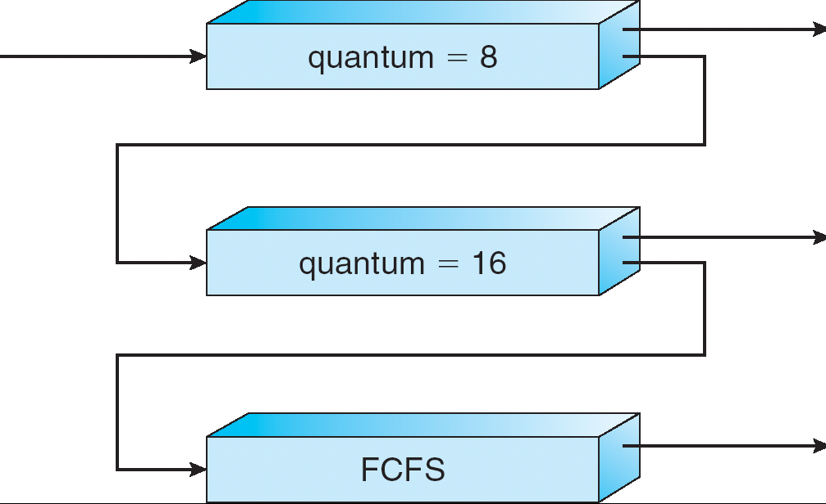
For example, consider a multilevel feedback queue scheduler with three queues, numbered from 0 to 2.
The scheduler first executes all the process in the queue 0.
Only when queue 0 is empty it executes processes in queue 1.
Processes in queue 2 will only be executed if queue 0 and 1 are empty.
A process that arrives for queue 1 will in turn be pre-empted by a process arriving for queue 0.

Slide 65
  Operations on Processes
Process in most systems can execute concurrently and they may be created and deleted dynamically.
  Process Creation
  Process Termination

Slide 66
Process Creation
A process may create several new processes by using Create-process system call, during execution.
The creating process is called a parent process,
New processes are called the children of that process.
Each of these new processes may in turn create other processes, forming a tree of processes.
In most operating system s a process can be identified by using a unique process identifier (pid), which is typically an integer number.

Slide 67
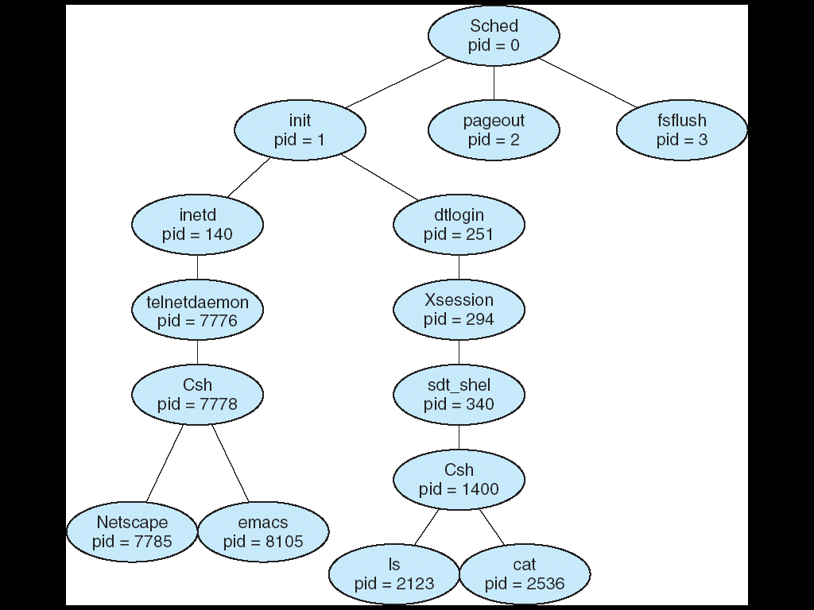
A tree of processes on a typical Solaris system

Slide 68
In Solaris, the process at the top of the tree is the sched process, with pid of 0.
The sched process creates several children processes-including pageout and fsflush.
These processes are responsible for managing memory and file systems.
The sched process also creates the init process, which serves as the root parent process for all user processes.

Slide 69
Two children of init-inetd and dtlogin.
inetd is responsible for networking services such as telnet and ftp
dtlogin is the process representing a user login screen. When a user logs in, dtlogin creates an X-windows session (Xsession), which in turns creates the sdt_shel process.
Below sdt shel, a user's command-line shell-the C-shell or csh-is created.
In this command line interface, the user can then invoke various child processes, such as the ls and cat commands.

Slide 70
On UNIX, we can obtain a listing of processes by using the ps command.
For example, the command ps -el will list complete information for all processes currently active in the system.

Slide 71
Resource sharing
In general, a process will need certain resources (CPU time, memory, files, I/0 devices) to accomplish its task. When a process creates a subprocess, that
Parent and children share all resources
Children share subset of parent’s resources
Parent and child share no resources

Slide 72
When a process creates a new process, two possibilities exist in terms of execution:
  Parent and children execute concurrently
  Parent waits until children terminate

Slide 73
There are also two possibilities in terms of the address space of the new process:
  The child process is a duplicate of the parent process (it has the same c program and data as the parent).
  The child process has a new program loaded into it.

Slide 74
A new process is created by the fork ( ) system call.
The new process consists of copy of Address space of the original process. Here parent process easily communicates with its child process.
Both parent and child process continues execution at the instruction after the fork ( ) with one difference:
The return code for fork ( ) is zero for child process whereas the non zero process identifier of the child is returned to parent.

Slide 75
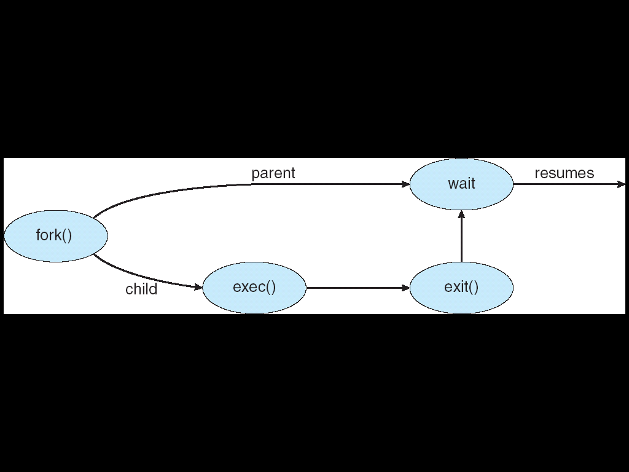
Process Creation

Slide 76
The exec ( ) system call is invoked after fork ( ) and then parent will create more children or if it has nothing else to do it waits while the child runs by invoking wait ( ) system call.
If child completes its execution and terminates then parent also terminates using exit ( ) system call.

Slide 77
Process Termination
A Process terminates when it finishes executing its last statement and asks the operating system to delete it by using exit ( ) system call.
All the resources the resources of the process including physical and virtual memory, open files and I/O buffers and de allocated by the operating system.
Termination can occur in other circumstances as the process can cause termination of another process. Parent process can terminate its child process.

Slide 78
Parent may terminate execution of children processes (abort)
  Child has exceeded allocated resources
  Task assigned to child is no longer required
  If parent is exiting Some operating system do not allow child to continue if its parent terminates.
If a process terminates either normally or abnormally, then all of its children must also be terminated.
This phenomenon is referred to as - cascading termination

Slide 79
Inter-process Communication
Processes executing concurrently in the operating system may be either independent process or cooperating process.
Independent Process:
  An independent process is a process which cannot affect or be affected by other processes in the system. Any process that does not share data with any other process is independent.
Cooperating Process:
  It can effect or be affected by other process executing in the system. Any process that shares information with other process is a cooperating process.

Slide 80
There are several reasons behind process cooperation:
Information Sharing: Several users may be interested in the same piece of information for example a shared file; we must allow concurrent access to such information.
Computation Speed: If we want a particular task to run faster, we must break it into subtasks, each of which will be executing in parallel with others.
Modularity: We may want to construct the system in a modular fashion, dividing the system functions into separate processes or threads.
Convenience: Even an individual user may work on many tasks at the same time. For instance, a user may be editing, printing and compiling in parallel.

Slide 81
Cooperating processes require an inter process communication (IPC), which allow them to exchange data and information.
There are two fundamental models in Inter Process Communication:
1. Shared memory systems.
2. Message Passing Systems.
In shared- memory model, a region of memory that is shared by cooperating processes is established.
Processes can then exchange information by reading and writing the data to the shared region.
In message- passing, the communication takes place by means of messages exchanged between cooperating processes.

Slide 82
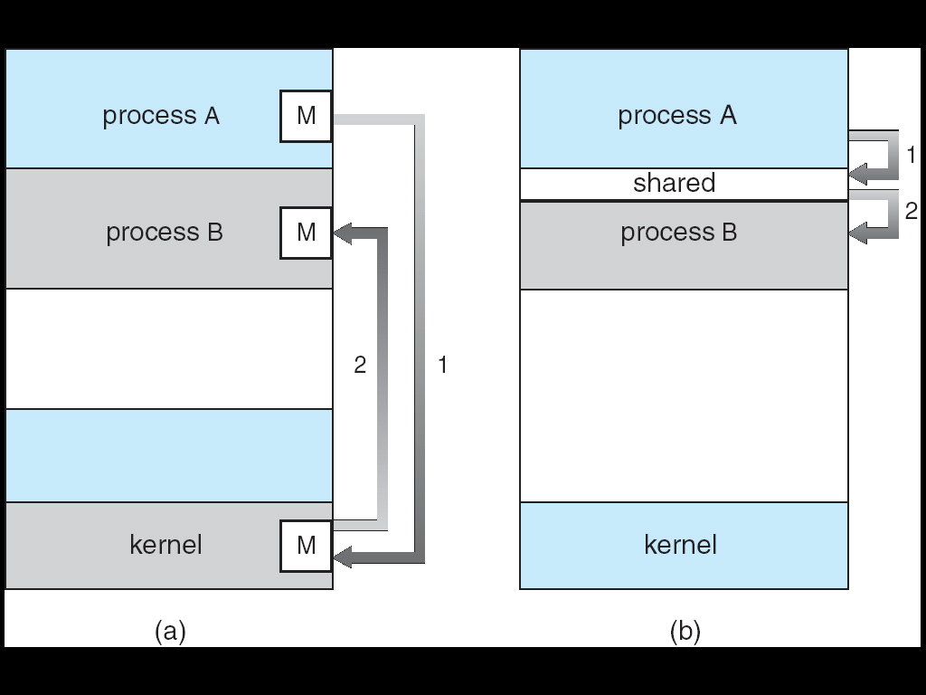
Communications models (a) Message passing (b) Shared Memory

Slide 83
Message passing is useful for exchanging smaller amounts of data, it is also easier to implement than shared memory.
Shared memory allows maximum speed and convenience of communication, as it can be done at memory speeds when within a computer.
Shared memory is faster than message passing systems.

Slide 84
Shared memory Systems
Inter-process communication using shared memory requires communicating processes to establish a region of shared memory.
A shared memory region resides in the address space of the process creating the shared memory segment.
The other processes that wish to communicate using this shared memory segment must attach it to their address space. The form of the data and the location are determined by
these processes and are not under the operating system's control.
The processes are also responsible for ensuring that they are not writing to the same location simultaneously.

Slide 85
Ex: The concept of cooperating process can be illustrated by Producer-Consumer problem.
The producer produces the information that is consumed by a consumer process.
If producer and consumer process are executing concurrently, then the buffer is filled by producer and emptied by consumer.
Two types of buffers are used:
Unbounded Buffer: This has no limit on the size of buffer. The consumer may have to wait for new items, but producer can always produce new items.
Bounded Buffer: Here buffer size is fixed. The consumer must wait, if buffer is empty and producer must wait if buffer is full.

Slide 86
The following variables reside in a region of memory shared by the producer and consumer processes:
#define BUFFER_SIZE 10
typedef struct
}item;
item buffer[BUFFER_SIZE];
int in = 0;
int out = 0;

Slide 87
The shared buffer is implemented as a circular array with two logical pointers: in and out.
The variable in points to the next free position in the buffer; out points to the first full position in the buffer.
The buffer is empty when in== out; the buffer is full when ((in+ 1)% BUFFER_SIZE) == out.

Slide 88
The producer process has a local variable nextProduced in which the new item to be produced is stored.
The consumer process has a local variable next Consumed in which the item to be consumed is stored.

Slide 89
The producer process code
item nextProduced;
while (true) {
/* produce an item in nextProduced */
while ( ((in + 1) % BUFFER_SIZE) == out)
; /* do nothing */
buffer[in] = nextProduced;
in = (in + 1) % BUFFER_SIZE;
}

Slide 90
The consumer process code
item nextConsumed;
while (true) {
while (in == out)
; /*do nothing*/
nextConsumed = buffer[out];
out = (out + 1) % BUFFER_SIZE;
/* consume the item in nextConsumed */
}

Slide 91
Message Passing System
This system allows processes to communicate without sharing some address space, here communicating processes may reside on different computers connected by a network.
A message passing facility provides at least two operations: send (message) and receive (message).
Messages sent by a process can be either fixed size or variable size.
Fixed size: If fixed size messages only sent, the system level implementation is straight forward and programming is more difficult.
Variable size: Variable sized messages required a more complex system level implementation, but programming task become simpler.

Slide 92
If process p and q want to communicate they must send messages to and receive messages from each other, a communication link must exist between them.
The link may be physical implementation such as shared memory hardware bus, or network or logical implementation.
Logical implementation of a link include send ( )/ receive ( ) operations.
1. Naming
2. Synchronization
3. Buffering

Slide 93
1. Naming
Processes that want to communicate must have a way to refer each other. They use either direct or indirect communication.
Direct Communication
  Each process that wants to communicate must explicitly name the recipient or sender of the communication.
  Send (p, message) ---- send a message to process p.
  Receive (q, message) --- receive a message from process q.
  Here communication link is established with exactly two processes.
  This scheme exhibits symmetry in addressing;
  Therefore both sender and receiver processes must name the other process. Asymmetric in addressing, here only sender names, the recipient, where recipient is not require to name the sender.
  Send (p, message) ---- send a message to process p.
  Receive (id, message) --- receive a message from any process.
  The variable id is set to the name of process with which communication has taken place.

Slide 94
Indirect Communication
Here, the messages are sent to and received from mailboxes or ports.
A process can communicate with other process can communicate with other process only if the processes has shared mailbox.
Send (A, message) ---- send a message to mailbox A.
Receive (A, message) --- receive a message from mailbox A.
Here communication link may be associated with more than two processes.
For example the processes p1, p2 and p3 all shared mailbox A. Process P1 sends message to A. while both P2 and P3 both executes receive() from A.
The operating system will provide a mechanism that allows a process to do the following:
Create a new mail box
Send and receive messages through the mail box
Delete mail box

Slide 95
2. Synchronization
Communication between processes takes place through calls to send () and receive ( ) primitives.
Message passing may be either blocking or non blocking also known as synchronous and non synchronous.
Blocking send: The sending process is blocked until the message is received by receiving process or by the mailbox.
Non-Blocking send: The sending process sends the message and resumes operation.
Blocking receive: The receiver blocks until a message is available
Non Blocking receiver: The receiver retrieves either a valid message or null.

Slide 96
3. Buffering
Whether a communication is direct or indirect, messages exchanged by communicating processes reside in temporary queue.
These queues are 3 types.
Zero capacity: Maximum length of queue is zero, here link cannot have any messages waiting in it, therefore the sender must block until recipient receives message.
Bounded Capacity: Queue has finite length n; thus almost n messages can reside in it. If queue is not full when a new message is sent, the message is placed in queue, and sender continues execution without waiting. If link is full the sender must block until space is available.

Slide 97
Unbounded capacity: The queue's length is potentially infinite; thus, any number of messages can wait in it. The sender never blocks.
The zero-capacity case is sometimes referred to as a message system with no buffering; the other cases are referred to as systems with automatic buffering.

