Slide 1

Synchronization

Slide 2


public class Main implements Runnable {
public static int totalc=0;
public void run() {
for(int counter=1;counter<=100000;counter++){
totalc++;
}
}
public static void main(String args[]) throws Exception
{
Main threadDemo = new Main();
Thread t1 = new Thread(threadDemo);
Thread t2 = new Thread(threadDemo);
t1.start();
t2.start();
t1.join();
t2.join();
System.out.println(totalc);
}
}
Synchronization

Slide 3
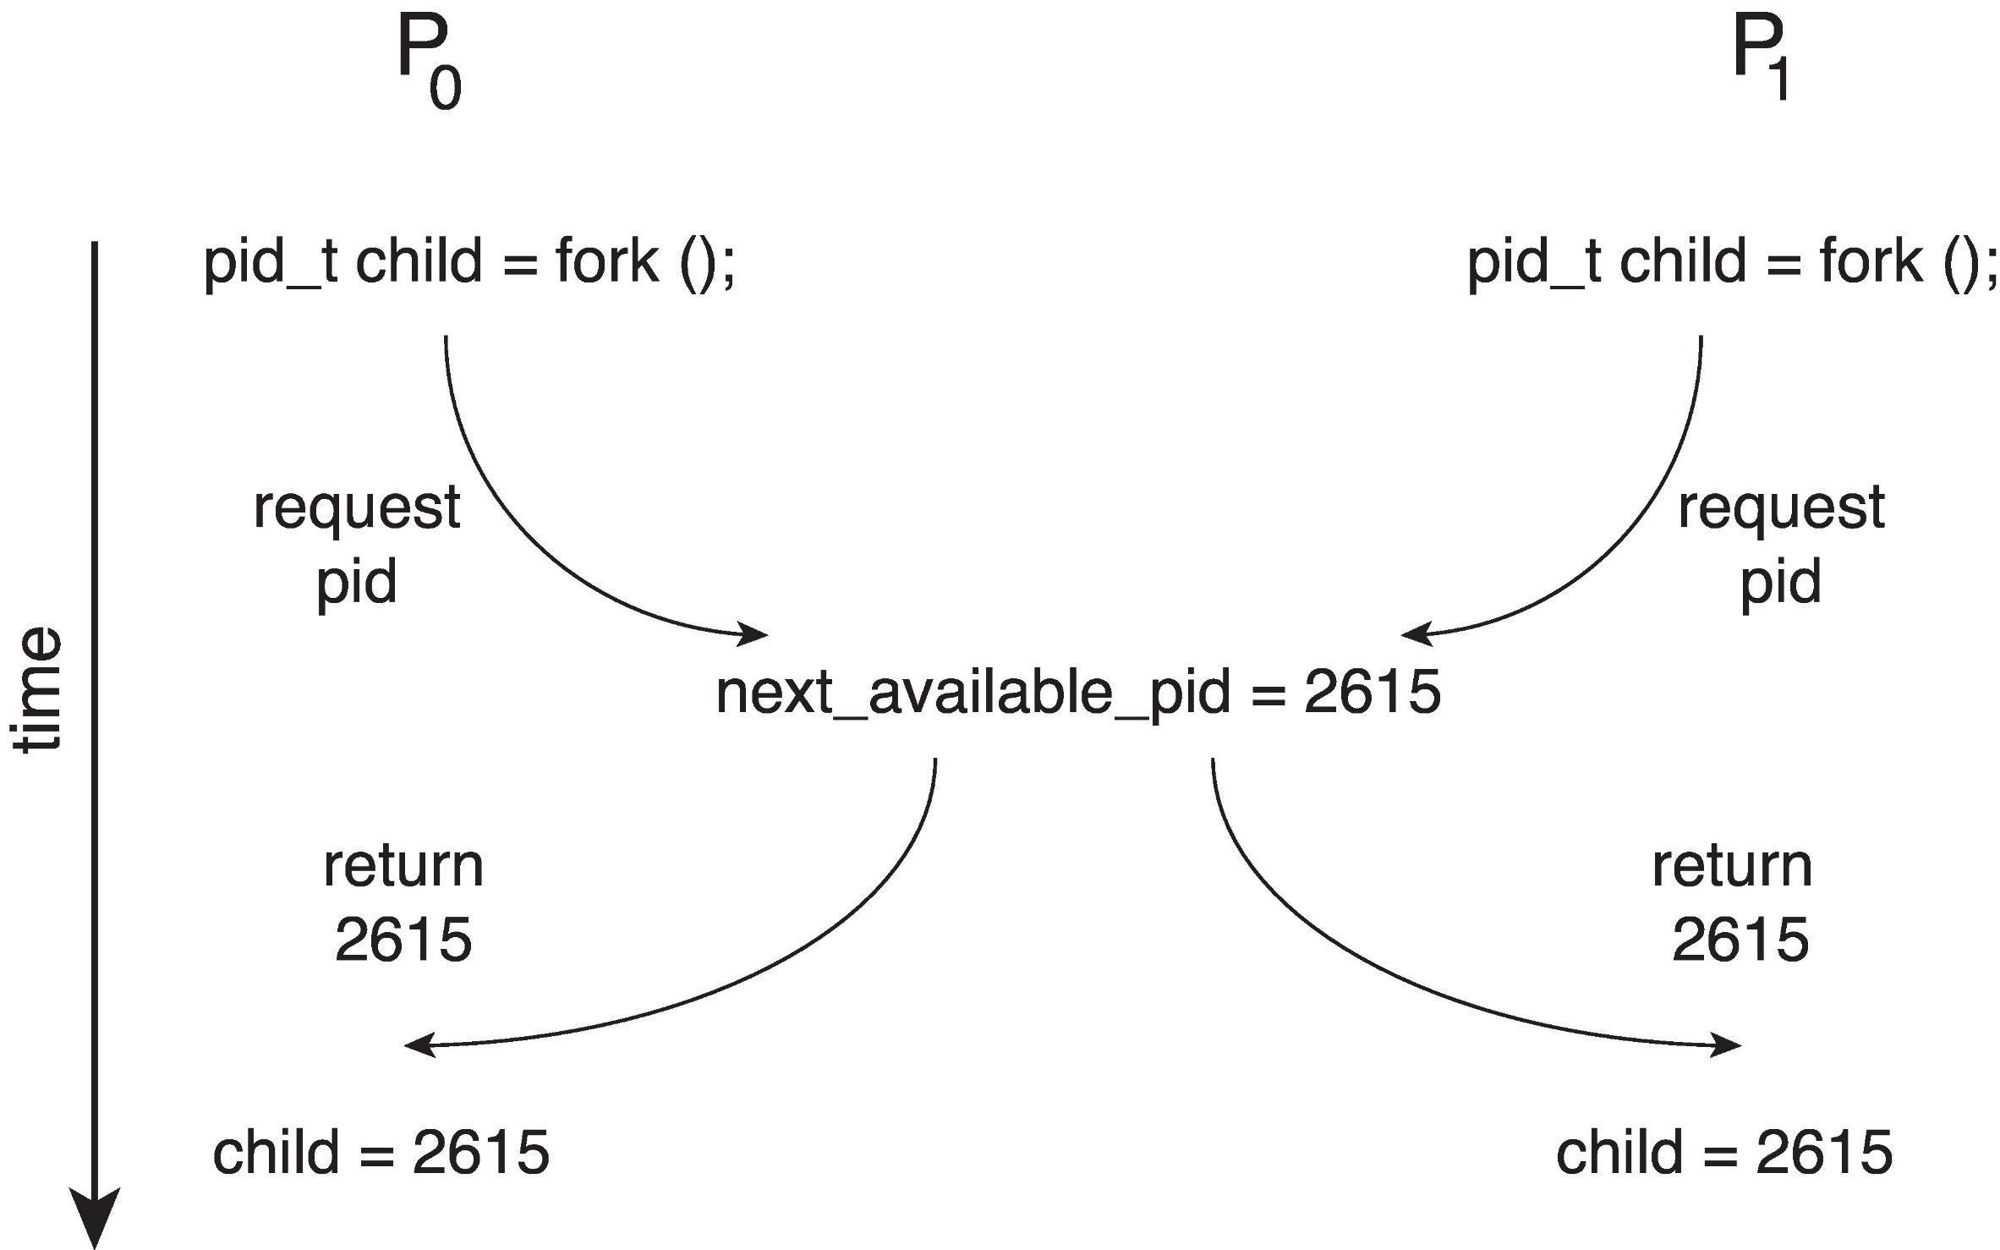
Synchronization

Slide 4
Race Condition
A race condition is a concurrency bug that occurs when a program’s behavior depends on the relative timing of multiple threads or processes. This can lead to unpredictable and potentially erroneous behavior.
Types of Race Conditions
Read-Write Race
Write-Write Race
Check-Then-Act Race

Slide 5
Race Condition
Read-Write Race: Occurs when one thread is reading a shared variable while another thread is writing to it.
Thread T2 (Reader)
Reads the current value of x (e.g., x = 10).
2. Prints the value of x.
Thread T1 (Writer)
Reads the current value of x (e.g., x = 10).
Increments the value of x by 1 (e.g., x = 11).
Writes the new value of x back to the shared variable.
In this example, the RW race condition leads to:-
Stale data: T2 prints an outdated value of x.
Incorrect results: The printed value of x does not reflect the latest update.

Slide 6
Race Condition
Write-Write Race: Occurs when multiple threads are writing to a shared variable simultaneously.
Example Program of two threads in Java incrementing global counter.
Lost update: The update made by T1 is lost, and the final value of x is incorrect.

Slide 7
Race Condition
Check-Then-Act Race: Occurs when a thread checks a condition and then acts on it, but another thread modifies the condition before the first thread can act.
Thread T1
Checks if account A has sufficient funds (balance ≥ transfer amount).
If sufficient funds are available, transfers the funds from account A to account B.
Thread T2
Checks if account A has sufficient funds (balance ≥ transfer amount).
If sufficient funds are available, transfers the funds from account A to account C.

Slide 8
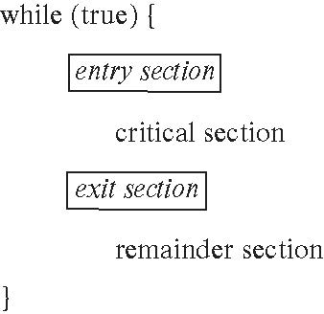
Critical Section
A critical section is a segment of code that accesses shared resources, such as variables, data structures, or I/O devices, and must be executed atomically to prevent race conditions, deadlocks, or other concurrency-related issues.
Examples of Critical Sections
Updating a shared counter: A critical section that increments or decrements a shared counter variable.
Accessing a shared data structure: A critical section that reads or writes to a shared data structure, such as a queue or a stack.
Performing I/O operations: A critical section that performs I/O operations, such as reading or writing to a file.

Slide 9
Critical Section - Requirements
Mutual Exclusion - If process Pi is executing in its critical section, then no other processes can be executing in their critical sections
Progress - If no process is executing in its critical section and there exist some processes that wish to enter their critical section, then the selection of the process that will enter the critical section next cannot be postponed indefinitely
Bounded Waiting - A bound must exist on the number of times that other processes are allowed to enter their critical sections after a process has made a request to enter its critical section and before that request is granted

Slide 10
Interrupt-based solution
An interrupt-based solution for critical sections involves disabling interrupts while executing the critical section, ensuring that the thread or process cannot be interrupted by other threads or processes, or by hardware interrupts.
Steps
  Disable interrupts: Before entering the critical section, the thread or process disables interrupts using a special instruction or system call.
  Execute critical section: The thread or process executes the critical section, accessing shared resources without fear of interruption.
  Enable interrupts: After completing the critical section, the thread or process enables interrupts, allowing other threads or processes to execute.

Slide 11
Interrupt-based solution
Disadvantages
  Priority inversion: Interrupt-based solutions can lead to priority inversion, where a higher-priority thread or process is delayed by a lower-priority thread or process holding the critical section.
  Starvation: Interrupt-based solutions can also lead to starvation, where a thread or process is unable to access the critical section due to repeated interruptions by other threads or processes.
  Limited scalability: Interrupt-based solutions may not be suitable for large-scale systems, where the overhead of disabling interrupts can become significant.

Slide 12
Peterson's solution
Peterson's solution is a well-known algorithm for synchronizing access to a shared resource in a multi-threaded or multi-process environment.
Steps
  Flag variables: Each process/thread has a flag variable (e.g., flag[0] and flag[1]) that indicates whether it wants to access the shared resource.
  Turn variable: A turn variable (e.g., turn) indicates whose turn it is to access the shared resource.
  Request access: When a process/thread wants to access the shared resource, it sets its flag variable to true and checks the turn variable.

Slide 13
Peterson's solution
Check turn: If the turn variable indicates that it's the process/thread's turn, it enters the critical section.
Wait: If it's not the process/thread's turn, it waits until the turn variable changes.
Release: When a process/thread exits the critical section, it sets its flag variable to false and changes the turn variable to indicate the next process/thread's turn.

Slide 14
// Critical section
shared_variable++;
printf("Thread %d: shared_variable = %d\n", id, shared_variable);
// Exit critical section
flag[id] = 0; // Reset flag
}
return NULL;
}
int main() {
pthread_t threads[2];
int ids[2] = {0, 1};
pthread_create(&threads[0], NULL, thread_function, &ids[0]);
pthread_create(&threads[1], NULL, thread_function, &ids[1]);
pthread_join(threads[0], NULL);
pthread_join(threads[1], NULL);
return 0;
}
Peterson's solution
#include <stdio.h>
#include <pthread.h>
int flag[2] = {0, 0}; // Flag variables
int turn = 0; // Turn variable
int shared_variable = 0; // Shared variable
void *thread_function(void *arg) {
int id = *(int *)arg;
int other_id = 1 - id;
for (int i = 0; i < 10; i++) {
flag[id] = 1; // Set flag to indicate intention to enter critical section
turn = other_id; // Set turn to other process
// Wait until other process is not in critical section and it's our turn
while (flag[other_id] && turn == other_id) {
// Busy wait
}

Slide 15
Peterson's solution
Limited to two processes: Peterson's solution is designed for two processes and cannot be easily extended to multiple processes.
Complexity: Although the basic idea is simple, the implementation can be complex, especially when dealing with multiple processes or priorities.
Starvation: Peterson's solution can suffer from starvation, where one process is unable to access the shared resource because the other process is holding the lock for an extended period.
Priority inversion: Peterson's solution can also suffer from priority inversion, where a higher-priority process is unable to access the shared resource because a lower-priority process is holding the lock.
Busy waiting: Peterson's solution uses busy waiting, which can be inefficient and waste CPU cycles.
Not suitable for real-time systems: Due to the potential for starvation and priority inversion, Peterson's solution is not suitable for real-time systems, where predictable and timely access to shared resources is critical.

Slide 16
Peterson's solution
To address these problems, other synchronization techniques have been developed, such as
Mutex locks: Provide mutual exclusion and can be used with multiple processes.-
Semaphores: Provide a more flexible synchronization mechanism and can be used for both mutual exclusion and synchronization.
Monitors: Provide a high-level synchronization mechanism and can be used for both mutual exclusion and synchronization.

Slide 17
Mutex Locks

Slide 18
Locks
Lock is a variable to provide the synchronization among the processes/threads executing concurrently.
Initially, lock value is set to 0.
Lock value = 0 means the critical section is currently vacant and no process is present inside it.
Lock value = 1 means the critical section is currently occupied and a process is present inside it.

Slide 19
Mutex Lock or Mutex
Mutex is a Lock that works on Mutual Exclusion Principle.
The Mutex is a locking mechanism that makes sure only one thread can acquire the Mutex at a time and enter the critical section. This thread only releases the Mutex when it exits the critical section.
Its value starts at 0, meaning that it is unlocked. If you wish to lock the mutex, you check if it is zero and then assign 1. The mutex is now locked, and you are the owner of it.

Slide 20
Mutex Lock or Mutex
The definition of acquire() is as follows:
acquire() {
while (!available); /* busy wait */
available = false;
}
The definition of release() is as follows:
release() {
available = true;
}
while (true) {
acquire lock
critical section
release lock
remainder section
}
But this solution requires busy waiting
  This lock therefore called a spinlock

Slide 21
#include <pthread.h>
#include<stdio.h>
// Shared counter variable
int shared_counter = 0;
// Binary mutex
pthread_mutex_t mutex = PTHREAD_MUTEX_INITIALIZER;
// Thread function for Thread 1
void *thread1_function(void *arg) {
for (int i = 0; i < 100000; i++) {
// Lock the mutex
pthread_mutex_lock(&mutex);
// Increment the shared counter
shared_counter++;
// Unlock the mutex
pthread_mutex_unlock(&mutex);
}
return NULL;
}
// Thread function for Thread 2
void *thread2_function(void *arg) {
for (int i = 0; i < 100000; i++) {
// Lock the mutex
pthread_mutex_lock(&mutex);
// Increment the shared counter
shared_counter++;
// Unlock the mutex
pthread_mutex_unlock(&mutex);
}
return NULL;
}

Slide 22
int main() {
// Create threads
pthread_t thread1, thread2;
pthread_create(&thread1, NULL, thread1_function, NULL);
pthread_create(&thread2, NULL, thread2_function, NULL);
// Wait for threads to finish
pthread_join(thread1, NULL);
pthread_join(thread2, NULL);
// Print final value of shared counter
printf("Final value of shared counter: %d\n", shared_counter);
return 0;
}

Slide 23
Mutex Lock or Mutex
Problems
Deadlocks: Mutex locks can lead to deadlocks, where two or more processes are blocked indefinitely, each waiting for the other to release a lock.
Starvation: Mutex locks can also lead to starvation, where one process is unable to access a shared resource because other processes are holding the lock for an extended period.
Priority inversion: Mutex locks can cause priority inversion, where a higher-priority process is unable to access a shared resource because a lower-priority process is holding the lock.
Lock contention: Mutex locks can lead to lock contention, where multiple processes compete for the same lock, leading to performance degradation.
Overhead: Mutex locks can introduce significant overhead, including the time it takes to acquire and release locks, as well as the memory required to store lock metadata.

Slide 24
Semaphores

Slide 25
Semaphore
A semaphore is a variable or abstract data type that provides a simple, yet powerful, way to control access to a shared resource in a concurrent system.
A semaphore is essentially a counter that keeps track of the number of available resources.
Binary Semaphore: A binary semaphore is a semaphore that can take on only two values: 0 and 1. It's used to control access to a single resource.
Counting Semaphore: A counting semaphore is a semaphore that can take on any non-negative integer value. It's used to control access to multiple resources.

Slide 26
Semaphore
TWO operations which can be used to access and change the value of the semaphore variable
i.e wait ( ) and signal ( )
Wait () and signal () operations are also denoted by P (or) down and V (or) up respectively.
Semaphore has two parts: –
An integer counter
A FIFO waiting queue

Slide 27
Semaphore
Initialization: The semaphore is initialized with a value that represents the number of available resources.
P Operation: When a process wants to access the shared resource, it performs a P operation (also known as "wait" or "acquire") on the semaphore.
  If the semaphore value is greater than 0, the process decrements the semaphore value and accesses the resource.
  If the semaphore value is 0, the process is blocked until the semaphore value becomes greater than 0.

Slide 28
Semaphore
V Operation: When a process finishes accessing the shared resource, it performs a V operation (also known as "signal" or "release") on the semaphore.
  This increments the semaphore value, indicating that the resource is now available.

Slide 29
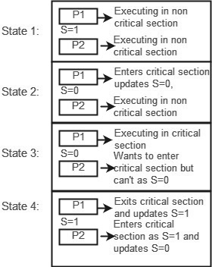
Binary Semaphore
Binary semaphore takes only two values 0 and 1
Let there be two processes P1 and P2 and a semaphore s is initialized as 1.
Now if suppose P1 enters in its critical section then the value of semaphore s becomes 0.
Now if P2 wants to enter its critical section then it will wait until s > 0, this can only happen when P1 finishes its critical section and calls V(signal) operation on semaphore s.
This way mutual exclusion is achieved.

Slide 30
Semaphore vs Mutexes
There is a misconception that binary semaphore is same as mutex variable but both are different
Binary semaphore apart from providing a locking mechanism also provides two atomic operations Signal and wait, which means after releasing the resource, semaphore will provide a signalling mechanism for the processes that are waiting for the resource.

Slide 31
Counting Semaphore
Counting semaphore takes values greater than one.
Suppose there is a resource whose number of instance is 4 i.e No.of resources=04.
Now we initialize S = 4 and rest is same as for binary semaphore.
Whenever process wants that resource , then it calls P(down) or wait function and when it is done it calls V(up) or signal function.
If the value of S becomes zero then a process has to wait until S becomes positive.
If another process P5 wants the resource then it should wait until one of the four processes calls signal/V/up function and value of semaphore becomes positive.

Slide 32
Counting Semaphore
S = 3
Resources
2
3
Threads
3
4
5
6
1
1
2
S-- = 2 – T1 Executes
S-- = 1 – T2 Executes
S-- = 0 – T3 Executes
S = 0(-1) T4 in Waiting Queue
S = 0 (-2) T5 in waiting queue
S++ = 1 signals T4 to execute s-- = 0
S = 0 T6 in waiting Queue
S++ = 1 signals T5 to execute s--=0
S++ = 1 signals T6 to execute S--=0
S++ = 1 no one to wakeup
S++ = 2 no one to wakeup
S++ = 3 no one to wakeup
T1 - wait()
T2 - wait()
T3 - wait()
T4 - wait()
T5 - wait()
T1 - signal()
T6 - wait()
T2 - signal()
T3 - signal()
T4 - signal()
T5 - signal()
T6 - signal()
T4
T4 | T5
T5 | T6

Slide 33
Counting Semaphore
wait(semaphore *S) {
if (S->value == 0) {
add this process to S->list;
block();
}
S->value--;
access resource;
}
signal(semaphore *S) {
S->value++;
if (S->value >= 0) {
remove a process P from S->list;
wakeup(P);
}
}

Slide 34
Semaphore vs Mutexes
Semaphores and mutexes are both used for synchronization, but they serve different purposes:
Mutexes: Mutexes are used to protect a critical section of code, ensuring that only one thread or process can execute it at a time.
Semaphores: Semaphores are used to control access to a shared resource, ensuring that a limited number of threads or processes can access it simultaneously.

Slide 35
Monitors

Slide 36
Monitors
A monitor is a high-level synchronization construct that allows threads to have both mutual exclusion and the ability to wait (block) for a certain condition to become true.
Only one process is active in a monitor at any given time - high level mutual exclusion
Monitors support condition variables for thread cooperation.
Monitors guarantee “automatic” mutual exclusion
Condition variables support two operations: wait and signal
  Signaling has no effect if there are no waiting threads!

Slide 37
Monitors
Monitors
Only one monitor procedure active at any given time
monitor example
integer i;
condition c;
procedure p1( );
.
.
.
end;
procedure p2( );
.
.
.
end;
end monitor;
Components of a Monitor
Lock: A lock is used to ensure mutual exclusion.
Condition Variables: Condition variables are used to signal threads when a certain condition is met.
Procedure: A procedure is a piece of code that executes inside the monitor.
Slide taken from a presentation by Gadi Taubenfeld from IDC

Slide 38
Monitors
Characteristics of Monitors
Mutual Exclusion: Monitors provide mutual exclusion, meaning that only one thread can execute inside the monitor at a time.
Condition Variables: Monitors have condition variables that allow threads to wait until a certain condition is met.
Automatic Locking: Monitors automatically lock and unlock the critical section, reducing the risk of deadlock or starvation.

Slide 39
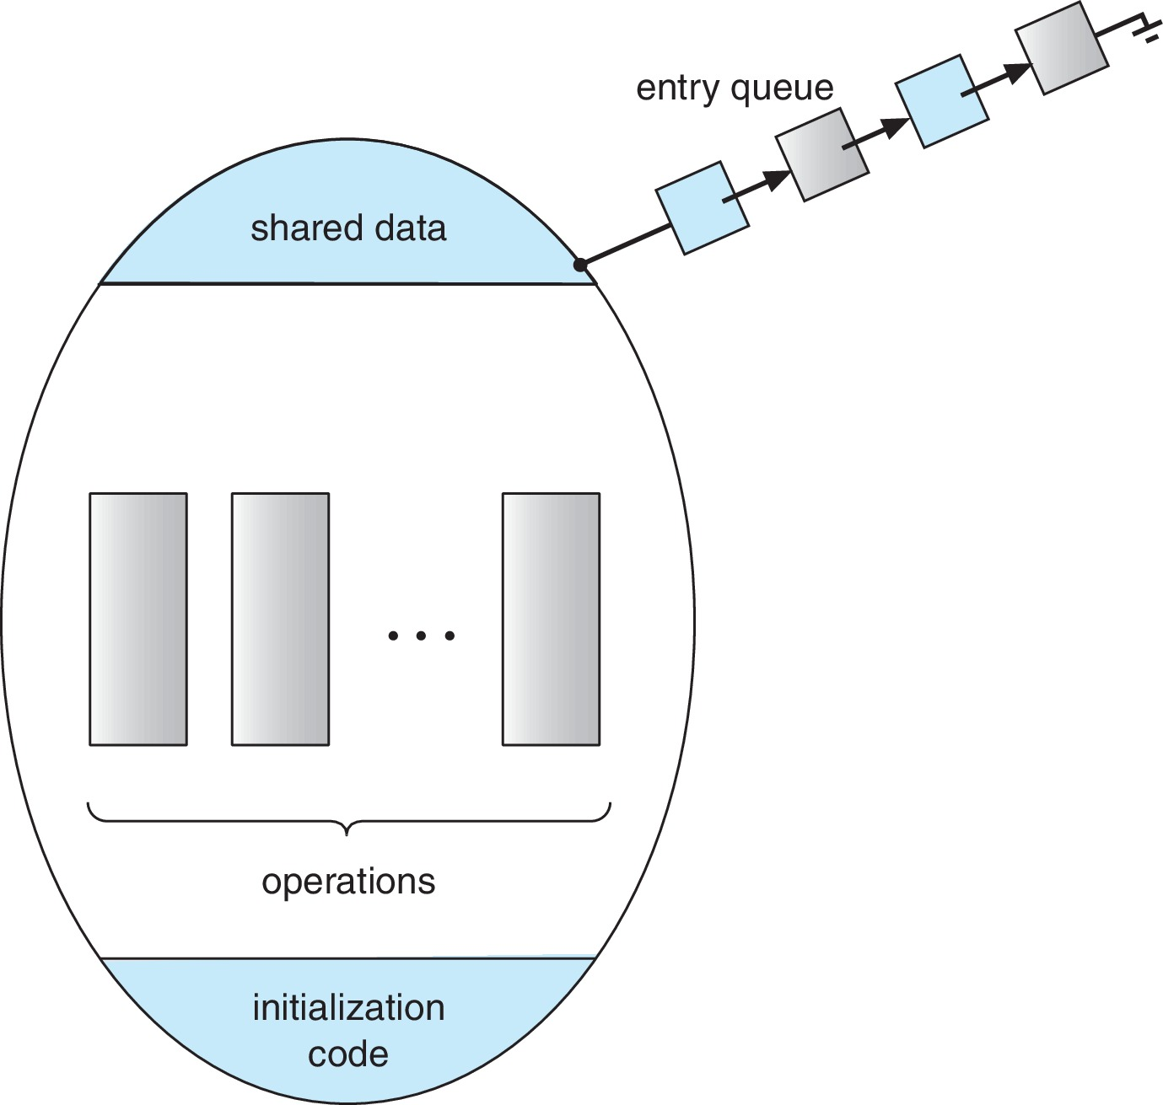
Monitors

Slide 40
Bank Account Monitor
import java.util.concurrent.locks.Condition;
import java.util.concurrent.locks.Lock;
import java.util.concurrent.locks.ReentrantLock;
public class BankAccountMonitor {
private double balance;
private final Lock lock;
private final Condition sufficientFunds;
public BankAccountMonitor(double initialBalance) {
balance = initialBalance;
lock = new ReentrantLock();
sufficientFunds = lock.newCondition();
}

Slide 41
public void deposit(double amount) {
lock.lock();
try {
balance += amount;
sufficientFunds.signalAll();
} finally {
lock.unlock();
}
}
public void withdraw(double amount) throws InterruptedException {
lock.lock();
try {
while (balance < amount) {
sufficientFunds.await();
}
balance -= amount;
} finally {
lock.unlock();
}
}

Slide 42
public class Main {
public static void main(String[] args) throws InterruptedException {
BankAccountMonitor account = new BankAccountMonitor(1000);
Thread thread1 = new Thread(() -> {
try {
account.withdraw(500);
} catch (InterruptedException e) {
Thread.currentThread().interrupt();
}
});
Thread thread2 = new Thread(() -> account.deposit(200));
thread1.start();
thread2.start();
thread1.join();
thread2.join();
System.out.println("Final balance: " + account.getBalance());
}
}
public double getBalance() {
lock.lock();
try {
return balance;
} finally {
lock.unlock();
}
}
}

Slide 43
Three Popular Classical Synchronization Problems
Producer-Consumer Problem(Bounded Buffer Problem)
Dining Philosophers Problem
Readers-Writers Problem

Slide 44
Producer Consumer Problem

Slide 45
Producer-Consumer Problem-Statement
It is a problem that describes two processes, the producer and the consumer, who share a common, fixed-sized buffer(memory) used as a queue.
The producer's job is to generate data, put it into the buffer(memory), and start again.
At the same time, the consumer is consuming the data (i.e., removing it from the buffer), one piece at a time.

Slide 46
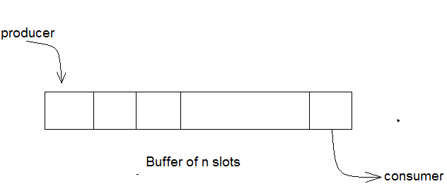
What's the Problem ?
The producer may try to add data into the buffer when it's full and the consumer try to remove data from an empty buffer.
These two processes won't produce the expected output if they are being executed concurrently.
There needs to be a way to make the producer and consumer work in an independent manner

Slide 47
Solution
The solution for the producer is to either go to sleep or discard data if the buffer is full. The next time the consumer removes an item from the buffer, it notifies the producer, who starts to fill the buffer again.
In the same way, the consumer can go to sleep if it finds the buffer empty. The next time the producer puts data into the buffer, it wakes up the sleeping consumer.

Slide 48
Solution using Semaphores
One solution to this problem is to use semaphores. The semaphores which will be used here are:
m, a binary semaphore that is used to acquire and release the lock.
empty, a counting semaphore whose initial value is the number of slots in the buffer, since, initially all slots are empty.
full, a counting semaphore whose initial value is 0.
At any instant, the current value of empty represents the number of empty slots in the buffer and full represents the number of occupied slots in the buffer(memory).

Slide 49
Producer
do
{
wait(empty);
wait(mutex);
/* perform the insert operation in a slot */
// release lock
signal(mutex);
signal(full);
}
while(TRUE)
A producer first waits until there is at least one empty slot. Then it decrements the empty semaphore because, there will now be one less empty slot, since the producer is going to insert data in one of those slots.
Then, it acquires lock on the buffer, so that the consumer cannot access the buffer until producer completes its operation.
After performing the insert operation, the lock is released and the value of full is incremented because the producer has just filled a slot in the buffer

Slide 50
Consumer
do
{
wait(full);
wait(mutex);
/* perform the remove operation in a slot */
// release the lock
signal(mutex);
signal(empty);
}
while(TRUE);
The consumer waits until there is at least one full slot in the buffer. Then it decrements the full semaphore because the number of occupied slots will be decreased by one, after the consumer completes its operation.
After that, the consumer acquires lock on the buffer.
Following that, the consumer completes the removal operation so that the data from one of the full slots is removed.
Then, the consumer releases the lock.
Finally, the empty semaphore is incremented by 1, because the consumer has just removed data from an occupied slot, thus making it empty.

Slide 51
Readers Writers Problem

Slide 52
Readers Writers Problem
The readers-writers problem relates to an object such as a file that is shared between multiple processes.
Some of these processes are readers i.e. they only want to read the data from the object and some of the processes are writers i.e. they want to write into the object.
The readers-writers problem is used to manage synchronization so that there are no problems with the object data.

Slide 53
Readers Writers Problem
For example - If two readers access the object at the same time there is no problem. However if two writers or a reader and writer access the object at the same time, there may be problems.
To solve this situation, a writer should get exclusive access to an object i.e. when a writer is accessing the object, no reader or writer may access it.
However, multiple readers can access the object at the same time.
This can be implemented using semaphores.

Slide 54
Readers Writers Problem
Goal:
  Let multiple reader threads grab lock (shared)
  Only one writer thread can grab lock (exclusive)
    No reader threads
    No other writer threads

Slide 55
Readers Writers Problem
1 typedef struct _rwlock_t {
2 sem_t lock;
3 sem_t writelock;
4 int readers;
5 } rwlock_t;
6
7 void rwlock_init(rwlock_t *rw) {
8 rw->readers = 0;
9 sem_init(&rw->lock, 1);
10 sem_init(&rw->writelock, 1);
11 }
12
Here, we use one semaphore lock and a semaphore writelock.
An integer variable readers is used to maintain the number of readers currently accessing the resource. The variable readers is initialized to 0.
A value of 1 is given initially to lock and writelock.

Slide 56
13 void rwlock_acquire_readlock(rwlock_t *rw) {
14 sem_wait(&rw->lock);
15 rw->readers++;
16 if (rw->readers == 1)
17 sem_wait(&rw->writelock);
18 sem_post(&rw->lock);
19 }
Readers Writers Problem
21 void rwlock_release_readlock(rwlock_t *rw) {
22 sem_wait(&rw->lock);
23 rw->readers--;
24 if (rw->readers == 0)
25 sem_post(&rw->writelock); ]
26 sem_post(&rw->lock);
27 }

Slide 57
Readers Writers Problem
T1: acquire_readlock()
T2: acquire_readlock()
T3: acquire_writelock()
T2: release_readlock()
T1: release_readlock()
T4: acquire_readlock()
T5: acquire_readlock()
T3: release_writelock()
rwlock_acquire_writelock(rwlock_t *rw)
{
sem_wait(&rw->writelock);
}
rwlock_release_writelock(rwlock_t *rw)
{
sem_post(&rw->writelock);
}

Slide 58
Dining Philosophers Problem

Slide 59
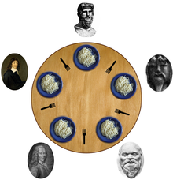
Dining Philosophers Problem

Slide 60
Deadlock

Slide 61
Deadlock
Deadlock:
No progress can be made because two or more threads are waiting for the other to take some action and thus neither ever does

Slide 62


Deadlock
STOP
STOP
B
A
D
C
STOP
STOP

Slide 63
Deadlock
Deadlock can arise if four conditions hold simultaneously.
Mutual exclusion: only one process at a time can use a resource
Hold and wait: a process holding at least one resource is waiting to acquire additional resources held by other processes
No preemption: a resource can be released only voluntarily by the process holding it, after that process has completed its task
Circular wait: there exists a set {P₀, P₁, …, P_{n}} of waiting processes such that P₀ is waiting for a resource that P1 holds, P₁ is waiting for a resource that is held by P₂, …, P_{n–1} is waiting for a resource that Pn holds, and P_{n} is waiting for a resource that is held by P₀.

Slide 64
Resource-Allocation Graph
A set of vertices V and a set of edges E.
V is partitioned into two types:
  P = {P1, P2, …, Pn}, the set consisting of all the processes in the system
  R = {R1, R2, …, Rm}, the set consisting of all resource types in the system
request edge – directed edge Pi → Rj
assignment edge – directed edge Rj → Pi

Slide 65
Resource-Allocation Graph
Process
Resource Type with 4 instances
P_{i} requests instance of R_{j}
P_{i} is holding an instance of R_{j}
P_{i}
R_{j}
P_{i}
R_{j}

Slide 66
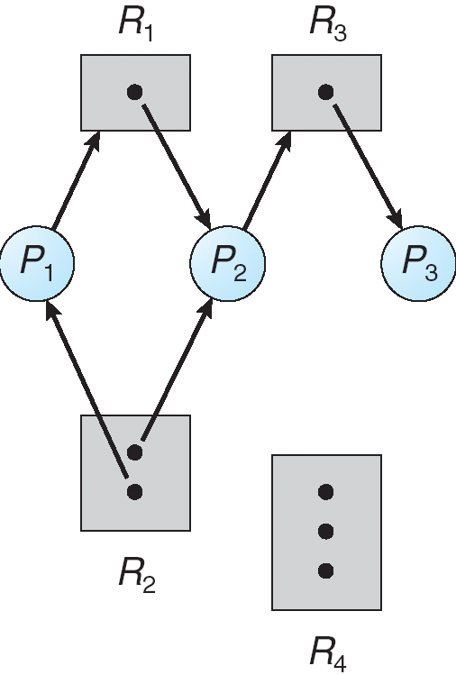
Resource-Allocation Graph

Slide 67
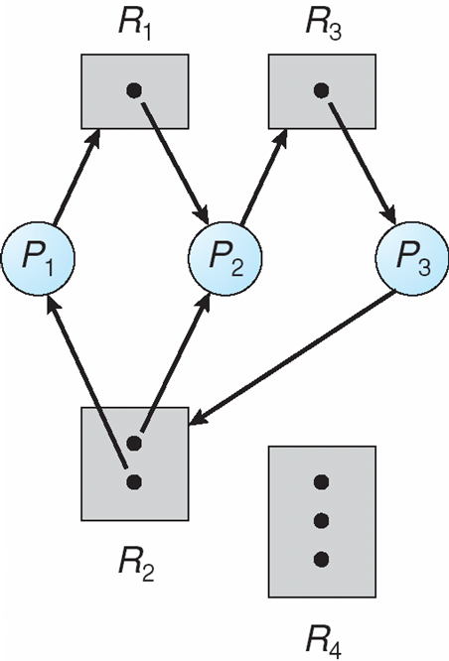
Resource-Allocation Graph

Slide 68
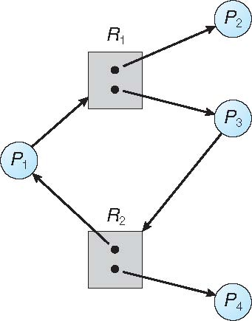
Resource-Allocation Graph

Slide 69
Resource-Allocation Graph
If graph contains no cycles ⇒ no deadlock
If graph contains a cycle ⇒
  if only one instance per resource type, then deadlock
  if several instances per resource type, possibility of deadlock

Slide 70
Handling Deadlock
Ensure that the system will never enter a deadlock state:
  Deadlock prevention
  Deadlock avoidance
Allow the system to enter a deadlock state and then recover
Ignore the problem and pretend that deadlocks never occur in the system, used by most operating systems, including UNIX.

Slide 71
Deadlock prevention
Mutual exclusion:
Threads claim exclusive control of resources that they require (e.g., thread grabs a lock)
Strategy: Eliminate locks!
Try to replace locks with atomic primitive:
int CompAndSwap(int *addr, int expected, int new)
Returns 0: fail, 1: success
void add (int *val, int amt) {
Mutex_lock(&m);
*val += amt;
Mutex_unlock(&m);
}
void add (int *val, int amt) {
do {
int old = *value;
} while(!CompAndSwap(val, old, old+amt);
}

Slide 72
Deadlock prevention
Hold and Wait
must guarantee that whenever a process requests a resource, it does not hold any other resources
Require process to request and be allocated all its resources before it begins execution, or allow process to request resources only when the process has none allocated to it. Low resource utilization; starvation possible

Slide 73
Deadlock prevention
No Preemption
If a process that is holding some resources requests another resource that cannot be immediately allocated to it, then all resources currently being held are released
Preempted resources are added to the list of resources for which the process is waiting
Process will be restarted only when it can regain its old resources, as well as the new ones that it is requesting

Slide 74
Deadlock prevention
Circular Wait
Impose a total ordering of all resource types, and require that each process requests resources in an increasing order of enumeration.
Thread 1:
lock(&A);
lock(&B);
Thread 2:
lock(&B);
lock(&A);

Slide 75
Deadlock Avoidance
Requires that the system has some additional a priori information
available.
  Simplest and most useful model requires that each thread declare the maximum number of resources of each type that it may need
  The deadlock-avoidance algorithm dynamically examines the resource-allocation state to ensure that there can never be a circular-wait condition
  Resource-allocation state is defined by the number of available and allocated resources, and the maximum demands of the processes

Slide 76
Deadlock Avoidance – Safe State
When a thread requests an available resource, system must decide if immediate allocation leaves the system in a safe state
System is in safe state if there exists a sequence <T1, T2, …, Tn> of ALL the threads in the systems such that for each Ti,
  the resources that Ti can still request can be satisfied by currently available resources + resources held by all the Tj, with j < I

Slide 77
Deadlock Avoidance – Safe State
That is:
  If Ti resource needs are not immediately available, then Ti can wait until all Tj have finished
  When Tj is finished, Ti can obtain needed resources, execute, return allocated resources, and terminate
  When Ti terminates, Ti +1 can obtain its needed resources, and so on

Slide 78
Deadlock Avoidance – Safe State
If a system is in safe state → no deadlocks
If a system is in unsafe state → possibility of deadlock
Avoidance → ensure that a system will never enter an unsafe state.

Slide 79
Avoidance Algorithms
Single instance of a resource type
  Use a resource-allocation graph
Multiple instances of a resource type
  Use the Banker’s Algorithm

Slide 80
Resource-Allocation Graph Scheme
Claim edge Tj → Rj indicated that process Tj may request resource Rj; represented by a dashed line
Claim edge converts to request edge when a thread requests a resource
Request edge converted to an assignment edge when the resource is allocated to the thread
When a resource is released by a thread, assignment edge reconverts to a claim edge
Resources must be claimed a priori in the system

Slide 81
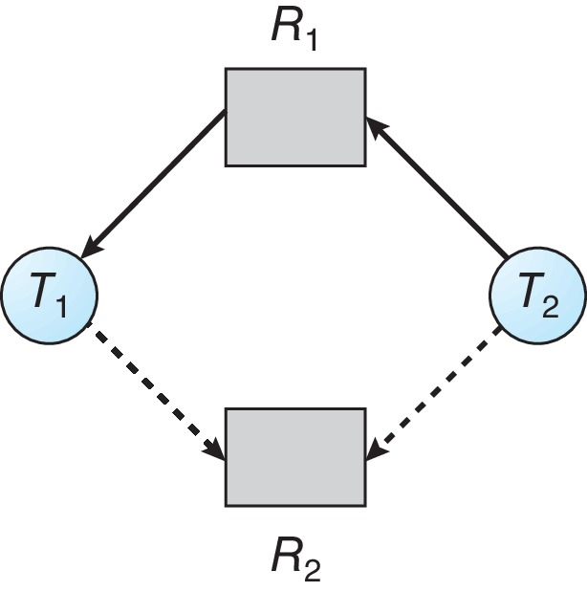
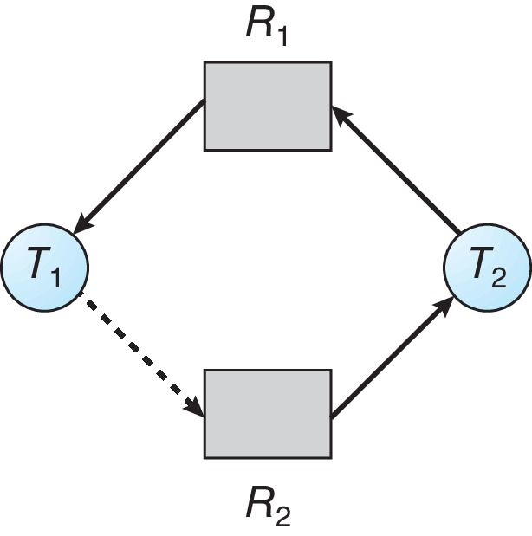
Resource-Allocation Graph Scheme
Suppose that thread Ti requests a resource Rj
The request can be granted only if converting the request edge to an assignment edge does not result in the formation of a cycle in the resource allocation graph

Slide 82
Banker’s Algorithm
Multiple instances of resources
Each thread must a priori claim maximum use
When a thread requests a resource, it may have to wait
When a thread gets all its resources it must return them in a finite amount of time

Slide 83
Banker’s Algorithm
Let n = number of processes, and m = number of resource types.
Available: Vector of length m. If available [j] = k, there are k instances of resource type Rj available
Max: n x m matrix. If Max [i,j] = k, then process Ti may request at most k instances of resource type Rj
Allocation: n x m matrix. If Allocation[i,j] = k then Ti is currently allocated k instances of Rj
Need: n x m matrix. If Need[i,j] = k, then Ti may need k more instances of Rj to complete its task
  Need [i,j] = Max[i,j] – Allocation [i,j]

Slide 84
Banker’s Algorithm – Safety Algorithm
Let Work and Finish be vectors of length m and n, respectively. Initialize:
  Work = Available
  Finish [i] = false for i = 0, 1, …, n- 1
Find an i such that both:
  (a) Finish [i] = false
  (b) Need_{i} <= Work
If no such i exists, go to step 4
3. Work = Work + Allocation_{i}
Finish[i] = true
go to step 2
4. If Finish [i] == true for all i, then the system is in a safe state

Slide 85
Resource-Request Algorithm for Process Pi
Request_{i} = request vector for process Ti. If Request_{i} [j] = k then process Ti wants k instances of resource type Rj
If Request_{i} < Need_{i} go to step 2. Otherwise, raise error condition, since process has exceeded its maximum claim
If Request_{i} <= Available, go to step 3. Otherwise Ti must wait, since resources are not available
Pretend to allocate requested resources to Ti by modifying the state as follows:
Available = Available – Request_{i};
Allocation_{i} = Allocation_{i} + Request_{i};
Need_{i} = Need_{i} – Request_{i};
If safe => the resources are allocated to Ti
If unsafe => Ti must wait, and the old resource-allocation state is restored

Slide 86
Banker’s Algorithm
5 threads T₀, T₁, T₂, T₃, T₄,
3 resource types:
A (10 instances), B (5instances), and C (7 instances)
Snapshot at time T₀:
 | Max |  |  | Allocation |  |  | Need |  |  | Available
 | A | B | C | A | B | C | A | B | C | A | B | C
T0 | 7 | 5 | 3 | 0 | 1 | 0 | 7 | 4 | 3 | 3 | 3 | 2
T1 | 3 | 2 | 2 | 2 | 0 | 0 | 1 | 2 | 2
T2 | 9 | 0 | 2 | 3 | 0 | 2 | 6 | 0 | 0
T3 | 2 | 2 | 2 | 2 | 1 | 1 | 0 | 1 | 1
T4 | 4 | 3 | 3 | 0 | 0 | 2 | 4 | 3 | 1

Slide 87
Banker’s Algorithm
5 threads T₀, T₁, T₂, T₃, T₄,
3 resource types:
A (10 instances), B (5instances), and C (7 instances)
Snapshot at time T₀:
 | Max |  |  | Allocation |  |  | Need |  |  | Available
 | A | B | C | A | B | C | A | B | C | A | B | C
T0 | 7 | 5 | 3 | 0 | 1 | 0 | 7 | 4 | 3 | 3 | 3 | 2
T1 | 3 | 2 | 2 | 2 | 0 | 0 | 1 | 2 | 2
T2 | 9 | 0 | 2 | 3 | 0 | 2 | 6 | 0 | 0
T3 | 2 | 2 | 2 | 2 | 1 | 1 | 0 | 1 | 1
T4 | 4 | 3 | 3 | 0 | 0 | 2 | 4 | 3 | 1
Can request for (3,3,0) by T₄ be granted?

Slide 88
Banker’s Algorithm
5 threads T₀, T₁, T₂, T₃, T₄,
3 resource types:
A (10 instances), B (5instances), and C (7 instances)
Snapshot at time T₀:
 | Max |  |  | Allocation |  |  | Need |  |  | Available
 | A | B | C | A | B | C | A | B | C | A | B | C
T0 | 7 | 5 | 3 | 0 | 1 | 0 | 7 | 4 | 3 | 3 | 3 | 2
T1 | 3 | 2 | 2 | 2 | 0 | 0 | 1 | 2 | 2
T2 | 9 | 0 | 2 | 3 | 0 | 2 | 6 | 0 | 0
T3 | 2 | 2 | 2 | 2 | 1 | 1 | 0 | 1 | 1
T4 | 4 | 3 | 3 | 0 | 0 | 2 | 4 | 3 | 1
Can request for (0,2,0) by T₀ be granted?

Slide 89
Deadlock Detection
Allow system to enter deadlock state
Detection algorithm
Recovery scheme

Slide 90
Single Instance of Each Resource Type
Maintain wait-for graph
Nodes are threads
  Ti → Tj if Ti is waiting for Tj
Periodically invoke an algorithm that searches for a cycle in the graph. If there is a cycle, there exists a deadlock
An algorithm to detect a cycle in a graph requires an order of n² operations, where n is the number of vertices in the graph

Slide 91
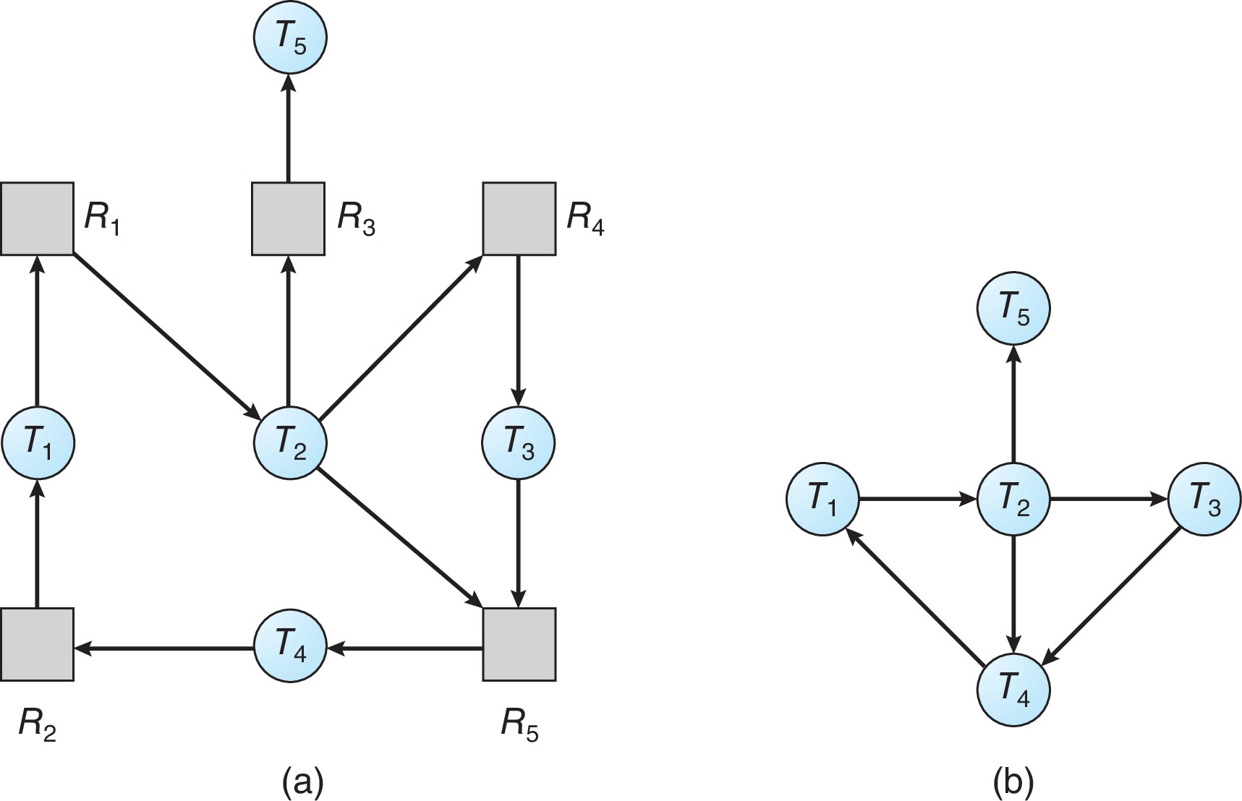
Single Instance of Each Resource Type
Resource-Allocation Graph
Corresponding wait-for graph

Slide 92
Several Instances of a Resource Type
Available: A vector of length m indicates the number of available resources of each type
Allocation: An n x m matrix defines the number of resources of each type currently allocated to each thread.
Request: An n x m matrix indicates the current request of each thread. If Request [i][j] = k, then thread Ti is requesting k more instances of resource type Rj.

Slide 93
Detection Algorithm
Let Work and Finish be vectors of length m and n, respectively Initialize:
Work = Available
For i = 1,2, …, n, if Allocation_{i} ≠ 0, then
Finish[i] = false; otherwise, Finish[i] = true
2. Find an index i such that both:
Finish[i] == false
Request_{i} <= Work
If no such i exists, go to step 4

Slide 94
Detection Algorithm
3. Work = Work + Allocationi
Finish[i] = true
go to step 2
4. If Finish[i] == false, for some i, 1 <= i <= n, then the system is in deadlock state. Moreover, if Finish[i] == false, then Ti is deadlocked
Algorithm requires an order of O(m x n²) operations to detect whether the system is in deadlocked state

Slide 95
Example of Detection Algorithm
Five threads T0 through T4; three resource types
A (7 instances), B (2 instances), and C (6 instances)
Snapshot at time T0:
 | Allocated |  |  | Request |  |  | Available
 | A | B | C | A | B | C | A | B | C
T0 | 0 | 1 | 0 | 0 | 0 | 0 | 0 | 0 | 0
T1 | 2 | 0 | 0 | 2 | 0 | 2
T2 | 3 | 0 | 3 | 0 | 0 | 0
T3 | 2 | 1 | 1 | 1 | 0 | 0
T4 | 0 | 0 | 2 | 0 | 0 | 2

Slide 96
Example of Detection Algorithm
Five threads T0 through T4; three resource types
A (7 instances), B (2 instances), and C (6 instances)
Snapshot at time T0:
 | Allocated |  |  | Request |  |  | Available
 | A | B | C | A | B | C | A | B | C
T0 | 0 | 1 | 0 | 0 | 0 | 0 | 0 | 0 | 0
T1 | 2 | 0 | 0 | 2 | 0 | 2
T2 | 3 | 0 | 3 | 0 | 0 | 1
T3 | 2 | 1 | 1 | 1 | 0 | 0
T4 | 0 | 0 | 2 | 0 | 0 | 2

Slide 97
Recovery from Deadlock: Process Termination
Abort all deadlocked threads
Abort one process at a time until the deadlock cycle is eliminated
In which order should we choose to abort?
  Priority of the thread
  How long has the thread computed, and how much longer to completion
  Resources that the thread has used
  Resources that the thread needs to complete
  How many threads will need to be terminated
  Is the thread interactive or batch?

Slide 98
Recovery from Deadlock: Process Termination
Selecting a victim – minimize cost
Rollback – return to some safe state, restart the thread for that state
Starvation – same thread may always be picked as victim, include number of rollback in cost factor

Slide 99
Questions

Slide 100
S. NO. | QUESTIONS | CO | Bloom’s Level | MARKS
1 | Explain Race condition. | CO1 | L2 | 2M
2 | Describe critical section problem. | CO1 | L2 | 2M
3 | Explain Mutual Exclusion. | CO1 | L2 | 2M
4 | Demonstrate operations that can be performed on semaphore. | CO1 | L2 | 2M
5 | Explain Dead lock. | CO1 | L2 | 2M
6 | Outline the necessary conditions for deadlock occurrence. | CO1 | L2 | 2M
7 | Outline the necessary conditions for deadlock prevention. | CO1 | L2 | 2M
8 | Explain safe state. | CO1 | L2 | 2M
9 | Describe methods for Handling Deadlocks. | CO1 | L2 | 2M
10 | Explain the usage of Monitor for synchronization construct. | CO1 | L2 | 2M

Slide 101
S. NO | QUESTION | CO | LEVEL | MARKS
1 | Outline critical section problem. Explain Peterson solution to the critical section problem. | CO3 CO3 | L2 L2 | 5 M 5 M
2 | Explain about Mutex Locks. Illustrate about Semaphores and their usage. | CO3 CO3 | L2 L2 | 5 M 5 M
3 | Make use of semaphores for solving Bounded buffer problem. Reader-Writer classical synchronization problem. | CO3 | L3 | 10 M
4 | Develop a solution for dining philosopher’s problem using semaphores. Utilize Monitors for solving process synchronization problem. | CO3 CO3 | L3 L3 | 5 M 5 M
5 | Explain about deadlock? Explain about the deadlock characterization in detail? | CO3 | L2 | 10 M
6 | Explain the different methods for handling deadlocks. Summarize briefly about the prevention the occurrence of deadlocks. | CO3 CO3 | L2 L2 | 5M 5M
7 | Explain about deadlock avoidance. Explain in detail about Banker’s algorithm. | CO3 CO3 | L2 L2 | 5 M 5 M

Slide 102
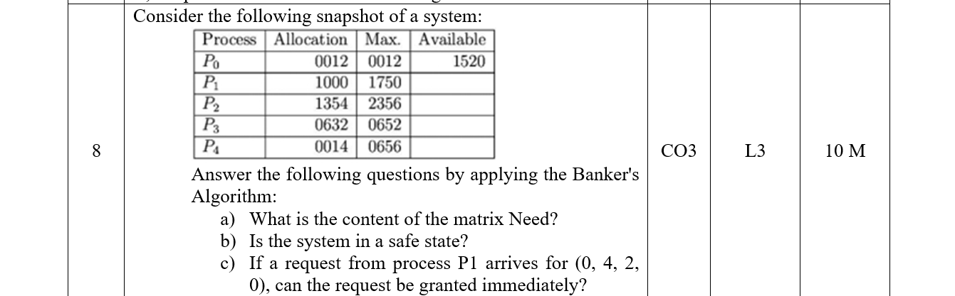

Slide 103
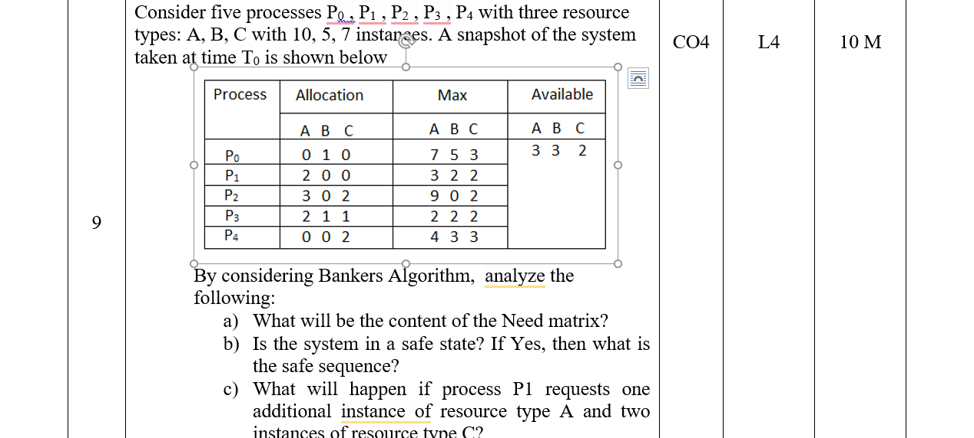

Slide 104
10 | Summarize about deadlock detection? Explain how to recover from deadlocks? | CO3 CO3 | L2 L2 | 5 M 5 M

