Slide 1

Operating System

Slide 2

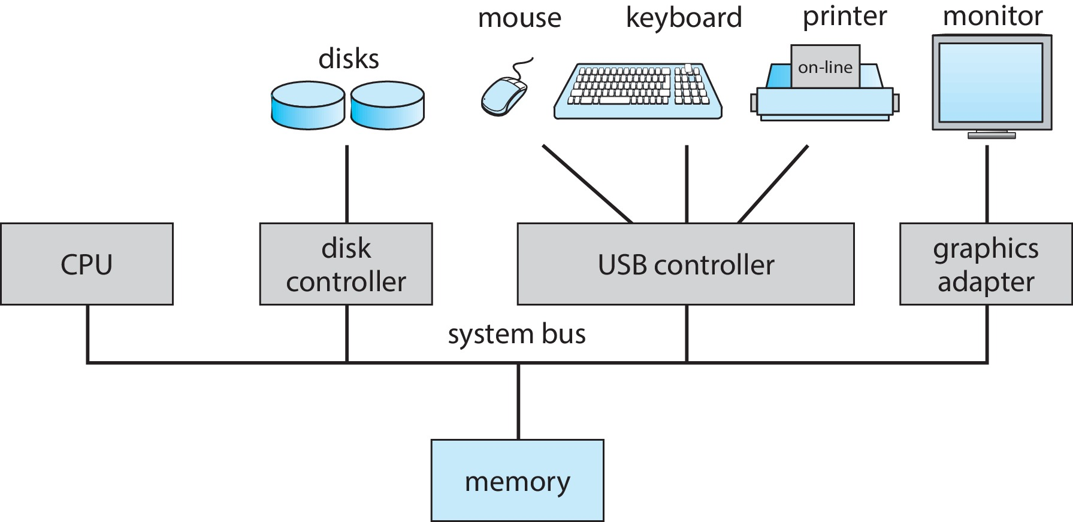

Computer System Organization

Slide 3
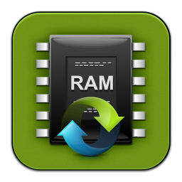
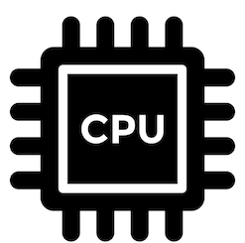


Program
Void main()
{
1 int a,b;
2 printf(“Enter a”);
3 scanf(“%d”,&a);
4 printf(“\n Enter b”);
5 scanf(“%d”,&b);
int c;
c=a+b;
8 printf(“a+b is %d”,c);
}
6
7
1
?
4
2
8
3
5

Slide 4
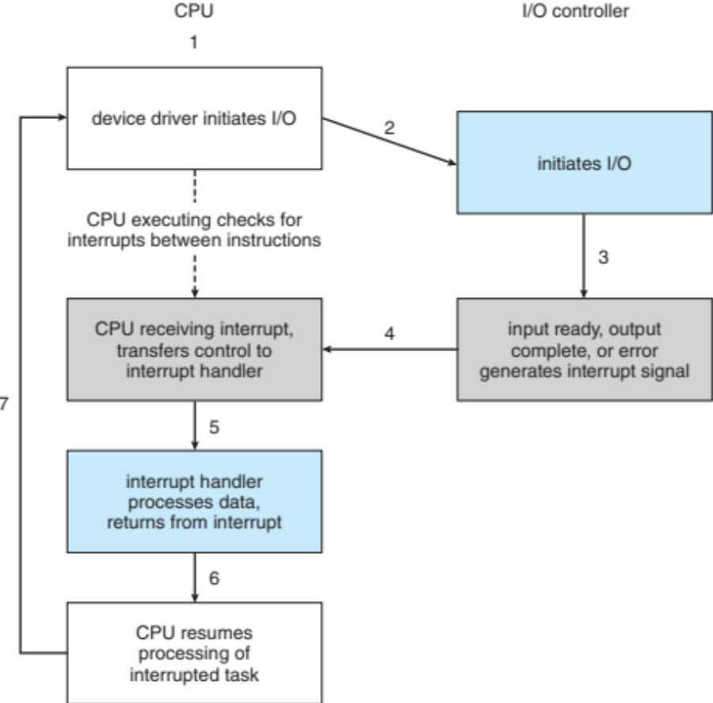
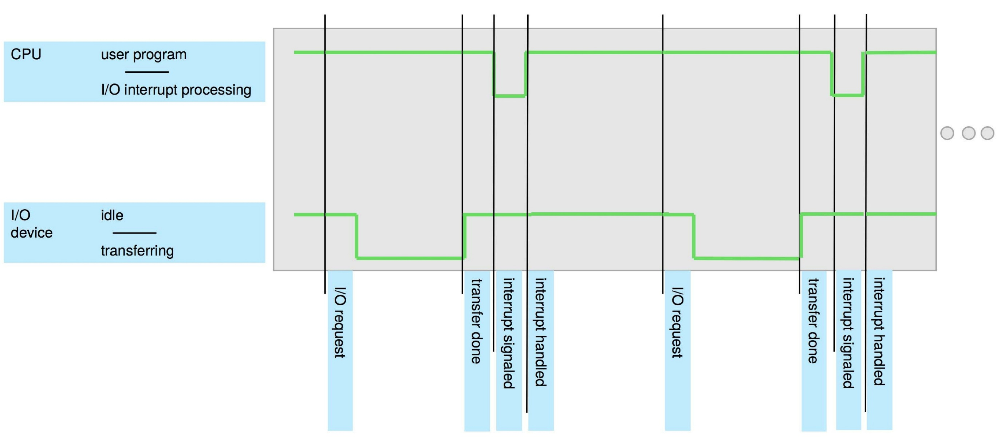
Interrupt Timeline

Slide 5
Operating System
?
It’s a software, in fact, that is responsible for making it easy to run programs, allowing programs to share memory, enabling programs to interact with devices, and other activities.
Operating system (OS) makes sure the system operates correctly and efficiently in an easy-to-use manner.

Slide 6
Operating System
Users
Everything in system that isn’t an application or hardware
compilers
databases
word processors
Applications
Software that converts hardware into a useful form for applications
Operating System
An operating system (OS) is system software that manages computer hardware and software resources and provides common services for computer programs.
CPU
memory
I/O devices
Hardware

Slide 7
Roles of Operating System
Resource coordinator (I.e., manager)
OS is known as a resource manager as it manages the resources like CPU, memory, and disk efficiently or fairly or indeed with many other possible goals in mind
Provide standard Library (I.e., abstract resources)
Resource abstraction is the process of hiding the details of how the hardware operates, making computer hardware relatively easy for an application programmer to use

Slide 8
Design Goals of OS
To build up some abstractions in order to make the system convenient and easy to use
Minimize the overheads of the OS and thus provide high performance
To Provide protection between applications, as well as between the OS and applications
Operating systems often strive to provide a high degree of reliability
Energy-efﬁciency is important in our increasingly green world
Security against malicious applications is critical, especially in these highly-networked times
Mobility is increasingly important as OS also runs on smaller and smaller devices.

Slide 9
Components of OS
Kernel: Core components of the OS
Process scheduler
  Determines when and for long each process executes
Memory manager
  Determines when and how memory is allocated to processes
  Decides what to do when main memory is full
File system
  Organizes named collections of data in persistent storage
Networking
  Enables processes to communicate with one another
Protection and Security
  Protection – A mechanism for controlling access of processes (or users) to resources defined by the OS
  Security – A defense of the system against internal and external attacks

Slide 10
History of
Computer/Operating
Systems

Slide 11
Computer History
Two distinct phases of history
  Phase 1: Computers are expensive (1950 – 80)
    Goal: Use computer’s time efficiently
    Maximize throughput (I.e., jobs per second)
    Maximize utilization (I.e., percentage busy)
  Phase 2: Computers are inexpensive (1980 - )
    Goal: Use people’s time efficiently
    Minimize response time

Slide 12
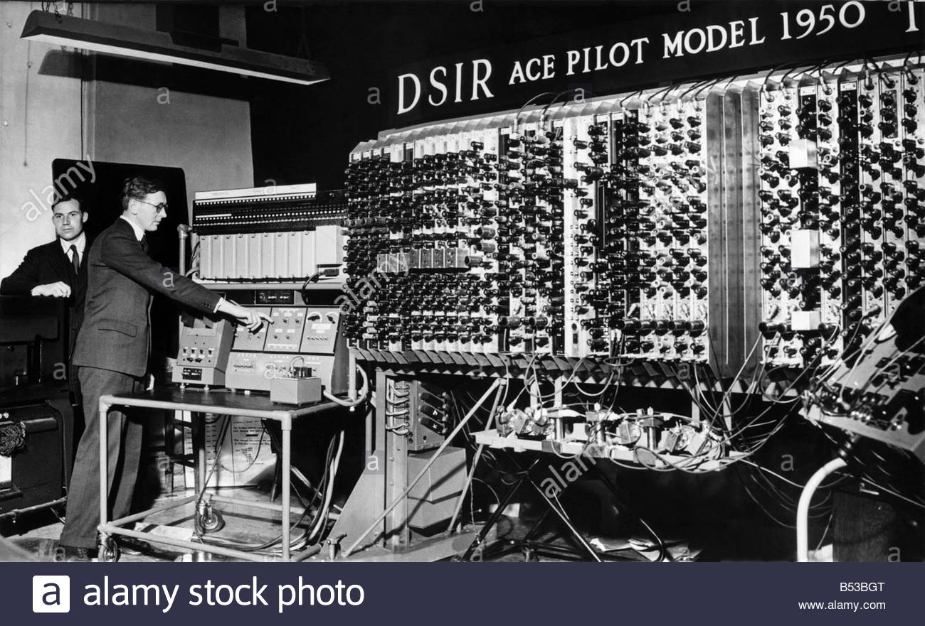
First commercial systems
1950s Hardware
  Enormous, expensive, and slow
  Input/Output: Punch cards and line printers
Goal of OS
  Get the hardware working
  Single operator/programmer/user runs and debugs interactively
OS Functionality
  Standard library only (no sharing or coordination of resources) (FORTRAN Monitor System)
  Monitor that is always resident; transfer control to programs
Problems
  Inefficient use of hardware (throughput and utilization)
Advantages
  Worked and allowed interactive debugging

Slide 13
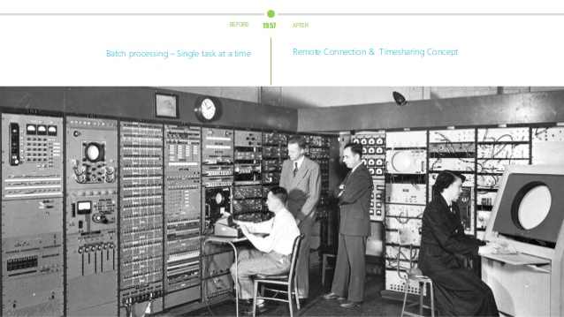
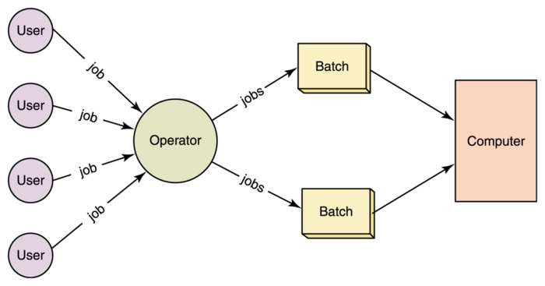
Batch Processing
Goal of OS: Better throughput and utilization
Batch: Group of jobs submitted together
  Operator collects jobs; orders efficiently; runs one at a time
Advantages
  Reduce setup costs over many jobs
  Operator more skilled at loading tapes
  Keep machine busy while programmer thinks
  Improves throughput and utilization
Problems
  User must wait until batch is done for results
  Machine idle when job is reading from cards and writing to printers

Slide 14
Spooling
Hardware
  Mechanical I/O devices much slower than CPU
  Read 17 cards/sec vs. execute 1000s instructions/sec
Goal of OS
  Improve performance by overlapping I/O with CPU execution
Spooling: Simultaneous Peripheral Operations On-Line
  Read card punches to disk
  Compute (while reading and writing to disk)
  Write output from disk to printer
OS Functionality
  Buffering and interrupt handling
Problem
  Machine idle when job waits for I/O to/from disk

Slide 15
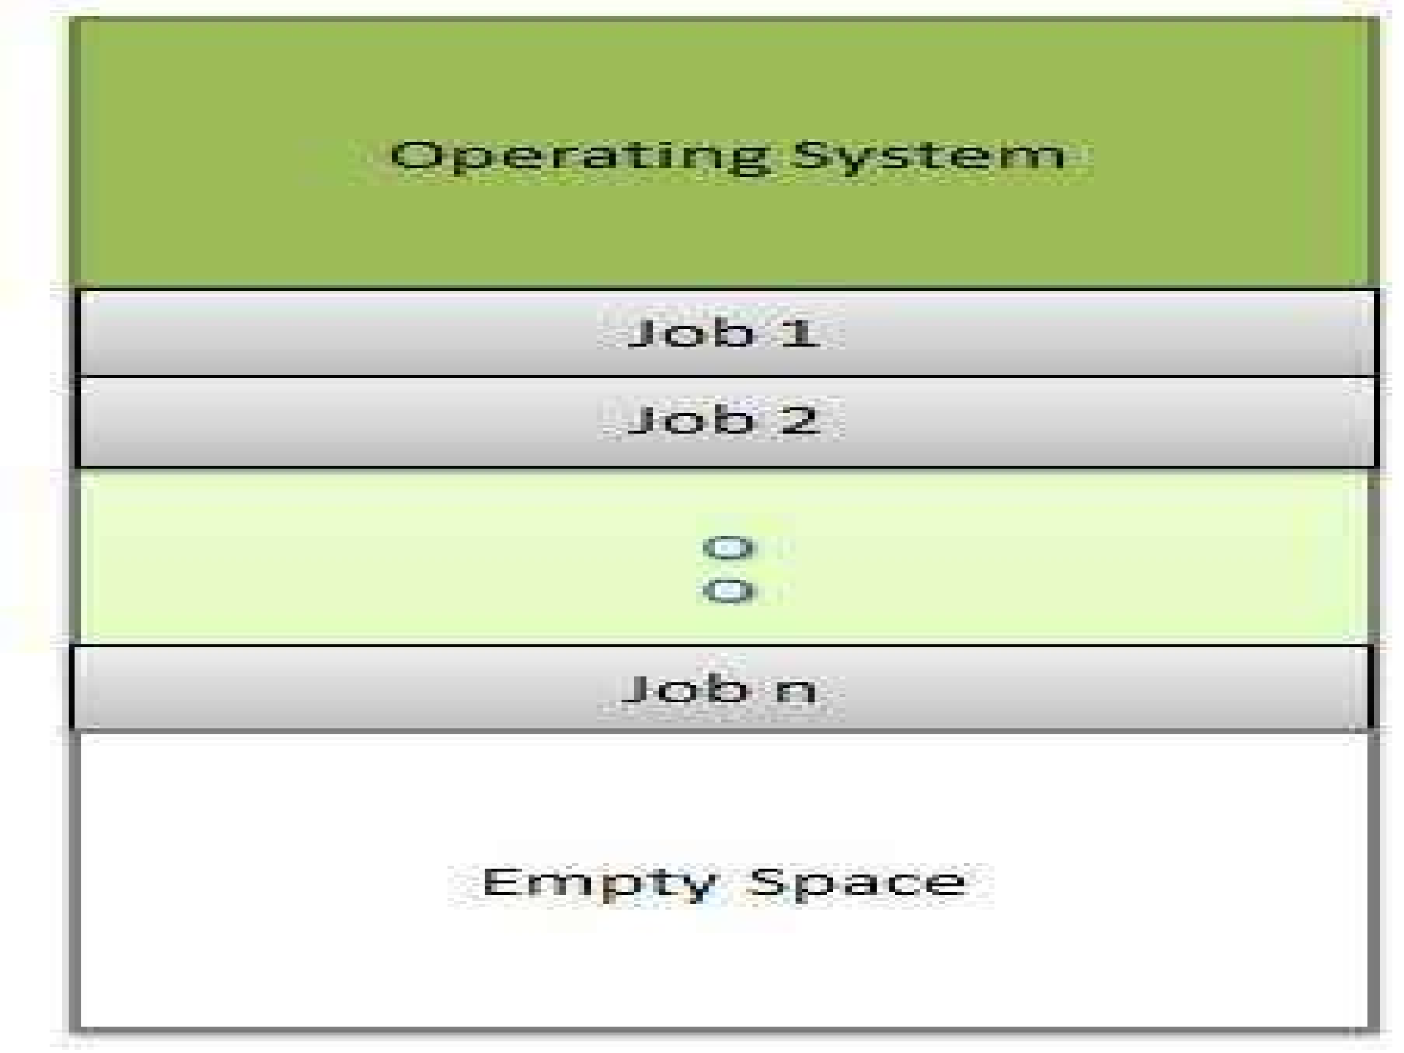
Multiprogram Batch Systems
Observation: Spooling provides pool of ready jobs
Goal of OS
  Improve performance by always running a job
  Keep multiple jobs resident in memory
  When job waits for disk I/O, OS switches to another job
OS Functionality
  Job scheduling policies
  Memory management and protection
Advantage: Improves throughput and utilization
Disadvantage: Machine not interactive

Slide 16
Inexpensive Peripherals
1960s Hardware
  Expensive mainframes, but inexpensive keyboards and monitors
  Enables text editors and interactive debuggers
Goal of OS
  Improve user’s response time
OS Functionality
  Time-sharing: switch between jobs to give appearance of dedicated machine
  More complex job scheduling
  Concurrency control and synchronization
Advantage
  Users easily submit jobs and get immediate feedback

Slide 17
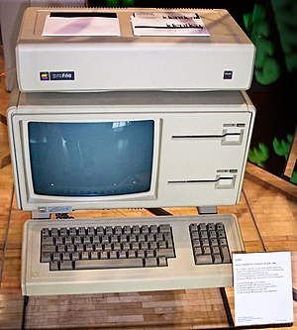
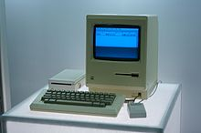
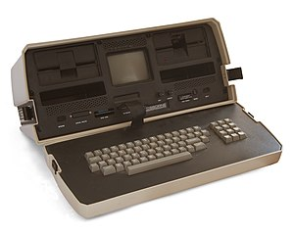
Inexpensive Personal Computers
1980s Hardware
  Entire machine is inexpensive
  One dedicated machine per user
Goal of OS
  Give user control over machine
OS Functionality
  Remove time-sharing of jobs, protection, and virtual memory
Advantages
  Simplicity
  Works with little main memory
  Machine is all your own (performance is predictable)
Disadvantages
  No time-sharing or protection between jobs

Slide 18
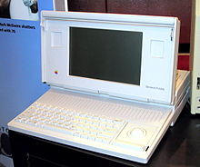
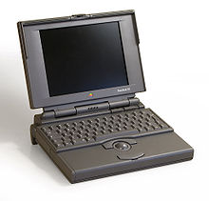
Inexpensive, Powerful Computers
1990s+ Hardware
  PCs with increasing computation and storage
  Users connected to the web
Goal of OS
  Allow single user to run several applications simultaneously
  Provide security from malicious attacks
  Efficiently support web servers
OS Functionality
  Add back time-sharing, protection, and virtual memory

Slide 19
Powerful Computers
Real Time Operating Systems
  Real time system is defined as a data processing system in which the time interval required to process and respond to inputs is so small that it controls the environment.
  Hard RTS: Air Traffic Control, Vehicle Control Sub systems, Nuclear Power Plant etc.
  Soft RTS: Multimedia transmission and reception, Telecom Networks etc
Distributed Operating Systems
  Multiple systems interconnected and projected as a single system image to the user.

Slide 20
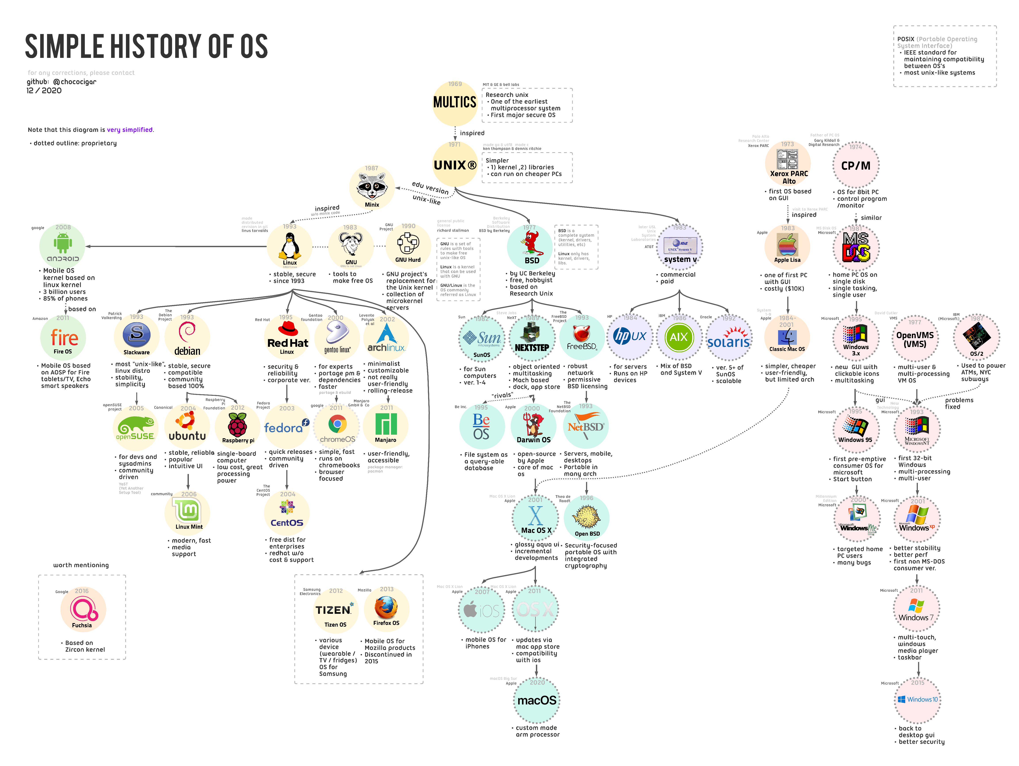

Slide 21
Operating System
Architecture

Slide 22
Kernel Based Operating Systems
Kernel is the core of the operating system.
It controls everything in a computer.
Types of Architecture
  Monolithic architecture
  Microkernel architecture
  Hybrid Kernel architecture

Slide 23
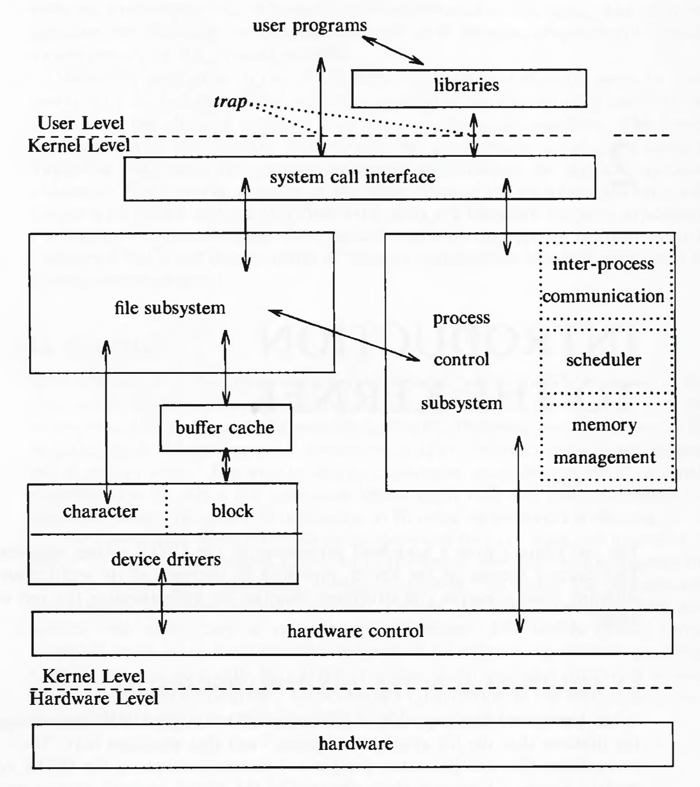
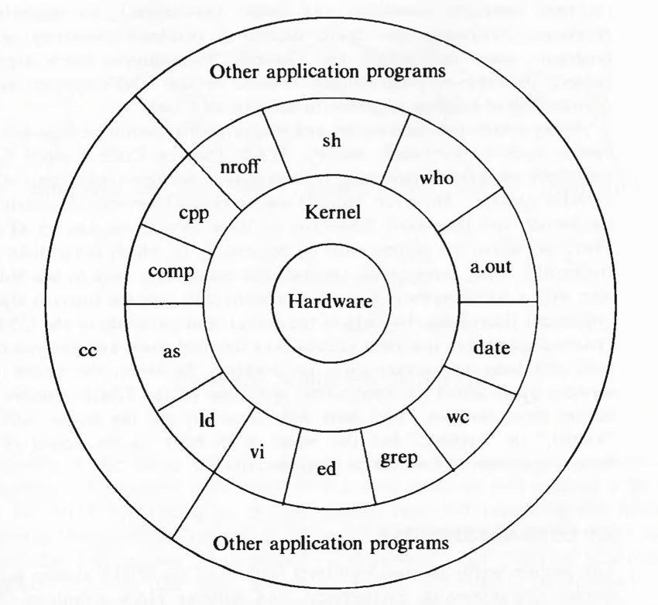
Unix- Monolithic Kernel

Slide 24
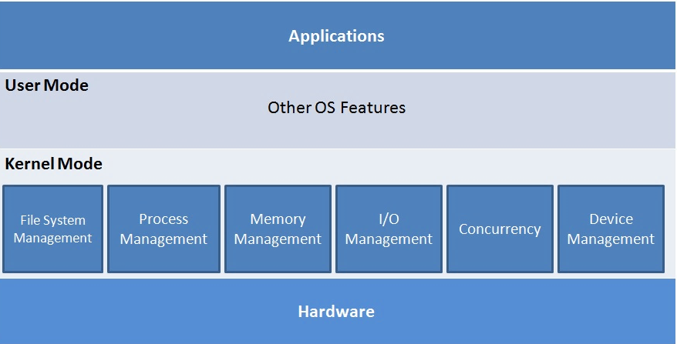
Monolithic Kernel
All services within a single kernel.
Less flexible for modifications
Kernel mode and User mode
Windows 95, 98, ME.
All Linux distributions.
Android uses a modified Linux Kernel

Slide 25
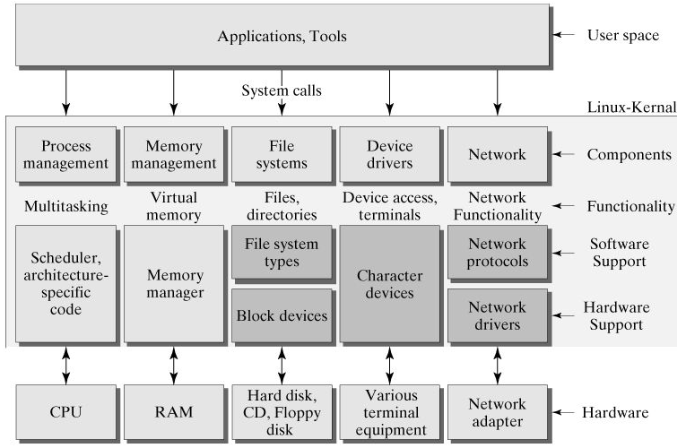
Linux - Monolithic Kernel
Linux has a monolithic Kernel.
System libraries and Device drivers help Software applications pass instructions to the Kernel or the Device drivers.
User mode has applications or tools which in turn interact with Kernel directly or indirectly via system libraries, device drivers.

Slide 26
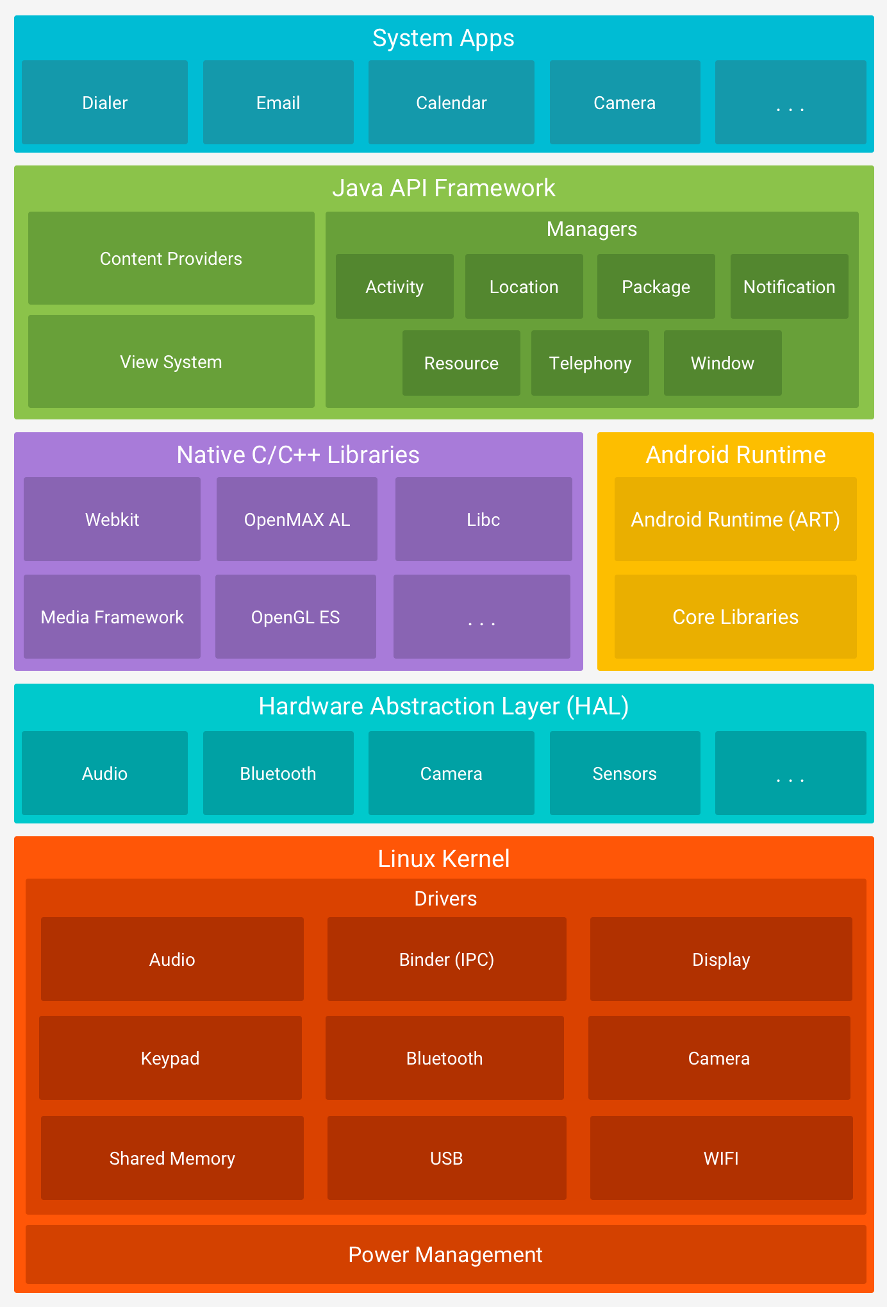
Android
Uses Linux kernel for underlying functionalities such as threading, key security features and low-level memory management.
HAL provides standard interfaces that expose device hardware capabilities to the higher-level Java API framework.
Android version 5.0 (API level 21) or higher, each app runs in its own process and with its own instance of the Android Runtime (ART).
ART, HAL and other components use Native C/C++ libraries.
The entire feature-set of the Android OS is available through APIs written in the Java language.

Slide 27
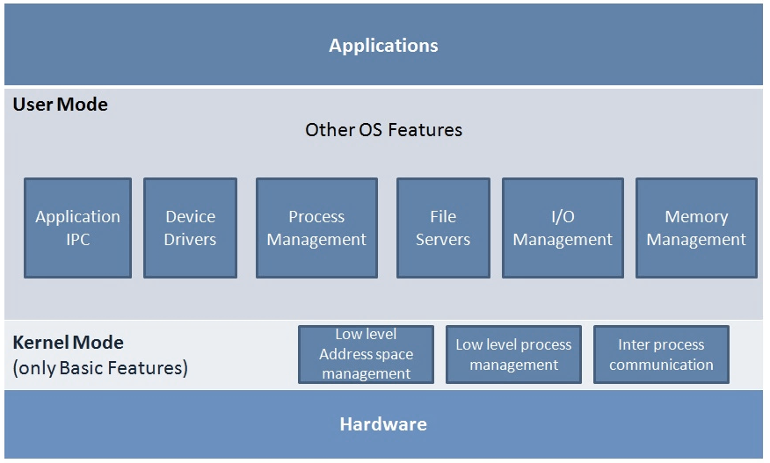
Micro Kernel Operating Systems
Kernel have the basic interaction with hardware and the basic Inter-Process Communication mechanisms.
Flexibility to add or modify features
IPC, scheduling and memory management are the core services in a micro-kernel.
Rest of the OS services exist as independent services.
Examples: Eclipse IDE, Mach, OKL4, Codezero, Fiasco.OC, PikeOS, seL4, QNX

Slide 28
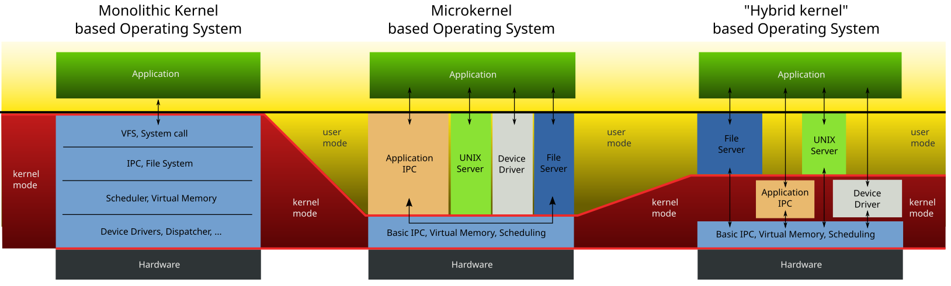
Hybrid Kernel Operating Systems
Hybrid kernel aims to have an optimal performance and the flexibility to modify and upgrade kernel services
Windows NT, Windows 2000, Windows XP, Windows Vista, Windows 7, Windows 8, Windows 8.1, Windows 10
Apple's macOS for desktop machines, Apple's iOS for mobiles uses hybrid (XNU)

Slide 29
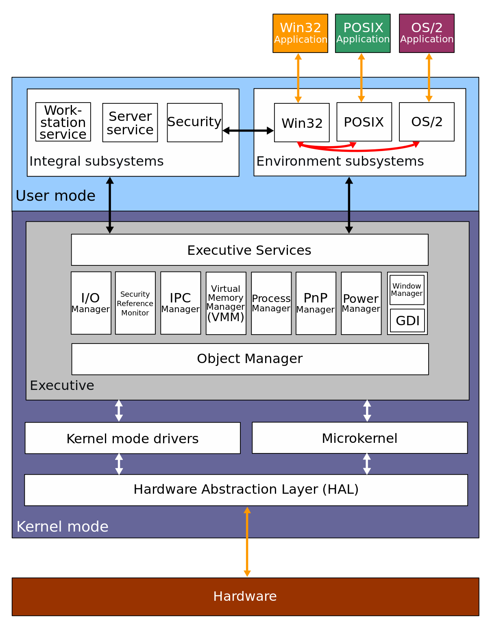
Windows NT
HAL was designed to hide differences in hardware and provide a consistent platform on which the kernel is run.
The Executive interfaces, with all the user mode subsystems, deal with I/O, object management, security and process management.
The kernel sits between the hardware abstraction layer and the Executive to provide multiprocessor synchronisation, thread and interrupt scheduling and dispatching, and trap handling and exception dispatching.
The kernel is also responsible for initializing device drivers at bootup.

Slide 30
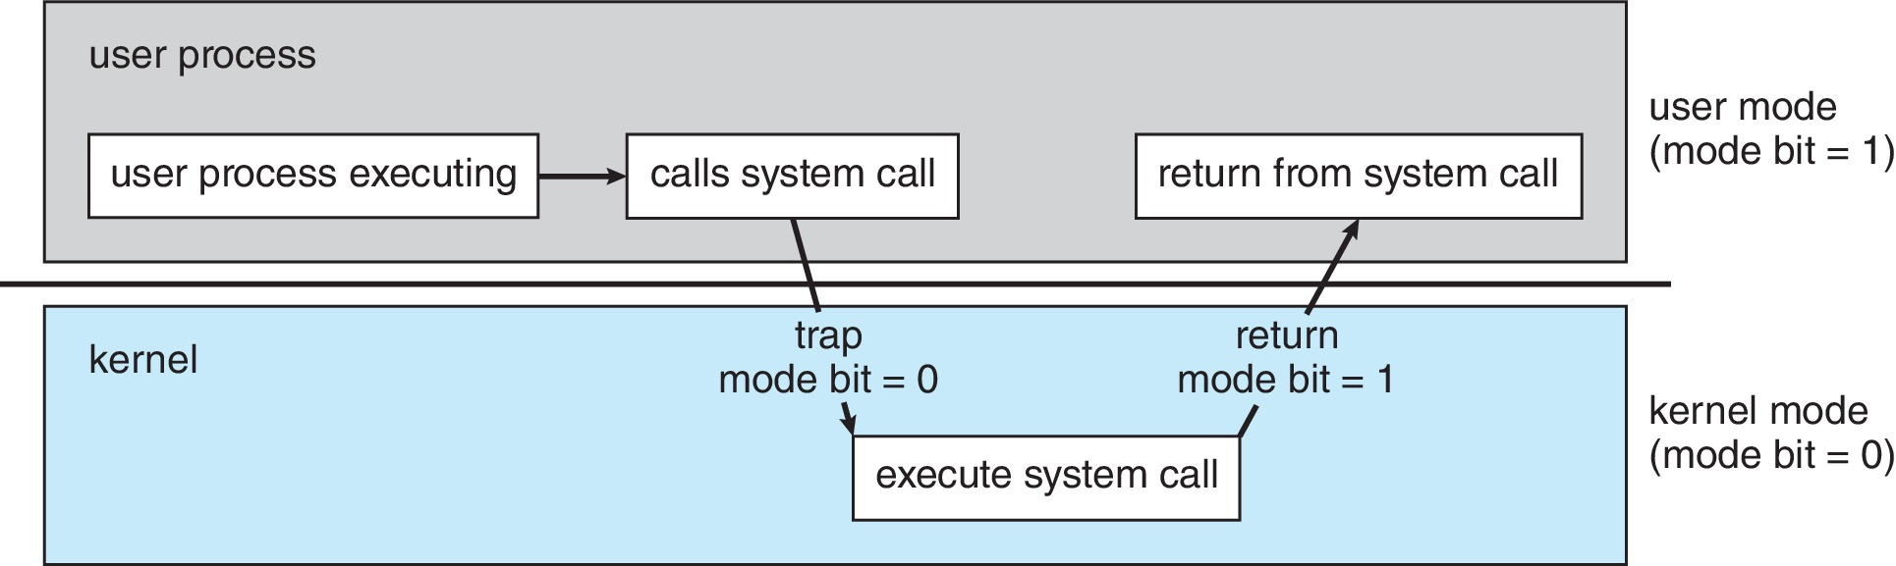
Dual Mode Operation
Dual-mode operation allows OS to protect itself and other system components
  User mode and kernel mode
Mode bit provided by hardware
Provides ability to distinguish when system is running user code or kernel code.
System call changes mode to kernel, return from call resets it to user
Some instructions designated as privileged, only executable in kernel mode

Slide 31
Operating System
Functions

Slide 32
Process Management
A process is a program in execution. It is a unit of work within the system.
  Program is a passive entity; process is an active entity.
Process needs resources to accomplish its task
  CPU, memory, I/O, files and Initialization data
Process termination requires reclaim of any reusable resources
Single-threaded process has one program counter specifying location of next instruction to execute
  Process executes instructions sequentially, one at a time, until completion
Multi-threaded process has one program counter per thread

Slide 33
Process Management
Typically system has many processes, some user, some operating system running concurrently on one or more CPUs
  Concurrency by multiplexing the CPUs among the processes / threads
The operating system is responsible for the following activities in connection with process management:
  Creating and deleting both user and system processes
  Suspending and resuming processes
  Providing mechanisms for process synchronization
  Providing mechanisms for process communication
  Providing mechanisms for deadlock handling

Slide 34
Memory Management
To execute a program all (or part) of the instructions must be in memory
  All (or part) of the data that is needed by the program must be in memory
Memory management determines what is in memory and when
  Optimizing CPU utilization and computer response to users
Memory management activities
  Keeping track of which parts of memory are currently being used and by whom
  Deciding which processes (or parts thereof) and data to move into and out of memory
  Allocating and deallocating memory space as needed

Slide 35
File-System Management
OS provides uniform, logical view of information storage
  Abstracts physical properties to logical storage unit - file
  Files usually organized into directories
  Access control on most systems to determine who can access what
OS activities include
  Creating and deleting files and directories
  Primitives to manipulate files and directories
  Mapping files onto secondary storage
  Backup files onto stable (non-volatile) storage media

Slide 36
Mass Storage Management
Usually disks used to store data that does not fit in main memory or data that must be kept for a “long” period of time
Entire speed of computer operation hinges on disk subsystem and its algorithms
OS activities
  Mounting and unmounting
  Free-space management
  Storage allocation
  Disk scheduling
  Partitioning
  Protection

Slide 37
Caching
Important principle, performed at many levels in a computer (in hardware, operating system, software)
Information in use copied from slower to faster storage temporarily
Faster storage (cache) checked first to determine if information is there
  If it is, information used directly from the cache (fast)
  If not, data copied to cache and used there
Cache smaller than storage being cached
  Cache management important design problem
  Cache size and replacement policy

Slide 38
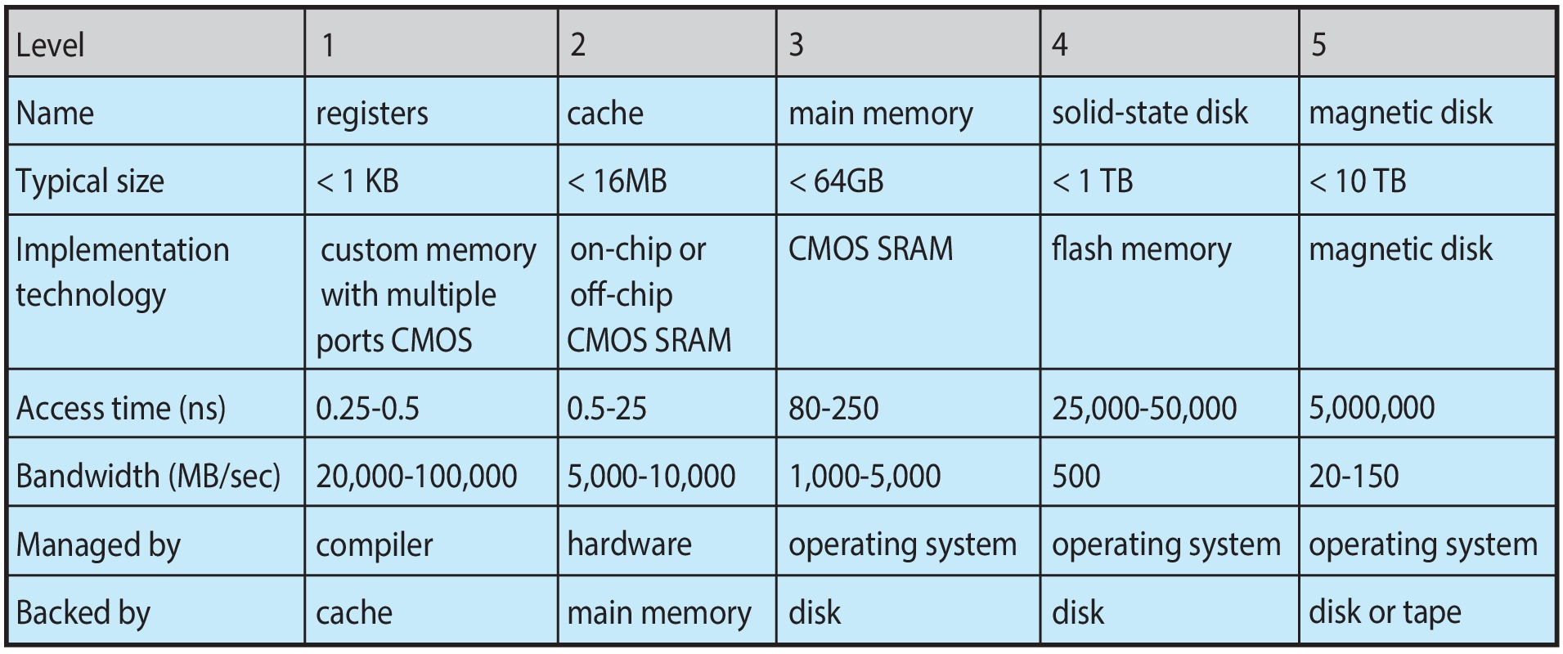
Characteristics of Storage
Movement between levels of storage hierarchy can be explicit or implicit

Slide 39
I/O Subsystem
One purpose of OS is to hide peculiarities of hardware devices from the user
I/O subsystem responsible for
  Memory management of I/O including buffering (storing data temporarily while it is being transferred),
  caching (storing parts of data in faster storage for performance),
  spooling (the overlapping of output of one job with input of other jobs)
  General device-driver interface
  Drivers for specific hardware devices

Slide 40
Protection & Security
Protection – any mechanism for controlling access of processes or users to resources defined by the OS
Security – defense of the system against internal and external attacks
  Huge range, including denial-of-service, worms, viruses, identity theft, theft of service
Systems generally first distinguish among users, to determine who can do what
  User identities (user IDs, security IDs).
  Group identifier (group ID).
  Privilege escalation.

Slide 41
Computing
Environments And
Operating Systems

Slide 42
Computing Environments/OS
Batch Operating System
Time-Sharing Operating System
Distributed Operating System
Real-Time Operating System (RTOS)
Multi-User Operating System
Single-User Operating System
Mobile Operating System
Network Operating System
Embedded Operating System
Cloud Operating System

Slide 43
Batch Processing Systems
In batch systems, users submit their tasks (jobs) to the computer in batches.
The OS processes jobs one by one in a sequential manner, without user interaction during execution.
  Suitable for tasks like payroll, billing, and processing large volumes of data.
Advantages: Efficient for repetitive tasks, reduces idle CPU time.
Disadvantages: No user interaction during execution, troubleshooting is difficult.
Example: IBM OS/360.

Slide 44
Time Sharing Systems
Allows multiple users to interact with a computer simultaneously by sharing CPU time.
Each user gets a small, fixed time slice of CPU processing, making it appear as though the system is dedicated to them.
  Ideal for interactive applications like education, research, and programming.
Advantages: Minimizes idle time, provides better user interaction.
Disadvantages: Can become slow if too many users are active.
Examples: Unix, Multics.

Slide 45
Distributed System
Manages a collection of interconnected computers, presenting them as a single system to the user.
Resources (CPU, memory, storage) are distributed across multiple nodes in the network.
Common in applications requiring high availability and scalability, like cloud computing.
Advantages: Resource sharing, fault tolerance, scalability.
Disadvantages: Complexity in setup and maintenance.
Examples: Windows Server, Apache Hadoop.

Slide 46
Real Time Systems
Designed for systems where tasks must be completed within strict time constraints.
Commonly used in embedded systems for industrial control, robotics, and automotive systems.
Types:
  Hard Real-Time: Guarantees task completion within deadlines (e.g., pacemakers).
  Soft Real-Time: Prioritizes deadlines but allows minor delays (e.g., video streaming).
Advantages: Predictable, highly reliable.
Disadvantages: Limited multitasking, expensive development.
Examples: VxWorks, FreeRTOS

Slide 47
Multi User Systems
Allows multiple users to access the computer resources simultaneously.
Each user gets a separate environment to work without interference.
Used in servers, mainframes, and database management systems.
Advantages: Efficient resource utilization, strong user management.
Disadvantages: Can slow down under heavy loads.
Examples: Linux, Unix, Windows Server.

Slide 48
Mobile Systems
Specifically designed for mobile devices such as smartphones, tablets, and wearable technology.
Optimized for power efficiency, touch interfaces, and connectivity.
Includes features like app stores, GPS, and mobile security.
Advantages: Lightweight, optimized for portability.
Disadvantages: Limited hardware support compared to desktop OS.
Examples: Android, iOS

Slide 49
Network Systems
Provides functionality for managing network resources like servers, printers, and shared files.
Users on the network can access and share resources efficiently.
Used in environments like offices and educational institutions.
Advantages: Centralized control, enhanced security.
Disadvantages: Requires skilled management, can be expensive.
Examples: Windows Server, Novell NetWare.

Slide 50
Embedded Systems
Designed for specialized devices, often with limited hardware resources.
Used in devices like ATMs, smart TVs, and IoT devices.
Often real-time in nature to ensure timely task execution.
Advantages: Lightweight, efficient for specific tasks.
Disadvantages: Limited flexibility and upgradability.
Examples: Embedded Linux, QNX.

Slide 51
Cloud Computing Systems
Operates in a cloud environment to manage and allocate resources dynamically.
Supports virtual machines, containers, and remote user access.
Common in businesses utilizing cloud infrastructure for scalability and efficiency.
Advantages: High scalability, remote accessibility.
Disadvantages: Dependence on network availability, potential security concerns.
Examples: OpenStack, Microsoft Azure.

Slide 52
Free and Open-Source
Operating Systems

Slide 53
Free and Open Source OS
Free and open-source operating systems (FOSS OS) are software platforms where the source code is made publicly available, allowing users to view, modify, and distribute the software.
These systems are built collaboratively by communities of developers and are known for their flexibility, transparency, and cost-effectiveness.

Slide 54
Free and Open Source OS
Open Source Code: Users can access the source code to study, modify, or enhance the operating system.
Community Support: Maintained and updated by a global community of developers and contributors.
Cost-Effective: Free to download and use, often with optional paid support or services.
Customizability: Users can tailor the OS to specific needs.
Security: Transparent code allows vulnerabilities to be identified and fixed quickly.
Cross-Platform Compatibility: Many FOSS OSs work on various hardware architectures

Slide 55
Free OS VS Open OS
A free operating system is software that can be obtained without any monetary cost. It may or may not allow access to the source code or grant users the freedom to modify, redistribute, or study the software.
An open-source operating system is software whose source code is made publicly available under a license that allows users to view, modify, and distribute it.

Slide 56
Free OS VS Open OS
Feature | Free Operating System | Open-Source Operating System
Cost | Always free of charge (gratis). | Often free of charge, but not always.
Source Code Access | May or may not be accessible. | Always accessible to the public.
User Rights | Limited if proprietary. | Users have rights to modify, share, and study.
Example Licenses | May include proprietary licenses. | Governed by open-source licenses like GPL or MIT.
Focus | Free to use (cost aspect). | Freedom to use, study, modify, and distribute.

Slide 57
Operating System (OS)
Interfaces

Slide 58
OS Interface
The interface of an Operating System (OS) refers to the layer that separates the user from the underlying hardware and software components of the computer system.
It provides a way for users to interact with the OS, access its services, and manage its resources.

Slide 59
Purpose of OS Interface
User Interaction: Provides a way for users to communicate with the OS, using commands, menus, icons, or other graphical elements.
Resource Management: Allows users to manage system resources, such as processes, memory, storage, and I/O devices.
Service Access: Enables users to access various OS services, including file management, networking, security, and more.
Hardware Abstraction: Hides the complexities of the underlying hardware from the user, providing a standardized way to interact with the system.

Slide 60
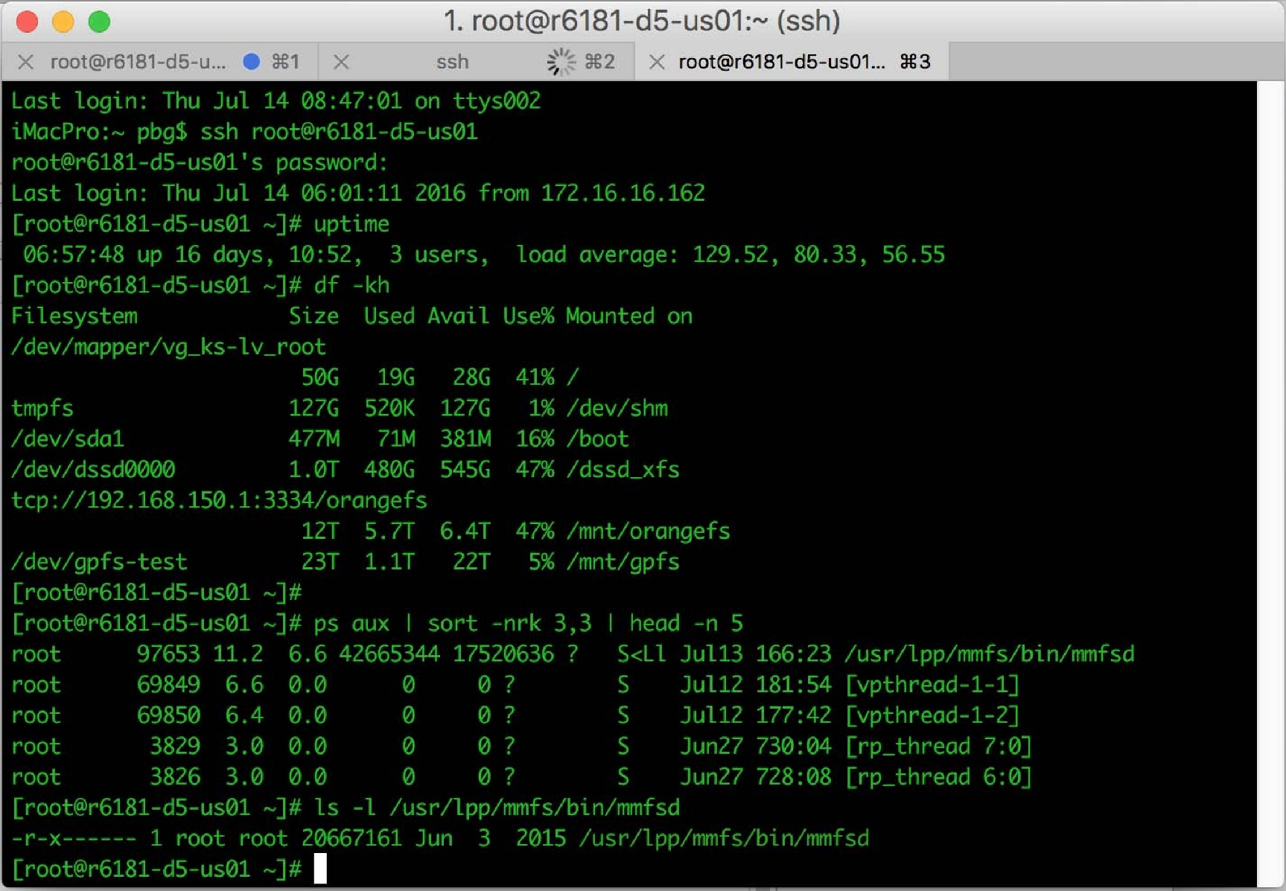
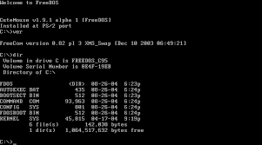
Command-Line Interface (CLI)
Text-based interface: Users interact with the OS using commands and receive text-based output.
Examples: Unix shell, Windows Command Prompt, Linux terminal.

Slide 61
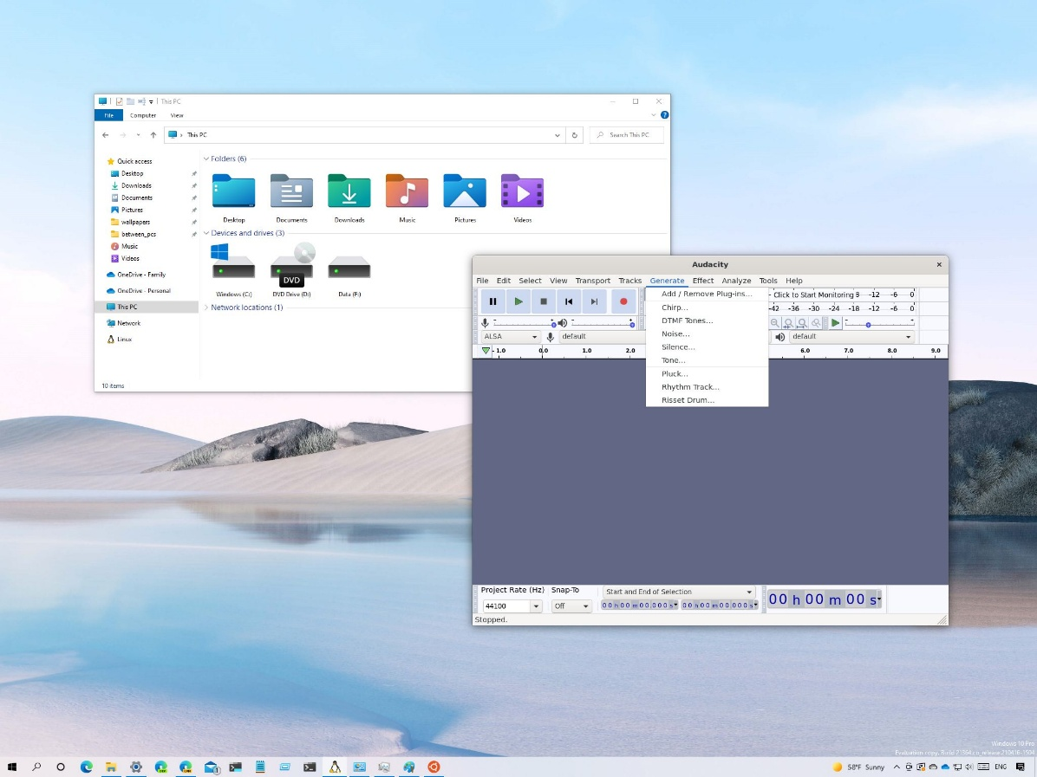
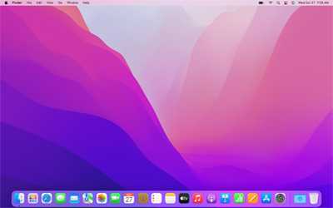
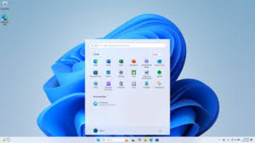
Graphical User Interface (GUI)
Visual interface: Users interact with the OS using graphical elements such as windows, icons, and menus.
Examples: Windows, macOS, Linux distributions with GUI (e.g., Ubuntu, Fedora).

Slide 62
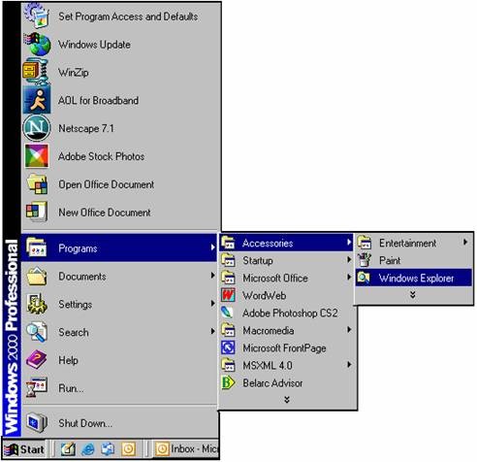
Menu-Driven Interface
Menu-based interface: Users select options from menus to interact with the OS.
Examples: Older operating systems like Windows, MS-DOS, some embedded systems.

Slide 63
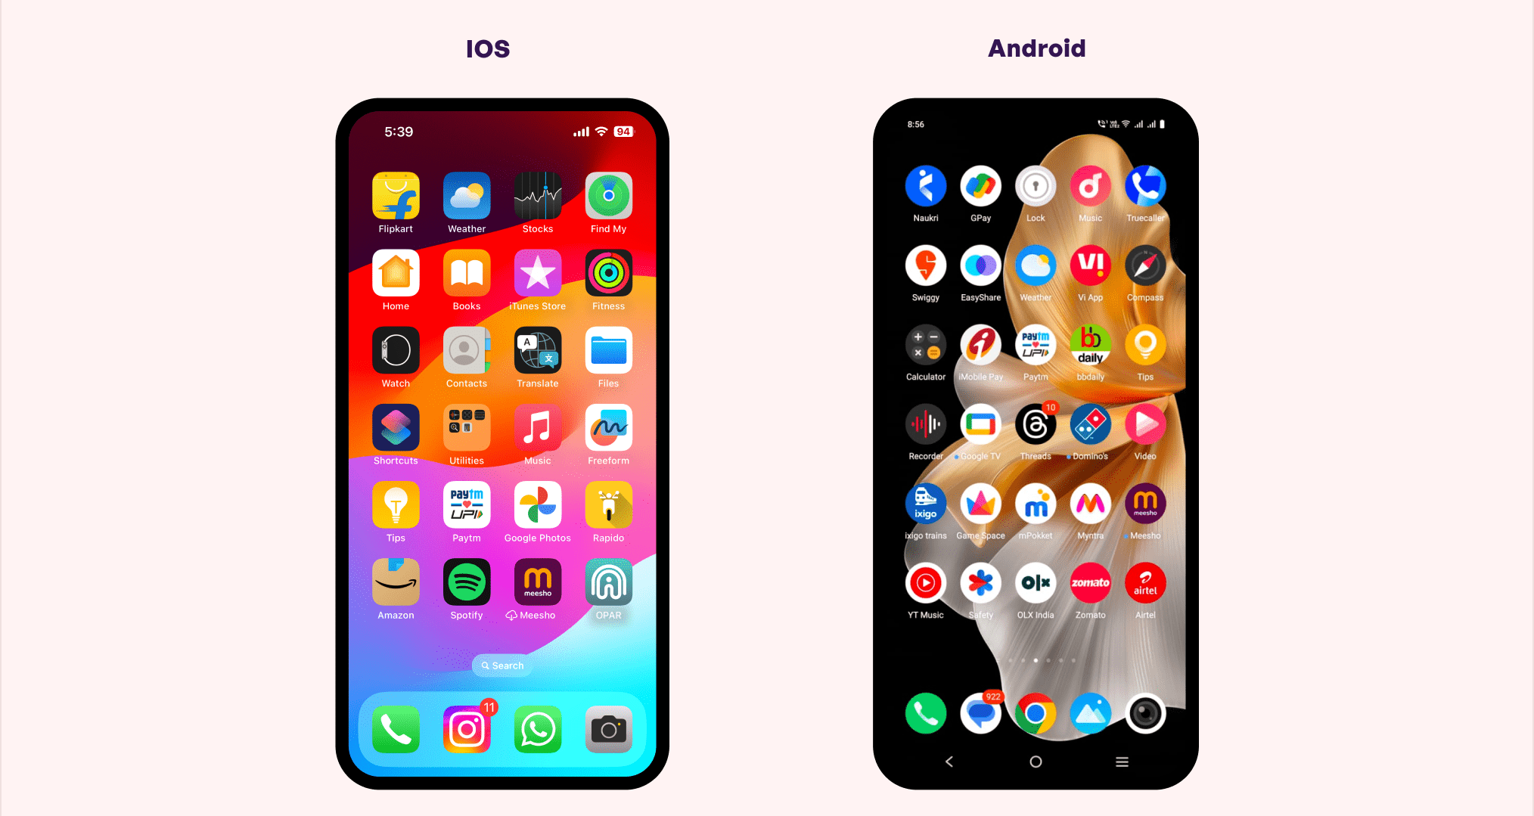
Touch-Sensitive Interface
Touch-based interface: Users interact with the OS using touch gestures on a touchscreen display.
Examples: Mobile operating systems like Android, iOS, Windows Phone.

Slide 64
Voice-Activated Interface
A voice-activated interface for an Operating System (OS) allows users to interact with the OS using voice commands.
Types of Voice-Activated Interface
Speech Recognition: Converts spoken words into text, allowing users to input commands and data.
Voice Command: Allows users to execute specific commands, such as "open browser" or "play music".
Natural Language Processing (NLP): Enables users to interact with the OS using natural language, such as "what's the weather like today?".

Slide 65
Web Based Interface
A web-based interface in an Operating System (OS) allows users to interact with the OS using a web browser.
This interface provides a platform-independent way to manage and configure the OS, as well as access its services and resources.
Webmin: A web-based interface for managing Linux and Unix systems.
cPanel: A web-based interface for managing web hosting and server administration tasks.
Windows Server Core: A web-based interface for managing Windows Server Core installations.
Chrome OS: A web-based interface for managing Chrome OS devices.

Slide 66
System Calls

Slide 67
System Calls
A system call is a request from a program to the operating system (OS) to perform a specific service or function.
It is a way for a program to interact with the OS and access hardware resources, such as memory, I/O devices, and network connections.

Slide 68
System Calls
Typically, a number is associated with each system call
System-call interface maintains a table indexed according to these numbers
The system call interface invokes the intended system call in OS kernel and returns status of the system call and any return values
The caller need know nothing about how the system call is implemented
Most details of OS interface hidden from programmer by API

Slide 69
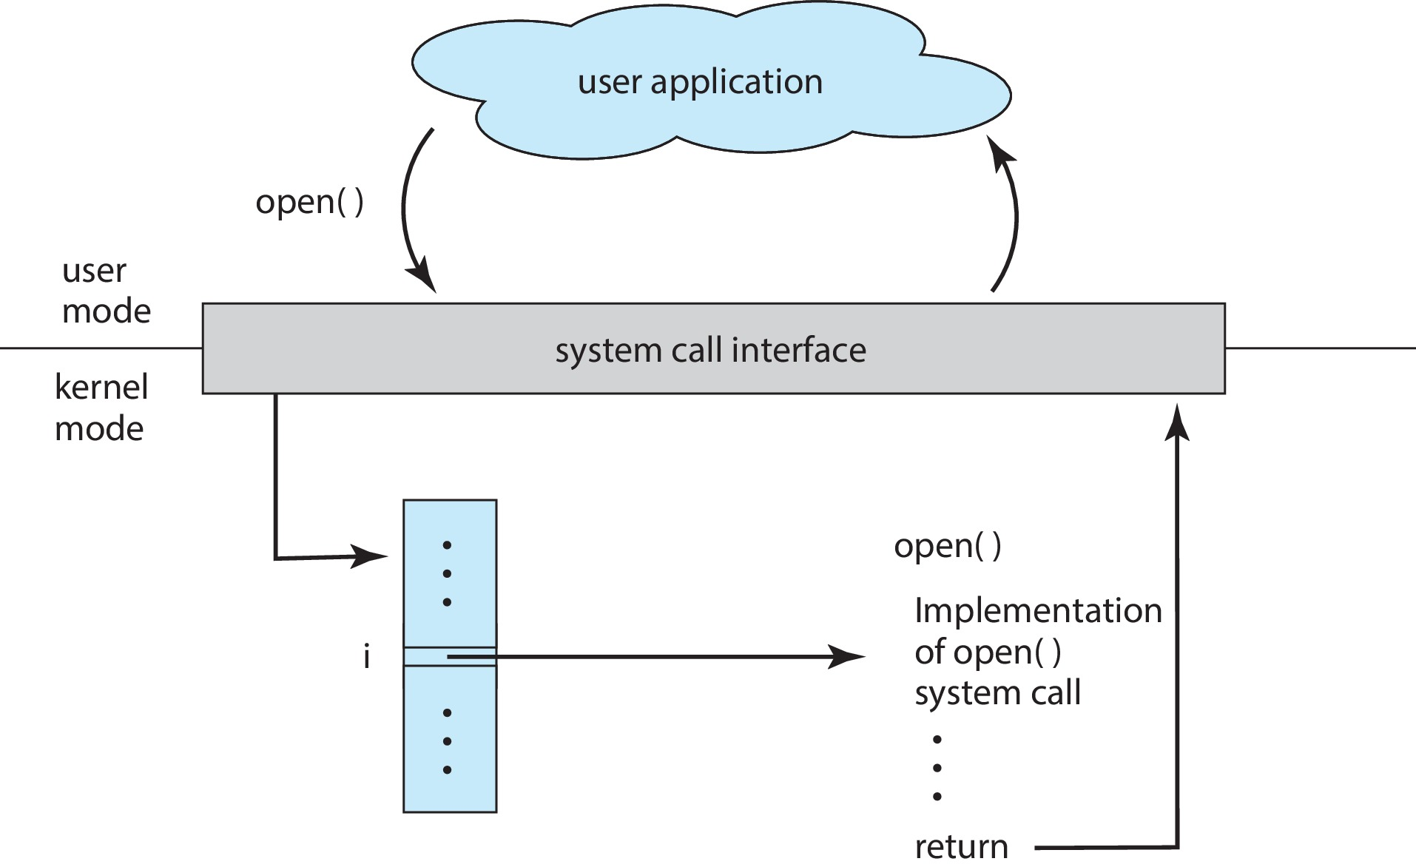
System Calls

Slide 70
System Calls
Three general methods used to pass parameters to the OS
1. Simplest: pass the parameters in registers
  In some cases, may be more parameters than registers
2. Parameters stored in a block, or table, in memory, and address of block passed as a parameter in a register
  This approach taken by Linux and Solaris
3. Parameters placed, or pushed, onto the stack by the program and popped off the stack by the operating system
  Block and stack methods do not limit the number or length of parameters being passed

Slide 71
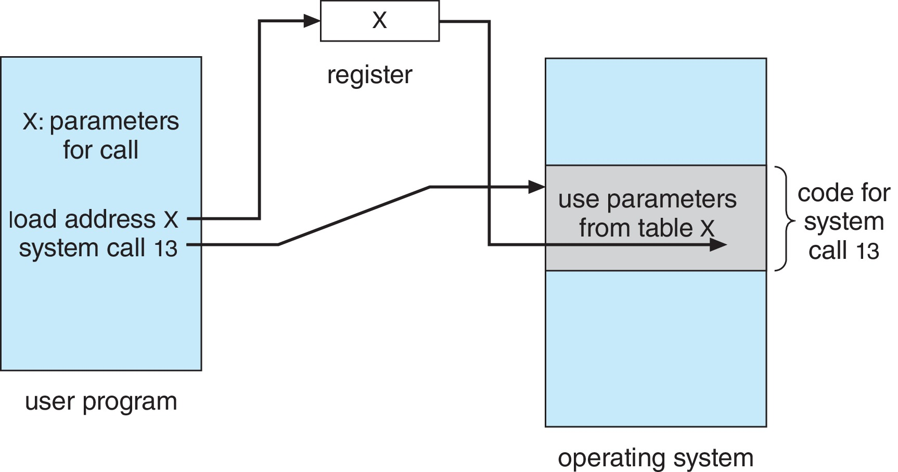
System Calls

Slide 72
Need for System Calls
Hardware Abstraction: System calls provide a layer of abstraction between the program and the hardware. This allows programs to be written without worrying about the underlying hardware details.
Resource Management: System calls enable the OS to manage resources, such as memory, I/O devices, and network connections, on behalf of the program.
Security: System calls provide a way for the OS to enforce security policies and access control, preventing programs from accessing unauthorized resources.

Slide 73
Need for System Calls
Portability: System calls enable programs to be written in a way that is portable across different hardware platforms and OSes.
Efficient Use of Resources: System calls allow the OS to optimize resource usage, such as scheduling processes, managing memory, and handling I/O operations.
Error Handling: System calls provide a way for the OS to handle errors and exceptions, such as page faults, division by zero, and I/O errors.

Slide 74
API’s for System Calls
Unix-based Systems
POSIX (Portable Operating System Interface): A standardized API for Unix-based systems.
  Around 100-200 system calls
System V: A system call API used by System V Unix.
BSD (Berkeley Software Distribution): A system call API used by BSD Unix.
Windows-based Systems
Win32: A system call API used by Windows operating systems. Around 500-600 system calls
Windows Runtime (WinRT): A system call API used by Windows 8 and later.

Slide 75
API’s for System Calls
Linux-based Systems
Linux System Call Interface: A system call API used by Linux operating systems.
Around 300-400 system calls
2. glibc (GNU C Library): A library that provides a system call API for Linux.
MacOS-based Systems
Mach System Call Interface: A system call API used by MacOS operating systems.
  Around 200-300 system calls
Darwin System Call Interface: A system call API used by MacOS operating systems.

Slide 76
API’s for System Calls
Android System Call Interface: A system call API used by Android operating systems.
iOS System Call Interface: A system call API used by iOS operating systems.

Slide 77
Types of System Calls
Process control
  create process, terminate process
  end, abort
  load, execute
  get process attributes, set process attributes
  wait for time
  wait event, signal event
  allocate and free memory
  Dump memory if error
  Debugger for determining bugs, single step execution
  Locks for managing access to shared data between processes

Slide 78
Types of System Calls
File management
  create file, delete file
  open, close file
  read, write, reposition
  get and set file attributes
Device management
  request device, release device
  read, write, reposition
  get device attributes, set device attributes
  logically attach or detach devices

Slide 79
Types of System Calls
Information maintenance
  get time or date, set time or date
  get system data, set system data
  get and set process, file, or device attributes
Protection
  Control access to resources
  Get and set permissions
  Allow and deny user access

Slide 80
Types of System Calls
Communications
  create, delete communication connection
  send, receive messages if message passing model to host name or process name
  From client to server
  Shared-memory model create and gain access to memory regions
  transfer status information
  attach and detach remote devices

Slide 81
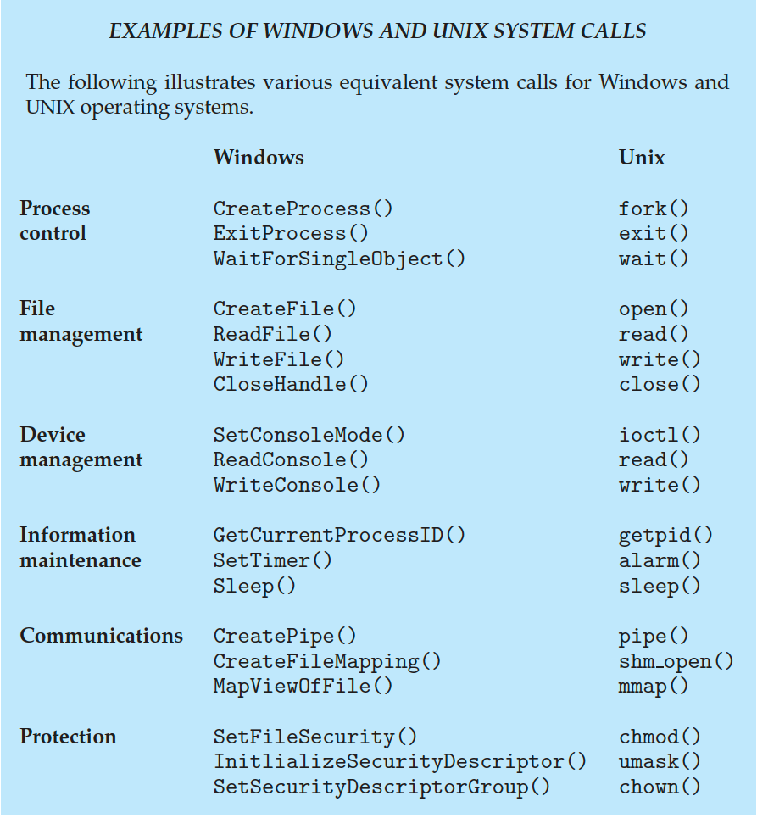
Examples

Slide 82
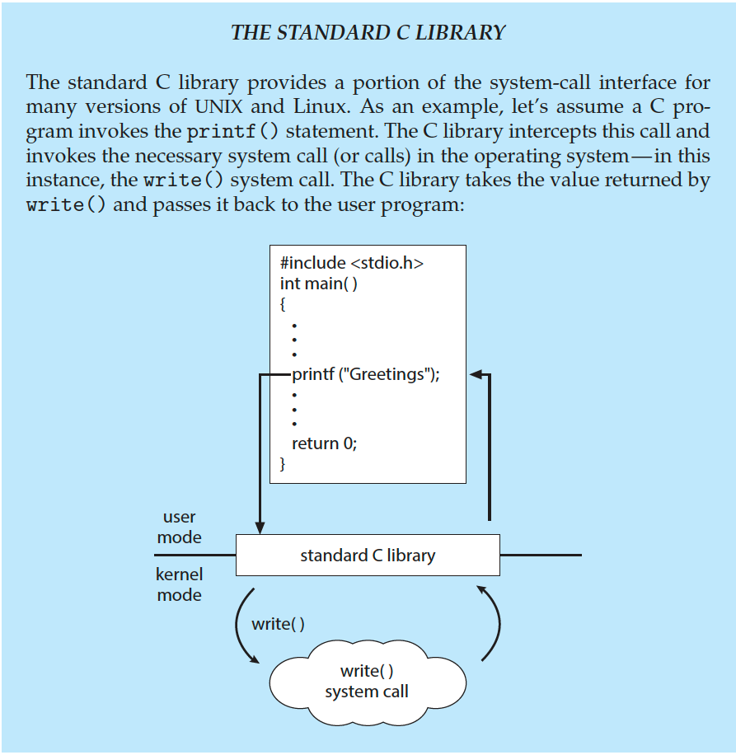
Examples

Slide 83
System Programs
System programs provide a convenient environment for program development and execution. They can be divided into:
  File manipulation
  Status information sometimes stored in a file
  Programming language support
  Program loading and execution
  Communications
  Background services
  Application programs
  Most users’ view of the operating system is defined by system programs, not the actual system calls

Slide 84
System Calls Vs System Programs
Features | System Call | System Program
Definition | It is a technique in which a computer system program requests a service from the OS kernel. | It offers an environment for a program to create and run.
Request | It fulfils the low-level requests of the user program. | It fulfils the high-level request or requirement of the user program.
Programming Languages | It is usually written in C and C++ programming languages. Assemble-level language is used in system calls where direct hardware access is required. | It is commonly written in high-level programming languages only.

Slide 85
System Calls Vs System Programs
Features | System Call | System Program
User View | It defines the interface between the services and the user process provided by the OS. | It defines the user interface (UI) of the OS.
Action | The user process requests an OS service using a system call. | It transforms the user request into a set of system calls needed to fulfil the requirement.
Classification | It may be categorized into file manipulation, device manipulation, communication, process control, information maintenance, and protection. | It may be categorized into file management, program loading and execution, programming-language support, status information, file modification, and communication.

Slide 86
Quiz
Which of the following is not an operating system?
  Windows
  Linux
  Oracle
  DOS
When was the first operating system developed?
  1948
  1949
  1950
  1951

Slide 87
Quiz
When was MS windows operating systems proposed?
  1994
  1990
  1992
  1985
What else is a command interpreter called?
  prompt
  kernel
  shell
  command

Slide 88
Quiz
What is the full form of FAT?
  File attribute table
  File allocation table
  Font attribute table
  Format allocation table
BIOS is used?
  By operating system
  By compiler
  By interpreter
  By application software

Slide 89
Quiz
Which of the following is a single-user operating system?
  Windows
  MAC
  MS-Dos
  None of these
Which of the following is not application software?
  Windows 7
  WordPad
  Photoshop
  MS-excel

Slide 90
Quiz
Which of the following windows does not have a start button?
  Windows 7
  Windows 8
  Windows XP
  None of these
Which of the following operating systems does not support more than one program at a time?
  Linux
  Windows
  MAC
  DOS

Slide 91
Quiz
Who provides the interface to access the services of the operating system?
  API
  System call
  Library
  Assembly instruction

Slide 92
Questions
1 | Define operating system.
2 | Outline the operating system functions.
3 | Explain the two modes of operating system operations.
4 | Explain any two computing environments.
5 | List the examples of open source operating systems.
6 | Describe the operating system services.
7 | Compare the command-line interface (CLI) with graphical user interfaces (GUI).
8 | Define system call.
9 | Summarize the file management system calls.
10 | Outline the design goals of operating system.

Slide 93
Questions
1 | Explain the difference between the user view and system view of an operating system.
2 | Outline different types of operating system interfaces.
3 | Summarize the operating system operations.
4 | Explain how an operating system handles protection and security.
5 | Explain various operating system functions.
6 | Summarize the operating system services.
7 | Outline different types of user and operating system interfaces.
8 | What is a system call? Explain exactly how a system calls switches a process to kernel mode during its execution and how is it switched back to user mode on return from a system call.
9 | Summarize about the system programs.
10 | Explain the purpose of all types of system calls and discuss the calls related to Process Control, device management in detail.

Slide 94
End of Unit 1

