Slide 1
USER INTERFACE DESIGN

Slide 2
Prescribed Books:
  Book -1: The essential guide to user interface design, Wilbert O Galitz, Wiley DreamTech.
  Book-2: Designing the user interface. 3rd Edition Ben Shneidermann, Pearson Education Asia
Reference Books:
  Book1: Human – Computer Interaction. Alan Dix, Janet Fincay, Gre Goryd, Abowd, Russell
  Bealg, Pearson Education
  Book2: Interaction Design Prece, Rogers, Sharps. Wiley Dreamtech,
  Book3: User Interface Design, Soren Lauesen , Pearson Education.

Slide 3
UNIT-I
Introduction to User Interface:
Defining the user interface and its importance, The importance of Good design, Benefits of Good design, History of Screen design, Characteristics of graphical and web user interfaces, Principles of user interface design

Slide 4
Defining the User Interface
User interface (UI) design is the process designers use to build interfaces in software or computerized devices, focusing on looks or style. Designers aim to create interfaces which users find easy to use and pleasurable. UI design refers to graphical user interfaces and other forms.

Slide 5
Defining the User Interface
Human-Computer Interaction (HCI)
User Interface (UI) Components.
Input Components
Output Components
Effective Interface Design

Slide 6
Human-Computer Interaction (HCI)
HCI involves the study, planning, and design of how people and computers work together to meet user needs effectively.
HCI designers consider user expectations, physical abilities, perceptual and information processing systems, and user enjoyment and attractiveness.
Technical characteristics and limitations of computer hardware and software are also considered.

Slide 7
User Interface (UI) Components
The UI is the part of a computer and its software that users interact with through sight, hearing, touch, speech, etc.
The UI has two main components: input and output.

Slide 8
Input Components
Input involves how users communicate their needs to the computer.
Common input components include keyboards, mice, trackballs, touch-sensitive screens or pads, and voice commands.

Slide 9
Output Components
Output is how the computer conveys results and requirements to users.
The most common output mechanism is the display screen, followed by auditory outputs like voice and sound.
The use of touch for output in interface design is still largely unexplored.

Slide 10
Effective Interface Design
Effective interface design combines well-designed input and output mechanisms that meet user needs, capabilities, and limitations.
The best interface is unobtrusive, allowing users to focus on the information and tasks rather than the mechanisms used to present and perform them.

Slide 11
1.2 The Importance of Good Design
With today’s technology and tools, and motivation we need to create really effective and usable interfaces and screens, why do we continue to produce systems that are inefficient and confusing or, at worst, just plain unusable? Is it because:
1. We don’t care?
2. We don’t possess common sense?
3. We don’t have the time?
4. We still don’t know what really makes good design?

Slide 12
Impact of Poor Design
Confusing and inefficient designs can lead to job difficulties, mistakes, and user frustration.
Extreme user reactions to poor design include acts of physical violence against computers.
Poor design can have significant financial costs and, in critical systems, can compromise user and public safety.

Slide 13
Importance of Good Design
A well-designed interface and screen are crucial for users as they are the primary interaction points with the system.
The interface impacts the user's perception of the system and can influence the organization's relationship with customers and profitability.

Slide 14
1.3 The Benefits of Good Design
Increased Productivity
Cost Savings
Improved Usability and User Satisfaction
Reduced Training and Support Costs
Enhanced Customer Service
Economic Benefits

Slide 15
Increased Productivity
Less crowded screens improve productivity by 20%.
Reformatted screens lead to 25% faster transactions and 25% fewer errors.
Good design principles reduce decision-making time by about 40%, resulting in significant person-year savings.
Cost Savings
Properly designed screens can save substantial amounts of money by reducing processing time.
Example: One graphical window redesign saved a company about $20,000 in its first year.

Slide 16
Improved Usability and User Satisfaction
Users can locate desired information more efficiently, improving their satisfaction and reducing frustration.
Example: A redesigned homepage improved search success rate and reduced search time.
Reduced Training and Support Costs
Better design lowers training costs as less training time is needed.
Support line costs decrease due to fewer assist calls.

Slide 17
Enhanced Customer Service
Better-designed interfaces lead to improved service quality for customers.
Users' tasks are more manageable, and errors are minimized.
Economic Benefits
Early identification and resolution of design problems during development save significant costs.
Every dollar invested in usability can return $10 to $100.

Slide 18
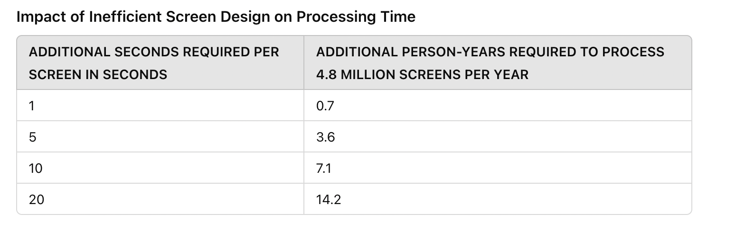
The table shows how small inefficiencies in screen design can significantly increase the total processing time and resource requirements.
Additional Seconds Required Per Screen in Seconds:
This column indicates the extra time a user needs to spend on each screen due to inefficient design. For example, if poor design forces users to spend 1 additional second per screen, it means that each interaction with the screen is slightly slower than it could be with better design.

Slide 19
Additional Person-Years Required to Process 4.8 Million Screens Per Year:
This column shows how much additional human labor is required to process a set number of screens annually due to the extra seconds spent per screen. A person-year is a unit of measurement that represents the amount of work one person can do in a year.
This demonstrates how even small inefficiencies in screen design can accumulate to significant additional time and resource costs, highlighting the critical need for good design practices to enhance productivity and reduce unnecessary labor.

Slide 20
1.4 A Brief History of the Human-Computer Interface
Initially humans have communicated through gestures, spoken language, and written language for centuries.
Spoken language is usually faster and more efficient than written language, and writing is generally faster than typing.
Earlier computers required users to type commands on keyboards, which was slow and difficult for many people.
Popular voice assistants like Siri (Apple), Google Assistant (Google), Alexa (Amazon), and Cortana (Microsoft).
Popular apps like Google Keep, Microsoft OneNote, Apple Notes, and Evernote.

Slide 21
Introduction of the Graphical User Interface
Earlier computers didn't have pictures or icons. Instead, they used text commands, which made them hard to use because people had to remember exact commands to do anything.
Xerox PARC developed the GUI concept, using a mouse for pointing and selecting objects on a graphical interface. Graphical user interface (GUI) allows users to interact with computers using pictures, icons, and a mouse, making it much easier than typing text commands.

Slide 22
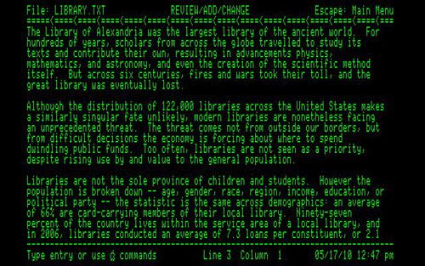
text-based computer screens

Slide 23
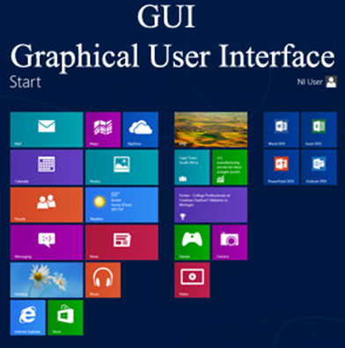
GUI based screen

Slide 24
Introduction of the Graphical User Interface
Xerox PARC and the Mouse: In 1970s, researchers at Xerox PARC developed the concept of a GUI and invented the mouse, a device to point and click on icons. The mouse made interacting with the computer more intuitive.
1984 - Apple Macintosh: In1984, Apple released the Macintosh, the first commercially successful computer with a GUI. This was a big step because it showed that people preferred using GUIs over text commands.
1985 - Microsoft Windows 1.0: In 1985 Microsoft entered the market with Windows 1.0, bringing the GUI to a broader audience.

Slide 25
Introduction of the Graphical User Interface
Other companies like Commodore and IBM, as well as UNIX-based systems, started developing their own GUIs. Some even included advanced features like 3D interfaces.
In the 1990s and 2000s, Microsoft and Apple became the leading forces in GUIs. They kept improving their interfaces, which helped establish GUIs as the standard way to interact with personal computers.

Slide 26
The Blossoming of the World Wide Web
Early Development (1960s-1980s):
1962: A scientist, J.C.R. Licklider, dreamed of connecting computers worldwide.
1969: The first version of the Internet, called ARPANET, connected four universities.
1974: The first commercial Internet, Telenet, was launched.
1982: The Internet was officially named, and more places started using it.

Slide 27
The Blossoming of the World Wide Web
Formation of the World Wide Web:
1989: Tim Berners-Lee at CERN had an idea for a way to link information using hypertext.
1991: He created HTML and launched the World Wide Web, making it easier to share information.

Slide 28
The Blossoming of the World Wide Web
Key Milestones:
1991: The Gopher system was created to make Internet navigation easier.
1992: Delphi started offering Internet access to the public.
1993: The Mosaic browser was developed, making the Web more visual and user-friendly.
1994: Netscape Navigator became the most popular browser until Microsoft released Internet Explorer in 1995.

Slide 29
The Blossoming of the World Wide Web
Commercialization and Competition:
1995: Companies like AOL, Yahoo, and Lycos made the Internet more commercial.
1998: Netscape made its browser free, leading to the development of Mozilla.
2003: Apple launched Safari, and Mozilla Firefox was released in 2004, challenging Internet Explorer.

Slide 30
The Blossoming of the World Wide Web
Ongoing Development:
1994: The World Wide Web Consortium (W3C) was formed to develop Web standards.
Today: The Web is a vast information space where people can read and write using connected computers.

Slide 31
A Brief History of Screen Design
Early Screen Design (1970s):
Introduction of IBM 3270: IBM introduced its 3270 cathode ray tube text-based terminal, sparking interest in screen design. Early screens were very basic and hard to use. They looked like a list of confusing codes and words.
Challenges: Users had to remember a lot of commands and the screens were hard to read.

Slide 32
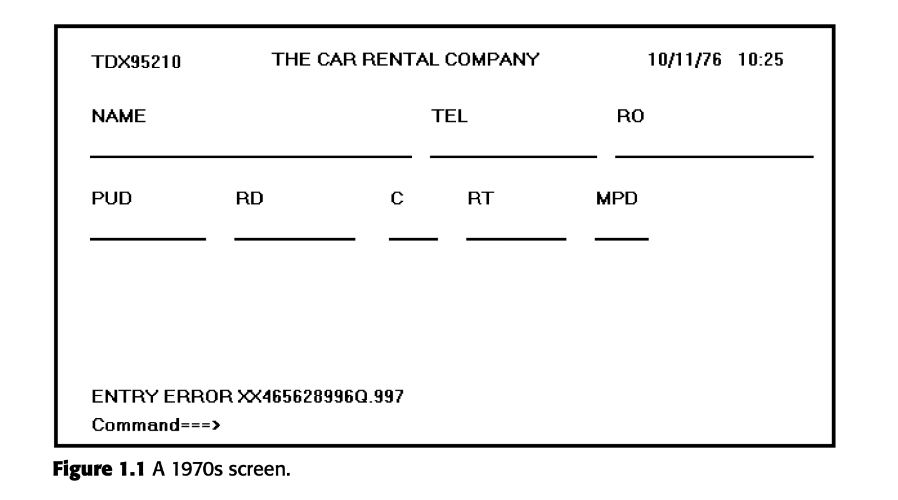

Slide 33
A Brief History of Screen Design
Early Screen Design (1980s):
Screens got a bit better. Designers started to organize information in a clearer way.
Screens were less cluttered, with better labels and some instructions on the screen.

Slide 34
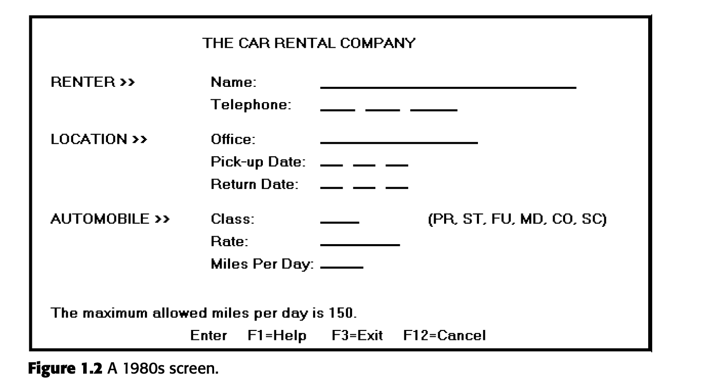

Slide 35
A Brief History of Screen Design
Early Screen Design (1990s):
The big change came with graphics. Screens started to look more like what we see today, with buttons, menus, and different colors.
Easier to use because you could click on things instead of typing commands. More visually appealing.

Slide 36
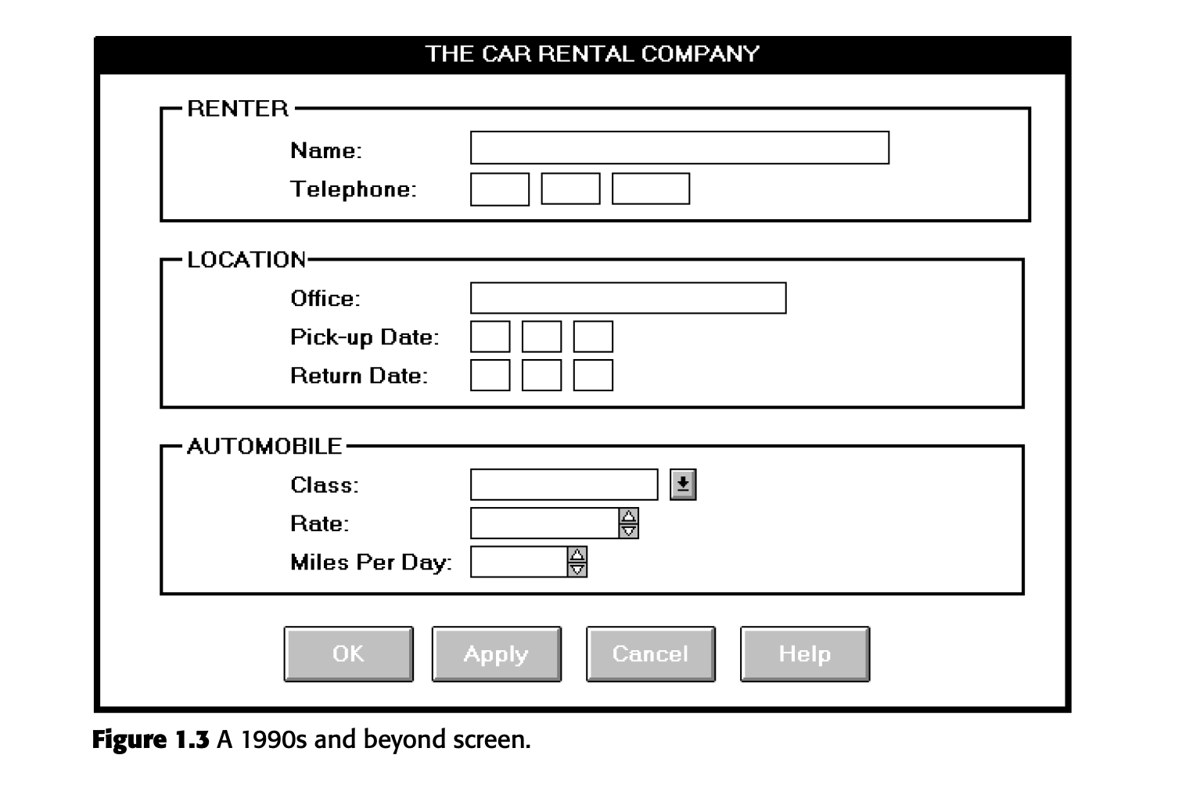

Slide 37
A Brief History of Screen Design
Screen Design (Now):
Today, screens are very advanced, user-friendly, and visually engaging.
Technology allows for smooth and interactive designs that are easy to use and understand.

Slide 38
Characteristics of graphical and web user interfaces
The following are the characteristics of GUI interfaces are
Interaction styles.
The concept of direct manipulation.
The characteristics of graphical interfaces.
The characteristics of Web interfaces.
Web page versus Web application design.
The general principles of user interface design.

Slide 39
1.Interaction Style
An interaction style is the way users communicate with a computer system. When designing graphical systems, web pages, or applications, designers can choose from several interaction styles.
When designing a computer system, the choice of interaction styles can be influenced by the type of system and the devices used to interact with it (like keyboards, mice, touchscreens, etc.).

Slide 40
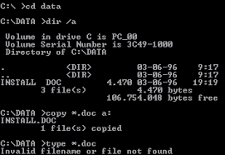
1.Interaction Style
1.1 Command Line:
Description: The Command Line Interface (CLI) is the oldest way of interacting with a computer. Imagine it as a blank screen where you have to type specific commands to tell the computer what to do.
We press a function key or type a command into a special area on the screen. Commands can be simple letters, short words, or even multiple words.
Examples:
  Typing "copy file.txt D:" to copy a file.
  Typing "delete file.txt" to delete a file.

Slide 41
1.Interaction Style
Advantages:
Powerful: It gives us direct access to almost all functions of the computer.
Flexible: We can add options to commands to make them do different things. For example, "copy file.txt D:\backup" tells the computer to copy the file to a specific folder.
Disadvantages:
Memory-Dependent: We have to remember the exact commands, as there are no hints or lists on the screen to help you.
Complexity: Commands can be hard to understand and use, with complicated rules for typing them correctly.
Error-Prone: It's easy to make typing mistakes, and the computer will not understand what you want if there's even one small error.

Slide 42
1.Interaction Style
1.2 Menu Selection
Description: Menu Selection is an interaction style where users choose from a list of options or choices presented on the screen. These choices can be selected using a mouse, keyboard, or even by voice commands.

Slide 43
1.Interaction Style
1.2 Menu Selection :
On Screens:
  Users see a list of options.
  They use a mouse, keyboard, or touchscreen to select an option.
  For example, clicking "File" and then "Save" in a software application.
By Voice:
  Users can select options by speaking.
  For example, when you call a business and hear "Press 1 for customer service," you are using a menu selection by voice.

Slide 44
1.Interaction Style
1.2 Menu Selection :
Advantages
Menus help users recognize options rather than recall commands from memory.
Menus guide users through complex tasks by breaking them into smaller, manageable steps.
Disadvantages
Experienced users might find menus slower because they have to go through several steps to complete a task.
If labels are confusing, users may make errors or take longer to make a selection.

Slide 45
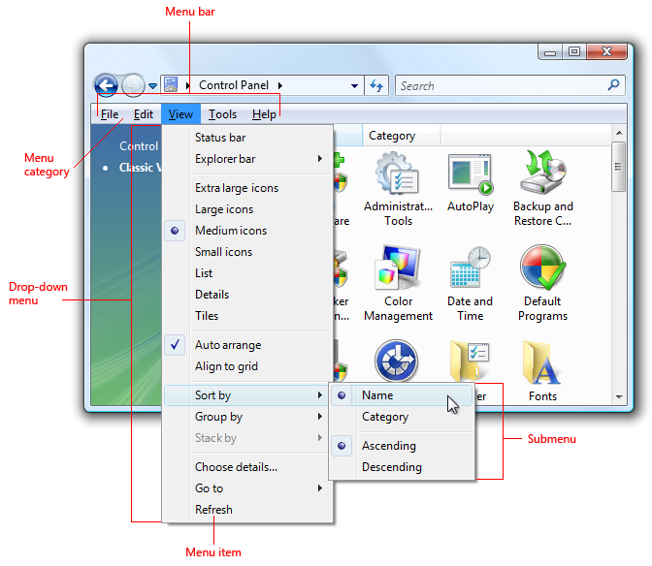
1.Interaction Style
1.2 Menu Selection :

Slide 46
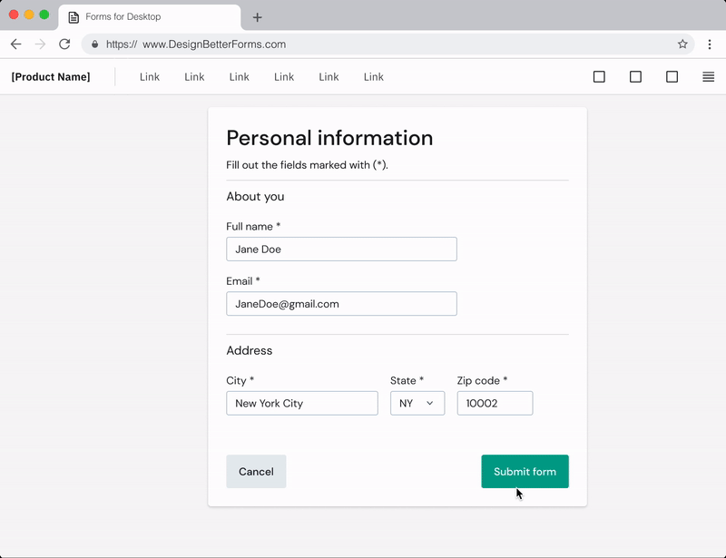
1.Interaction Style
1.3 Form Fill-in :
Form Fill-In Style is a method used to collect information from users by having them fill out fields on a screen. These fields can be text boxes, drop-down lists, checkboxes, and other controls where users enter or select information.

Slide 47
1.Interaction Style
1.3Form Fill-in:
Advantages
Forms are easy to understand because they look like paper forms most people use it.
Well-designed forms help users to quickly enter information.
Disadvantages
A poorly designed form can be frustrating and slow to complete.

Slide 48
1.Interaction Style
1.4 Direct Manipulation :
Direct Manipulation is an interaction style where users directly interact with the objects on the screen.
For example, icons, buttons, and sliders.
Instead of typing commands or selecting from menus, users use pointing devices like a mouse or joystick.
Users navigate the interface using visual elements like menu bars and pull-down menus.

Slide 49
1.Interaction Style
1.4 Direct Manipulation :
Advantages
Users can see the effects of their actions immediately, making it easier to understand.
Users receive immediate visual feedback from the system, helping them understand what actions they are performing.
Disadvantages
Limited screen space can make it difficult to display all necessary objects and options.
Direct manipulation interfaces can require more computing power and resources to support graphics and interactivity.

Slide 50
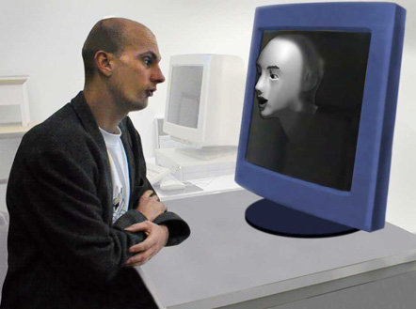
1.Interaction Style
1.5 Anthropomorphic Interface :
Anthropomorphic Interface: This type of interface aims to interact with people the same way humans interact with each other.
It includes natural language dialogues, hand gestures, facial expressions, and eye movements.

Slide 51
1.Interaction Style
1.5 Anthropomorphic Interface :
Advantages
These interfaces mimic human behaviour, making them feel more intuitive and natural.
Disadvantages
Developing these interfaces requires a deep understanding of human behavior and advanced technology.

Slide 52
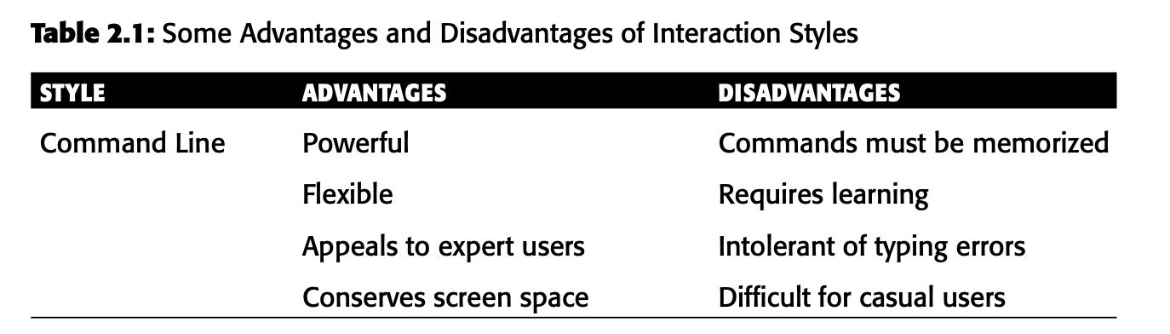

Slide 53
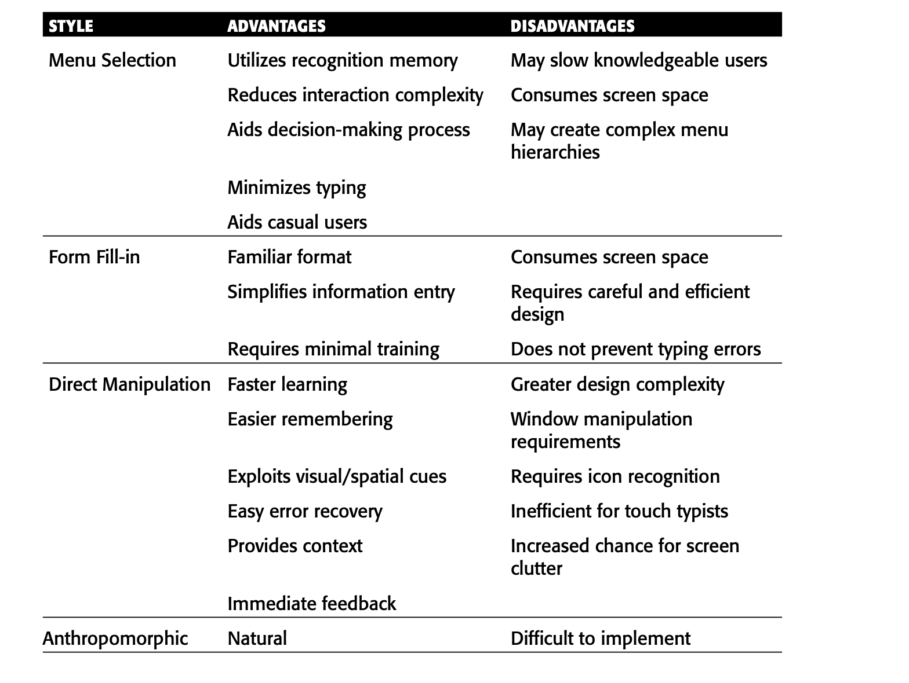

Slide 54
2. The Concept of Direct Manipulation
A type of graphical system where users interact directly with on-screen elements.The characteristics include
The system is portrayed as an extension of the real world.
Objects and actions are continuously visible.
Actions are rapid and incremental with visible display of results.
Incremental actions are easily reversible.

Slide 55
2. The Concept of Direct Manipulation
2.1The system is portrayed as an extension of the real world.
The system replicates real-world objects and actions on the screen.
Users interact with these objects as they would in the real world, making the interface intuitive.
A computer desktop mimics a real desk, with files and folders.

Slide 56
2. The Concept of Direct Manipulation
2.2 Objects and actions are continuously visible.
Just like how objects on a physical desk are always visible and accessible, in a direct manipulation interface, screen objects are continuously visible.
Eg: how icons on a computer desktop are always visible, and users can interact with them by clicking or dragging.
Advantages
Actions are rapid and incremental with immediate display of results, making the system responsive and user-friendly.
Easy to understand

Slide 57
2. The Concept of Direct Manipulation
2.3 Actions are rapid and incremental with visible display of results.
Actions are designed to be quick and happen in small steps. This means users can see the effects of their actions right away, without waiting (They can’t touch).
In addition to visual feedback, some systems also provide sounds to indicate that an action has been performed. This is called auditory feedback.(eg: Trash Button)

Slide 58
2. The Concept of Direct Manipulation
2.4 Incremental actions are easily reversible.
Finally, actions, if discovered to be incorrect or not desired, can be easily undone.

Slide 59
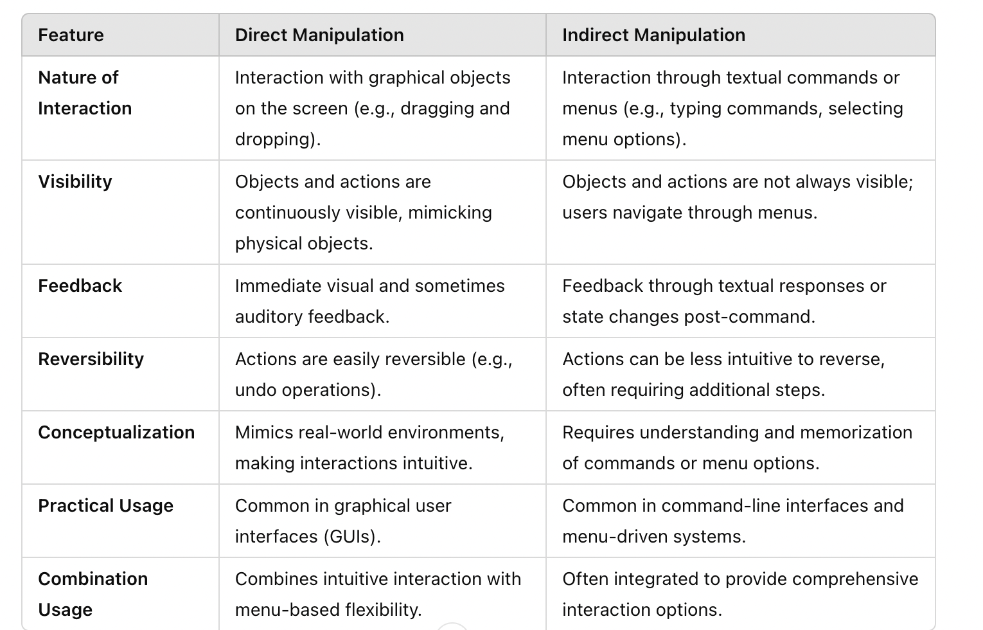

Slide 60
3. The Characteristics of GUI
A Graphical User Interface (GUI) is a type of user interface that allows users to interact with electronic devices using graphical icons, visual indicators, and elements such as windows, menus, and buttons, instead of relying solely on text-based commands.

Slide 61
3. The Characteristics of GUI
The characteristics of the Graphical User Interface (GUI) include
Sophisticated Visual Presentation
Pick-and-Click Interaction
Restricted Set of Interface Options
Visualization
Object Orientation
Extensive Use of Recognition Memory
Concurrent Performance of Functions

Slide 62
3. The Characteristics of GUI
3.1 Sophisticated Visual Presentation
Visual presentation refers to everything we see on a computer screen.
Visual Elements and Capabilities: Modern graphical systems display lines, drawings, icons, various fonts, up to 16 million colors, animations, photos, and videos.
Interface Components: These include windows (primary, secondary, or dialog boxes), menus (menu bar, pull-down, pop-up, cascading), icons, and screen-based controls (text boxes, list boxes, combo boxes, settings, scroll bars, and buttons).
Interaction Tools: Users interact with the interface using a mouse or pointing device and a cursor.
Objective of Visual Presentation: The aim is to create an interface that is realistic, meaningful, simple, and clear, making it user-friendly and reflective of the real world.

Slide 63
3. The Characteristics of GUI
3.2 Pick-and-Click Interaction
Pick: Identifying the element on the screen we want to interact with.
Click: Signaling the action we want to perform on that element.
Primary Mechanism - The Mouse: Move the mouse pointer over the element (pick), then press a button on the mouse (click) to perform the action.
Secondary Mechanism - The Keyboard: Many systems allow us to use keys to navigate and select items instead of the mouse.

Slide 64
3. The Characteristics of GUI
3.3 Restricted Set of Interface Options
Users can only choose from the options shown on the screen or those that can be accessed through these options. There are no hidden choices.
WYSIWYG (What You See Is What You Get)

Slide 65
3. The Characteristics of GUI
3.4 Visualization
Visualization is a way to help people understand complex or large amounts of information by changing how it is represented.
Example: If you want to compare sales over time, a line graph might be best. If you want to see the proportion of different items sold, a bar chart might be better.
Effective visualizations help people gain insights, increase productivity, and use data more quickly and accurately.

Slide 66
3. The Characteristics of GUI
3.5 Object Orientation
Imagine your computer screen is your workspace:
Objects: Think of the items on your desk—documents, folders, and your printer. Each of these is an object.
Actions: What you do with these items—open a document, move a folder, print a file.
Types of Objects:
  Data Objects: The text and images in a document.
  Container Objects: Folders on your desk that hold multiple documents.
  Device Objects: Your printer or trash can.

Slide 67
3. The Characteristics of GUI
3.5 Object Orientation
Relationships:
  Collections: Selecting multiple documents to move them together.
  Constraints: Changing the size of a picture in a document affects the layout of the text.
  Composites: A paragraph in a document is a composite of sentences and words.
  Containers: A folder on your desk that holds various documents.

Slide 68
3. The Characteristics of GUI
3.6 Extensive Use of Recognition Memory
Keeping objects and actions visible on the screen helps people remember and use them more easily.
When objects and actions are always on the screen, people can quickly see and use them without having to remember where they are or how to find them.

Slide 69
3. The Characteristics of GUI
3.7 Concurrent Performance of Functions(Graphic systems can perform multiple tasks at the same time.)
Types of Multitasking:
Cooperative Multitasking: The system handles background tasks when it's not busy with the main task.
Preemptive Multitasking: The system divides processing power into time slices and allocates portions to each running application.

Slide 70
ADVANTAGES of GUI
Symbols recognized faster than text
Faster learning
Faster use and problem solving
Easier remembering
More natural
Exploits visual/spatial cues
Fosters more critical thinking
Provides context

Slide 71
ADVANTAGES of GUI
Fewer errors
Increased feeling of control
Immediate feedback
Predictable system responses
Easily reversible actions
Less anxiety concerning use
More attractive
May consume less space

Slide 72
ADVANTAGES of GUI
Replaces national languages
Easily augmented with text displays
Low typing requirements
Smooth transition from command language system

Slide 73
disADVANTAGES of GUI
Greater design complexity
Learning still necessary
Lack of experimentally-derived design guidelines
Inconsistencies in technique and terminology
Working domain is the present
Not always familiar

Slide 74
disADVANTAGES of GUI
Window manipulation requirements
Production limitations
Few tested icons exist
Inefficient for touch typists
Inefficient for expert users
Not always the preferred style of interaction
Not always the fastest style of interaction

Slide 75
The Web User Interface
Revolutionary Impact: The Web transformed computing by enabling global communication, information access, and content publishing, giving users unprecedented control over how web pages are displayed and function.
Rapid Growth: The number of internet hosts and users grew exponentially, from over 1,000 hosts in 1984 to over 350 million hosts and one billion users by 2005, with the highest user base in the Asia/Pacific region.
User Control: Users have significant control over web page elements like typography, colors, graphics, data transmission, and cookies, which has led to more discerning preferences regarding web design.
Design Expectations: Poor web design, such as slow downloads, confusing navigation, and disturbing animations, leads to user abandonment, emphasizing the need for fast, intuitive, and well-organized websites.

Slide 76
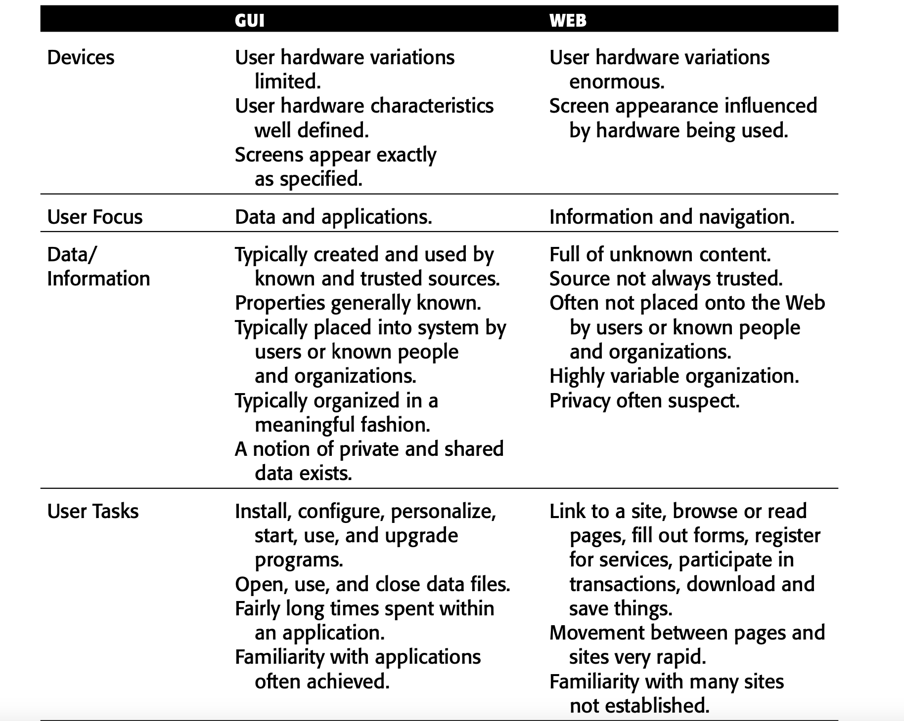
Characteristics of a Web Interface

Slide 77
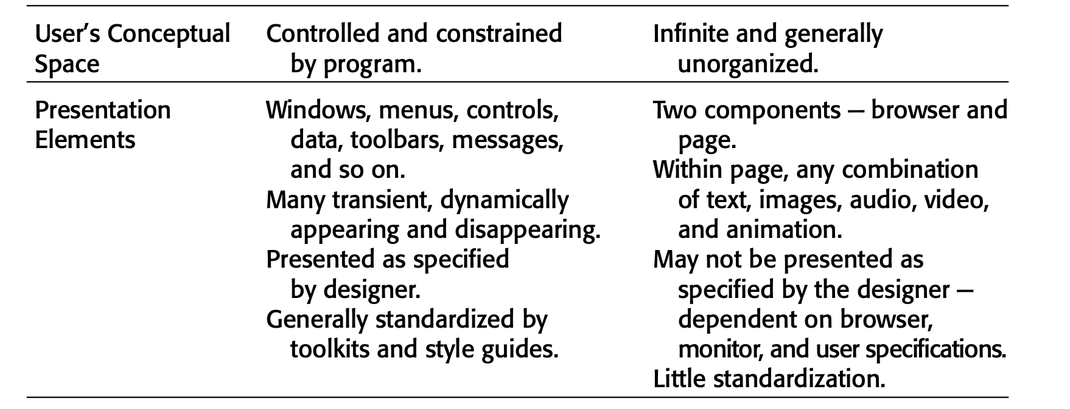
Characteristics of a Web Interface

Slide 78
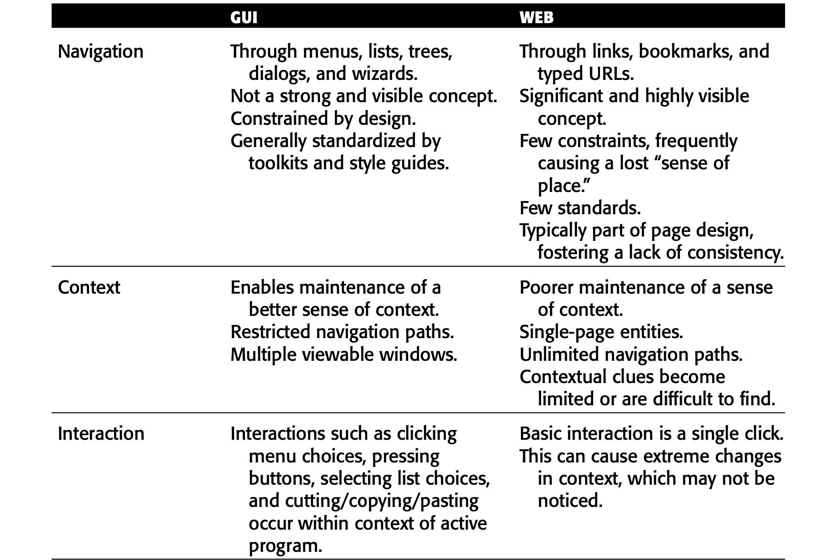
Characteristics of a Web Interface

Slide 79
Characteristics of a Web Interface

Slide 80
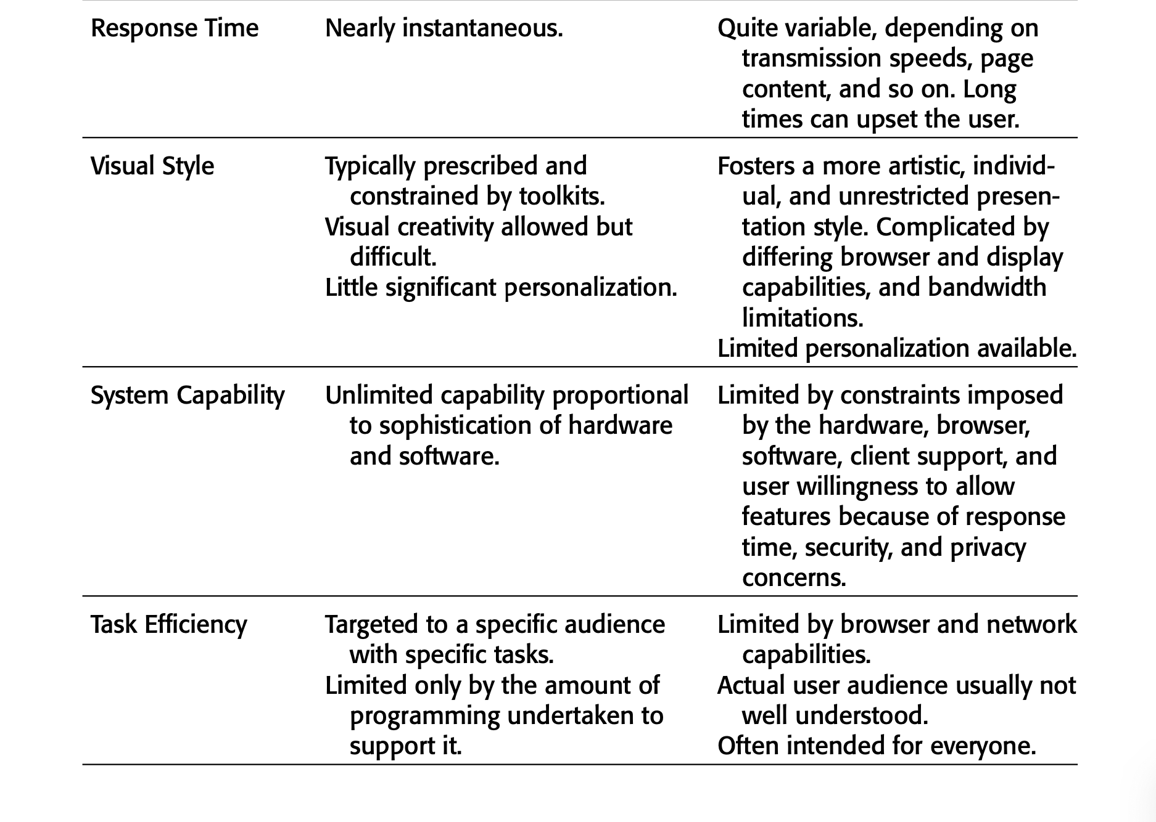
Characteristics of a Web Interface

Slide 81
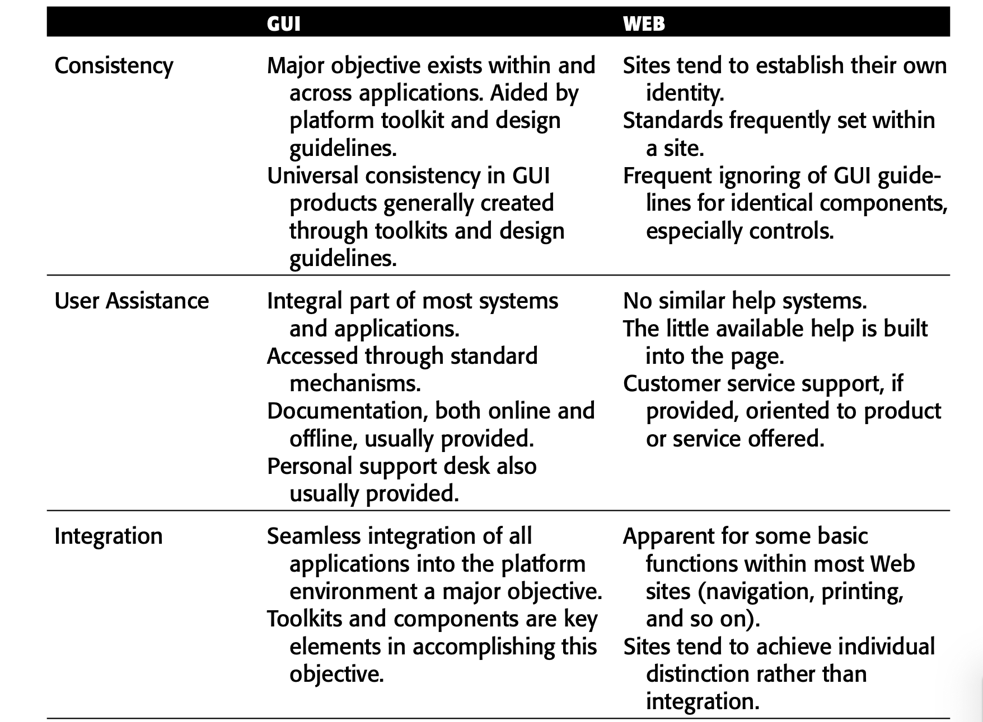
Characteristics of a Web Interface

Slide 82
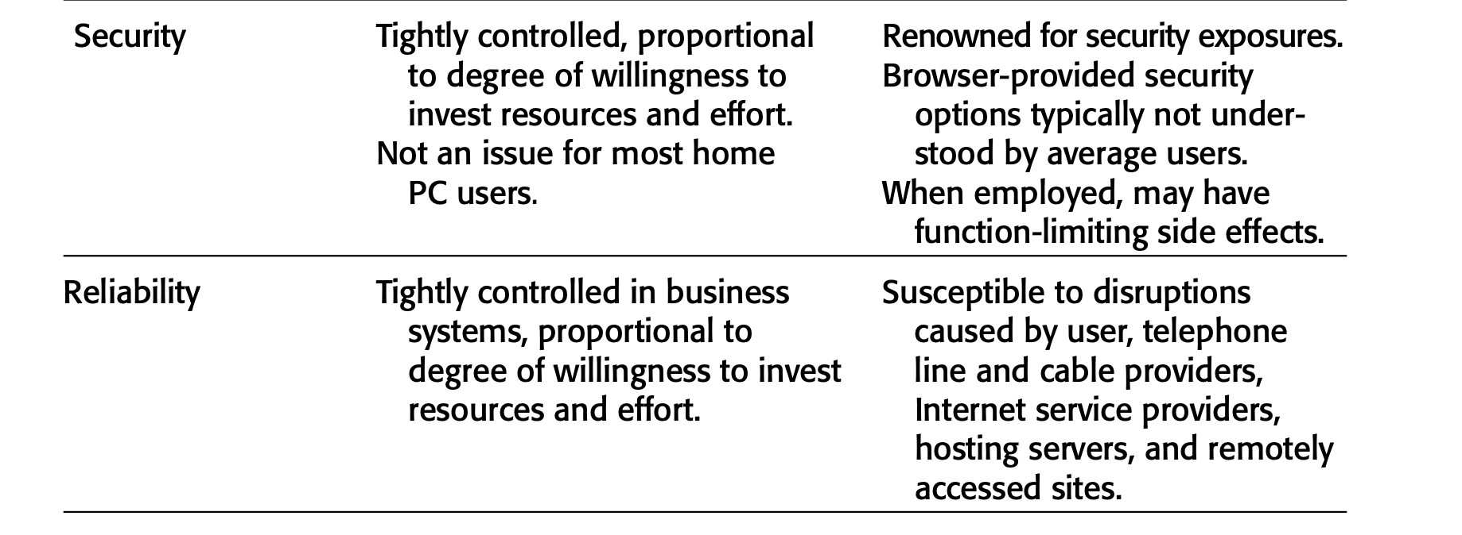
Characteristics of a Web Interface

Slide 83
differences between printed pages and web pages
Page Layout
Printed Pages: Precise and consistent layout.
Web Pages: Approximate layout, influenced by user’s device and browser.
Page Resolution
Printed Pages: High resolution, easy to read.
Web Pages: Lower resolution, screen reading is slower.

Slide 84
differences between printed pages and web pages
Page Size
Printed Pages: Fixed size, larger, designed as one complete entity.
Web Pages: Variable size, displayed in pieces, visual impact often fragmented.
Page Rendering
Printed Pages: Instant, complete view.
Web Pages: May load slowly, content appears piece by piece.

Slide 85
differences between printed pages and web pages
User Focus
Printed Pages: Complete information set, easy to gauge effort required.
Web Pages: Individual snapshots, often skimmed, less sense of overall structure.
Page Navigation
Printed Pages: Simple page turning.
Web Pages: Requires deciding on links to follow, can be complex.

Slide 86
differences between printed pages and web pages
Sense of Place
Printed Pages: Physical cues and organization provide a sense of location.
Web Pages: Lack physical cues, can cause disorientation.
Interactivity
Printed Pages: Static information, visually focused.
Web Pages: Dynamic interaction (scrolling, clicking), more engaging.
Page Independence
Printed Pages: Sequential, contextually dependent.
Web Pages: Independent, each page must be self-explanatory.

Slide 87
comparison between intranets and the Internet
Users
Intranet: Used by organization employees who are familiar with the organization’s structure, products, jargon, and culture.
Internet: Used by a broad audience, including customers who know much less about the organization.
Tasks
Intranet: Used for everyday organizational activities like complex transactions, queries, and communications.
Internet: Mainly used for finding information and performing simple transactions.

Slide 88
comparison between intranets and the Internet
Type of Information
Intranet: Contains detailed, frequently updated information necessary for organizational functioning.
Internet: Presents more stable information such as marketing materials, customer information, and reports.
Amount of Information
Intranet: Typically much larger, possibly ten to one hundred times the size of the organization’s Internet site.
Internet: Generally smaller in comparison, focusing on broader information for the public.

Slide 89
comparison between intranets and the Internet
Hardware and Software
Intranet: Operates in a controlled environment, allowing standardization of computers, monitors, browsers, and other software. Faster communication speeds enable the use of rich graphics and multimedia.
Internet: Requires cross-platform compatibility, often resulting in slower download times due to diverse user hardware and slower communication speeds.

Slide 90
comparison between intranets and the Internet
Design Philosophy
Intranet: Leans towards traditional GUI designs that are familiar to users, incorporating effective and visually appealing elements while avoiding unnecessary and distracting features.
Internet: Often includes promotional and diverse design elements to attract and engage a wide audience.

Slide 91
Principles of User Interface Design
The history of the human-computer interface, various researchers and writers have attempted to define a set of general principles of interface design.

Slide 92
Principles of User Interface Design
Principles for the Xerox STAR
Illusion of Manipulable Objects
Create objects on the screen that look and act like real objects you can interact with.
Key Points:
    Objects should be easy to understand and use.
    It should be obvious how to select and interact with these objects.
    Selected objects should clearly show they are selected.

Slide 93
Principles of User Interface Design
Principles for the Xerox STAR
2.Visual Order and Viewer Focus
Highlight important elements on the screen at the right time.
Key Points:
  Use visual contrast to make key parts stand out.
  Use animation and sound to draw attention.
  Provide feedback through the pointer, which often changes shape.

Slide 94
Principles of User Interface Design
Principles for the Xerox STAR
3 . Revealed Structure
Concept: Make the relationship between user actions and system responses clear and direct.
Key Points:
  Minimize the steps between what the user wants to do and the effect.
  Reveal the underlying structure during the selection process to help users understand their actions.

Slide 95
Principles of User Interface Design
Principles for the Xerox STAR
4. Consistency
Keep the interface consistent to make it easier to learn and use.
Key Points:
  Maintain consistency in element locations, commands, fonts, and selection indicators.
  Use consistent techniques for contrast and emphasis.

Slide 96
Principles of User Interface Design
Principles for the Xerox STAR
5.Appropriate Effect or Emotional Impact
Match the interface’s look and feel to the product’s purpose and market.
Key Points:
  Ensure the interface reflects the product’s intended emotional effect, whether professional, secure, playful, or imaginative.

Slide 97
Principles of User Interface Design
Principles for the Xerox STAR
6. Match with the Medium
Design the interface according to the capabilities of the display device.
Key Points:
  Consider the device’s resolution and color capabilities.
  Ensure the screen images are of high quality based on what the device can display.

Slide 98
Principles of User Interface Design
General Principles
1. Accessibility in Design
Systems should be designed so that everyone can use them without needing any special modifications.
Perceptibility: The design should be understandable to everyone, regardless of their sensory abilities (like sight or hearing).
Operability: The design should be usable by everyone, regardless of their physical abilities.
Simplicity : The design should be easy to understand and use, no matter the user’s experience, literacy, or focus level.
Forgiveness :The design should minimize errors and make it easy to fix them when they occur.

Slide 99
Principles of User Interface Design
General Principles
2. Aesthetically Pleasing
Provide visual appeal by following these presentation and graphic design principles:
–– Provide meaningful contrast between screen elements.(Use differences in color, size, and style to make important )
–– Create groupings.(Group related items together to show they are connected)
–– Align screen elements and groups. (Arrange items in a neat and orderly way)
–– Provide three-dimensional representation.(Use shading and shadows to give a sense of depth to objects.)
–– Use color and graphics effectively and simply. (Choose colors and images that are easy to understand and not overwhelming.)

Slide 100
Principles of User Interface Design
General Principles
3. Availability
Make all objects available at all times. (Users should be able to access any feature or function whenever they need it.)
Avoid the use of modes. (Avoid creating different modes where some actions are restricted or unavailable.)

Slide 101
Principles of User Interface Design
General Principles
4. Clarity
Ensure that the interface is easy to understand in terms of looks, functions, and wording.
Visual Elements(Make sure that icons, buttons, and other visual elements are easy to recognize and understand.)
Functions( Ensure that the functions (what the software does) are clear and easy to understand.)
Metaphors(Use familiar analogies that relate to real-world concepts to explain functions).
Words and Text( Use simple and clear language, avoiding technical jargon.)

Slide 102
Principles of User Interface Design
General Principles
4. Compatibility
Provide compatibility with the following:
–– The user (Design should meet the needs and perspectives of the user.)
–– The task and job(The system should align with the tasks users need to perform.)
–– The product (Make sure the new system works well with other systems the user already knows.)
Adopt the user’s perspective.

Slide 103
Principles of User Interface Design
General Principles
5. Configurability :Allow users to easily personalize and adjust settings to fit their needs and preferences.
Permit easy personalization, configuration, and reconfiguration of settings to do the following:
–– Enhance a sense of control. (Users should be able to customize the interface to suit their personal preferences.)
–– Encourage an active role in understanding. (Personalizing settings helps users engage more deeply with the system, leading to better understanding and efficiency.)

Slide 104
Principles of User Interface Design
General Principles
5. Consistency
A system should look, act, and operate the same throughout.
Similar components should:
–– Have a similar look. –– Have similar uses. –– Operate similarly.
The same action should always yield the same result.
The function of elements should not change.
The position of standard elements should not change.

Slide 105
Principles of User Interface Design
General Principles
6. Control
The user must control the interaction.
–– Actions should result from explicit user requests.
–– Actions should be performed quickly.
–– Actions should be capable of interruption or termination.
–– The user should never be interrupted for errors.
The context maintained must be from the perspective of the user. (The system should keep context from the user’s point of view.)
Users should have different ways to achieve their goals.
Avoid states where some actions aren’t available.
Users should be able to personalize the interface.
Provide good default settings for beginners.

Slide 106
Principles of User Interface Design
General Principles
6. Directness (Directness means that when you perform an action, you immediately see its effect.)
Provide direct ways to accomplish tasks.
–– Available alternatives should be visible.(All available options or choices should be clearly visible to the user)
–– The effect of actions on objects should be visible. (In direct manipulation systems, tasks are performed by directly interacting with objects.)

Slide 107
Principles of User Interface Design
General Principles
7. Efficiency
Minimize eye and hand movements, and other control actions.
–– Transitions between various system controls should flow easily and freely.
–– Navigation paths should be as short as possible.
–– Eye movement through a screen should be obvious and sequential. (When users look at a screen, their eye movement should be natural and sequential. )
Anticipate the user’s wants and needs whenever possible. (Good interface design anticipates what users might want)

Slide 108
Principles of User Interface Design
General Principles
8. Familiarity
Employ familiar concepts and use a language that is familiar to the user.
Keep the interface natural, mimicking the user’s behavior patterns.
Use real-world metaphors.

Slide 109
Principles of User Interface Design
General Principles
9. Flexibility
A system must be sensitive to the differing needs of its users, enabling a level and type of performance based upon:
–– Each user’s knowledge and skills.
–– Each user’s experience.
–– Each user’s personal preference.
–– Each user’s habits.
–– The conditions at that moment.

Slide 110
Principles of User Interface Design
General Principles
10. Forgiveness
Tolerate and forgive common and unavoidable human errors.
Prevent errors from occurring whenever possible.
Protect against possible catastrophic errors.
Provide constructive messages when an error does occur.

Slide 111
Principles of User Interface Design
General Principles
10. Immersion
Immersion means creating a seamless, engaging experience that keeps users focused and involved in their tasks without getting distracted or frustrated.

Slide 112
Principles of User Interface Design
General Principles
10. Obviousness
A system should be easily learned and understood. A user should know the following: –– What to look at
–– What it is
–– What to do
–– When to do it –– Where to do it –– Why to do it –– How to do it
The flow of actions, responses, visual presentations, and information should be in a sensible order that is easy to recollect and place in context.

Slide 113
Principles of User Interface Design
General Principles
11. Operability
■ Ensure that a system’s design can be used by everyone, regardless of physical abilities.

Slide 114
Principles of User Interface Design
General Principles
12. Perceptibility
■ Assure that a system’s design can be perceived, regardless of a person’s sensory abilities.

Slide 115
Principles of User Interface Design
General Principles
13. Predictability
The user should be able to anticipate the natural progression of each task. –– Provide distinct and recognizable screen elements.
–– Provide cues to the result of an action to be performed.
Do not bundle or combine actions.
All expectations should be fulfilled uniformly and completely.

Slide 116
Principles of User Interface Design
General Principles
13. Recovery
A system should permit:
–– Commands or actions to be abolished or reversed.
–– Immediate return to a certain point if difficulties arise.
Ensure that users never lose their work as a result of: –– An error on their part.
–– Hardware, software, or communication problems.

Slide 117
Principles of User Interface Design
General Principles
14. Responsiveness
  The system must rapidly respond to the user’s requests.
  Provide immediate acknowledgment for all user actions:
  –– Visual. –– Textual. –– Auditory.

Slide 118
Principles of User Interface Design
General Principles
15. Safety
■ Protect the user from making mistakes.
–– Provide visual cues, reminders, lists of choices, and other aids either automatically or upon request.

Slide 119
Principles of User Interface Design
General Principles
16. Simplicity
Provide as simple an interface as possible.
Ways to provide simplicity:
  –– Use progressive disclosure, hiding things until they are needed.
    Present common and necessary functions first.
    Prominently feature important functions.
    Hide more sophisticated and less frequently used functions.
  –– Provide an obvious visual hierarchy.
  –– Provide defaults.
  –– Minimize screen alignment points.
  –– Make common actions simple at the expense of uncommon actions being made
  harder.
  –– Provide uniformity and consistency.
  –– Eliminate unnecessary elements.

Slide 120
Principles of User Interface Design
General Principles
17. Transparency
■ Permit the user to focus on the task or job, without concern for the mechanics of the interface.
–– Workings and reminders of workings inside the computer should be invisible to the user.

Slide 121
Principles of User Interface Design
General Principles
18 Trade-Offs
■ Final design will be based on a series of trade-offs balancing often-conflicting design principles.
■ People’s requirements always take precedence over technical requirements.

Slide 122
Principles of User Interface Design
General Principles
19.Visibility
■ A system’s status and methods of use must be clearly visible.
■ Improve visibility through:
–– Hierarchical organization.
–– Context sensitivity.

