Slide 1
UNIT-II
Design Process:
Understanding how people interact with computers, Human characteristics in Design, Human Considerations , Human Interaction speeds

Slide 2
2.1 Understanding how people interact with computers
The Human Action Cycle is a model that describes how people interact with computer systems to achieve their goals. It was first introduced by Norman in 1988 and later adapted by Stone and others in 2005.
Goal Formation(what you want to achieve.)
Execution(how to achieve your goal )
Plan General Methods
Plan Action Sequence
Perform Actions
Evaluation(check if what you did achieved your goal.)
  Perceive Output: See what happens as a result of your actions.
  Interpret Outcome: Compare what happened to what you expected
  Compare with Goal: Decide if you reached your goal.

Slide 3
Why People Have Trouble with Computers
Historical Context
Old Design Practices: In the past, computer systems were designed mostly by programmers and system designers who knew a lot about technology but not much about how people use computers.
Recent Changes: Nowadays, with the rise of the Internet and graphical interfaces, graphic artists have joined design teams. However, like their predecessors, they often lack training in making systems easy to use.

Slide 4
Why People Have Trouble with Computers
Factors Making Systems Hard to Use
Too Much Flexibility
Designers add too many functions because they don’t fully understand what users need.

Slide 5
Why People Have Trouble with Computers
Factors Making Systems Hard to Use
2.Use of Jargon
Systems use unfamiliar or technical language (like "filespec" or "boot").

Slide 6
Why People Have Trouble with Computers
Factors Making Systems Hard to Use
3.Non-obvious Design
Complex designs are not intuitive and require mastery. Sometimes, actions have preconditions or delayed outcomes that are not clear.

Slide 7
Why People Have Trouble with Computers
Factors Making Systems Hard to Use
4.Fine Distinctions
Small differences in actions can lead to different outcomes, or the same action can have different effects.

Slide 8
Why People Have Trouble with Computers
Factors Making Systems Hard to Use
4.Fine Distinctions
Small differences in actions can lead to different outcomes, or the same action can have different effects.

Slide 9
Why People Have Trouble with Computers
Factors Making Systems Hard to Use
5.Disparity in Problem-solving Strategies
People learn by doing and often use trial and error to solve problems.

Slide 10
Why People Have Trouble with Computers
Factors Making Systems Hard to Use
6.Inconsistency
Inconsistent use of terms and actions. For example, "save" might be called "keep" on different screens.

Slide 11
Responses to Poor Design
Psychological Responses
Confusion
  Cause: Overwhelming detail, unclear patterns
  Effect: Difficult to understand system structure
Annoyance(Irritation)
  Cause: Task roadblocks(Unnecessary steps to perform a simple action) slow reactions, inconsistent design, outdated information.
  Effect: Task completion delays, user irritation

Slide 12
Responses to Poor Design
Frustration
Cause: Too many annoyances, inability to convey intentions or finish tasks, inflexible systems
Effect: Increased frustration, especially with irreversible or unclear responses
Panic/Stress
Cause: Overly complex systems, long delays, high-pressure situations
Effect: User stress, panic, especially under deadlines or customer pressure
Boredom
Cause: Underuse of cognitive abilities, slow pacing, simplistic tasks
Effect: Apathy, increased error rates

Slide 13
Responses to Poor Design
Physical Responses to Poor Design
Abandonment of the System
What? Users stop using it.
Why? They find other ways to get their work done.
Example: A manager choosing to use paper records instead of a confusing software.
Partial Use of the System
What? Users only use the easiest or most beneficial parts.
Why? Complex features are avoided.
Example: Using a word processor only for typing, not for advanced formatting.

Slide 14
Responses to Poor Design
Physical Responses to Poor Design
Indirect use of the System
What? Users ask someone else to use the system for them.
Why? They prefer not to deal with it themselves.
Example: Asking an assistant to enter data into a complicated system.
Modification of the Task
What? Users modify what they need to do to fit the system.
Why? The system can't handle the original task.
Example: Simplifying a report because the software can't handle complex calculations.

Slide 15
Responses to Poor Design
Physical Responses to Poor Design
Compensatory Activity
What? Users do extra work to make up for system issues.
Why? To get things done properly.
Example: Manually adjusting data before entering it into a system.
Misuse of the System
What? Users find shortcuts that aren't intended by the system.
Why? To make things easier or faster.
Example: Using unofficial methods to speed up a slow process.

Slide 16
Responses to Poor Design
Physical Responses to Poor Design
Direct Programming
What? Users change the system's code to suit their needs.
Why? To make the system work better for them.
Example: A tech-savvy user creating custom scripts to automate tasks.

Slide 17
Important Human Characteristics in Design
Characteristics Influencing Interface Design
Perception: How users interpret sensory information from the interface.
Memory: The ability to remember and recall information when using the interface.
Visual Acuity: The clarity of vision affecting how users see details on the screen.
Foveal Vision: The central vision used for focusing on details.
Peripheral Vision: The side vision that detects surroundings and movement.
Sensory Storage: The short-term holding of sensory information.
Information Processing: How users understand and act on information.
Learning: The process of gaining knowledge or skills over time.
Skill: The proficiency with which users can perform tasks.
Individual Differences: The unique attributes and preferences of each user.

Slide 18
Important Human Characteristics in Design
Characteristics Influencing Interface Design
Perception: Awareness and understanding of our environment through our senses (sight, sound, etc.)
Perceptual Characteristics
Proximity
Importance: Group related items together.
Example: Place buttons for similar actions near each other to indicate they are related.
Similarity
Importance: Use similar visual properties (color, shape) for similar functions.
Example: All "submit" buttons across different pages should look alike.
Matching Patterns
Importance: Ensure users can recognize patterns in different contexts.
Example: Icons for 'save' should be recognizable whether large or small.

Slide 19
Important Human Characteristics in Design
Perceptual Characteristics
Succinctness
Importance: Design simple and memorable shapes.
Example: Use clear, simple icons for common actions.
Closure
Importance: Help users see complete objects even if parts are missing.
Example: Ensure incomplete shapes still suggest the full shape (like a loading circle).
Unity
Importance: Create a sense of cohesion with closed shapes.
Example: Group elements within a well-defined boundary or box.

Slide 20
Important Human Characteristics in Design
Perceptual Characteristics
Continuity
Importance: Design interfaces that guide the user’s eye naturally.
Example: Use lines and arrows to lead users from one step to the next in a process.
Balance
Importance: Create a visually pleasing and stable design.
Example: Use symmetry and consistent alignment.
Three-dimensional Projection
Importance: Give a sense of depth when needed.
Example: Use shadows to make buttons look pressable.

Slide 21
Important Human Characteristics in Design
Perceptual Characteristics
Top-down Lighting Bias
Importance: Make designs look natural by simulating light from above.
Example: Use shading to enhance 3D effects.
Expectancies
Importance: Meet user expectations to avoid confusion.
Example: Ensure commonly used elements (like navigation bars) are in expected locations.
Context
Importance: Design elements considering their surroundings.
Example: Ensure text contrasts well with the background for readability.
Signals vs. Noise
Importance: Highlight important information, minimize distractions.
Example: Use bold or color to emphasize key actions, keep the background simple.

Slide 22
Important Human Characteristics in Design
Memory in UI Design
Memory Types:
Short-Term Memory (Working Memory)
  Definition: Holds a small amount of information for a short time (5-30 seconds).
  Capacity: Can hold about 3-4 items at once.
  Example: Remembering a phone number just long enough to dial it.
Long-Term Memory
  Definition: Stores information permanently.
  Capacity: Unlimited.
  Example: Remembering how to ride a bike or your home address.

Slide 23
Important Human Characteristics in Design
Design Strategies to Aid Memory:
Organized and Structured Information
  Explanation: Present information in a clear, logical manner.
  Example: Group related options together in a menu.
User Control
  Explanation: Let users control the pace of information.
  Example: Allow users to pause or skip through tutorials.
Close Proximity
  Explanation: Keep related information close together.
  Example: Place form labels next to their input fields.

Slide 24
Important Human Characteristics in Design
Design Strategies to Aid Memory:
4.Important Items First or Last
Explanation: Place crucial information at the beginning or end of lists.
Example: Highlight key instructions at the top or bottom of a webpage.
5.Comparison in Close Proximity
Explanation: Place items that need to be compared close together.
Example: Show side-by-side comparisons of product features.
6.Avoid Multitasking
Explanation: Don't require users to remember information while doing another task.
Example: Avoid asking users to read instructions and perform actions simultaneously.
7.Highlight Key Elements
Explanation: Make important items stand out.
Example: Use bold text or color to emphasize crucial buttons.

Slide 25
Important Human Characteristics in Design
3.Sensory Storage
What is Sensory Storage?
Definition: Sensory storage is like a temporary buffer where our senses (sight, sound, etc.) process information automatically.
Function: It constantly scans the environment for important information and quickly detects changes.

Slide 26
Important Human Characteristics in Design
3.Sensory Storage
Why Designers Need to Consider Sensory Storage:
Automatic and Unconscious: Since sensory storage works without conscious thought, users can easily get overwhelmed by too much information or visual clutter.
Quick to Detect Changes: Interfaces should highlight changes or important information quickly and clearly so users can notice them easily.
Noise Overload: Excessive irrelevant information can make it harder for users to focus on what’s important.

Slide 27
Important Human Characteristics in Design
3.Sensory Storage
Design Strategies for Sensory Storage:
Minimize Clutter: Keep the interface simple and relevant.
  Example: Use only necessary buttons and links.
Highlight Key Information: Make important details stand out.
  Example: Use bold text or contrasting colors for alerts.
Reduce Unnecessary Elements: Avoid overloading users with too many options or decorations.
  Example: Limit the number of animations or flashing elements.

Slide 28
Important Human Characteristics in Design
Visual Acuity:
Definition: Visual acuity is the eye's ability to see details clearly. It means that objects become clearer as we focus directly on them and blurrier as we look away.

Slide 29
Important Human Characteristics in Design
Visual Acuity characteristics
Focus and Clarity (The closer an object is to the center of our gaze (the fixation point), the clearer it appears. The further away it is, the less distinct it becomes.)
Optimum Area: The optimal area where we see best is within a small circle around our focal point, about 5 degrees in diameter.

Slide 30
Important Human Characteristics in Design
Visual Acuity characteristics
Implications for Design:Place the most important information within this small circle to ensure it’s easily readable
Sensitivity and Perception: Our eyes are most sensitive to characters or objects closest to the focal point and less so to those at the edges of this optimal circle.

Slide 31
Important Human Characteristics in Design
Foveal Vision: This is the sharp, detailed vision we use to focus directly on something. It's like the spotlight in our vision, giving us a clear view of the details right in front of us.
Peripheral Vision: This is the blurry, less detailed vision that senses things around the edges of where we are looking. It helps us detect motion and see general shapes and patterns, but not fine details.

Slide 32
Important Human Characteristics in Design
Peripheral vision can distract us from what we are focusing on with our foveal vision, especially if there is movement.
Use peripheral vision to guide users’ eyes through a screen with patterns and alignments.

Slide 33
Important Human Characteristics in Design
Individual Differences:
Everyone has different abilities, speeds, and ways of interacting with technology. This diversity must be considered when designing user interfaces.
Because of these differences, designing for a wide range of users is complex.

Slide 34
Important Human Characteristics in Design
Skill
The goal of human performance is to perform tasks skillfully, which involves doing things in the right order and with the right precision. Skillful performance is consistent and efficient.

Slide 35
Important Human Characteristics in Design
Performing actions in the correct order and with enough accuracy.
Doing tasks in a reliable way without wasting effort.
Skills improve over time with practice and learning shortcuts or more efficient methods.
Basic skills combine to form more complex skills.
User interfaces should help users develop and improve their skills over time.

Slide 36
Important Human Characteristics in Design
Information processing:
Our brains process information on two levels—conscious (high level) and unconscious (low level). Good design uses this understanding to make interfaces that are easy to use and understand.

Slide 37
Important Human Characteristics in Design
Information Processing
Two Levels of Processing:
High-Level Processing: Conscious, slow, sequential, used for reading and understanding. Example: Reading a book.
Low-Level Processing: Unconscious, fast, parallel, used for familiar tasks. Example: Recognizing a stop sign while driving.

Slide 38
Important Human Characteristics in Design
Both levels work together. The high level handles complex reasoning, while the low level quickly processes familiar information
With practice, tasks move from high-level (conscious) to low-level (unconscious). Example: Learning to type without looking at the keyboard.

Slide 39
Important Human Characteristics in Design
Types of Interference:
Stroop Interference: Conflict between aspects of a stimulus. Example: The word "RED" printed in blue ink.
Proactive Interference: Old memories interfere with new learning. Example: Mixing up grammar rules when learning a new language.
Retroactive Interference: New learning interferes with old memories. Example: Forgetting an old phone number after learning a new one.

Slide 40
Important Human Characteristics in Design
Performance Load
Performance load refers to how much effort is needed to complete a task. The less effort required, the more likely the task will be completed successfully. Performance load includes both mental (cognitive) and physical (kinematic) effort.

Slide 41
Important Human Characteristics in Design
Performance Load
Two Types of Performance Load:
Cognitive Load: The mental effort needed to perform a task. Example: Remembering a password.
Kinematic Load: The physical effort needed to perform a task. Example: Typing a long command.

Slide 42
Important Human Characteristics in Design
Performance Load
Reducing Cognitive Load
Eliminate Unnecessary Information
Properly Format and Group Information
Use Recognition Over Recall
Automate Memory-Intensive Tasks

Slide 43
Important Human Characteristics in Design
Performance Load
Reducing Kinematic Load
Minimize Steps
Minimize Movements
Automate Repetitive Tasks

Slide 44
Human Considerations in the Design of Business Systems
When designing systems or interfaces, it's important to take into account a variety of user and task characteristics. This helps ensure that the system is usable and effective for its intended audience. Below is a summary of these characteristics, followed by a more detailed description based on Mayhew (1992)

Slide 45
Human Considerations in the Design of Business Systems
The User’s Knowledge and Experience.
The User’s Tasks and Needs.
The User’s Psychological Characteristics.
The User’s Physical Characteristics.

Slide 46
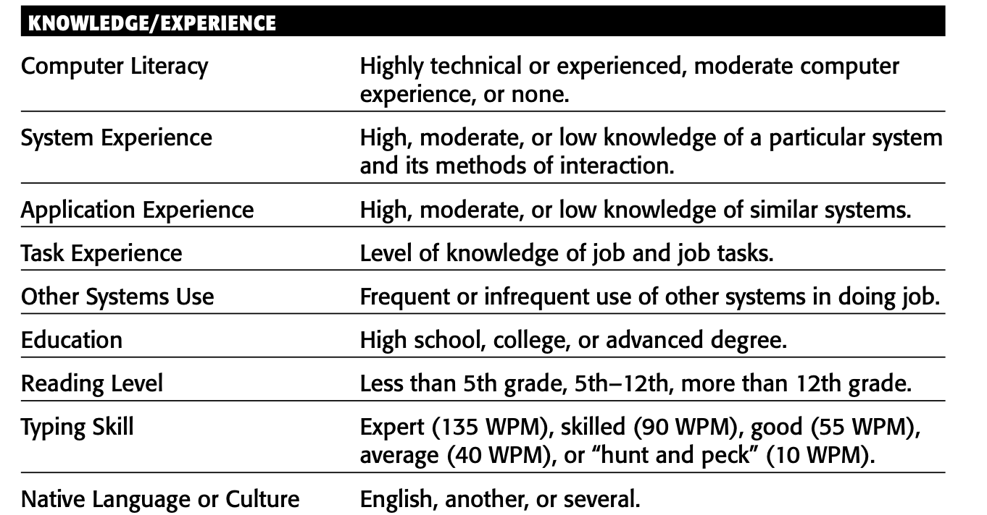
Human Considerations in the Design of Business Systems
The User’s Knowledge and Experience.

Slide 47
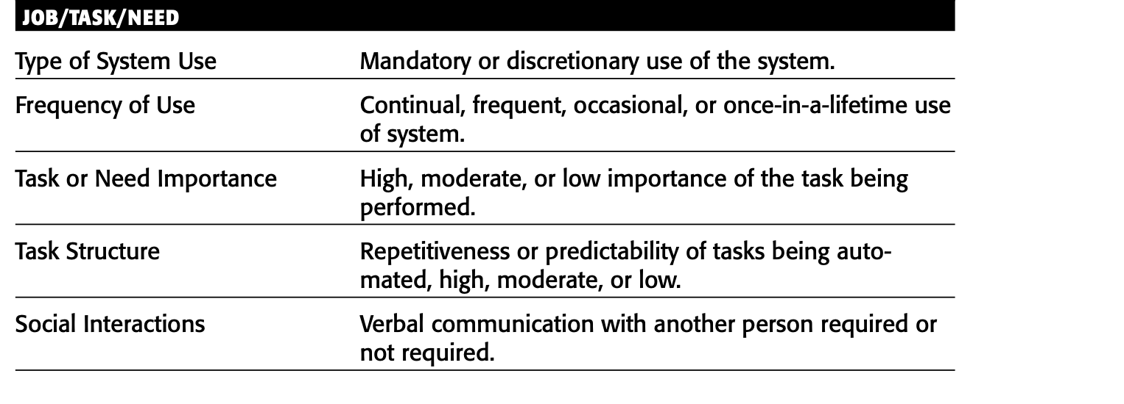
Human Considerations in the Design of Business Systems
The User’s Tasks and Needs.

Slide 48
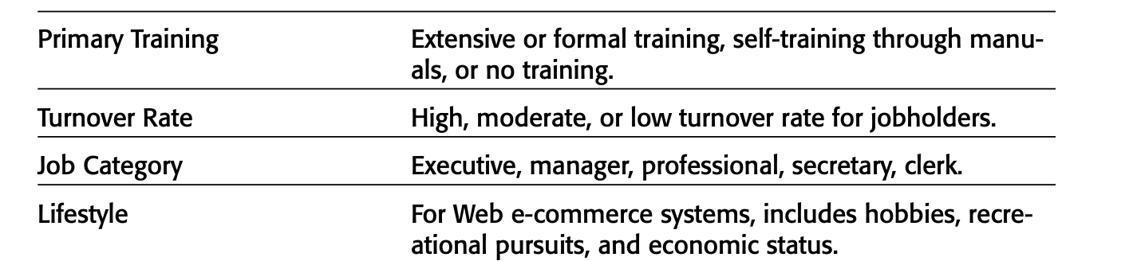
Human Considerations in the Design of Business Systems
The User’s Tasks and Needs.

Slide 49
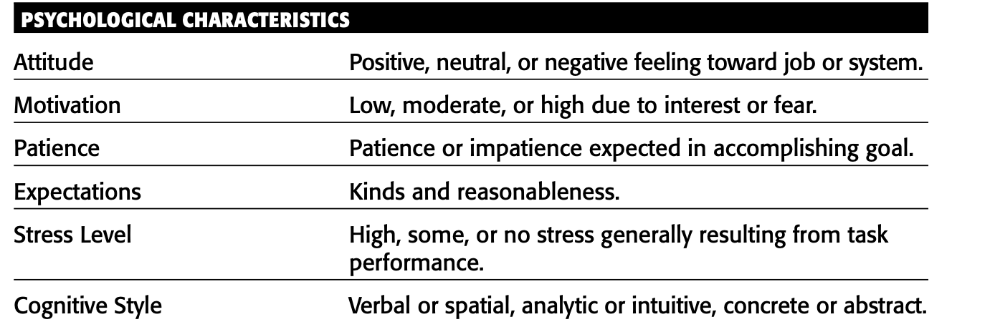
Human Considerations in the Design of Business Systems
The User’s Psychological Characteristics.

Slide 50
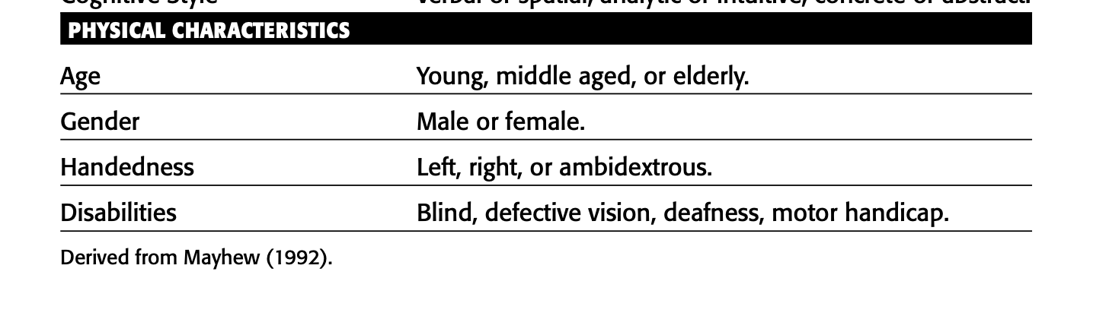
Human Considerations in the Design of Business Systems
The User’s Physical Characteristics.

Slide 51
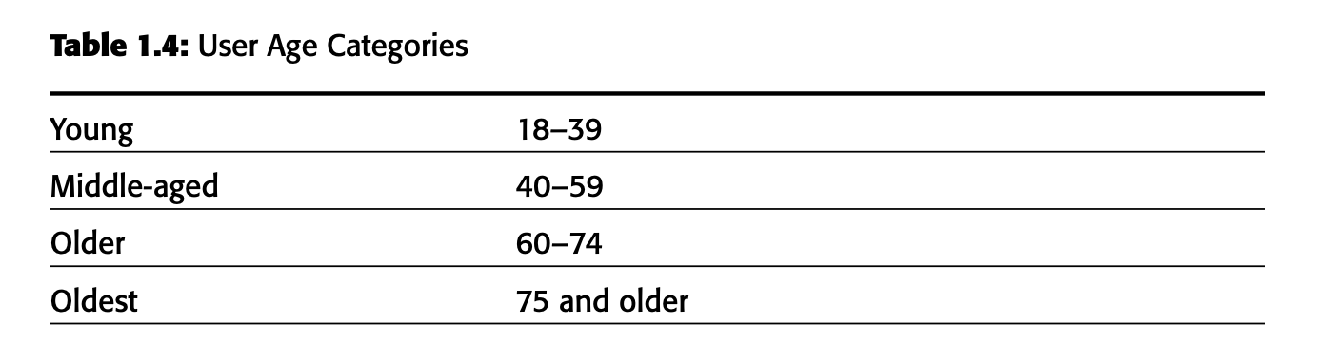
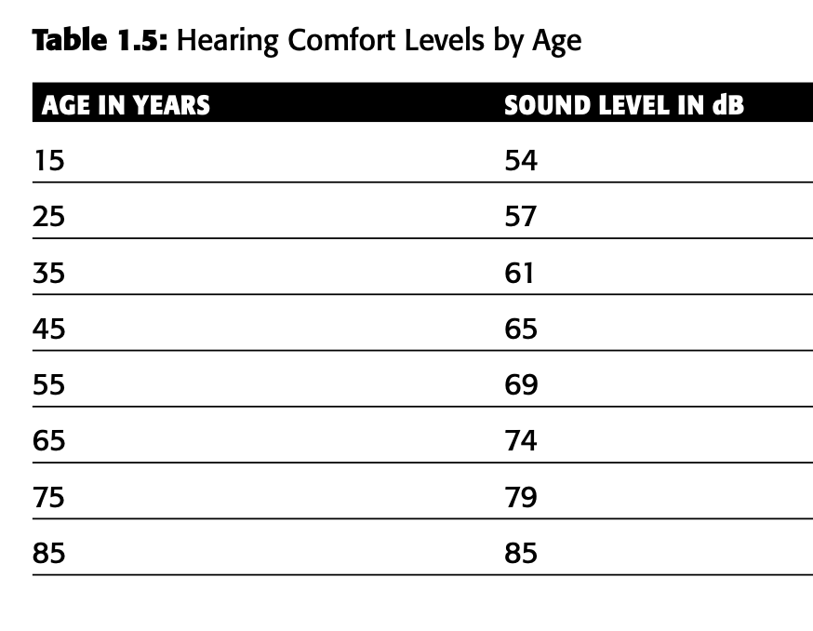
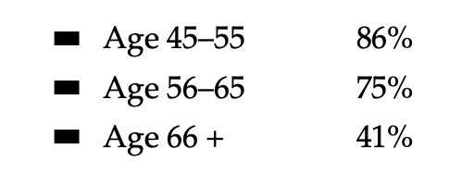
Human Considerations in the Design of Business Systems
The User’s Physical Characteristics.

Slide 52
Human Interaction Speeds
These speeds, as summarized by Bailey (2000), provide insight into how efficiently users can interact with different systems. Here are the typical interaction speeds for various tasks.

Slide 53
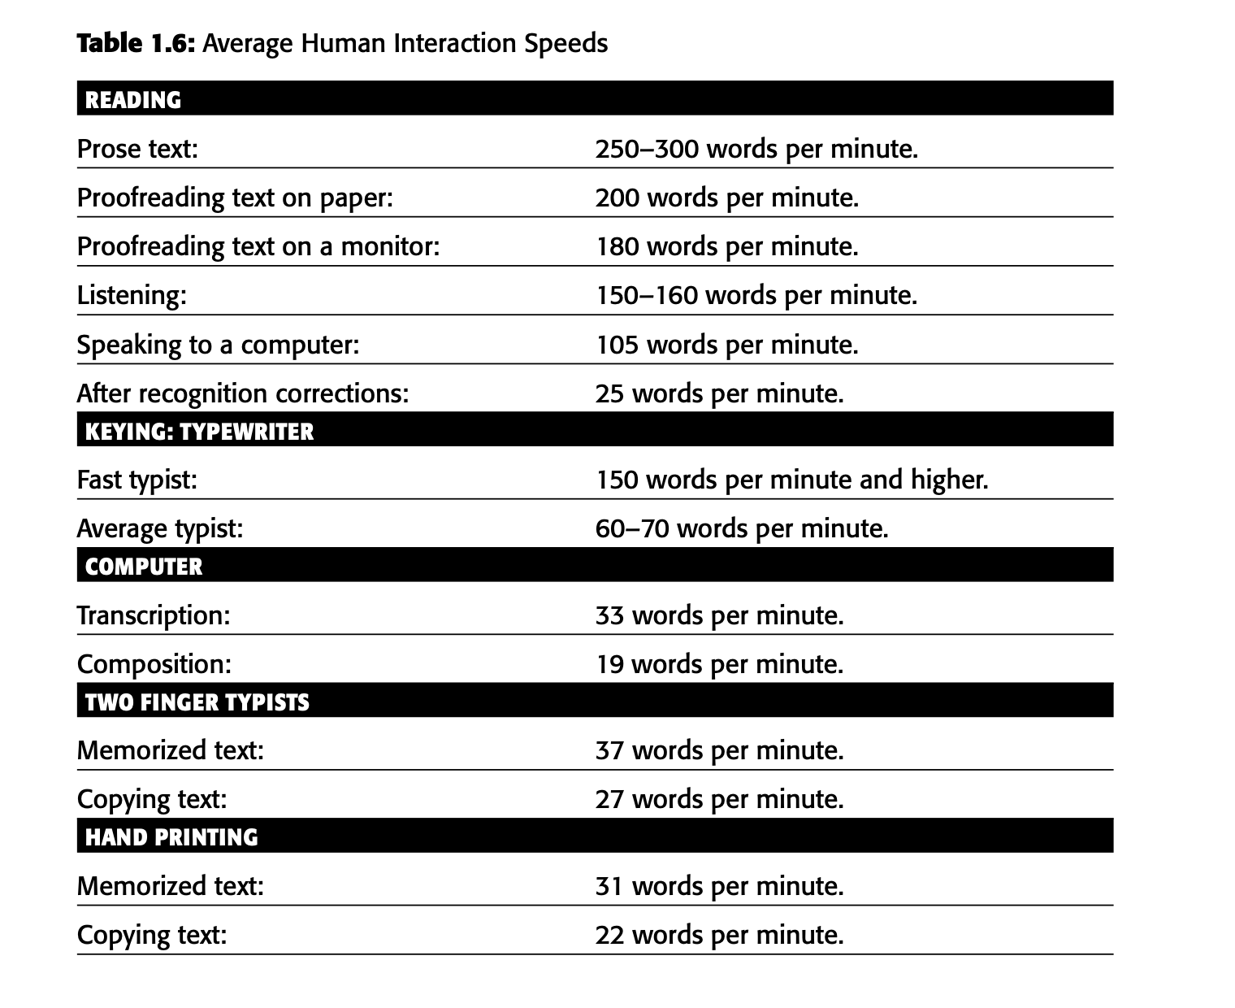
Human Interaction Speeds

Slide 54
Performance vs Peference
Performance: In the context of interface design, performance refers to how well an interface allows users to complete tasks. This is often measured by:
Speed: How quickly users can accomplish tasks.
Accuracy: How correctly users can perform tasks without errors.
Efficiency: How easily users can complete tasks with minimal effort and resources.

Slide 55
Performance vs Peference
Preference: Preference in interface design is about what users like or choose based on their:
Personal Tastes: Individual likes and dislikes.
Familiarity: Comfort with interfaces they have used before.
Aesthetics: Visual appeal and design elements.
Perceived Effort: How easy or difficult they think the interface is to use.

Slide 56
Methods for Gaining an Understanding of Users
Preference: Preference in interface design is about what users like or choose based on their:
Personal Tastes: Individual likes and dislikes.
Familiarity: Comfort with interfaces they have used before.
Aesthetics: Visual appeal and design elements.
Perceived Effort: How easy or difficult they think the interface is to use.

