Slide 1
UNIT-III
Screen Designing:
Screen and Web Page Meaning and Purpose, organizing screen elements, ordering of screen data and content, screen navigation and flow, visually pleasing composition, Presenting information simply and meaningfully.

Slide 2
The principles of good interface and screen design.
A test for a good design.
Organizing screen elements.
Screen navigation and flow.
Visually pleasing composition.
Typography.
Keying procedures.
Data output.
Web sites and Web pages.
Statistical graphics.
Technological considerations.

Slide 3
3.1 A test for a good design
Identify Elements without Reading Words:
Good design allows you to recognize elements (like titles, buttons, and headings) without reading the words.
Importance of Visual Cues:
Visual cues help you quickly find what you're looking for. They make navigation easier and reduce confusion.
Consequences of Poor Design:
If everything looked the same and moved around every day, finding anything would be a hassle.
Good Design Practices:
Use different sizes and styles for text.
Keep important elements in consistent places.
Use white space effectively to separate elements.
Group related items together.

Slide 4
3.1 Screen and Web Page Meaning and Purpose
Example :"Imagine you're using an app to book a flight. You see buttons, text, images, and forms. Each of these should help you book your flight quickly and easily. If there's a random picture of a cat, it doesn’t help you book your flight, right? It’s just noise. Good design means every button, piece of text, and image has a reason for being there – to help you book your flight. If it doesn’t help, it shouldn’t be there."

Slide 5
3.1 Screen and Web Page Meaning and Purpose
Each element
Every control
All text
The screen organization
All emphasis
Each color
Every graphic
All screen animation
Each message
All forms of feedback
Must
— Have meaning to users.
— Serve a purpose in performing tasks.
All interface elements must have meaning to users and serve a purpose in performing tasks or fulfilling needs. If an element does not have meaning for the user, do not include it in the interface because it is noise

Slide 6
3.2 Organizing Elements Clearly and Meaningfully
Visual clarity in design refers to how easily users can understand and interact with the elements on a screen. Achieving visual clarity means organizing and presenting display elements in a way that is meaningful, understandable, and recognizable. When a screen is clear and well-organized, users can quickly identify the important elements and ignore less critical information when necessary.

Slide 7
3.2 Organizing Elements Clearly and Meaningfully
Clarity is influenced by a multitude of factors:
consistency in design,
a logical and sequential ordering, the presentation of the proper amount of information
a visually pleasing composition
groupings,
alignment of screen items.

Slide 8
Consistency
The concept of consistency in interface design refers to ensuring that elements and interactions across an application or website are predictable and familiar to users. This consistency can be divided into two main types: real-world consistency and internal consistency.

Slide 9
Consistency
Real-World Consistency:
The design should reflect users' real-world experiences, expectations, work conventions, and cultural conventions.
Example: A trash icon for deleting items reflects the real-world experience of throwing away trash.

Slide 10
Consistency
Internal Consistency:
All aspects of the interface should follow the same rules and conventions.
This includes operational and navigational procedures, visual identity, and component organization, presentation, usage, and locations.

Slide 11
Consistency
Consistency in Operational and Navigational Procedures:
The way users interact with the interface and navigate through it should be consistent.
Example: If a swipe gesture is used to delete an item in one part of an app, it should work the same way in all parts.

Slide 12
Consistency
Consistency in Visual Identity or Theme:
The visual appearance should be uniform across all screens.
Example: Using the same color scheme, fonts, and button styles throughout the application or website.
.

Slide 13
Consistency
Consistency in Component Organization, Presentation, Usage, and Locations:
The way components are organized, presented, used, and located should be the same throughout.
Example: If a search bar is at the top of one page, it should be at the top of all pages.
.

Slide 14
Consistency
Deviate Only When Beneficial:
Deviations from consistency should only be made when they provide a clear benefit to the user.
Example: Highlighting a critical error message in a different color to ensure it stands out.
.

Slide 15
Consistency
Importance of Consistency:
  Consistent design reduces user errors and task completion times, increases satisfaction, and shortens learning time.
  It helps users form expectations and employ conceptual learning and transfer training.
  Users can anticipate the location of screen elements, aiding in quicker navigation.
.

Slide 16
Consistency
Consequences of Inconsistency:
Forces users to memorize different ways to perform tasks or interpret information.
Makes it difficult to develop a coherent mental structure of the interface.
Can be distracting and confusing, leading to errors and inefficiencies.
.

Slide 17
How people read the webpage or screen
Upper-Left Corner: Always start looking at the screen from the upper-left corner.
Focus on the most important parts of the screen.
Textual Displays:People’s eyes move from the upper-left to the bottom-right in a clockwise direction when looking at text.

Slide 18
How people read the webpage or screen
Graphical and Web Displays:
Visual Cues: Additional visual cues like white space affect how we scan the screen.
Text First: People tend to look at text before images.
Larger Type: Larger text captures attention more than smaller text.
Changing Info: Changing information is looked at before static information.

Slide 19
How people read the webpage or screen
Nielsen’s F-Pattern:
Reading Pattern: People often read web pages in an F-shaped pattern:
  Top Bar: First, they look horizontally across the upper part.
  Lower Bar: Next, they move down and look across a shorter horizontal area.
  Stem: Finally, they scan the left side vertically.
Variations: The pattern can also resemble an upside-down L or an E, but generally looks like an F.

Slide 20
How people read the webpage or screen
Nielsen’s F-Pattern:
Reading Pattern: People often read web pages in an F-shaped pattern:
  Top Bar: First, they look horizontally across the upper part.
  Lower Bar: Next, they move down and look across a shorter horizontal area.
  Stem: Finally, they scan the left side vertically.
Variations: The pattern can also resemble an upside-down L or an E, but generally looks like an F.

Slide 21
3.2 Ordering of Data and Content
Divide Information into Logical Units:
Break down large amounts of information into smaller, logical parts.
Example: Think about how a textbook is divided into chapters, sections, and subsections. Each part covers a specific topic, making it easier to read and understand.
Organize by Relationships:
Group related information together.
Example: In a grocery list, you might group items by category like fruits, vegetables, dairy, etc., because it makes shopping easier.

Slide 22
3.2 Ordering of Data and Content
Prioritize According to User Needs:
Arrange information based on what users find most important or expect to see first.
Example: On a news website, breaking news is usually at the top because it’s what people want to see first.
Possible Ordering Schemes:
Conventional:
  Follow traditional or standard ways of ordering information.
  Example: Days of the week (Monday, Tuesday, etc.) or months of the year (January, February, etc.).

Slide 23
3.2 Ordering of Data and Content
Possible Ordering Schemes:
Sequence of Use:Order information in the sequence it’s typically used.
Example: When entering an address, the order is usually street, city, state, zip code.
Frequency of Use:Put the most frequently used information at the top.
Example: On a frequently visited website, the most popular links might be at the top.
Function or Category:Group information by its function or category.
Example: On a shopping website, items might be grouped into categories like electronics, clothing, and home goods.

Slide 24
3.2 Ordering of Data and Content
Possible Ordering Schemes:
Importance:Arrange information by its importance.
Example: Emergency contact information is placed prominently in an employee handbook.
General to Specific: Start with broad information and move to more specific details.
Example: In a science article, you might start with an overview of the topic and then dive into specific studies and details.

Slide 25
3.2 Ordering of Data and Content
Form Comprehensive Groups:
Make sure all related information is grouped together, covering all possibilities.
Example: In a car manual, you might have a section for each part of the car (engine, brakes, etc.), ensuring nothing is left out.
Ensure Visibility for Comparison:
Information that needs to be compared should be visible at the same time.
Example: When comparing product features on a website, having them side-by-side is more helpful than flipping between pages.

Slide 26
3.2 Ordering of Data and Content
Present Relevant Information:
Show only the information relevant to the user’s current task.
Example: When filling out a form, only display the fields needed for the specific process, not unrelated ones.

Slide 27
3.2.1 Ordering of Web pages
Establish Levels of Importance:
Prioritize information based on how important it is for the user.
Example: In user interface design, prioritize critical elements like the main navigation menu, search bar, and featured promotions at the top of the page. Place important items like product categories just below, and less urgent information such as customer reviews and company details further down, ensuring users can easily find what they need quickly.

Slide 28
3.2.1 Ordering of Web pages
Place Critical Information Near the Top of the Website:
Important information should be easy to find, so it goes near the top.
Example: On a news website, the latest headlines are at the top because that’s what people want to see first.
Place Important Items at the Top of a Page:
Important details and options should be placed high on the page for easy access.
Example: On a shopping website, key deals and discounts are shown at the top of the homepage.

Slide 29
3.2.1 Ordering of Web pages
Organize Information Clearly:
Information should be organized in a clear and logical way that makes sense to the user.
Example: In a recipe, you first list the ingredients, then the steps to cook. It’s a clear and logical structure.
Place Important Items Consistently:
Explanation: Keep the location of important items the same across all pages.
Example: On a website, the menu should be in the same place on every page so users know where to find it.

Slide 30
3.2.1 Ordering of Web pages
Facilitate Scanning:
Design the page so users can quickly scan and find what they need.
Example: Use headings, bullet points, and short paragraphs to make information easy to skim through.
Structure for Easy Comparison:
Place related items close together so they can be easily compared.
Example: In an online store, show similar products side by side for easy comparison.

Slide 31
3.3 Navigation and Flow
Provide an Ordering of Screen Information and Elements
1.Is rhythmic, guiding a person’s eye through the display
Example: Imagine a website with a header, body, and footer. The header has a large, bold title, followed by a smaller subtitle, and then the main content. This creates a rhythm that guides the eye naturally from top to bottom.
2. Encourages natural movement sequences
Example: On an e-commerce website, the user’s journey might start with a search bar at the top, followed by search results, and ending with a “Buy Now” button. This sequence mimics the natural thought process of searching, finding, and purchasing.
3. Minimizes pointer and eye movement distances
Example: In a form, place the “Submit” button directly below the input fields rather than at the bottom of the page. This reduces the distance the pointer and eyes need to travel, making the form easier to complete.

Slide 32
3.3 Navigation and Flow
Locate the Most Important and Most Frequently Used Elements or Controls at the Top Left
Example: On a dashboard, place the main navigation menu at the top left. This is where users often start looking, making it easy to find and use frequently accessed features.
Maintain a Top-to-Bottom, Left-to-Right Flow
Example: In a blog post, start with the title at the top, followed by the content, and then the comments section. This top-to-bottom, left-to-right layout aligns with natural reading patterns in Western cultures.

Slide 33
3.3 Navigation and Flow
Assist in Navigation Through a Screen
1.Aligning elements
Example: In a form, align all labels and input fields to the left. This alignment creates a clean and organized look, making it easier for users to scan and fill out the form.
2.Grouping elements
Example: On a product page, group related information such as product details, pricing, and reviews together. This grouping helps users find all relevant information without searching the entire page.
3. Using line borders
Example: Use borders to separate different sections on a webpage, such as the sidebar, main content area, and footer. Borders visually indicate distinct areas, guiding the user’s eye through the content.

Slide 34
3.3 Navigation and Flow
Through Focus and Emphasis, Sequentially, Direct Attention to Items That Are
1. Critical
Example: On a banking app, highlight the account balance in a larger, bold font at the top of the screen. This ensures users see the most critical information first.
2. Important
Example: Below the account balance, display recent transactions in a slightly smaller but still prominent font. This positions important information directly after the critical information.

Slide 35
3.3 Navigation and Flow
Through Focus and Emphasis, Sequentially, Direct Attention to Items That Are
3. Secondary
Example: Display secondary information, like promotional offers or lesser-used features, below the recent transactions. Use a smaller font or lighter color to indicate these are less critical.
4. Peripheral
Example: Place the least important information, such as terms and conditions or copyright notices, at the bottom of the page. These elements should not distract from the main content.

Slide 36
3.3 Navigation and Flow
Tab Through Windows in Logical Order of Displayed Information
Example: In a multi-step form, the tab order should follow the natural progression of the form fields. For instance, tabbing from “First Name” to “Last Name” to “Email Address” rather than jumping around the form.
Locate Command Buttons at End of the Tabbing Order Sequence
Example: In a form, place the “Submit” or “Save” button at the end of the tab order. This ensures users can fill out the form and then submit it without needing to backtrack or use the mouse.

Slide 37
3.3 Navigation and Flow
When Groups of Related Information Must Be Broken and Displayed on Separate Screens, Provide Breaks at Logical or Natural Points in the Information Flow
Example: In an online checkout process, break the process into logical steps such as “Shipping Information,” “Billing Information,” and “Order Review.” Each step should flow naturally into the next, with clear breaks between them.

Slide 38
3.4 Visually Pleasing Composition
Provide a visually or aesthetically pleasing composition possessing the following qualities:
— Balance
— Symmetry
— Regularity
— Predictability
— Sequentiality
— Economy
— Unity
— Proportion
— Simplicity
— Groupings

Slide 39
3.4.1 Balance
Balance in screen design is about creating a sense of stability and equilibrium on a screen. It ensures that elements are distributed evenly, so the screen feels harmonious and visually comfortable.

Slide 40
3.4.1 Balance
Equal Weight of Elements:
Left and Right: Elements should be evenly distributed across the screen, so neither side feels heavier than the other.
Top and Bottom: Similarly, the top and bottom of the screen should balance each other out.

Slide 41
3.4.1 Balance
Visual Weight:
Heavy Elements: Dark colors, unusual shapes, and larger objects draw more attention and feel heavier.
  Example: A dark, bold headline at the top of a webpage.
Light Elements: Light colors, regular shapes, and smaller objects feel lighter.
  Example: Light-colored buttons and small icons.

Slide 42
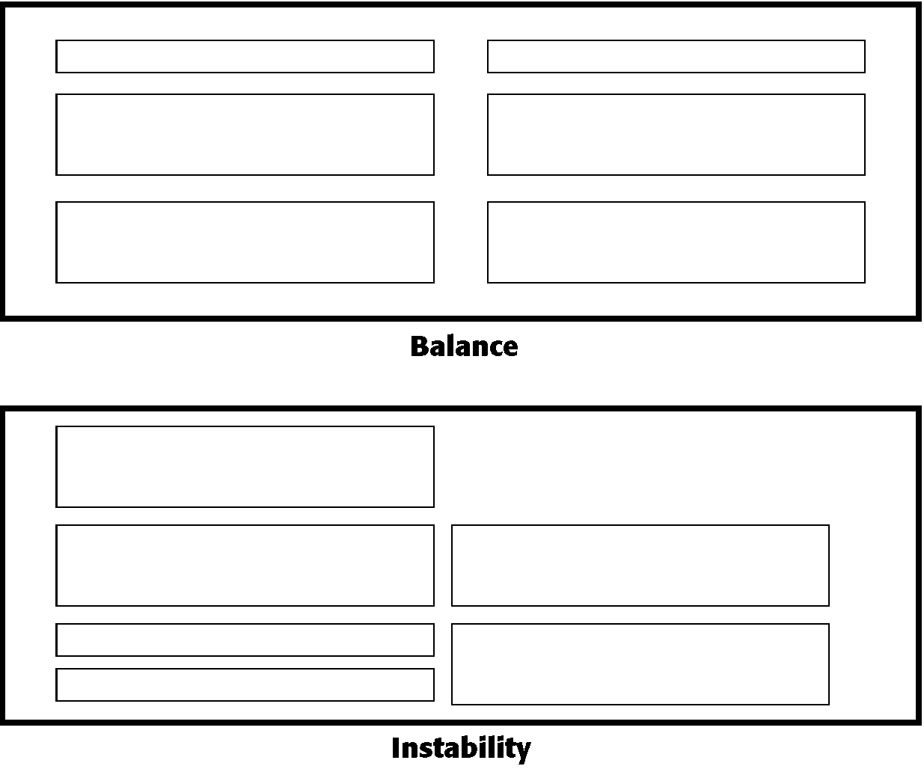
3.4.1 Balance

Slide 43
3.4.2 Symmetry
Symmetry in screen design involves creating a mirror image on both sides of a centerline. This means that if you draw a vertical line down the middle of the screen, the elements on one side are exactly duplicated on the other side.

Slide 44
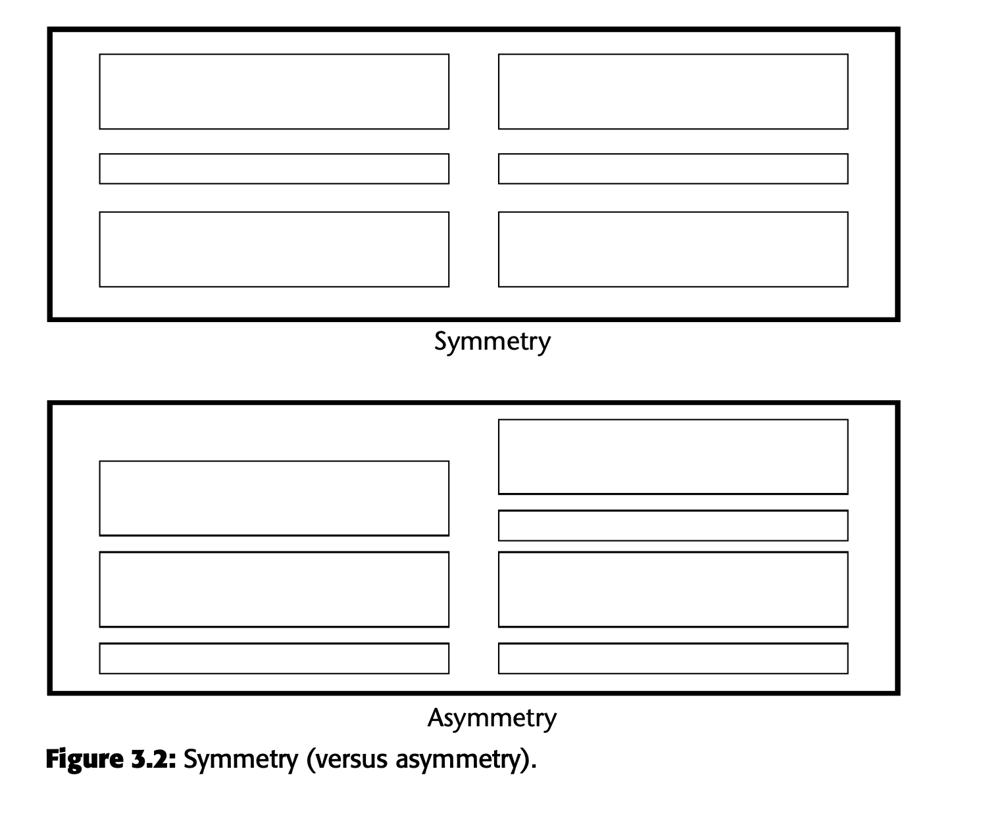
3.4.2 Symmetry

Slide 45
3.4.3 Regularity
Regularity in screen design means creating a consistent and orderly layout by aligning elements based on a uniform principle. This involves standardizing the spacing, size, shape, and color of elements to create a harmonious and predictable arrangement.

Slide 46
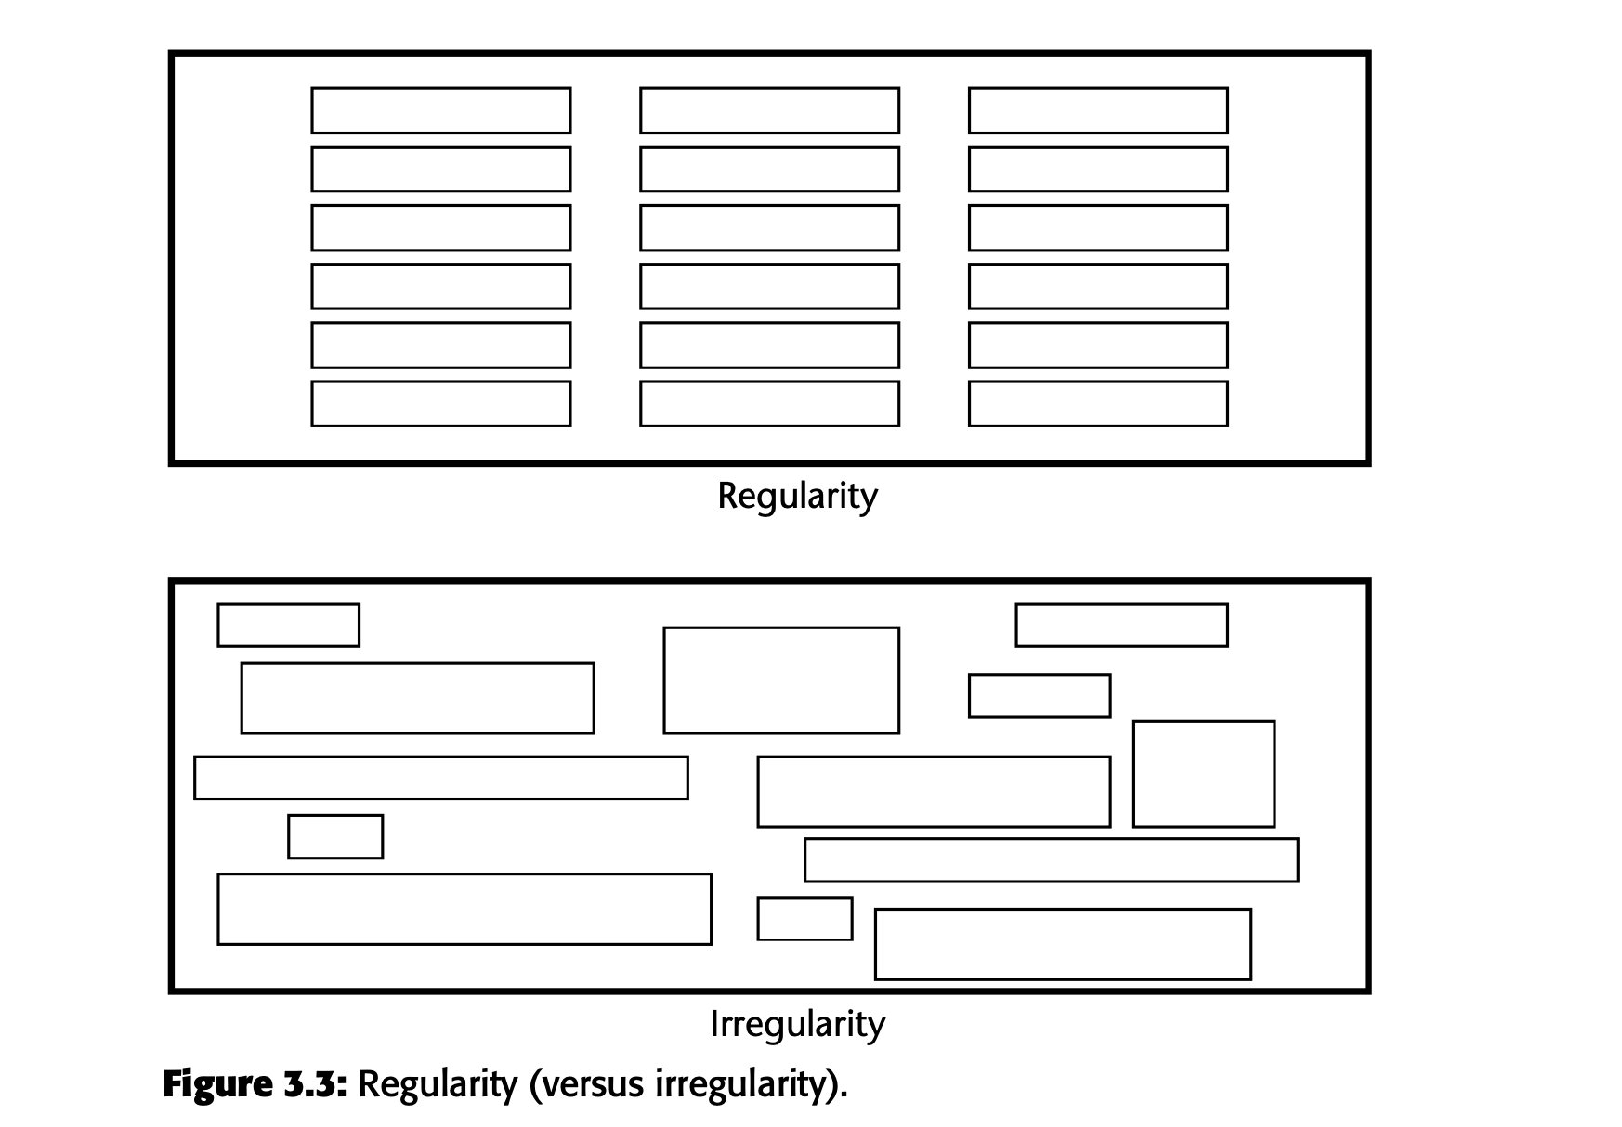
3.4.3 Regularity

Slide 47
3.4.4 Predictability
Predictability in screen design means creating a consistent and familiar layout that allows users to anticipate where elements will be and how the design will look. This helps users navigate more easily and feel comfortable using the interface.

Slide 48
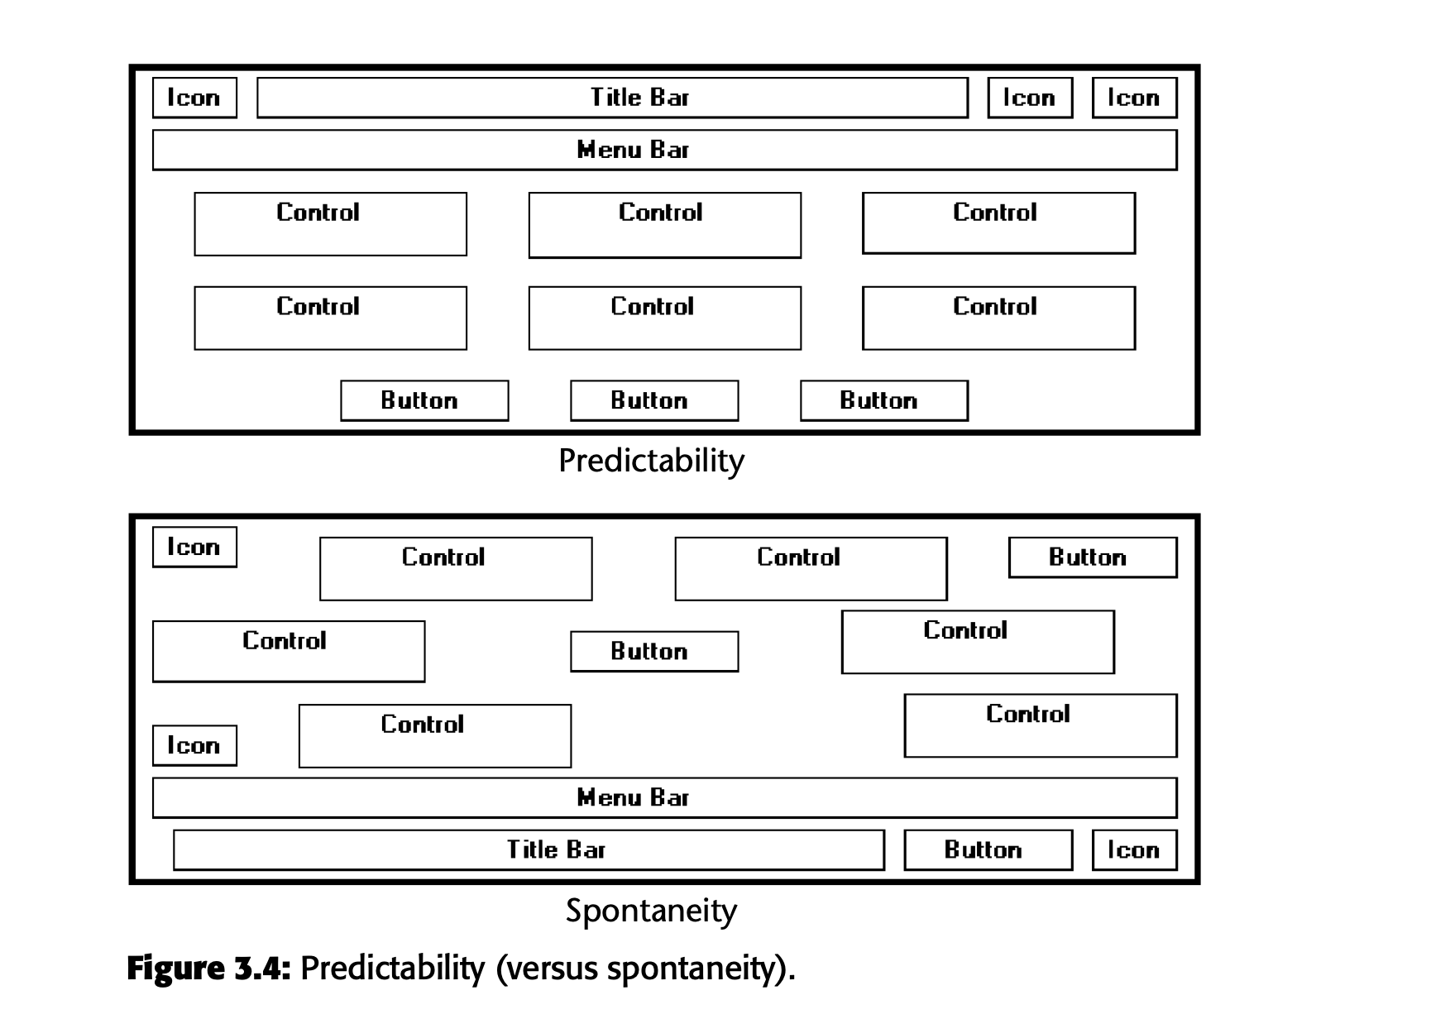
3.4.4 Predictability

Slide 49
3.4.5 Sequentiality
Provide sequentiality by arranging elements to guide the eye through the screen in an obvious, logical, rhythmic, and efficient manner.
The eye tends to be attracted to
— A brighter element before one less bright.
— Isolated elements before elements in a group.
— Graphics before text.
— Color before black and white.
— Highly saturated colors before those less saturated. — Dark areas before light areas.
— A big element before a small one.
— An unusual shape before a usual one.
— Big objects before little objects.

Slide 50
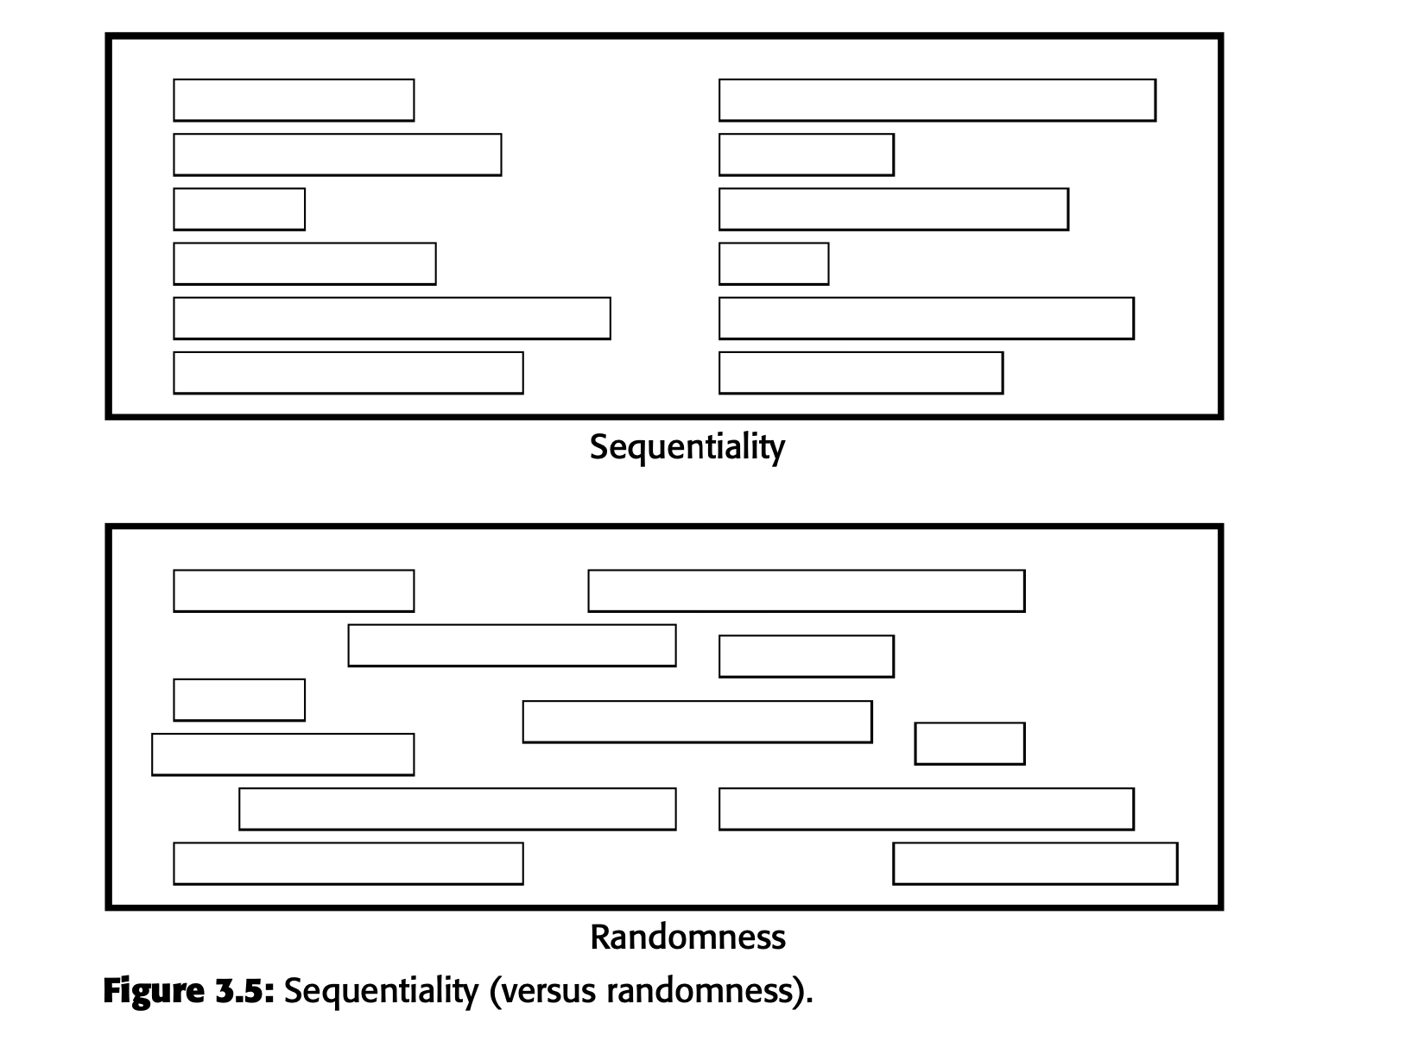
3.4.5 Sequentiality

Slide 51
3.4.6 Economy
Provide economy by using as few styles, display techniques, and colors as possible.
Imagine you're designing a classroom presentation. If you use too many different fonts, colors, and animations, your slides will look chaotic and distracting, making it hard for your audience to focus on the main points. Instead, if you use a limited set of styles and colors thoughtfully, your slides will be clear and easy to follow, effectively conveying your message.

Slide 52
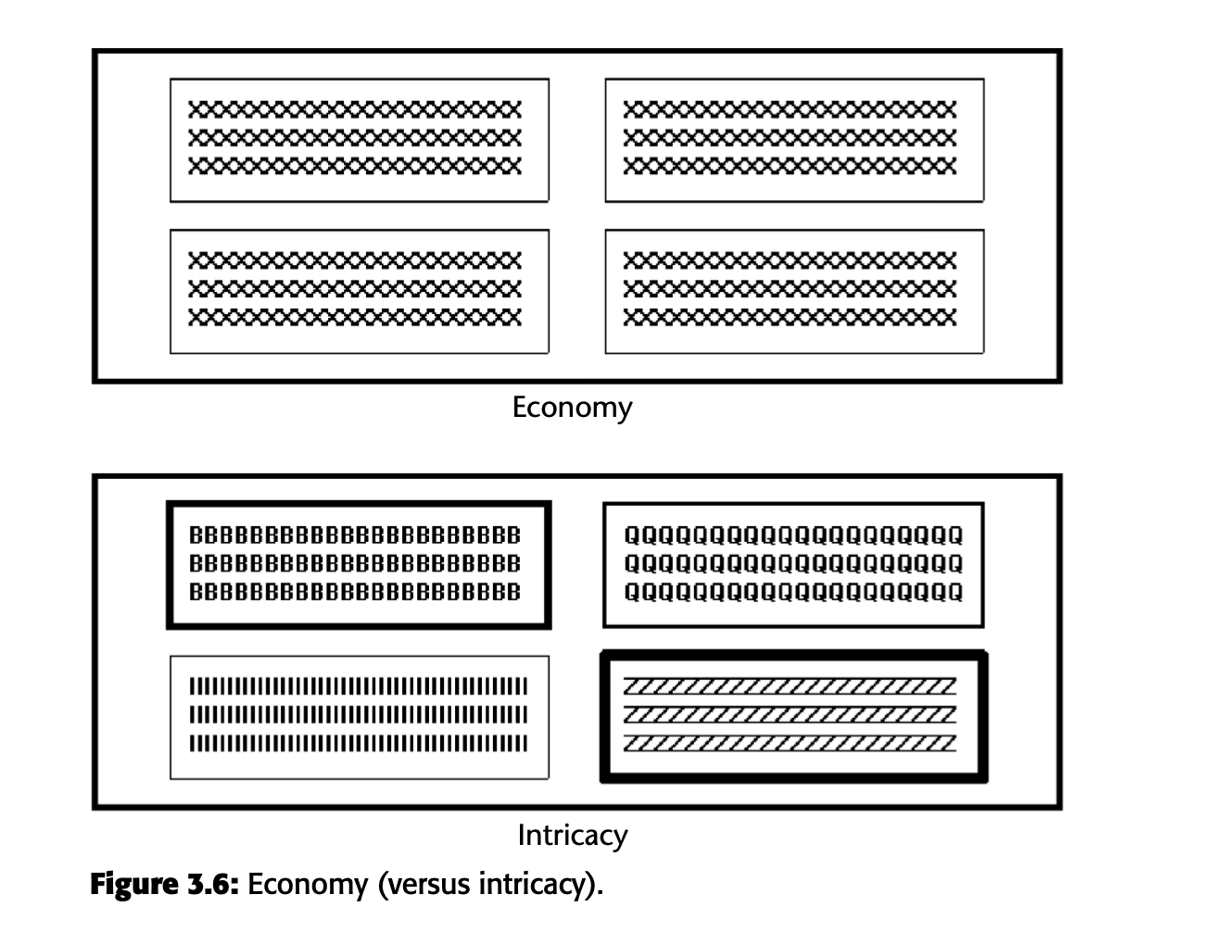
3.4.6 Economy

Slide 53
3.4.7 Unity
■Create unity by
— Using similar sizes, shapes, or colors for related information.
— Leaving less space between elements of a screen than the space left at the margins.

Slide 54
3.4.7 Unity
Imagine you have a bookshelf where you want to organize your books. If you group books of similar sizes, colors, and themes together, the bookshelf looks neat and cohesive. This is like creating unity in design.On the other hand, if you place books randomly without any order, the shelf looks chaotic and fragmented. This is the opposite of unity.

Slide 55
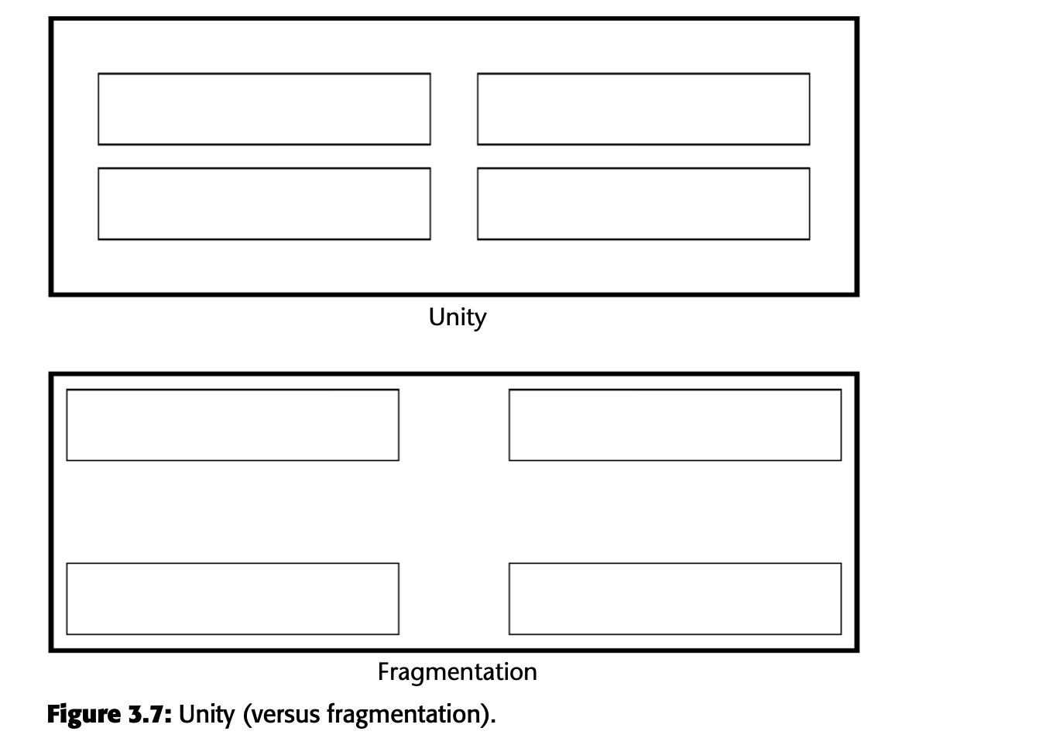
3.4.7 Unity

Slide 56
3.4.8 Proportion
Create windows and groupings of data or text with aesthetically pleasing proportions.
Proportions refer to the relationship between the width and height of shapes and that certain proportions are considered more visually appealing than others.

Slide 57
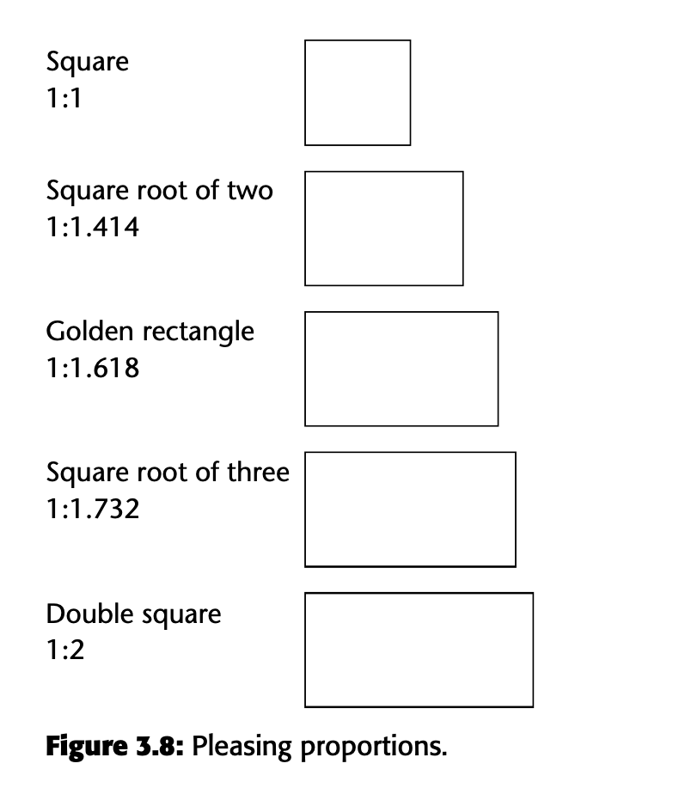
3.4.8 Proportion

Slide 58
3.4.8 Simplicity (Complexity)
Simplicity: simplicity in screen design means making it easy to understand and use. This involves using a minimal number of elements and arranging them in a clear, straightforward way.
.Complexity: complexity means having too many elements or a confusing arrangement, making it harder to understand and use.

Slide 59
3.4.9 Simplicity (Complexity)
Optimizing Elements on a Screen.
Minimizing Alignment Points
Using Standard Grids
Measurement of Complexity

Slide 60
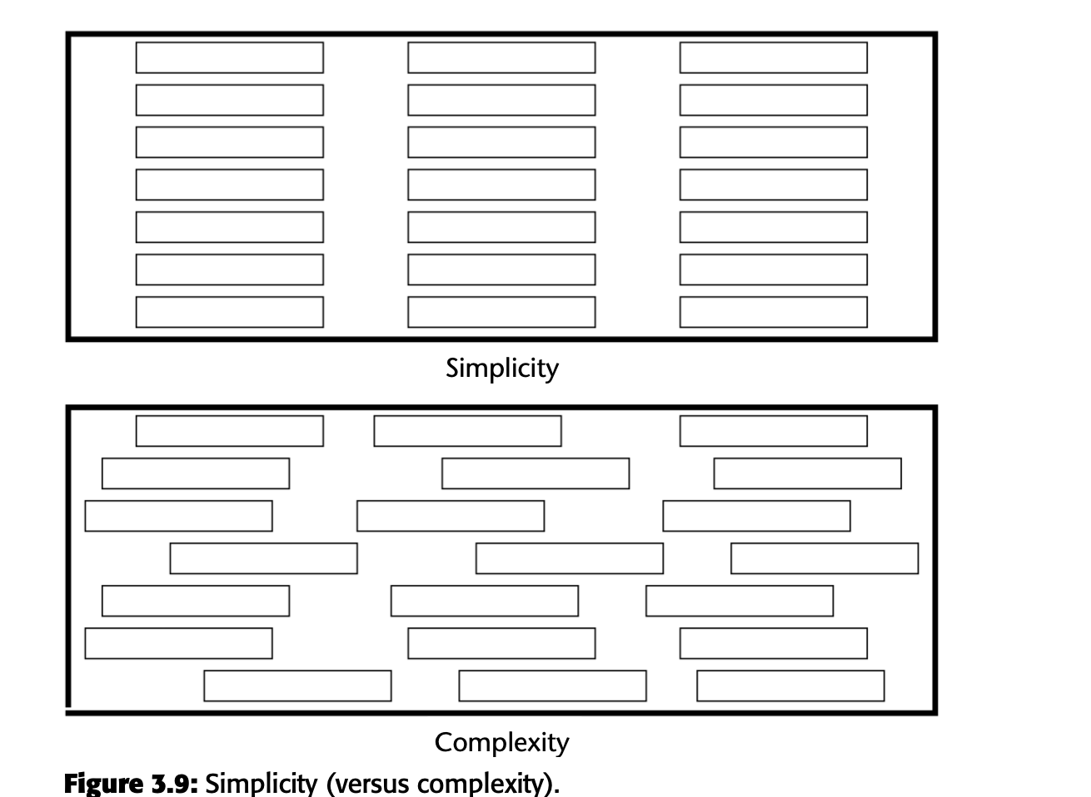
3.4.9 Simplicity (Complexity)

Slide 61
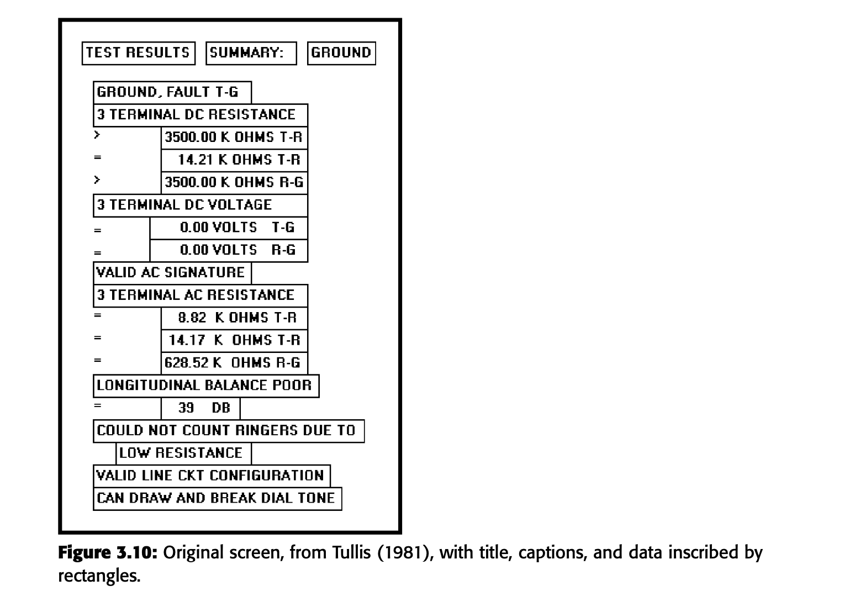
3.4.9 Simplicity (Complexity)
Introduce Tullis’s method of measuring complexity using the number of elements and alignment points. This screen has 22 fields with 6 horizontal alignment points and 20 vertical alignment points, resulting in 134 bits of complexity.

Slide 62
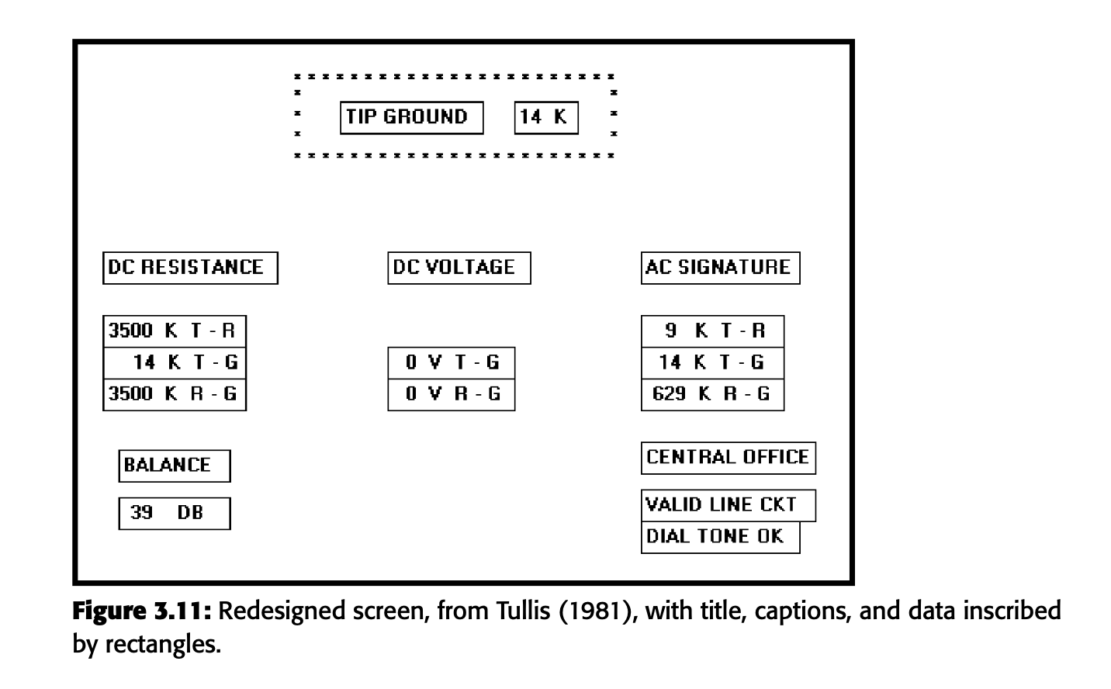
3.4.9 Simplicity (Complexity)
It has 18 fields with 7 horizontal alignment points and 8 vertical alignment points, resulting in 96 bits of complexity. We can see that redesigned screen is simpler and more efficient.

Slide 63
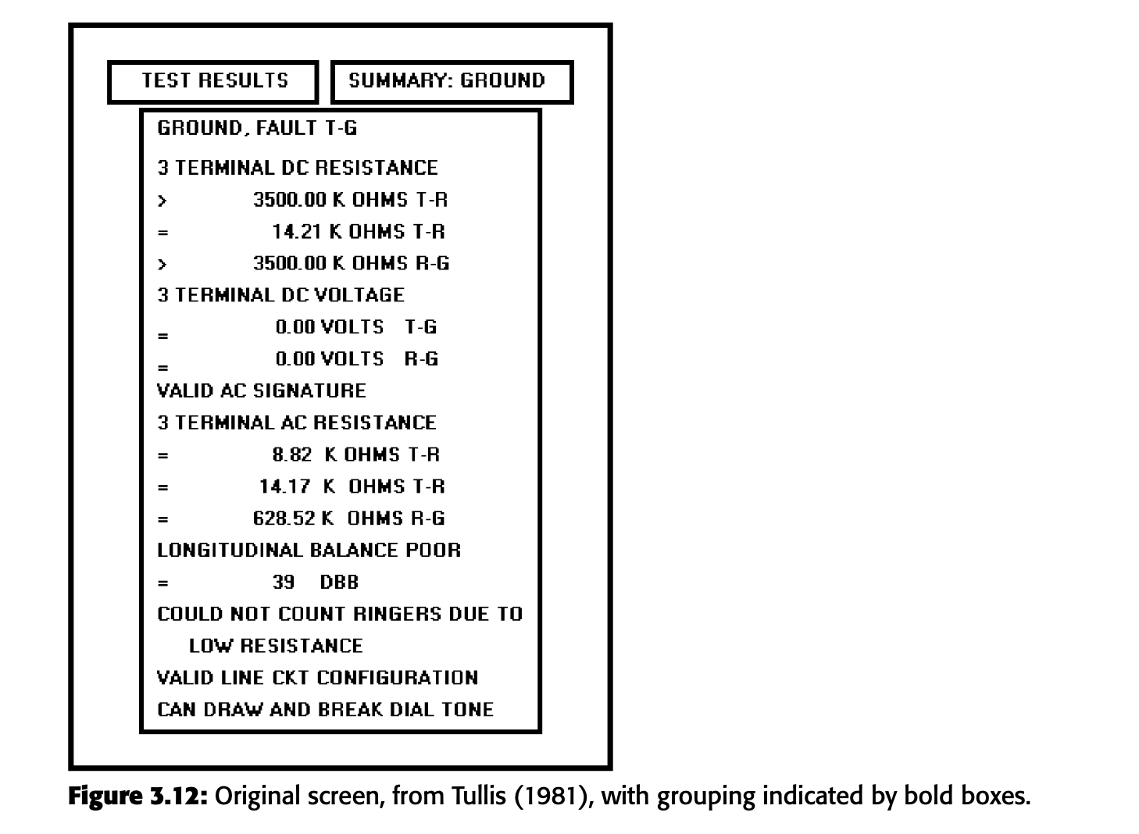
3.4.10 Groupings

Slide 64
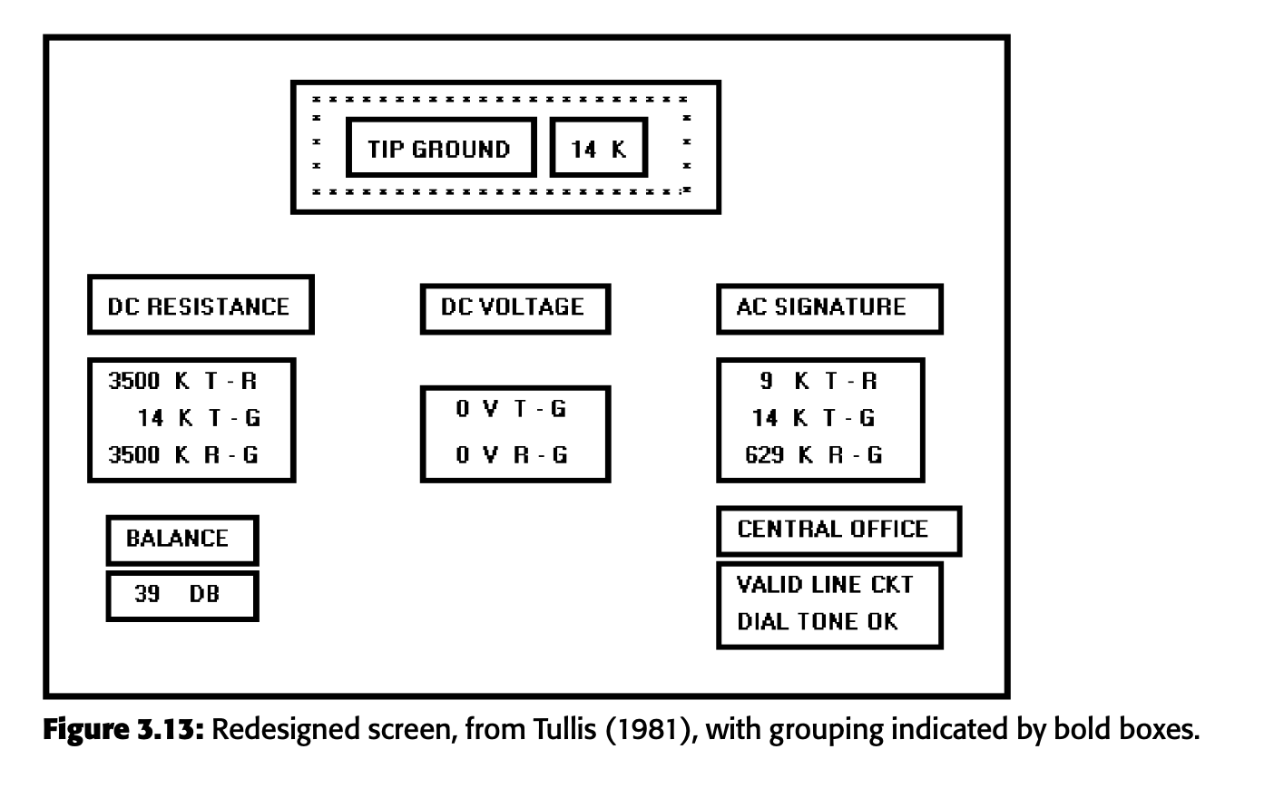
3.4.10 Groupings

Slide 65
3.4.10 Groupings
Relationship Between Number and Size of Groups:
Inverse Relationship: As the number of groups increases, their size decreases, and vice versa.
Middle-Ground Solution: A medium number of medium-sized groups is usually most effective.

Slide 66
3.4.10 Groupings
Functional and Semantic Grouping:
Meaningful Grouping: Information should be grouped in a way that makes sense to the user, with related information displayed together.
Logical Break Points: Break a screen between functional groups of information.
Avoid Massive Groupings: Large groups should be divided into smaller groups for clarity.
Guideline for Rows: Ideally, break groups every five rows. Groups can be six or seven rows if necessary, but should not exceed seven rows.

Slide 67
3.4.10 Groupings
Character Width Limitation:
Data Consideration: The width limit of 11-15 characters should not compromise data comprehensibility.
Focus on Legibility and Comprehension: These are the most important factors in determining the character width.

Slide 68
3.4.10 Groupings
Spacing and Unity:
Space Between Groups: Should be less than the space of the margins to give unity to the display.
Use of White Space: The most common way to achieve spacing is through white or blank space.
Other Spacing Methods: These include differing intensity levels, image reversals (e.g., white characters on a black background), borders, and color.
Importance of Spacing Over Color: Studies found that adequate spacing is a more important determinant of ease of use than color for uncluttered, highly structured inquiry screens.

Slide 69
Perceptual Principles and Functional Grouping
Creating Functional Groupings:
Proximity: Objects that are close to each other are perceived as a group. Example: 000 000 000
Similarity: Objects that are similar in appearance are grouped together. Example: AAABBBCCC
Closure: Objects that form a closed shape are seen as a group. Example: [ ] [ ] [ ]
Matching Patterns: Objects that follow a pattern are grouped together. Example: >> <<

Slide 70
Perceptual Principles and Functional Grouping
Combining Visual Organization Principles:
Proximity and Similarity: Combining objects that are close and similar. Example: AAA BBB CCC
Proximity and Closure: Combining objects that are close and form closed shapes. Example: [ ] [ ] [ ]
Matching Patterns and Closure: Combining patterned objects that form closed shapes. Example: ( ) < > { }
Proximity and Ordering: Combining objects that are close and in a specific order. Example: 1234 1 5 5678 2 6 3 7 4 8

Slide 71
Perceptual Principles and Functional Grouping
Avoiding Conflicting Principles:
Proximity Opposing Similarity: Avoid grouping objects close together if they are not similar. Example: AAA ABB BBC CCC
Proximity Opposing Closure: Avoid grouping objects close together if they don't form a closed shape. Example: ] [ ] [ ] [
Proximity Opposing Ordering: Avoid grouping objects close together if they disrupt the order. Example: 1357 1 2 2468 3 4 5 6 7 8

Slide 72
Grouping Using White Space
White space, also called space, refers to areas on a screen without text, graphics, or other elements.
It should be considered as important as any other screen element.

Slide 73
Grouping Using White Space
Separation and Proportion: White space defines and separates elements, giving a screen proportion and meaningful form.
Attention Direction: It directs attention to adjacent areas containing important information.
Clarity: Adequate white space helps avoid the perception of the screen as a cluttered mass, reducing the need for exhaustive searches to find information.

Slide 74
Grouping Using White Space
Trade-offs of Whitespace in Web Page Design
Conflict with Scrolling:
  Scrolling Requirement: More white space can increase the need for scrolling on web pages, which typically extend beyond the visible screen area.
  Information Relationships: Excessive white space can make page scanning difficult and spatially separates information, complicating the determination of relationships between pieces of content.

Slide 75
Grouping Using White Space
Contradictory Guidelines:
Moderate Use: Recommendations include using white space moderately and minimizing it in search tasks to avoid poor ratings.
User Preferences: Users prefer a moderate amount of white space, and performance differences are negligible with varying amounts of white space.
Positive Effects: White space can direct attention, enhance recall, and increase comprehension, as well as being a characteristic of top-rated websites.

Slide 76
Grouping Using White Space
Practical Recommendations
Balance: For longer web pages, reduce white space but maintain page clarity.
Evaluation: Each page should be evaluated based on its content, content relationships, and visual search requirements.
Trade-off: Establish a trade-off that best meets these needs, ensuring the page is clear and functional without excessive scrolling.

Slide 77
Grouping Using Borders
Borders help to draw attention to related pieces of information and guide the viewer's eye through the screen.
Example: Imagine a menu on a website. Borders around each category (like "Home," "About," "Services") make it clear they are separate but related.

Slide 78
Grouping Using Borders
Guidelines for Using Borders
Line Thickness and Styles:
  Limit Variations: Use no more than three different line thicknesses or two line styles on a screen to avoid clutter.
  Hierarchy: Use thicker lines for major sections and thinner lines for smaller groups.
  Example: On a form, use a thick border for the entire form, a medium border for different sections (like personal information, payment details), and a thin border for individual fields.
Consistency:
  Line Width and Height: Ensure horizontal lines are of equal width and vertical lines of equal height to maintain balance.
  Example: In a table, make sure all the row separators are of the same thickness and all column separators are of the same height.

Slide 79
Grouping Using Borders
Padding:
Space Between Content and Border: Leave enough space between the information and the borders so the content doesn’t look cramped.
Example: In a text box, ensure there is a margin between the text and the border to make it readable.
Alignment:
Align Borders: Make sure borders of adjacent groups are aligned left, right, top, and bottom.
Avoid Excessive White Space: Do not create too much empty space within bordered areas as it is not visually appealing.
Example: If you have two side-by-side images with borders, make sure their borders are aligned to give a neat look.

Slide 80
Grouping Using Borders
3. Specifics for Web Design
Horizontal Lines:
  Be Cautious: Use horizontal lines carefully as they can give the impression that the page ends there, potentially causing users to miss content below.
  Emphasize Differences: Reserve horizontal lines for areas where you need to highlight a clear distinction between sections.
  Example: Use a horizontal line to separate the footer from the main content but avoid using too many horizontal lines within the content area.
4. Benefits of Borders
Readability: Borders around text or groups of information make them easier to read and understand.
  Visual Appeal: Proper use of borders makes the screen look organized and aesthetically pleasing.

Slide 81
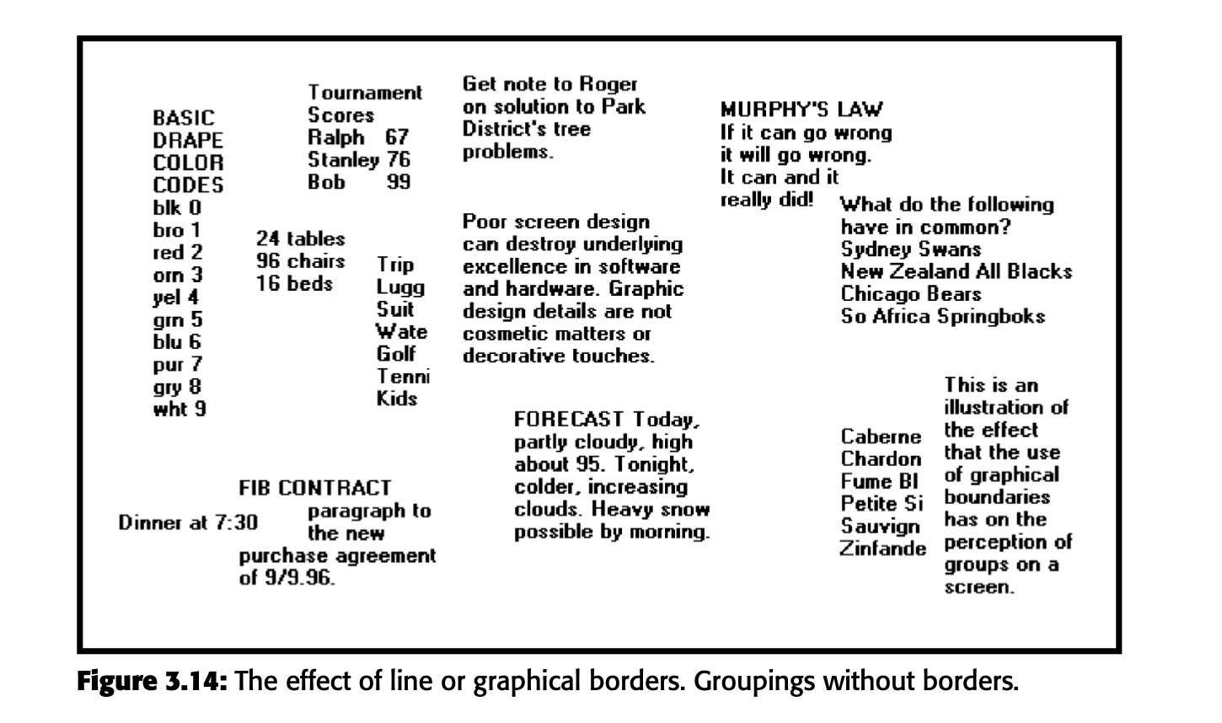
Grouping Using Borders

Slide 82
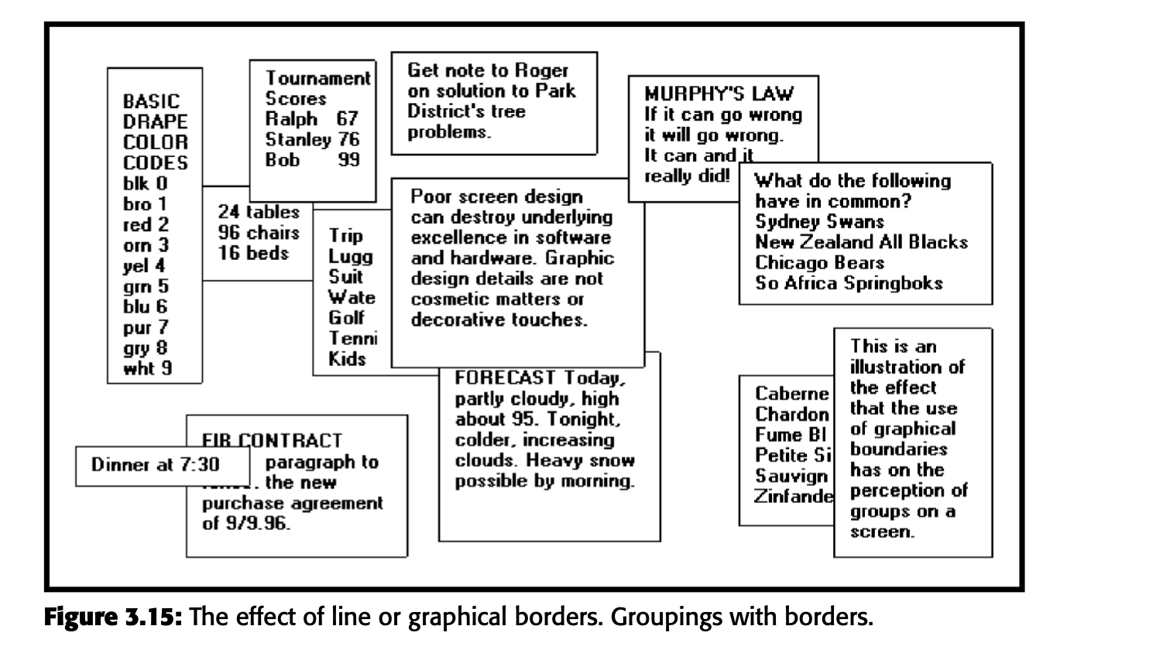
Grouping Using Borders

Slide 83
Grouping Using Backgrounds
Backgrounds help in organizing and distinguishing different sections or groups of related information.
They should make it easier for users to find and understand information, not distract them from the main content.

Slide 84
Grouping Using Backgrounds
Contrast Level:
The background should have a low contrast compared to the main content. This means using a lighter shade, such as a 25% gray, which is subtle and not too attention-grabbing.
Example: Think of a light gray box behind a list of related items. It helps group the items together without making them the focal point.
Emphasis and Attention:
High contrast and bold techniques should be reserved for elements that need the user's attention, like important buttons or alerts.
Example: A bright red button for emergency actions should stand out more than a light gray background grouping related text.

Slide 85
Grouping Using Backgrounds
Consistency and Simplicity:
Use backgrounds consistently and sparingly. Too many different backgrounds can make the screen look cluttered and confusing.
Example: If you use light gray for grouping related information on one part of the screen, use similar shades for other groupings to maintain visual harmony.
Borders for Separation:
When using background colors to separate different groups, adding a border can help clearly define these areas.
Example: If you have two adjacent sections with different background colors, a thin line or border between them helps prevent visual blending.

Slide 86
Grouping Using Backgrounds
Caution with Colors:
Be mindful that users might have the ability to change screen colors, which can alter the intended visual effect.
Example: If a user changes the background color to a darker shade, the contrast with the text should still be adequate for readability.

Slide 87
Visual Style in Web Page Design
A consistent and unified visual style across all pages of a website enhances user experience and builds a strong identity.

Slide 88
Visual Style in Web Page Design
Consistency Across the Website:
Definition: Visual style refers to the overall look and feel of a website, including colors, fonts, graphics, and layout.
Importance: Keeping this style consistent on every page helps users feel comfortable and recognize they are on the same site.
Factors Influencing Visual Style:
Website Owner's Goals:
  The visual style should align with what the website is trying to achieve (e.g., selling products, sharing information, entertaining users).
User Profile and Preferences:
  Understand who the users are and what they like. The design should appeal to their tastes and expectations.
Example: A website for a children's toy store might use bright colors and playful fonts, while a law firm's website would use more subdued colors and professional fonts.

Slide 89
Visual Style in Web Page Design
Elements of Visual Style:
Color Scheme:
  Use a consistent color palette across all pages. This reinforces the site's identity.
  Example: If a website uses blue and white as its main colors, these should be the dominant colors on every page.
Typography:
  Use the same fonts for headings, subheadings, and body text throughout the site.
  Example: If the main font for text is Arial, use Arial consistently instead of switching to other fonts randomly.
Graphics and Layout:
  Maintain a consistent style for images, icons, and the arrangement of elements on the page.
  Example: If images have rounded corners and a certain border style, apply this to all images on the site.

Slide 90
Visual Style in Web Page Design
Benefits of Consistency:
Enhanced Navigation:
  Users can navigate more easily when the design elements are predictable and consistent.
  Example: If the navigation bar is always at the top of the page, users will know where to find it on every page.
Increased Comfort and Familiarity:
  Consistent design helps users feel at ease and confident they are still within the same website.
  Example: Similar button styles and placement make it easier for users to interact with the site.

Slide 91
Example Imagine you're designing a website for a local bakery. Here's how you would apply these principles:
Owner’s Goals: The bakery wants to showcase its products and attract more customers.
User Profile: Most visitors are young adults and families who enjoy fresh, homemade baked goods.
Visual Style:
  Colors: Use warm, inviting colors like light brown, cream, and pastel shades.
  Fonts: Choose friendly, easy-to-read fonts for headings and body text.
  Graphics: Use high-quality images of baked goods with a consistent style, such as soft lighting and rounded corners.
  Layout: Keep the layout simple and clean, with a clear navigation bar at the top and featured products on the homepage.

Slide 92
3.5 Presenting Information Simply and Meaningfully
Legibility: Legibility means that text is easily noticeable and distinguishable.
  Use readable font styles and sizes.
  Ensure high contrast between text and background (e.g., black text on a white background).
  Example: Think of reading text on a website versus a printed book. Ensure the website’s text is just as easy to read.
Readability: Readability is how easy it is to understand the text.
  Use simple and clear language.
  Avoid long sentences and complicated words.
  Example: Instructions on a cooking website should be straightforward and easy to follow.

Slide 93
3.5 Presenting Information Simply and Meaningfully
Usability:Usability means the information is presented in a way that’s immediately understandable without needing extra steps or references.
  Avoid jargon or complex diagrams that need additional explanation.
  Example: A weather app should show the temperature directly instead of making users interpret a chart.
Contrasting Display Features: Use different styles to highlight important elements.
  Use bold or larger fonts for headings.
  Use different colors to distinguish interactive buttons from regular text.
  Example: Notice how news websites use larger, bold headlines to grab attention compared to the body text.

Slide 94
3.5 Presenting Information Simply and Meaningfully
Visual Lines: Guide the user’s eye through the layout using implicit (whitespace) and explicit (lines) methods.
  Align text and images neatly.
  Use whitespace to separate sections.
  Example: On an e-commerce site, products are often arranged in a grid, guiding the eye horizontally and vertically.
Consistency: Keep the visual appearance and interaction methods the same across the entire site.
  Use the same fonts, colors, and button styles throughout.
  Follow the same layout for similar pages.
  Example: Think of how social media platforms have consistent icons and layouts, making it easy to navigate regardless of the page.

Slide 95
Typography
Typography is the art and technique of arranging font type to make written language legible, readable, and visually appealing.

Slide 96
Typography
Choose Legible Fonts:
Select fonts that are easy to read on screens. Sans serif fonts like Arial or Verdana are often recommended for digital content.
Use Consistent Sizing:
Maintain a consistent font size for similar types of content to avoid confusion.
Adjust font size appropriately for different devices and resolutions.
Consider User Distance:
Remember that larger screens might be viewed from further away, so adjust font size accordingly.
Highlight Important Elements:
Use bold or larger fonts to emphasize headings or key points.
Use italics or different colors sparingly to add emphasis without overwhelming the reader.

Slide 97
Font Types and Families
  Use simple, common, and familiar fonts to achieve the best reading speed. — Arial or Verdana Sans Serif.
  — Times New Roman or Georgia Serif.
  — Avoid specialty or “cool” fonts.
  Use no more than two families, compatible in terms of line thicknesses, capital letter height, and so on.
  — Assign a separate purpose to each family.
  — Allow one family to dominate.

Slide 98
Font Size
Use no more than three sizes.
— Consider “x” height.
For graphical systems use
— 12 point for menus.
— 10 point for windows.
For Web pages use
— 12 to 14 points for body text.
— 18 to 36 points for titles and headings.
For line spacing use one to one and one-half times font size.
Never change established type sizes to squeeze in more text.

Slide 99
Font Styles and Weight
Use no more than
  Two styles of the same family.
    Standard and italic.
    Italic is best presented in a serif font.
    Two weights.
    Regular and bold.
    Bold is best presented in a sans serif font.
Use italics when you want to call attention.
Use bold when you want to call attention or create a hierarchy.
In Web pages, use an underline only to indicate a navigation link.

Slide 100
Font Case
Use mixed-case for
— Control captions.
— Data.
— Control choice descriptions.
— Text.
— Informational messages.
— Instructional information.
— Menu descriptions.
— Button descriptions.
Consider using upper case or capitalization for
— Title.
— Section headings.
— Subsection headings.
— Caution and warning messages.
— Words or phrases small in point size.
Use all lowercase with caution.

Slide 101
Consistency
Create a consistent system for using different fonts, styles, and sizes.
Choose a specific font for each level of importance.
Show this hierarchy through variations in size, weight, and color.

Slide 102
Text Backgrounds
Use black text on simple, high-contrast backgrounds to enhance readability and comprehension.

Slide 103
Defaults
For graphical operating systems, use the standard system fonts.
For Web pages and applications design for the default browser fonts.
Consider that the user may change the fonts.

